Slide 1
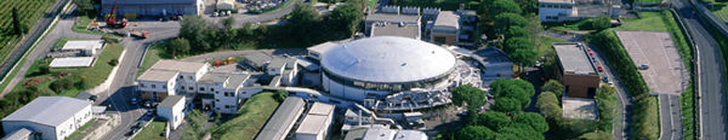

Theoretical modeling for the thermal stability of solid targets in LEMMA muon collider
Gianmario Cesarini for the LEMMA Team

Slide 2
Outline
Introduction of the LEMMA project
Features of the Positron beam
Numerical simulation of the deposited energy onto the target
Temperature behaviour of the thermal parameters of Beryllium and Carbon
Temperature field after a single bunch – temperature temporal evolution
Target steady state temperature
Thermal stability of the target in case of rotating system
Conclusions

Slide 3
Introduction of the LEMMA project
Low EMittance Muon Accelerator
INFN institutions involved: LNF, Roma1, Pd, Pi, Ts, Fe
Universities: Sapienza, Padova, Insubria
Contributions from: CERN, ESRF, LAL, SLAC
A µ⁺µ⁻ collider offers an ideal technology to extend lepton high energy frontier in the multi-TeV range:
  No synchrotron radiation (limit of e⁺e⁻ circular colliders)
  No beamstrahlung (limit of e⁺e⁻ linear colliders)
  but muon lifetime is 2.2 ms (at rest)

Slide 4
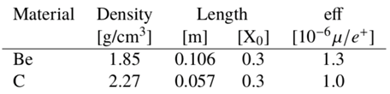
Muon source
e⁺e⁻ annihilation - positron beam on target : very low emittance and
no cooling needed, baseline for our proposal
e⁺ on standard target (including crystals in channeling)
→ Need Positrons of ≈ 45 GeV
e⁺ beam
target
Beam with e⁺ and µ⁺µ⁻
  Ideally muons will copy the positron beam
e⁺ beam
on target
L
μ^{+/-}
e⁺
(finite target length)

Slide 5
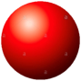


Target size and discretization in the FLUKA code
Pulsed beam
Pulse duration τ : 10 ps
Spot size a : three case studies
(10, 50, 140) μm
Beryllium thickness: 3 mm
Beryllium radius : 5 cm
W
Δr
Radial simmetry in the distribution of deposited energy: use of cylindrical coordinates (r, φ=1) and discretization along z.
Φ
ΔT
Δz
Φ

Slide 6
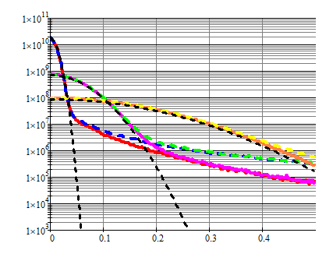
Energy density deposited for the three case studies
N_{part} = 3·10¹¹ positrons
z =0 mm
z =3 mm
Spot 50 µm
Heat density, J/m³
Spot 140 µm
Spot 10 µm
Theoretical
Gaussian beam
Radial axis, mm

Slide 7
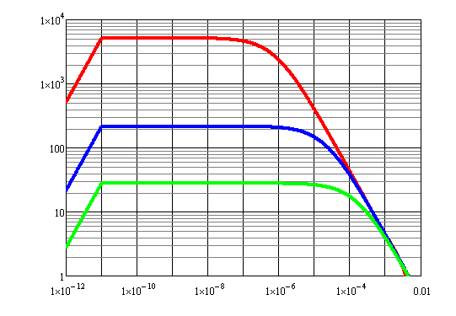
Temperature simulations with constant thermal parameters:
linear model – surface temperature rise
Spot = 10 µm
Spot = 50 µm
Temperature rise in the beam centre, K
Spot = 140 µm
Time, s
During the bunch
Heat diffusion process
Non-diffusive period

Slide 8
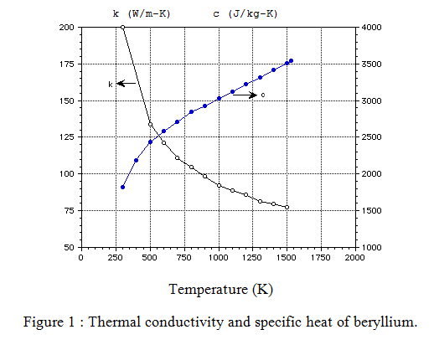
Temperature behaviour of the thermal parameters of Beryllium
Specific heat and thermal conductivity of Beryllium are strongly dependent on temperature in the range from room temperature to 1500 K
k
Beryllium
c
References
Goodfellow. Metals, Alloys, Compounds, Ceramics, Polymers, Composites. Catalogue 1993/94.
J. Phys. Chem. Ref. Data, Vol. 14, Suppl. 1, 1985, pg 354 (JANAF).
Thermophysical Properties of High Temp. Solid Materials Vol. 1, pt 1, pg 55 - 59.
Status Report, KfK Contribution to the Development of : Demo-Relevant Test Blankets for NET/ITER, October 1991, pg 264 - 266.
Modelling, Analysis and Experiments for Fusion Nuclear Technology. FNT Progress Report : Modelling and finesse, January 1987, Chapter 2.2.
Eric A. Brandes. Smithells Metals Reference Book, Sixth Edition, Chapter 14, pp 1 - 3.

Slide 9
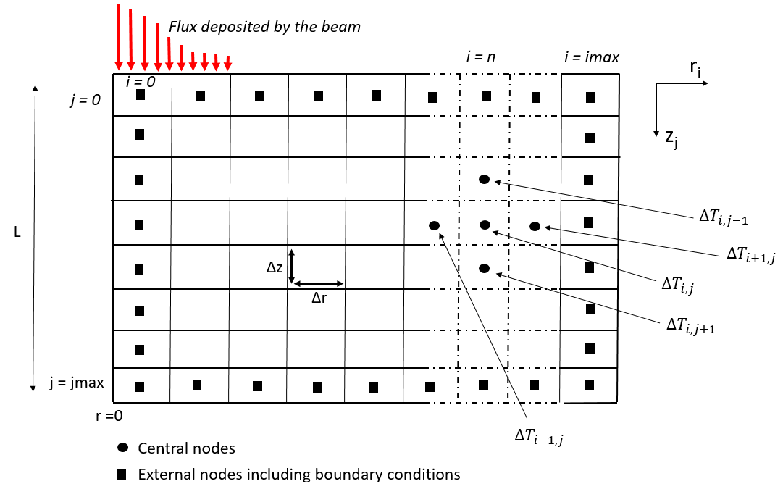
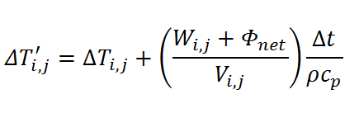

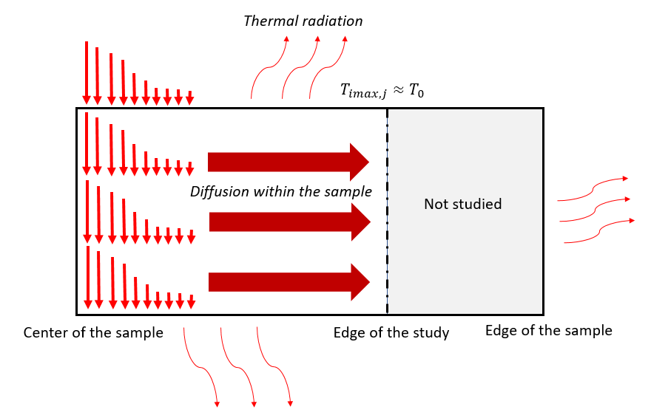
Numerical model for temperature variation inside the material
Basic model equation
Convergence condition
( Fourier number F0 = Dt/L² ≤ ½):
i scan on r, j scan on z
ΔT_{i,j}’ temperature at time t’, ΔT_{i,j} at time t
W_{i,j} power deposited in element i,j
Φ_{net} heat flow exchanged by the element i,j in the time unit
Δt time lapse
V element volume i,j
ρ density
C_{p} specific heat
D thermal diffusivity

Slide 10
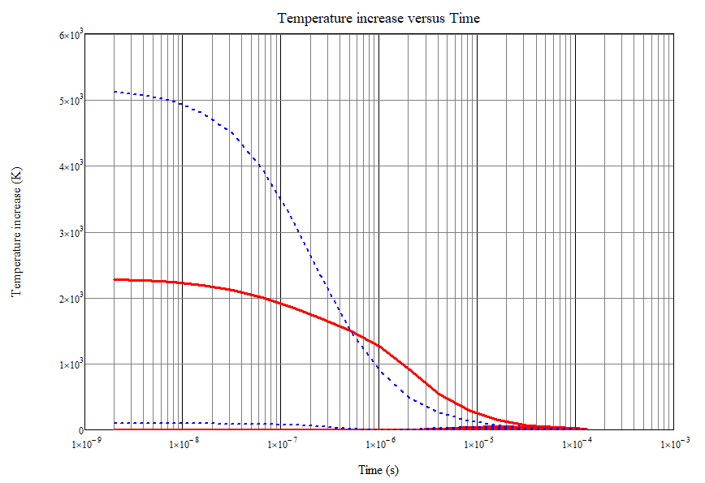
Comparison between linear model and numerical model with thermal parameters as a function of temperature (Gaussian beam spot 10 µm)
FDTD nonlinear
Linear model
r = 0 µm
Temperature, K
r = 0 µm
r = 50 µm
Time, s

Slide 11
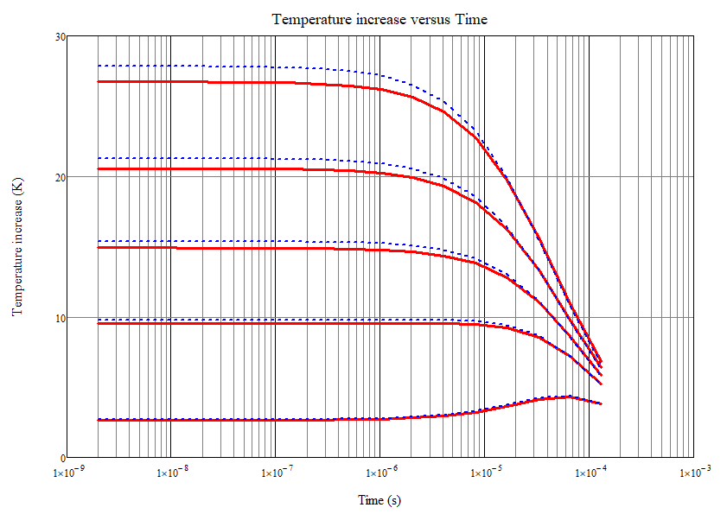
Comparison between linear model and numerical model with thermal parameters as a function of temperature (Gaussian beam spot 140 µm)
r = 0 µm
FDTD nonlinear
Linear model
r = 50 µm
r = 75 µm
Temperature, K
r = 100 µm
r = 150 µm
Time, s

Slide 12
Features of the benchmark positron beam
Symbol | Description | Reference Value
a | Gaussian beam spot size | 300 µm
τ | bunch duration | 10 ps
N_{part} | positron number | 3·10¹¹
N_{pulses} | number of consecutive bunches | 100
T_{pulse} | time between two bunches | 400 ns
T_{heating} | total time of N_{pulses} | 40 µs
T_{rep} | repetition time of the N_{pulses} sequence | 0.1 s
N_{pulses}
T_{heating}
T_{pulse}
T_{rep}
Cooling time
time

Slide 13
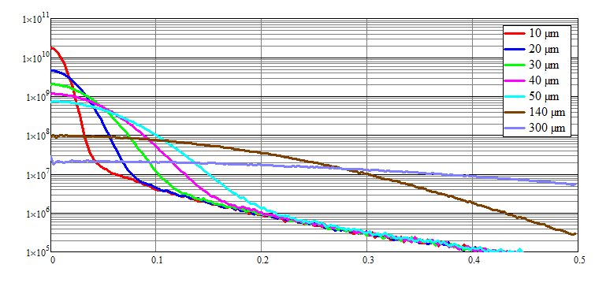
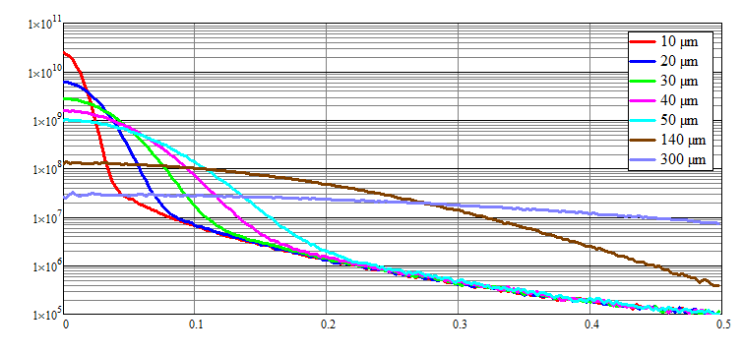
Numerical simulation of the deposited energy onto the target
For this purpose Monte Carlo simulations have been performed with FLUKA both for Beryllium and Carbon (Low-Z materials). The figures show the heat deposited by a single bunch of 3·10¹¹ e⁺ as a function of the radial distance from the center.
Beryllium
Heat density (J/m³)
Carbon
Radial axis (mm)
Heat density (J/m³)
Radial axis (mm)

Slide 14
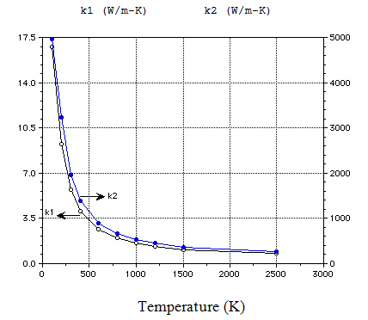
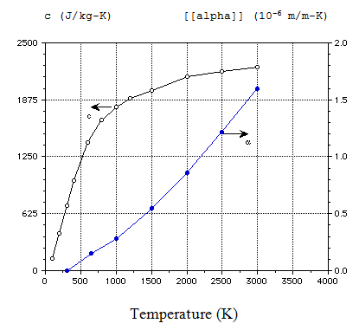
Temperature behaviour of the thermal parameters of Beryllium and Carbon
Carbon
c
k₂ //
α
k₁
Thermal conductivity of pyrolytic graphite both parallel and perpendicular to the layers.
Specific heat and coefficient of thermal expansion of pyrolytic graphite.
References
Goodfellow. Metals, Alloys, Compounds, Ceramics, Polymers, Composites. Catalogues 1993/94.
Frank P. Incropera, David P. Dewitt, Fundamentals of Heat Mass Transfer, Second Edition pg 759.

Slide 15
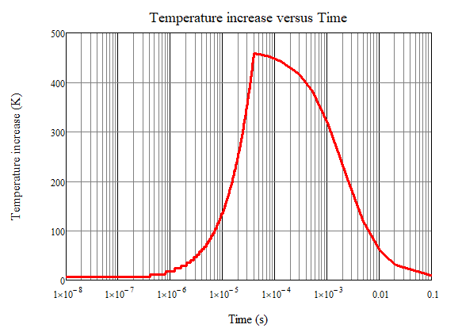
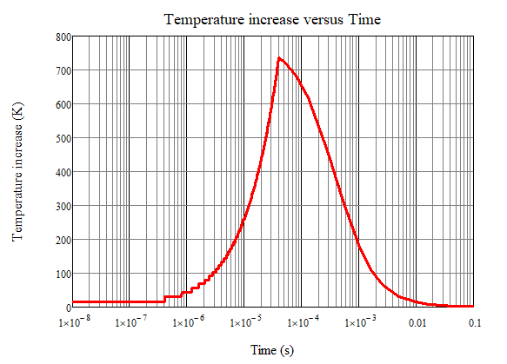
Temperature temporal evolution in the beam spot center after a sequence of bunches
Beryllium
After 100 bunches
Temperature, K
Carbon
Time, s
Temperature, K
Time, s

Slide 16
Asymptotic temperature increase: Steady State Temperature
Obtained from the energy balance between the deposited energy and the dissipation by thermal radiation
r
L
ɛ emissivity, σ_{B} Stefan-Boltzmann constant, T_{rep} pulse train repetition period, C_{max,a} deposited energy density peak by the Fluka data

Slide 17
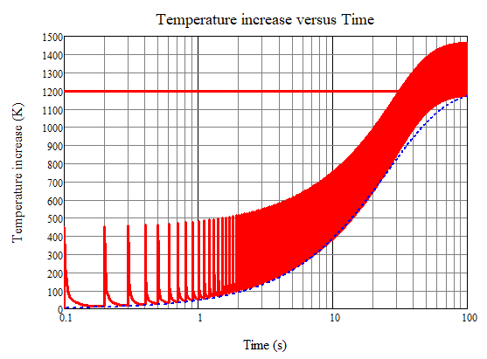
Comparison between the numerical model and the model based on the energy balance for the Beryllium target
5mm Structure
Steady State Temperature
Simulations performed for a reduced structure in order to validate the models and reduce the calculation time.
FDTD model
Temperature rise in the beam centre, K
Energy Balance
Time, s

Slide 18
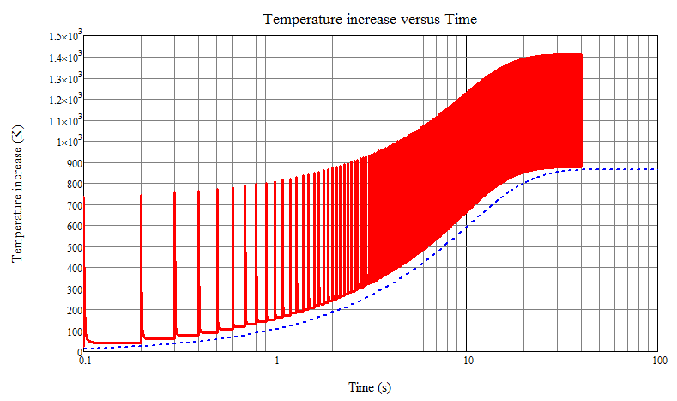
Comparison between the numerical model and the model based on the energy balance for the Carbon target
5mm Structure
FDTD model
Steady State Temperature
Temperature rise in the beam centre, K
Energy Balance
Simulations performed for a reduced structure in order to validate the models and reduce the calculation time.
Time, s

Slide 19
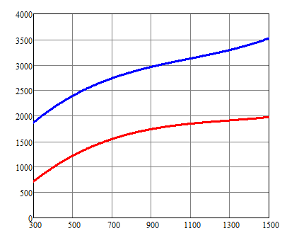
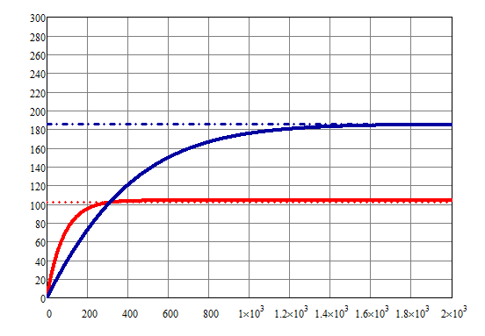
Energy Balance Model and Steady State Temperature
Beryllium
Carbon
Specific Heat, J/KgK
R = 5 cm, L = 3 mm
Beryllium
R = 5 cm, L = 1 mm
Temperature , K
Carbon
Time, s
Pagina 19

Slide 20
Steady State Temperature
Beryllium target
radius r = 5 cm, thickness L = 3 mm;
Beam spot size: a = 300 µm;
Number of positrons: N = 3·10¹¹
Cooling time: T_{Rep} = 0.1 s.
Steady state temperature increase: ΔT_{SS} = 185.5 K
Melting point: 1551 K
Carbon target
radius r = 5 cm, thickness L = 1 mm;
Beam spot size: a = 300 µm;
Number of positrons: N = 3·10¹¹
Cooling time: T_{Rep} = 0.1 s.
Steady state temperature increase: ΔT_{SS} = 102.5 K
Melting point: 3923 K

Slide 21
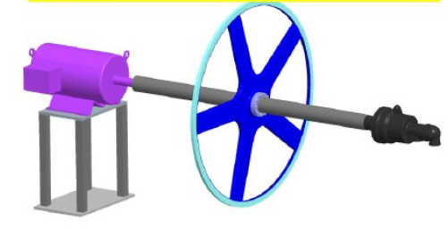
Thermal stability of the target in case of rotating system
Wheel rim speed 100 m/s
Wheel diameter ~ 1 m
We can discriminate single bunches
a
a
r_{external}
r_{inner}
Target

Slide 22
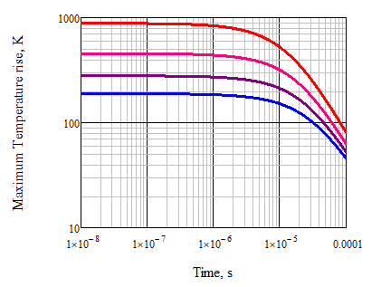
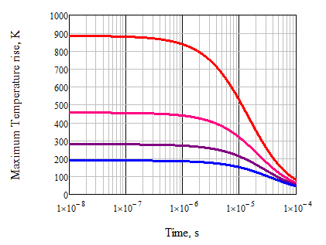
Temperature field after a single bunch – temperature temporal evolution (1)
The spatial and temporal distribution of the thermal field has been calculated using the Fourier heat transfer from the heat density deposited taking into account the dependence on temperature of the thermal parameters of the material. A Finite difference time domain method (FDTD) code has been developed for the evaluation of the temperature gradient on the target and the timing of heat diffusion on the latter.
Beryllium
20 μm
20 μm
50 μm
30 μm
Temperature, K
Temperature, K
40 μm
50 μm
Time, s
Time, s
Melting point 1551,15 K

Slide 23
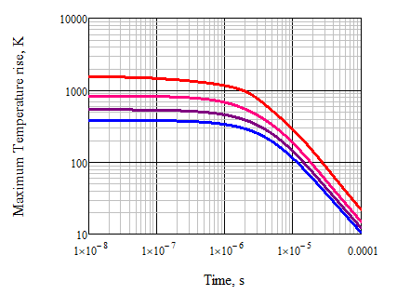
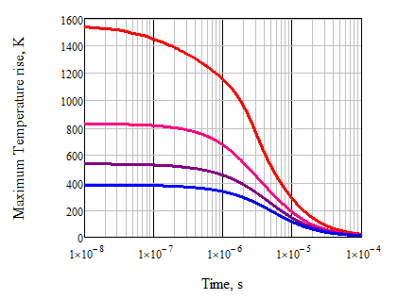
Temperature field after a single bunch – temperature temporal evolution (2)
Here we have chosen smaller spot sizes in order to evaluate the increase in temperature in the incidence area as the spot size decreases. For both materials considered as targets, cylindrical symmetry was used for the analysis of heat diffusion, starting from the symmetry of the Gaussian beam.
Carbon
20 μm
20 μm
30 μm
Temperature, K
50 μm
40 μm
Temperature, K
50 μm
Time, s
Time, s
Melting point 3773 K
Work in progress..

Slide 24
Conclusions
We can use a two-way approach:
use the numerical model (FDTD) in order to evaluate the spatial and temporal gradients of temperature due to a single bunch or to sequence of bunches that can cause thermomechanical stresses and therefore damage or fractures of the target;
use the model based on the energy balance to obtain the steady state temperature and evaluate its sustainability both for a static configuration of the target and for an application on a rotating support.

Slide 25
Acknowledgments
Special thanks to A. Variola, M. Antonelli, M. Boscolo, O. Blanco,
A. Ciarma (INFN – LNF),
G. Cavoto, F. Anulli, F. Collamati, M. Bauce (INFN – Sezione di Roma),
R. Li Voti (Sapienza – Università di Roma)

Slide 26
Thanks for your attention

