Slide 1
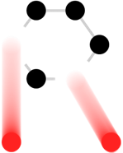
Challenges of Neutrino Targets and the Role of the HiRadMat Facility
Patrick Hurh
International HiRadMat Workshop 2019 (CERN)
11 July 2019
hurh@fnal.gov
Notes:
30 sec

Slide 2
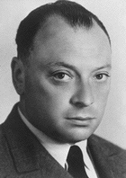
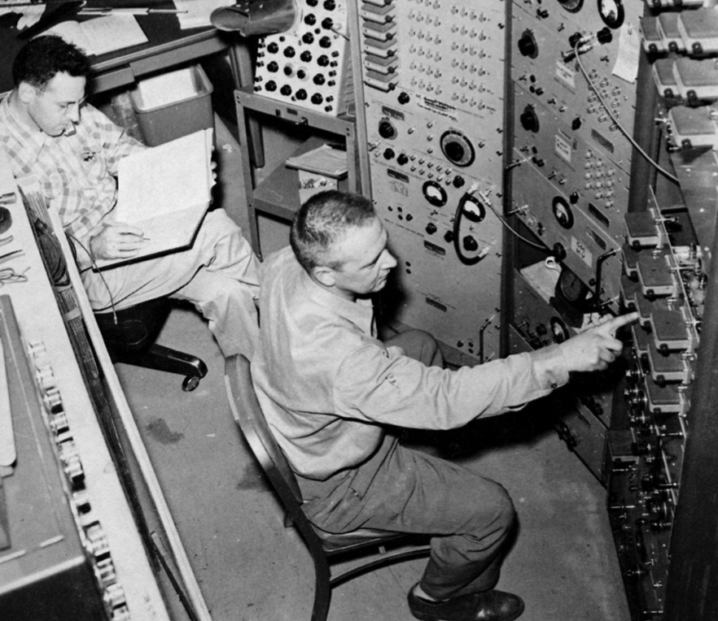
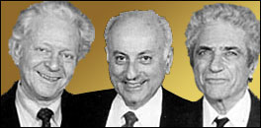
The Nobel of Neutrinos
Invented as a particle “impossible” to detect (Pauli, 1930)
  Save conservation of energy and angular momentum
Detected electron neutrino by Cowan & Reines in 1956 (Nobel 1995)
Lederman, Schwartz, & Steinberger developed the Neutrino Beam in 1962 (Nobel 1988) & Detection of Muon Neutrino
Notes:
2:20

Slide 3
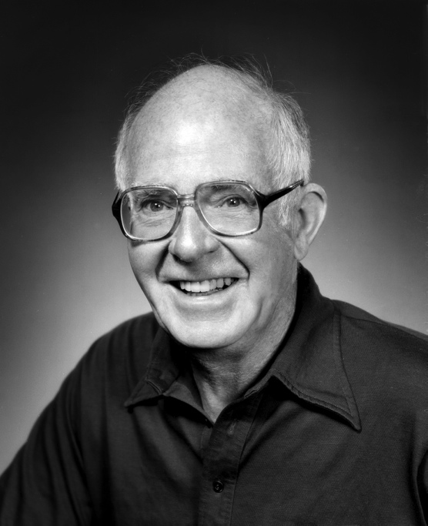


The Nobel of Neutrinos
Cosmic Neutrinos (solar, atmospheric, and supernovae) discovered over several decades, Nobel in 2002 for Koshiba & Davis
2015 Nobel for Neutrino Oscillations (with solar & in-beam) for Kujita & McDonald
What is left in store?
Notes:
2:50

Slide 4


Neutrinos are fundamental (-ly weird)
Neutrinos come in 3 flavors:
electron
muon
tau
And in 3 masses (v1, v2, v3)
But the masses do not correlate with specific flavors
A neutrino of a particular flavor is made of a combination of masses (1, 2, and 3), and a neutrino of a certain mass (such as the lightest neutrino) has a certain probability of interacting in a detector to make a certain flavored charged particle (electron, muon, or tau).
Credit: Symmetry Magazine/Sandbox Studio, Chicago
Notes:
3:50

Slide 5

If you don’t like the flavor of your neutrino, just wait
As a neutrino travels through space-time, the mass ratio changes (oscillates) meaning that the probability that it interacts as a certain flavor changes. Which you don’t know until you try to measure it!
Illustration by Fermilab
Notes:
4:25

Slide 6



Are Neutrinos the Reason Matter Exists?
https://neutrinos.fnal.gov/
Are there any right-handed neutrinos?
Charge-parity violation?
One of the biggest mysteries in neutrino research is whether neutrinos and their antimatter twins, antineutrinos, behave the same way. This turns out to be a very important question—if the answer is no, it could explain how our universe full of matter came to exist.
Credit: Symmetry Magazine/Sandbox Studio, Chicago
Notes:
5:35

Slide 7
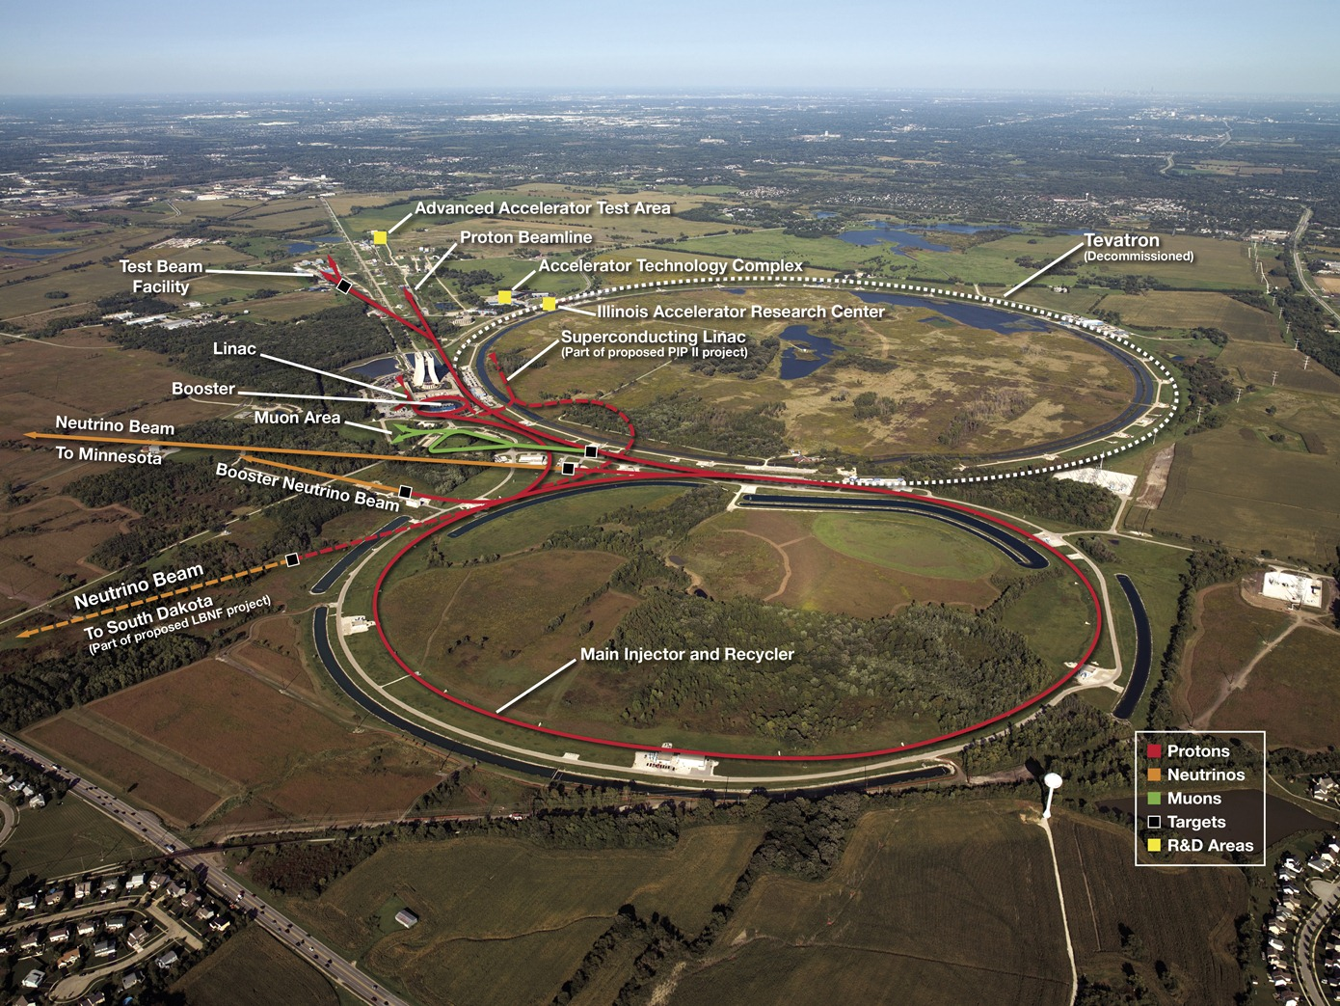
Fermilab Accelerator Complex
Notes:
6:35

Slide 8
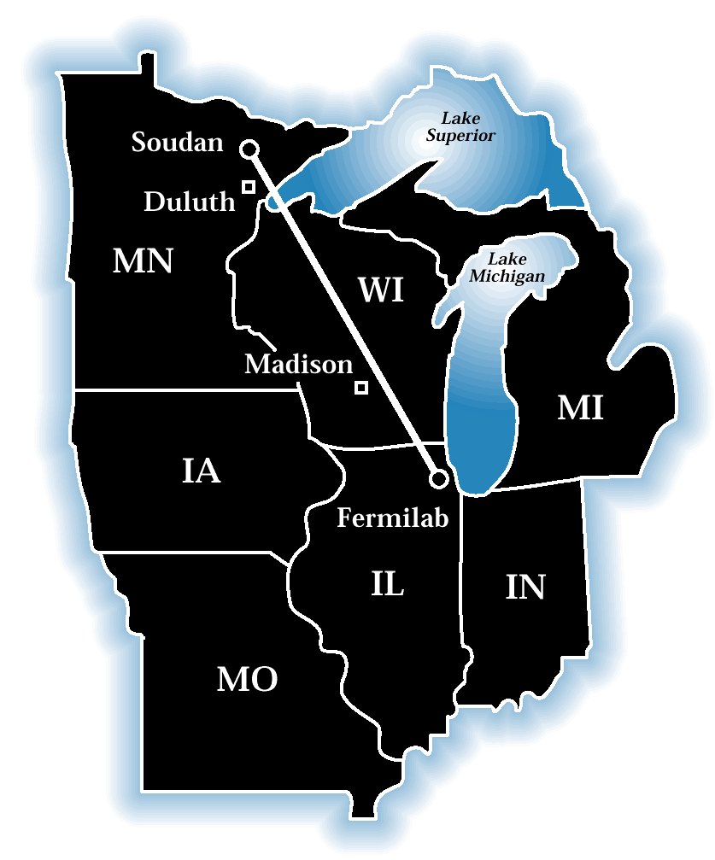
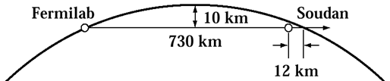
The NuMI Facility
“Neutrinos (ν – Nu) at the Main Injector”
Intense muon-neutrino beam directed towards Minnesota
Main Injector supplies 25 – 50 trillion 120GeV protons every 1.33 seconds
  Operating regularly at 700 kW
  Upgrade to 900+ kW in 2020
Each pulse produces about 10¹⁴ ν _{μ}
  ~ 20,000,000 Pulses per year
Direct beam 3º down
On-site and off-site experiments
Different types of neutrino beams
Beam is 10s of kilometers wide at exit
Near Detector: 980 tons
Far Detector: 5400 tons
5
Notes:
7:30

Slide 9
Defining Characteristics of Long Baseline Beams
Proton Beams: synchrotron based, nearing 1 MW currently
  High Stored Energy: ~ 1 MJ
  Small Beam Spot: 1 – few mm
  High Proton Energy: 30-120 GeV
  Single-turn extraction, long cycle time: 1 – few seconds
  Pulsed beam with pulse length of ~4 – 10 µsec
Pion Focusing: Pulsed horns
  Horns more efficient than quadrupole magnets
  High currents: few hundred kA
Large Decay volume
  Meters in cross-section and 100s of meters in length
Beam radiation dispersed over extended area
  Tritium, activation, corrosion, cooling
Notes:
9:00

Slide 10
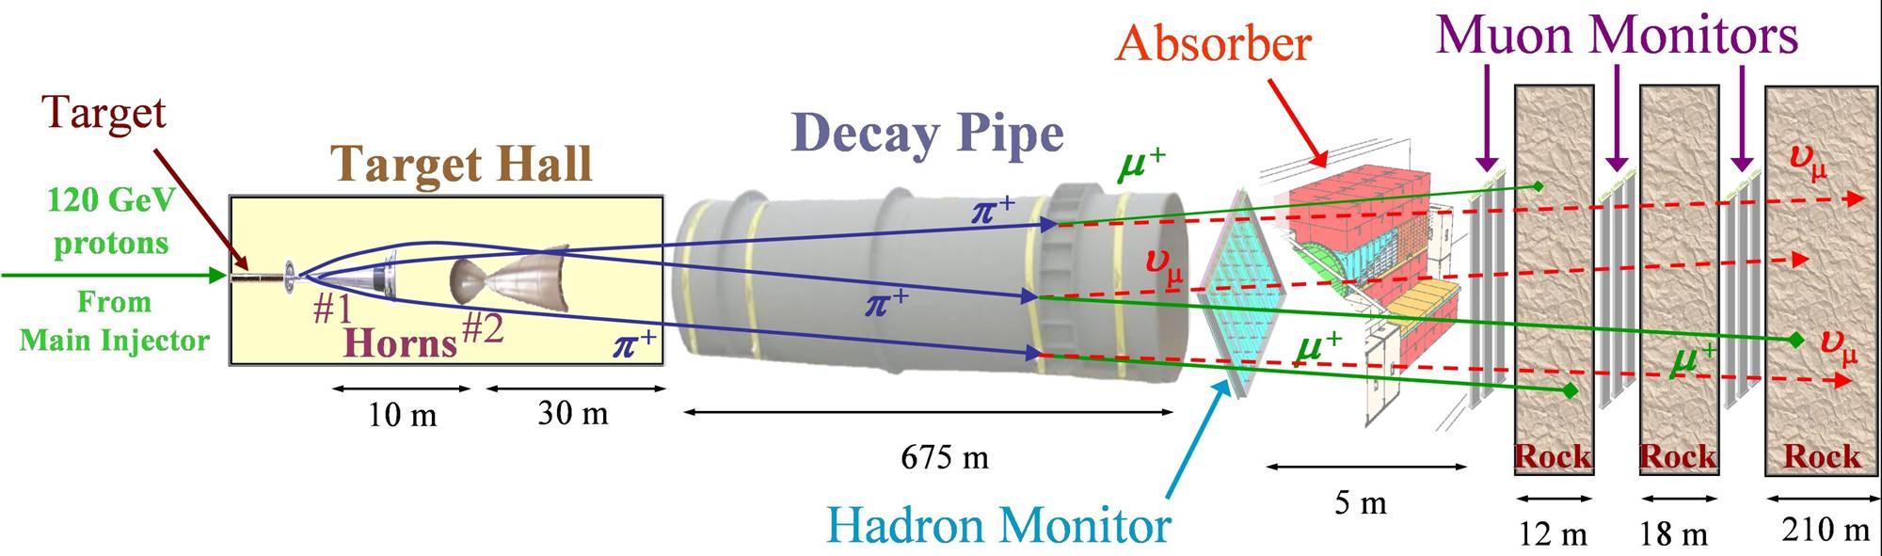
The NuMI Beam “Neutrinos at the Main Injector”
Absorbs ~ 40 % of beam power
Allows high-energy muons to penetrate
2 m diameter
Roughly decay length for 10 GeV π⁺
He-filled
2 interaction length, C target
Produces π⁺, K⁺ mesons
400 kW design average power
700 kW upgrade for NOvA
1 MW capable by 2020
σ ∼ 1 mm
Pulsed focusing horns
Toroidal magnetic field
Parabolic inner conductor profile
Focus meson momentum band
Measure hadron & muon fluxes
Arrays measure distributions
Notes:
10:00

Slide 11
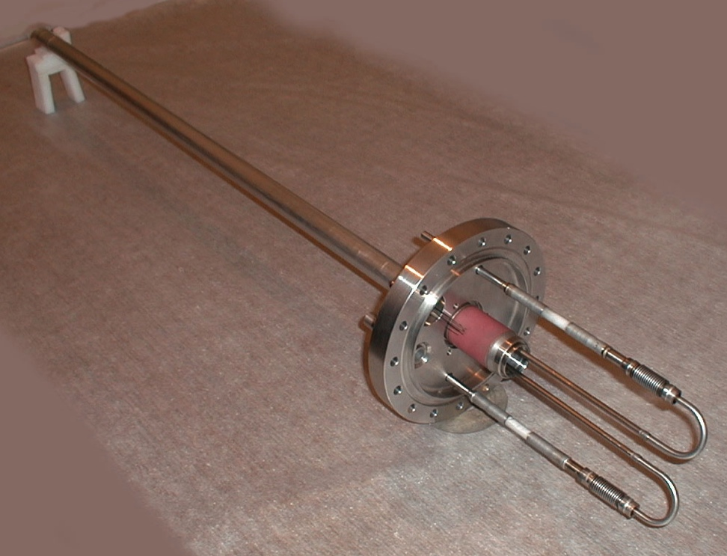
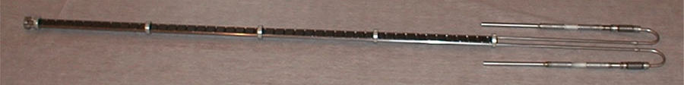
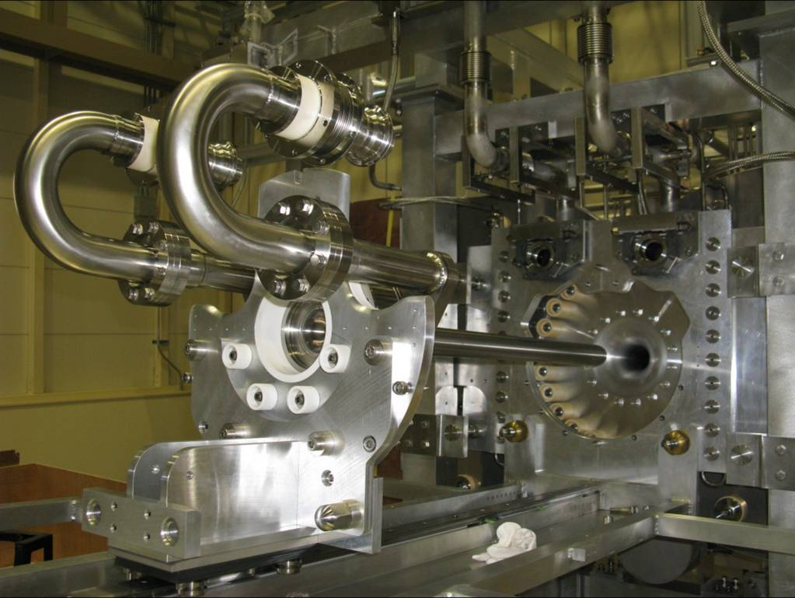
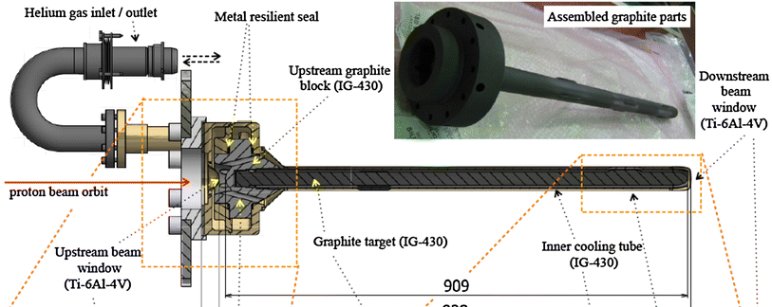
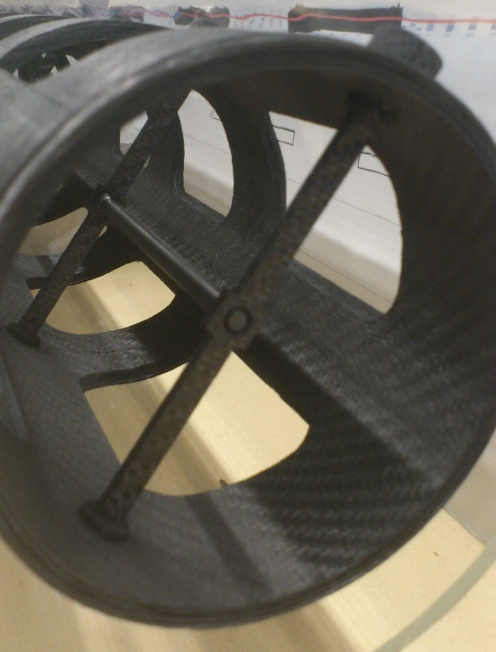
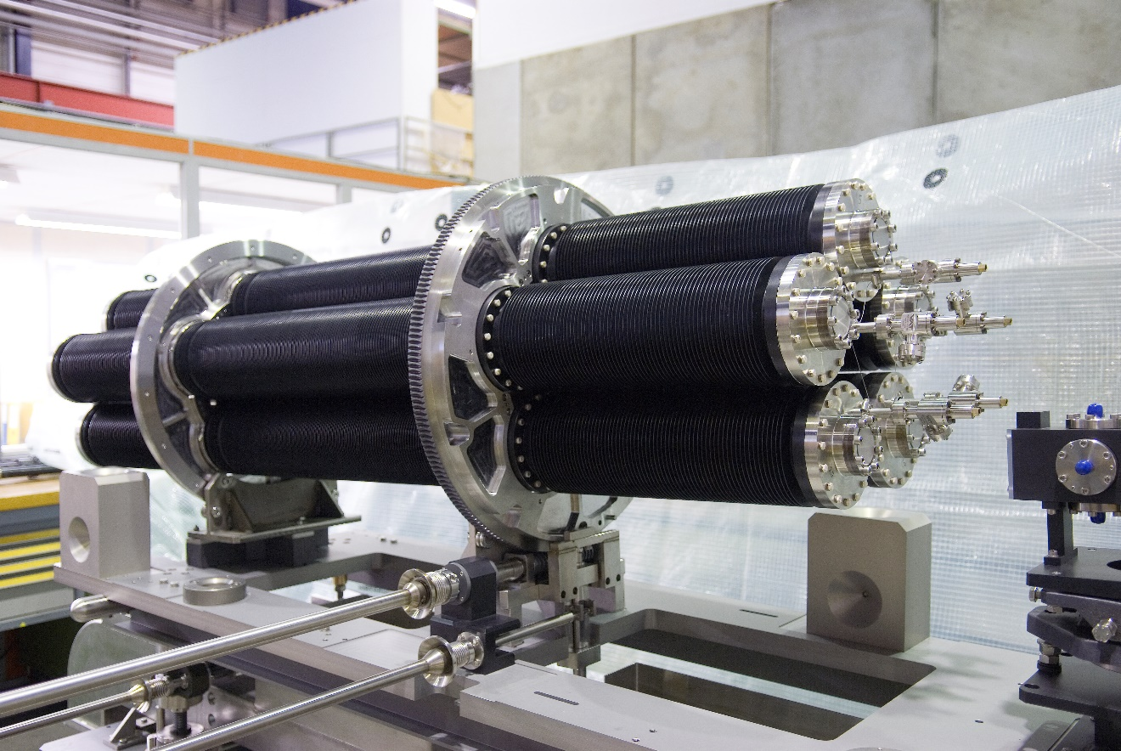
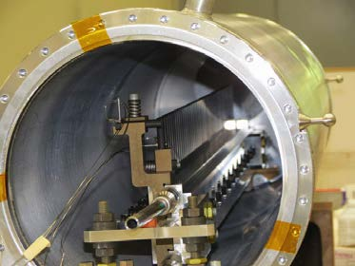
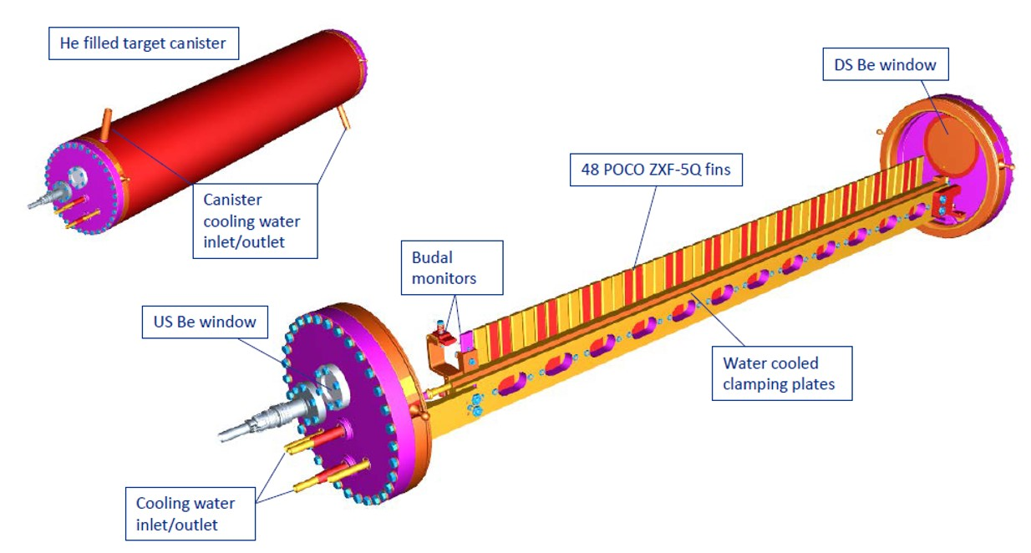
Neutrino Targets Around the World
NuMI - MINOS water-cooled carbon target (J. Hylen)
T2K helium-cooled carbon target (C. Densham)
NUMI – NOvA water-cooled carbon target (K. Ammigan)
CNGS radiatively-cooled carbon targets (CERN)
Notes:
11:25

Slide 12
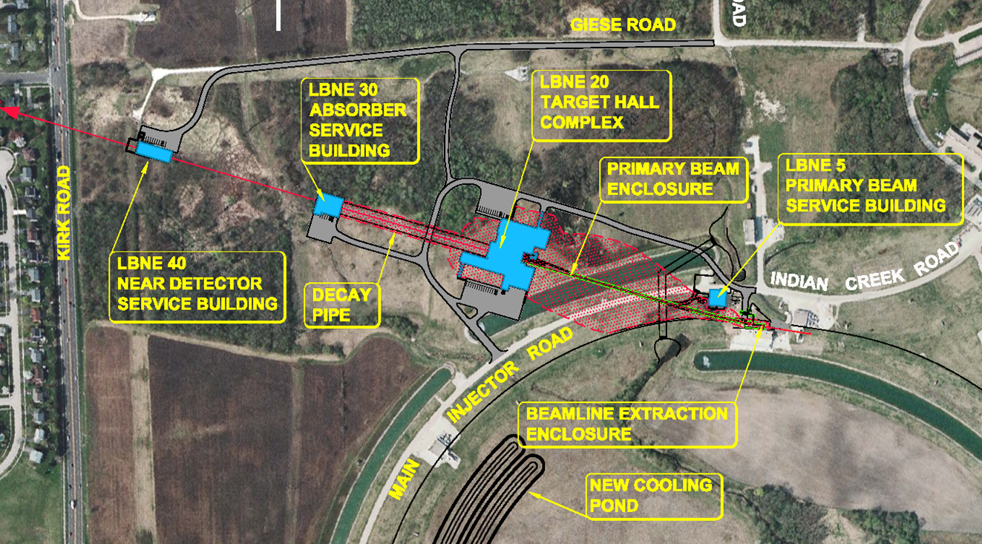
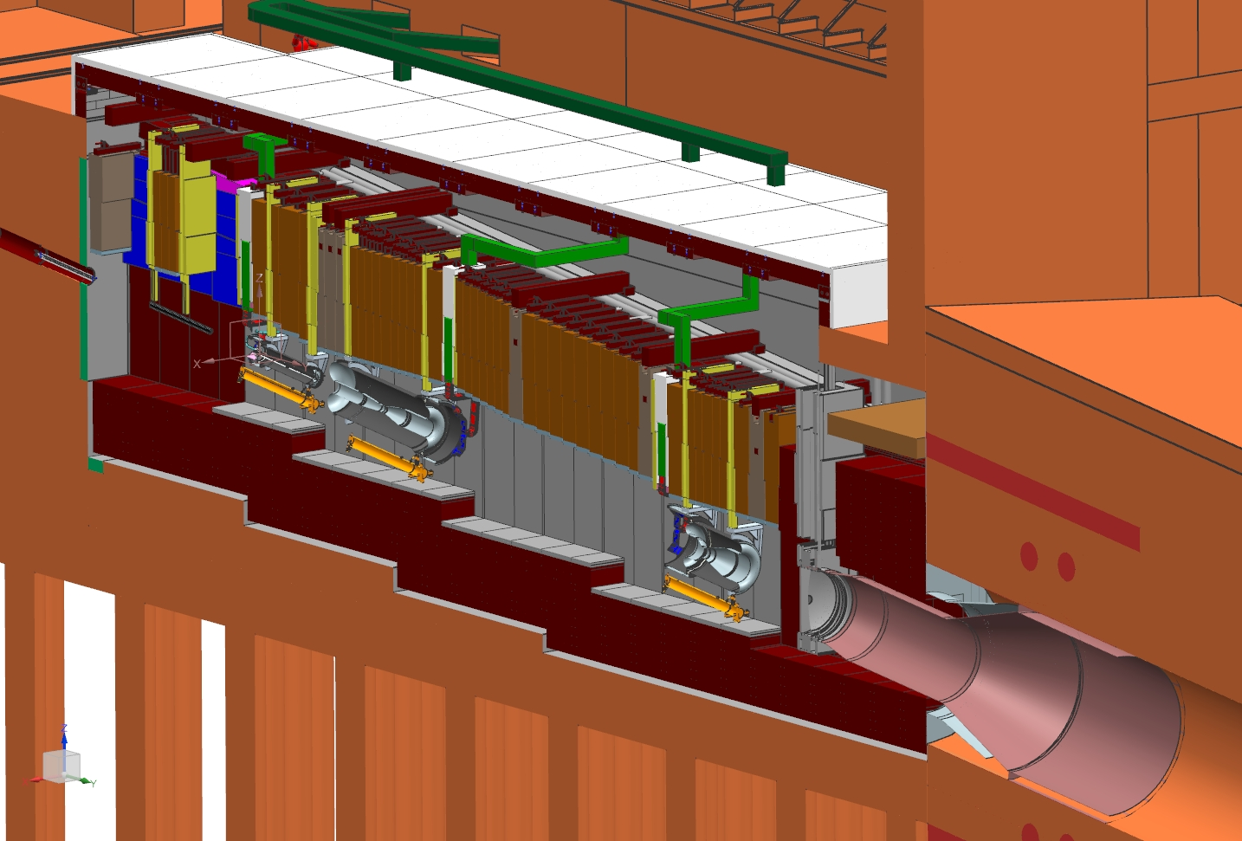
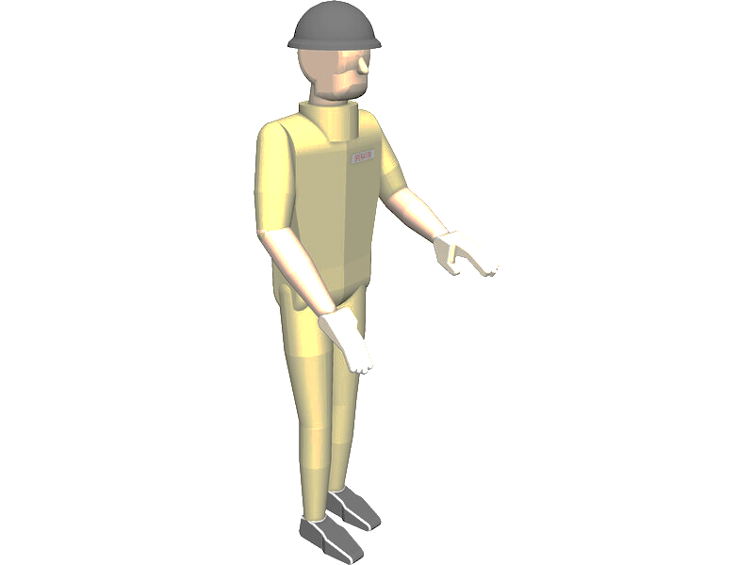
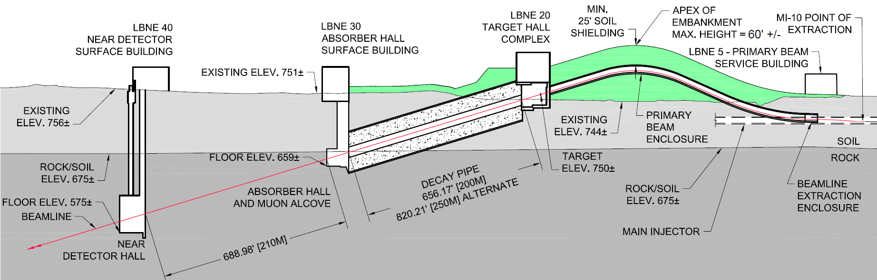
DUNE: Deep Underground Neutrino Experiment
LBNF: Long-Baseline Neutrino Facility (1.2 MW -> 2.4 MW!)
Stripline
Target Shield Pile
Liner
Decay Pipe
Upstream Window
Nitrogen Cooling Lines
Horn A with Target
Horn B
Decay Pipe Snout
Cooling Panels
Horn C
Proton Beam Energy (GeV) | Protons per cycle | Cycle Time (sec) | Beam Power (MW)
120 | 7.5 x 10¹³ | 1.2 | 1.20
120 | 1.5 x 10¹⁴ | 1.2 | 2.40
Notes:
14:40

Slide 13
High Power/Intensity Targetry Challenges
Material Behavior
  Thermal “shock” response
  Radiation damage
  Highly non-linear thermo-mechanical simulation
Targetry Technologies (System Behavior)
  Target system simulation (optimize for physics & longevity)
  Rapid heat removal
  Radiation protection
  Remote handling
  Radiation accelerated corrosion
  Manufacturing technologies
HiRadMat relevant
Notes:
15:50

Slide 14
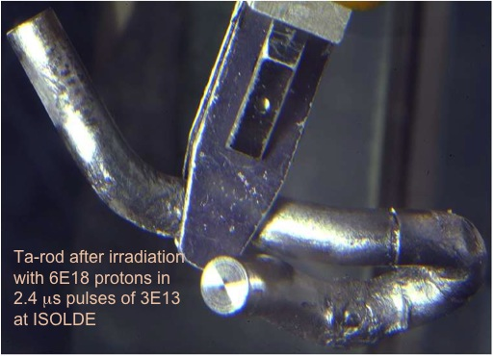
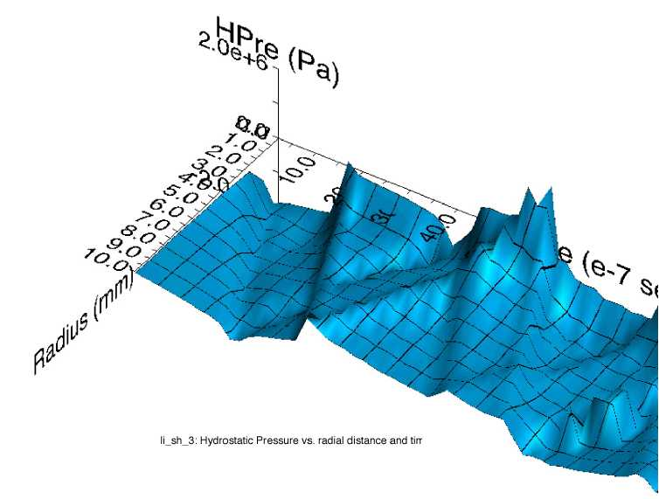
Thermal Shock (stress waves)
Ta-rod after irradiation with 6E18 protons in 2.4 μs pulses of 3E13 at ISOLDE (photo courtesy of J. Lettry)
Simulation of stress wave propagation in Li lens (pbar source, Fermilab)
Fast expansion of material surrounded by cooler material creates a sudden local area of compressive stress
Stress waves (not shock waves) move through the target
Plastic deformation, cracking, and fatigue can occur
Notes:
17:20

Slide 15
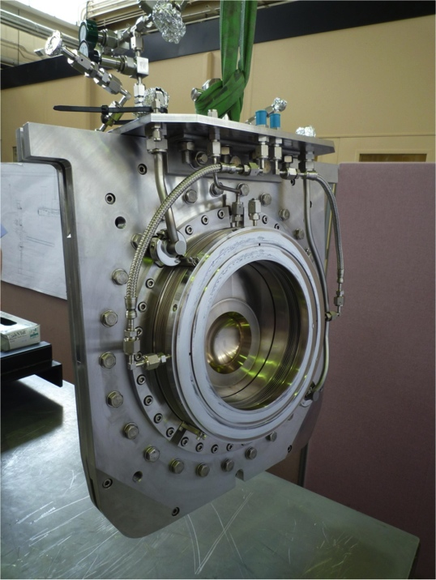
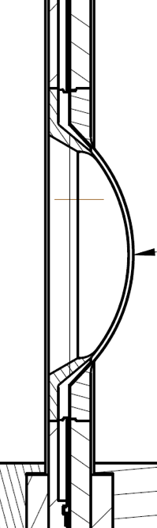
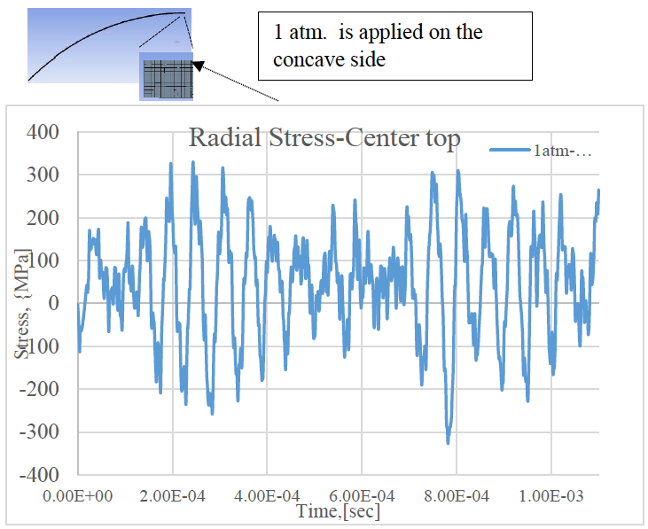
Stress wave example: T2K window
Preliminary
Material response dependent upon:
  Specific heat (temperature jump)
  Coefficient of thermal expansion (induced strain)
  Modulus of elasticity (associated stress)
  Flow stress behavior (plastic deformation)
  Strength limits (yield, fatigue, fracture toughness)
S. Bidhar, FNAL
Heavy dependence upon material properties, but:
Material properties dependent upon Radiation Damage…
Notes:
I will NOT speak to every material property as I did in the practice talk. I will gloss over and make the main point at the bottom of the slide
18:30

Slide 16
Nu HPT R&D Materials Exploratory Map
Uncharted Territory
Future Nu 4 MW
NuMI-MINOS Target NT-02 (damaged)
NuMI-NOvA Target TA-01 (survived)
NT-07
NT-04
LBNF-2.4 MW Tau Nu
NT-06
NT-05
NT-03
NT-01
Thermal Shock Severity (p/cm²/pulse)
LBNF-2.4 MW (Ideal)
LBNF-1.2 MW (CDR)
LBNF-2.4 MW (CDR)
T2K First Target
SNS range for 1.4 MW operation for 1 year
Radiation Damage Severity
(damage equivalent fluence, p/cm²)

Slide 17
Role of HiRadMat to Explore Thermal Shock in Nu Targets
Thermal Shock
Single Pulse
Cyclic Loading
(fatigue)
Non-irradiated
Condition
Irradiated
Condition
So, not really a lifetime test
Objectives –
Material limits in different conditions
Validate Material Models & Analyses
Explore Thermal Shock Resistance of Novel Materials (e.g. nano-fibers, expanded graphite)
Evaluate fracture/deformation mechanisms to develop more thermal shock tolerant materials
Explore Novel Target Concepts (e.g. powder targets)
Test prototypes for accident conditions

Slide 18
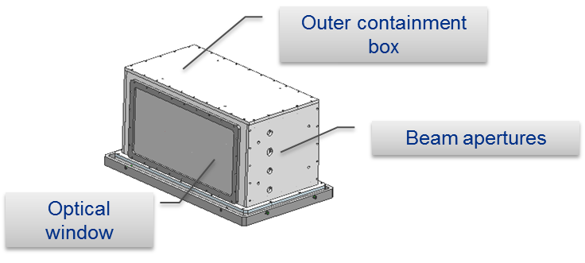
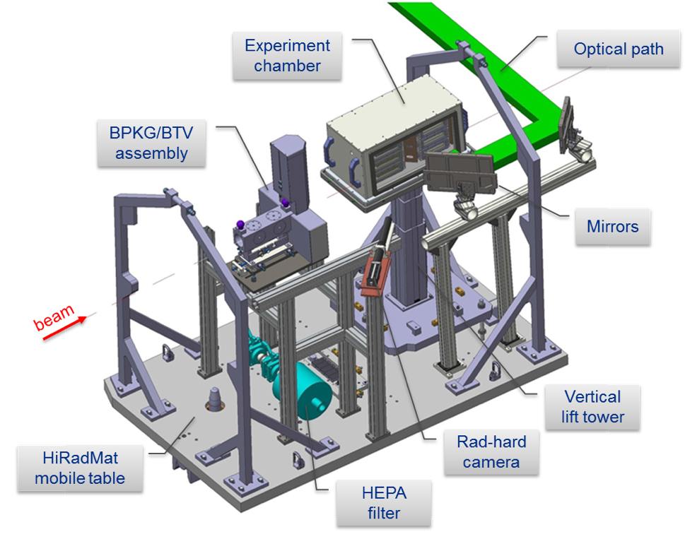
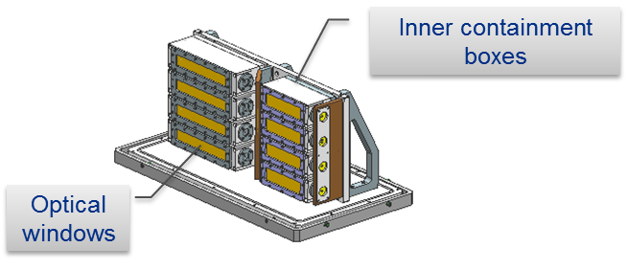
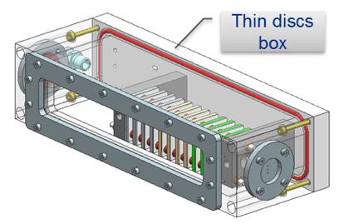
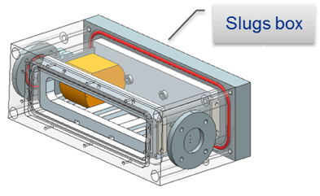
BeGrid1 (HRMT24) – experimental set-up
Experiment successfully completed in September 2015
Consisted of four specimen arrays of thin Beryllium discs and slugs
  Various commercial grades (S200F, S200FH, PF60, S65F) and thicknesses
  Real time measurements of temperature, strain and displacement
  PIE of thin disc specimen at the University of Oxford (2016-2017)

Slide 19
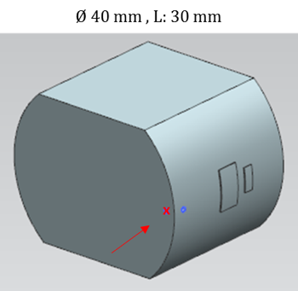
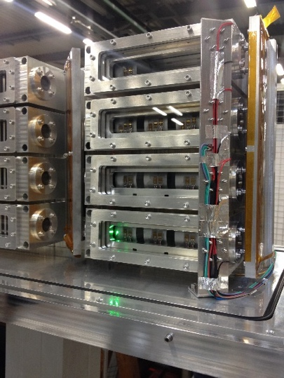
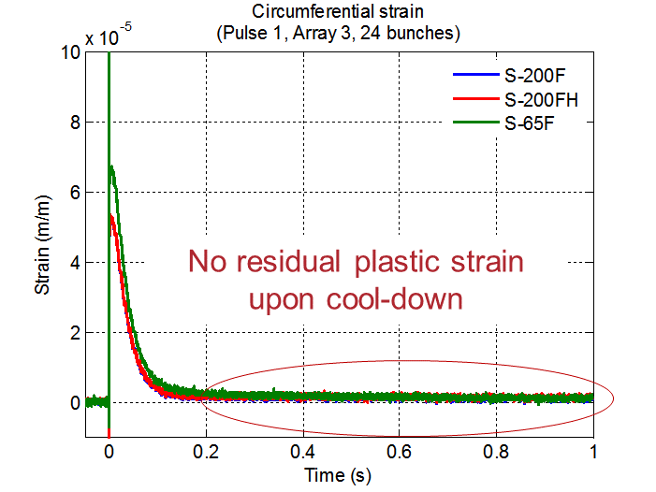
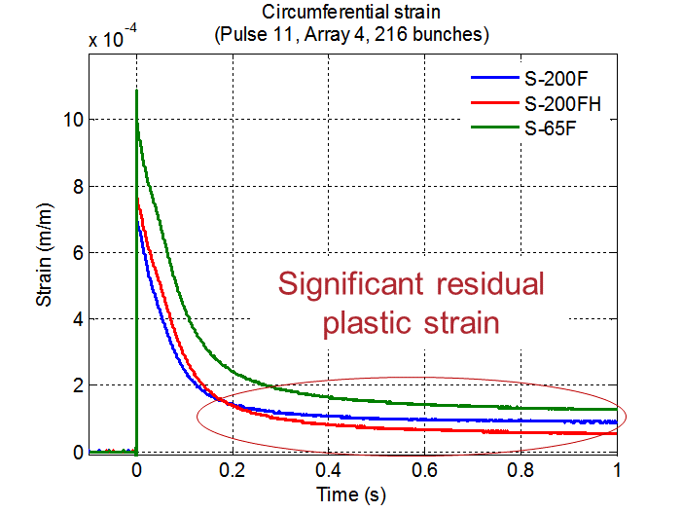
BeGrid1 (HRMT24) – online results
Real-time thermomechanical measurements
Instrumented Be slugs in downstream containment boxes
LDV for radial displacement measurements
Strain and temperature gages
Distinctive strain response for the three different Be grades
Residual plastic strain observed upon cool-down
Array 3 – 24 bunches, 3.2e12 POT
Array 4 – 216 bunches, 2.8e13 POT

Slide 20
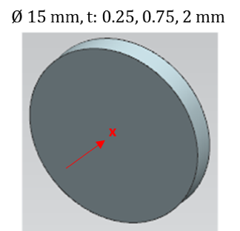
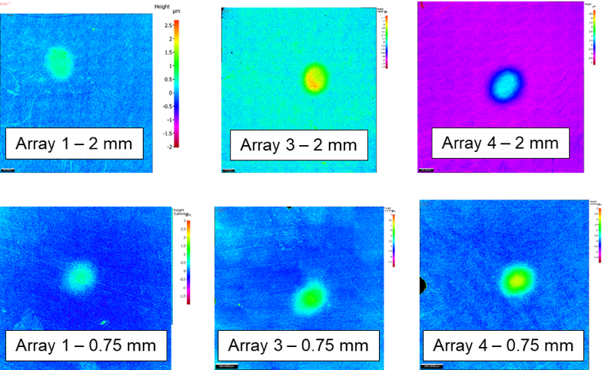
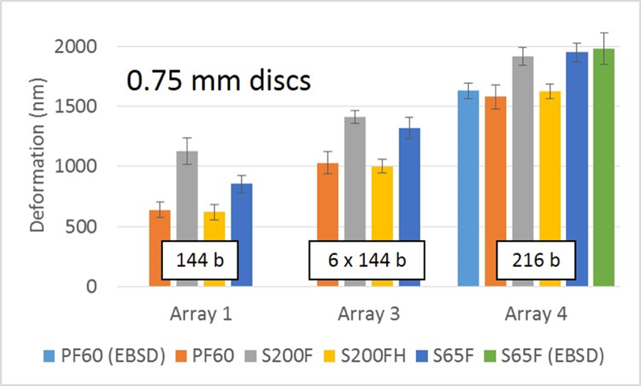
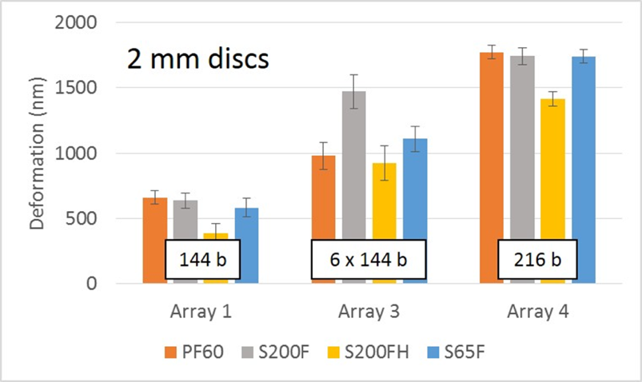
BeGrid1 (HRMT24) – Post Irradiation Examination Results
Thin disc specimen PIE performed at University of Oxford
Optical microscopy and profilometry to measure out-of-plane plastic deformations
S-65F grade specimens
All Be grades showed less plastic deformation than predicted by available literature strength models
S200FH showed least plastic deformation, in agreement with empirical strength model
Observed plastic strain ratcheting in Array 3
Glassy carbon windows survived without signs of degradation
V. Kuksenko (University of Oxford)

Slide 21
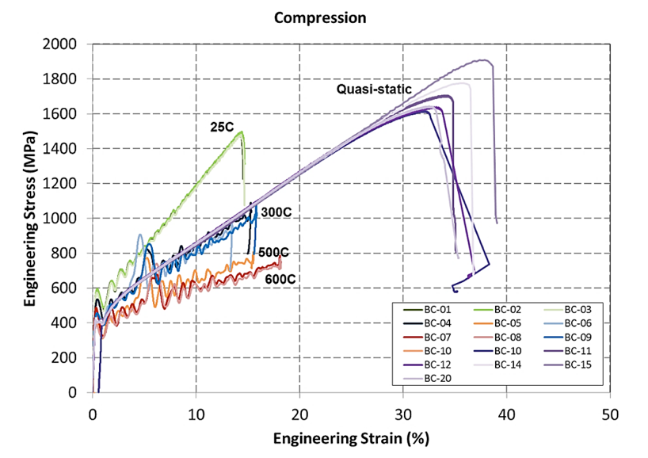
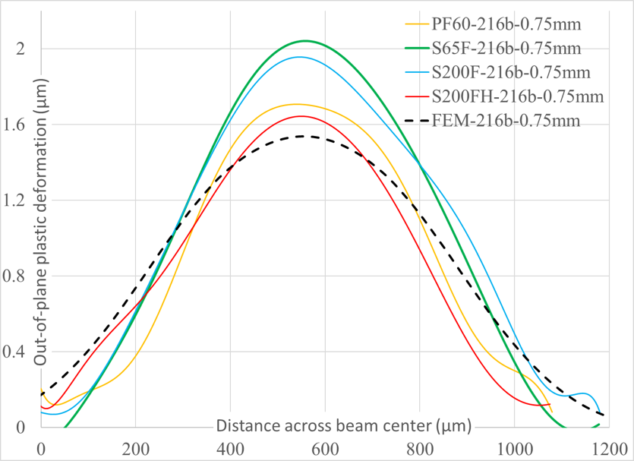
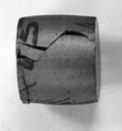

BeGrid1 (HRMT24) – data analysis
“Thermal shock experiment of beryllium … pulses”, K. Ammigan, et al., Phys. Rev. Accel. Beams 22, 044501, 4 April 2019
Beryllium S-200FH Johnson-Cook strength model
Strength model parameters empirically determined at Southwest Research Institute (SwRI)
High strain rate and elevated temperature testing with Split-Hopkinson pressure bar
$$σ_{Y}=\left[A+B(ε_{eff}^{p})^{n}\right]\left[1+Cln{\dot{ε}}^{∗}\right]\left[1−T_{H}^{m}\right]$$
Yield stress (σ_{y}) dependent on strain rate and temperature
Model parameters A, B, C, m, n empirically determined
Be JC damage model postponed due to limited funding
S-200FH 0.75 mm thick specimen
Good agreement
S. Bidhar (FNAL)
HRMT24 completed successfully and safely with valuable PIE results and validation of advanced strength model

Slide 22
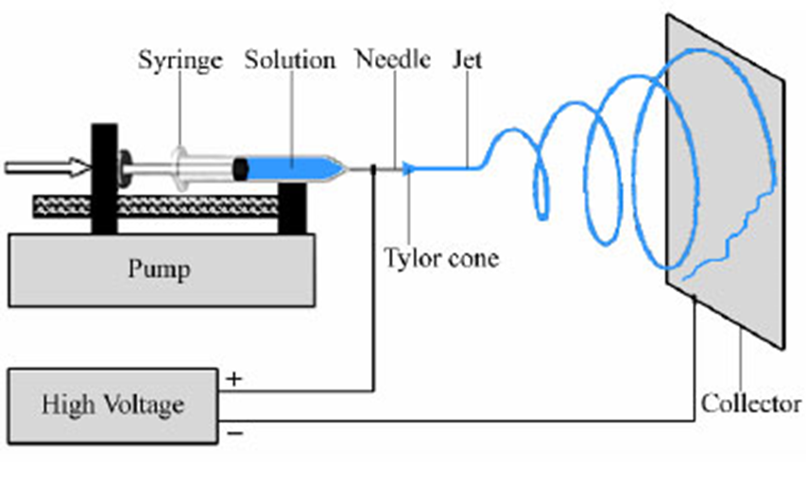
BeGrid2 (HRMT43)
Beam taken on Oct. 1st week (2018)
Primary Objectives:
Compare thermal shock response between non-irradiated and previously irradiated material specimens from BNL BLIP (Be, C, Ti, Si, Si-coated graphite)
  First/unique test with activated materials at HiRadMat
Explore novel materials such as metal foams (C, SiC) and electrospun fiber mats (Al₂O₃, ZrO₂) to evaluate their resistance to thermal shock and suitability as target materials
Electrospinning concept
SEM: as-spun Al₂O₃
Notes:
35:00

Slide 23
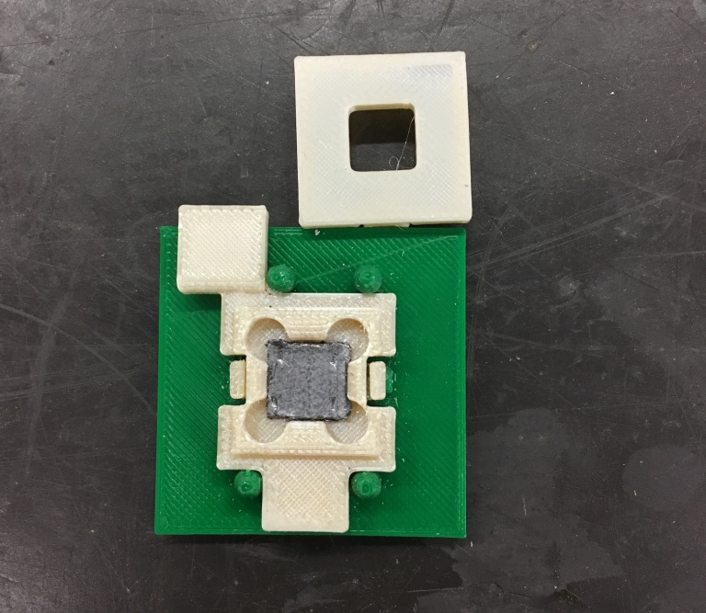
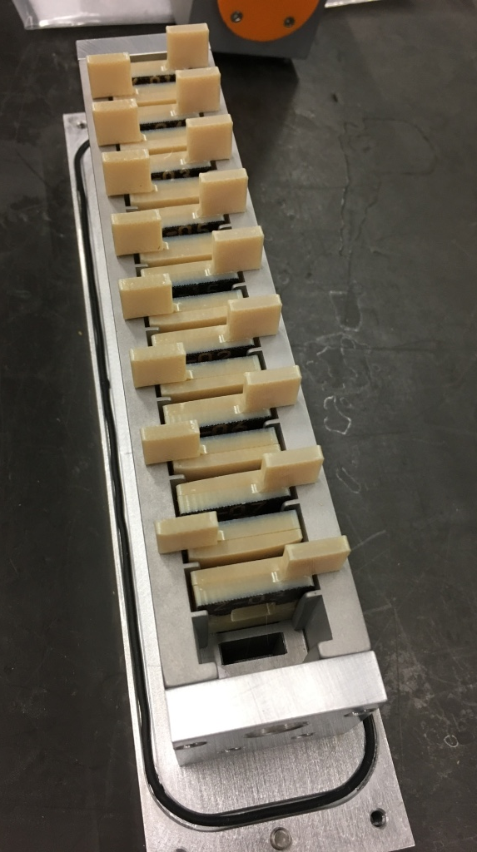
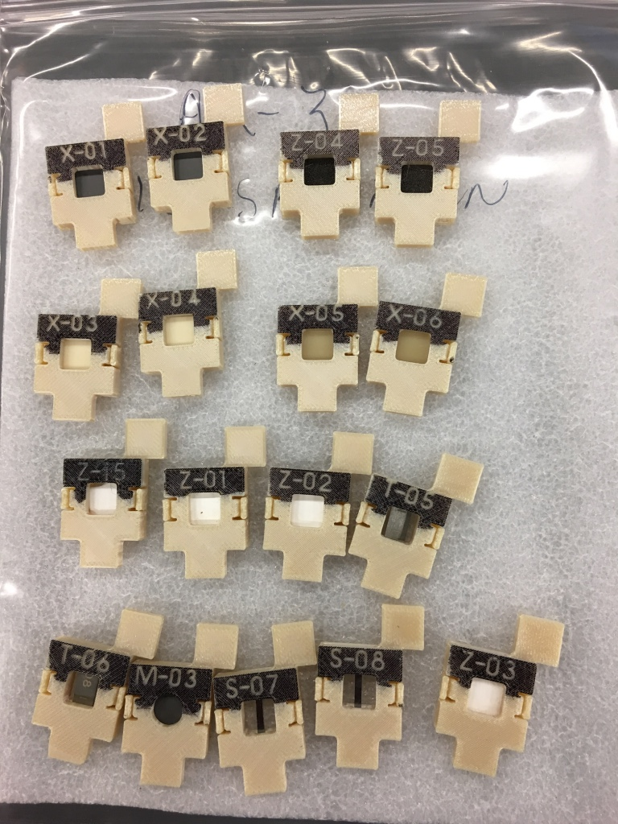
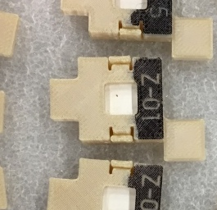
BeGrid2 (HRMT43) – 3-D printed specimen holders
Notes:
35:15

Slide 24
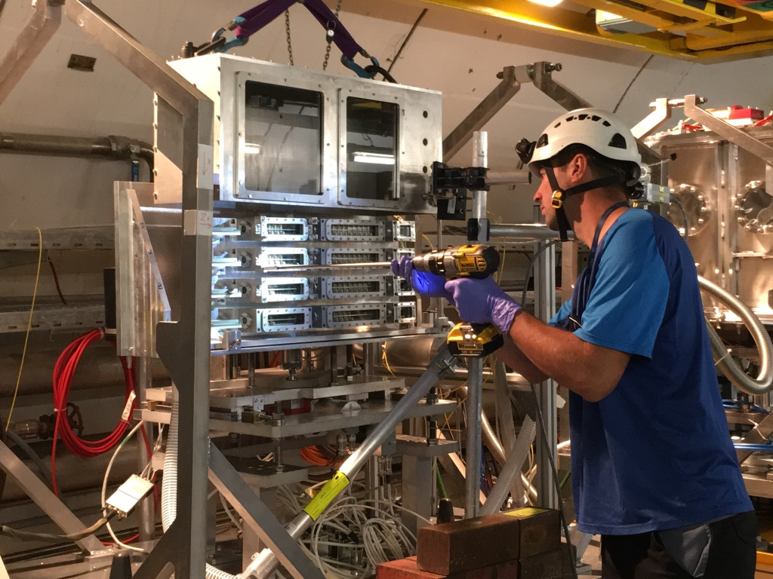
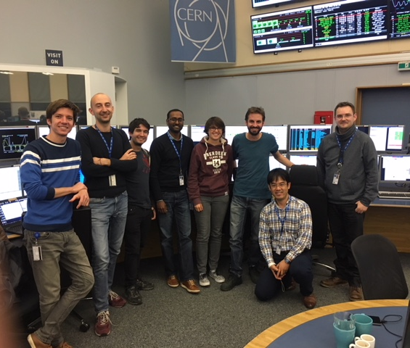
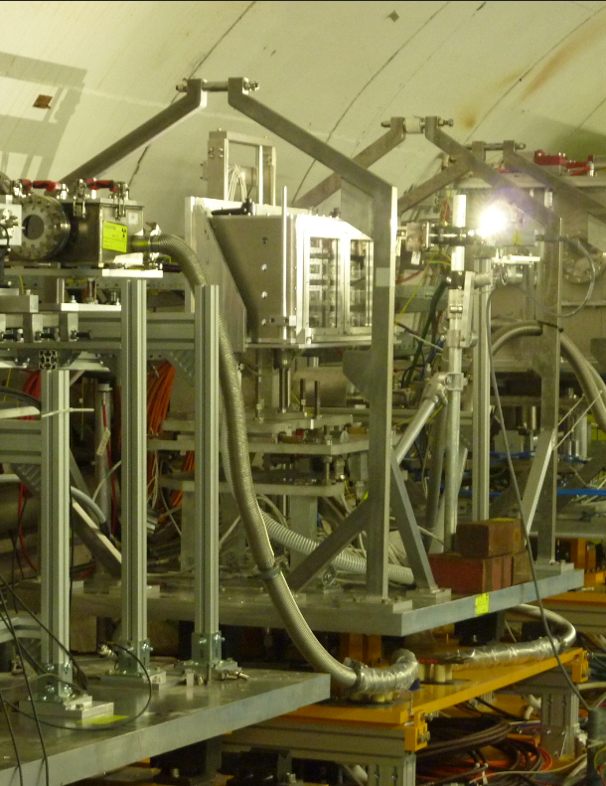

BeGrid2 – Remote handled installation & beam impact
October 1 – 2, 2018 4:00am
BeGrid2 Exposure has been completed !
PIE to begin in July 2019
Impact: Benefits facilities that use Be or Ti beam windows or graphite targets (LBNF, T2K, FRIB, and more)
Notes:
35:45

Slide 25






HRMT43 online data and PIE plans
Temperature on cylindrical surface of slugs
Bulk of results will be generated from PIE work (86 specimens)
Profilometry to measure beam-induced out-of-plane plastic deformation
  Confocoal Laser Raman Microscopy, with specimens in their 3D-printed holders
Optical and Scanning Electron Microscopy (SEM) of beam spot area of specimens to image surface cracks (if any)
LDV velocity measurement
Numerical simulations currently being updated with experimental beam parameters to benchmark results

Slide 26
Nu HPT R&D Materials Exploratory Map
Uncharted Territory
HiRadMat Beam Test - 2
Thermal Shock Test (planned) MIMiC
Future Nu 4 MW
HiRadMat Beam Test - 1
Graphite Fin Studies
NT-02
LBNF-2.4 MW Tau Nu
NT-04
NT-07
NT-06
NT-05
NT-03
TA-01
NT-01
LBNF-2.4 MW (CDR)
LBNF-2.4 MW IDEAL
NuMI Be Beam Window
Thermal Shock Severity (p/cm²/pulse)
T2K-1
LBNF-1.2 MW (CDR)
BLIP Irradiation - 1
BLIP Irradiation – 2
Ion Irradiation (planned) MIMiC
Radiation Damage Severity
(damage equivalent fluence, p/cm²)

Slide 27
Nu Targetry Future HiRadMat Needs
Higher DPA irradiated materials thermal shock testing
Higher protons per pulse
  Enables 40% larger beam sigma while preserving required high fluence per pulse
Elevated temperature testing
  Important to test thermal shock at prototypical operating conditions, especially to evaluate impact of radiation damage
Pinpoint beam position accuracy
  Pre-cracked specimens (crack propagation)
  Match pre-irradiated small beam spot (< 0.5 mm) to replicate radial gradient in radiation modified material properties
More Novel materials and target concepts
  Advances in materials and fabrication require constant evaluation
  Stress-wave diffusion/dampening concepts
Notes:
37:00

Slide 28
Nu and Muon Related LOI’s
RaDIATE Collaboration – P. Hurh
J-PARC-KEK Nu beam – T. Nakadaira/T. Ishida
STFC-RAL Powder Targets – C. Densham
J-PARC-KEK Muon production – S. Makimura
INFN LEMMA Muon Collider – G. Cesarini

Slide 29







R a D I A T E Collaboration
Radiation Damage In Accelerator Target Environments
To generate new and useful materials data for application within the accelerator and fission/fusion communities;
To recruit and develop new scientific and engineering experts who can cross the boundaries between these communities;
To initiate and coordinate a continuing synergy between research in these communities, benefitting both proton accelerator applications in science and industry and carbon-free energy technologies
In 2017, MoU revision has counted J-PARC (KEK+JAEA) & CERN as official participants
http://radiate.fnal.gov
CERN
PNNL
STFC
FRIB
ESS
J-PARC
FNAL
@J-PARC, Sep.20, 2017
@FNAL, Dec.11, 2017

Slide 30
Back-Up Slides Follow

Slide 31
Why a Beam? – Controlled Laboratory Experiment
Natural sources exist – but they are very weak and not necessarily well understood
  Solar and atmospheric neutrinos only understood once oscillations were established and well understood
    Moving from observation to experiment
  Supernovae are hard to come by
Artificial beams are controlled and intense
  Decide when, where, and how the beam is generated
  Detectors are placed strategically
  Beams can be controlled with precision – vital as measurements approach 1%
Applications:
  Today neutrino oscillation is the first focus
  Probe of nuclear structure
  Observation of the neutral current
  Demonstration of neutrino flavor (muon, tau)
  Measurement of weak mixing angle
  CP violation

Slide 32








Development of New Targetry Materials
    An ultimate objective is to develop new materials specifically addressing the requirements of future target facilities. Some progress is being made in exploring some of the newer materials and forms of material that have been developed.
      Glassy carbon (BeGrid2 material, CERN/FNAL)
      Molybdenum graphite (RaDIATE BLIP run material, CERN)
      Metal foams (BeGrid2 material, FNAL)
      3-D Printed Ti alloy (RaDIATE BLIP run material, FRIB)
      Nano-fiber mats (BeGrid2 material, FNAL LDRD)
Glassy Carbon
Moly Graphite
Metal Foams
3-D Printed Ti
TiO₂ nano-fiber material
Moly Graphite

Slide 33
NT-02 Target
Proton beam
Upstream end
Downstream end
Graphite fin core
47 fins – 6.4 mm x 15 mm x 20 mm segments
Graphite fins soldered to water cooling tubes attached on top/bottom of fins
Target autopsy
Performed in hot cell at FNAL
Cracks observed along centerline
Some fins broken in halves
Cracks along centerline
Autopsy work by V. Sidorov, Fermilab
Slides courtesy of K. Ammigan, Fermilab

Slide 34



BLIP Graphite Irradiation Run (2010)
Target box
Specimen irradiation
Beam energy ~ 180 MeV
Beam spot: σ_{x} ~ 10 mm, σ_{y} ~ 7 mm
Peak DPA: 0.1
Peak temperature: 200 ◦C
Irradiation time: 9 weeks
Proton beam
Graphite specimens
POCO ZXF-5Q [27]
IG-430 [48]
SGL R7650 [27]
C2020 [27]
3D C/C composite [18]
Layered graphite specimens
Slides courtesy of K. Ammigan, Fermilab

