Slide 1


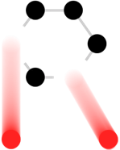

Demands for Thermal Shock Experiments of Pulsed-Muon-Production
Target Materials
HiRadMat workshop at CERN
10th July, 2019
J-PARC Center, MLF Division, Muon Section
High Energy Accelerator Research Organization, Institute of Material and Structural Science
(IMSS, KEK)
Shunsuke Makimura
Shunsuke.makimura@kek.jp

Slide 2
Contents
J-PARC, Muon
S. Makimura, N. Kawamura, S. Matoba, T. Yamazaki, K. Shimomura, and Muon Section
J-PARC
T. Ishida, E. Wakai, and J-PARC
NITE-SiC/SiC
N. Nakazato, H. Kishimoto, J.S. Park, and Muroran Institute of Technology
A. Sato, D. Tomono, K. Ninomiya, M. Aoki and Osaka University
TFGR W-TiC, tungsten alloy
H. Kurishita, K. Niikura, H.C. Jung, M. Onoi, H. Ishizaki, and Metal Technology Co., LTD
HiRadMat
M. Calviani, I. L. Garcia, C. Torregrosa, J. B. Descarrega, E. Fornasiere and CERN collaboration
Irradiation, PIE, and SiC-coated graphite
P. Hurh, K. Ammigan, N. Simos, D. Senor, A. Casella, and RaDAITE collaboration
Muon Science & Pulsed Muon
Muon Target at J-PARC
Previous Research at HiRadMat
  SiC-coated graphite
  NITE SiC/SiC
  TFGR W-TiC, tungsten alloy
Summary and
Expect to HiRadMat facility

Slide 3
Muon Science
& Pulsed Muon
3

Slide 4

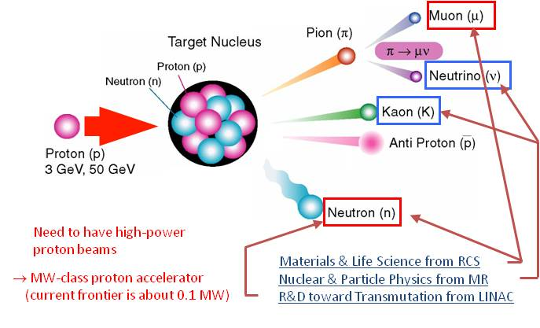
Muon
Muon is classified with a lepton.
It is one of the most popular cosmic rays
A cosmic muon reach on your palm in a second.
μ+: like the isotopes of hydrogen
μ -: 200 times larger mass than electron
A pion decays into a muon and a neutrino.
The decay of the positive muon into a positron and two neutrinos occurs after a mean lifetime of 2.2 μsec
4

Slide 5
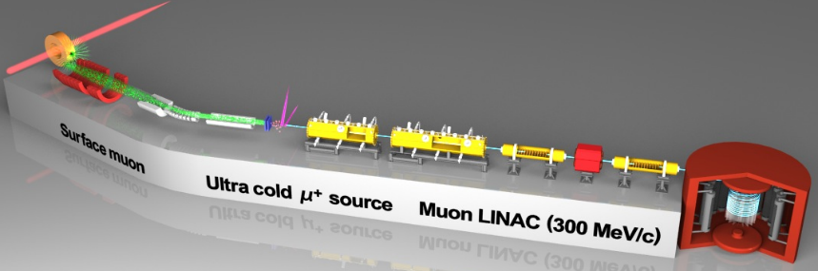
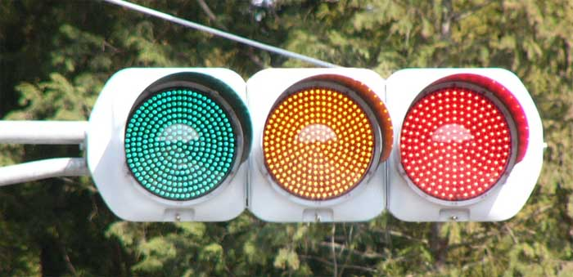

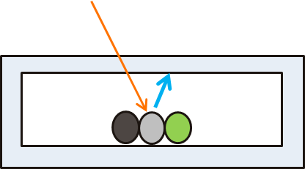
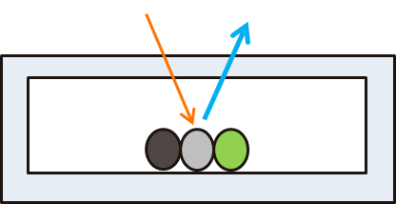
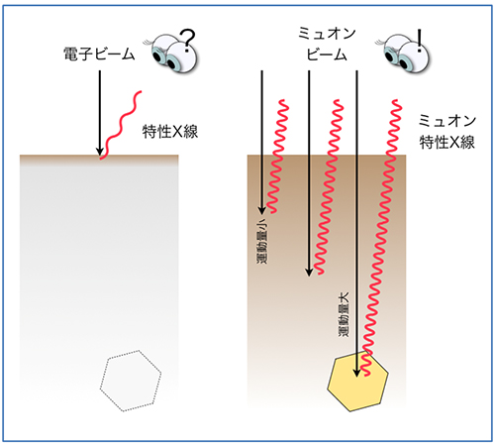
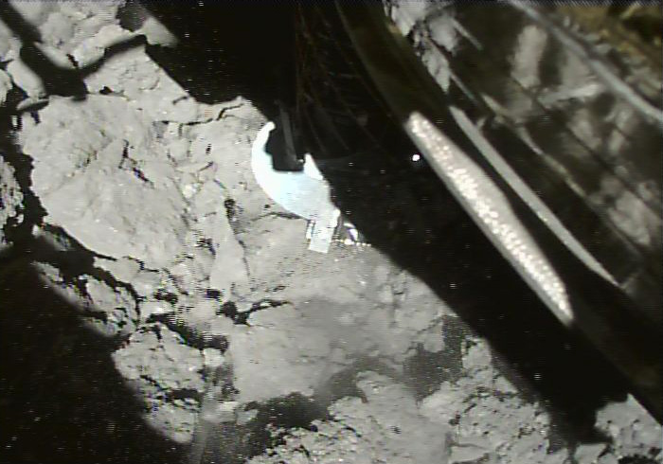
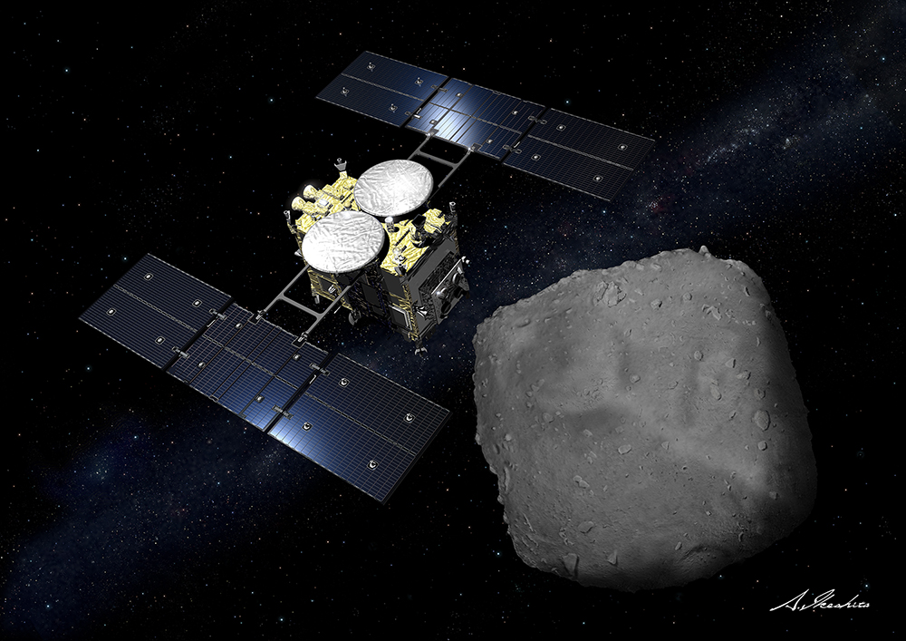
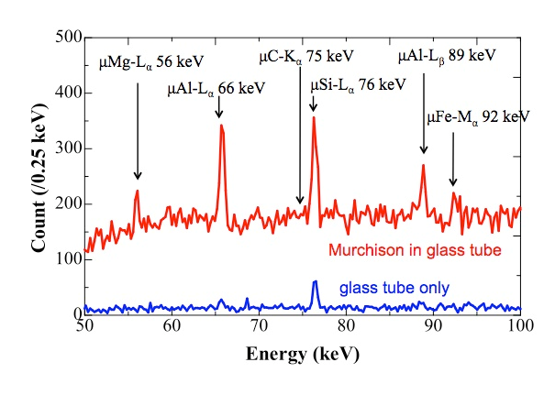
Topics explored by Muon
Various & Unique science
Material and Life Science (μ+)
Fundamental Physics
Superconductor Hydrogen in matter
Ion diffusion Biomaterial etc. etc.
Muon g-2,Mu HFS, μ-e conversion etc.
by μSR
For ex.
Many useful semiconductors
(GaN, TiO₂ etc. ) exhibit n type
conductivity. Why?
↓ Muonium ~ Hydrogen
Hydrogen impurity plays as a donor.
Electron
Muon
Nondestructive Element Analysis (μ-)
Sample from Ryugu can be kept in a vacuum
Electron
Negative Muon
Scientific Reports volume 4, Article number: 5072 (2014)
X ray
X ray
Hayabusa2 successfully touched down to Ryugu, and picked up the materials this morning!!
JAXA, University of Tokyo and collaborators
Asteroid explorer~Hayabusa2 (JAXA)
5
Characteristic Muonic X-ray ~ Higher transmittance by heavy mass of negative muon
The scheme was successfully validated at J-PARC MLF

Slide 6
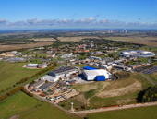
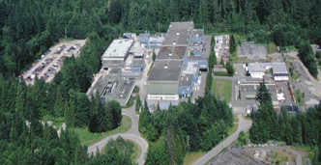
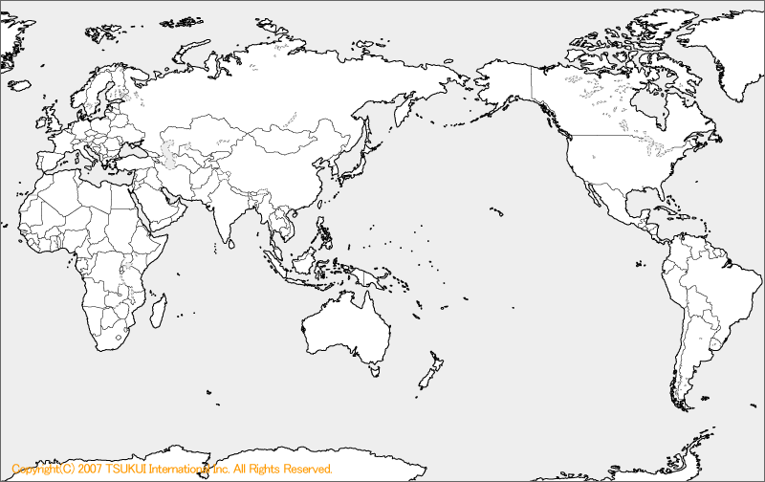

Muon Facilities in the world
ISIS
(pulse)
TRIUMF
(DC)
J-PARC
(pulse)
PSI (DC)
RCNP, Osaka (DC)
Opportunity of experiments is limited.
Two kinds of muon facility
DC muon beam VS Pulsed muon beam
6

Slide 7
continuous DC Muon vs. Pulsed muon
Continuous DC muon
Fine time resolution – Sub-ps order
Fast muon spin depolarization
High frequency (field) muon spin rotation is observable.
Low peak intensity is beneficial to avoid saturation of the positron detectors.
intensity
Pulsed muon (150 ns, double pulse, 25 Hz)
40ms
DC muon
time
Pulsed muon
Pulsed muon can be used with synchronized pulsed devices.
e.g. laser resonant ionization of muonium
Synchronizing measurement with muon incident can be conducted to reduce background
Pulsed muon and DC muon are complemental.
Demands for further peak intensity of pulsed muon!!
7

Slide 8
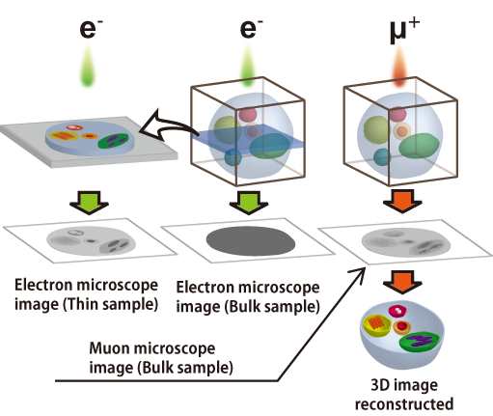
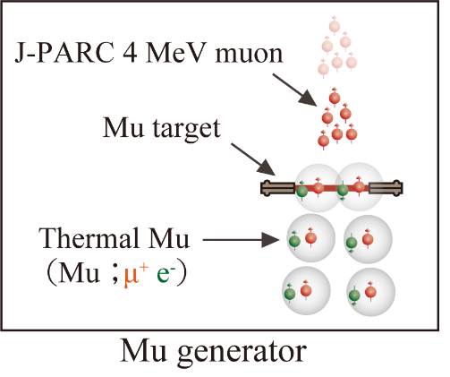
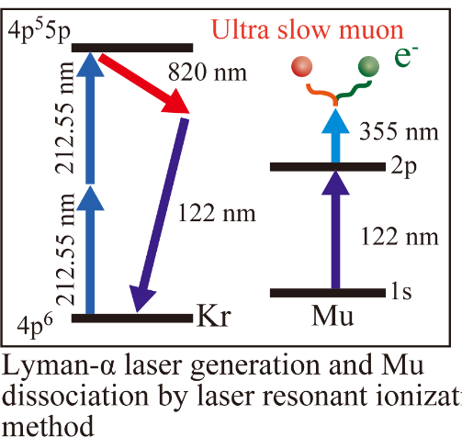
Unique science by pulsed muon 1
Transmission Muon Microscope
(Stage of feasibility study)
Ultra slow muon generation
laser resonant ionization of Mu
Electron Microscope can observe sample
less than 1μm thickness.
Muon Microscope can observe 200 times thicker samples,
because of 200 times heavier mass,
enabling us to observe alive cell through
a window!
To obtain higher-quality muon beam, higher peak intensity of muon synchronized with laser is essential.
8
Applying re-accelerated high-quality muons
(Narrow time and energy width)

Slide 9
Unique science by pulsed muon 2
DeeMe: μ-e Conversion Search
Prohibited phenomena in standard model
Current Upper Limits:
  BR[μ⁻ Ti→ e⁻ Ti] < 4.6 × 10⁻¹²@TRIUMF
  BR[μ⁻ Au→ e⁻ Au] < 7 × 10⁻¹³@PSI
DeeMe @ J-PARC MLF Muon Facility
  RCS: World-leading High-Power High-Purity Pulsed Proton Beam
  Novel Idea: μ-e Conversion in the primary production target itself
  S.E.S: 1×10⁻¹³(Graphite Target),
  5×10⁻¹⁵(SiC Target)
Pulsed Proton Beam is a Key:
  To reduce Prompt Backgrounds
  To reduce/monitor Cosmic-Ray induced Backgrounds
Pulsed Proton Beam with SiC target realizes high sensitivity.
9
Signal Window
BG Monitor

Slide 10
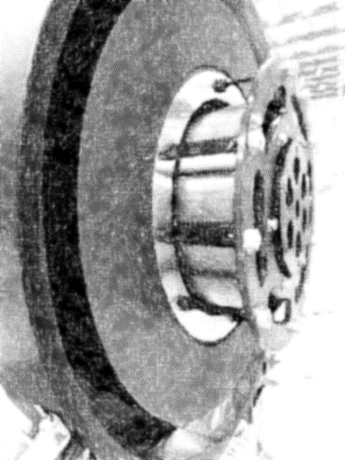
Muon target at J-PARC
10

Slide 11
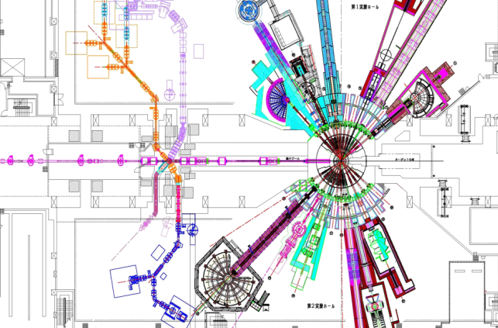
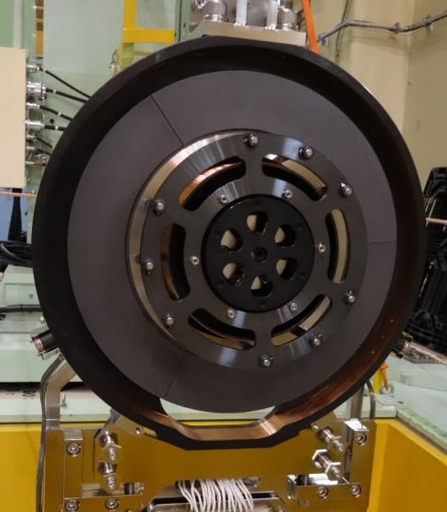
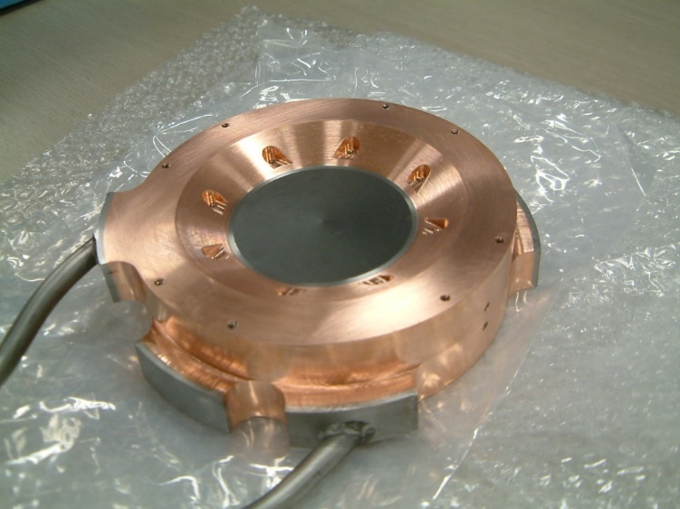
Current Muon Target
Target material is polycrystalline graphite, IG-430U.
Fixed target was replaced with rotating target to disperse the radiation damage of graphite.
Mu target
N- target
340 mm
P-Beam diameter; 14 mm (2σ)
4kW heat @ 1MW proton beam
Thickness of graphite 20 mm
70 mm
Fixed target, from 2008 to 2014
Water-cooling by thermal conduction
Lifetime: Irradiation damage of graphite
1 year at 1 MW operation
Rotating target, from 2014
Cooling by thermal radiation
Lifetime: Bearings
Aiming Lifetime: 10 years at 1 MW operation
11

Slide 12
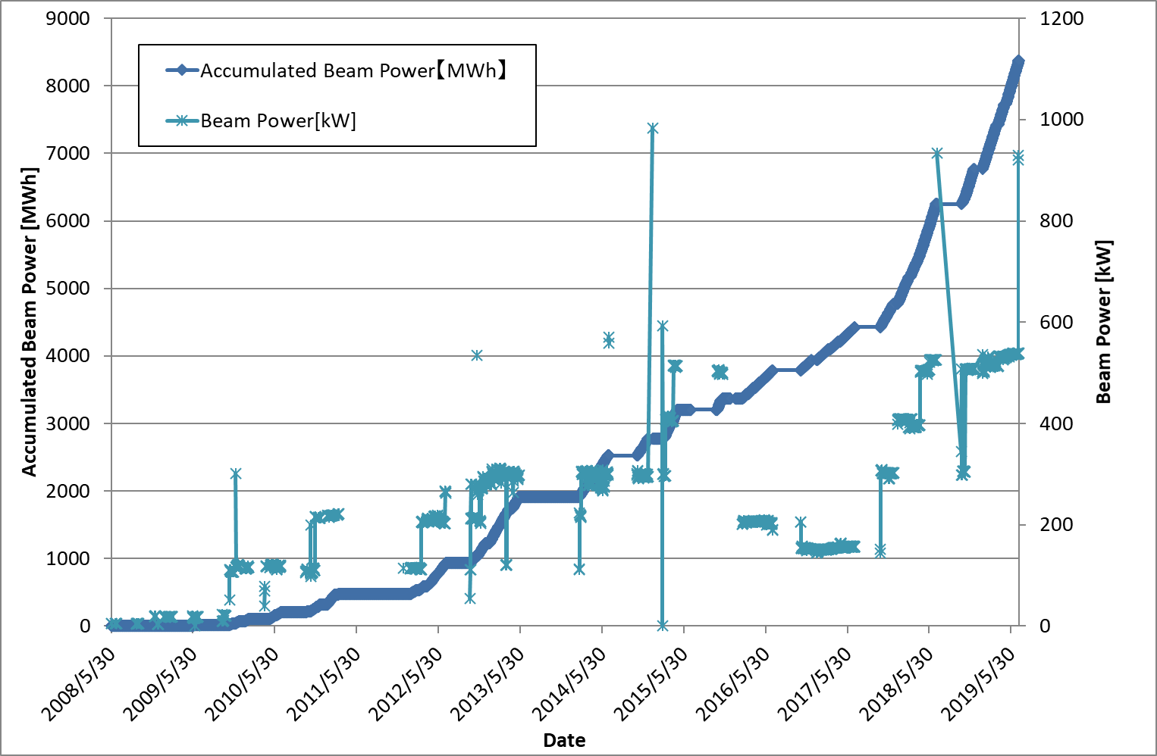
History of Beam operation
Oct. 2014
By Fixed target
By Rotating target
Rotating Target without replacement
Operational time:
17000 hours (Nov. 2014 ~ July. 2019)
6000 MWh
Rotation : ~16 M revolutions
(4.5 M revolutions /year @ 15r.p.m.)
Stable 500-kW operation in 1 year
12

Slide 13
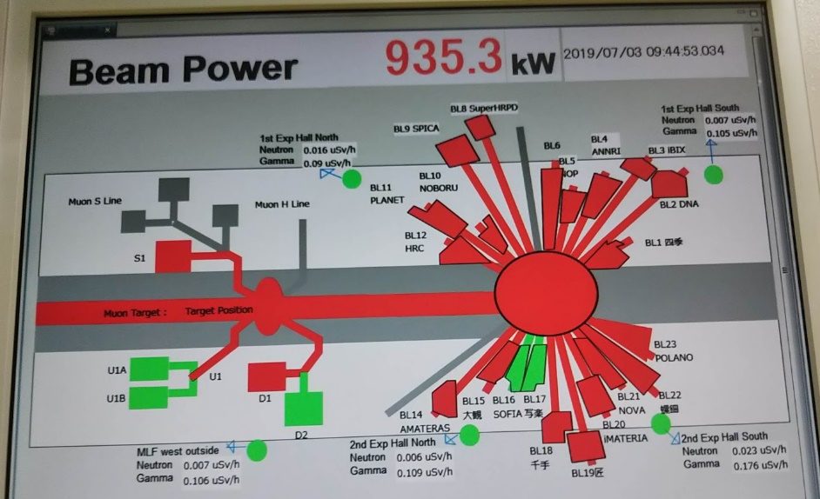
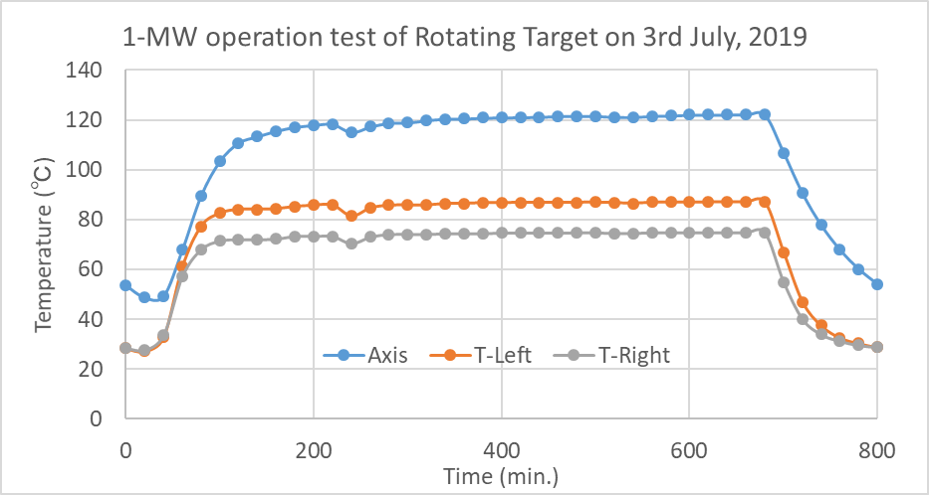
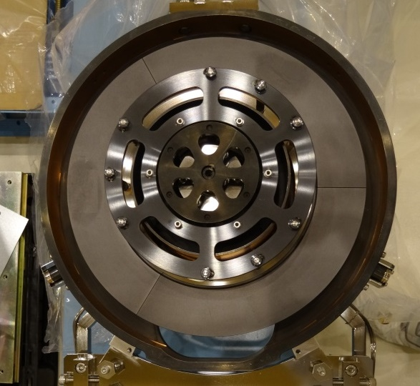
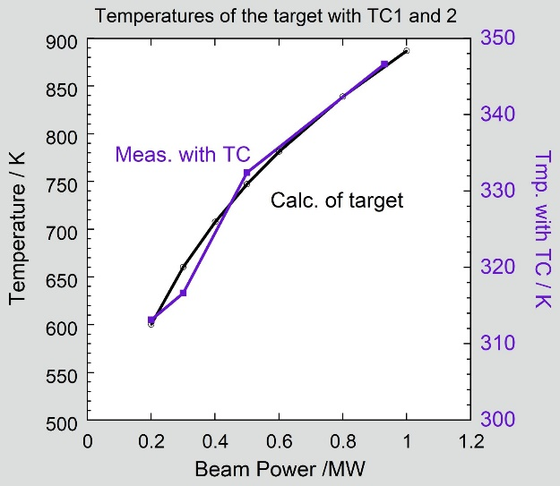
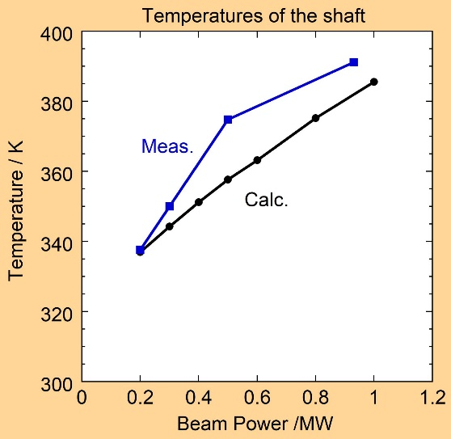
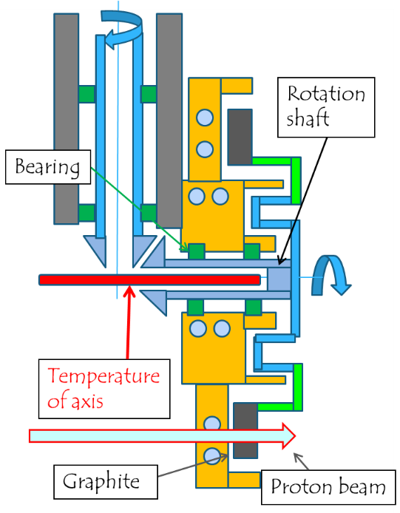
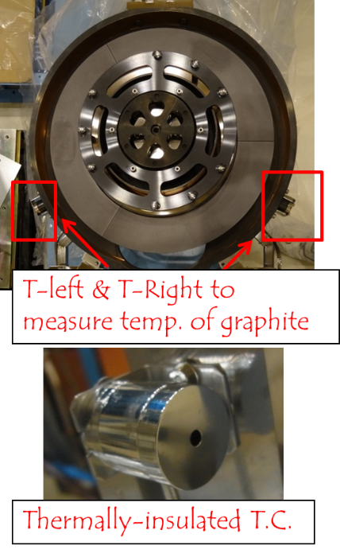
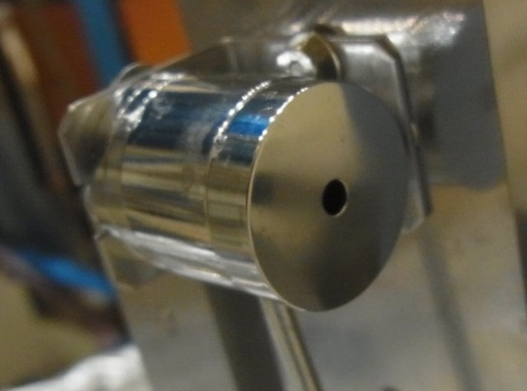
Almost 1-MW operation test
The 1-MW operation for 11 hours was successfully completed on 3rd July, 2019
Rotation shaft
Bearing
Thermal equilibrium
T-left & T-Right to measure temp. of graphite
Temperature of axis
Graphite
Proton beam
Thermally-insulated T.C.
13
The results were in good agreement with predictions from the simulations.

Slide 14
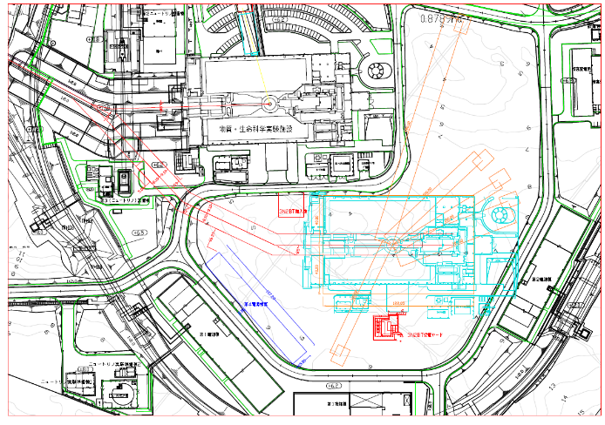
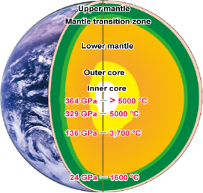
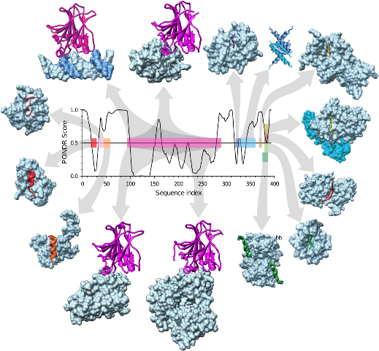
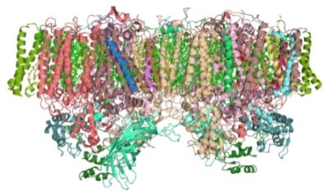
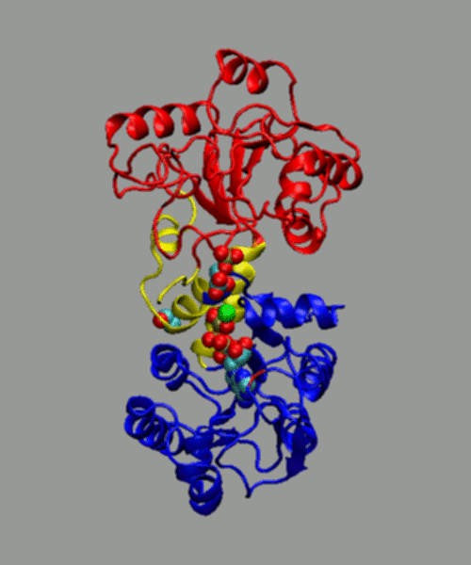
MLF 2nd Target Station (TS2)
Proposal of Future Project was submitted
Current MLF facility: tandem target
RCS
TS1
1.5MW 25Hz
Double pulse
0.75MW 25Hz
Single pulse
TS2
0.75MW 12.5Hz
Single pulse
MLF 2nd target station: common target
One of the plans for time structure
--Science by higher peak intensity
Extreme Condition
(High pressure, High external field)
Muon Micro Beam：small sample
Bio Science（soft matter）
Muon Micro Beam ：small protein crystal
Real Space, Real time（nonuniform system）
Muon Micro Beam, Stroboscopic measurement
Imaging, In situ, Operand, Element analysis
Industrial applications,
14

Slide 15
Demands for New Target Materials
Muon Target
For MLF TS1:
Graphite is the most popular and excellent target material.
Demands for Graphite-substitute material
  Higher oxidation resistance:
  SiC-coated graphite
  Higher density: NITE SiC/SiC
Muon transport
Higher density leads higher efficiency of muon transport, because of lower spatial volume of mu/pion on target.
Proton
For MLF TS2:
Common target with Neutron target
Tungsten is desired for higher efficiency of Muon and Neutron production.
TFGR W-TiC tungsten: solution to recrystallize and irradiation embrittlement
 | Density
 | g/cc
W | 19.3
Hg | 13.5
Pb | 11.4
PbBi | 10.6
Fe | 7.87
Muon intensity
10⁻⁵
x 50
10⁻⁷
Intensity [a.u.]
10⁻⁹
0 5 10 15
Energy [MeV]
15
TS1 vs TS2

Slide 16

Why HiRadmat?
Rotating Target can disperse total heat density and radiation damage of target material. However,,,
Time width of proton beam for the pulsed muon is about 100 ns.
Too short to disperse the local heat density.
For application of new target materials,
Thermal shock resistance against H.E. proton beam is essential.
Compressive stress P by thermal shock
Unique aspect of H.E. proton irradiation
E; Young’s modulus
α; Th. Expansion
P$∝Eα∆T$
Thermal shock on local volume of beam path
* R.T. | Graphite | SiC | Tungsten
E (GPa) | 11 | 440 | 411
α (ppm/K) | 6 | 4.3 | 4.5
Graphite: Excellent thermal resistant material
Combination of proton-irradiation damage of materials must be considered as well.
HiRadMat is an unique facility to investigate thermal shock
for higher peak intensity to new target materials.
16

Slide 17
Previous research at HiRadMat 1
SiC-coated graphite
Thanks to CERN collaboration
This program is supported by US-JP collaboration.
17

Slide 18
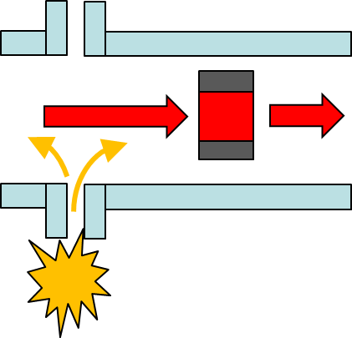
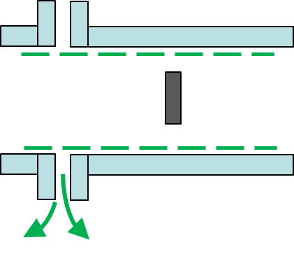
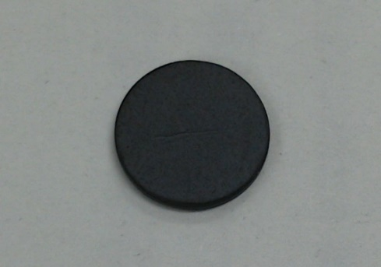
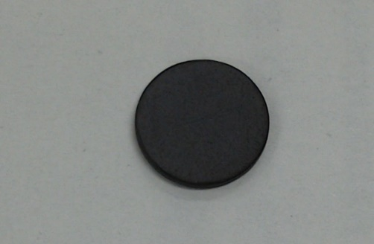
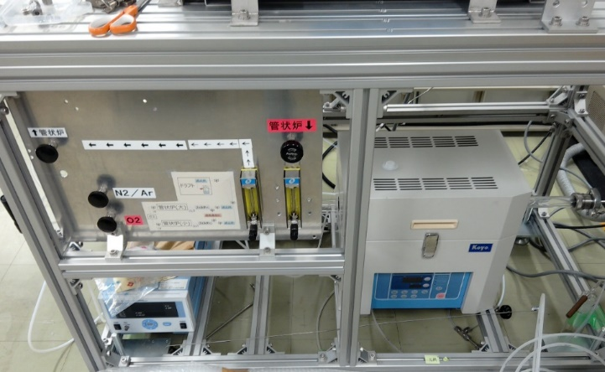
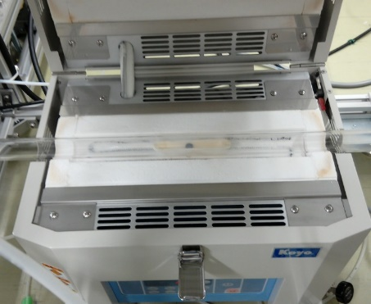
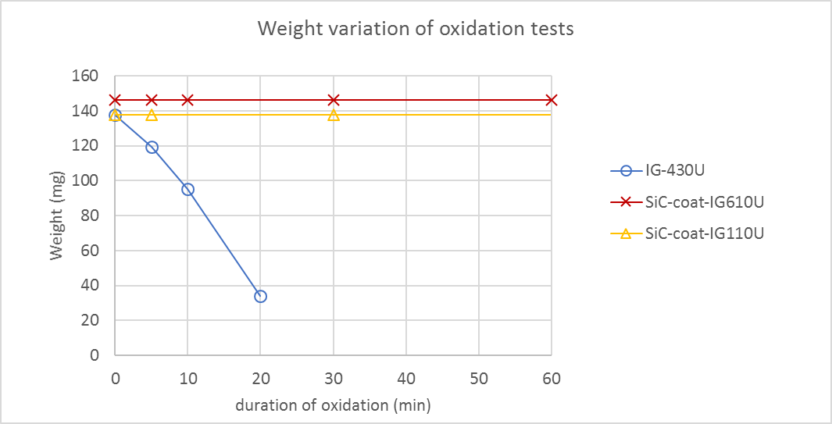
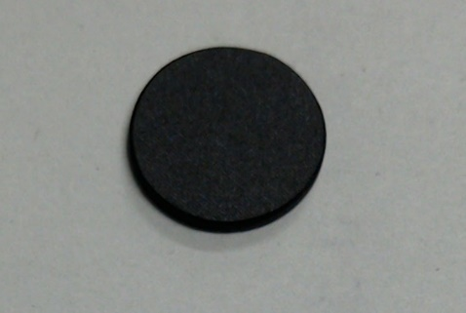
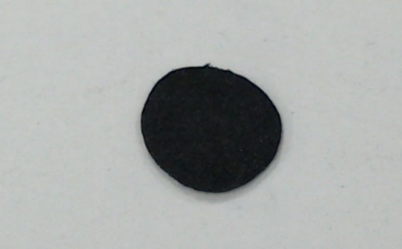
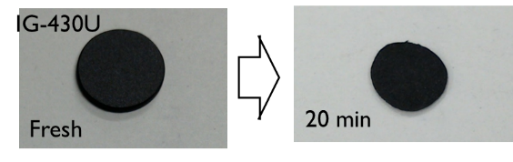
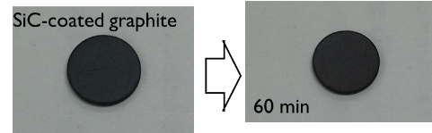
Motivation of SiC-coated graphite
SiC-coating on graphite improves oxidation resistance.
In case of graphite target
Graphite is easily oxidized at high temperature.
Hot graphite target
Graphite-oxidation contaminants complicate recovery.
SiC-coated graphite
Unexpected air introduction to vacuum during beam operation
Fresh
60 min
Oxidation tests of SiC-coated graphite
Much higher oxidation resistance
IG-430U
Fresh
20 min
18
Volume loss was observed on graphite and not observed on SiC coated graphite.

Slide 19
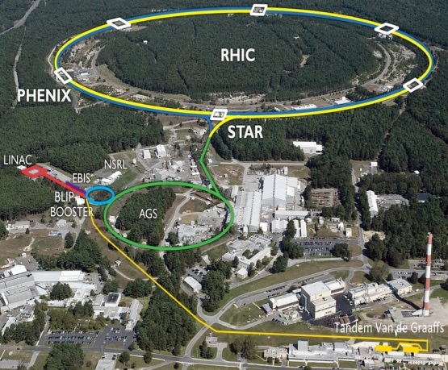
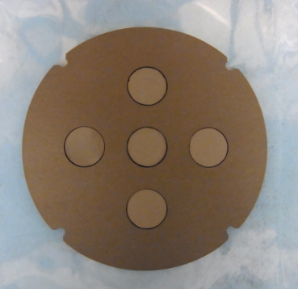
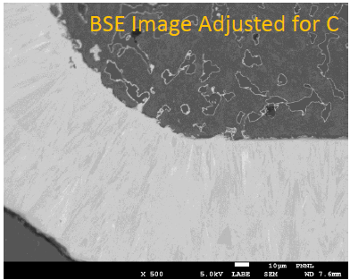
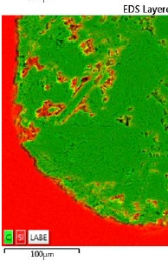
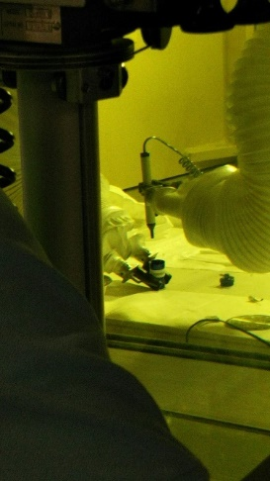

Proton Irradiation at BLIP, BNL and PIE tests under RaDIATE collab.
No. | Substrate Material | Crack | PIE (Newly revised, 14th March)
C-14 (Toyo-t) | IG-110U | Yes | SEM, TEM
C-9 (Toyo-t) | IG-110U | Yes | (TEM)
B-4 (Toyo-t) | IG-610U | No | HiRadMat
B-6 (Toyo-t) | IG-610U | No | SEM
No.2 (Ibiden) | ETU-10 | No | SEM after TDS, 1300K TDS,
9
14
2
4
6
SiC coated IG-110 were finally broken to pieces
after re-polishing with no colloidal silica
PIE testing at Pacific Northwest National Laboratory
Visual check of irradiated specimens
Crack was observed only on IG-110U substrate specimens, that was not designed for SiC coating
19
SEM microscope analysis of cold specimens
SiC coating deposited by CVD is intact.

Slide 20






Thermal shock experiments at HiRadMat, HRT43
SiC-coated graphite / Titanium Alloy (cold & irradiated at BLIP) exposed to thermal shock at HiRadMat on 1st Oct, 2018
3 boxes with irradiated-specimens assembled at PNNL hot-cell
(Exported to CERN)
BOX-3
Ti-6Al-4V Gr5
Ti-3Al-2.5V Gr9
SiC-coated Graphite IG-630U
LDV signal
Assembly at CERN-BA7
Oct.1(Mon)-2(Tue) 4:00am
exposure completed !
Sep.26
How did the SiC-coating on graphite behave ?
How different between irradiated at BLIP / un-irradiated ?
K.Ammigan, RaDIATE2018
20

Slide 21
Previous research at HiRadMat 2
NITE SiC/SiC
Thanks to CERN collaboration
This program is supported by JSPS KAKENHI Grant Number JP16H03994.
21

Slide 22

Motivation of NITE SiC/SiC
Higher transport efficiency by SiC target material, which is denser than graphite. (1.8 vs 3.2 g/cc)
For DeeMe, 6 times larger efficiency can be expected.
Beamline simulation for H line J-PARC, MLF through G4 beamline by T. Yamazaki
1.7 times larger surface-muon-yield at H-line experimental area.
Monolithic SiC
SiC/SiC
composite
Rate [1/s]
 | Graphite ABLA | SiC ABLA
Proton 1MW | 2e15 | 2e15
Surface μ (4π) | 5.58e10 | 8.50e10
hs1ent | 6.25e8 | 9.93e8
Focal point | 1.62e8 | 2.75e8
Monolithic Silicon Carbide cannot be used as target material, because it is brittle.
NITE-SiC/SiC: developed at Muroran Institute of Technology for fusion material
Pseudo-ductility to disturb the propagation of crack
22

Slide 23





Progress on NITE SiC/SiC as target material
392 MeV, 0.5 μA, 30 min. Proton-irradiation tests at RCNP, Osaka university
Higher residual radiation dose (400 times higher dose than that of graphite after 1 year cooling)
Tritium emission of NITE-SiC/SiC is completely different from CVD-SiC, probably, because of the effect of graphite matrix.
Sample holder at the irradiation test
Measurement of residual radionuclides for validation of simulation
Preliminary
23
Two tube furnace and 3H traps, which can distinguish HT with HTO.

Slide 24



Thermal shock experiments at HiRadMat, HRT35
To confirm the resistance to thermal shock resiatance
NITE SiC/SiC was included in the experiments for coated low-Z absorbing materials for the Target Dump Internal in August 2017.
PIE testing conducted by J. Maestre C. Bahamonde and I. Lamas (Results of PIE from Slides of IWSMT14 at Iwaki)
Temperature rise: 2100 K
Results of SEM observation
(Top view, upstream, Deep impact)
Stripe-like damage was observed.
440 GeV, 1.2E11 protons/pulse, Gaussian, σ=0.3 mm.
24
Disturbance of crack propagation was observed.

Slide 25
Previous research at HiRadMat 3
TFGR W-TiC, tungsten
Thanks to CERN collaboration
This program is supported by MTC-KEK collaboration, This program is supported by JSPS KAKENHI Grant Number 19H01913.
25

Slide 26


Tungsten as target material
Tungsten is expected as the target material.
For use of tungsten as muon production target, the boundary between cooling material and vacuum in beamline disturb transportation of muon. Thermal radiation cooling is desired. It should be used at high temperature. (MLF TS2, COMET, mu2e,,,)
Tungsten is brittle.
Brittleness is improved by heavy plastic working.
Irradiation embrittlement
H. Bolt et al., (2002)
J.Reiser et al. JNM, 423 (2012) 1.
brittle
Plastic working
Ductile
G. Pintsuk et al.
Recrystallization embrittlement
Ductile to Brittle Transition Temperature should be less than room temperature.
The use of W as target material is limited by “recrystallization embrittlement” and “irradiation embrittlement”.
26

Slide 27

Motivation of TFGR W-TiC tungsten
Toughened Fine-Grained Recrystallized W-TiC, (TFGR W-TiC) is developed by Prof. Kurishita at Tohoku University. Now the activities are transferred to KEK and Metal Technology Co. LTD collaboration.
Equiaxed, fine grains with TiC precipitates
GB reinforced by TiC enrichment
No recrystallization embrittlement
High sink density: Resistance to irradiation is anticipated.
DBTT (nil-ductility tem.) < RT
As-received
Mater. Trans. 54 (2013) 456-465.
1.5 mm t
1240˚C x 1 hr anneal
1650 degC GSMM
Fracture strength: 3.2 GPa
Y
10 mm t
Number is fracture strength
2500
2000
2150
Y
1500
1230
1320
X
Stress (MPa)
1100
870
Z
TFGR W-TiC
1000
840
500
250
320
27
0
Pure hot-rolled W
Strain
3-points bending test at RT

Slide 28







Progress of development for TFGR W-TiC
Sintering
GSMM process
Mechanical alloying
Purification of Powder
The apparatuses for fabrication is ready.
Revival of TFGR W-TiC is almost completed.
Future plans in up-coming three years:
Economical and Mass production under collaboration with industries
  Funding from Ministry of Economy, Trade and Industry was approved in June, 2019
Higher-temperature resistance by W-TaC
  Funding, JSPS Kakenhi was approved in April, 2019
Study for irradiation effect
  Ion-irradiation at HIT, Tokyo University in Aug. 2019,
  and H.E. proton irradiation under RaDIATE collaboration
Confidential!!
28
New Sintering & GSMM apparatus

Slide 29



Thermal shock experiments at HiRadMat, HRT48 PROTAD, Sep. 28, 2018
TFGR W-TiC was included in HRT48.
We are waiting for PIE testing.
Beam Parameters
Beam energy | 440 GeV
Max. bunch intensity | 1.2 x 10¹¹
No. of bunches | 1 – 288
Max. pulse intensity | 3.5 x 10¹³ ppp
Max. pulse length | 7.2 µs
Gaussian beam size | 1σ: 0.1 – 2 mm
29

Slide 30
Summary &
Expect to HiRadMat facility
30

Slide 31
Summary &
EXPECT to Hiradmat facility
Summary
Pulsed muon contributes to various, brand-new and unique science in material science, fundamental physics, and industrial use.
Higher peak intensity is desired in muon community, i.e. MLF TS2.
Further thermal shock resistance is required to the new target materials.
Developments of new target material, SiC-coated graphite, NITE SiC/SiC, and TFGR W-TiC are in progress, including thermal shock testing at HiRadMat.
My personal suggestion to HiRadMat as one of the users
How to connect between the results of HiRadMat and the evaluation of actual long-term operation
Saving time of PIE testing after irradiation, Upgrade of remote handling replacement?
Expect to HiRadMat Facility
HiRadMat is an unique facility to investigate thermal shock for higher intensity to new target materials.
I always appreciate kind collaborations with CERN and RaDIATE.
31

Slide 32
Back up slides

Slide 33



Rotation motor
What happened to Muon Target?
Rotating target has been successfully operated for 4 years.
On this regular maintenance: replacement of rotation feedthrough from air to vacuum, the flexible coupling was broken.
During operation, it was intact.
We found the mistake of the machining process.
We can replace the broken one.
But the problem is that two couplings are used in the rotating target. The lower one cannot be replaced easily.
Flexible couplings
Wrong directions of machining
Machining for key should be solid line.
Broken flexible coupling
Rotating target

Slide 34



For beam operation,
and replacement of target
It has been confirmed that the rotating target is not damaged with 500-kW proton beam even without rotation through FEM simulation . Furthermore Monitoring system is upgraded.
The main issue is emission of tritium.
The exhaust of vacuum pump is temporarily stored in a buffer tank system and is vented after measurement of concentration of RI.
500-kW operation is now going on.
The target will be replaced with a new and appropriate one during next new-year maintenance interval.

Slide 35
Insufficient research for irradiation effect of W-TiC
Tirr = 873K, 2×10²⁴n/m² (En >1 MeV),
0.08 dpa, JMTR
Tirr = RT, 1-2×10¹⁹ions/m² (2.4 MeV Cu2+),
2-4 dpa, Tohoku Univ. IMR
Tirr = RT, 1×10²¹D2+/m² (2.0 keV D2+)
Vickers microhardness
Before irr.
After irr.
Thermal Desorption Spectroscopy of D2
The D retention in pure W is significantly increased by Cu2+ irradiation, while that in TFGR is relatively insensitive to the damage level.
Nanostructured W-0.5TiC/Ar)
1164
1108
1039
1034
HV
Nanostructured W-0.5TiC/H
Pure W (Commercially available, SR）
619
521
Irradiation effect research of TFGR is mainly for D retention.
ΔHV = 98
・ No radiation hardening
H.Kurishita et al. JNM 377 (2008) 34.
TFGR-W
W/O GSMM
H.Kurishita et al. Phys. Scr. T159(2014)014032

Slide 36



Current status of W development (1)
Preparation and handling of purified powders
Setup of High-purity glove box (GB) with vacuum chamber/furnace for handing highly pure powders without gaseous contaminations
Purification and (remote) handling of starting powders (W, TiCx,) and MAed powders (W-Ti-C)
Fully degassing of MA vessels and balls, HIP capsule etc. before use
Powders in Ta boat for purification
Comparison of impurity content in MAed powder
 | High-Purity GB, KEK/MTC |  |  | Typical GB, KEK/NIFS
Impurity | O | N | Mo | O | N | Mo
Content (wt%) | 0.091 | 0.009 | 1.98 | 1.0 | 0.18 | 1.25

Slide 37




Current status of W development (2)
Mechanical Alloying (MA) in vacuum
MA: Introduction of ultrafine grains (~20 nm) and alloying by using high energy ball milling
3MPDA
The MA Vessel is filled with
Previous work: Hydrogen, This work: Vacuum
Setup of 3MPDA high energy ball mill with cooling system (~ -20ºC) to prevent strong adhesion of MAed powder to the vessel inner walls
Powder with hard balls in a vessel (TZM)
(a)
3MPDA: 3 Mutually Perpendicular Directions Agitation
Mo impurity (~ 2%) coming from TZM balls and vessels
(b)
(a) SEM, (b) EDS(Ti) mapping for MAed W-1.2%TiC powder

Slide 38



Current status of W development (3)
HIP (Hot Isostatic Pressing)
HIP: Densification of MAed powder without exposure to air
Densified compacts with equiaxed, ultra-fine grains
3h
Steel capsule filled with MAed W-1.2%TiC powder
HIPed W-1.2wt%TiC compact
Density : 17.92 g/cm³
Chemical compositions (wt%) of W-1.2%TiC before and after HIP
 | Ti | C | O | N | Mo
HIPed compact | 0.88 | 0.23 | 0.038 | 0.010 | ---
MAed powder | --- | --- | 0.091 | 0.009 | 1.98

Slide 39



GSMM (Grain boundary sliding-based microstructural modification) process
GSMM : Reinforcement of intrinsically weak GBs in W by enhancement and optimization of TiC precipitation and their segregation
Removal of the residual bubbles/pores through GB diffusion
by using superplastic deformation, driven by GB sliding, where the recrystallized, equiaxed grain geometry is maintained and active grain rotation and extensive relative displacement of the adjacent grains are operative.
Shear stress
Superplastic deformation by GB sliding at high temperature
N. Wakai, Materia 45 (2006) 644.
The number of GSMM operations at 1650ºC attempted to date is 10 times with various final loads
γ (shear strain)
γ = 0
γ = 1
γ = 2
1650ºC
Reduction ratio: 85.3%
8φ x 20 mm

Slide 40





Three point bend (3PB) testing at RT
3PB testing : Demonstrate that the fabricated W alloys exhibit very high fracture strength ( > 2~3 GPa) and appreciable ductility at RT in the nanostructured, recrystallized state
3PB specimen
1.1 mm x 0.9 mm x 15 mm
Overview of 3PB testing at RT and 0.3mm/min
Specimen deflection during 3PB testing
3PB test fixture used

Slide 41


3PB test results at RT
W-1.2wt%TiC in the nanostructured, recrystallized state
#8 specimen: MA-HIP-GSMM (RR : 82. 9%)
Very high fracture strength of 2590 MPa and slight ductility at RT
→ TFGR (Toughened, Fine Grained, Recrystallized) W- 1.2%TiC alloy
In order to manufacture much more ductile W-1.2%TiC alloys, the microstructure of the #8 specimen has thoroughly been examined.
#8 specimen broken in two pieces after testing

Slide 42





Microstructures of #8 specimen SEM, EDS
SEM
3 μm
Ti
C
O
EDS
A large precipitate of titanium oxy-carbide with approximately 1 μm diameter observed is attributable to locally insufficient progress of the MA process; the starting TiC phase has not completely been decomposed into Ti and C solutes in the W matrix by MA. The optimization of the MA process is required for ductility enhancement of W-1.2%TiC alloy.
TEM analysis by Prof. Sakamoto at Ehime University will come soon.

