Slide 1


Material Testing Demands by
Heavy-Ion Pulsed Beams – by FAIR
Helmut Weick, GSI Helmholtzzentrum
HiRadMat workshop, 11.07.2019
In-Flight Rare Ion Production
FAIR / Super-FRS
Beam Power Comparison
Targets and Beam Catchers
Material Tests at GSI

Slide 2
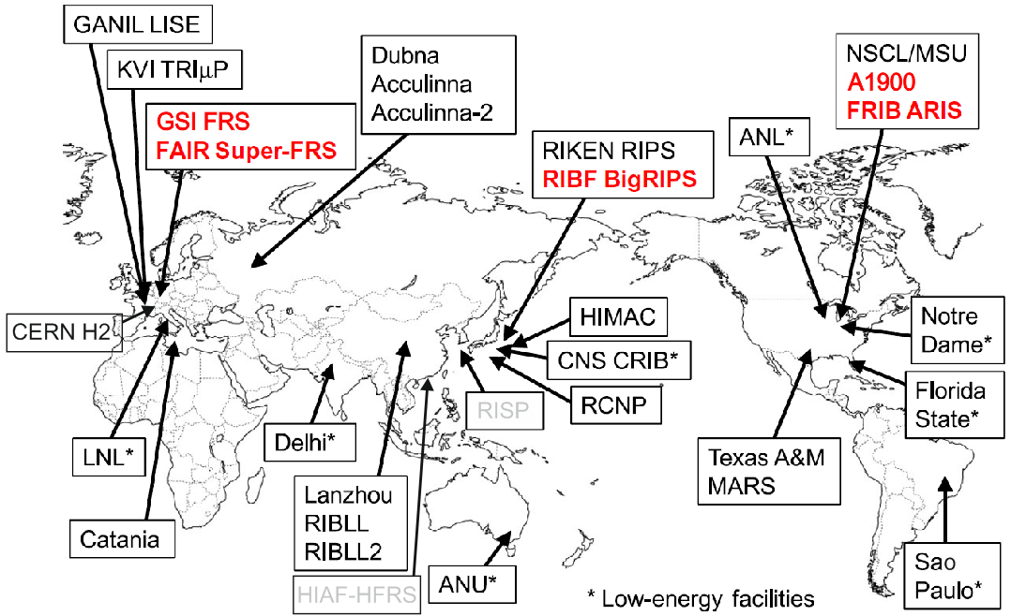
Production of RIBs In-Flight
pulsed beams
for storage rings
HIAF-HFRS
adapted from T. Kubo, NIM B 376,102 (2016)

Slide 3
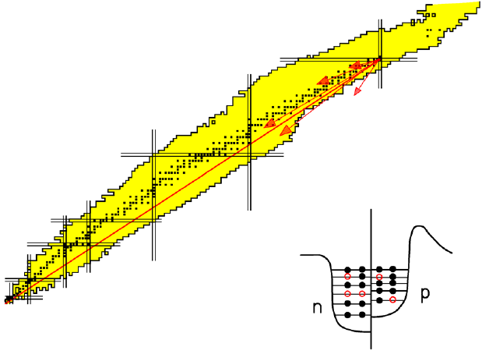
How to produce Rare Isotopes ?
Fragmentation
Removal of nucleons in quasi-free nucleon-nucleon collisions
protons (Z)
neutrons (N)

Slide 4
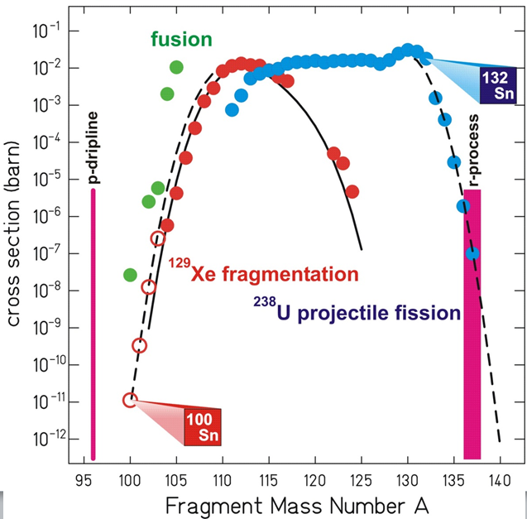
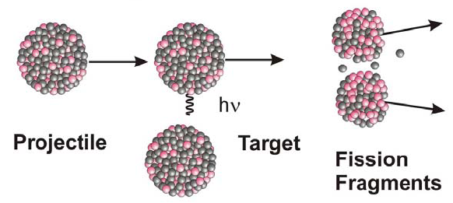
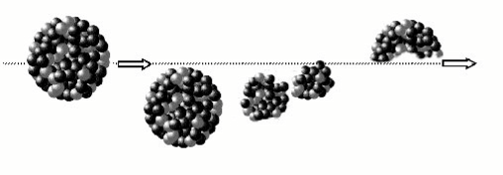
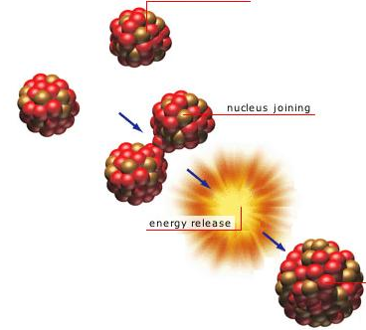
Production Cross sections
Projectile fission
Tin isotopes by different methods
²³⁸U
Projectile fragmentation
Projectile ¹²⁹Xe
Main Fragment
Target
Fusion (only at lower velocity)

Slide 5
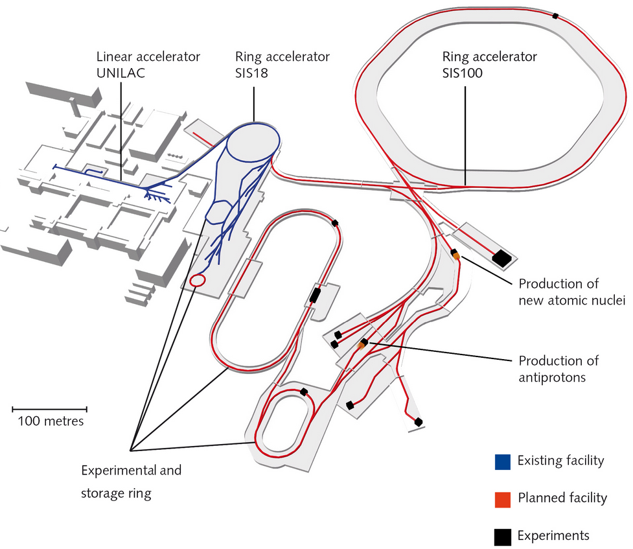
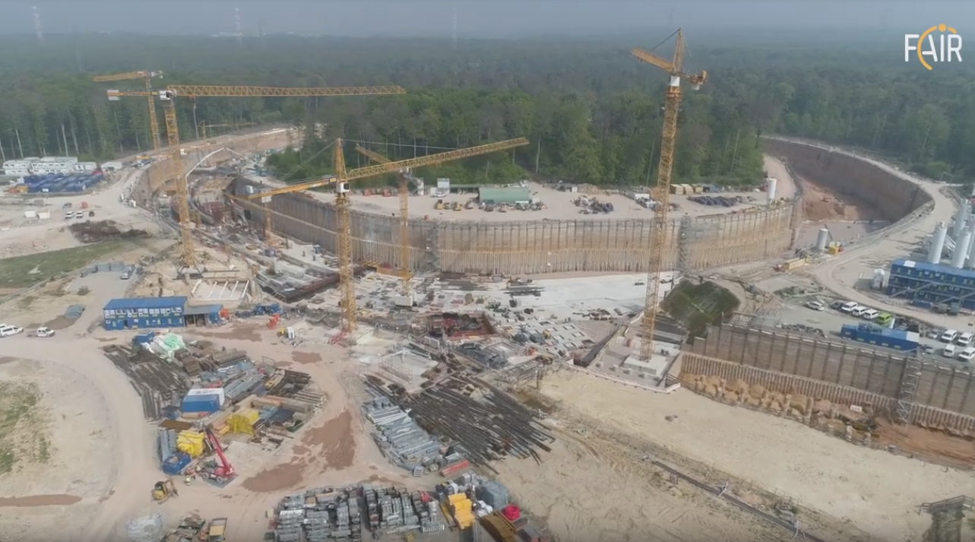
FAIR
Facility for Antiproton and Ion Research
0.4-2.7 GeV/u U²⁸⁺, 5x10¹¹/pulse
11 GeV/u Au⁷⁹⁺, 10¹⁰/pulse
28 GeV protons, 2x10¹³/pulse
fast or slow extraction
Darmstadt May 2019

Slide 6
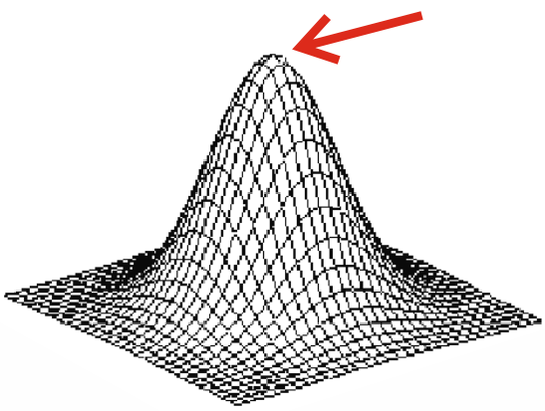
Beam Comparison
Energy deposition in copper for σ_{x}= σ_{y} = 0.5 mm beam spot.
In peak of 2-dim Gaussian: dE/dm_{ion} = 1 / (2π σ²) * dE/dρx
GSI / FAIR beams only one bunch per pulse.
 | HiRadMat | HiRadMat | FAIR | GSI | GSI
 | protons | Pb | U²⁸⁺ | U²⁸⁺ | U⁷³⁺
E / m = | 437 | 173.5 | 1.5 | 0.125 | 1.0 | GeV/u
dE/dρx = | 0.00211 | 12.8 | 13.8 | ~35 | 14.5 | GeV/(g/cm²)
dE/dm_{ion} = | ~0.94 | 817 | 878 | 2228 | 922 | GeV/g
N / bunch = | 1.5e11 | 5e7 | 5e11 | 2e10 | 2.5e9
bunches = | 288 | 52 | 1 | 1 | 1
dE/dm = | ~26.0 | 0.34 | 70.3 | 7.1 | 0.37 | kJ/g
pulse length Δt = | 7.2 | 5.2 | 0.09 | 0.4 | 0.1 | μs
Δs = c Δt = | 27.4 | 19.8 | 0.34 | 1.52 | 0.38 | mm
*
*
* incl. build-up

Slide 7
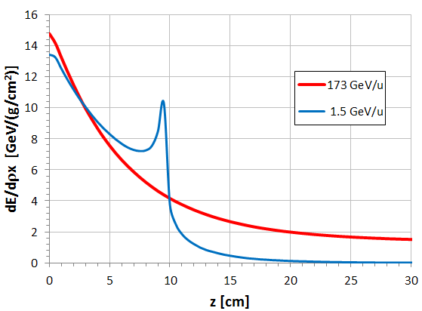
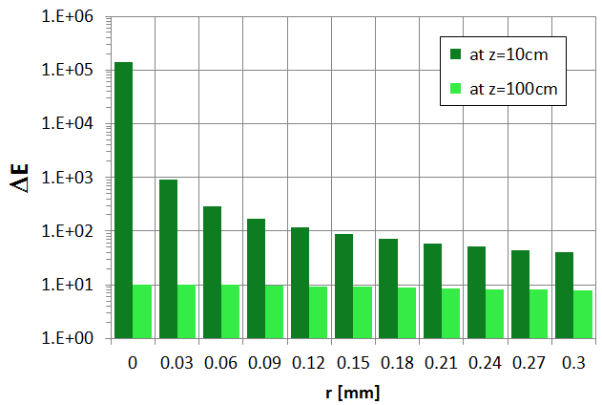
ΔE for Pb-ions
ΔE in graphite target (ρ = 1.84 g/cm³)
Radial distribution
of point-like beam
for 173 GeV/u
high ΔE region dominated
by beam spot size
FLUKA, Ekaterina Kozlova
FLUKA in mode DEFAULT does not
give a good dE/dx description,
→ rescaled according to ATIMA predictions

Slide 8
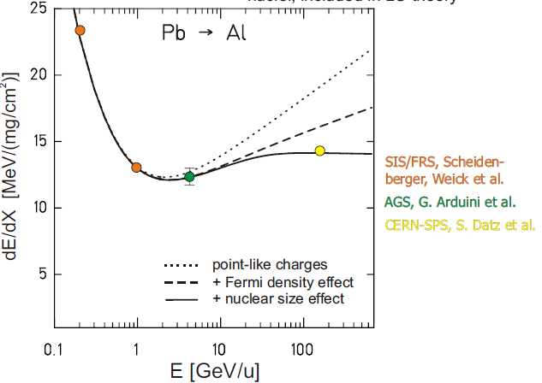
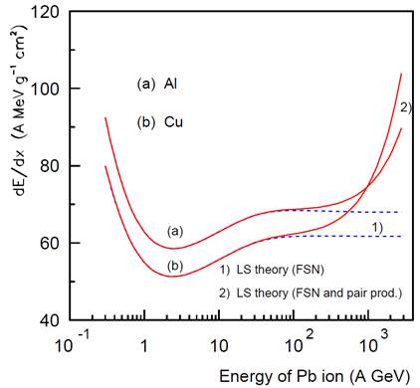

dE/dx for Relativistic Heavy Ions
ΔL_{LS}(Z₁,v)
Lindhard-Sørensen extension,
includes nuclear size effect for γ >> 1.
0
+ e⁺,e⁻ pair production
Fermi density effect
for relativistic velocities
- δ/2 +ΔL_{e+,e-}

Slide 9
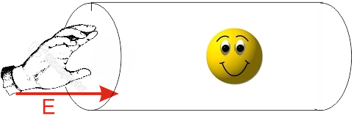
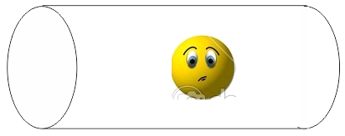
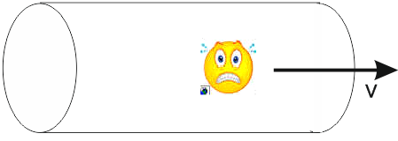

The fate of accelerated ions
Yeah, I am an
accelerated ion.
By the way, what
do you do with accelerated ions?
Aaarrgh !

Slide 10
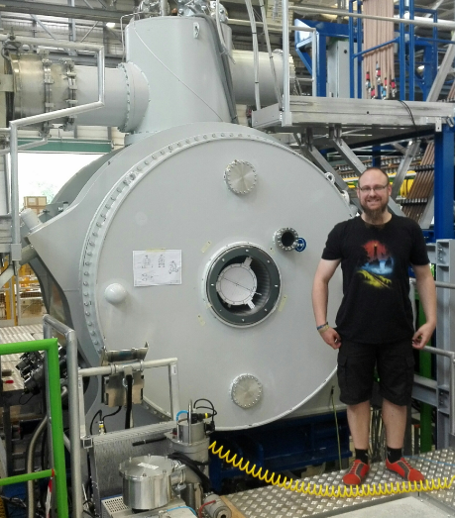
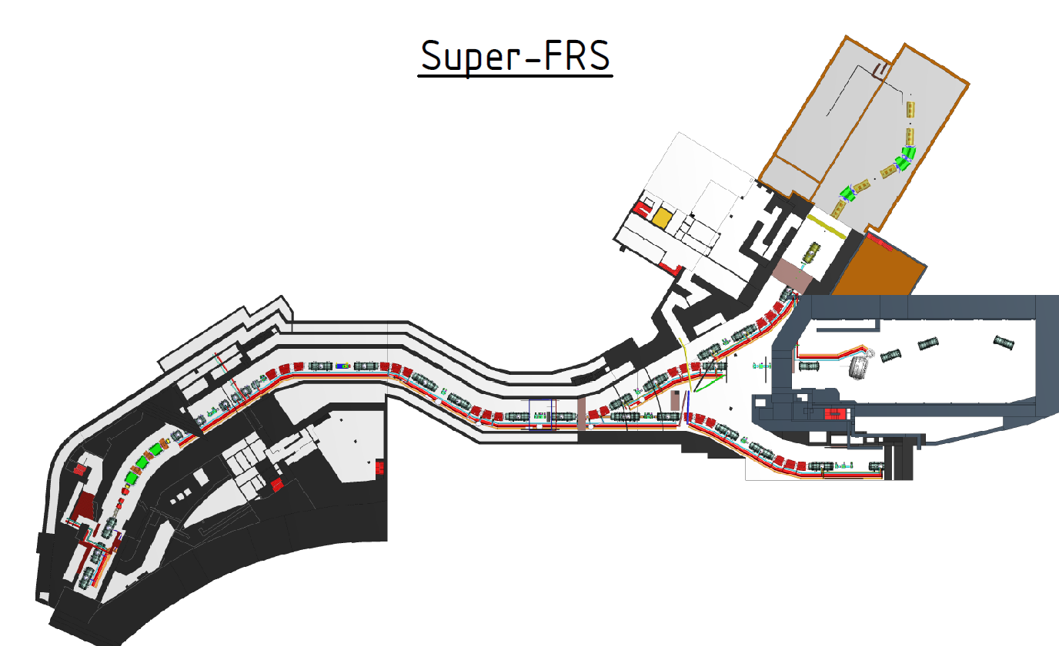
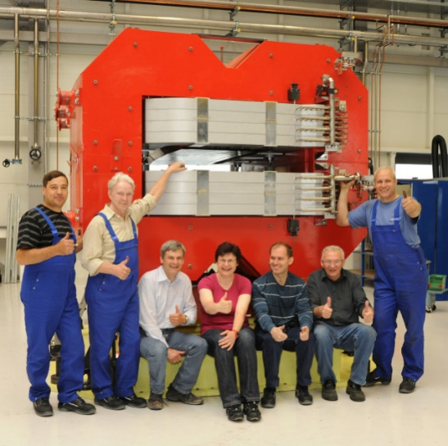
Super-FRS
(Super-Conducting Fragment Separator)
Bρ_{max} = 7 Tm
~ 300 MeV/u
7 m
33 SC multiplets
rad. hard dipole 95 t
33 SC multiplets
presep
main sep
Bρ_{max} = 20 Tm
to CRing
740 MeV/u
degrader
Bρ_{max} = 13 Tm
target
²³⁸U²⁸⁺ 0.4-2.7 GeV/u
200m

Slide 11
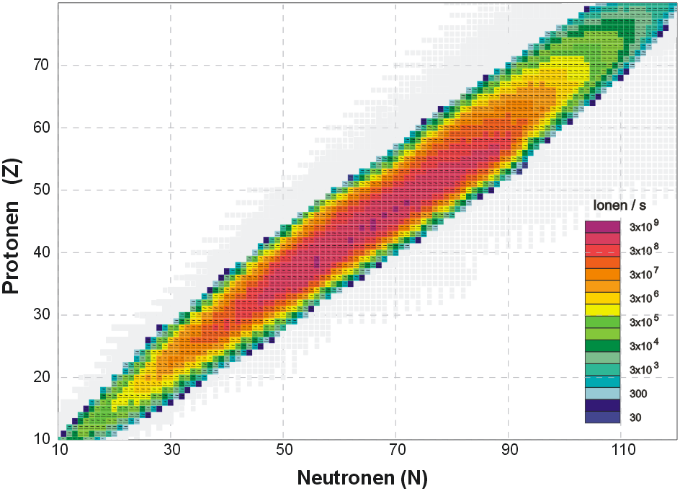

Separation
All fission fragments after target, 1.5 GeV/u ²³⁸U --> 4 g/cm² ¹²C
3x10¹¹ U/s
Protons
Neutrons

Slide 12
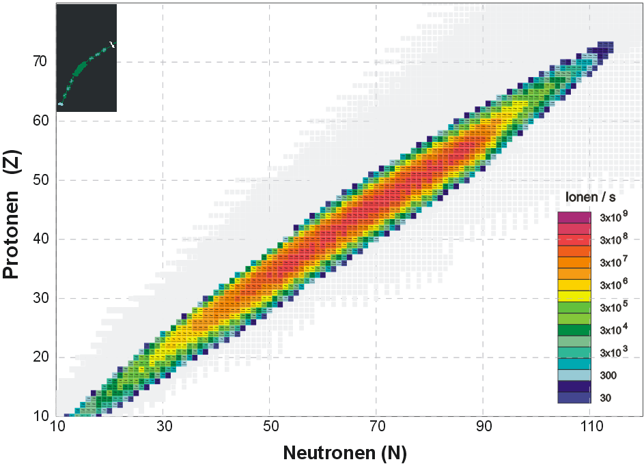
Separation
Separation only by Bρ
Protons
Σ = 5x10⁹/s
LISE++ Simulation
Neutrons

Slide 13
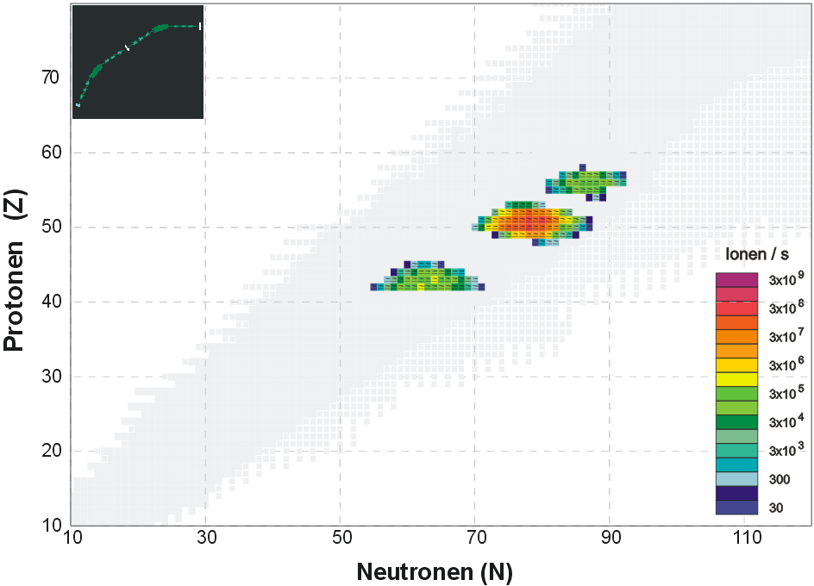
Separation
Separation after pre-separator (Bρ-ΔE-Bρ)
Protons
Protons
Σ = 3x10⁸/s
LISE++ Simulation
Neutrons
Neutrons

Slide 14
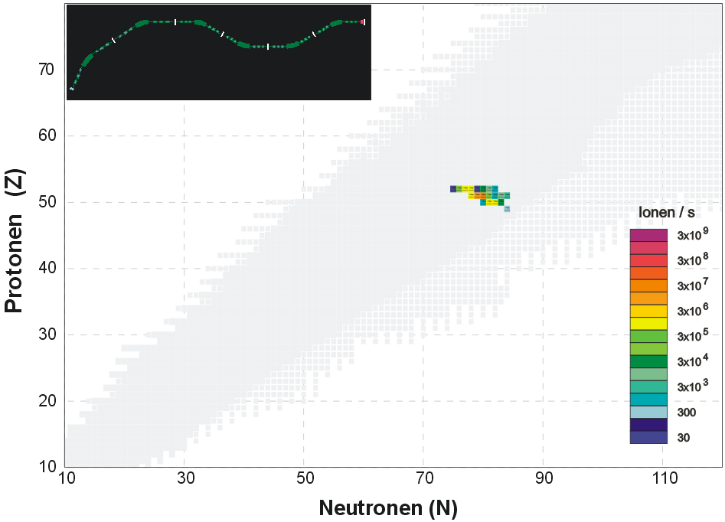
Separation
Separation after main separator (Bρ-ΔE-Bρ) x (Bρ-ΔE-Bρ)
Protons
LISE++ Simulation
Neutrons

Slide 15
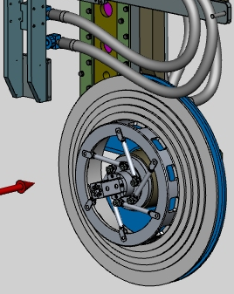
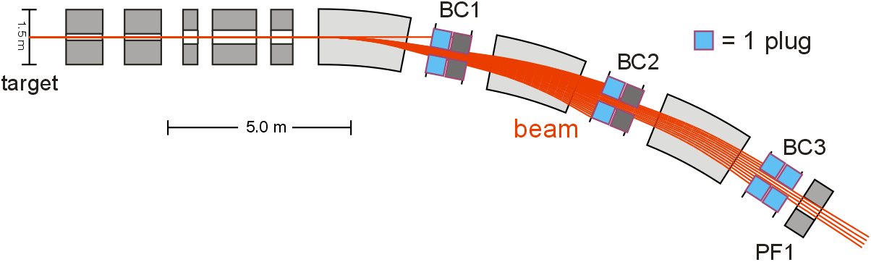
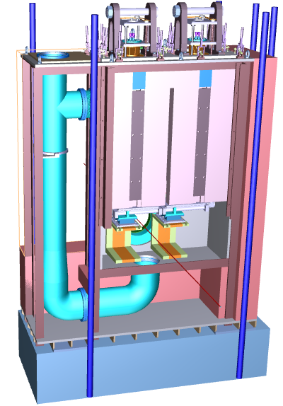
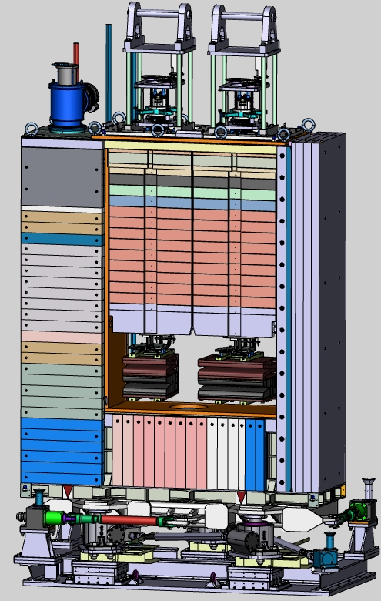
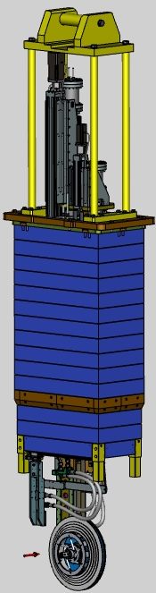
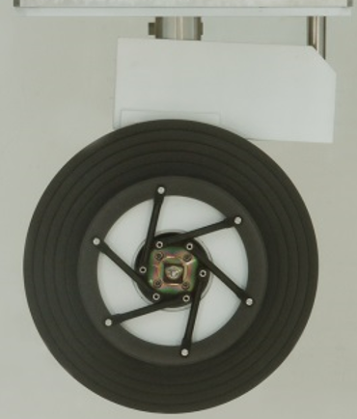


Beam Interaction Points
unreacted primary beam
wanted fragment beam
magnets
Beam Catcher Chamber
Target plug,
Graphite wheel
plug
plug
shielding
4.2 m
beam
absorbers
KVI-CART
Michel
Lindemulder
CSIR-CMERI Durgapur
Avik Chatterjee,
Abhijit Mahapatra
pumping
duct
3 m

Slide 16
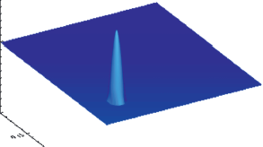
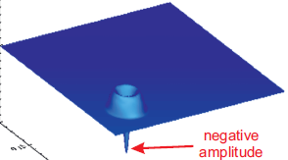
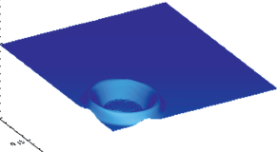
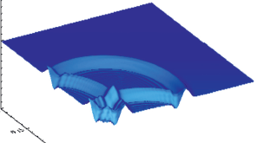
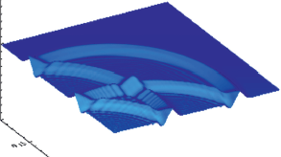
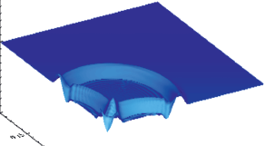
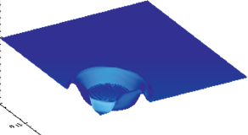
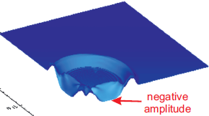
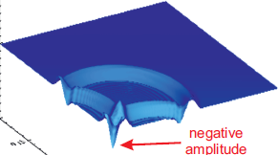
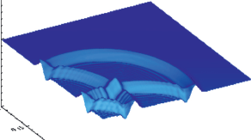




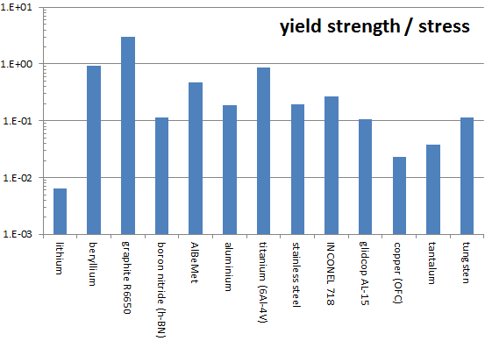
Material Choice
a simple temperature and stress calculation
Instantaneous energy deposition
pressure
at high T
low A ➔ low ΔT
polycrystalline graphite,
more nuclear x-section
less slowing-down by
electrons.
Initial compressive pressure,
wave propagates to boundary
tensile stress.
Be
graphite
AlBeMet
stainless
steel
Ti (6Al-4V)
INCONEL
h-BN
Al
glidcop
yield strength / stress
for 5x10¹¹ U on 1cm²
Cu-OFC
W
Ta
plastic deformation
not exactly elastic,
cyclic stress, cracks?
Li

Slide 17
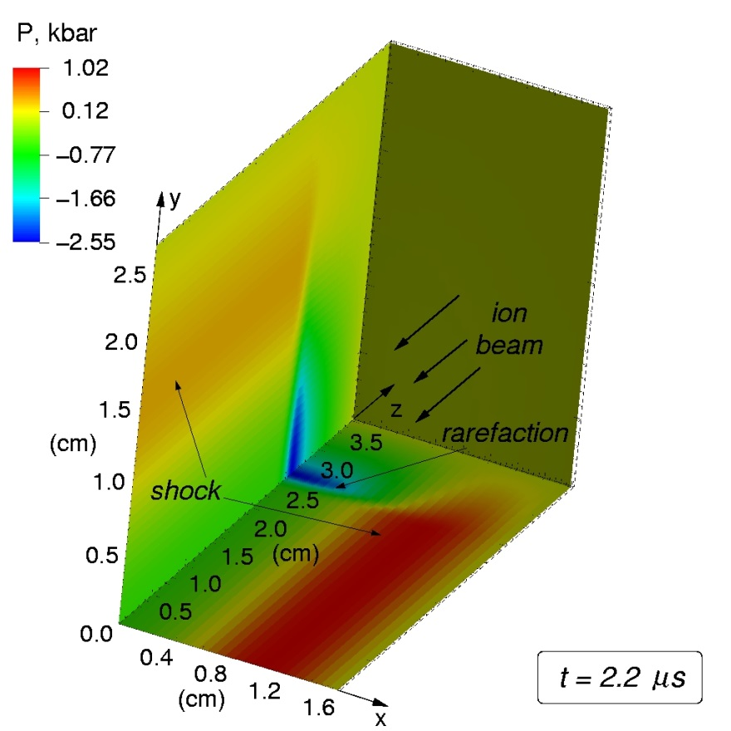
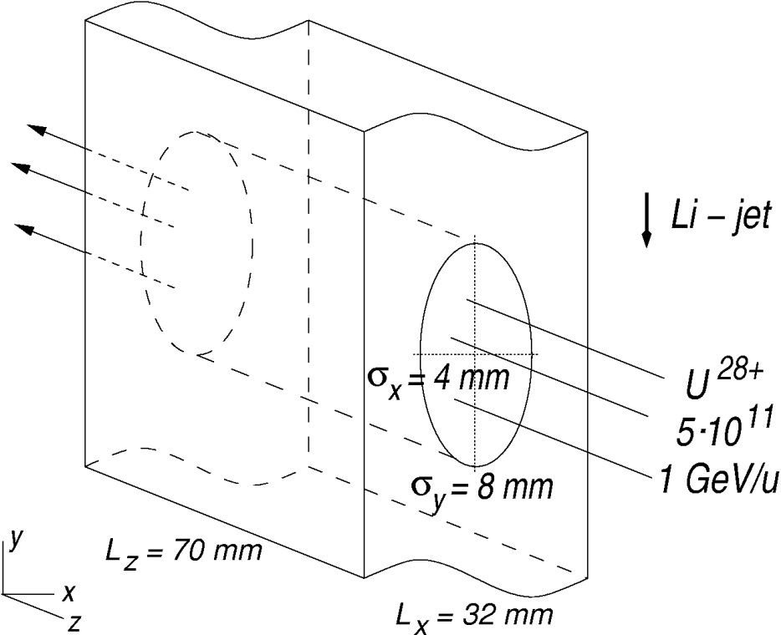
Liquid Lithium Jet - Spall Strength
Hydro-dynamical calculation:
Anna Tauschwitz et al., NIM A 591 (2008) 447
Negative
pressure!
Calculated spall strength P_{s} of
liq. Li is only -0.09 kbar = -9 MPa
Li jet will break after 210 ns,
many droplets with v > 100 m/s

Slide 18
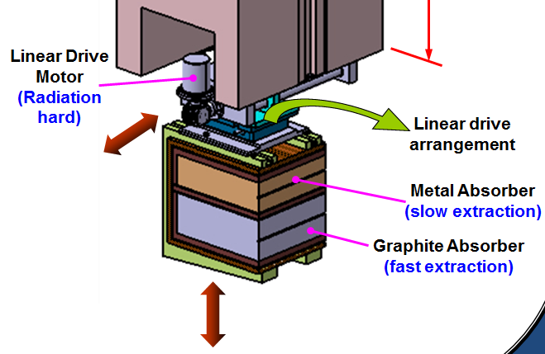
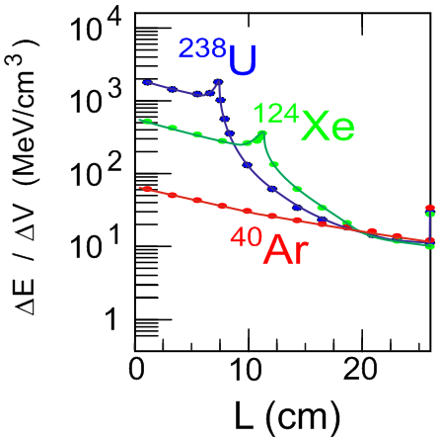
Energy Deposition and Absorber Design
beryllium
copper
graphite
490 mm
~ 300 kg
beam
copper
heat sink
water cooled
graphite

Slide 19
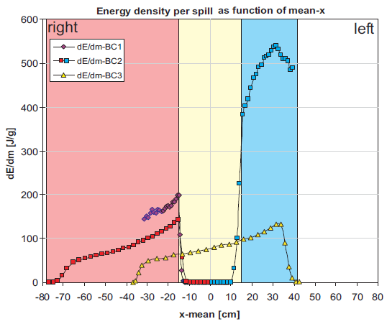
Beam Spot on Absorber
n-rich
settings
n-deficient
new optics
setting
Optics fixed for fragment beam,
primary beam of different
magnetic rigidity, ΔBρ/Bρ ≤ 30%
ΔE includes Bragg peak.
spot sizes: 0.7 cm² - 3 cm²

Slide 20
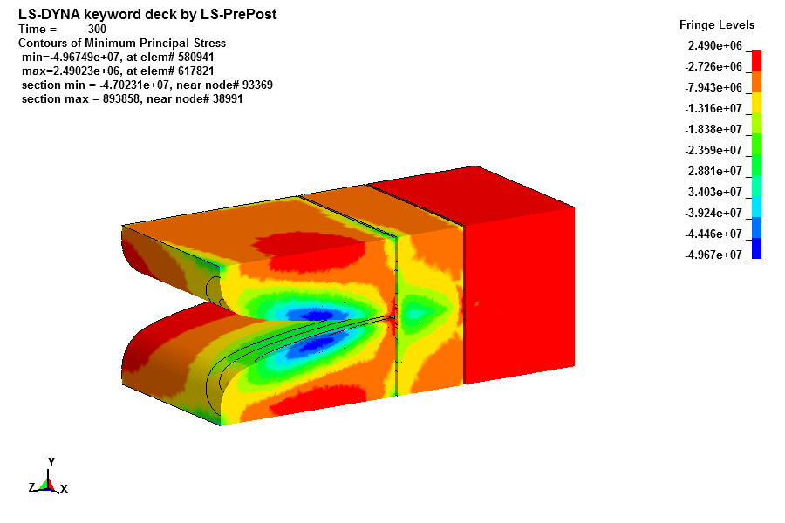
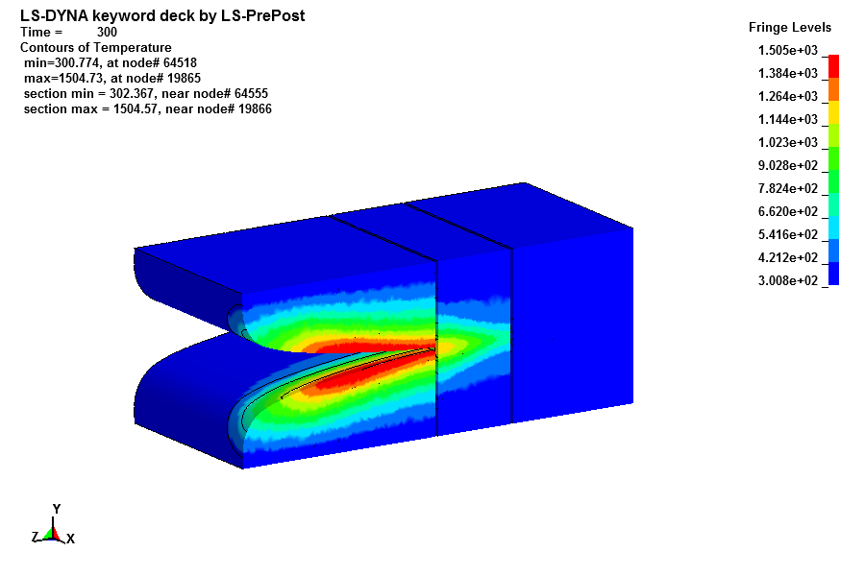
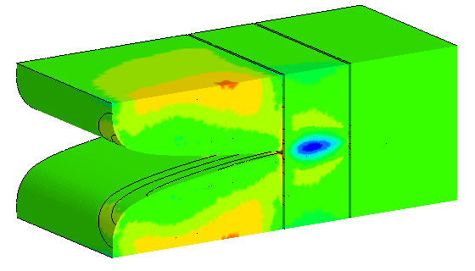
Beam Absorber Simulation
Use Gaussian beam spot and 17.2 kW (1500 MeV/u ²³⁸U)
beam comes in 50ns pulses with 28.6kJ every 1.67s.
CSIR-CMERI Durgapur
Amit Kumar with
ANSYS + LS-Dyna
graphite SGL 6650
compression in
hot spot on inside
σ3_{min} → 50 MPa
absorber
divided into
6 segments
after reaching thermal equilibrium
T_{max} → 1504 K
301 K
tensile stress by reflected pressure wave on outside
σ1_{max} → -19 MPa
beam
Apply radiation damage only
in inner region of beam spot
λ =15 W/m-K in radiation damaged areas

Slide 21
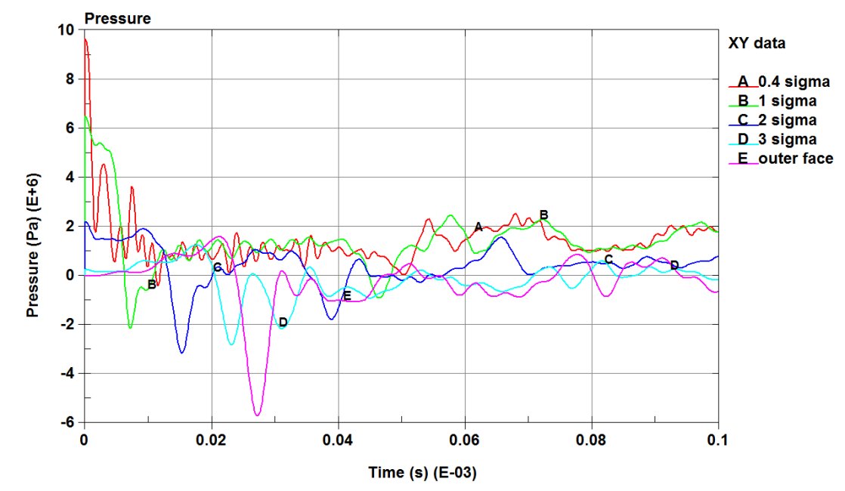
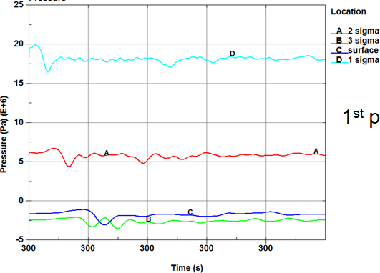
Beam Catcher Stress
Amit Kumar with LS-Dyna
1st pulse
pulse in thermal equilibrium (>300s)
initial compression
around beam spot
pressure [MPa]
pressure [MPa]
reflected pressure wave
tensile stress, outer face
time [ms]
time [ms] – 300s
initial energy = 1500 MeV/u, 740 MeV/u
T_max = 1504 K, 720 K
ΔT_max = 134 K, 310 K
max. pressure = 11 MPa, 23 MPa
min. pressure = -6.0 MPa, -8.4 MPa
E
A
ok, according to Coulomb-Mohr criterion
for brittle materials with factor > 1.5

Slide 22





Tests at FRS Target Stations, GSI 2014
Ø=20mm targets, t <1mm
1x10¹⁰ U²⁹⁺/pulse at 125 MeV/u,
long pulse FWHM ~ 500ns
in peak ~2 kJ/g => Cu melts
on target 1: σ_{x} = 0.4 mm, σ_{y}= 1.0 mm
on target M: σ_{x}= 1.2 mm, σ_{y}= 1.4 mm
Tantalum melts in beam spot, but
cannot drill through cm thick target
in 100 pulses (range = 0.55 mm).
copper-
diamond
Cu
No effect after 100-1000 pulses on:
graphite, Mo-graphite, beryllium,
20mm
flexible graphite (SIGRADUR),
glassy carbon
Cu
Al
graphite
pre-irrad.
Ronja Knöbel, HW
Marilena Tomut
in graphite:
E/m_{max} = 2.9 kJ/g => ΔT ~1400 K (target 1)
E/m_{max} = 0.75 kJ/g => ΔT ~ 360 K (target M)
but no clear shock wave front, too long pulses.
from
GSI-UNILAC

Slide 23
Radiation Damage by Heavy Ions
Track formation at high dE/dx (high Z ions Uranium, Pb, Au)
track diameter few nm, at fluence 10¹⁴/cm² track next to track
With 3x10¹¹ U/s max. fluence ~ 10¹⁷ /cm²
on same spot of target wheel or catcher.
At 0.4 - 1.5 GeV/u lower dE/dx
damage reduced by factor ~1000
ok for target wheel
- but beam stops in beam catcher
Big effect at low velocity (Bragg peak)
Use UNILAC at GSI (8.6 MeV/u),
for sample preparation,
Low activation for maximum damage.
Limited area max. 1cm², range = 0.1 mm.
30 nm x 30 nm
surface of HOPG graphite hit by U ions
Efficiency of track formation at higher velocity?
Recrystallization into what structure? (glass-like)

Slide 24



S334, Experimental Setup
GSI plasma physics cave (HHT) 2007, together with CERN
Laser
Doppler
Vibrometer
²³⁸U
²³⁸U beam at 350 MeV/u
≤ 2.5•10⁹ ²³⁸U/pulse
300ns (FWHM) pulse
σ_{x} = σ_{y} ≈ 0.365 mm
cylinder targets,
d=10 mm, L=10mm
(graphite, Cu, W, Pb)
Roman Wilfinger, Jacques Lettry,
Dmitry Varentsov, Serban Udrea,
Aleksandra Kelic, et al.
elastic response (5x10⁸/pulse)
Roman Wilfinger

Slide 25

Elastic Radial Stress Wave
Pulse 2486:
- Intensity: 2.5x10⁹ ²³⁸U part/spill
- Beam-spot size: σ = 0.365 mm
- Graphite sample d=10 mm, L=10 mm
ΔE/Δm = 1.3 – 1.7 kJ/g in max. of peak
ΔT (from deposited energy) ~ 700 K
calc. pressure +42 .. -25 MPa
Laser-
Doppler Vibrometer
(1)
(3)
(1) . . . Compression wave,
(2) . . . Tension wave,
(3) . . . Compression → reflection → tension front,
(4) . . . Tension → reflection → compression front.
(2)
(4)

Slide 26

Downscale for Testing ?
Future: enlarged beam spots to make target survive.
Today: test with small beam spot on downscaled prototype.
Peak energy can be reached, but stress at critical surfaces?
Also time structure needs to be scaled down.
Problem in 2014 test, bunch compression cavity was broken.
Δt (FWHM) ~ 0.5 μs, v=2.2 mm/μs, sample 1mm thick, spot~1mm
Now new 2nd cavity in SIS-18 => Δt (FWHM) = 100 ns possible.
SIS-100: 9 cavities to merge four SIS-18 pulses to one 90ns pulse,
by barrier bucket and bunch compression cavities.
HiRadMat is good, but more difficult with 288 bunches over 7.2μs.
However, A. Bertarelli’s talk yesterday, 1/10 downscaled LHC jaws,
a reasonable “shock” front can be formed.
16 mm
20cm
beam
2.2 mm
SPS bunch compression for LHC but no bunch merging.
PS booster pulses?
Test with stress concentrator geometry.
Match size for positive superposition ?

Slide 27
Summary - Conclusion
HiRadMat with Pb beam no gain compared to proton beam.
Lower energy density and Pb projectile fragments very fast.
Heavy-Ion Testing should be done at lower energy facility.
Proton beam reaches values for FAIR testing.
Superposition of many bunches requires improved simulation.
Key questions for FAIR: What is the best carbon material?
No damage outside beam spot -> properties preserved
in spot dramatic changes (see talk M. Tomut).
Pulsed beam testing
with real shapes with
in beam diagnostics
High dose heavy-ion
irradiation at low E

Slide 28
empty

Slide 29




Thermal Simulations by CMERI
- consider radiation damage -
Use Gaussian beam spot and 17 kW (1500 MeV/u ²³⁸U)
Amit Kumar
with ANSYS
fresh SGL 6650
to copper heat sink
300 K
Apply radiation damage only
in inner regions of spot (c1..c3)
950 K
modified material
λ =15 W/m-K in center (c1-c3)
λ =15 W/m-K, shaped better
301 K
301 K
2210 K
1504 K

Slide 30

Energy Deposition in Copper Cylinder
FLUKA simulation of ΔE by 350 MeV/u ²³⁸U beam on copper cylinder
GeV/cm³ per primary
thesis Herta Richter, TU Vienna 2011
Eur. Phys. J. A 42, 301–306 (2009)

Slide 31



Target Ladder Scan
scan y1
7μm Ti
scan y2
MW11
scan x
N
26+
25+
x
0

