Slide 1
Positron Sources and Beam Dumps for the International Linear Collider-ILC
International HiRadMat Workshop
10-12 July 2019
CERN
Peter Sievers (CERN-Retired)

Slide 2
Outline
1.-Introduction
2.- e-Driven Positron Source
3.-Undulator Driven Positron Source
4.-Dump of the Photon Beam from the Undulator
5.-Main Dumps of the spent e- and e+ beams
6.- Comments and Conclusion

Slide 3
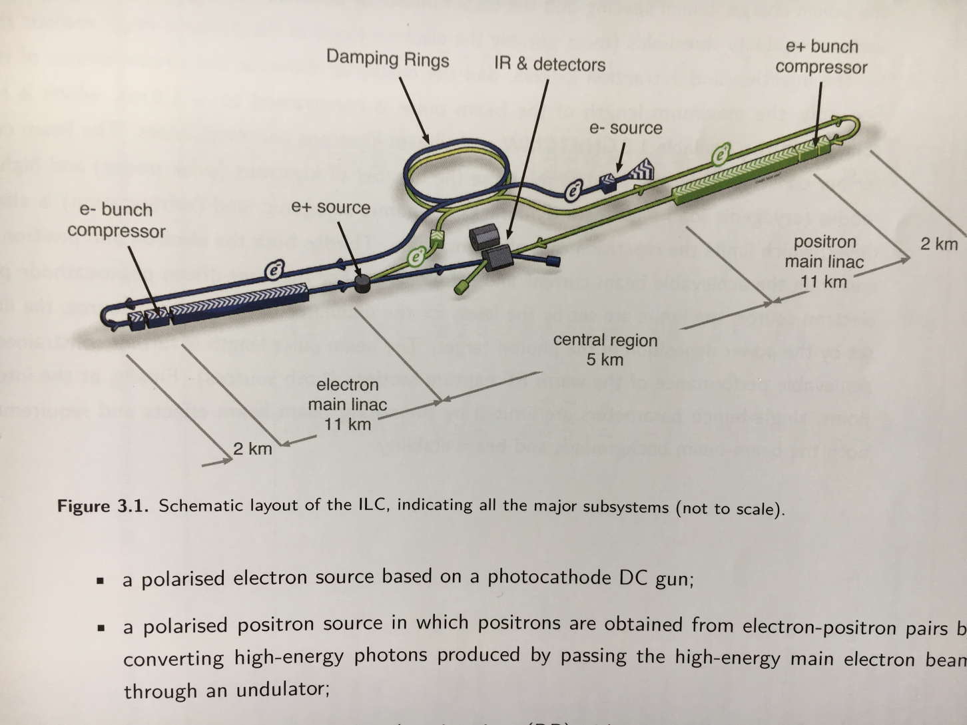
1.: Introduction: The International Linear Collider-ILC.

Slide 4
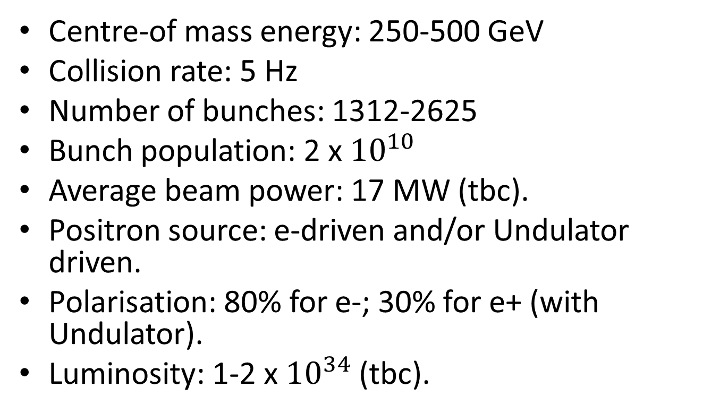
Some Machine Parameters
Centre-of mass energy: 250-500 GeV
Collision rate: 5 Hz
Number of bunches: 1312-2625
Bunch population: 2 x ${10}^{10}$
Average beam power: 17 MW (tbc).
Positron source: e-driven and/or Undulator driven.
Polarisation: 80% for e-; 30% for e+ (with Undulator).
Luminosity: 1-2 x ${10}^{34}$(tbc).

Slide 5
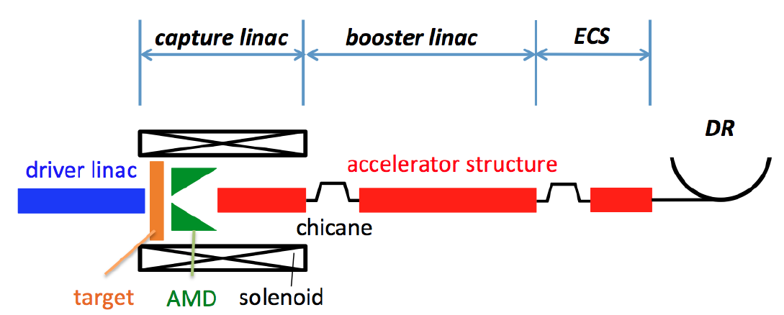
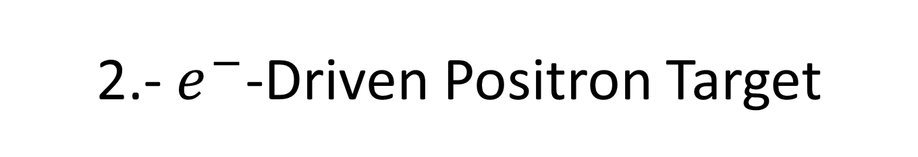
2.- $e^{−}$-Driven Positron Target
3 GeV e-Beam
T. Omori-KEK

Slide 6
Pulse Structure for the Conventional e-driven Target
1 µs
3.3 ms
20 packets, 63 ms, 300 Hz
200 ms, 5 Hz
T. Omori-KEK

Slide 7
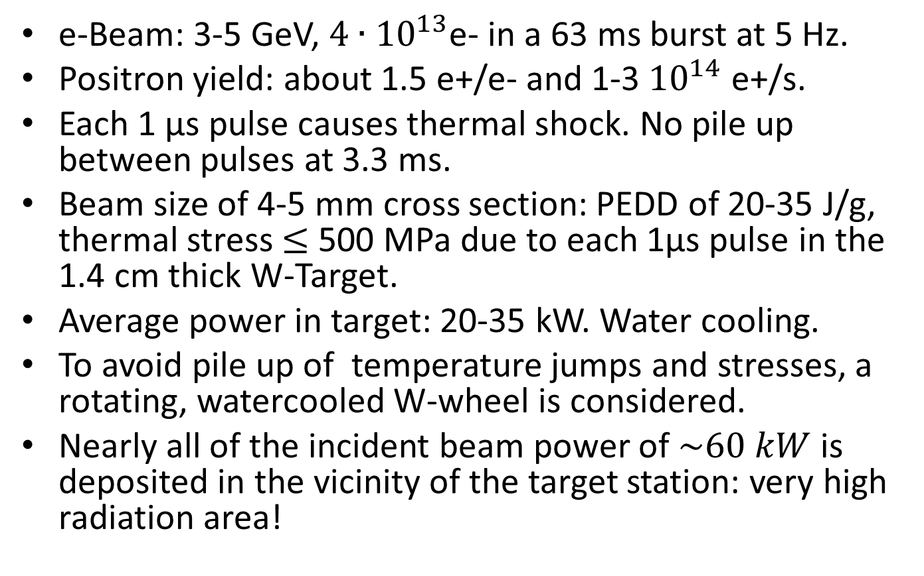
Design Parameters for the e-driven Positron Source (t.b.c.).
e-Beam: 3-5 GeV, $4∙{10}^{13}$e- in a 63 ms burst at 5 Hz.
Positron yield: about 1.5 e+/e- and 1-3${10}^{14}$ e+/s.
Each 1 µs pulse causes thermal shock. No pile up between pulses at 3.3 ms.
Beam size of 4-5 mm cross section: PEDD of 20-35 J/g, thermal stress $≤$ 500 MPa due to each 1µs pulse in the 1.4 cm thick W-Target.
Average power in target: 20-35 kW. Water cooling.
To avoid pile up of temperature jumps and stresses, a rotating, watercooled W-wheel is considered.
Nearly all of the incident beam power of $\sim 60 kW$is deposited in the vicinity of the target station: very high radiation area!
T.Omori-KEK

Slide 8
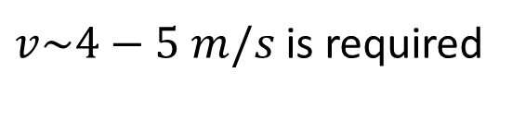
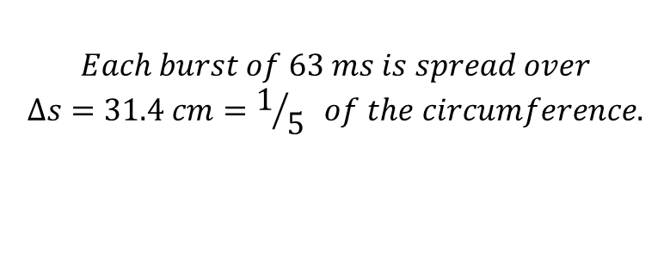
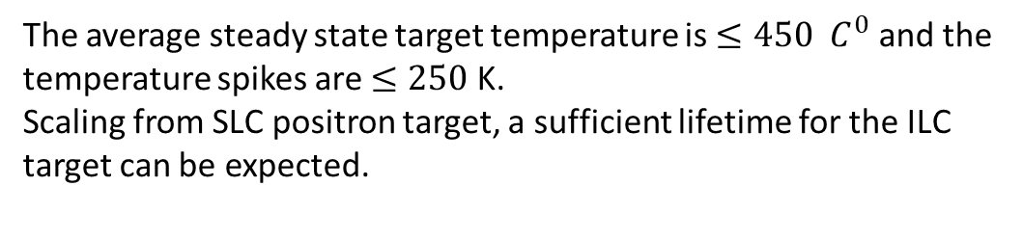
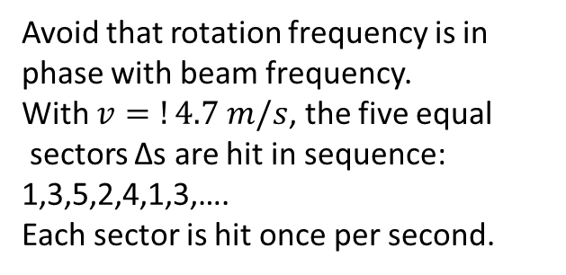
Rotation of the Wheel
Beam Impact
$v\sim 4−5 m/s$ is required
Rotation
1
2
Avoid that rotation frequency is in phase with beam frequency.
With $v=!4.7 m/s$, the five equal
sectors Δs are hit in sequence: 1,3,5,2,4,1,3,…. Each sector is hit once per second.
R=25 cm
5
3
Δs
$$Each burst of 63 ms is spread over$$
$$∆s=31.4 cm=1/{5 }of the circumference.$$
4
The average steady state target temperature is $≤450 C^{0}$ and the temperature spikes are $≤250$ K.
Scaling from SLC positron target, a sufficient lifetime for the ILC target can be expected.

Slide 9
Water Cooled e-Driven Target Wheel
Beam Vacuum
Flux Concentrator
Rotating Target Wheel
Rotating Axis
Motor
Rotating Water Connection
Water Flow
Tungsten Target
Ball Bearings
Rotating Ferro-Fluid Seal
Vacuum Pump
Backup Labyrinth Vacuum Buffer
Critical Issue of Rotating Seal: Leak tightnes for UHV. Radiation resistance and radiochemistry of iron powder in oil, and permanent magnets.

Slide 10
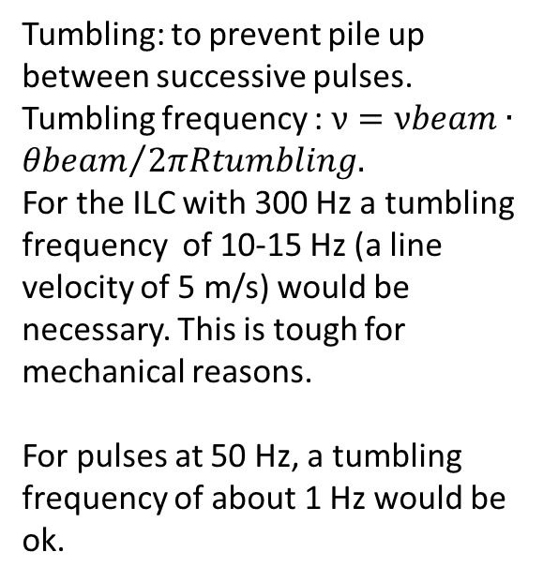

SLC-SLAC Water Cooled Tumbling Target
Z
Water Supply
$$α$$
Tumbling: to prevent pile up between successive pulses. Tumbling frequency : $ν=νbeam∙{θbeam}/{2πRtumbling.}$
For the ILC with 300 Hz a tumbling frequency of 10-15 Hz (a line velocity of 5 m/s) would be necessary. This is tough for mechanical reasons.
For pulses at 50 Hz, a tumbling frequency of about 1 Hz would be ok.
External Pivot
Bellows
Vacuum
Beam Impact
Add No of hits

Slide 11
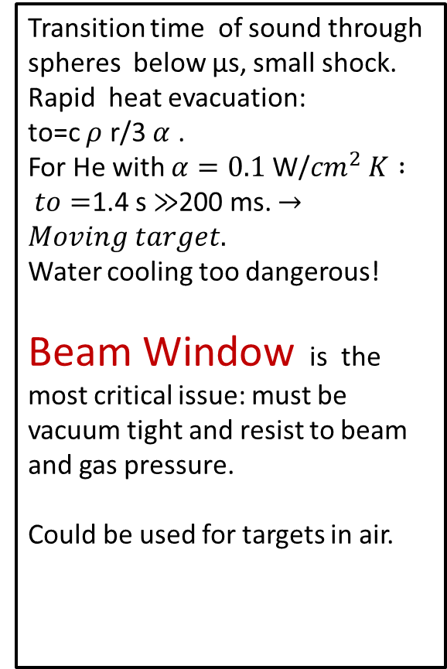
He-Cooled Granular Target
W-spheres, 3 mm
He-Outlet
Transition time of sound through spheres below µs, small shock.
Rapid heat evacuation: to=c $ρ$ r/3 $α$ .
For He with $α=0.1$ W/${cm}^{2} K : to=$1.4 s $≫$200 ms. $→Moving target.$
Water cooling too dangerous!
Beam Window is the most critical issue: must be vacuum tight and resist to beam and gas pressure.
Could be used for targets in air.
Beam Window
Beam
He-Inlet

Slide 12
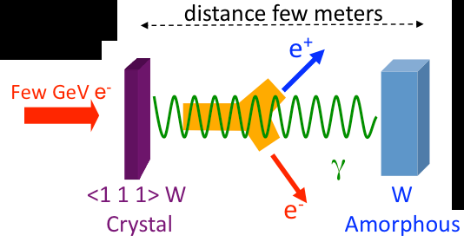

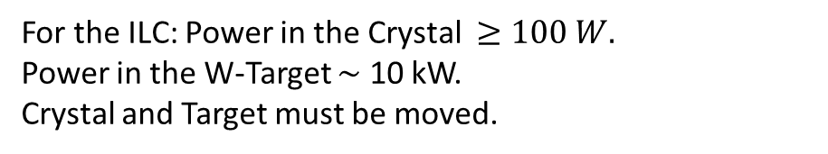
Hybrid e+ Source (Base Line for CLIC)
Crystal
Thin W-Crystal
$$e^{+}$$
Beam Windows
Sweeping Magnet
Target
He-Gas Cooling with windows or edge cooling without windows.
For the ILC: Power in the Crystal $≥100 W.$
Power in the W-Target $\sim$ 10 kW.
Crystal and Target must be moved.
R. Chehab-LAL, I. Chaikovska-LAL
Ch. Xu-IHEP

Slide 13
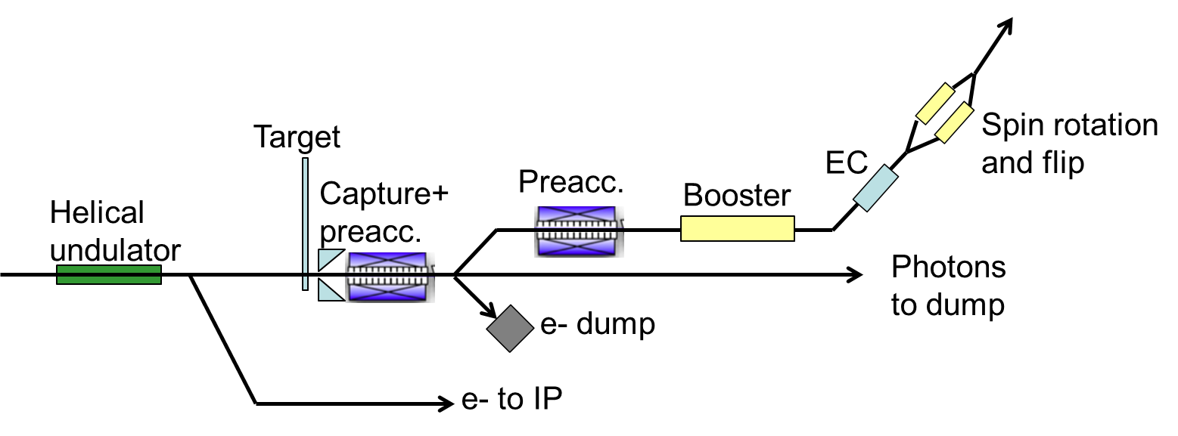

3.- ILC-Undulator Driven e+ Target
e+ to IP
Photon Beam
$$e^{+} GeV$$
S. Riemann-DESY; M. Kuriki-Hir.Univ.

Slide 14
Pulse Structure for the Undulator-Driven Target
τ=1 ms
t
200 ms, 5 Hz
Wheel, rotating at 100 m/s: each spot on the target is hit at 0.16 Hz, one hit spread over 10 cm every 6.3 s. Target radius 0.5 m, 1920 rpm. Helps cooling and life time.
T
Δt=1 ms
6.3 s
t
X
Small temperature spikes: ΔT= To φ/τ v =2% To. dT/dt =To/τ. Velocity of the ’plane ‘ $≪c$.

Slide 15
Design Parameters of the Undulator driven Positron Target.
The 7-10 MeV photon beam from the Undulator with a pulse duration of 1 ms and a rep. rate of 5 Hz hits a Ti-Target.
The Ti-Target Wheel with a diameter of 1 m and a thickness of 7 mm absorbes about 2 kW, only about 3% of the incident power. Cooling by Heat Radiation.
To dilute the PEDD in the target to some 40-70 J/g, a rotation velocity of 100 m/s, 2000 rpm, is required, spreading the burst over a sector of 10 cm.
Each sector of the wheel of 10 cm width is hit every 6.3 s, provided that the velocity is finely tuned to avoid «resonances»: wheel frequency = n beam frequency.
S.Riemann-DESY, A. Ushakov-Hmb. Univ.

Slide 16
Irradiation tests of Ti are under way at the Microtron at Mainz/Germany with e- energies of 3.5-14 MeV. Ref. S. Riemann, A. Ushakov.
The pulsed magnetic field from the Flux Concentrator downstream of the target will induce currents, additional power and forces in the fast rotating wheel. Under study.

Slide 17
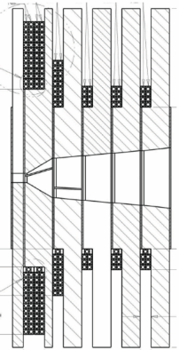
Radiation Cooled Rotating Wheel
Strip line
(Flux Concentrator)
Ti-Target
Photon Beam
Cu-radiator, rotating
Pulsed, Conical Solenoid
Cu-cooler, stationary + water inlet
FC
Rotating Wheel
Vacuum Tank
Cooling water for FC
Motor
Magnetic
bearing
Magnetic
bearing
Rotating Axis
Water cooled, stationary Cu-cooler
S.Riemann-DESY

Slide 18
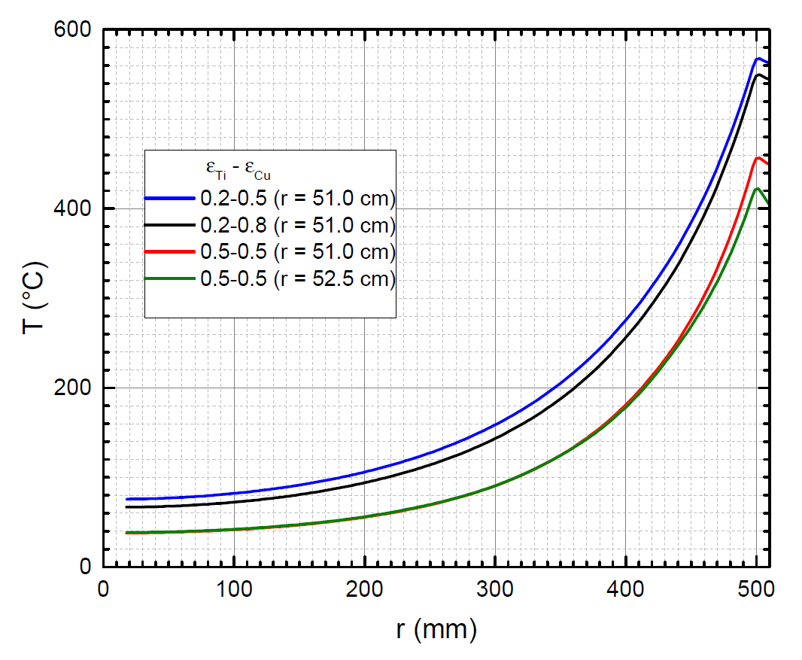
Average temperature in wheel as function of radius r for different surface emissivities of target and cooler (Cu)
Photon beam impact always at r=50cm
ε_{eff}= 0.33 for ε_{Ti} = ε_{Cu}=0.5
Deposited E = 2kW
T_{ave} ≤ 460˚C
F. Dietrich
S.Riemann-DESY

Slide 19
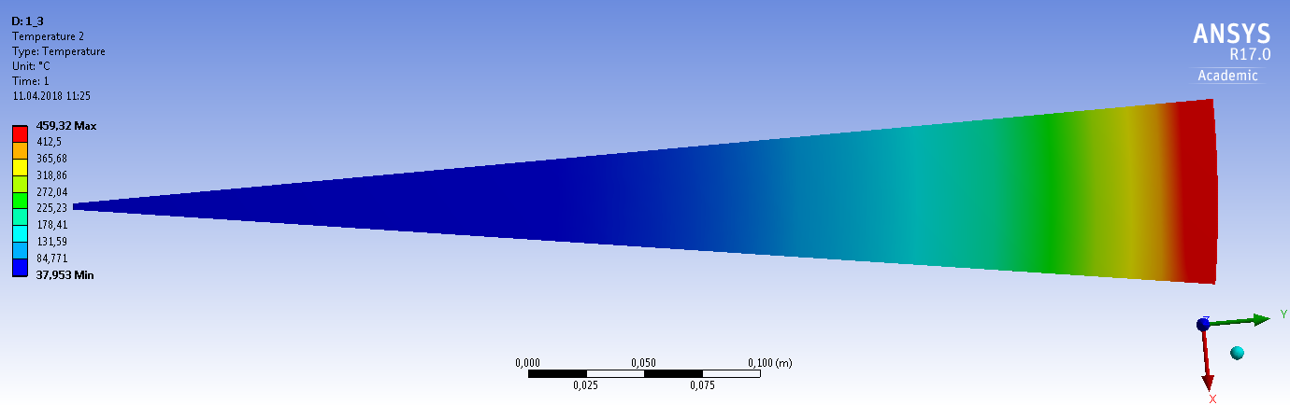

Radial Temperature in Radiation Cooled Ti-Wheel
450 oC average for 2 kW
Thermal stress$≤400 MPa$
S.Riemann-DESY

Slide 20
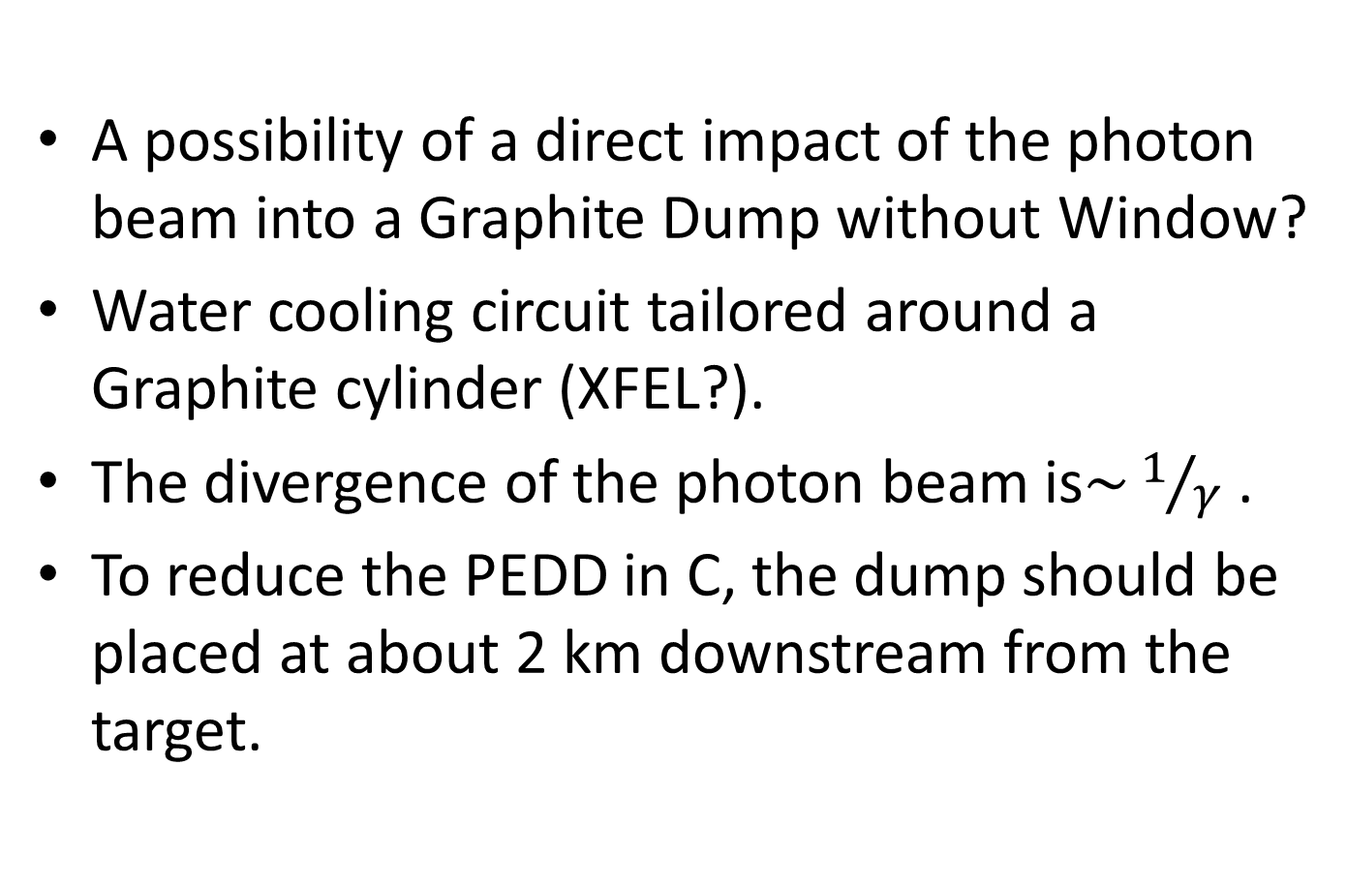
4.- The Dump for the Photon Beam from the Undulator .
A possibility of a direct impact of the photon beam into a Graphite Dump without Window?
Water cooling circuit tailored around a Graphite cylinder (XFEL?).
The divergence of the photon beam is$\sim 1/γ$ .
To reduce the PEDD in C, the dump should be placed at about 2 km downstream from the target.

Slide 21
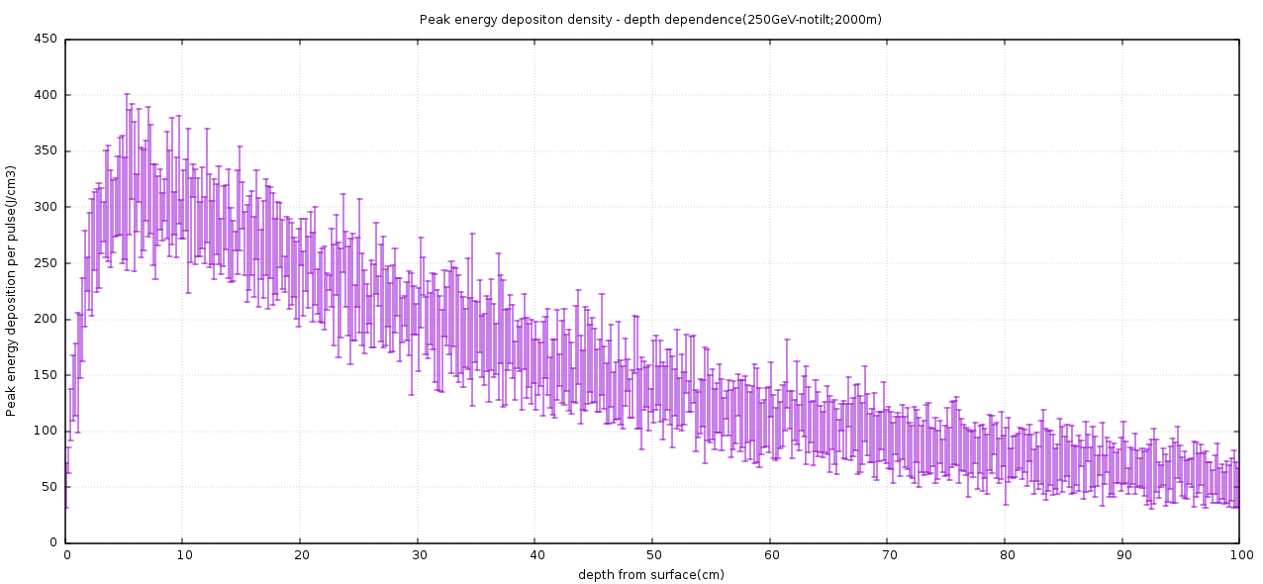
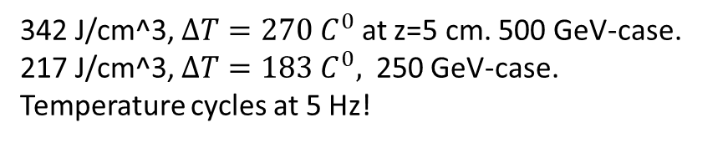
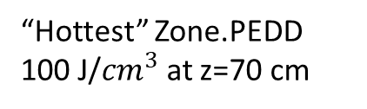

Absorption of photon beam in far (2 km) Graphite.
342 J/cm^3, $∆T=270 C^{0}$ at z=5 cm. 500 GeV-case.
217 J/cm^3, $∆T=183 C^{0},$ 250 GeV-case.
Temperature cycles at 5 Hz!
No Tilt
Will the Graphite at the entrance between z=0-5 cm survive?
Steady state temperature?
“Hottest” Zone.PEDD 100 J/${cm}^{3}$ at z=70 cm
PEDD $\sim 0$at z=0
Yu Morikawa/KEK

Slide 22


Design of a Tilted Graphite Photon Dump
【Base Idea】
①To enlarge the photon beam spot on beam dump
・putting long distance between positron target and beam dump(2km).
②To absorb beam heat only by thin Graphite
・tilting beam dump (almost horizontally:10mrad)
【Base Design】
[Back plate]Absorbing scattering beam
Thin Graphite of 1 cm thickness, brazed onto a water cooled Cu-bed.
Photon Beam
Copper
10mrad
[Main plate]
Absorbing⇒72kW(62%) of beam power@250GeV stage
Scattering⇒84kW(38%) of beam power@250GeV stage
Cooling mechanism : Only cooling water in copper
No cooling, protection gas : No need to introduce to beam window
Yu Morikawa-KEK

Slide 23
Tilted C-Dump
Xo
Direct impact, no tilt
Beam
Xo
Tilted impact
Beam
For ideal dE/dx energy deposition : no gain, the impacted volume remains the same. Gain only due to lateral spread of cascade.

Slide 24
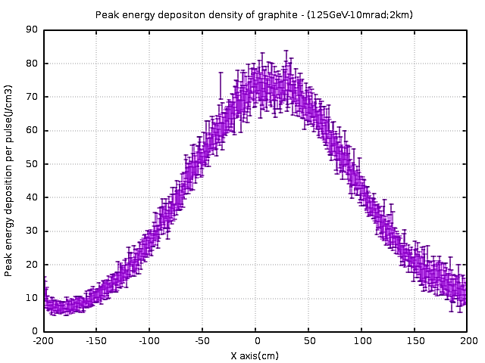
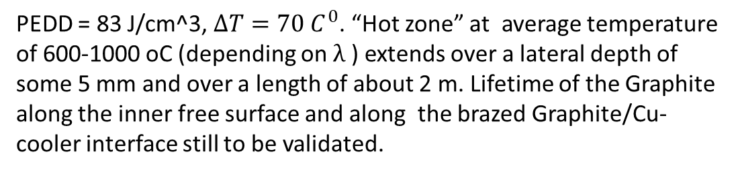
Absorption of Photon Beam in the far (2 km) tilted Graphite Beam.
PEDD = 83 J/cm^3, $∆T=70 C^{0}$. “Hot zone” at average temperature of 600-1000 oC (depending on $λ$ ) extends over a lateral depth of some 5 mm and over a length of about 2 m. Lifetime of the Graphite along the inner free surface and along the brazed Graphite/Cu-cooler interface still to be validated.
PEDD with tilted Dump is reduced by a factor
2.-2.5 as compared to direct impact
2 m
Yu Morikawa-KEK

Slide 25
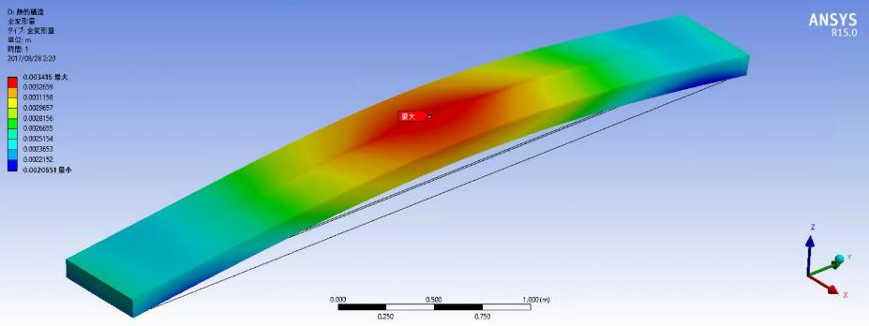
Deformation, Stress, Cooling to be studied.
【Total Deformation】
Deformation by thermal expansion. (not including the self-weight)
Main plate is expanded and main plate is arched 3.4mm in the surface direction
Yu Morikawa-KEK
Notes:
This slide shows total deformation of main plate.
This simulation don’t include self-weight, so this deformation is only due to thermal expansion.
Looking at the this results, Graphite is expanded and main plate is arched 3.4mm in the surface direction.

Slide 26
Water Dump for the Photon Beam
Create a vertical water flow (Waterfall) in a tank.
With a water velocity of 5 cm between beam pulses at 200 ms, i.e. 0.25 m/s is trivial.
If the water survives one single pulse, the water will live eternally?
But one needs a vacuum window.

Slide 27
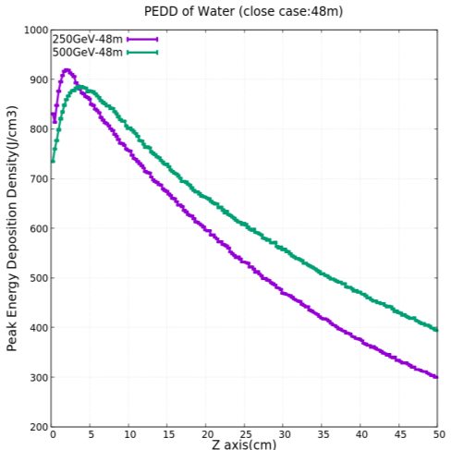

Water Dump placed at 48 m: boiling.
ΔT$\sim 200 oC$
Zone of Boiling above 340 J/g
With a pre-load of above 10 bar, boiling of water at 200 oC can be prevented.
Yu Morikawa-KEK

Slide 28
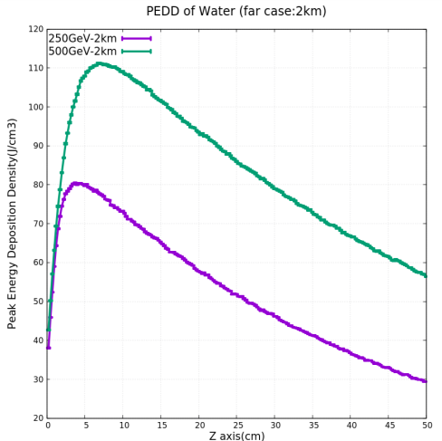
Water Dump placed at 2 km, no boiling.
ΔT (K) at | 250 GeV | 500GeV
Z=0 cm | 12. K | 12. K
Z=5-10 cm | 19.1 K | 26.5 K
Water will not boil at 1 bar. Some slow dynamic response due to thermal expansion and mass inertia of the water can occur? Depleation waves and reduction of water density during the 1 ms pulse?
Yu Morikawa-KEK

Slide 29
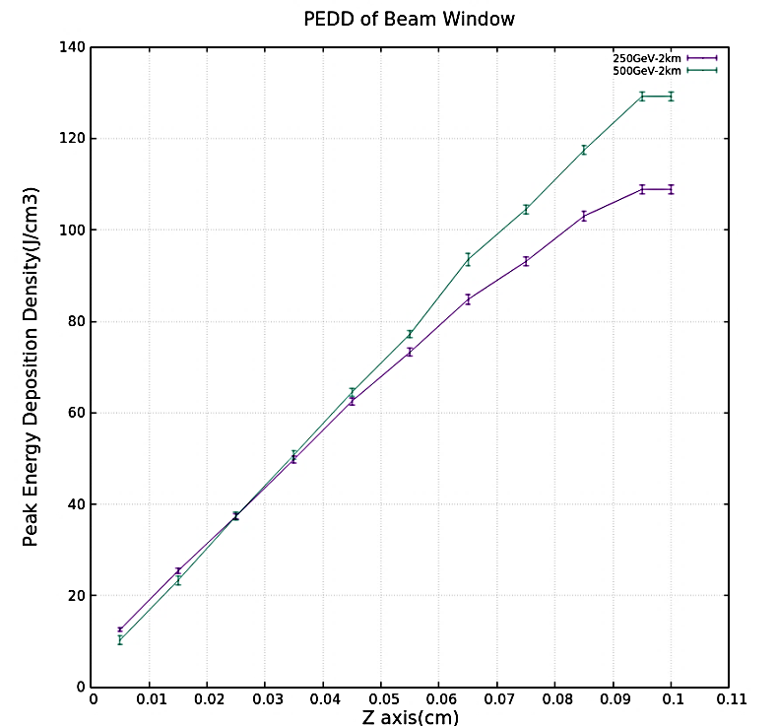
The Titanium Vacuum Window upstream of the Water Dump at the 2 km Position.
Only thin Ti-windows with 0.2-0.4 mm thickness will survive when displaced between pulses: Tumbling Window
Yu Morikawa-KEK

Slide 30
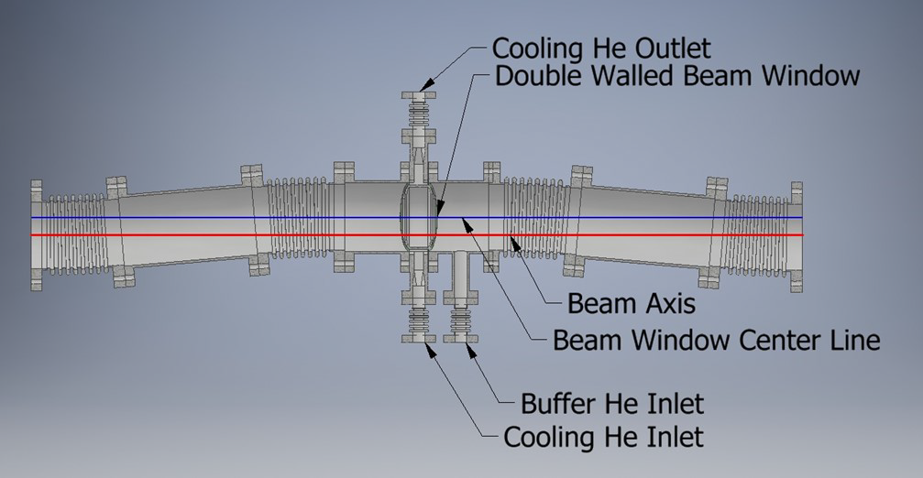
Tumbling Window 10 m upstream of the Far Photon Water Dump
Water Dump
Movement in sychronized X- and Y-Directions
Yu Morikowa-KEK

Slide 31
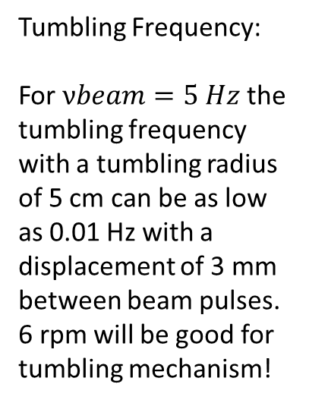
Tumbling Window
Flange
Window Foil
Circle of Beam Impacts
Tumbling Frequency:
For $νbeam=5 Hz$ the tumbling frequency with a tumbling radius of 5 cm can be as low as 0.01 Hz with a displacement of 3 mm between beam pulses. 6 rpm will be good for tumbling mechanism!
Synchronized lateral X and Y Displacement, no rotation!
Tumbling Radius

Slide 32
Design Values for a He-Cooled, Moving Window, displaced by 3 mm between Pulses.
Window Thickness (mm) | 0.2 | 0.4
PEDD J/g | 7.2 | 12.7
ΔT/Pulse | 14.4 | 25.4
Pulsed Stress (MPa) | 21.6 | 38.1
Av. Power (W) | 16.2 | 43.3
Peak Temp. (oC), moving window + He-cooling. | 34.5 | 48.5
Dpa/5000 h | 0.25 | 0.25
Lifetime (h) for Dpa=0.5 | 10’000 | 10’000
Yu Morikava-KEK

Slide 33
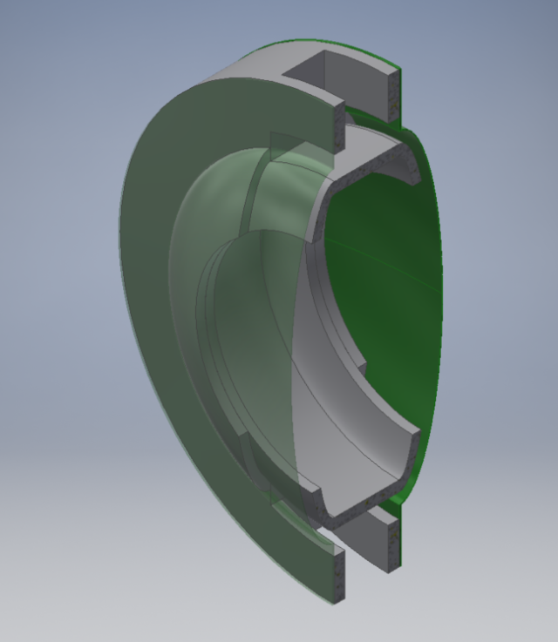
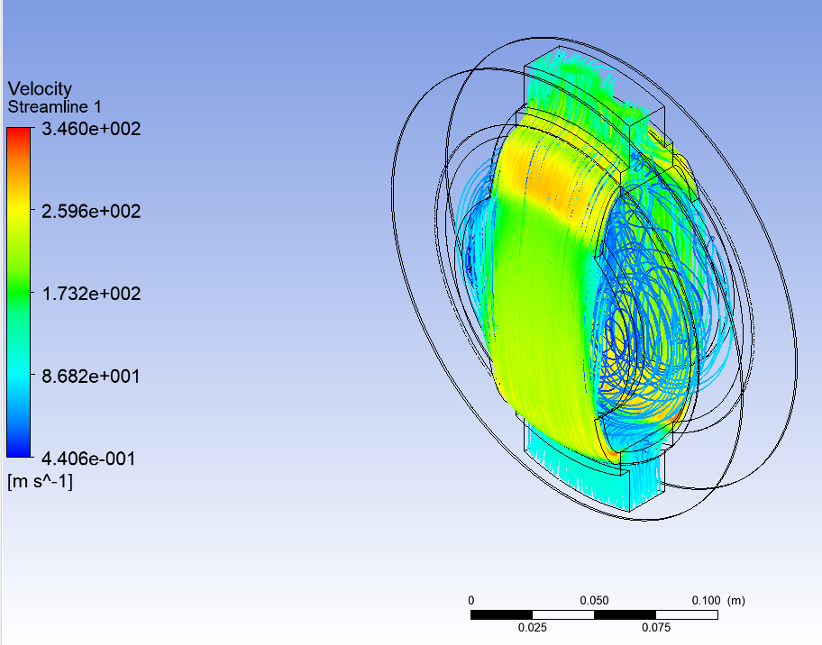
Double Walled He-Cooled Vacuum Window
He gas
outlet
Hydro-formed 0.2 mm thick Ti-window
He gas inlet, 100 m/s, 1 bar.
Vibrations and local buckling in thin membranes?
Yu Morikowa-KEK

Slide 34
Drive Mechanism for the Tumbling Window
Tumbling Window, Flange and Vacuum Pipe
Tumbling Vacuum Pipe
Circle of Beam Impacts
Center of Excentric Vacuum Window
Ball Bearing
Circle of Window Center
Beam Axis coincides with Rot. Center of Outer Drive Disk
Outer Drive Disk

Slide 35
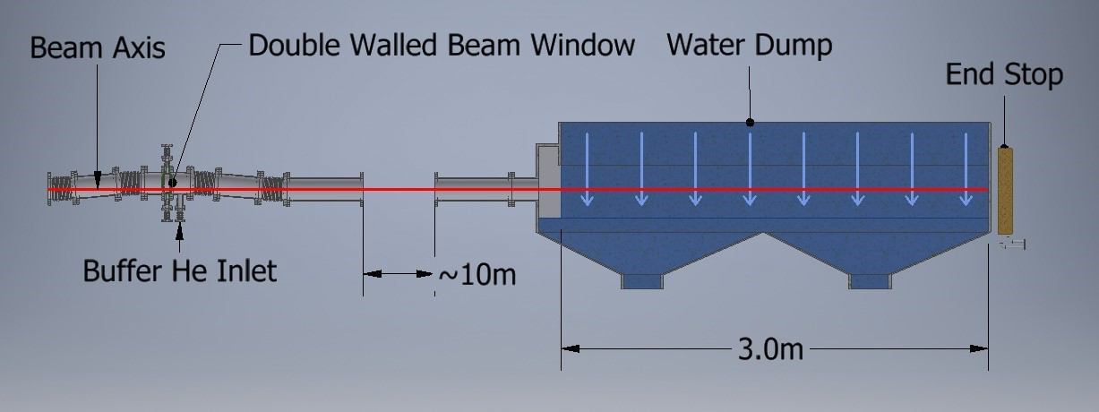
Layout of Water Dump for the Photon Beam. Easy Access to the Window for Maintenance and Exchange.
No direct Ti-Window/ Water Contact.
Water Flow 5 cm/s
Cooling He outlet
He Buffer Volume
Cooling He Inlet
Tumbling Drive
Yu Morikowa-KEK

Slide 36
5.- 17 MW Water Dumps to absorb the spent e- and e+ Beams of up to 500 GeV at 5 Hz.
See ILC TDR
Publ. of P. Satyamurthy et al., Nucl. Instr. and Meth. A 679 (2012) 67-81.
Recent Review by Yu Morikowa-KEK, Oct. 2018.

Slide 37
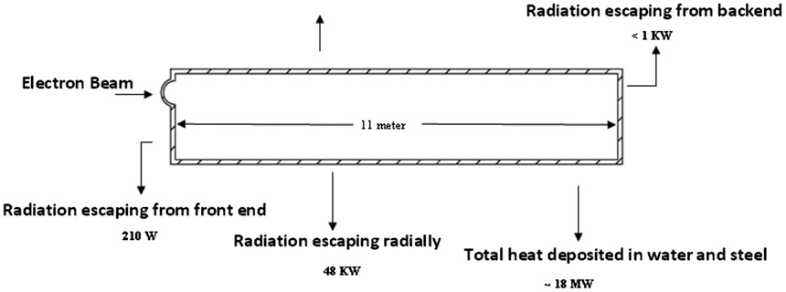

Layout of ILC-Water Dump
Preload 10 bar
1.8 m
1mm Ti-Window
$$\sim 17 MW$$

Slide 38
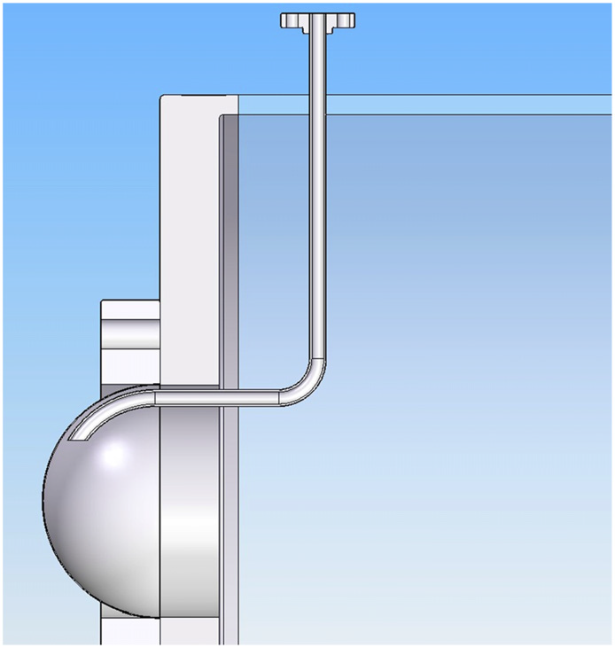
Window for ILC 17 MW Main Dump
Vacuum
Swept Beam
Water, Pre-Load 10 bar
1 mm thick Ti-Window, diameter 30 cm

Slide 39
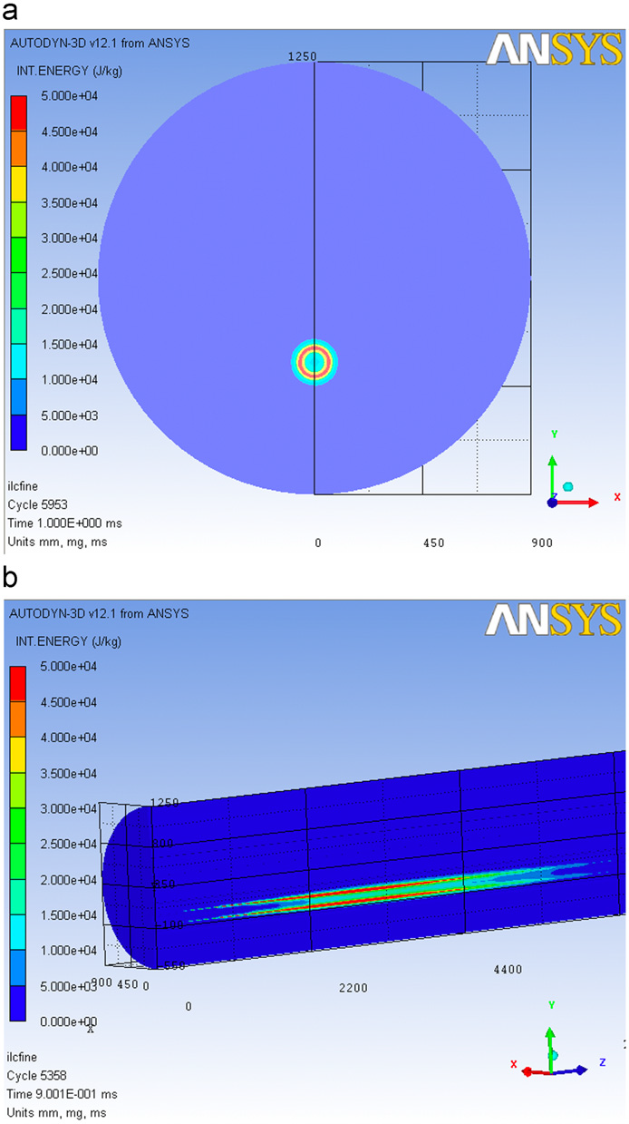
Beam is laterally swept with a radius around a circle of 6 cm radius at 1 kHz

Slide 40
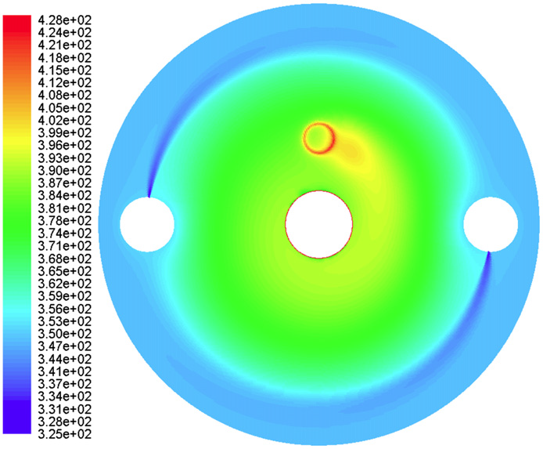
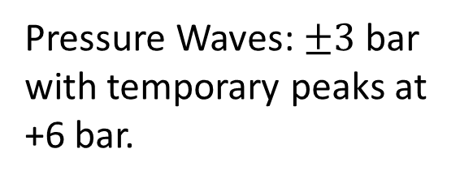
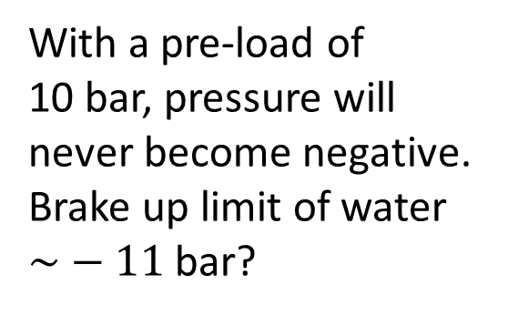
Front View of the Water
Tmax=68 oC for 125 GeV
Tmax=121 oC for 500 GeV
Units:
Pressure Waves: $±3$bar with temporary peaks at +6 bar.
With a pre-load of 10 bar, pressure will never become negative.
Brake up limit of water $\sim −11$ bar?

Slide 41
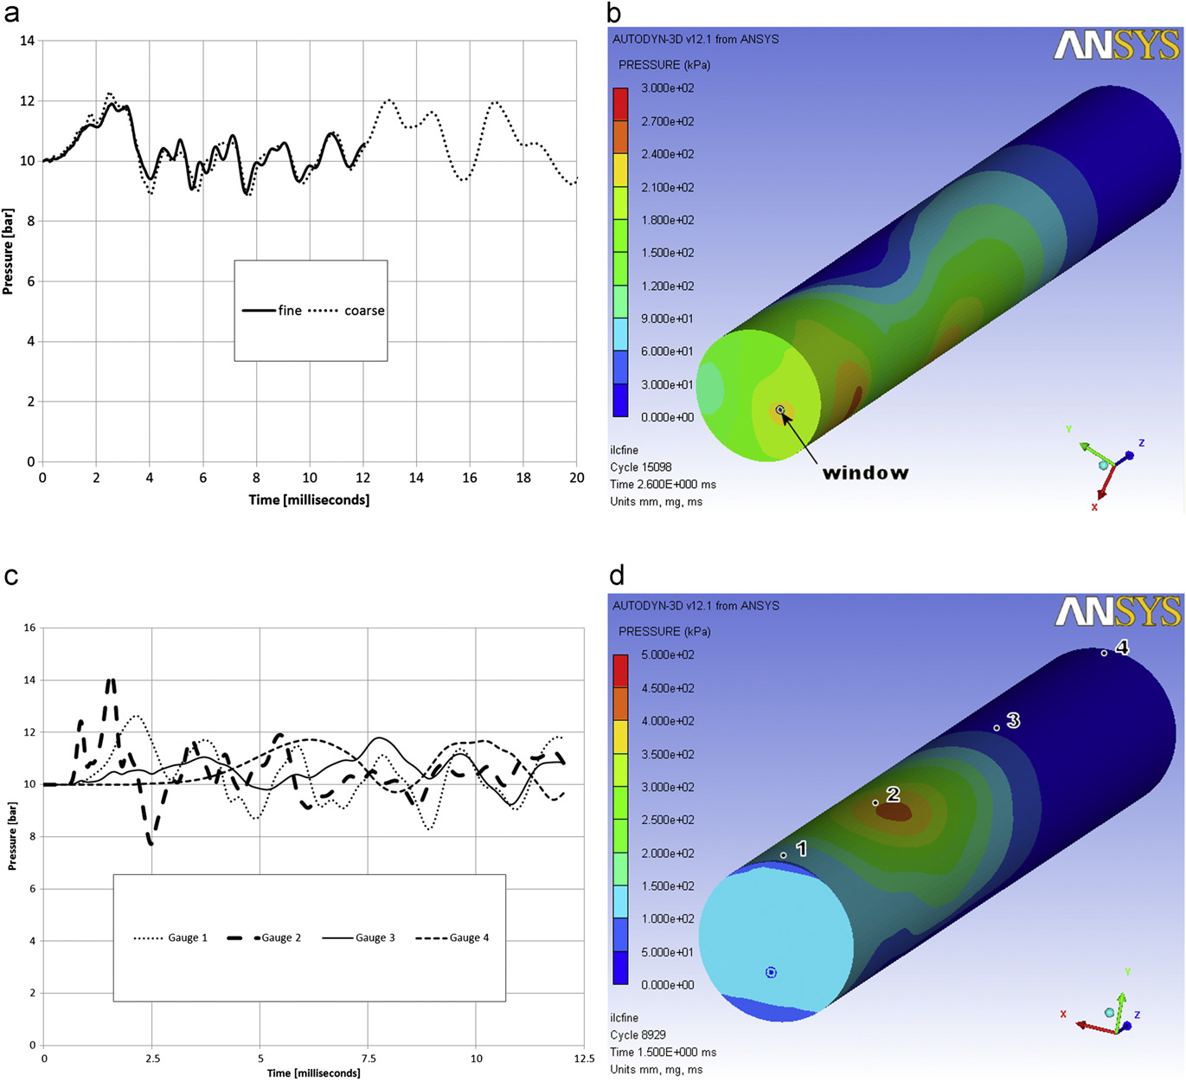

Pressure Waves at the Window-Water Interface. No Cavitation expected.
$$∆P\sim 2−3 bar$$

Slide 42
Water Dumps
Prevent boiling by pressure preload. No phase change.
Pressure waves governed by classical wave equation in an «elasic» continuum,involving:
Volume forces due to pressure gradients, mass inertia, thermal expansion, compressibility.
Fast beam impacts lead to ionisation, spallation, rapid heating, high local pressure rises,……
Can this still lead to rapid depleation of water density, local boiling, cavitation,…..during the beam pulse?
Are these phenomena reliably included in the codes?

Slide 43
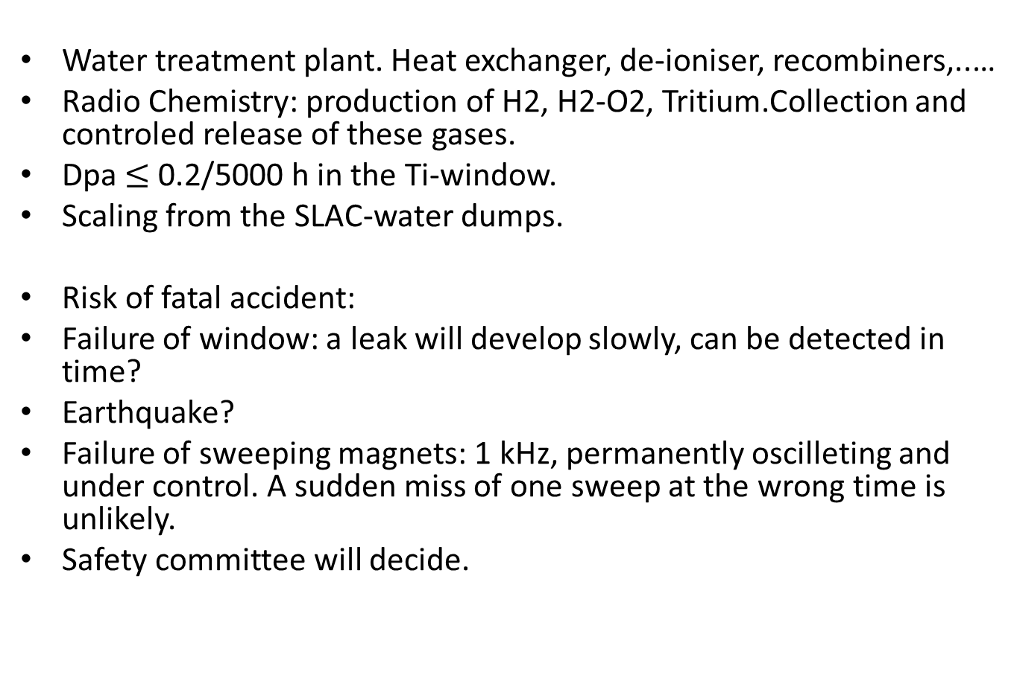
Water treatment plant. Heat exchanger, de-ioniser, recombiners,..…
Radio Chemistry: production of H2, H2-O2, Tritium.Collection and controled release of these gases.
Dpa $≤$0.2/5000 h in the Ti-window.
Scaling from the SLAC-water dumps.
Risk of fatal accident:
Failure of window: a leak will develop slowly, can be detected in time?
Earthquake?
Failure of sweeping magnets: 1 kHz, permanently oscilleting and under control. A sudden miss of one sweep at the wrong time is unlikely.
Safety committee will decide.

Slide 44
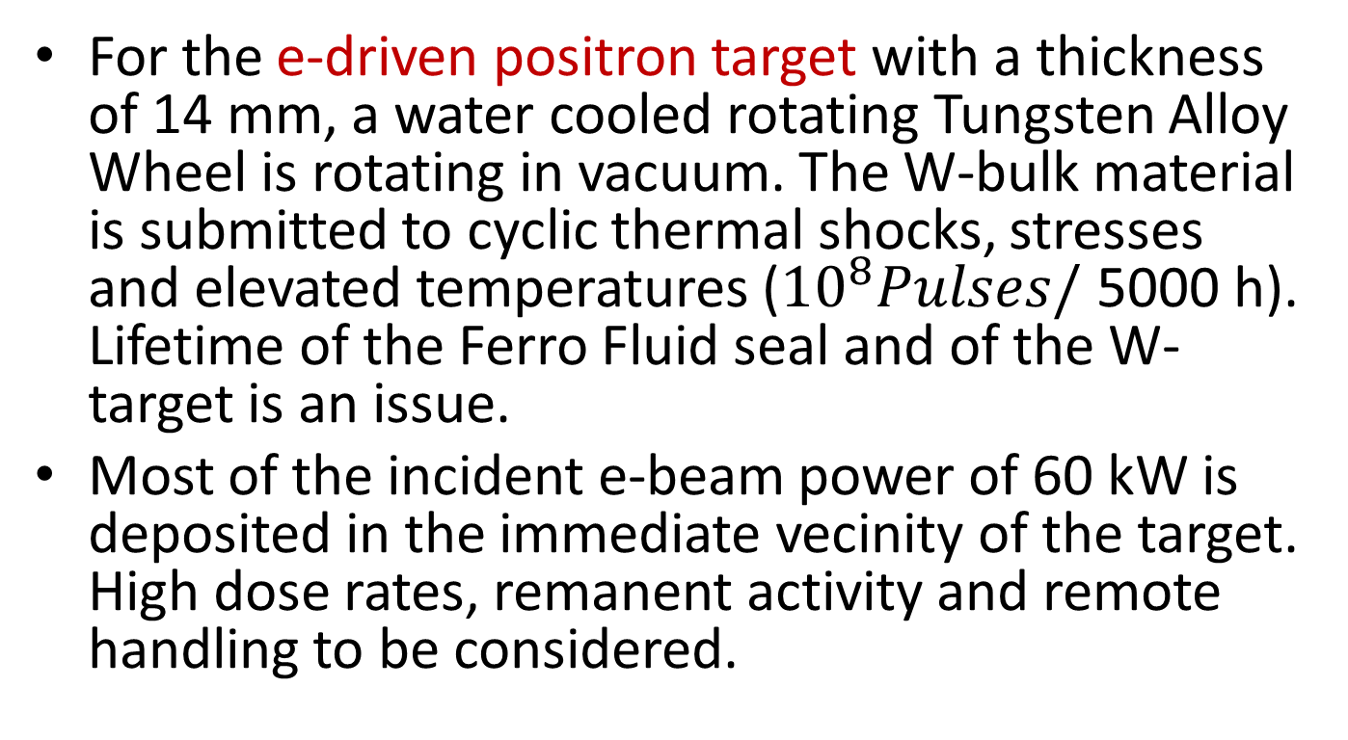
6.-Comments and Conclusions.
For the e-driven positron target with a thickness of 14 mm, a water cooled rotating Tungsten Alloy Wheel is rotating in vacuum. The W-bulk material is submitted to cyclic thermal shocks, stresses and elevated temperatures (${10}^{8}Pulses/$ 5000 h). Lifetime of the Ferro Fluid seal and of the W-target is an issue.
Most of the incident e-beam power of 60 kW is deposited in the immediate vecinity of the target. High dose rates, remanent activity and remote handling to be considered.

Slide 45
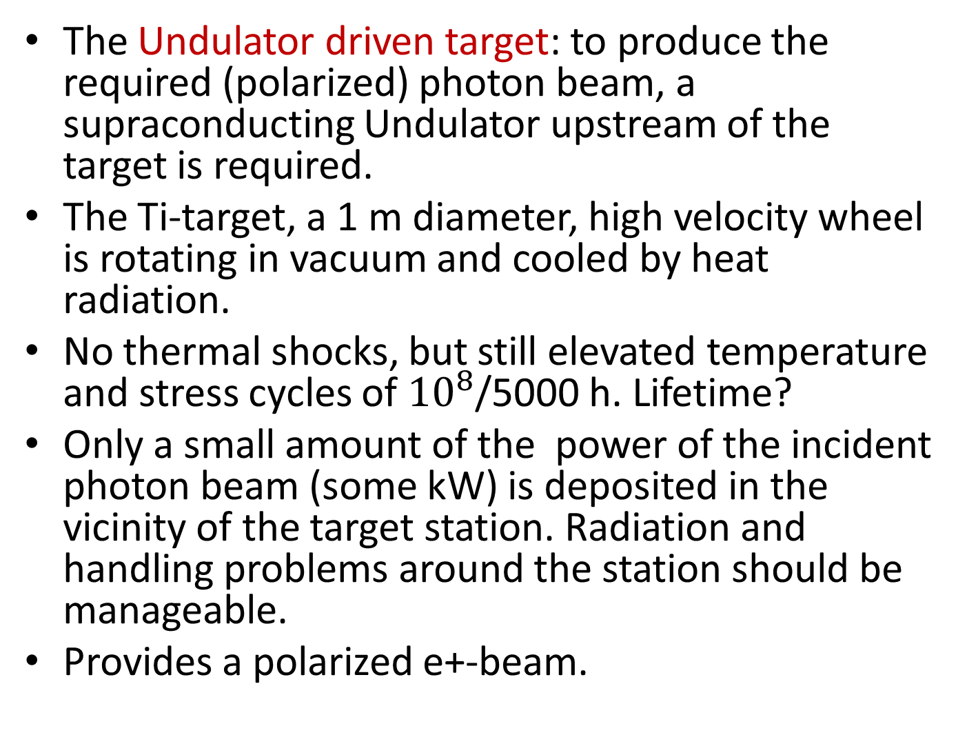
The Undulator driven target: to produce the required (polarized) photon beam, a supraconducting Undulator upstream of the target is required.
The Ti-target, a 1 m diameter, high velocity wheel is rotating in vacuum and cooled by heat radiation.
No thermal shocks, but still elevated temperature and stress cycles of ${10}^{8}$/5000 h. Lifetime?
Only a small amount of the power of the incident photon beam (some kW) is deposited in the vicinity of the target station. Radiation and handling problems around the station should be manageable.
Provides a polarized e+-beam.

Slide 46
For the Undulator scheme, a particular design of the Photon Dump is required.
A Graphite dump, without beam window, and a water dump, with a thin Ti-vacuum window, are being studied at present.
The Main Dumps for the up to 17 MW spent e-and e+ beams, swept across a vacuum window into water, look feasible.
The risk of catastrophic failure of the window, should be acceptable , by tight controls and interlocks.

Slide 47
Material Tests for the ILC at HighRadMat?
Lifetime of Ti- and W-Bulk material.
Lifetime of thin Ti- (Be) vacuum windows. In-plane stress waves and axial buckling vibrations.
Response of water to beam pulses. Not very popular! But to rely only on “classical” hydrocodes and simulations?
Can effects, induced by electrons and photons reliably be benchmarked by GeV-protons?
How reliable are the codes (FLUKA, GEANT,…) for very small beams (µm) and with extremely short time bins (ns)?
Support a Hot Lab for timely inspection and post mortem tests somewhere near the beam test facility for fast feed back.

Slide 48
Thanks are due to the Members of the Positron Working Group:
Report on the ILC Positron Source. May 23, 2018.
Convenor and Editor: K. Yokoya-KEK.
Thank You for Your Attention!

Slide 49
Back Ups

Slide 50
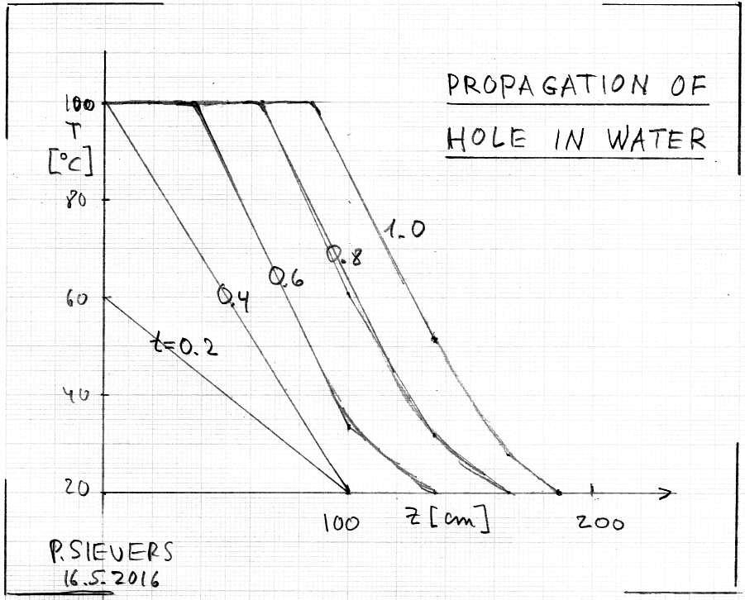
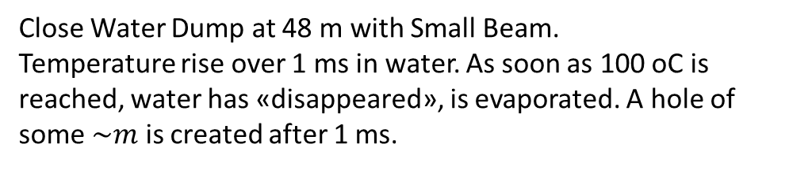
Close Water Dump at 48 m with Small Beam.
Temperature rise over 1 ms in water. As soon as 100 oC is reached, water has «disappeared», is evaporated. A hole of some $\sim m$ is created after 1 ms.
0.6, no evaporation

Slide 51
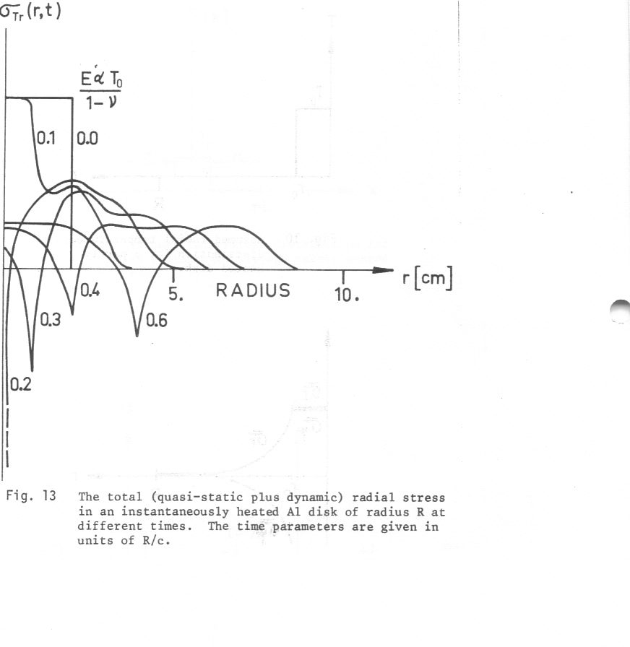
Backups

Slide 52
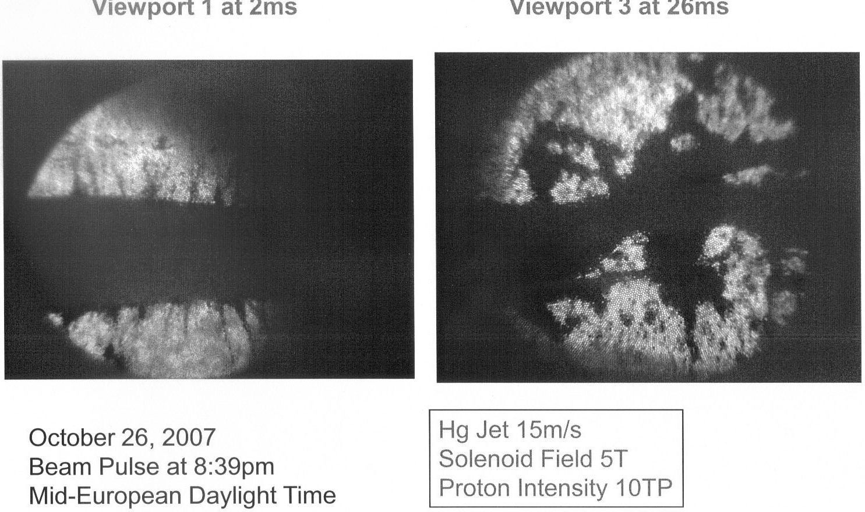
Free Hg-Jet in Beam

Slide 53
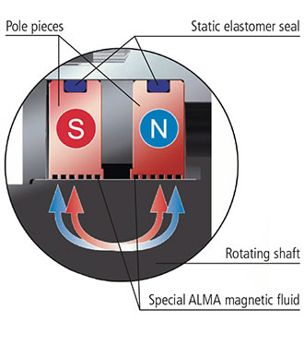
Ferro Fluid Seal-ALMA/D

Slide 54
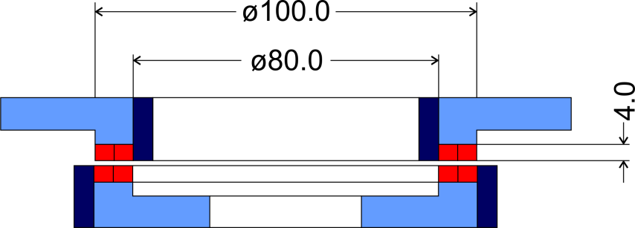
Magnetic Bearings.
Juelich Forschungszentrum/D
Weight of 100 kg supported by 0.2 kg ferromagnetic material.

