Slide 2
Beam Dump Facility (BDF)
Beam instrumentation requirements
Y. Dutheil, C. Hessler

Slide 3
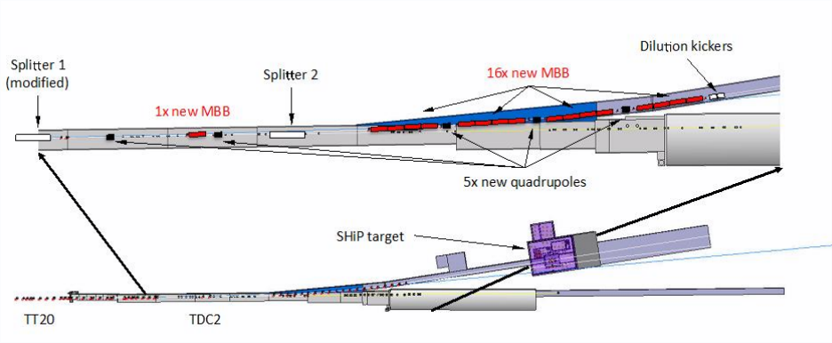
Beam line design: overview
New splitter replaces the first splitter (MSSB.211713 to MSSB.211732) to allow for fast switching between the new and existing lines.
Beam dilution system to reduce maximum energy density on target and made of horizontal and vertical dipoles.
Beam line design and integration:
  Optics, magnet choice and
  powering schemes.
  Instrumentation decision.
  Error study and correction
  schemes.
  Failure study and interlock
  procedures.
[1] TT20 for BDF: splitters and TL design, indico.cern.ch/category/8700/, 2017
[2] Extraction and beam transfer for the SHiP facility, https://edms.cern.ch/document/1495859/1.1

Slide 4
Beam parameters
  Energy : 400GeV
  Cycle length : 7.2s
  Spill length : 1s
[1] TT20 for BDF: splitters and TL design, indico.cern.ch/category/8700/, 2017
[2] Extraction and beam transfer for the SHiP facility, https://edms.cern.ch/document/1495859/1.1

Slide 5
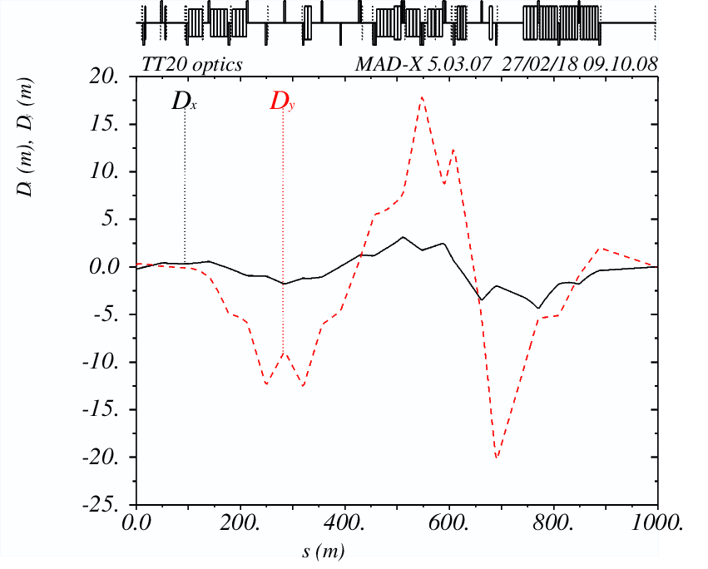
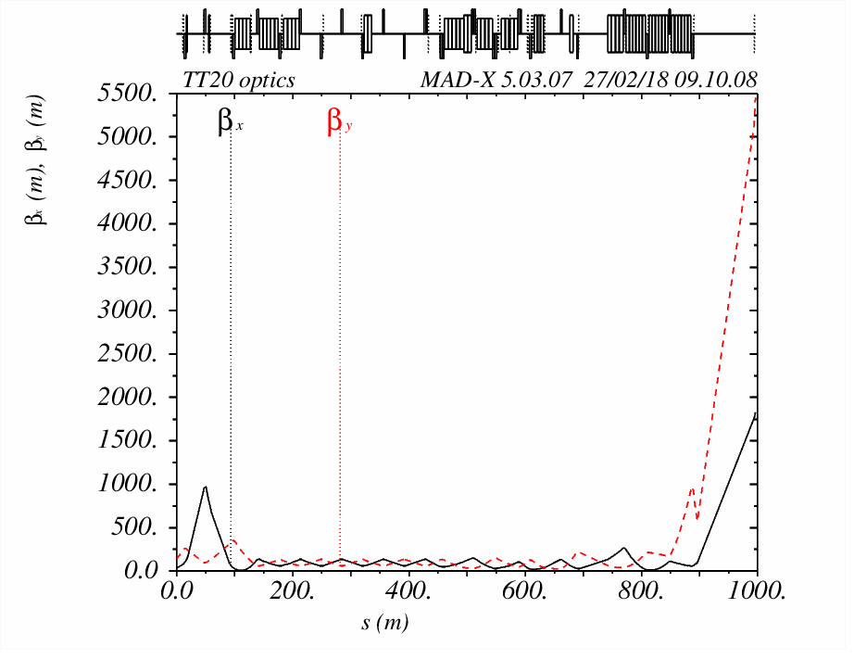
Optics
FODO lattice
Beam radius (1σ) at target: 8 mm
Dispersion suppressed at target
Beam size small

Slide 6
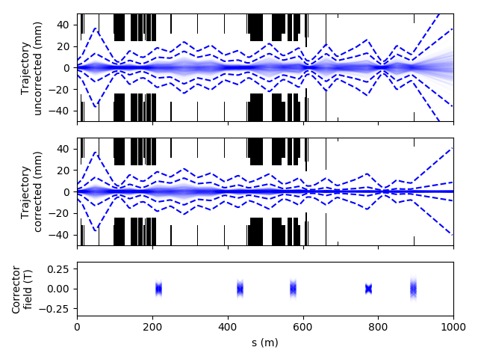
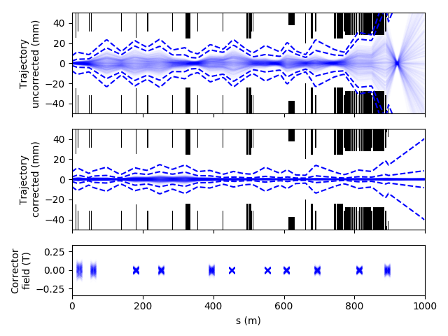
Trajectory correction study
5 beam position monitors. Characteristics to be determined
No corrector or monitor between the new splitter and the second quadrupole of the new line due to limited space between existing and new lines.
Vertical plane, 3 new correctors
Horizontal plane, 2 new correctors

Slide 7
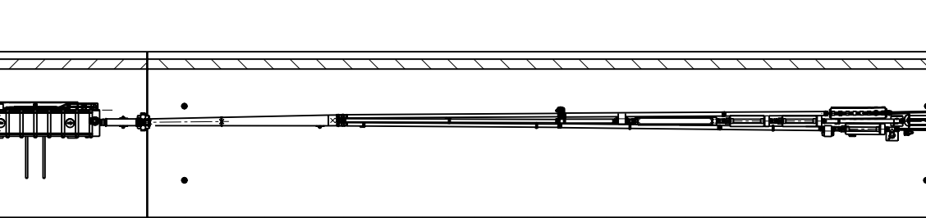
BI BSGV.220075
First splitter
Needs new design, larger tank
Cost ?

Slide 8
BDF line requirements
6 (4 locations) new profile and position monitors in existing TT21
10(5 locations) new profile and position monitors in new BDF line
1 Full 2D monitoring, screen-type
1 beam current monitor
A target beam monitoring system
Beam loss monitors, 9 in total

Slide 9
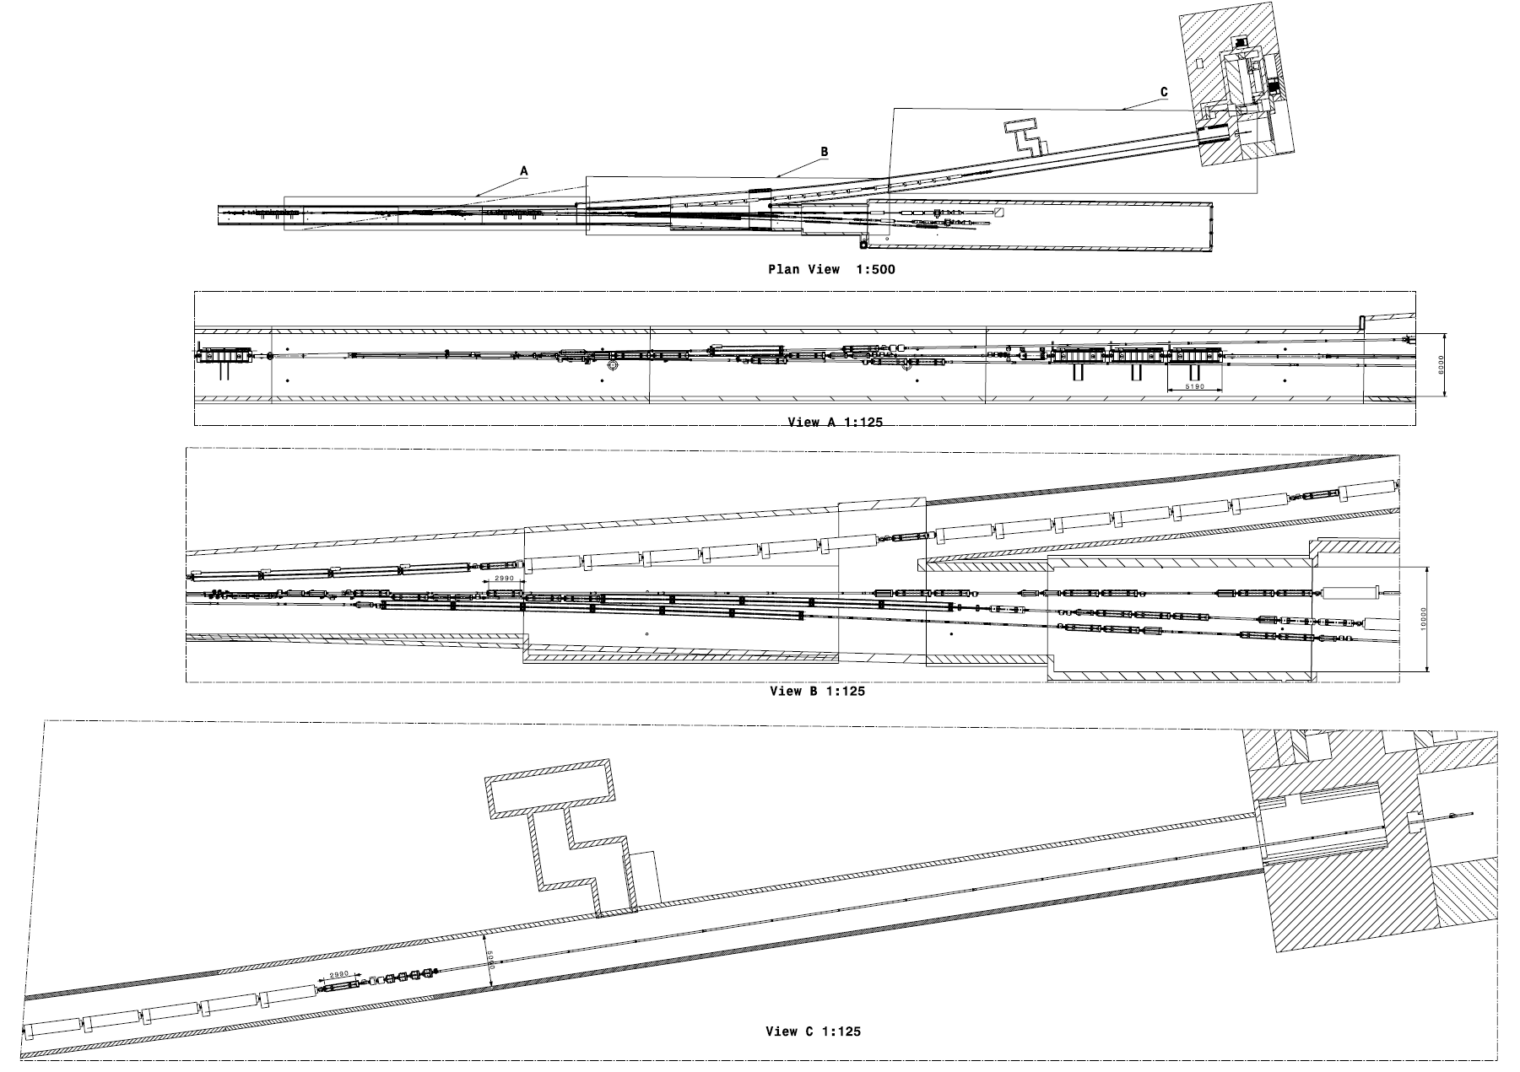
Beam size/position monitors
Loss monitors
.02
.04
.04
.03
.05

Slide 10
Timeline
30th of November
  Cost estimate needed for annex to executive summary for the European commission. To be sent by M. Lamont by 18th of December.
  Cost estimates needs to account for racks, cable, devices, everything, as much as possible. Any estimation will be the best available.
7th of December
  Write-up, for a final submission of the yellow report early 2019.
  Available on overleaf

Slide 11
Thank you

