Slide 1
Experiment IS550 P-344:
Study of the di-nuclear system ^{A}Rb + ²⁰⁹Bi (Z₁ + Z₂ = 120)
Status report
SPOKESPERSON:
Sophia Heinz
GSI Helmholtzzentrum and Justus-Liebig-Universität Gießen, Germany
Eduard Kozulin
Joint Institute for Nuclear Research, Dubna
ISOLDE and Neutron Time-of-Flight Experiments Committee
60th meeting of the INTC
7th and 8th November 2018
CERN, Geneva

Slide 2
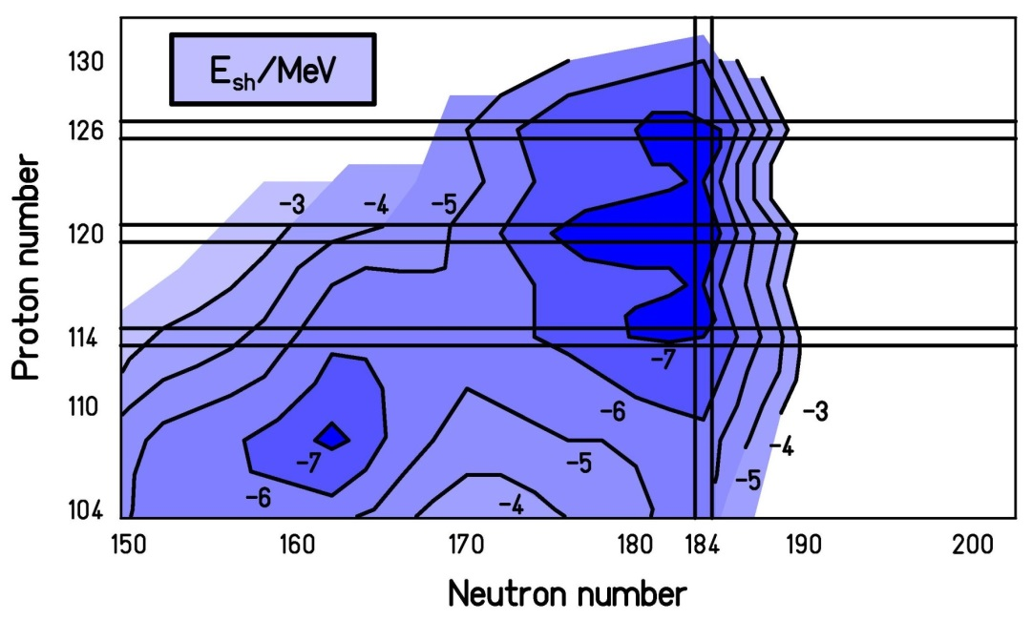
Magic numbers in superheavy nuclei ?
N=184 ?
Z=126 ?
Z=120 ?
Z=114 ?
● fusion with stable projectiles
fusion with RIBs

Slide 3
Magic numbers in superheavy nuclei ?
Problem:
▪ Nuclear systems with N = 184 cannot be reached in fusion reactions with stable beams
▪ Fusion reactions with RIBs lead to N=184, but beam intensities are too small for cross-sections σ < 1 pb
Approach:
Study of quasi-fission and fusion-fission with RIBs

Slide 4
The Fusion Process in Heavy Systems
~100 mb
capture
FUSION
Compound
Nucleus (CN)
QUASI-FISSION (QF)
FUSION-FISSION (FF)
Fission
Fragments
Evaporation
Residue (ER)
σ_{ER} = σ_{capture} ∙ P_{CN} ∙ P_{survival}
Superheavy systems: σ_{ER} << σ_{capture}
→ σ_{capture} ≈ σ_{QF} + σ_{FF} ≈ 100 mb

Slide 5
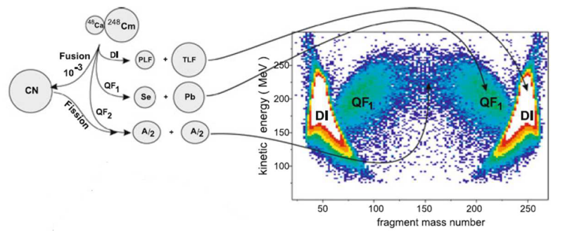
Shell effects are revealed by QF and FF products
FF
Experimental realization:
Study of mass and energy distributions of QF and FF products
as a function of projectile neutron number and beam energy.

Slide 6
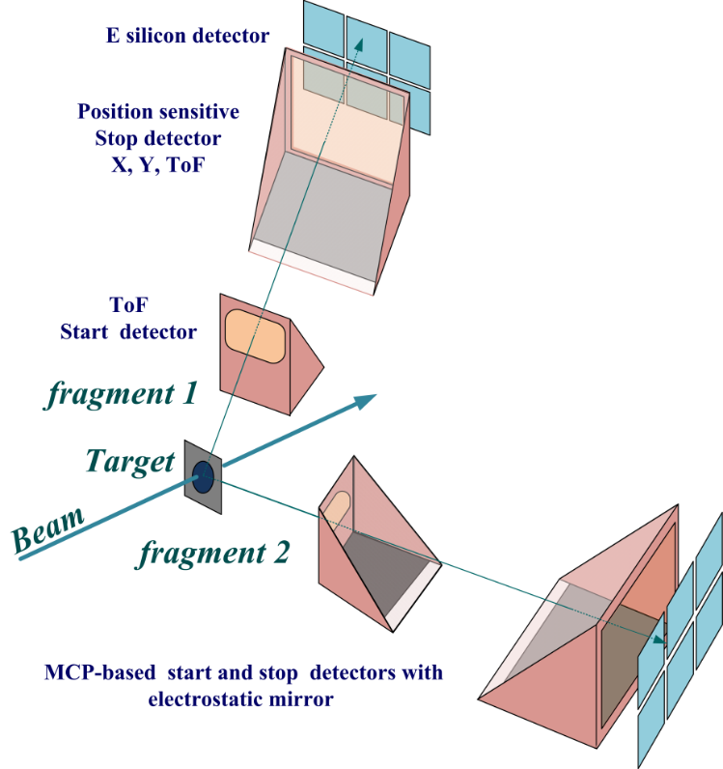
ToF-E spectrometer (CORSET)
Time resolution | 150-180 ps
ToF base | 10-30 cm
ToF arm rotation range | 15°-165°
Solid angle | 100 -200 msr
Angular resolution | 0.3°
Mass resolution | 2-4 u
Energy resolution | 1%
Measured parameters:
ToF, X, Y, energy of each fragment
Extracted parameters :
Velocity, energy, angles and mass of each fragment
TKE
Notes:
The two-arm time-of-flight spectrometer CORSET has been developed at the Flerov Laboratory of Nuclear Reactions to study the mechanisms of reactions with heavy ions.
The spectrometer consists of two identical TOF arms, which measure the velocities of both fragments of reactions. Each arm of the spectrometer consists of a compact start detector and a position-sensitive stop detector, based on microchannel plates.
The high time and angular resolutions of the spectrometer permit the setting of minimum TOF distances (up to 10 cm) without significant deterioration of the spectrometer as a convenient trigger of fission fragments in correlation measurements of neutrons and γ rays in 4π spectrometers, such as GASP, EUROBALL, GAMMA-SPHERE, and DEMON.
The CORSET Spectrometer
Typical Configuration and Characteristics

Slide 7
Approved Beamtime
Requested Beamtime (INTC, October 2012):
Projectile | ^{85,87}Rb (stable) | ^{A}Rb (neutron-rich)
beam energy | ~ 5 MeV/u | ~ (5 – 6) MeV/u
experiment | Tuning of the setup | Excitation functions for QF, FF
shifts | 6 | 3 x 12
Beamtime recommended by INTC: 12 shifts of n-rich Rb

Slide 8
Technical
Upgrades / Developments
for the run at HIE-ISOLDE

Slide 9
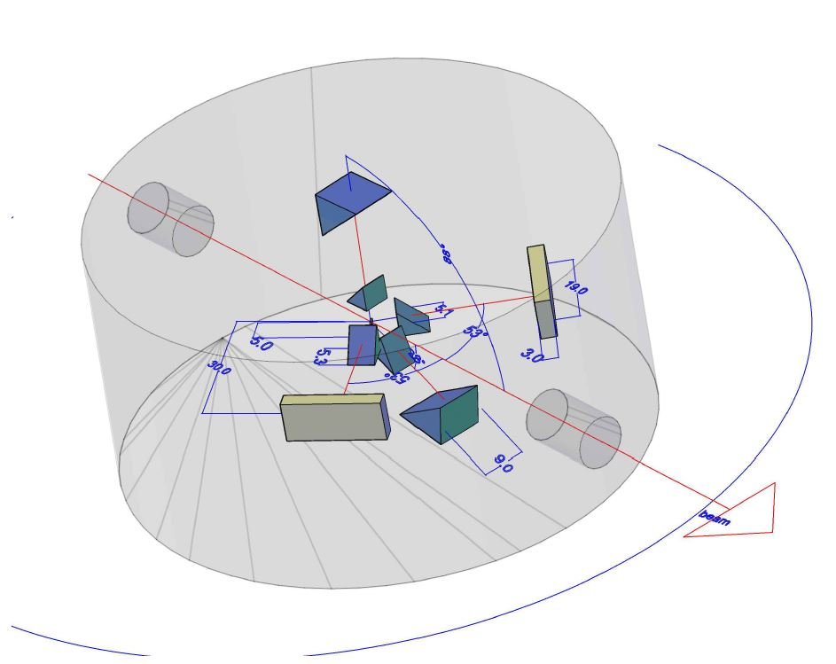
Two additional detector arms
NEW SETUP GEOMETRY

Slide 10
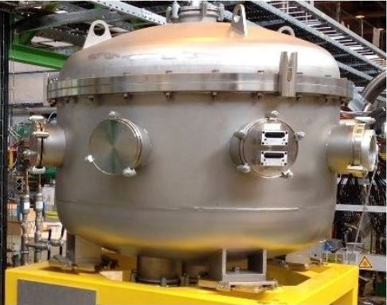
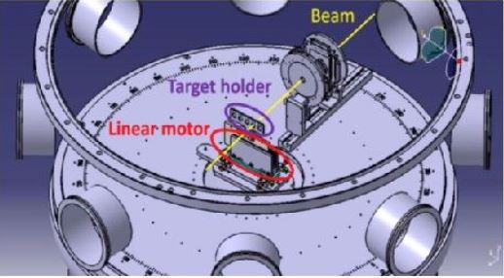
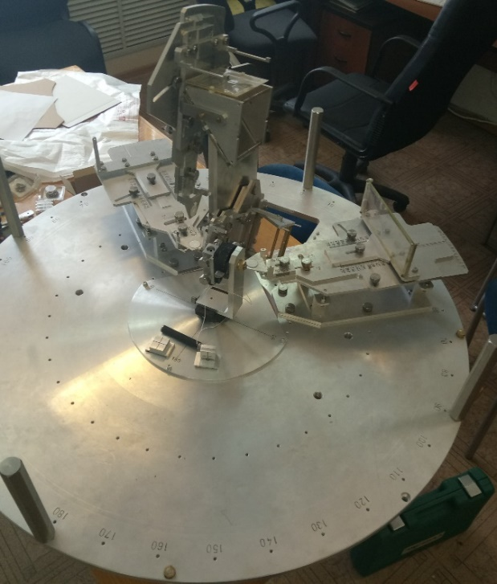
Scattering Experimental Chamber
S E C @ XT03 beamline of HIE-ISOLDE
Disc with suport
structure for the ToF
and DSSD
+ feedthrough for target stick

Slide 11

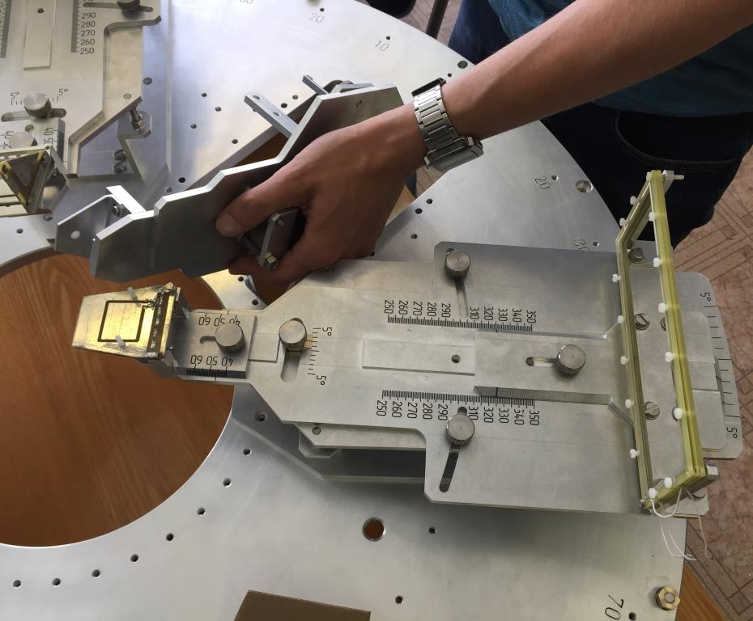
New components
1) Electronics (Dubna)
2) DAQ system
3) Mechanics: support disc
4) Support structure for the ToF
and DSSD
5) Feedthrough for Target stick
Tested at GSI
August 2018
100% Ready

Slide 12
Rate Estimate
Cross section: 100mb
Beam Intensity: 10⁶ pps
Target Thickness: 2x10¹⁸ atom/cm²
Efficiency ~ 0.1 (CORSET)
#Events/s :0,2 event/s = 20000 event/day
#Events (total in 4 days): 80000 events

Slide 13
Status of Experiment
Remaining shifts: 12 / 12
Physics case still relevant? yes
HIE-ISOLDE still unique for this study
in >2021 ? yes

Slide 14
Z = 120
The mass and energy distributions of binary fragments formed in the reactions ⁵²Cr + ²⁴⁸Cm, ⁵⁸Fe + ²⁴⁴Pu, and ⁶⁴Ni + ²³⁸U, leading to the formation of composite systems with Z = 120 at energies above the Bass barrier.
From top to bottom: the M-TKE matrices of binary reaction products; the mass distributions and the average total kinetic energy as a function of mass of fissionlike fragments inside the contour line on M-TKE matrices

Slide 15
Z = 120
The mass and energy distributions of binary fragments formed in the reactions ⁵²Cr + ²⁴⁸Cm, ⁵⁸Fe + ²⁴⁴Pu, and ⁶⁴Ni + ²³⁸U, leading to the formation of composite systems with Z = 120 at energies above the Bass barrier.
From top to bottom: the M-TKE matrices of binary reaction products; the mass distributions; the average total kinetic energy and its variance as a function of mass of fissionlike fragments inside the contour line on M-TKE matrices

Slide 16
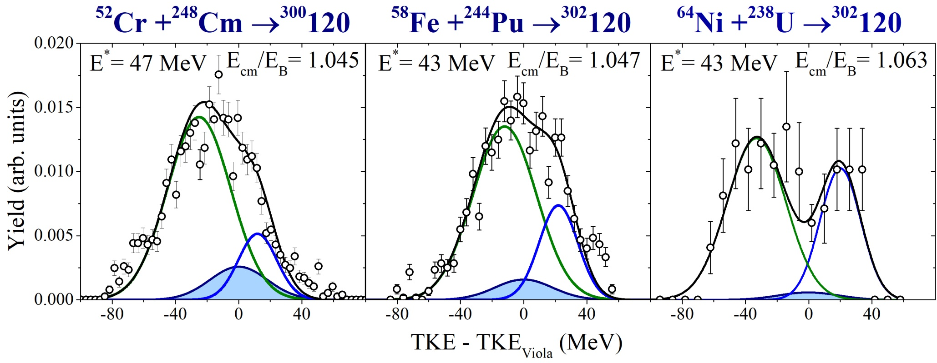
TKE distribution of symmetric fragments
E.M. Kozulin et al., Physical Letters B 686, (2010) 227-232.
Notes:
In figure the TKE distributions of the fragments in the mass region A_{CN}/2 ± 20 u are presented for the reaction ⁴⁸Ca + ²³⁸U at E_{lab} = 232 MeV, ⁵⁸Fe + ²⁴⁴Pu at E_{lab} = 328 MeV and for the reaction ⁶⁴Ni + ²³⁸U at E_{lab} = 358 MeV. It seen that TKE distributions have a complex structure which is not consistent with only CNF. Thus, in these reactions the mass-symmetric fragments may be formed by different modes: either as a result of CNF or symmetric QF processes or as a tail of asymmetric QF process. Notice that the TKE distribution in the case of 48Ca+238U has a maximum at energy predicted by Viola systematics for CN 0f 112 element and contribution of this component is about 65%. In contrast to the Ca reaction in the case of Ni reaction we observe a minimum in the region of TKE where we expect the fission fragment of CN of 120 element according to the Viola systematics. You can see the decomposition of TKE distributions for symmetric fragments into components associated with CNF, QF_{asym} and QF_{sym}. This provides a method to estimate capture and CNF cross sections. CNF covers about 2% and 0.2% of the TKE distribution for the composite systems ³⁰²120. Clearly the system ⁶⁴Ni + ²³⁸U is the one less suitable to produce element Z = 120.

Slide 17
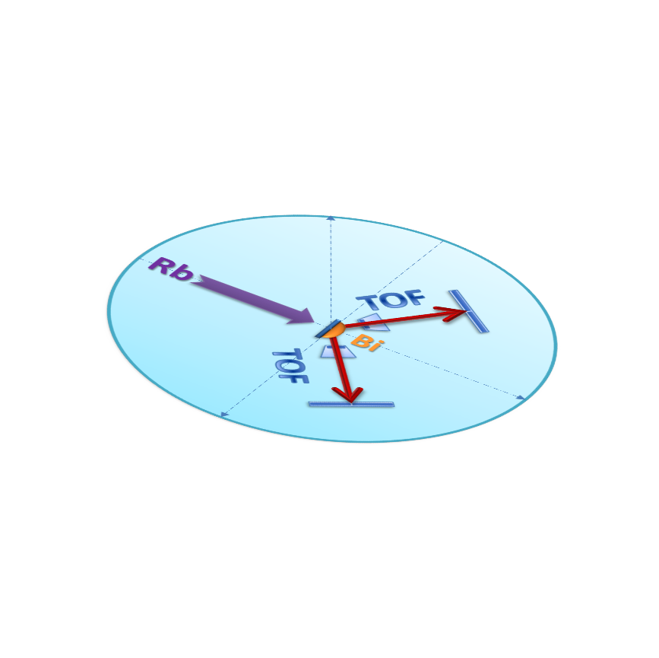
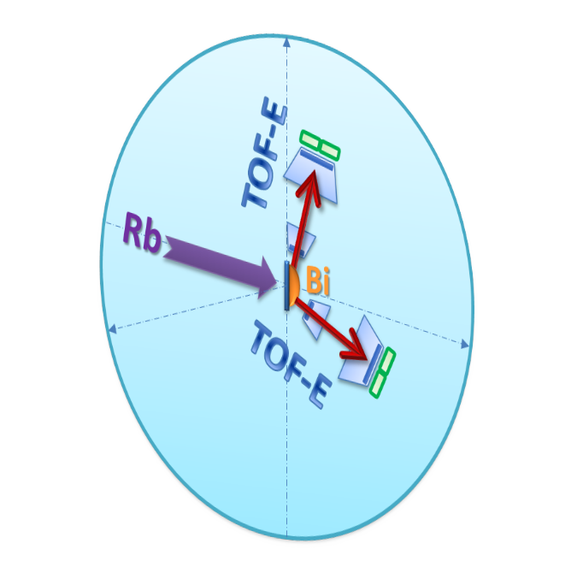
CORSET
The main CORSET characteristics
Time resolution | 150-180 ps
ToF base | 10-30 cm
Arm rotation range | 15°-165°
Solid angle | 100-200 msr
Angular resolution | 0.3°
Mass resolution | 2-4 u
Energy resolution | ±2%

Slide 18
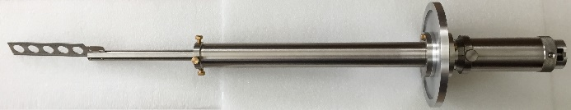
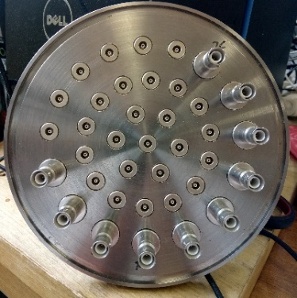
Frame holder
Flange DN160
with 27 LEMO
and
10 SHV connectors

Slide 19
⁹⁵Rb + ²⁰⁹Bi, E_{lab}= 450 MeV
Detector 9x7 cm²
TOF base = 20 cm
Detector 18x7 cm²
TOF base = 25 c
Split ±3мм
Registration efficiency
of the hole set of detectors

Slide 20
⁹⁵Rb + ²⁰⁹Bi, E_{lab}= 450 MeV
Detector 9x7 cm²
TOF base = 20 cm
Detector 18x7 cm²
TOF base = 25 c
Split ±3мм
Registration efficiency
of the hole set of detectors

Slide 21
⁹⁵Rb + ²⁰⁹Bi, E_{lab}= 495 MeV
Registration efficiency of the whole set of detectors

Slide 22
ALTERNATIVE A IS550 95 Rb Arrive in June 10 days for mechanics set-up DAQ and Calibration 5 days RUN July Dismount IS616 Set-up GLORIA August Run Early September IS561 Set up end September RUN October | ALTERNATIVE B IS561 9Li (t,p) Setup June RUN Early July IS616 Set-up GLORIA August Run Early September IS550 95 Rb Arrive in mid September 10 days for mechanics set-up DAQ and Calibration 5 days RUN October Dismount

Slide 23
Within the current project to prepare to the IS550 experiment
the following was performed:
New detectors based on the microchannel plates (MCP) to measure fragments velocities using time-of-flight (TOF) technic were designed and produced. The registration efficiency of these detectors increased 2 times.
To measure fragments energy (TOF-E technic) strip detectors were added in each arm of the spectrometer. The use of strip detectors and TOF-E method allows to increase considerably the quality and reliability of the experimental data.
New reaction chamber was designed and produced.
Meetings and workshops with colleagues from CERN (Geneve), GSI (Darmstadt, Germany) and the Department of Physics of Jyvaskyla University (Jyvaskyla, Finland) to discuss preliminary experimental data obtained using upgraded CORSET setup as well as the preparations to the experiment at HIE-ISOLDE CERN and optimization of the experimental conditions were hold.
Preliminary tuning and calibration of the CORSET spectrometer to prepare completely to the experiment at CERN were performed at the Department of Physics of Jyvaskyla University.
The CORSET spectrometer and electronics were transported to CERN and GSI during the reporting period.
The experiment was was planned for October-November 2018 year.

