Slide 1
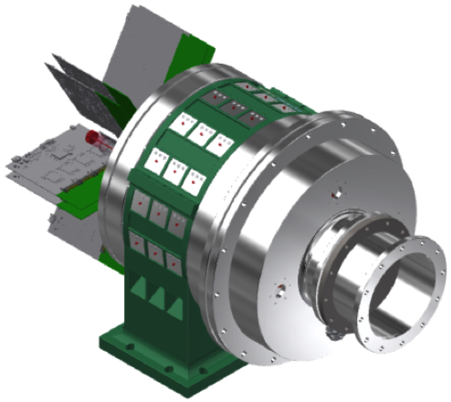
SpecMAT
Spectroscopy of exotic nuclei
in a Magnetic Active Target
Riccardo Raabe
KU Leuven, Instituut voor Kern- en Stralingsfysica

Slide 2
The active-target method
Time-Projection Chamber (TPC)
+ gas is the target
  Full 3D track reconstruction
  High luminosity,
  keeping energy resolution
  Energy of stopped particles
  Particle identification
  Versatile:
  different gases, pressures, configurations
  ancillary detectors
LOI I-119

Slide 3
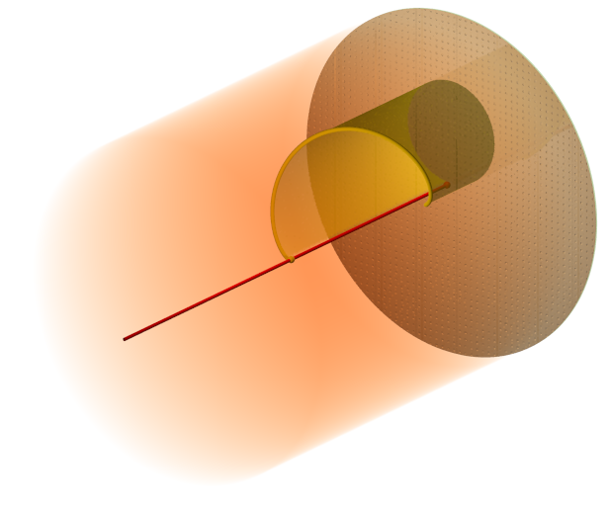
The active-target method
Time-Projection Chamber (TPC)
+ gas is the target
  Full 3D track reconstruction
  High luminosity,
  keeping energy resolution
  Energy of stopped particles
  Particle identification
  Versatile:
  different gases, pressures, configurations
  ancillary detectors
  SpecMAT:
  Magnetic field parallel to the beam direction
  Drift field parallel to magnetic field

Slide 4
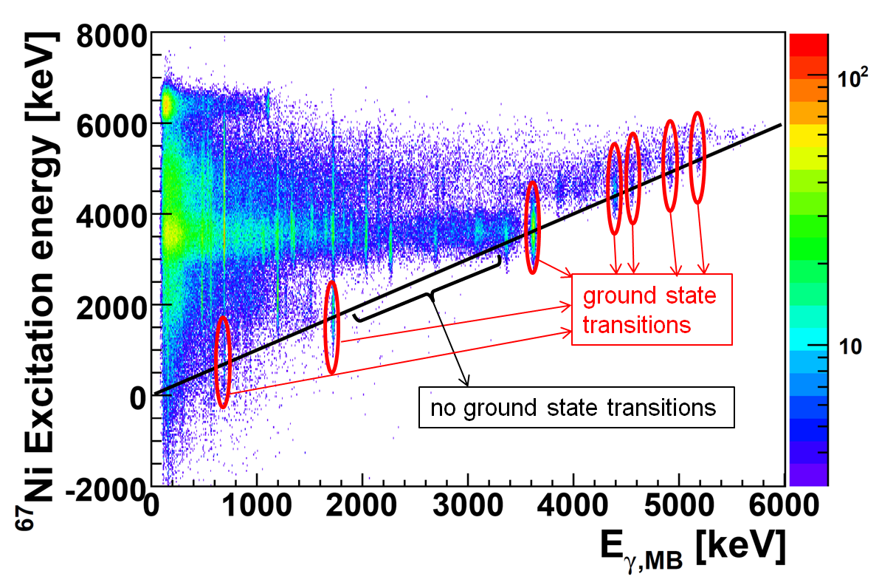
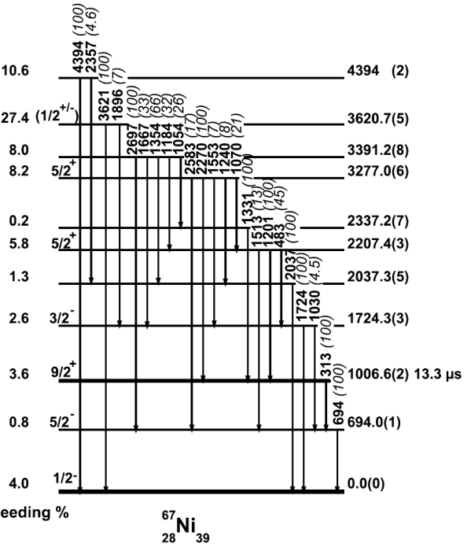
The active-target method
𝛾-ray detection
  CeBr₃ scintillators:
  good efficiency and resolution
  Si photomultipliers
J. Diriken et al., PLB 736, 533 (2014)
J. Diriken et al., PRC 91, 054321 (2015)
`

Slide 5
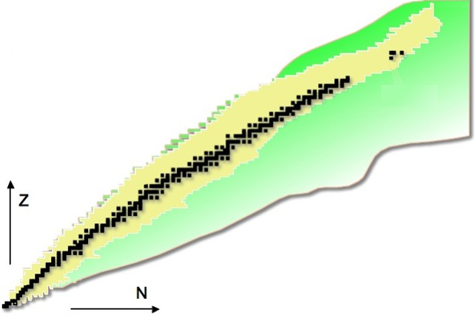
Physics goals
Changes
in nuclear structure
far from stability
  Shell evolution
  towards ⁷⁸Ni
  Shape coexistence
  “west” of ²⁰⁸Pb
stable nuclei
observed nuclei
unknown nuclei (predicted)
82
²⁰⁸Pb
50
126
28
⁷⁸Ni
82
20
50
8
20
28
2
8

Slide 6
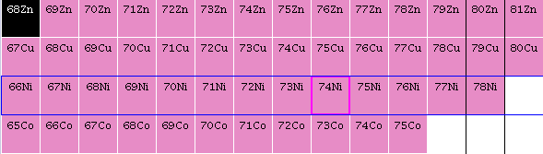
Shell evolution towards ⁷⁸Ni
  Migration of πf_{7/2}, πf_{5/2}
  as νg_{9/2} is filled
  (tensor interaction)
K. Flanagan et al.,
PRL 103 (2009) 142501

Slide 7
Shell evolution towards ⁷⁸Ni
  Migration of πf_{7/2}, πf_{5/2}
  as νg_{9/2} is filled
  (tensor interaction)
Proposal P-495: ^{72,74,76}Zn(d,³He)
to directly measure the f_{7/2}-f_{5/2} gap
LOI I-191
K. Flanagan et al.,
PRL 103 (2009) 142501

Slide 8
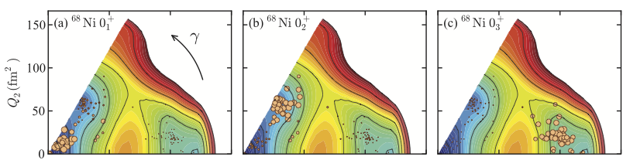


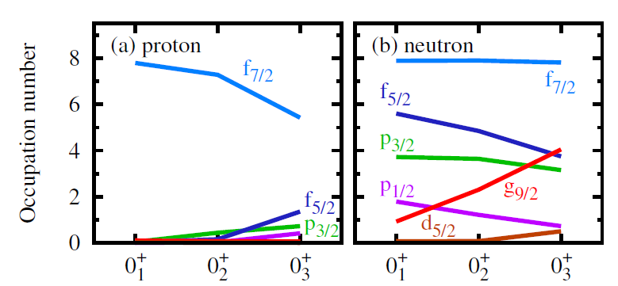

Shell evolution and shape coexistence
Y Tsunoda, T Otsuka et al., PRC 89 (2014) 031301
⁶⁸Ni

Slide 9
Shell evolution and shape coexistence
Y Tsunoda, T Otsuka et al., PRC 89 (2014) 031301
T Otsuka and Y Tsunoda, JPG 43 (2016) 024009
⁶⁸Ni

Slide 10
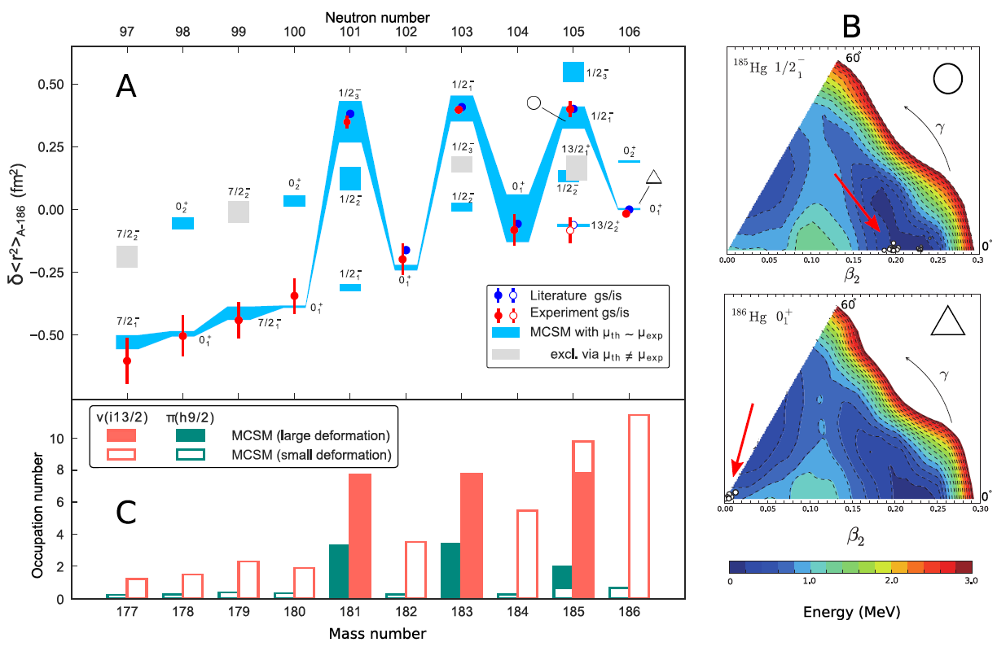
The n-deficient Pb region
B A Marsh et al., Nature Physics (2018)
Hg

Slide 11
The n-deficient Pb region
  Transfer reactions in Hg
  ^{185g,m}Hg (d,p), (p,d), (α,³He)
  Beam intensity ≈ 10⁵ pps → feasible!
Data: NNDC, figure courtesy of Liam Gaffney
Original figure in R. Julin et al.,
J. Phys. G 27 (2001) R109

Slide 12
The n-deficient Pb region
  Transfer reactions in Hg
  ^{185g,m}Hg (d,p) and (p,d)
  Beam intensity ≈ 10⁵ pps → feasible!
LOI I-195
Data: NNDC, figure courtesy of Liam Gaffney
Original figure in R. Julin et al.,
J. Phys. G 27 (2001) R109

Slide 13
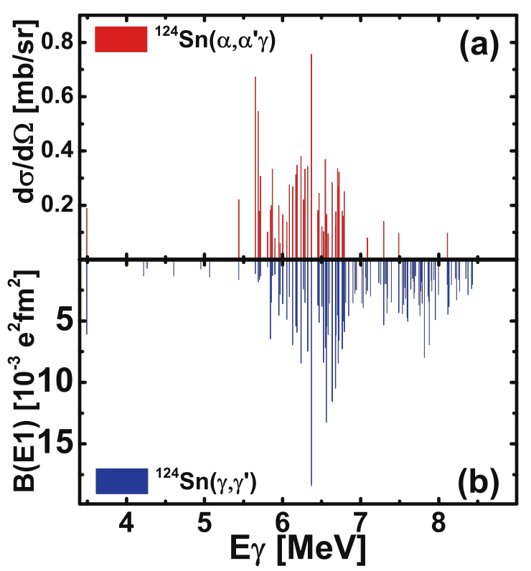
Study of the Pigmy Dipole Resonance
  Low-energy dipole strength
  First observation in 1961
  𝛾 rays from neutron capture
  G.A. Bartholomew, Annu. Rev. Nucl. Sci. 11 (1961) 259
  First use of “pygmy resonance” (PDR)
  J.S. Brzosko et al., Can. J. Phys 47 (1969) 2849
  Description as a collective excitation
  Mohan et al., Phys. Rev. C 3 (1971) 1740
  “Three-Fluid Hydrodynamical Model of Nuclei”:
  Neutron excess oscillates against the N=Z core
  Different experimental probes
  to investigate the isospin nature of these states
isoscalar
isoscalar+
isovector
  Figure A. Bracco et al.,
  Eur. Phys. J. A 51 (2015) 99
  Data from K. Govaert et al.,
  Phys. Rev. C 57 (1998) 2229
  and J. Endres et al.,
  Phys. Rev. C 85 (2012) 064331

Slide 14
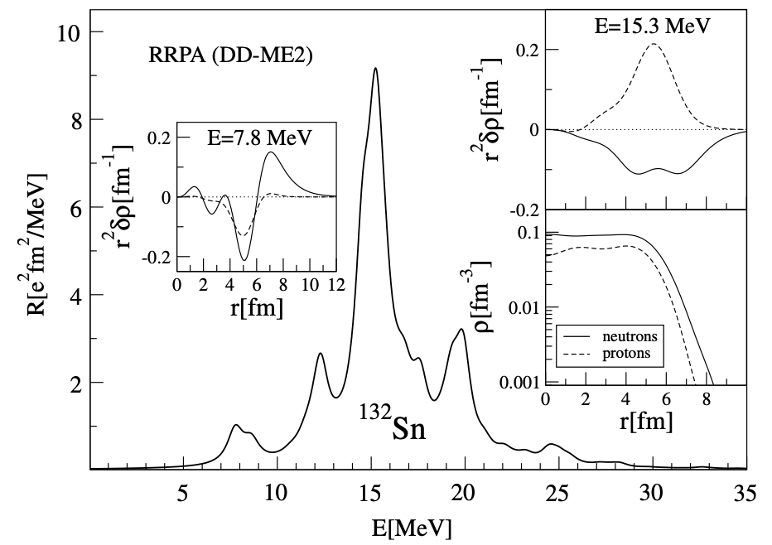
Study of the Pigmy Dipole Resonance
  D. Vretenar et al., J. Phys. G 35 (2008) 014039
IVGDR
PDR
Core in phase
+neutron skin

Slide 15
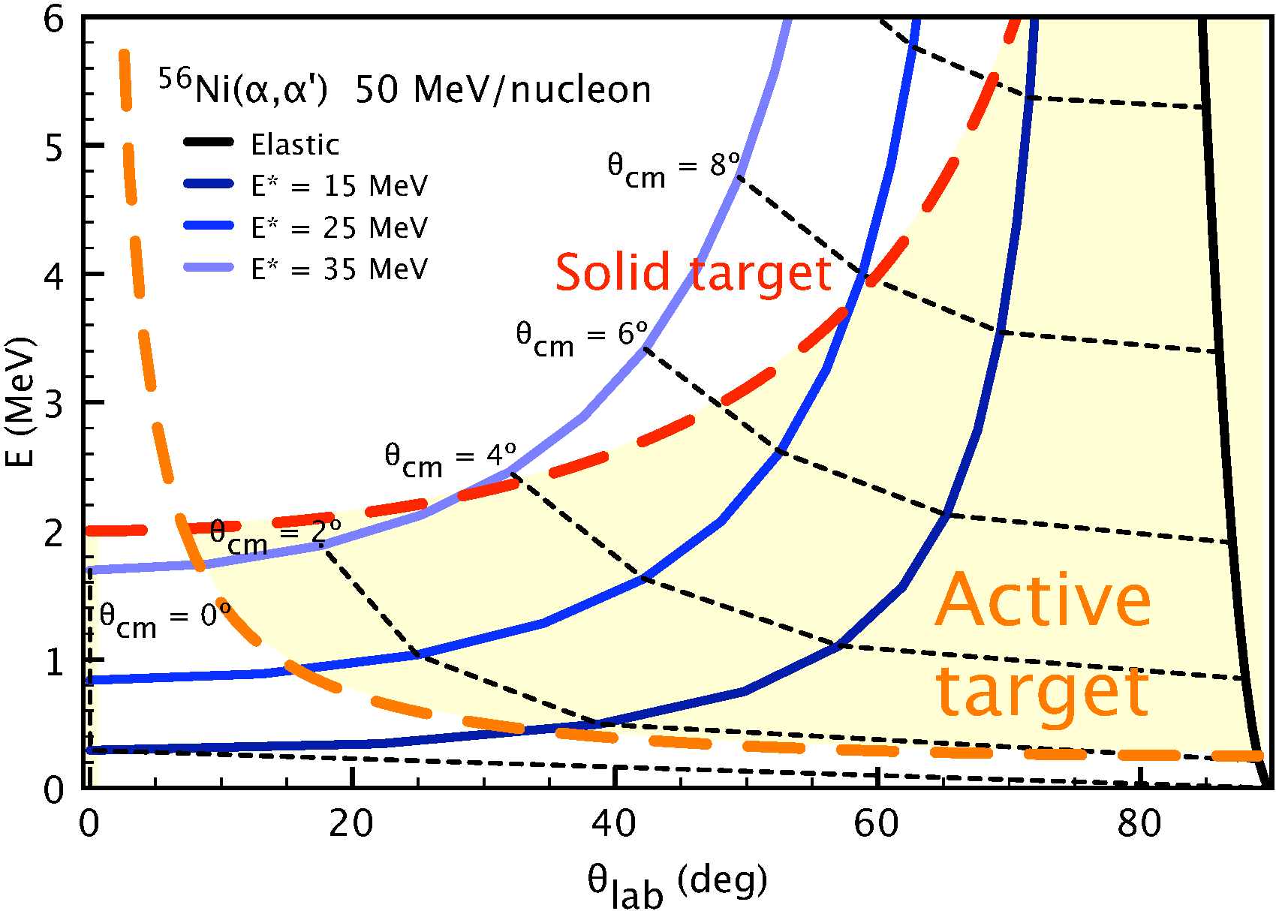
Study of the Pigmy Dipole Resonance
  Isoscalar probe:
  (α,α’) inelastic scattering
  SpecMAT:
  𝛾 rays from decay of bound states
  Cases: ⁹⁰Sr, ¹⁹⁴Hg, ^{146,148,150}Gd
  ≈10 MeV/nucleon
LOI I-194

Slide 16
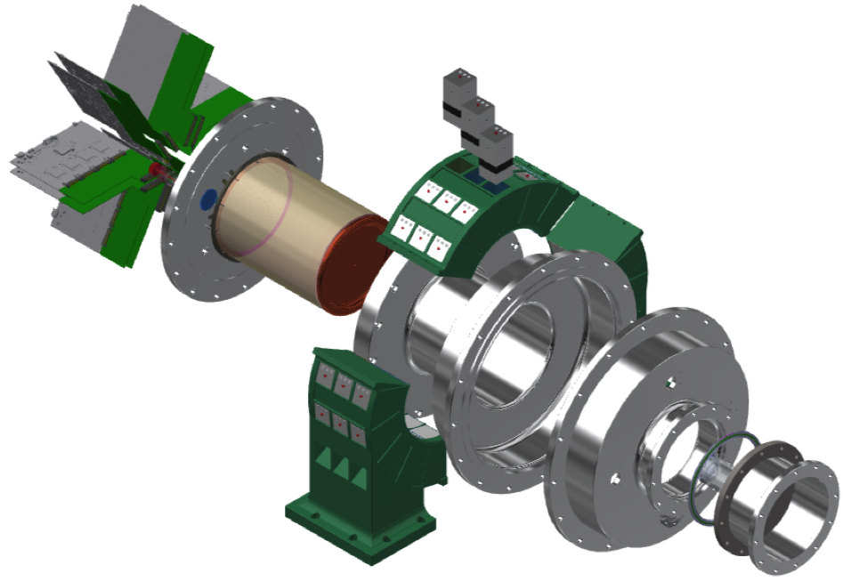
Status
Design: O. Poleshchuk, KU Leuven
  GET Electronics (2048 channels): purchased and commissioned
  Pad plane and field cage
  designed in CERN (EP-DT-DD MPT)
  to be ordered shortly
  Chamber finalized
  and ordered
  Scintillators + SiPMs purchased,
  commissioning ongoing
  48x48x48 mm³
  Photopeak efficiency 8% at 1 MeV
  Nominal resolution 3.9% at 661 keV
  No degradation in 3-T magnetic field

Slide 17
Status
Design: O. Poleshchuk, KU Leuven
  GET Electronics (2048 channels): purchased and commissioned
  Pad plane and field cage
  designed in CERN (EP-DT-DD MPT)
  to be ordered shortly
  Chamber finalized
  and ordered
  Scintillators + SiPMs purchased,
  commissioning ongoing
  48x48x48 mm³
  Photopeak efficiency 8% at 1 MeV
  Nominal resolution 3.9% at 661 keV
  No degradation in 3-T magnetic field

Slide 18
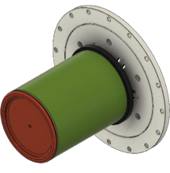
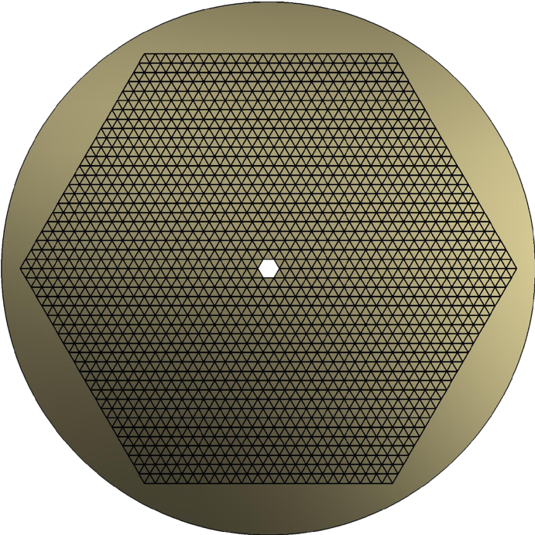
Status
Design: O. Poleshchuk, KU Leuven
  GET Electronics (2048 channels): purchased and commissioned
  Pad plane and field cage
  designed in CERN (EP-DT-DD MPT)
  to be ordered shortly
  Chamber finalized
  and ordered
  Scintillators + SiPMs purchased,
  commissioning ongoing
  48x48x48 mm³
  Photopeak efficiency 8% at 1 MeV
  Nominal resolution 3.9% at 661 keV
  No degradation in 3-T magnetic field

Slide 19
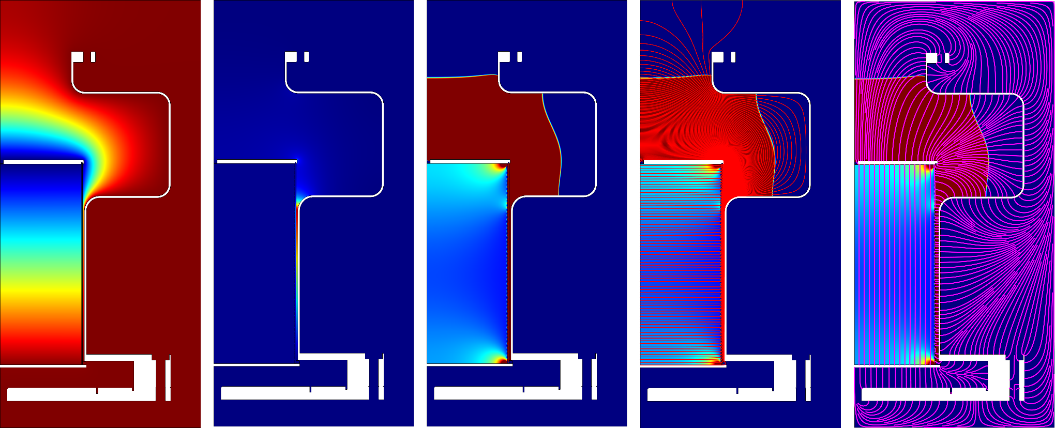
Status
Design: O. Poleshchuk, KU Leuven
  GET Electronics (2048 channels): purchased and commissioned
  Pad plane and field cage
  designed in CERN (EP-DT-DD MPT)
  to be ordered shortly
  Chamber finalized
  and ordered
  Scintillators + SiPMs purchased,
  commissioning ongoing
  48x48x48 mm³
  Photopeak efficiency 8% at 1 MeV
  Nominal resolution 3.9% at 661 keV
  No degradation in 3-T magnetic field
  Simulations for:
  electric field, mechanical stress, gas flow

Slide 20
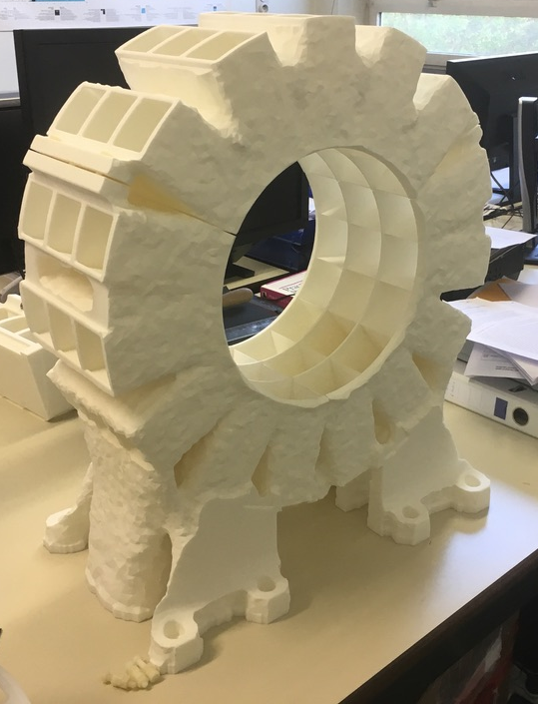
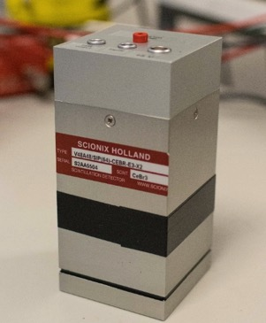
Status
Design: O. Poleshchuk, KU Leuven
  GET Electronics (2048 channels): purchased and commissioned
  Pad plane and field cage
  designed in CERN (EP-DT-DD MPT)
  to be ordered shortly
  Chamber finalized
  and ordered
  Scintillators + SiPMs purchased,
  commissioning ongoing
  48x48x48 mm³
  Photopeak efficiency 8% at 1 MeV
  Nominal resolution 3.9% at 661 keV
  No degradation in 3-T magnetic field

Slide 21
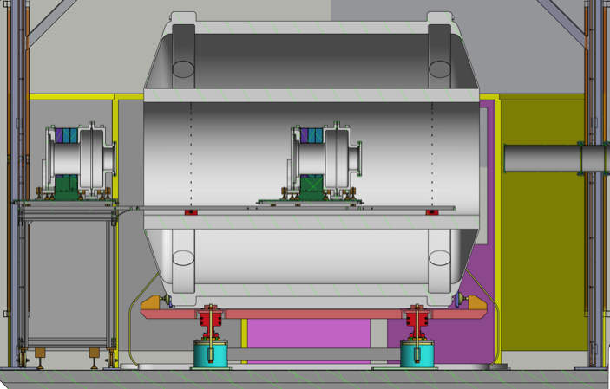
Installation
  Installation through a platform
  and rails from the back of the ISS
  Cables (8m) running to the
  electronics racks
  outside the cage
  To be coordinated
  with the installation
  of the new ISS array

Slide 22
Planning
  January – March 2019:
  characterisation of the full system
  Characterisation of the 𝛾-ray array
  Leak tests of the detector chamber
  Commissioning of the gas control system
  Tests of the electric field cage
  Characterisation of particle tracks
  2019 Move to CERN
  Safety clearance
  Installation

Slide 23
Summary
  Thanks to the SpecMAT team!
  A. Arokja Raj, H. De Witte, O. Poleshchuk, J. Refsgaard, M. Renaud, J. Yang
  With us in the past: S. Ceruti, M. Babo, T. Marchi, C. Swartz
  The research leading to these results has received funding from the
  European Research Council under the European Union's Seventh
  Framework Programme (FP/2007-2013) / ERC Grant Agreement n. 617156

