Slide 1

Beams Department
Overview and purchasing plans
Javier Serrano, CERN BE-CO-HT
Spain at CERN, 13 November 2018
With help from Ronny Billen, Frank Gerigk, Lars Jensen, Thibaut Lefevre, Alessandra Lombardi, Anna Mackney, Eric Montesinos, Pierre Ninin, Suitbert Ramberger, Marc Vanden Eynden, Fernando Varela and Tomasz Włostowski.

Slide 2
BE Organization, 2018
Department Head: P. Collier
Deputy: M. Lamont
Head of Department’s Office
(BE-HDO)
P.Collier
Admin., Safety and Resources
(BE-ASR)
R. Billen
7
5
Activities
Operation/Exploitation:
Machines,
Technical Infrastructure
Experimental Areas
Site Access & Safety Systems
Projects:
Consolidation
Upgrades
Approved Projects
Studies:
New Facilities and machines
Accelerators & Beam Physics
(BE-ABP)
G. Arduini
Beam Instrumentation
(BE-BI)
R. Jones
50
68
Controls
(BE-CO)
E. Hatziangeli
Industrial Controls & Safety Systems
(BE-ICS)
P. Sollander
61
61
Radio Frequency
(BE-RF)
E. Jensen
Operations
(BE-OP)
R.Steerenberg
92
84
DAO : J. Kotzian
DPO : R. Billen
DSO : M. Tavlet
DTO : E. Montesinos
RSO : F. Pirotte
HRA : S. Bott (HR)
428 Staff
(1st March 2018)

Slide 3
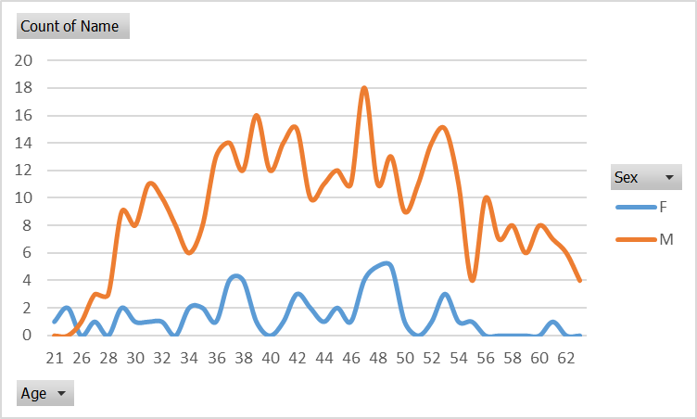
BE Department (March 2018)
 | Staff | %
Scientific and Engineering | 234 | 55
Technical and Technical Engineering | 182 | 42
Office and Admin | 13 | 3
Total | 428 | 100
Staff :
302 on IC contracts, 70 %
127 on LD contracts, 30 %
Primary Nationality | Number
AM | 2
AT | 17
AU | 3
BE | 20
BG | 4
BY | 1
CA | 1
CH | 51
CN | 7
CY | 3
CZ | 4
DE | 79
DK | 10
ES | 74
FI | 11
FR | 143
GB | 75
GR | 39
HU | 10
IN | 2
IR | 4
IR | 4
IT | 112
JP | 9
KR | 1
LB | 1
LK | 1
MT | 3
MX | 5
NL | 12
NO | 12
PK | 3
PL | 47
PS | 1
PT | 12
RO | 2
RS | 1
RU | 33
SE | 13
SK | 4
TR | 11
UA | 3
US | 12
43 Nationalities
 |  | %
Staff | 428 | 50
Fellows & Trainees | 142 | 16
Doctoral Students | 54 | 6
Technical Students | 48 | 6
Project Associates | 40 | 5
Other Associates | 149 | 17
Total | 861 | 100
Staff Age Profiles
F:13% M: 87%
+ 203 colleagues in Industrial support contracts
+ 64 colleagues in a partnership contract (ADAM)
Only half of all people working in BE are staff members – the other types of personnel are a vital resource to allow the department to fulfill its mandate

Slide 4

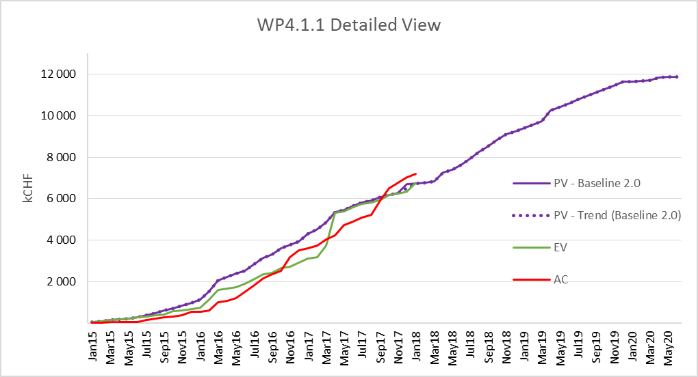



ASR: Administration, Resources & Safety Group
Responsible for:
The overall management and planning of departmental resources.
Safety in the beams Department and safety during operation of all beam facilities at CERN.
Group Leader
Ronny Billen

Slide 5
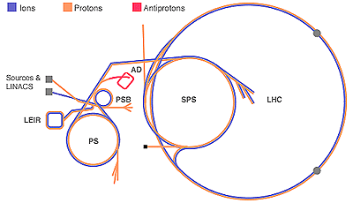
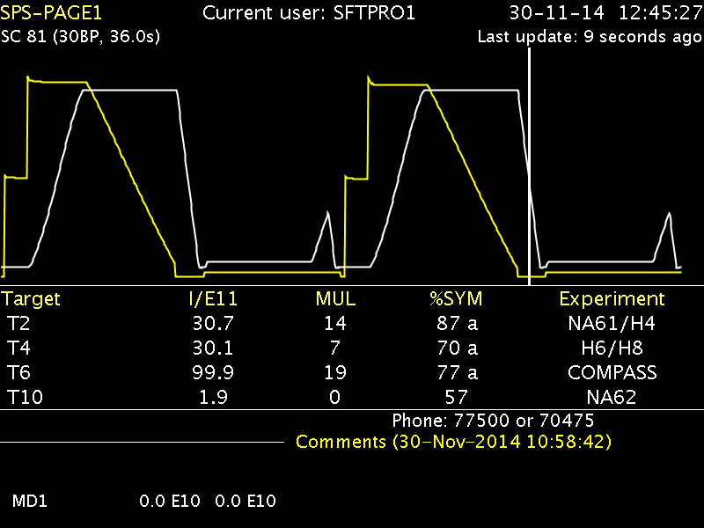
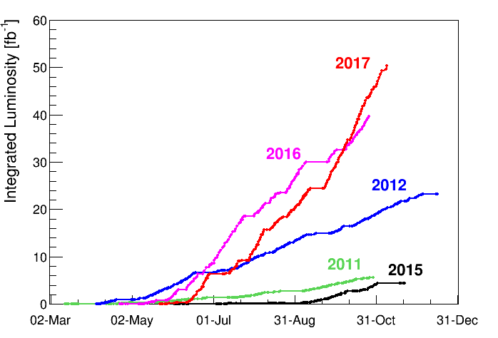
OP: Operations Group
Responsible for:
The co-ordination & operation of all CERN accelerators and experimental areas including safety and access in the installations.
Monitoring of technical infrastructure for the whole CERN site.
Wide range of additional activities including machine studies, application software, operational procedures & statistics.
Group Leader
Rende Steerenberg

Slide 6
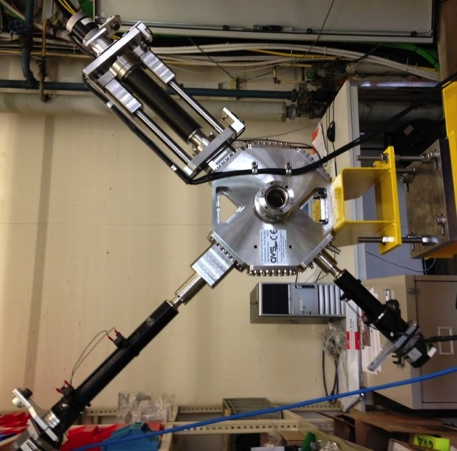
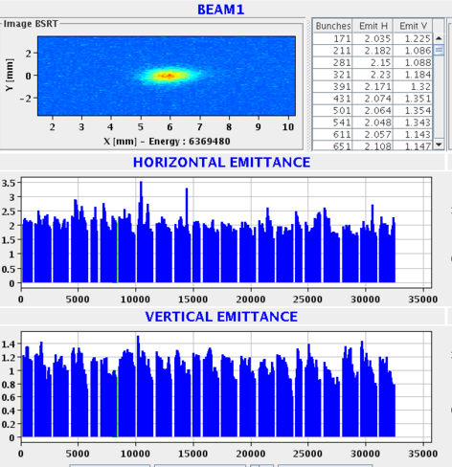
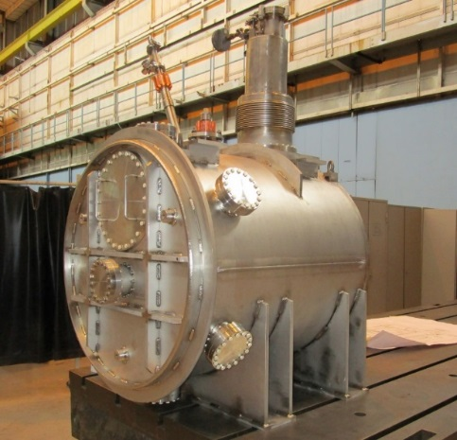

BI: Beam Instrumentation Group
Responsible for:
Designing, building and maintaining the instruments that allow observation of the particle beams and the measurement of related parameters for all CERN accelerators and transfer lines.
It is also engaged in research and development to improve existing detection techniques and explore new avenues to allow further optimization of the current machines and to meet the challenges associated with future accelerators.
Activities include: accelerator physics, detector technology, custom built electronics, mechanical and vacuum engineering for detector housings and software engineering.
HIE-Isolde Short DB
Group Leader
Rhodri Jones
AD Cryogenic Current Comparator

Slide 7
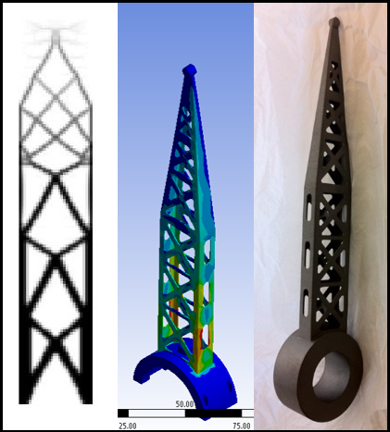
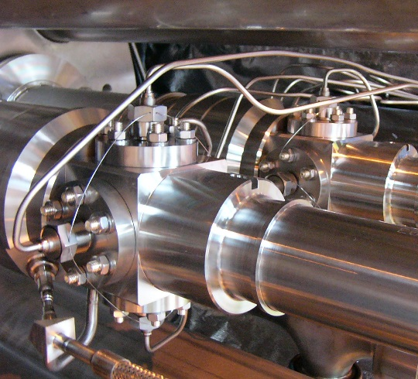
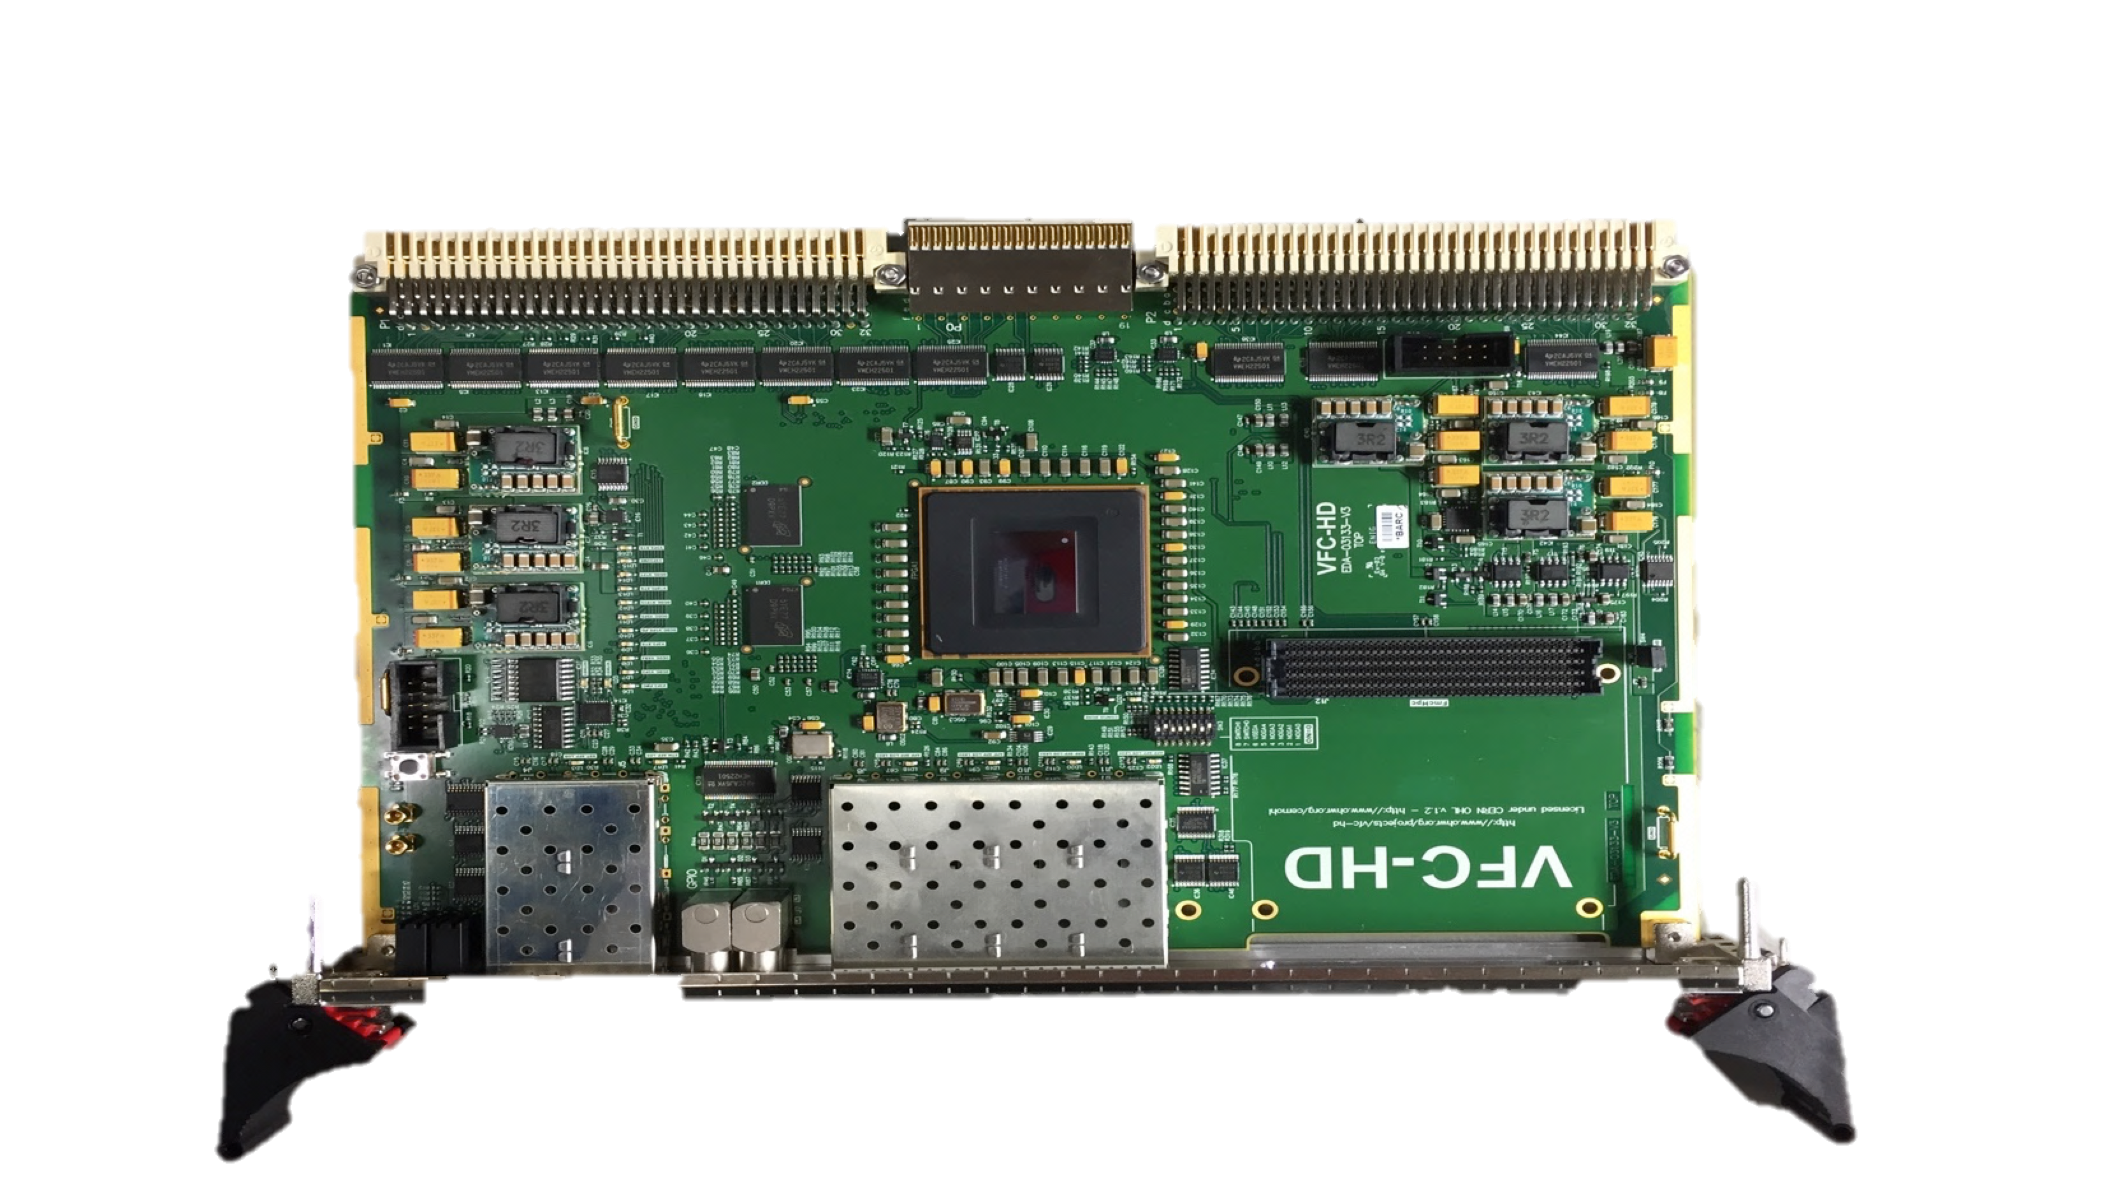
Collaboration with industry in BE-BI
Recent collaborations
Mechanics
Electronics
Cables
Structure optimisation for production using 3D machining: Titanium wire-scanner forks
Generic FMC carrier board. Large order recently placed for >1000 units
50 Ω co-axial RF cable to bring the signal from the cryostat to radiation-hard electronics

Slide 8
Collaboration with industry in BE-BI
Future known contracts
What | Units | Competencies required
Ionisation chambers (gas filled tubes) | 200 ⇒ 500 | Ceramics, mechanics, feedthroughs
Beam position monitors | ~250 | UHV, glass ceramics, RF (->5GHz)
HF semi-rigid cables | ~250 | Cable, RF technology and measurement
Imaging optical fibre bundles | 10 ⇒ 100 | Fibre-optic manufacturing and assembly
Radiation-hard cameras | 10 ⇒ 100 | Camera manufacturing or supply
Streak-cameras | 4 | Supply
PCB production | 10 ⇒ 3000 | Production, assembly and test
UHV systems | 1 ⇒ 20 | Precision machining, UHV
Magnetic Solenoid production | 3 | Magnet production, assembly and test
8

Slide 9
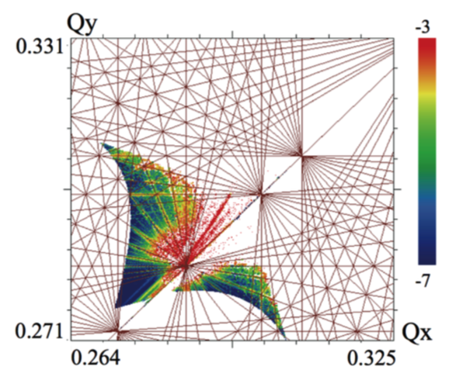
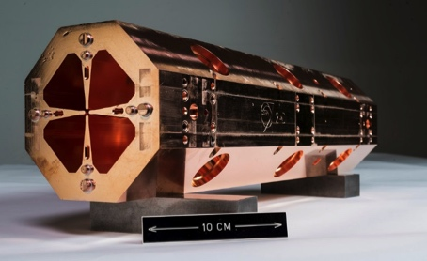
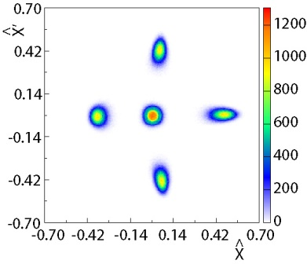
ABP: Accelerators and Beam Physics Group
Responsible for:
Accelerator Physics & beam dynamics studies over the complete CERN accelerator complex with the aim of improving accelerator performance.
Providing operational support for the exploitation of the complex.
Operation, maintenance and development of hadron sources and Linacs.
Development and maintenance of accelerator physics computer codes.
Beam and machine parameters and beam dynamics studies for the LHC and Injector Upgrades.
Studies for future accelerators, New Acceleration Techniques and Medical Accelerators.
Teaching accelerator physics in international schools.
750 MHz RFQ
Group Leader
Gianluigi Arduini
PS Multi-turn Extraction Scheme
Uncompensated Beam-Beam Footprint in HL-LHC

Slide 10
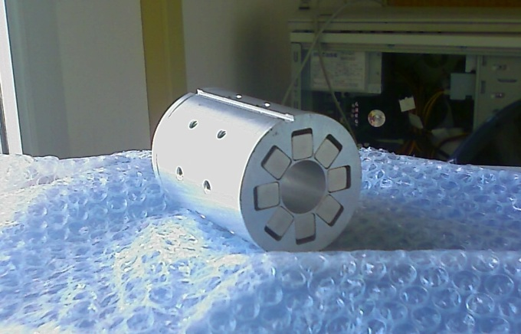
Collaboration with industry in BE-ABP
Recent
Permanent magnet quadrupoles for Linac 4.
80 out of a total of 120 produced by Elytt.
Future
PMQ for tank 2, 60 mm in diameter and 80 mm in length
Components for particle sources
Magnets, power supplies, RF amplifiers (SSPA).
Diagnostics (in collaboration with BE-BI).

Slide 11

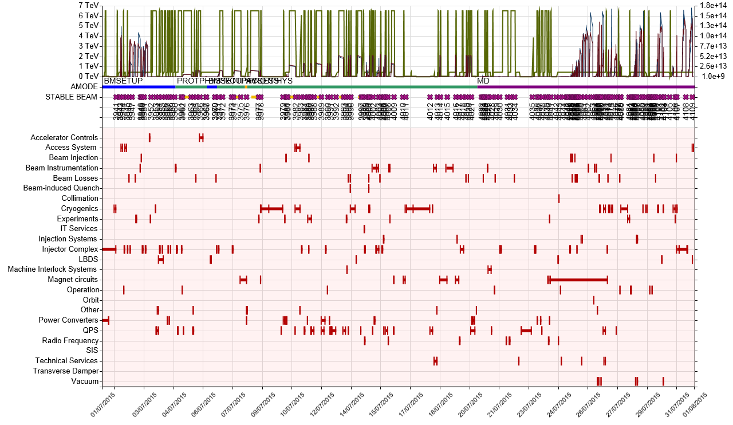
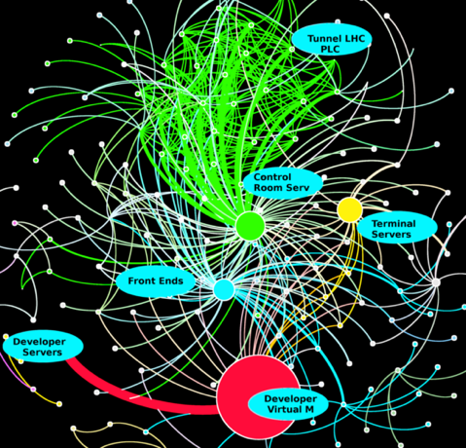
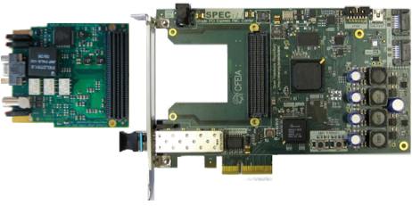
CO: Controls Group
Responsibilities:
Responsible for the controls infrastructure for all CERN accelerators, transfer lines and experimental areas.
Covers from embedded front end controllers up to the applications software.
Provides standardised hardware and software services and frameworks as well as timing distribution, signal observation, alarms, surveillance, logging and data management.
Also provides desktop support to the department as well as security policy and electronic instrument repair and calibration.
Open Hardware
Group Leader
Eugenia Hatziangeli
Accelerator Fault Tracking
TN-GPN network traffic & dependencies

Slide 12

Collaboration with industry in BE-CO
Recurrent
Industrial PC procurement.
Data centre gear (usually in collaboration with IT): racks, servers, storage, air conditioning.
Crates (VME, MTCA.4), Single Board Computers (SBC), data acquisition boards, redundant power supplies, remote reboot solutions.
Control room infrastructure: wall screens, consoles, furniture.
Cabling and connectors.
Collaboration with
Seven Solutions
Upcoming
VME crates call for tender (~1.5MCHF).
PCB production, testing and support (e.g. 1GS/s ADC FMC board).
Video distribution system for the accelerators.
New version of the White Rabbit switch.

Slide 13
ICS: Industrial Controls and Safety Systems Group
Responsibilities:
Design, implement, install, maintain and support:
  CERN’s safety and access control systems (site and machines).
  Industrial control systems for experiments, technical infrastructure, accelerator interlocks and other equipment.
Evaluate, select and support related tools and technologies.
Provide the necessary tools, frameworks and interfaces to integrate these systems in the CERN environment.
Group Leader
Peter Sollander

Slide 14
Collaboration with industry in BE-ICS
Ongoing
Renovation of SPS Access and Safety systems.
New SPS Safety Fire system.
SPS sprinkler system.
CERN site and building access.
Successful collaboration with Procon Systems.

Slide 15
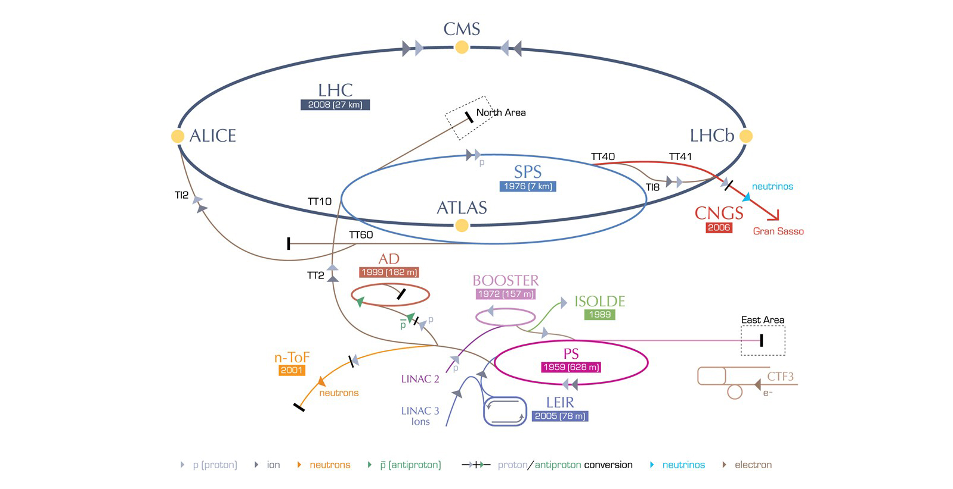
Upcoming collaborations with industry in BE-ICS
Refurbishing of LHC Experiments, combined Gas ODH, 2022
Renewal of LHC underground Fire Detection + including HL-LHC, 2022
Renewal of LHC Gas Detection including HL-LHC, 2022
LaserPPS, 2019
LHC Personnel protection System P+M, 2020
PS Personnel protection System, 2021
CERN Access control SW, 2019
CERN site Access control 2019
Safety & Industrial controls , 2020
Note: Years are to be understood as those of the launch of the relevant market survey
CERN Wide Safety Alarm Monitoring, 2021
CERN Wide Gas & ODH, 2022

Slide 16
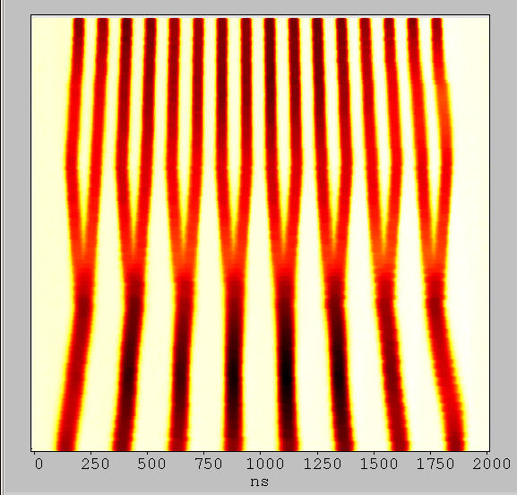
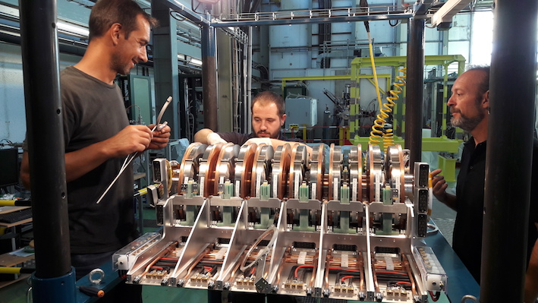
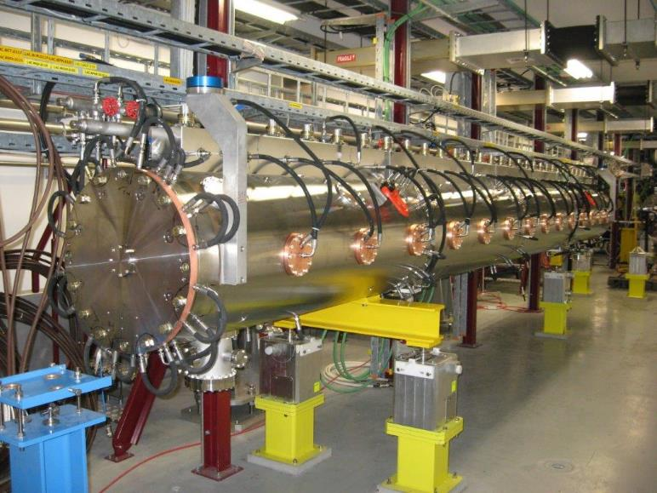
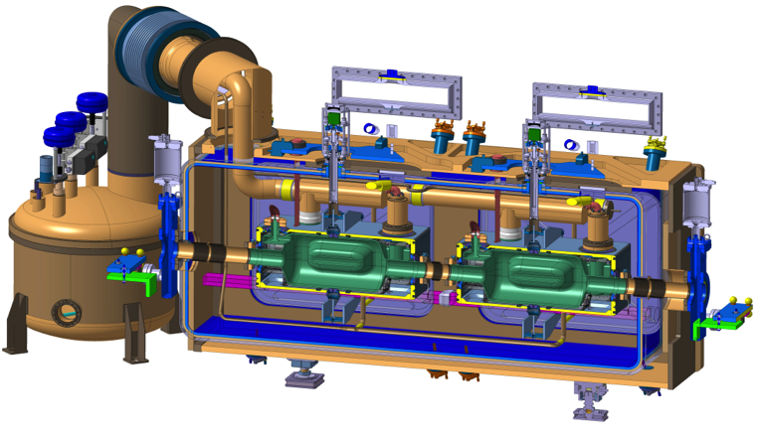
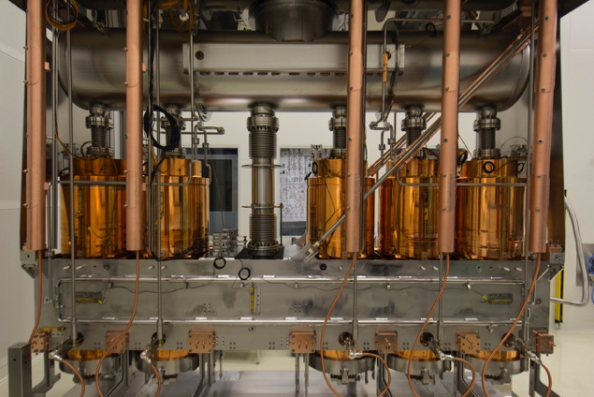
RF: Radio Frequency Group
Responsible for:
Accelerating and damping systems for all accelerators at CERN
Operation, maintenance and upgrades of these systems in all existing machines
Design and construction for new approved machines ;
Research & development and design studies for future machines
RF parameters and longitudinal dynamics in present and future accelerators
PSB FinemetTM System
Linac4 DTL Tank 3
Crab cavity cryomodule
Group Leader
Erk Jensen
HIE-Isolde Cryomodule

Slide 17
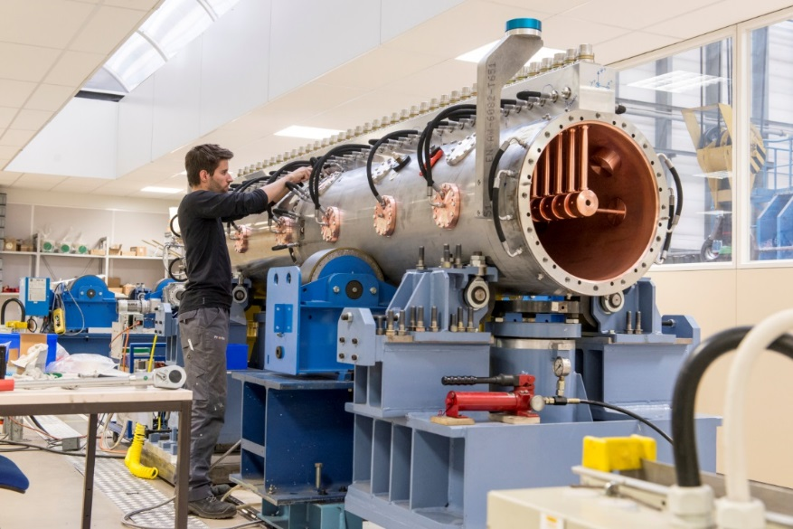
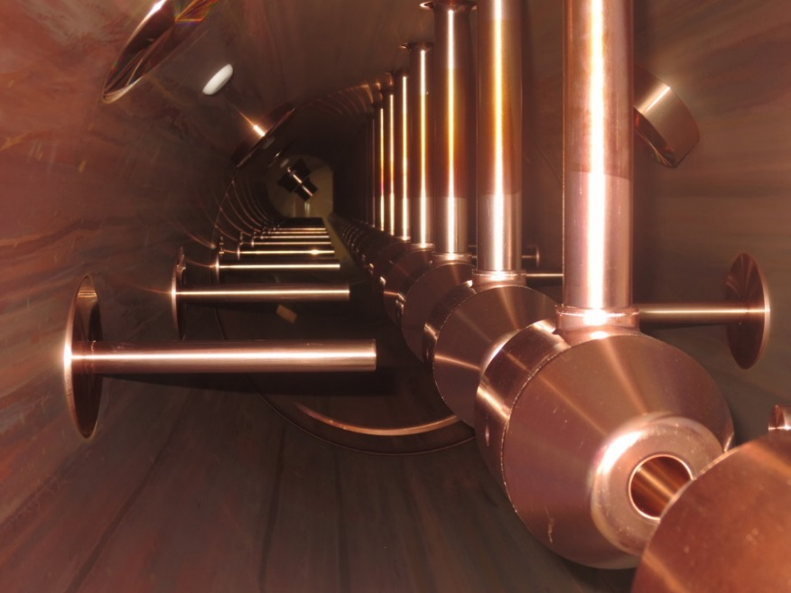
Collaboration with industry in BE-RF
Recent
High-precision machining for Linacs.
Design and prototyping at CERN, series manufacturing in collaboration with industry.
Aluminium, copper, stainless steel.
RF cavities for Linac 4, DTL, CCDTL, buncher cavities, PIMs, RFQ.
Some examples of successful collaborations: DMP-Egile, Cadinox, Mancisidor, Inmepre, ESS Bilbao.

Slide 18
Collaboration with industry in BE-RF
Recent
Crab cavities.
bulk Nb “Crab” cavity for
High Luminosity LHC

Slide 19
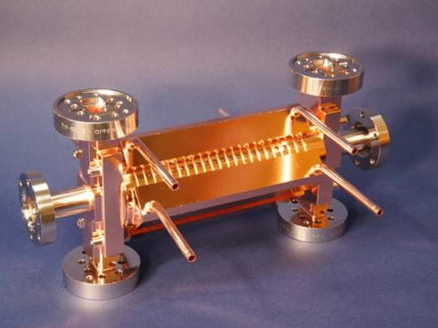
Collaboration with industry in BE-RF
Recent
RF Amplifiers
  100 MHz – 1 GHz: sometimes (e.g. if in TV band) from catalogue, sometimes bespoke.
  Different technologies: klystron, tetrode, diacrode, IOT, SSPA.
  Examples:
    101 MHz pulsed 350 kW solid state amplifiers for Linac 3.
    2 x 2 MW CW solid-state amplifiers for SPS 200 MHz upgrade.
    1 kW @ 704 MHz with ESS.
  Some successful collaborations: TTI Norte, Jema, BTESA.
Upcoming
RF Amplifiers
  5 kW pulsed amplifiers.
  Many specific developments for labs and testing
  new technologies for new projects (FCC, CLIC…).
Low-Level RF (LLRF) electronics manufacturing and testing (through CERN’s centralised Design of Electronic Modules service).
Transport of extremely delicate merchandise.
CLIC structures (~500 k€ spent in 2018).

Slide 20
Reserve slides

Slide 21
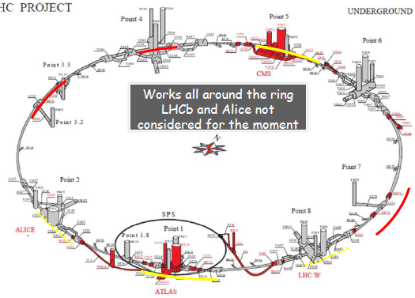
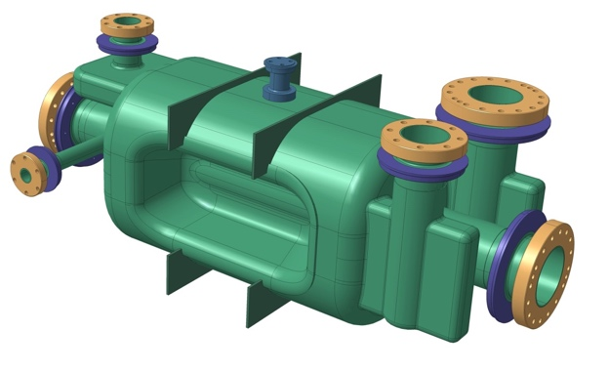
Projects: HL-LHC
New IR-quads Nb₃Sn (inner triplets)
  New 11 T Nb₃Sn (short) dipoles
  Collimation upgrade
  Cryogenics upgrade
  Crab Cavities
  Cold powering
  Machine protection
  …
Aim to deliver 10x the LHC design – 3000 fb⁻¹
Total cost ~950MCHF

Slide 22
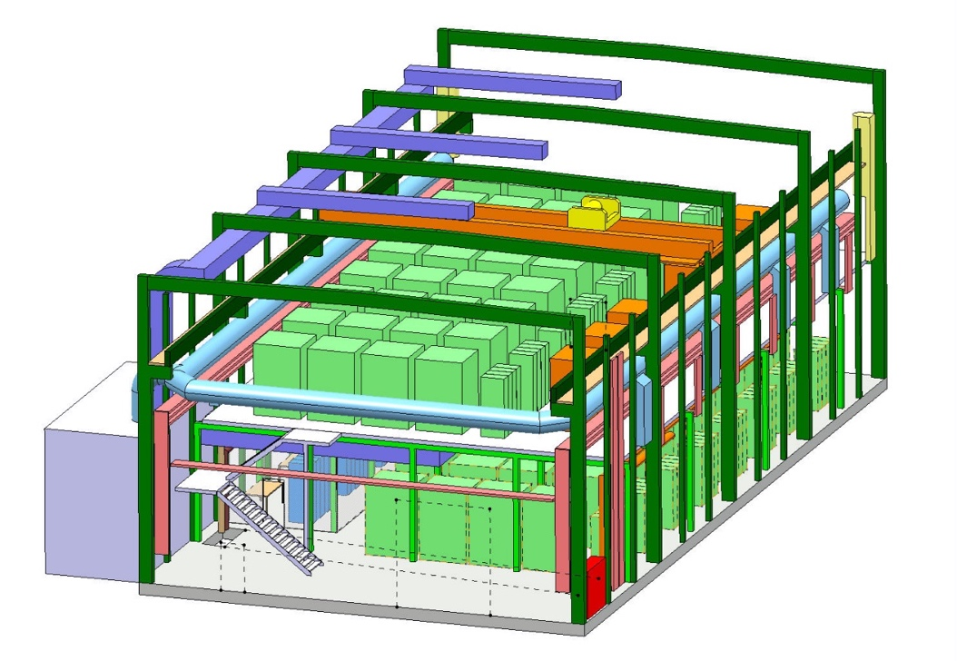
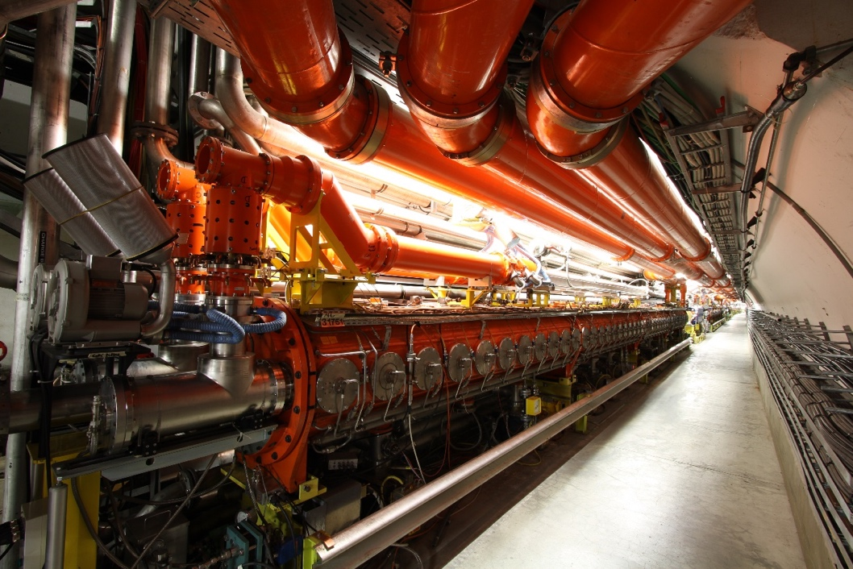
Projects: LIU (LHC Injector Upgrade)
Linac4 : Injection of H⁻ at 160 MeV into PSB
PSB : Increased Extraction energy from 1.4 to 2 GeV
PS : Higher Injection Energy
SPS : RF System upgrade
Aim to double the intensity per bunch delivered to the LHC.

Slide 23

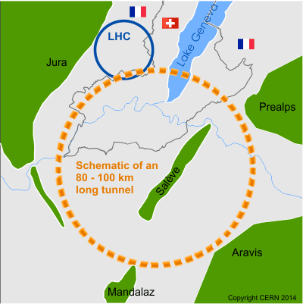
Energy Frontier Studies: CLIC & FCC
Staged Energy up to 3TeV – a ‘discovery’ machine
Based on Room Temperature RF Technology producing 100MV/m
Uses a novel ‘twin-beam’ system
International collaboration on R&D and Studies
Site specific studies undertaken at CERN
Very challenging technologies – TDR_{lite} in 2018
42km
100 km tunnel infrastructure in the Geneva area
Design driven by hadron-hadron collider:
  100 TeV centre of mass collisions.
  16 Tesla Nb₃Sn magnets.
e⁺-e⁻ operation at 45GeV (Z), 80GeV (W), 120GeV (H) & 175GeV(T)
Conceptual Design Report and Cost Review by End of 2018

