Slide 1
Open Access at all flanks articles, books, multimedia and data (in the next talk)
21st November 2018
Jens Vigen, CERN

Slide 2


Slide 3
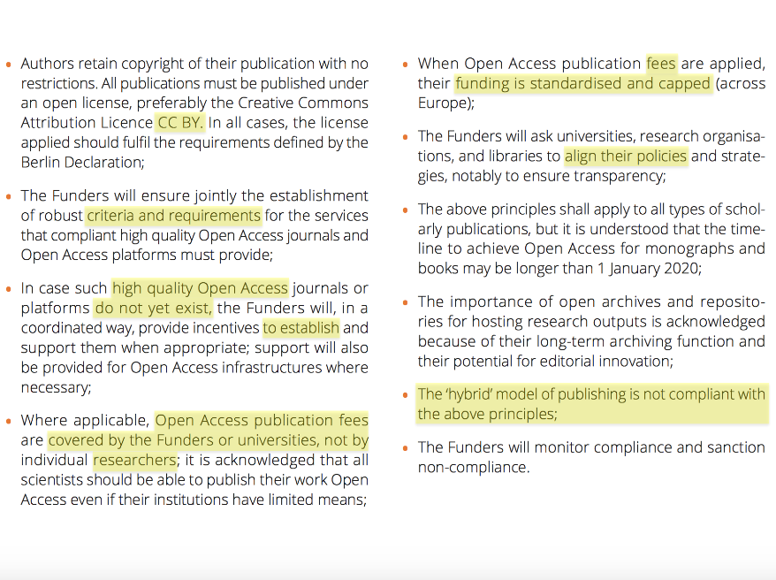

Slide 4
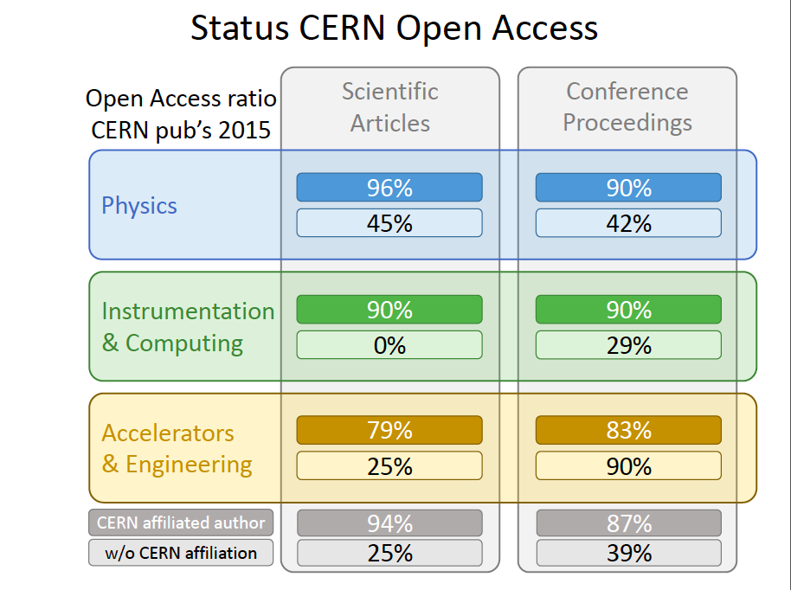

Slide 5
Publishing policy
Release of a policy for gold OA 2014, revised 2016
Preference to SCOAP³ journals
Main outlets currently causing “OA issues”
  Nature
    “Solved” on a case by case basis
  Science
    “Digital reprint” available as “free to read”
  APS journals
    Partnership agreed on top of SCOAP³ for **all CERN** until end 2018
Conferences remain a difficult problem to solve
  Better campaigns to influence conference organizers to be developed

Slide 6
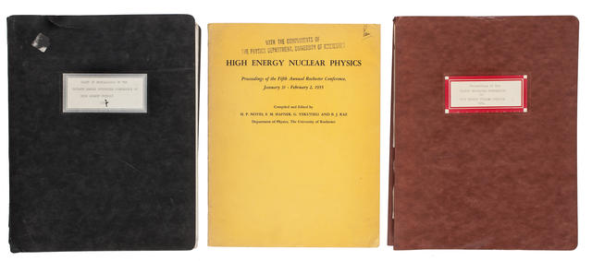
Conference proceedings
Campaign to get all the “classics” online.
Clearing rights
Digitizing
Uploading metadata/fulltext
ICHEP 58 (CERN)
ICHEP 59 (Kiev)
ICHEP 60 (Rochester)
ICHEP 62 (CERN)
ICHEP 64 (Dubna)
ICHEP 66 (Berkeley)
ICHEP 68 (Vienna)
ICHEP 70 (Kiev)
ICHEP 74 (London)
ICHEP 76 (Tbilisi)
ICHEP 78 (Tokyo)
ICHEP 84 (Leipzig)
ICHEP 90 (Singapore)
Cyclotrons Conference 75
Cyclotrons Conference 78
Cyclotrons Conference 82
Cyclotrons Conference 84
Cyclotrons Conference 86
Cyclotrons Conference 89
Cyclotrons Conference 92
Cyclotrons Conference 95
Cyclotrons Conference 98
Rochester 52
Rochester 54
Rochester 55
Rochester 56
Rochester 57
DIS 95 and DIS 2003

Slide 7
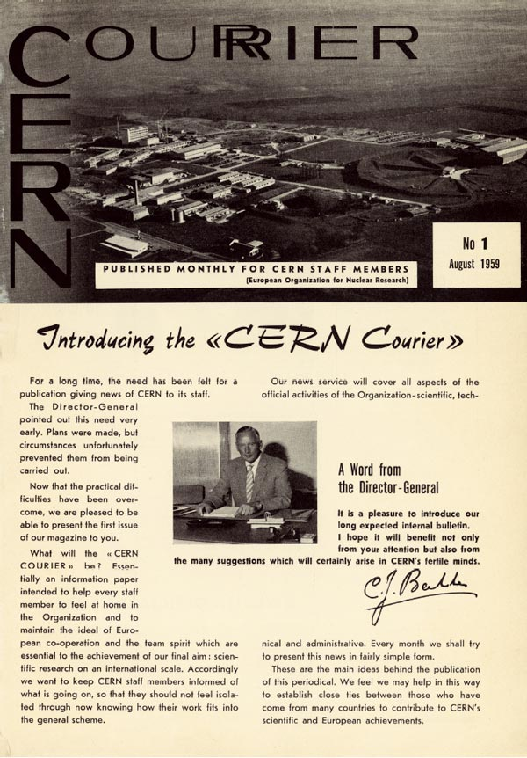
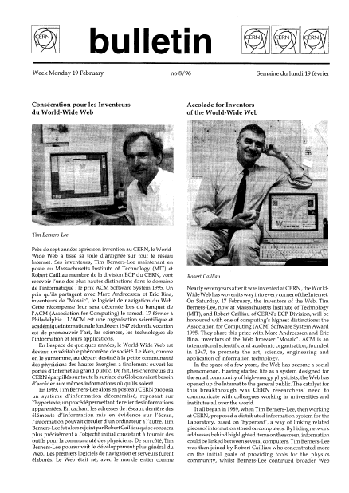
Accomplished digitization projects
Digitization done by a company
Post-processing@CERN
Both journals available via the CERN Document Server
and of course retrievable in Google ☺

Slide 8
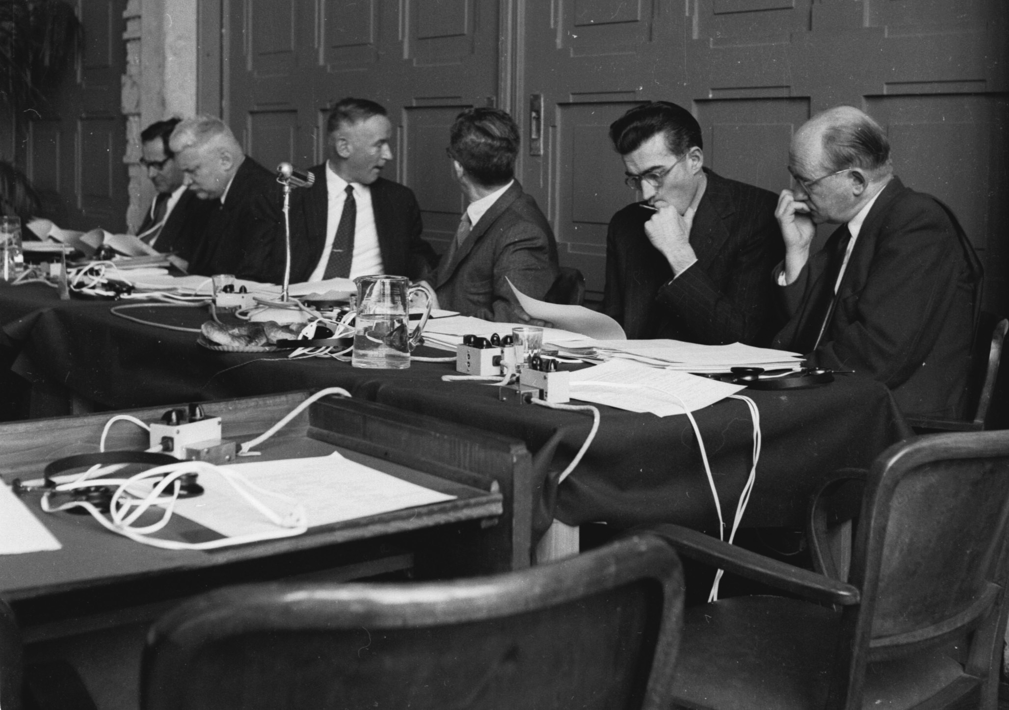
Second Council meeting,
held in the Bâtiment électoral

Slide 9
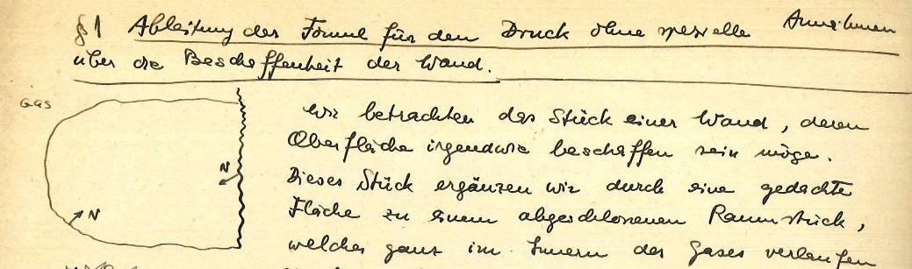
The Pauli Archive
New online resource
  Notes taken by Josef Jauch of Wolfgang Pauli's 1935-1938 ETH lectures (Courtesy of the Department of Theoretical Physics, University of Geneva).
Heisenberg Archive
  Digitization of Heisenberg’s letters to Pauli
  Rights held by the Heisenberg-Gesellschaft

Slide 10
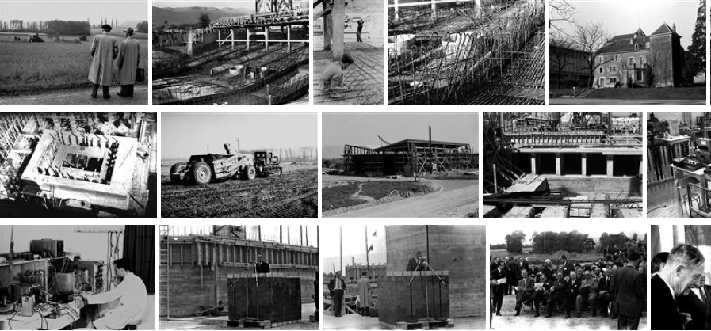
Completed digitization of the B-W collection
The colour collection is underway
120 000 pictures sent to
CONTENTRA TECHNOLOGIES - BVBA FONS
(40% India, 60% Belgium)
Scanning: 40 CHF cents per picture
Manual enhancement with Photoshop: 17 CHF cents per picture
Total contract: 85 500 CHF (+ equal size of CERN effort)

Slide 11
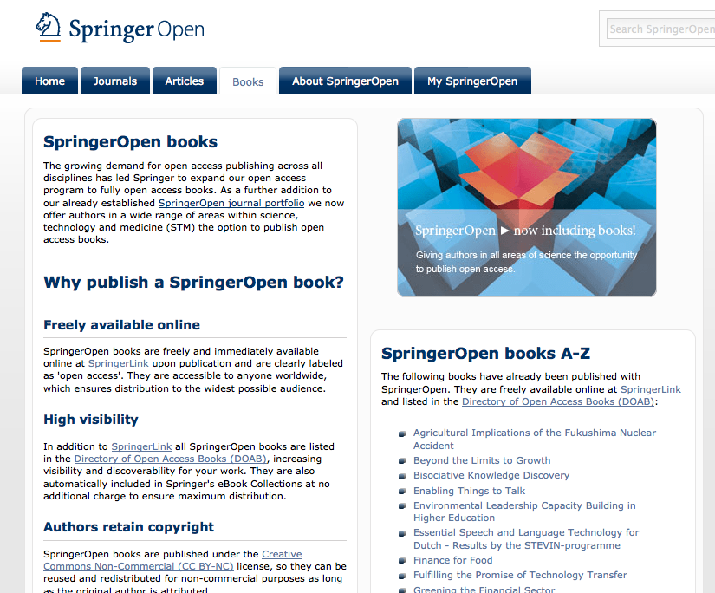
Open Access books
More and more publishers do now offer Open Access books:
The prices are comparable to the production of a Yellow Report
Good distribution and discoverability via publishers online platforms
The Scientific Information Service can consider “sponsorship” of authors planning to publish relevant “CERN works”

Slide 12
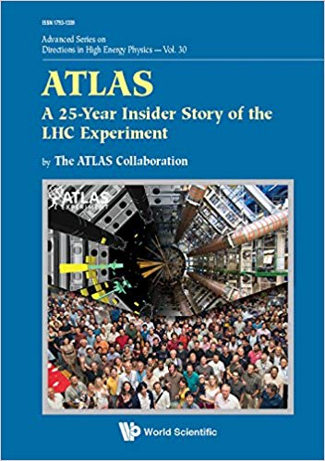

Typical “CERN books”
Open access monographs under way

Slide 13
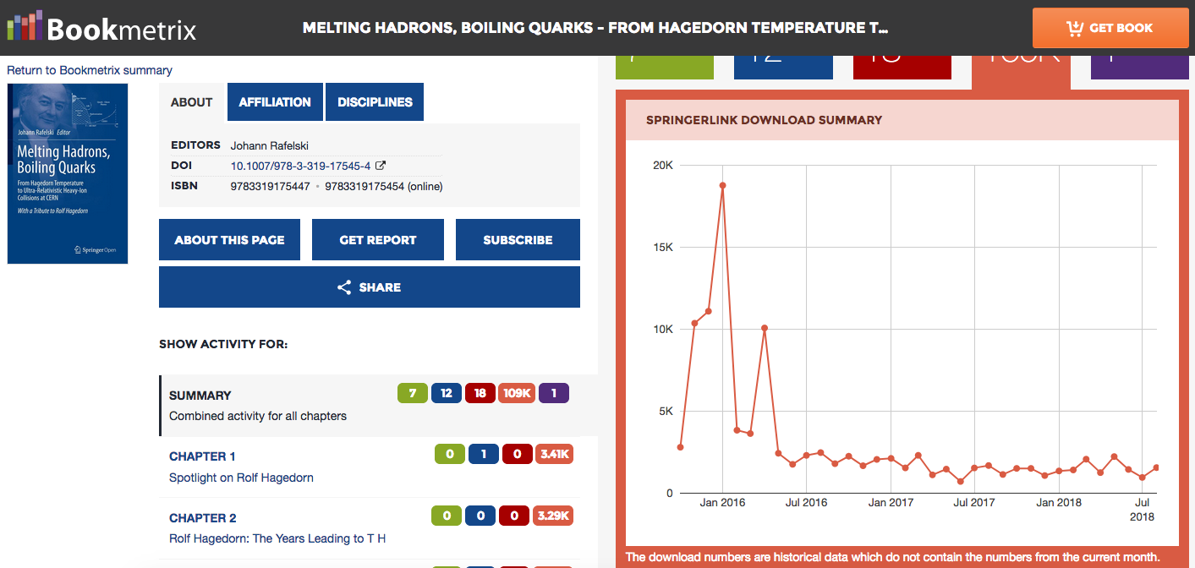
Success for open access book
1 book equivalent = the total number of downloads by number of chapters
The downloads for Hagedorn (2016), open access, correspond to 3200 book equivalents
Can be compared with downloads for Källén (2014), trad. model, correspond to 1500 books

Slide 14

New open access monograph
In the pipeline (expected early 2019)
Particle Physics References
Vols 1-3 and to be published under the CERN/Springer OA book agreement:
Vol. 1 : Theory and experiments
Vol. 2 : Detectors for particles
Vol. 3 : Accelerators and colliders
An updated and revised version of LB volumes

Slide 15


Slide 16
Happy to be published ☺
A 50-year story from High-Energy Physics
… Nobody cared about retaining copyright …
… which is obviously causing issues today
You shall avoid this mistake and still be published!

Slide 17


Slide 18
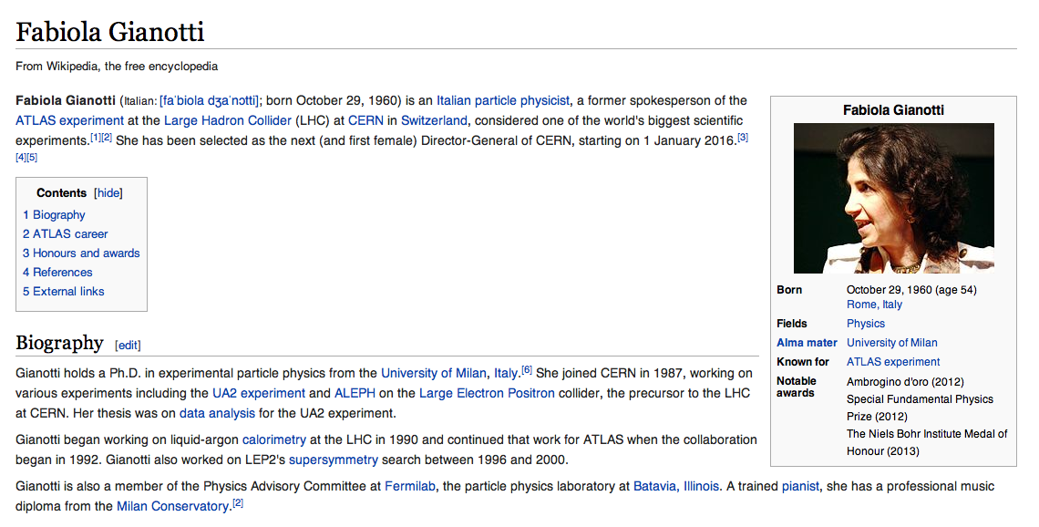
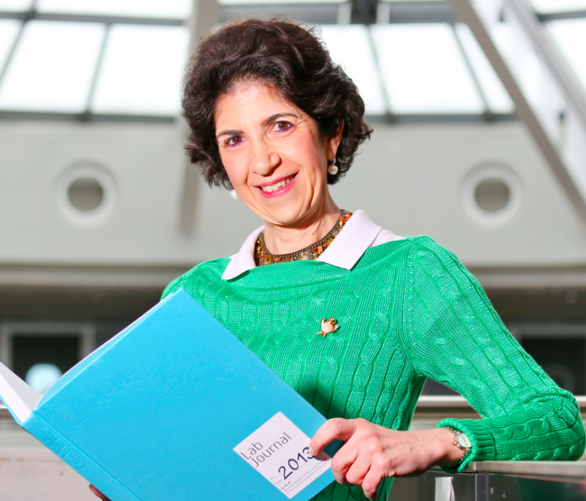
Why does not Wikipedia have the best picture?

Slide 19
CERN multimedia is Open Access, but does not carry the right license …
The CERN license is not recognized by Wikipedia and other actors …
CERN strives to move towards a scheme of generally recognized licenses
Creative Commons has become mainstream
LHC exps. publish under CC-BY since 2009
The Management is now going through a process with the intention to implement the same license conditions for multimedia as for our scientific publications (without running non-understood risks)
Still unclear when the new license can be implemented

Slide 20
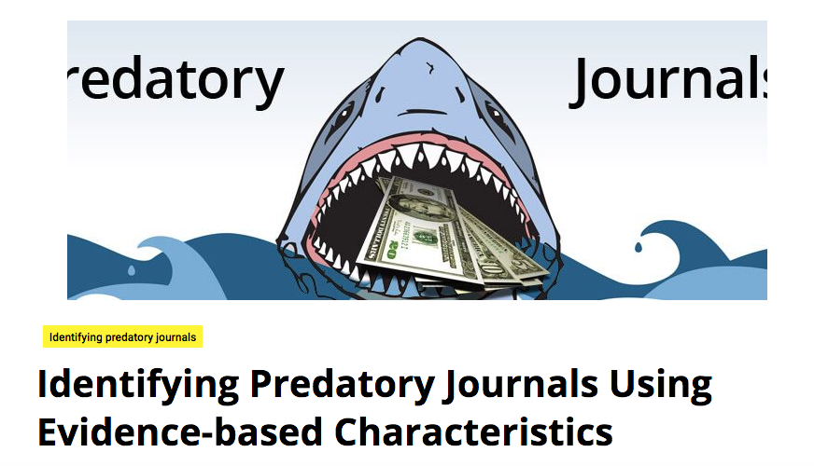
Predatory journals

Slide 21



Librarians can assist academics to avoid embarrassing traps
Closed since January 2017

