Slide 1
LBE Line Planning Update

Slide 2
Introduction
Revision of LBE line planning following feedback from last LIU-PT meeting
  Original proposal Linac4: 4 w IST, 1.5 w HWC, 11 w BC
  Original proposal Switchyard: 3 w IST, 2 w HWC, 9 w BC
The following points should be addressed:
Compress planning
New version should also take into account Open Days for Switchyard due to manpower constraints
Manpower commitment should be assured, in particular for the RF team, to avoid conflicts with other projects/activities

Slide 3
Steps Taken and Modifications
Added Open Days in Switchyard planning
  Reduces IST duration for the Switchyard to <2.5 w (includes Jeune Genevois)
Obtained input from TE-EPC and TE-MPE concerning new power converter commissioning, WIC tests etc. → together with some optimisations could reduce IST duration for Linac4 from 4 to 2 w
Planning optimisation saved 1 w for tests with beam

Slide 4
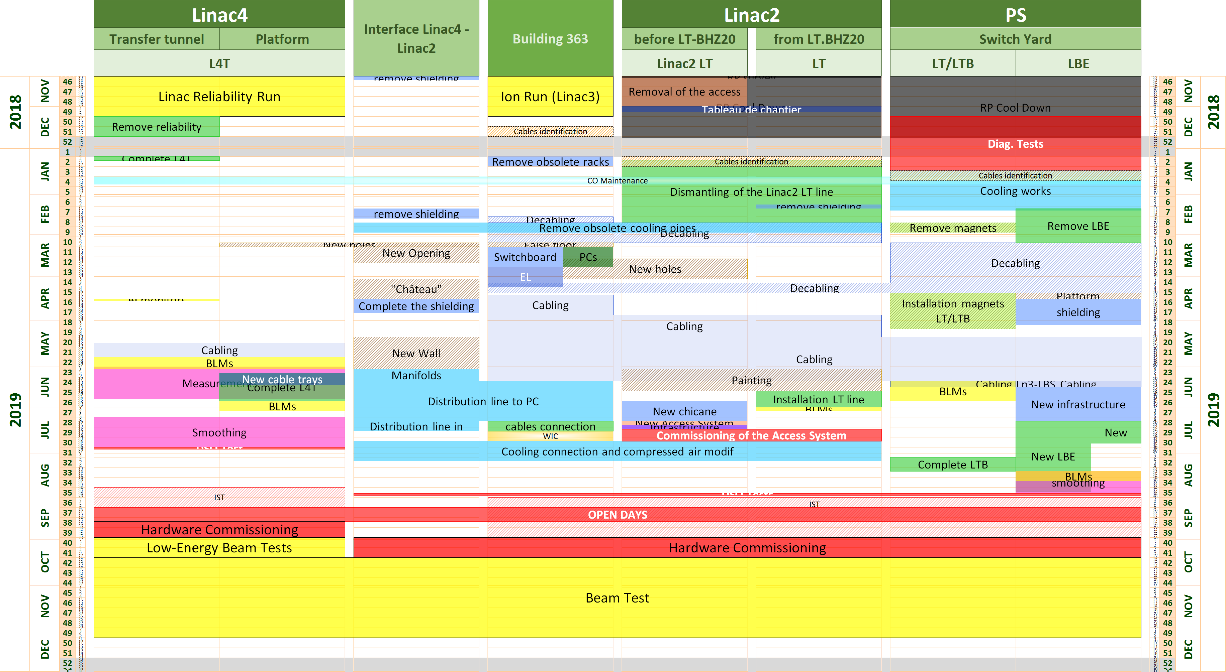
New LBE Line Run Schedule (see Julie’s talk)

Slide 5
RF Team for LBE Line Run
Specialists within RF committed to cover the LBE Line activities (supported by GL)
* Klystron filament supply correction (part of shutdown activities, tbd before the LBE line run):
RF-MK section: O. Brunner, P. Martinez Yanez, C. Nicou
RF-CS section: D. Landre (L. Arnaudon)
* DSO test:
RF-MK section: P. Martinez Yanez (O. Brunner, G. Mcmonagle)
RF-CS section: D. Landre, D. Glenat
RF-LRF section: G. Piccinini (C. Gagliardi, L. Timeo)
RF-FB section: R. Borner (P. Baudrenghien)
* Solid state amplifier (3x Buncher, Debuncher):
RF-LRF section: G. Piccinini (C. Gagliardi, L. Timeo, M. Delrieux)
RF-CS section: D. Glenat
* Chopper:
RF-IS section: M. Paoluzzi , A. Jones
RF-FB section: G. Hagmann, J. Simonin
* Low Level RF:
RF-FB section: R. Borner (P. Baudrenghien)
RF-CS section: B. Bielawski
* General coordination:
R. Wegner (S. Ramberger)

Slide 6
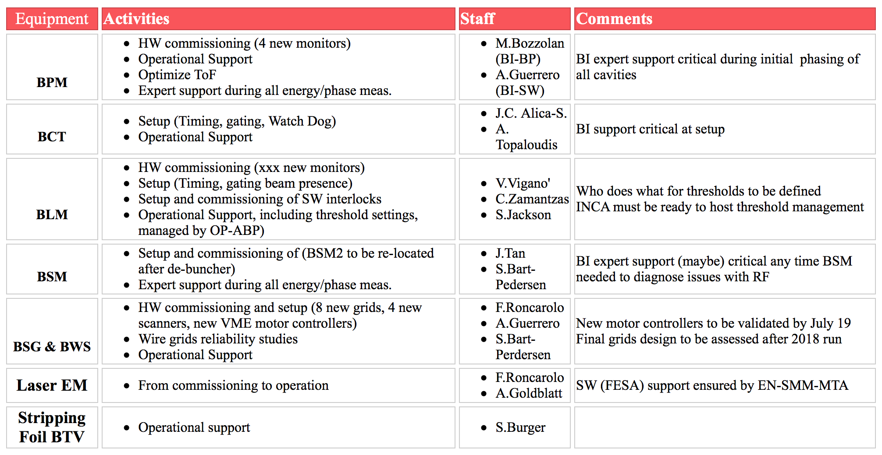
BI Team for LBE Line Run
Specialists within BI committed to cover the LBE Line activities (supported by GL)

Slide 7
Summary
Compressed overall planning by 3 weeks
Linac4: 2 w IST, 1.5 w HWC, 10 w BC
Linac4 Switchyard + LBE: <2.5 w IST, 2 w HWC, 8 w BC
Different groups checked manpower availability

