Slide 1
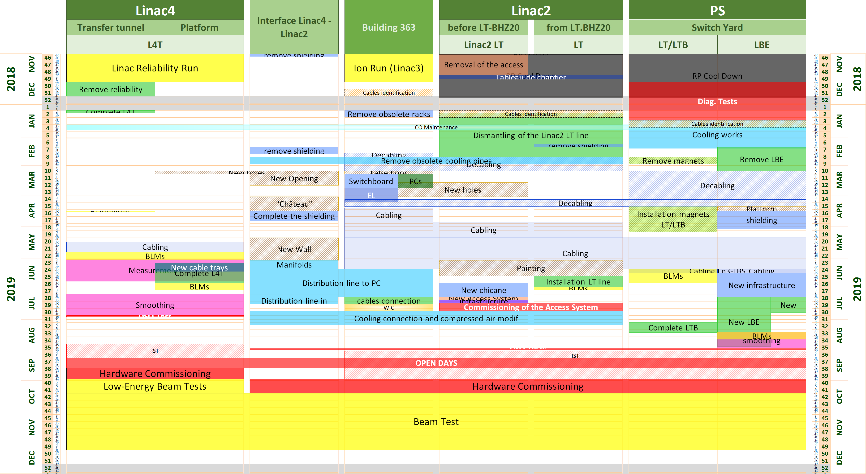
LIU-PLI
Linac4 Connection Schedule

Slide 2
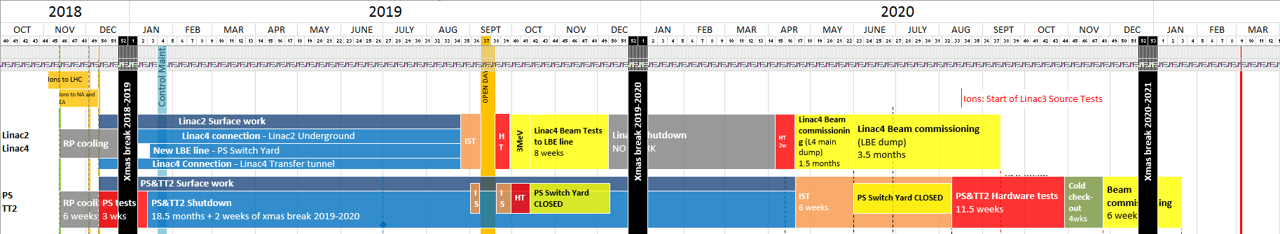
LIU-PLI
LS2 Master Schedule v.1.3 IN WORK

Slide 3
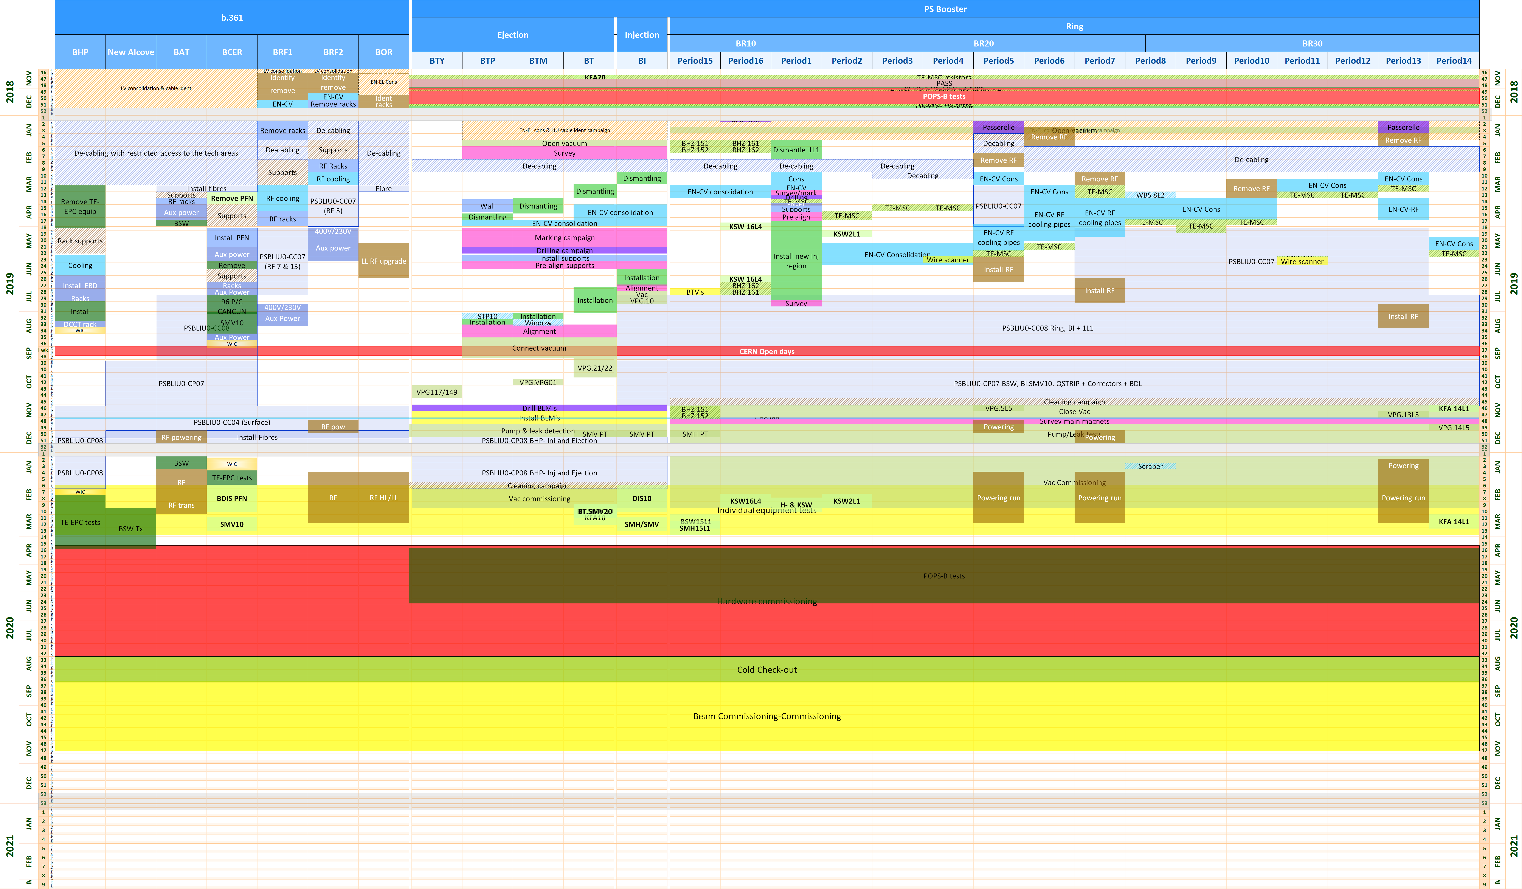
LIU-PLI
PS Booster Schedule

Slide 4
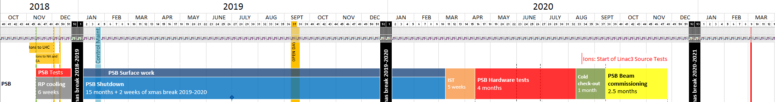
LIU-PLI
LS2 Master Schedule v.1.3 IN WORK

Slide 5
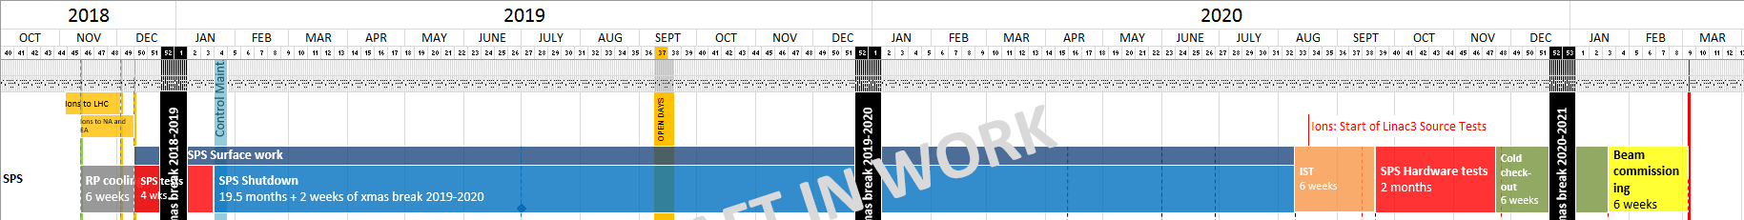
LIU-PLI
LS2 Master Schedule v.1.3 IN WORK
10 weeks
Kickers 1st phase– 2 weeks
Kickers 1st phase– 2 weeks
Septa – 8 weeks
Septa – 8 weeks
RF – 15 weeks
TPSC4 – 2 weeks
Kickers – 2 months
Kickers – 2 months
Reliability Run Beam Dump ?
TPSG6 – 3 weeks
Septa ?

Slide 6
LIU-PLI
LS2 Master Schedule v.1.3 IN WORK
6 weeks
Kickers 1st phase– 2 weeks
Septa – 8 weeks
RF – 15 weeks
TPSC4 – 2 weeks
Kickers – 2 months
Reliability Run Beam Dump ?
TPSG6 – 3 weeks
Septa ?

Slide 7
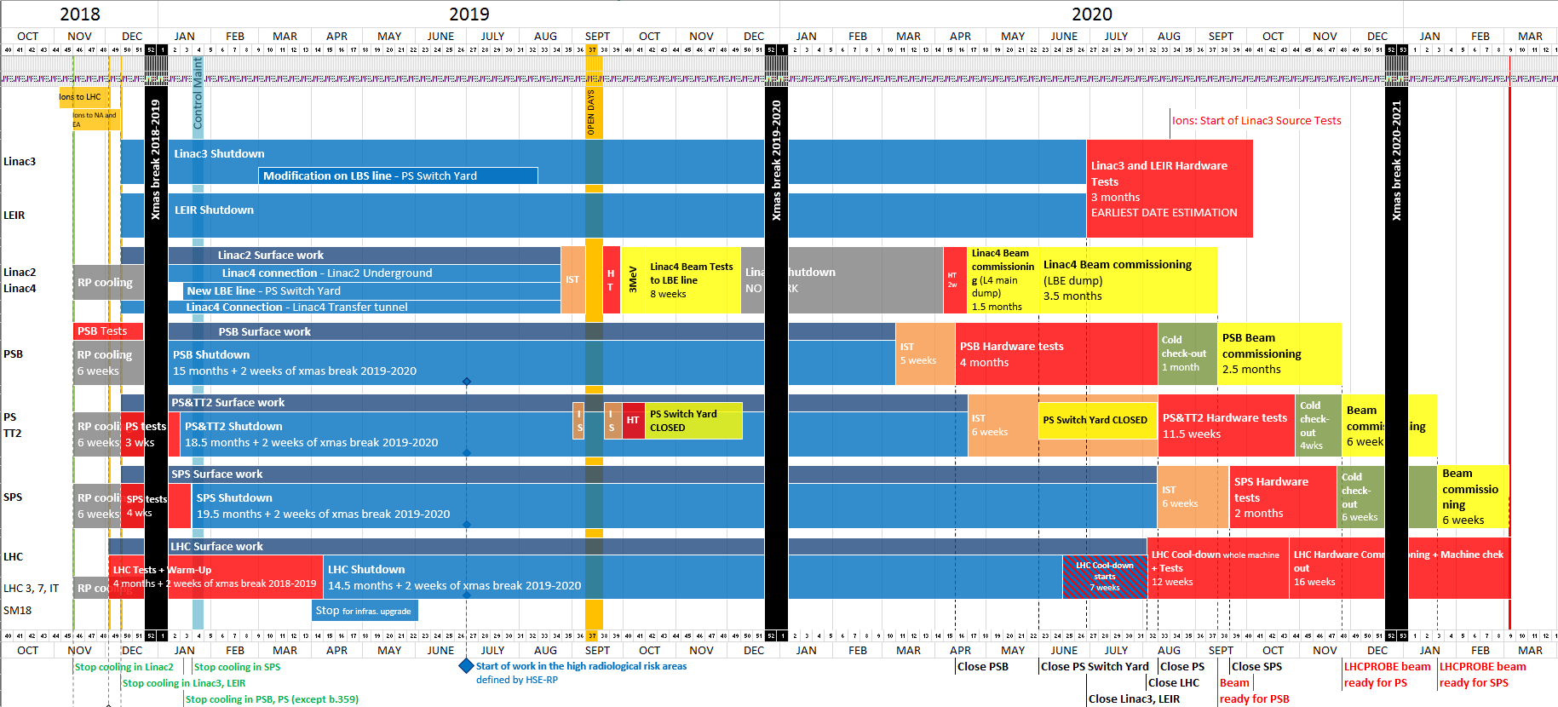
LIU-PLI
LS2 Master Schedule v.1.3 IN WORK

