Slide 1


Colloquium
Bachelor Thesis
Alignment of nozzle and skimmers of the Beam Gas Curtain (BGC)
Johanna Glutting

Slide 2


Outlook
Context (BGC) and problem definition (alignment)
Developed solutions (alignment setup and procedure)
Maximal alignment precision compared to objectives
Gas jet pressure calculation (with gas jet thickness)
Simulation to verify pressure calculations

Slide 3
Applications of a beam-gas jet instrument
Overlap monitor: monitor overlapping hollow electron beam (HEL) and LHC proton beam at the same time
Beam diagnostics: dense beam gas target, imaged by a secondary particle tracker
Beam-gas wire for future high energy colliders : similar functionality as a wire scanner

Slide 4
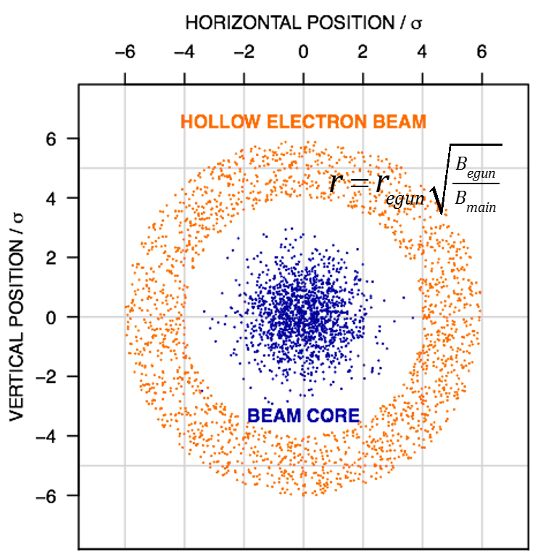
Application: Hollow Electron Lens (HEL)
Halo particles can collide with vacuum components and create losses
HEL gives particles out of centre a kick
Halo particles are easier to remove in the collimation system
→ Monitoring of the concentricity is important
Source: Adriana Rossi, BGC collaboration meeting 19 Mar. 2018 (modified); https://indico.cern.ch/event/712498/

Slide 5
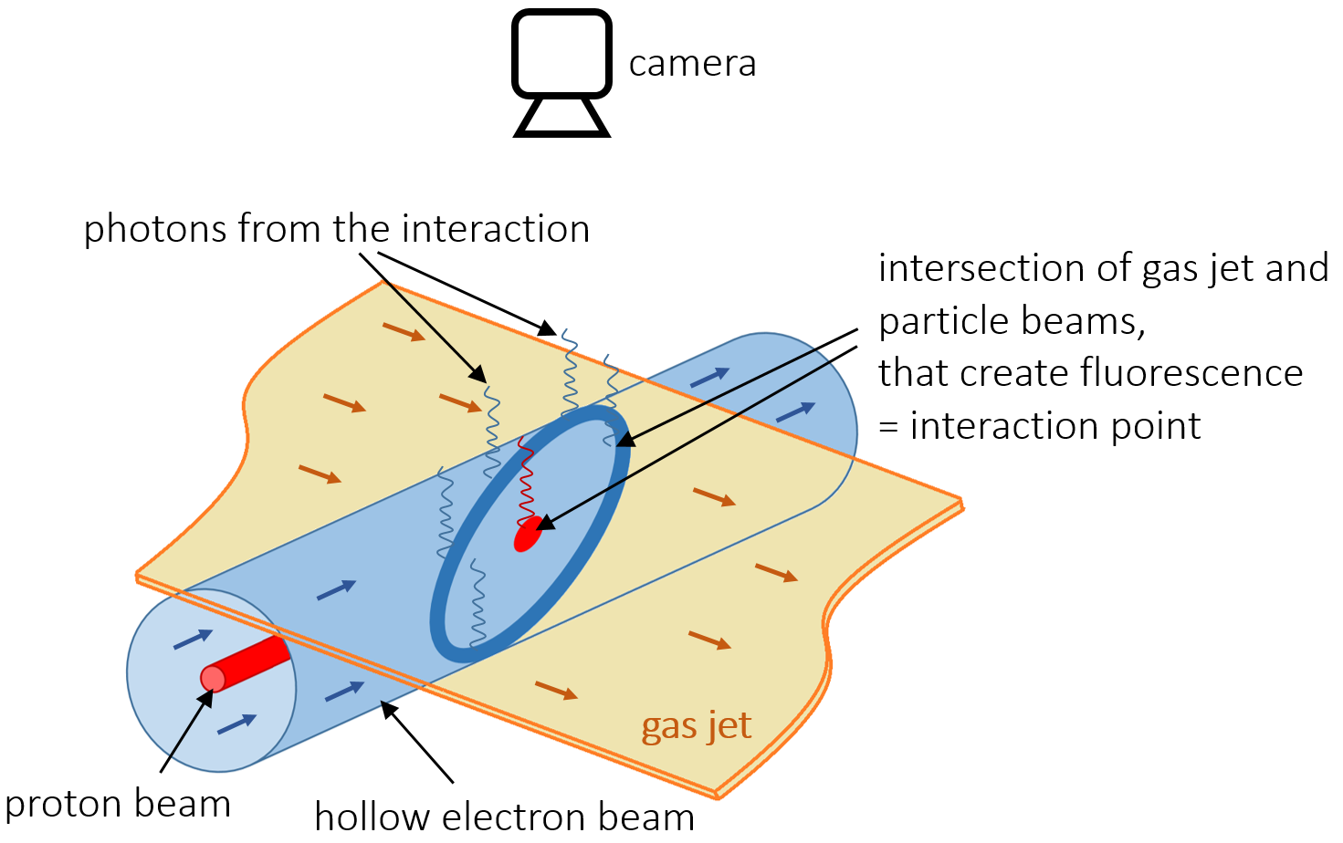
The BGC for the monitoring of HEL and LHC proton beam
BGC = Beam Gas Curtain
HEL = Hollow Electron Lens
LHC = Large Hadron Collider

Slide 6

The BGC for the monitoring of HEL and LHC proton beam
Fluorescence image of a single particle beam (e.g. only protons)
BGC = Beam Gas Curtain
HEL = Hollow Electron Lens
LHC = Large Hadron Collider

Slide 7
BGC Setup (simplified)
10⁻⁷mbar
10bar
10⁻³mbar
10⁻⁹mbar

Slide 8
BGC Setup (simplified)
2nd skimmer (Ø400μm)
1st skimmer (Ø180μm)
3rd skimmer (4mm x 0.4mm)
nozzle
(Ø30μm)
10⁻⁷mbar
10bar
10⁻³mbar
10⁻⁹mbar
2 ... 17
20.2
333
228.3

Slide 9
BGC Setup (simplified)
camera with optical components
2nd skimmer (Ø400μm)
1st skimmer (Ø180μm)
3rd skimmer (4mm x 0.4mm)
view port
nozzle
(Ø30μm)
10⁻⁷mbar
10bar
10⁻³mbar
10⁻⁹mbar
2 ... 17
20.2
333
228.3
particle beam perpendicular to gas jet and camera axis

Slide 10
BGC Setup (simplified)
camera with optical components
2nd skimmer (Ø400μm)
1st skimmer (Ø180μm)
3rd skimmer (4mm x 0.4mm)
view port
nozzle
(Ø30μm)
nozzle chamber
interaction chamber
10⁻⁷mbar
10bar
skimmer chamber
dump chamber
10⁻³mbar
10⁻⁹mbar
2 ... 17
20.2
333
228.3
particle beam perpendicular to gas jet and camera axis

Slide 11
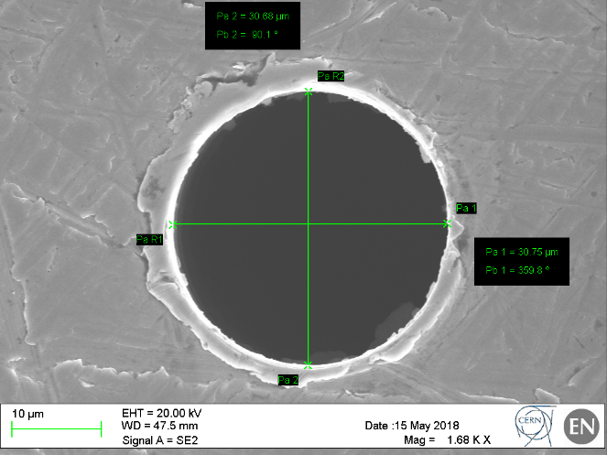
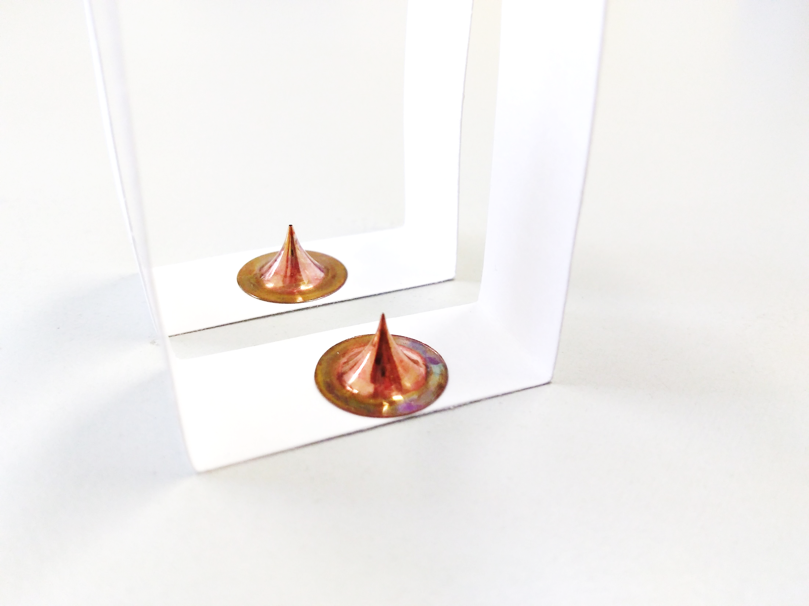
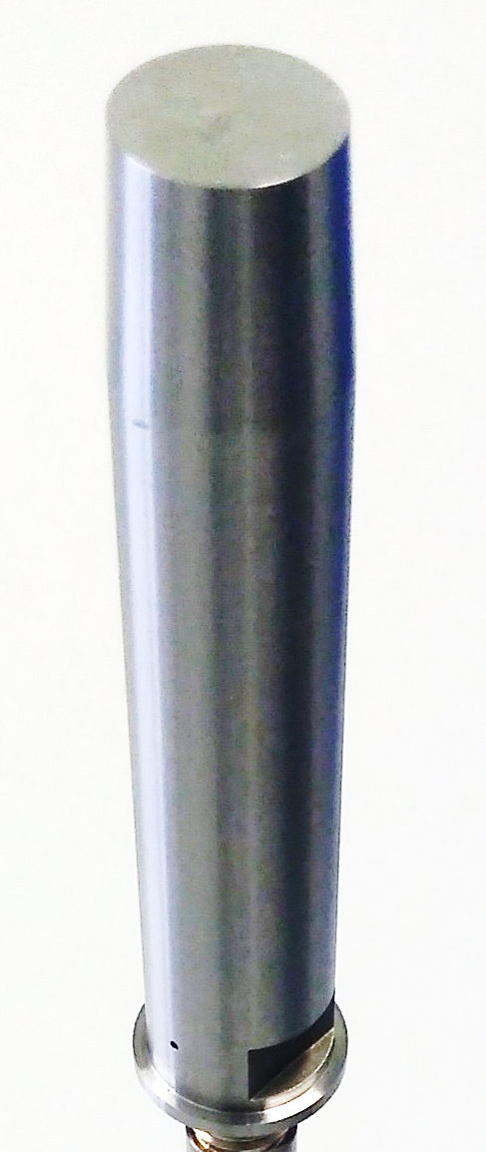
BGC Setup (simplified)
camera with optical components
2nd skimmer (Ø400μm)
1st skimmer (Ø180μm)
3rd skimmer (4mm x 0.4mm)
view port
nozzle
(Ø30μm)
nozzle chamber
interaction chamber
10⁻⁷mbar
10bar
skimmer chamber
dump chamber
10⁻³mbar
10⁻⁹mbar
2 ... 17
20.2
333
228.3
particle beam perpendicular to gas jet and camera axis

Slide 12
BGC Setup (simplified)
camera with optical components
2nd skimmer (Ø400μm)
1st skimmer (Ø180μm)
3rd skimmer (4mm x 0.4mm)
view port
nozzle
(Ø30μm)
nozzle chamber
interaction chamber
10⁻⁷mbar
10bar
skimmer chamber
dump chamber
10⁻³mbar
10⁻⁹mbar
2 ... 17
20.2
333
228.3
particle beam perpendicular to gas jet and camera axis

Slide 13
Alignment Objectives
Test at the experimental setup at CI:
Scan with the movable nozzle through the 1st skimmer
Recording of the gauge signal
The signal is at 90% of the maximum or higher within 60μm
90% of the maximum
60μm
Source: Hao Zhang, BGC regular meeting 13 Oct. 2017 (modified); https://indico.cern.ch/event/670010/

Slide 14
Alignment Concept
Installation of the equipment
Alignment of the laser to the nozzle (with the iris system)
▪ Maximization of the laser intensity
Alignment targets in the focal planes of nozzle 1st and 2nd skimmer
(laser is reference)
Alignment of the nozzle and skimmers

Slide 15
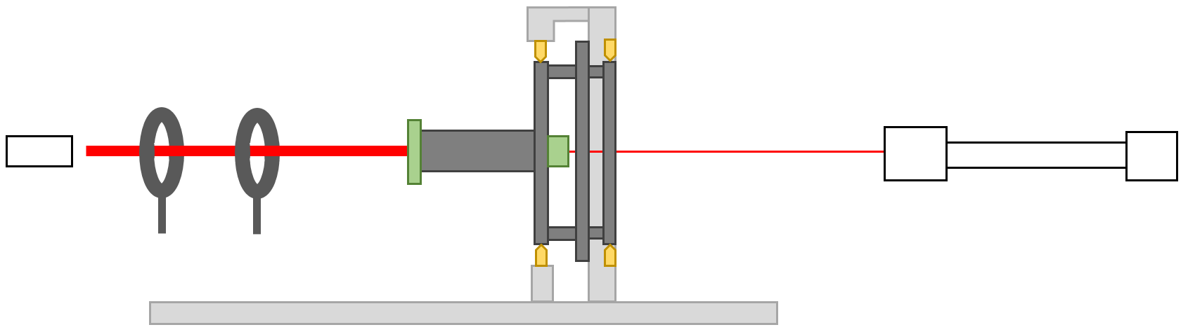
Scheme of the
Developed Alignment Setup
nozzle holder
1st skimmer holder
irises, one with 2 linear degrees of freedom
nozzle
2nd skimmer holder
camera with 3 linear degrees of freedom
laser with
2 linear and
2 rotational degrees of freedom
x
x
x
y
y
y
z
alignment frame
adjustment screws integrated in the frame
z → focus of the camera with linear stages

Slide 16
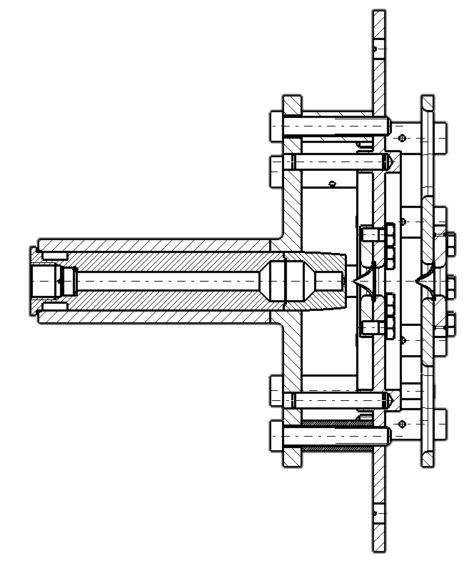
Scheme of the
Developed Alignment Setup
nozzle holder
1st skimmer holder
irises, one with 2 linear degrees of freedom
nozzle
2nd skimmer holder
camera with 3 linear degrees of freedom
laser with
2 linear and
2 rotational degrees of freedom
x
x
x
y
y
y
z
alignment frame
adjustment screws integrated in the frame
z → focus of the camera with linear stages

Slide 17
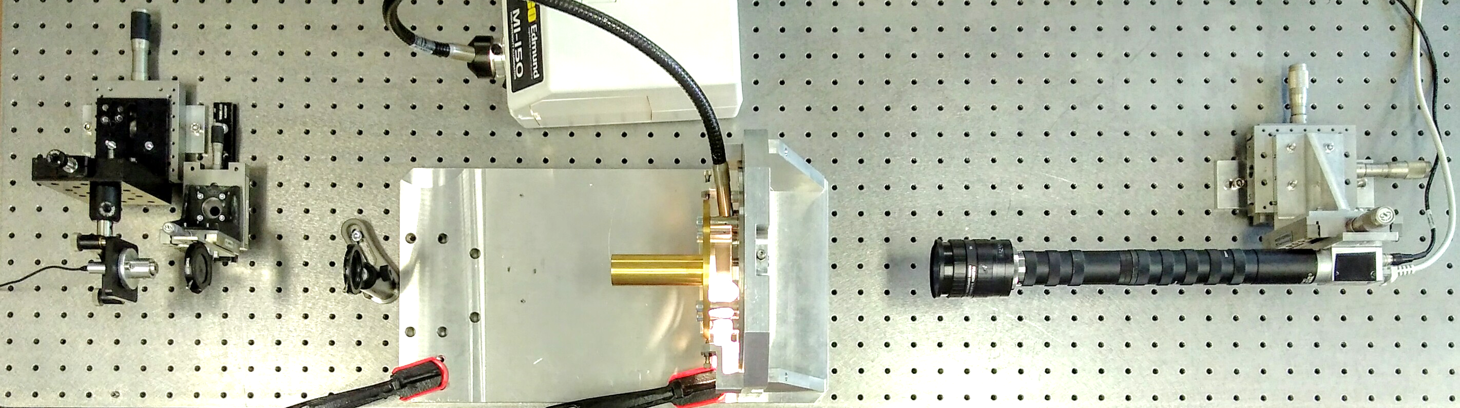
Alignment Setup in the Optical Lab

Slide 18
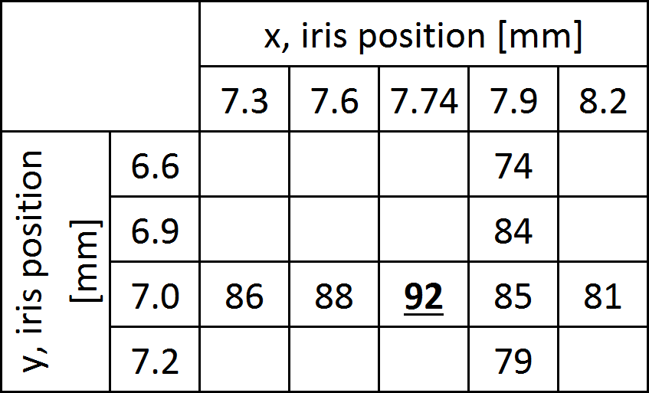
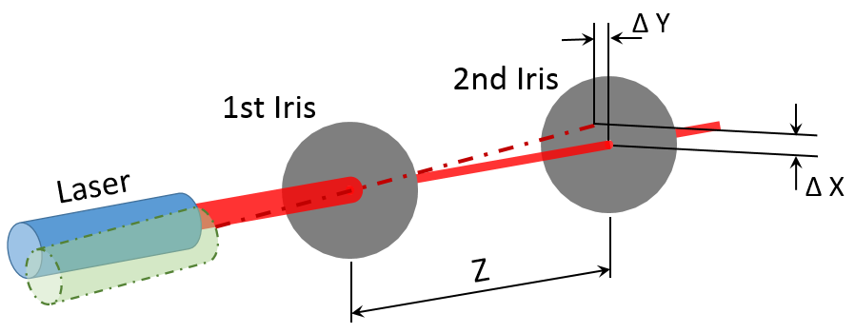
Laser Alignment (example)
Maximizing the light going through the nozzle
Irisis to define and measure laser angles
Recording of intensities at different iris positions
Finding the maximum in each axis
Laser diffraction pattern affects intensities, only reliable if the laser gets centred each time

Slide 19
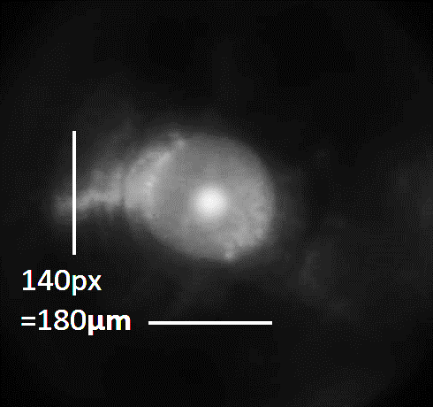
Nozzle 1st Skimmer Alignment (1)
The laser blurred up after leaving the nozzle
but is still visible in the first skimmer plane
Centring of the nozzle (laser spot) to the skimmer position

Slide 20
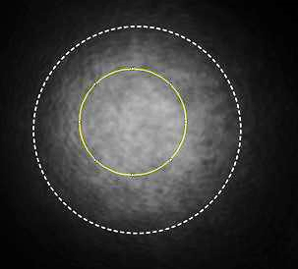
Nozzle – Skimmer Alignment (2)
Skimmer diameter
(400μm)
The laser blurred up after leaving the nozzle
Centre is not detectable in skimmer plane
References of the laser axis for alignment
Reference (Ø750μm)

Slide 21
Nozzle – Skimmer Alignment (2) larger distances
1st skimmer set → nozzle and 2nd skimmer position calculated
Coordinates of the Laser Reference
nozzle plane
1st skimmer plane
1st skimmer position
2nd
skimmer plane

Slide 22
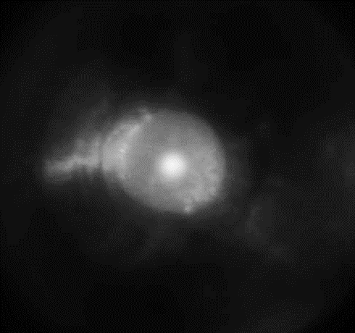
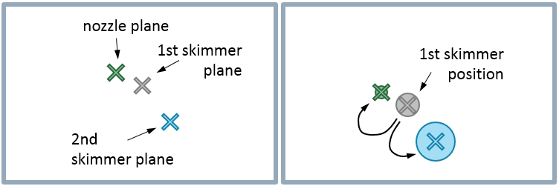
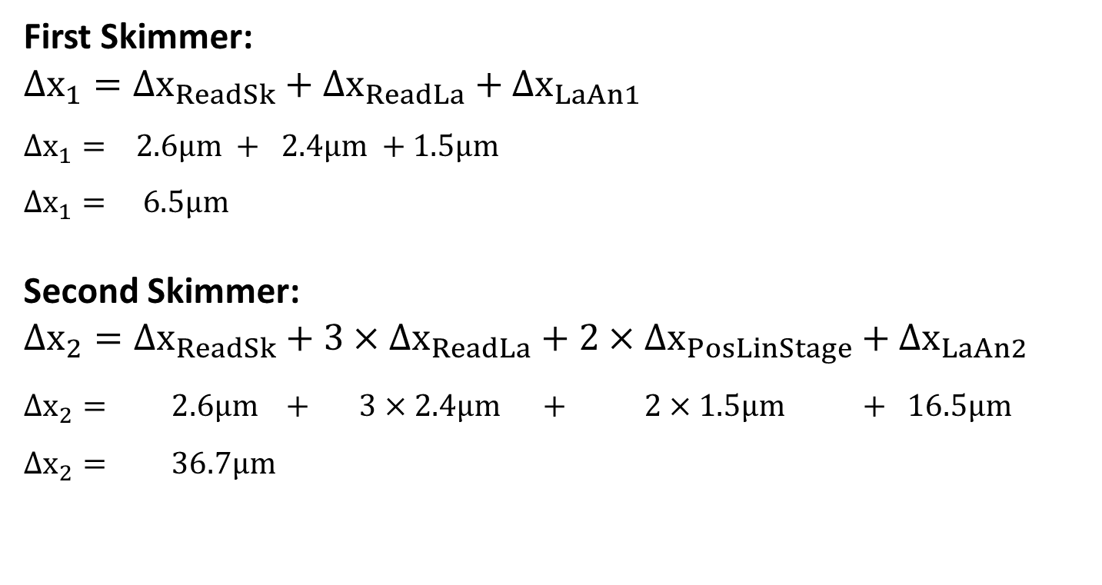
Achievable Alignment Precision
First Skimmer:
$$∆x_{1}=∆x_{ReadSk}+∆x_{ReadLa}+∆x_{LaAn1}$$
$$∆x_{1}= 2.6μm + 2.4μm +1.5μm$$
$$∆x_{1}= 6.5μm$$
Second Skimmer:
$$∆x_{2}=∆x_{ReadSk}+3×∆x_{ReadLa}+2×∆x_{PosLinStage}+∆x_{LaAn2}$$
$$∆x_{2}= 2.6μm + 3×2.4μm + 2×1.5μm + 16.5μm$$
$$∆x_{2}= 36.7μm$$
Notes:
1

Slide 23
Achievable Alignment Precision
First Skimmer:
$$∆x_{1}=∆x_{ReadSk}+∆x_{ReadLa}+∆x_{LaAn1}$$
$$∆x_{1}= 2.6μm + 2.4μm +1.5μm$$
$$∆x_{1}= 6.5μm$$
Second Skimmer:
$$∆x_{2}=∆x_{ReadSk}+3×∆x_{ReadLa}+2×∆x_{PosLinStage}+∆x_{LaAn2}$$
$$∆x_{2}= 2.6μm + 3×2.4μm + 2×1.5μm + 16.5μm$$
$$∆x_{2}= 36.7μm$$
Notes:
1

Slide 24
Achievable Alignment Precision
First Skimmer:
$$∆x_{1}=∆x_{ReadSk}+∆x_{ReadLa}+∆x_{LaAn1}$$
$$∆x_{1}= 2.6μm + 2.4μm +1.5μm$$
$$∆x_{1}= 6.5μm$$
Second Skimmer:
$$∆x_{2}=∆x_{ReadSk}+3×∆x_{ReadLa}+2×∆x_{PosLinStage}+∆x_{LaAn2}$$
$$∆x_{2}= 2.6μm + 3×2.4μm + 2×1.5μm + 16.5μm$$
$$∆x_{2}= 36.7μm$$
Notes:
1

Slide 25
Achievable Alignment Precision
First Skimmer:
$$∆x_{1}=∆x_{ReadSk}+∆x_{ReadLa}+∆x_{LaAn1}$$
$$∆x_{1}= 2.6μm + 2.4μm +1.5μm$$
$$∆x_{1}= 6.5μm$$
Second Skimmer:
$$∆x_{2}=∆x_{ReadSk}+3×∆x_{ReadLa}+2×∆x_{PosLinStage}+∆x_{LaAn2}$$
$$∆x_{2}= 2.6μm + 3×2.4μm + 2×1.5μm + 16.5μm$$
$$∆x_{2}= 36.7μm$$
Notes:
1

Slide 26
Gas Jet Pressure Measurement
Idea: Obtaining the gas jet pressure directly out of a fluorescence image
Photons emitted by the residual gas compared to photons emitted by gas jet
Residual gas pressure is known by pressure gauge (+calibration)
Pressure is linear to emitted fluorescence
Notes:
1

Slide 27
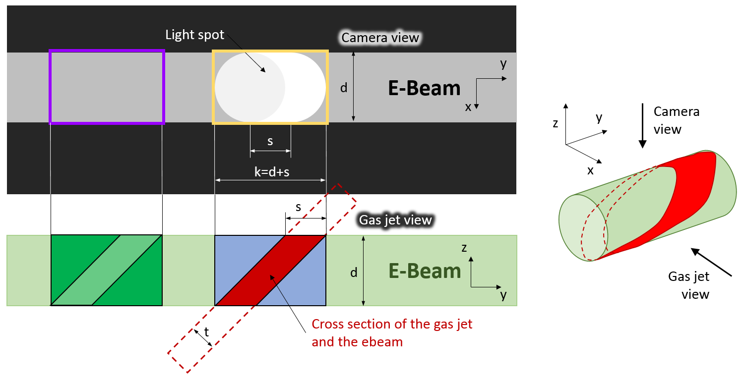
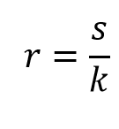
Prinziple Pressure Calculations

Slide 28
Pressure Calculation
Partial pressure of the gas jet:
$$p_{pasjet\left(part\right)}=p_{chamber}\frac{N_{gasjet}}{N_{background}}=p_{chamber}\frac{N_{peak}−N_{background}}{r N_{background}}$$
Absolute pressure of the gas jet:
$$p_{gasjet\left(abs\right)}=p_{gasjet\left(part\right)}+p_{chamber}$$

Slide 29
Assumptions for Fluorescence Simulation
The fluorescence is in a linear ratio to the gas density (constant e-beam density)
The e-beam excites a gas of consistent density at the same rate as it excites the phosphor screen to fluorescence → image taken with the phosphor screen represents the e-beam profile
The profile of the e-beam is constant over the whole regarded volume
The camera is sufficient far away of the interaction point
Sharp limitations of the gas jet

Slide 30
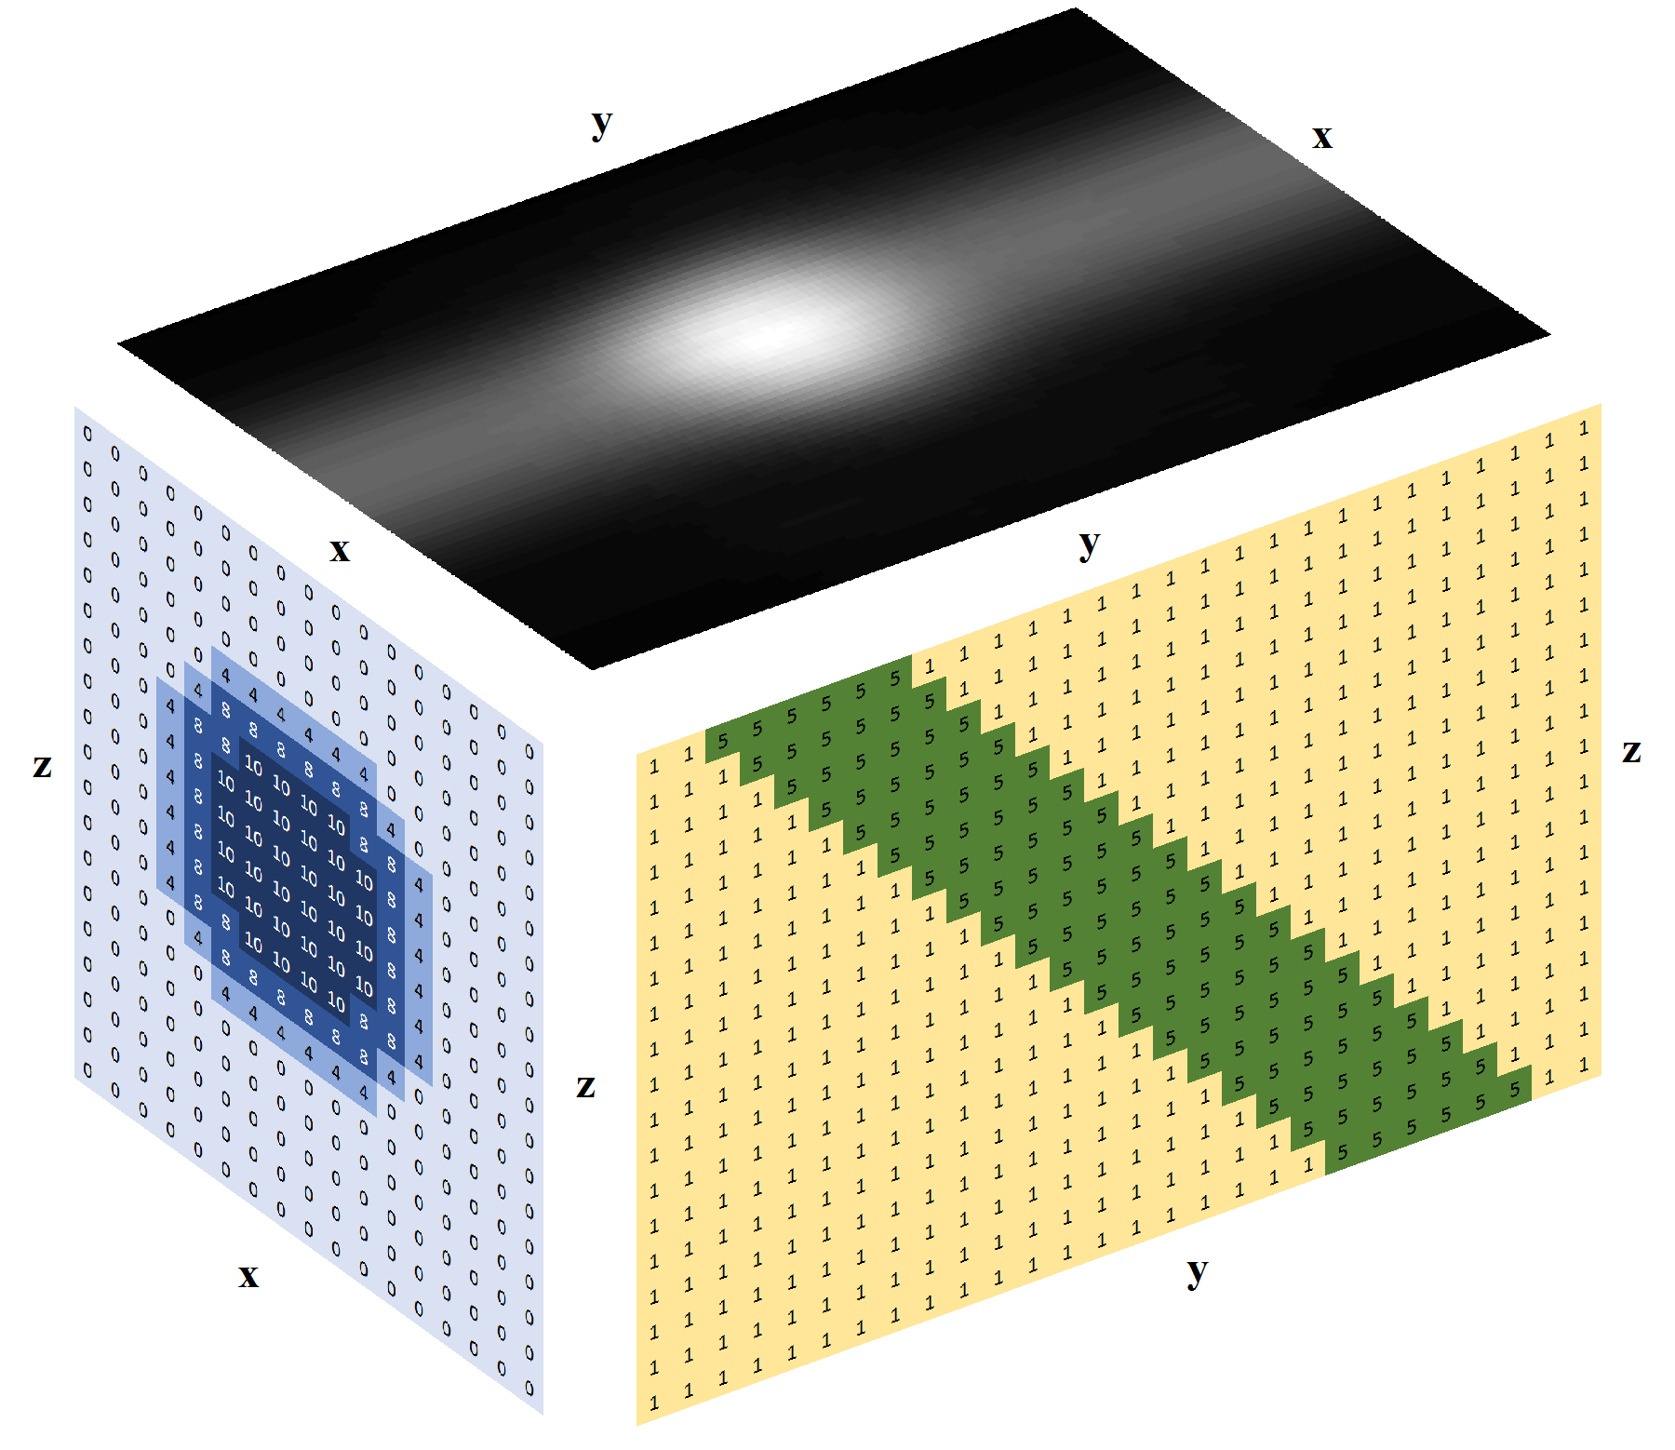
Simulation of the Fluorescence Image
xz plane = matrix (image) of the beam profile
yz plane = cross section of the gas jet = pressure distributions/thickness of the gas jet
  Each xyz volume element radiates fluorescence in linear dependency to pressure and beam intensity
  Suming up the fluorescence of the volume elements in the z-axis for each xy-pixcel
  Greyscale image of the fluorescence
e-beam
gas jet

Slide 31
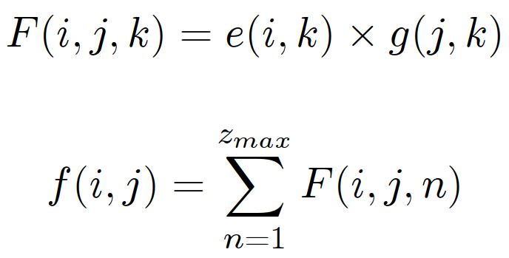
Simulation of the Fluorescence Image
e: E-beam image with 2 dimensions and an intensity value in the xz-plane
g: Gas jet density proﬁle in the yz-plane
F: Emittance of each volume element of the xyz-volume
f: Fluorescence signal projected in the xy-plane
f
e
g
Implemented first in Octave, then in c++

Slide 32


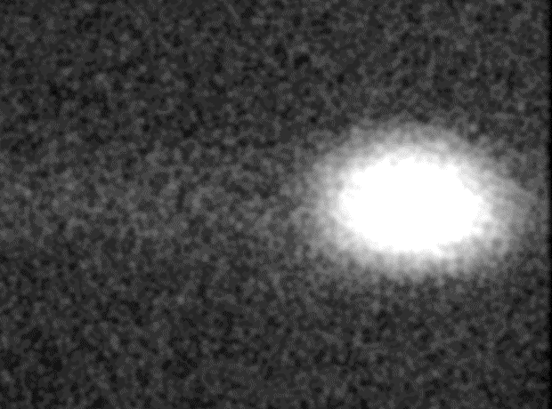

Cross Section of the E-Beam
simulated fluorescense image
beam profile
fluorescense image from the experiment
perfect cylindrical profile
real beam profile
modified for better contrast

Slide 33
Conclusions
Alignment of the first skimmer within 6.5 μm is possible
New calculation of gas jet pressure consider gas jet thickness
Simulations can verify reading out of fluorescense images

Slide 34
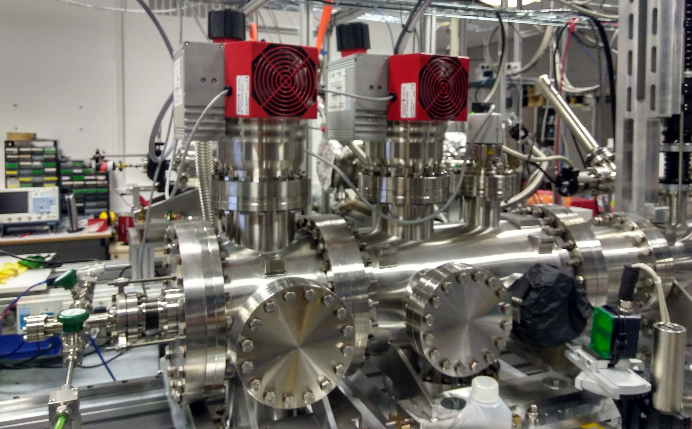
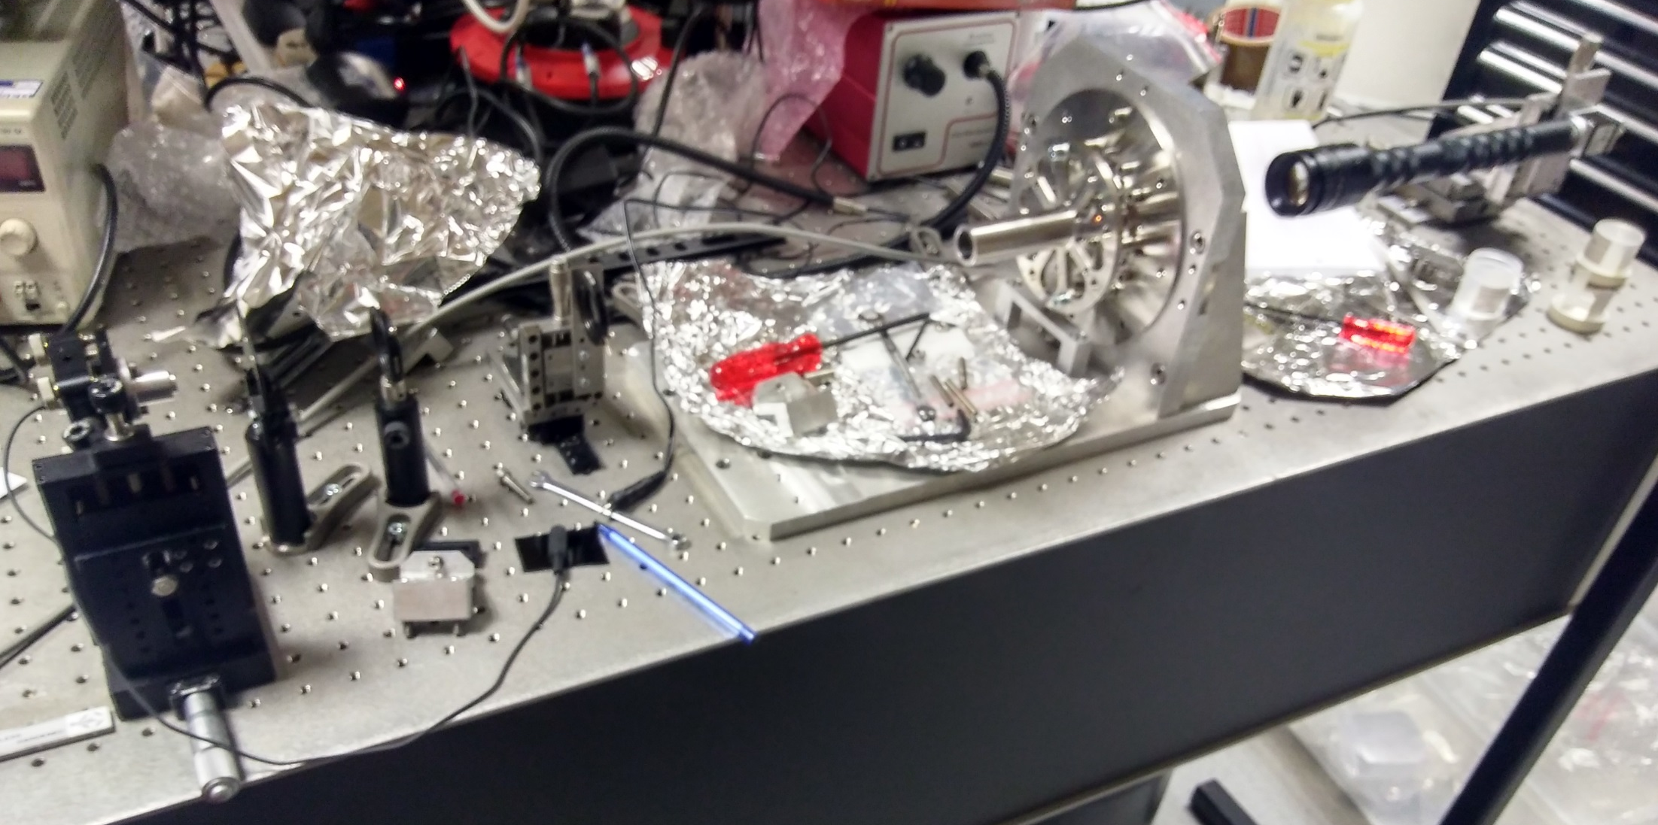
Conclusions
Verification of the functionality of the procedure in the real experimental setup at the Cockcroft Institute near Liverpool

Slide 35
Questions?

Slide 36
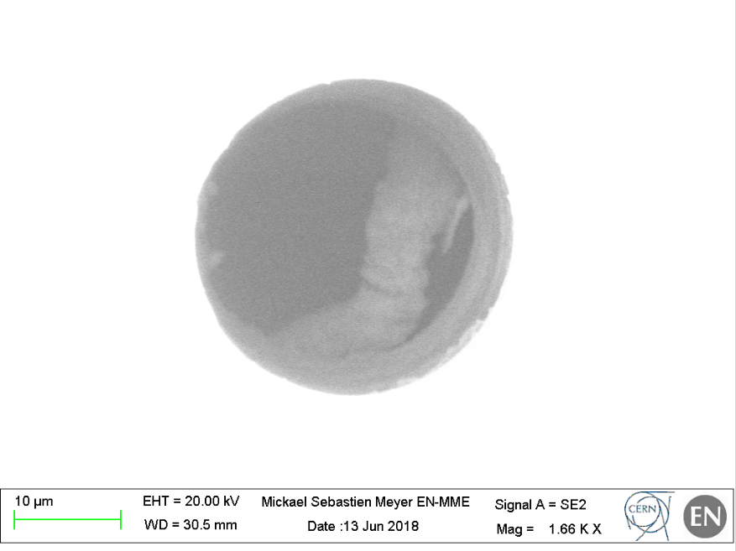
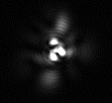
The 30μm hole

Slide 37
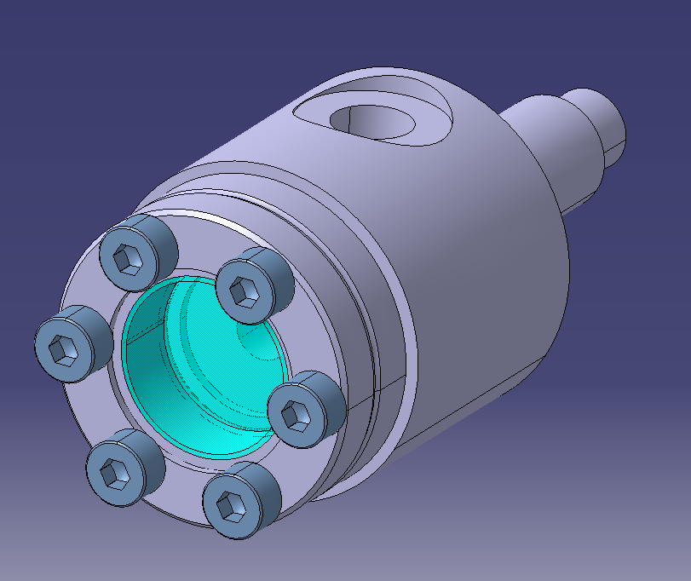
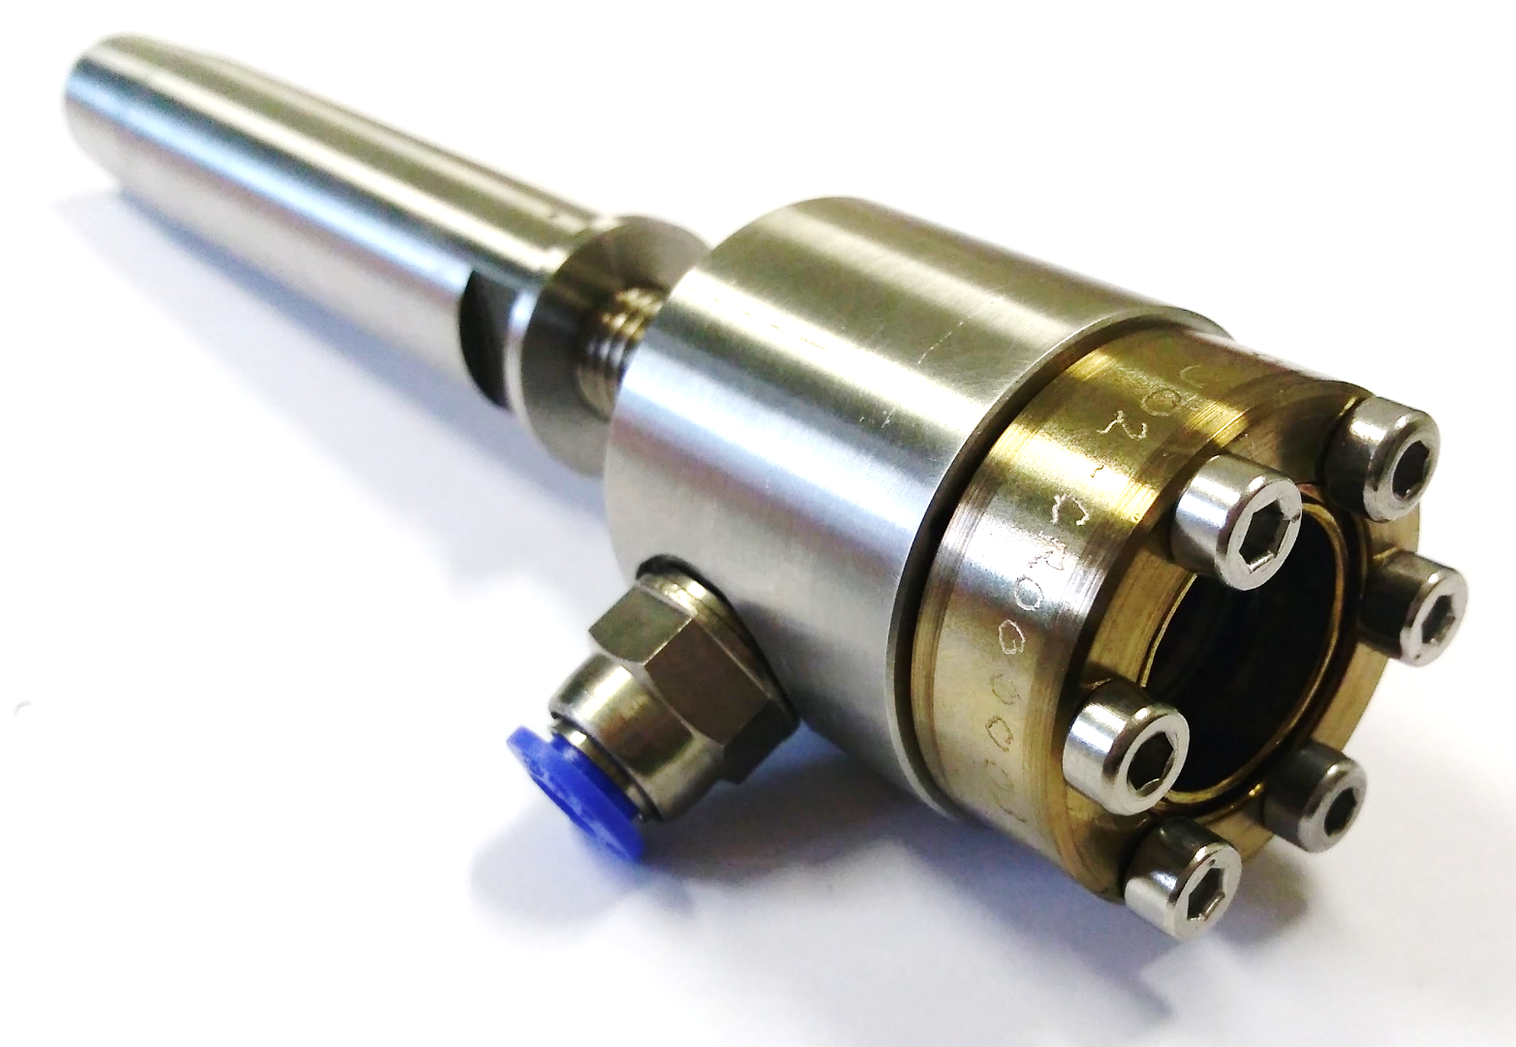
Release of the nozzle hole

Slide 38
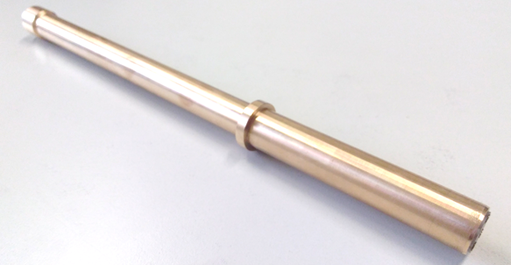
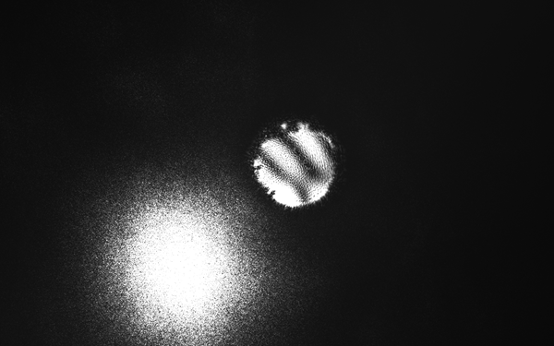
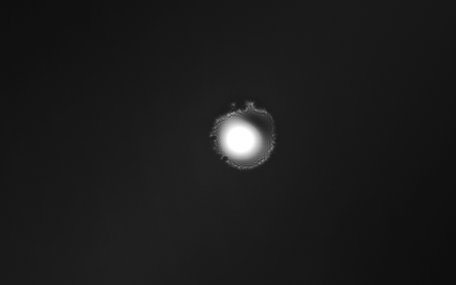
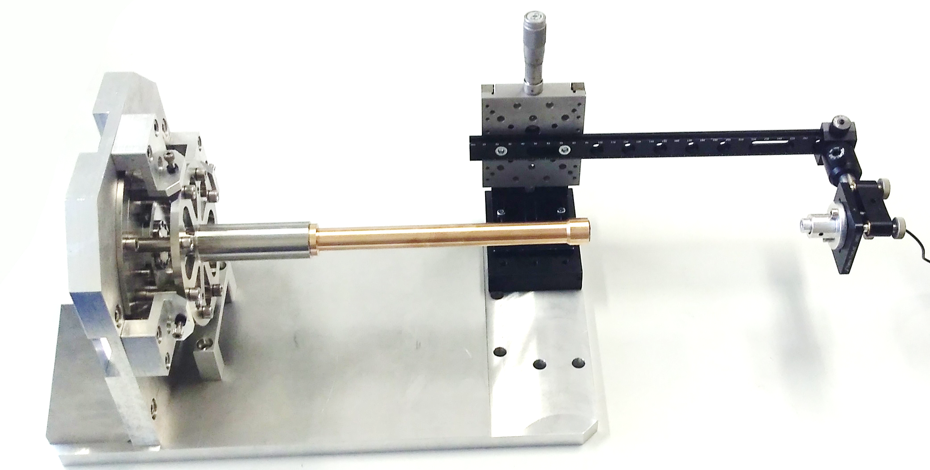
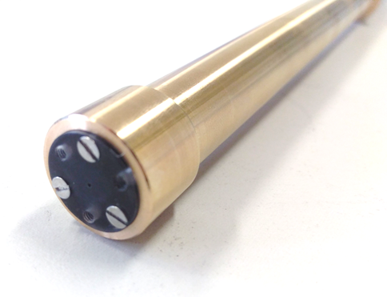
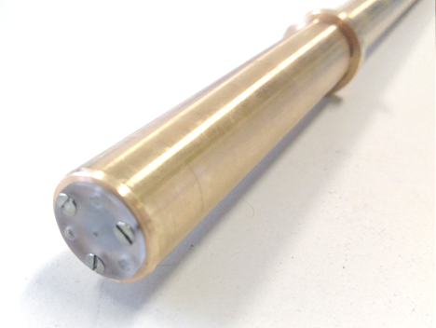
Prealignment
Length: 300mm
misaligned
aligned
centred holes of 0.8mm

Slide 39
Diffraction Pattern of the Laser

Slide 40
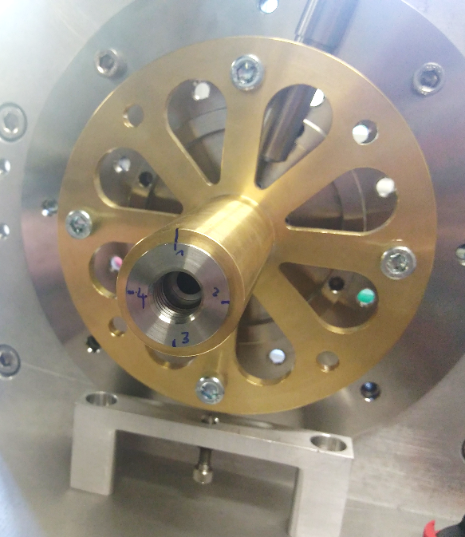



Position of the Nozzle at Different Orientations
Mean radius outside: 4.3
Mean radius inside: 8.5
Difference: 4.2
$$α_{dev}≈\arctan{\frac{4.2μm}{300μm}≈0.8°}$$
Measurable with the iris system:
$$α^{∗}≈\arctan{\frac{1.5mm}{173mm}≈0.5°}$$
If the nozzle is build in tuned by 180° this causes an angle error of 1.6°
Aligning to this angle (0.8°) will result in a deviation in the 3rd skimmer plane of the ideal position of :
$$∆x=356mm ∗ \frac{4.2}{300}=5mm$$

