Slide 1
Muon & Correlator Trigger Architecture Options
Achieving Muon Universality?
D.Acosta

Slide 2
Science Drivers and Requirements
Maintain sensitivity to electroweak scale physics at higher luminosity and pileup of the HL LHC
  Report all standalone muon coordinates and momenta in
  convention to facilitate global correlation with tracks from the Track Trigger
    The tracker will have far better P_{T} resolution for rate reduction
  Incorporate additional HL LHC forward muon detectors to improve
    Efficiency, redundancy, and improved standalone
    PT measurement
  Maintain standalone muon trigger (without track combination)
  for sufficiently high P_{T} threshold
    HL LHC is “only” 3-4X higher lumi, and we increased the max L1 rate
Add sensitivity to new physics scenarios, i.e. acceptance to displaced muons and HSCPs from long-lived particle decays
  Additional patterns/logic (displaced tracks, timing)
  Expanded momentum assignment (vertex constrained and not)

Slide 3
Comment about displaced muons in endcap
A large source of displaced muons for the endcap regions is beam halo, which is not included in our HL LHC simulations
Looking at rates in 2015, the halo muon rate per bunch was measured using the CSCTF (predecessor to EMTF).
Scaling to 2500 bunches gives ~30 kHz !
Algorithms for displaced muons will need to consider that other background source
  non-pointing, but not parallel to beamline (e.g. displaced in x-y)
(Thanks to Osvaldo Miguel Colin)

Slide 4
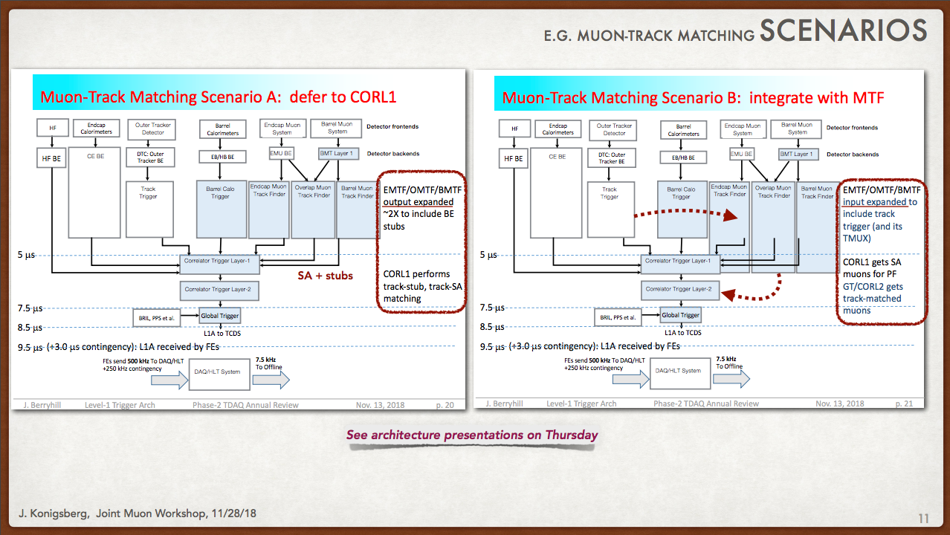
Muon-Track Matching Architectures
Original baseline
Another variant
Proposed from barrel muon trigger groups

Slide 5
Endcap Muon Standalone Track-Finding
Proposed baseline EMTF++ for Phase-2 does regional standalone (SA) track-finding in the endcaps (“Layer-1”)
  12 sectors, 6 per endcap
  Takes trigger primitives from existing or new muon detector electronics
Recent studies show that “tracker muons” (track + muon stub matches) are interesting to include for performance reasons beyond just track + SA muon
Could have EMTF++ send out muon stubs in addition to standalone muons to the Correlator for matching with tracks
  If time multiplexed, send all stubs within a time window around current BX (HSCPs, monitoring,…)

Slide 6
Variation of Muon Track-Finding
The proposed variation of this is to postpone SA muon track-finding and only send stubs from Layer-1 (concentrated to higher bandwidth links).
  Then the Correlator layer finds both standalone muons and track+muon matches
  Matches current barrel region architecture proposal
  Allows smaller/cheaper FPGAs for data concentration
  (or re-use old hardware)
  But adds to latency, and project cost (who does this concentration layer?)
    One option is to use current Phase-1 EMTF as a concentrator for Phase-2

Slide 7
Input Link Count for full Endcap Coverage
Prior assumptions, per 60° sector, with neighbor sharing (+N):
  CSC:
    3.2 Gbps links from legacy MPCs (40+9)
  RPC endcap via CPPF/New RPC electronics:
    12.5 Gbps links from LBs + RE1/3+RE2/3 (8+2)
  iRPC forward:
    RE3/1: 10 Gbps links (3+1)
    RE4/1: 10 Gbps links (3+1)
  GEM:
    ME0: 10 Gbps links (3+1)
    GE1/1: 10 Gbps links (8+2)
    GE2/1: 10 Gbps links (9+2)
  DT:
    10 Gbps links, 1/30° for MB2/1+MB2/2 (2+1)
Summary for Regional SA tracking:
  95 links per 60° sector [Includes sharing]
  12 cards total, ~1100 total input links for ~7 Tbps bandwidth
Assumes no CSC data concentration
Assumes link concentration for RPC as current CPPF
iRPC electronics will be distinct from RPC Link board replacement
Provision to cover overlap with barrel

Slide 8
Endcap Data Concentrator Only
Remove neighbor inputs (and barrel) for concentrator mode (no need)
  CSC:
    3.2 Gbps links from legacy MPCs (40)
  RPC endcap via CPPF/New RPC electronics:
    12.5 Gbps links from LBs + RE1/3+RE2/3 (8)
  iRPC forward:
    RE3/1: 10 Gbps links (3)
    RE4/1: 10 Gbps links (3)
  GEM:
    ME0: 10 Gbps links (3)
    GE1/1: 10 Gbps links (8)
    GE2/1: 10 Gbps links (9)
Summary:
  74 links per 60° sector
  Could fit into existing EMTF system, for example
    Optical link input limit is 84 x 10 Gbps for an MTF7 uTCA processor,
    and output is 24 x 10 Gbps

Slide 9
An Endcap Data Concentrator Layer-1
Despite the large number of input links, the stub occupancy in the muon system is rather low even at HL LHC
  The input links are mostly sending “zeroes”
The first layer can zero suppress, concentrate, and time multiplex muon stub data for transmission to Layer-2
  If this is an “intelligent” Layer-1, it also can perform standalone muon track-finding in the endcap in parallel to concentration (as currently)
What constitutes a stub?
  Could be a multilayer CSC LCT, or ME0 GEM stub
  RPC and GE1/GE2 hits might need a coincidence with a CSC because of background noise rates (for now don’t include in calculations)
    Good case for forming “super-primitives” in Concentration Layer
  Allows for finding “tracker muons” in Correlator (TT tracks + single stub)
Concentrator Layer-1 is essentially equivalent to a fast DAQ path, but sending data for every BX rather than on L1Accept (as current EMTF)
How much data?

Slide 10
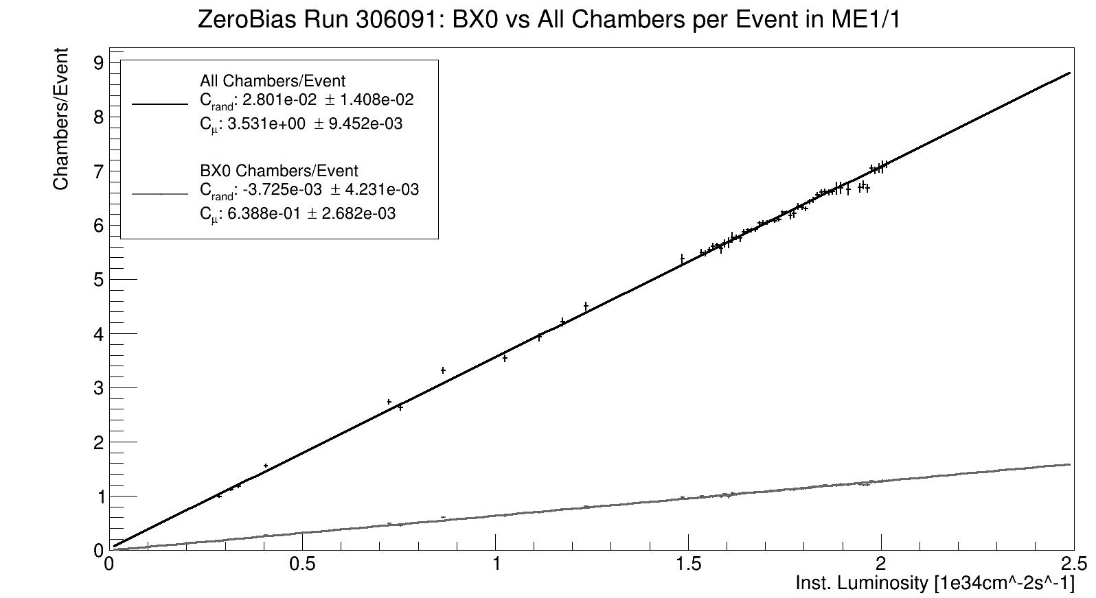
CSC LCT Occupancy from Data
A.Aubuchon, Northeastern U
All BX in readout
# CSC chambers with ≥1 LCT
BX0 only: 5.5X reduction
→ 6.5 stubs/BX
at HL LHC

Slide 11
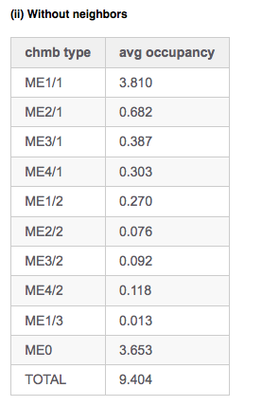
MC Study of CSC+ME0 LCT Occupancy
Jia Fu Low,
PU=200 sample
MC yields 5.8 CSC stubs/BX, in good agreement with data (6.5)
ME0 adds 3.7 stubs/BX for full eta region
(1.7 for |𝜂|<2.4)
Sum is ~10 stubs/BX, or ~0.8 stubs/BX/sector

Slide 12
Layer-1 Output Data for Standalone Muons
“Intelligent” Layer-1
Assume up to 3 muons / sector / BX
  Any combination of prompt or displaced muons
Start from Phase-1 Muon Trigger Detector Note:
  192 bits for 3 muons → 64 bits/μ (Phase-1)
To this add another P_{T} word for displaced μ hypothesis, (+9 bits), plus more spare bits for future use
Propose: ~100 bits/μ (a là Track-Trigger)
  Up to 3μ /sector/BX at 64/66 encoding → 300 bits
  → 1x 16 Gbps link/sector
  One output link ≥ 16 Gbps per sector per target destination for standalone tracks, even without longer time multiplexing latency
How many stubs need be sent on (perhaps) additional links?

Slide 13
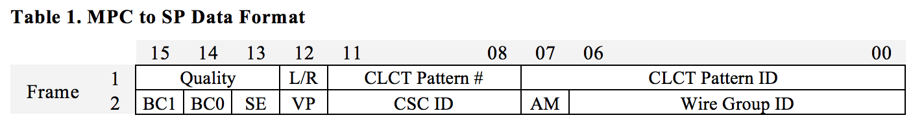
CSC+ME0 stubs per 60°sector
For now assume one stub takes as much data as a CSC LCT sent from the MPC: ~40 bits
  32 bits per correlated LCT
  Plus additional bits [7] for
  labeling which CSC LCT of the possible 5*18 = 90 CSC LCTs/BX/sector
Unassociated stubs from pileup are ~0.8/BX/sector
  ≤ 2 @ 95% CL → 80 bits / BX / sector
  If time-multiplexed, need to send stubs from a time window around current BX
    Useful for HSCP trigger plus commissioning and operations monitoring to see stubs before an after in-time crossing
    Including +/- 2 BX → ~4 unassociated stubs/sector (≤ 8 @ 95%CL)
    → 8 stubs * 40 bits = 320 bits / 5BX / sector
Allow stubs from up to 3 muon tracks per sector for a signal in event
  Assume muons (and their segments) are in-time (1 BX, even if TMUX)
  Assume each track can have 4 stubs
  3 tracks * 4 stubs * 40 bits ~ 500 bits

Slide 14
Endcap Data Bandwidth to Layer-2
~1 kb of data/sector
Endcap muon data to send to Layer-2, per sector
  Tracks: 300 bits (if done in Layer-1) → 12.5 Gbps
  Stubs: 600, 800 bits (TMUX=1, >1) → 25, 33 Gbps
  46 Gbps @ 64/66 encoding [33 Gbps stubs only]
For a latency of 1 BX+serdes for transmission (e.g. TMUX=1):
  Tracks + stubs: 3 x 16 Gbps links per sector, or 2 x 25 Gbps
  Stubs only: 1 x 25 Gbps links, TMUX=1
  or 2 x 16 Gbps links, TMUX>1
For a latency of 3 BX+serdes (e.g. for TMUX ≥ 3)
  1 x 16 Gbps link per sector (or higher BW)
    Or 1 x 10 Gbps (old EMTF concentrator, 8b10 encoding), 4 BX latency
For entire endcap muon tracks + stubs to a target Layer-2 node
  36 x 16 Gbps @ 1 BX [24 x 16 Gbps or 12 x 25 Gbps, stubs only]
  12 x 16 Gbps @ 3 BX
÷TMUX
Or even more data for longer latencies

Slide 15
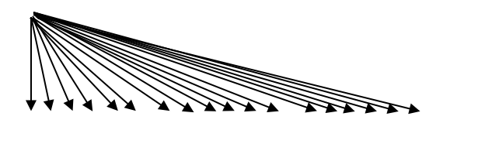
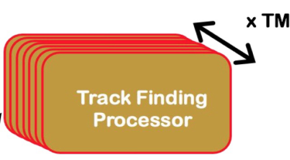
Muon+Correlator Architecture, TMUX Model
Barrel Muon System
(Standalone ME Muons) + Stub Data Concentrator
95
12 ME sectors
Layer-1
60 MB sectors
Track Trigger
18 x 1
…
In ~2.5 us
Layer-2
12
Correlator layer
In ~5 us
18 processors
(1 per time slice) take all muon and all Tracker data
9 x 2
9 regions by ~18 time slices, 2 links each

Slide 16
Muon Correlator Board Inputs, TMUX Model
Track Trigger
  18 x 25 Gbps (9 regions by 2 links per time sample)
Endcap Muon (New Layer-1)
  12 x ≥16 Gbps for 3BX + SerDes latency (stubs, or stubs+muons)
  or 36 x ≥16 Gbps (24 x 25 Gbps) for 1BX + SerDes latency
Endcap Muon (Re-use old EMTF as concentrator)
  12 x 10 Gbps, stubs only
Barrel Muon
  60 x ≥16 Gbps (60 layer-1 processors)
Total links per Concentrator (+standlone muon) module
  90 links for each of 18 cards (fits in APx card)
    Does not allow +12 more links from endcap if needed, in APx
    Does not allow links from other subsystems for correlation
options
Barrel muon dominates, could use its own concentrator layer?

Slide 17
Muon Correlator Board Logic and Latency
Note that latency to receive muon data should be ~2.5𝜇s, whereas that for the Track Trigger is ~5𝜇s
  Can receive (and buffer) all muon data for a given BX before tracks are available
  Standalone muon reconstruction can start in advance of track matching and not add to overall latency
    But now done globally, with TMUX, and not just regionally
      Increased logic, but also increased latency available
  Can immediately test tracks with all SA muons + stubs as tracks are received

Slide 18
With Dedicated Barrel Track-Finder/Concentrator
60 MB sectors
(Standalone ME Muons) + Stubs
(Standalone MB Muons) + Stubs
…
12 ME sectors
…
12 MB sectors
Maybe even far fewer
Correlator layer
Track Trigger
N processors
take all muon and all Tracker data
9 x 2
9 regions by ~18 time slices, 2 links each

Slide 19
Muon Correlator Board Inputs with MB Concentrator, TMUX Model
Track Trigger
  18 x 25 Gbps
Endcap Muon
  12 x ≥16 Gbps (or 10 Gbps)
Barrel Muon
  12 x ≥16 Gbps (assume same as for endcap)
Total links per Muon Correlator time slice
  42 links
Could fit more than one time slice per APx card:
  9 cards (2 time slices) → 60 links for longer muon serdes (+3BX)
  6 cards (3 time slices) → 78 links for longer muon serdes (+6BX)
Or could fit additional subsystem inputs for same 18 cards

Slide 20
Regional Track-Finding and Matching
Another alternative
60 MB sectors
(Standalone ME Muons) + Stubs
(Standalone MB Muons) + Stubs
12 ME sectors
12 MB sectors
Maybe even far fewer
Correlator layer
Track Trigger
9 processors
take all time slices for specific nonets
18 x 2
9 regions by ~18 time slices, 2 links each

Slide 21
Muon Correlator Board Inputs with MB Concentrator, Regional Model
Take all time slices into one board
Track Trigger
  36 x 25 Gbps (18 time slices by 2 links per 40∘ nonet region)
Endcap Muon
  (<) 12 x 25 Gbps (up to 12 sectors, higher bandwidth to get stubs in 1 BX without TMUX)
Barrel Muon
  (<) 12 x 25 Gbps (assume same as for endcap)
Total links per Muon Correlator time slice
  (<) 60 links (+12 if sending SA tracks from endcap Layer-1)
Target 9 APx cards (one per 40∘)
SA Muon Logic in Layer-2
  Could limit SA muon reconstruction to relevant sector around Tracker nonet → move SA muon tracking also to 40∘ sector ?
Correlator logic
  Will need stubs from wider region of muon system (~180∘), but covered by links above
  Leaving tracker data time multiplexed implies correlator target would receive links from 9 regions per time slice
Could even double region to 2 nonets (80∘) for 5 APx cards
  (<) 96 links (one board only gets a 40∘ region)

Slide 22
Architecture Conclusions, 1
Could perform standalone muon reconstruction and track matching in one layer for barrel-overlap-endcap in a set of 18 cards → unifies muon trigger
  I/O takes 90 links per card
  But need to verify logic usage in FPGA to check if logic for entire detector can fit in the FPGA resources and in the latency
  Requires rewriting EMTF algorithm from regional → global+TMUX
  Requires group(s) to contribute an endcap concentrator layer,
  or re-use the Phase-1 EMTF
    Could be used to form super-primitives
Adding a BMTF Concentrator/TF Layer can reduce number of Layer-2 cards required for track matching, or accommodate additional subsystem inputs
  Requires group(s) to contribute a barrel concentrator/TF layer

Slide 23
Architecture Conclusions, 2
Having an “intelligent Layer-1 that finds SA muons in addition to stub concentration does not significantly increase the data BW to Layer-2
  Still one output link per Correlator target
  Reduces logic resources required in Layer-2, but adds to Layer-1
  Would allow use of baseline regional EMTF++ algorithm
  But breaks barrel-endcap symmetry unless barrel region does same
    And would need to share data across boundary
A regional approach (vs. TMUX) is also feasible for track+muon correlation
Standalone muon reconstruction can take place before Tracker Trigger tracks are available for correlation
  ~2.5 𝜇s vs 5.0 𝜇s, either in Layer-1 or Layer-2 (assuming SA latency ~ Phase-1 latency)

Slide 24
BackUP

