Slide 1
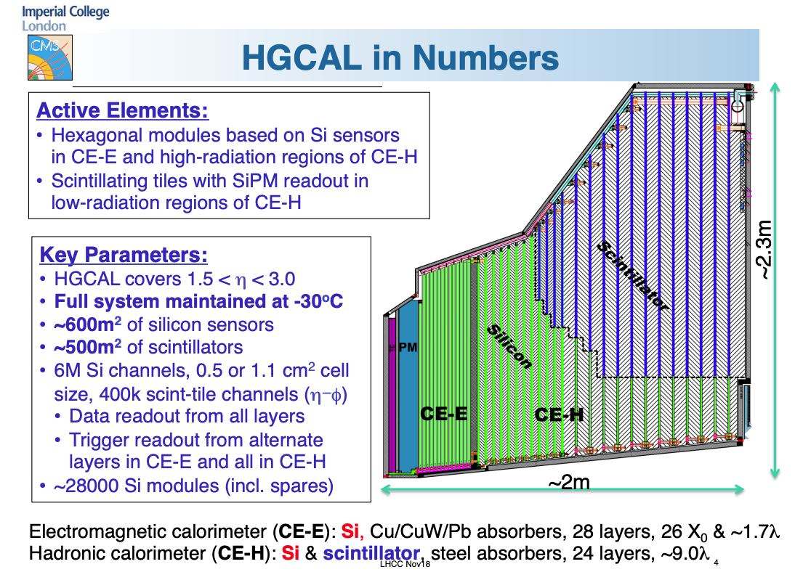
TDR

Slide 2
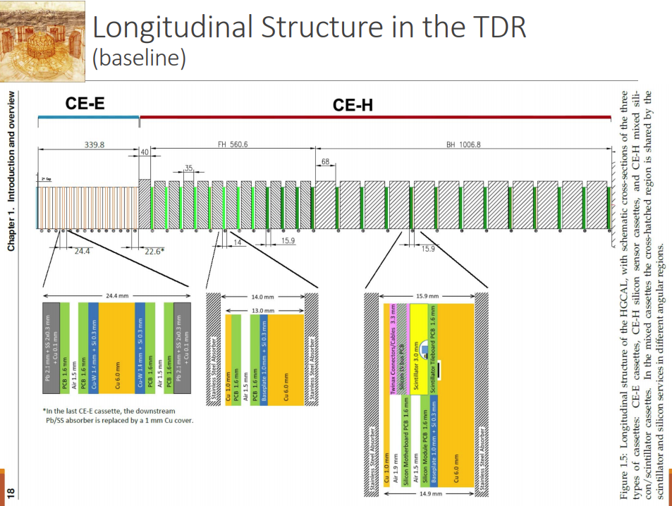
total
10.7 λ → 9.3 λ = −1.4 λ??
+75 mm
-93 mm

Slide 3
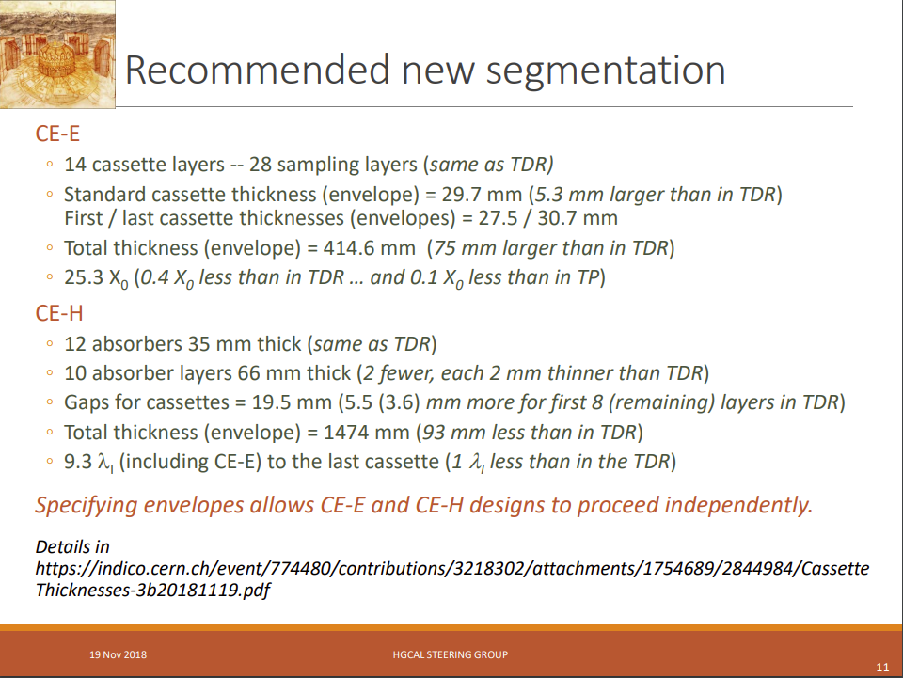

Slide 4
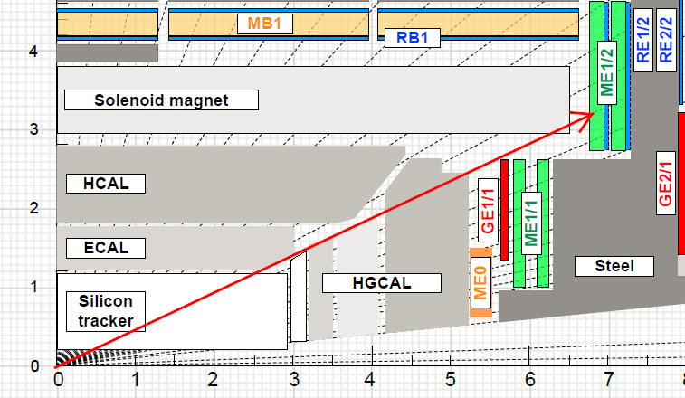
How the muon system is affected?
About ~1 λ (or more?) means that the probability for pions to cross the calorimeter without hadronic interaction will be 2.7 times higher
We need to understand the background and radiation level (Bril group involded)
Evaluate the performance (in particular trigger)
- new geometry in CMSSW need to be provided centrally→ new samples.
- redo all our performance studies (local recontruction, trigger)
- understand implication on aging.

