Slide 1
Muon trigger architecture
Joint P2 Muon Upgrade + P2 L1 Muon Algorithms workshop
29 November 2018

Slide 2
Muon Trigger architecture, version 1a
Tracking Trigger
DT
Barrel
RPC
Endcap RPC
CSC
GEM
Layer 1
Segment building
from DT and RPC hits
Station level (?)
Cross station (?)
Segments
(DT only, DT+RPC, CSC),
GEMs, Unmatched DT hits,
Unmatched RPC hits
No Time Multiplexing
Standalone candidates finding, including non-pointing and HSCPs
Barrel
MTF
Overlap MTF
Endcap MTF
5 μs
N.B. The latency of the current trigger till the uGMT out is 2.8 μs
GMT
Phi and Eta Ghost busting
Standalone candidates with loose quality (it can be even single DT segment)
With associated segments/hits
Correlator L1
Matches the muon segments/hits with the Tracking Trigger tracks,
TT isolation, Muon Ghost Busting.
Particle Flow
Time Multiplexing
Standalone candidates not matched to ttTracks
Correlator L2
Particle Flow
Global Trigger
~5 μs

Slide 3
Muon Trigger architecture, version 1b
Tracking Trigger
DT
Barrel
RPC
Endcap RPC
CSC
GEM
Layer 1
Segment building
from DT and RPC hits
Station level (?)
Cross station (?)
Segments
(DT only, DT+RPC, CSC),
GEMs, Unmatched DT hits,
Unmatched RPC hits
No Time Multiplexing
Standalone candidates finding, including non-pointing and HSCPs
Barrel
MTF
Overlap MTF
Endcap MTF
5 μs
N.B. The latency of the current trigger till the uGMT out is 2.8 μs
Standalone candidates with loose quality (it can be even single DT segment)
with associated segments/hits
GMT/Muon correlator
Standalone Phi and Eta Ghost busting
Matching the muon segments/hits with the Tracking Trigger tracks,
TT isolation, Muon Ghost Busting.
If GMT passes all ttTracks to the Correlator L1 then no need of direct connection from Tracking trigger to Correlator
Time Multiplexing
Correlator L1
Particle Flow
Standalone candidates not matched to ttTracks and ttTracks tagged as muons.
This connection might be very useful during commissioning
Correlator L2
Particle Flow
Global Trigger
~5 μs

Slide 4
Muon trigger algorithm draft version 1
Goal: do as much as possible before matching to the ttTracks - to reduce the latency
Build trigger primitives
  Barrel: layer based DT+ RPC,
  if BX identification not unique, sent to the Track Finders all reasonable segments (TF will clean them correlating with other layers).
  Sent to the TF not matched RPC or even DT hits
  Endcaps?
Track Finders – no TM
  Build standalone muon candidates including displaced and HSCPs. To maximise the efficiency allow for “wide roads”. Single layer (high quality) DT(+RPC) segment also threaded as standalone candidate
  For every standalone candidates in each layer at most one hit/segment should be assigned (this will simplify significantly the step 3c). If this requirement affect the performance, two hits/segments can also be allowed.
  Assigne standalone phi, eta, pT, charge, d0, BX
  Send the standalone candidates and associated hits/segments to the GMT/correlator
GMT/correlator – TM
  Standalone candidates eta and phi ghostbusting
  Coarse matching of the ttTracks to the standalone muon candidates – extrapolate the ttTrack to the muon system (based on ttTrack pT, charge, eta, phi) and select the standalone candidate that has compatible phi and eta (standalone muon pT measurement ignored).
  NB. One extrapolation for every ttTrack, therefore the logic should be as simple as possible.
  Fine matching of the selected ttTrack to the hits/segments of the matched standalone candidate.
  Ghost busting: choosing the ttTrack that fits best to given standalone candidate hits/segments.
  ⇒ each ttTrack is tagged as muon or not (pT, charge, eta and phi taken from the ttTRack), the standalone candidates not matched to any ttTrack become displaced candidates

Slide 5
Version 1b – TF-GMT link and GMT board count
Hit/segment global coordinates:
  Phi: ~14 bits
  phiB: ~10 bits
  Eta: ~10 bits
  Layer/station: 3 bits
  Sublayer or z: 2 bits
  Quality: 3 bits
  ~42 in total
  Assuming let’s say 8 hit/segments per standalone muon candidate = 336 bits
  standalone muon coordinates: ~40 bits for eta, phi, pT
  Everything just fits in data transmitter by 1 link during 1 BX:
  Links 16 Gbps 64b66b = 384 bits /bx
  One link from one Track Finder board can transmit up to n candidates and its hits/segments, where n is TM factor – much more then needed.
One GMT board receives then 36 links from TF (assuming the same number of boards as now) and 18 links from Tracking Trigger (2 links from each nonant) - assuming TM18.
Then 18 GMT boards needed.
But probably this can be reduced to 9 boards – assuming one TF-GMT link transmits data from 2 Bxes (total number of links 18+18+36)

Slide 6
Muon Trigger architecture, version 2
Tracking Trigger
DT
Barrel
RPC
Endcap RPC
CSC
GEM
Layer 1
Segment building
from DT and RPC hits
Station level (?)
Cross station (?)
Segments
(DT only, DT+RPC, CSC),
GEMs, Unmatched DT hits,
Unmatched RPC hits
No Time Multiplexing
NB. The fibers from each ttTracks processor must go to 5 TF boards
Barrel
MTF
Overlap MTF
Endcap MTF
Standalone candidates finding, including non-pointing.
5 μs
N.B. The latency of the current trigger till the uGMT out is 2.8 μs
Time Multiplexing
Correlator L1
Particle Flow
GMT
Ghost busting
Correlator L2
Particle Flow
Standalone candidates not matched to ttTracks and ttTracks tagged as muons.
This connection might be very useful during commissioning
Global Trigger
~5 μs

Slide 7
Muon trigger algorithm draft version 2
Build trigger primitives
  Barrel: layer based DT+ RPC,
  if BX identification not unique, sent to the Track Finder all reasonable candidate segments (TF will clean them correlating with other layers).
  Sent to the TF not matched RPC or even DT hits
  Endcaps?
Track Finders, ttTrack correlation – TM, one board for full phi, but system still segmented in eta.
  Build standalone muon candidates including displaced and HSCPs. To maximise the efficiency allow for “wide roads”. Single layer (high quality) DT(+RPC) segment also threaded as standalone candidate
  For every standalone candidates in each at most layer one hit/segment should be assigned (this will simplify significantly the step 3c). If this requirement affect the performance, two hits/segments can also be allowed.
  Assigne standalone phi, eta, pT, charge, d0, BX
  When ttTRacks arrive: coarse matching the ttTracks to the standalone muon candidates – extrapolate the ttTrack to the muon system (based on ttTrack pT, charge, eta, phi) and select the standalone candidate that has compatible phi and eta (standalone muon pT measurement ignored).
  NB. One extrapolation for every ttTrack (a few hundreds per BX), therefore the logic should be as simple as possible.
  Fine matching of the selected ttTrack to the hits/segments of the matched standalone candidate.
  Ghost busting: choosing the ttTrack that fits best to given standalone candidate hits/segments.
  ⇒ each ttTrack is tagged as muon or not (pT, charge, eta and phi taken from the ttTRack), the standalone candidates not matched to any ttTrack become displaced candidates
  Send the tagged ttTracks to the Correlator and GMT, send standalone displaced candidates to the GMT
GMT – TM
  Standalone and tagged ttTracks eta ghostbusting – needed to kill the standalone candidates found by the neighbouring Track Finders.
N.B. The need of tagged ttTracks ghostbusting between the track finders (i.e. in eta) can be avoided, if the ttTracks are sent to the Track Finders with sufficient overlay (~size of the W±2)

Slide 8
Remarks – latency
If the ttTrack coming from one nonant are sorted by eta, then the latency of the ttTracks to muons matching can be reduced – one does not have to wait for the last ttTrack from given BX to finalise the ghostbusting, i.e. one can send out the first ttTracks from the BX even before the last arrived
Standalone muon and its hits
η= -2.1
ttTracks not sorted
One must check every ttTtrack with every standalone muon/segmentes to say which fits best ⇒ you must wait for the last ttTrack before sending out the first one
ttTracks from one link
η= -2.2
η= 0.8
η= 0.1
η= -2.1
η= -2.0
η= -1.4
…
η= 1.1
η= -1.3
18 BX (up to ~70 ttTracks)

Slide 9
Remarks – latency
If the ttTrack coming from one nonant are sorted by eta, then the latency of the ttTracks to muons matching can be reduced – one does not have to wait for the last ttTrack from given BX to finalise the ghostbusting, i.e. one can send out the first ttTracks from the BX even before the last arrived
Standalone muon and its hits
η= -2.1
ttTracks sorted by eta
If the ttTracks are sorted by eta, one can ghost bust only the ttTracks separated maximally by a few BXs.
N.B. Ghost busting between the ttFibers is also needed
ttTracks from one link
η= 2.3
η= 1.8
η= -2.0
η= -2.2
η= 2.4
η= 2.0
…
η= -1.9
η= -2.1
18 BX (up to ~70 ttTracks)
Total latency contribution: transmission: ~6BX, matching and ghostbusting: ~6BX, waiting with ghostbusting ~6BX

Slide 10
Remarks
Bendnig of low pT tracks from vertex to the first muon station is up to 70° ⇒ the ttTracks from one nonant of the tracking (i.e. 40°) trigger must be merged with the muon segments/hits from 180° ⇒ the ttTrack merging with the muon segments/hits should not be divided between boards in phi.
The ttTracks tagging as muon should be as efficient as possible even for very low pT tracks, otherwise significant fraction of these low pT muons will be recognised as displaced muon (since not matched to ttTrack).
Fake tagging of very low pT ttTrack as a muon can reduce efficiency for displaced muons.
Otherwise is in principle not harmful (for the ttTracks below the lowest muon threshold) – provided for the particle flow the low pT tracks are not very important.

Slide 11
Backup

Slide 12
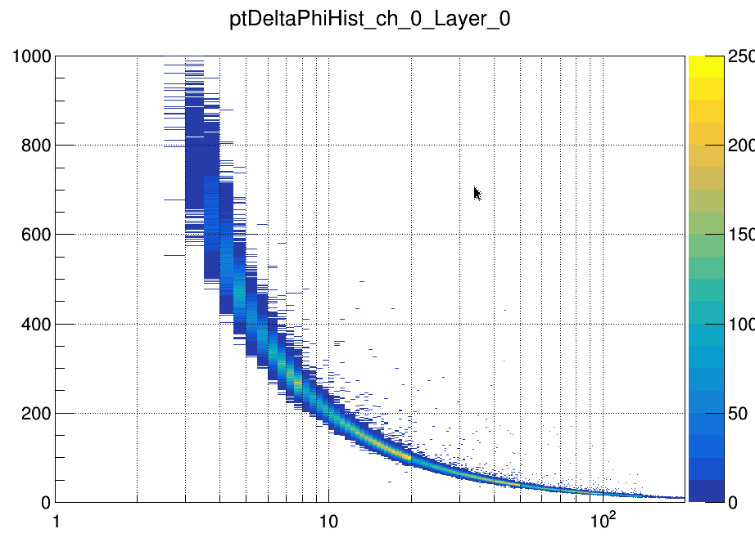
ϕ_{μ}-ϕ_{t} for DT MB1
67°
The distribution of ϕ_{μ}-ϕ_{t} is very wide – almost 70° - this indicated the range of the TT to the muon trigger connections (TT sector i.e. nonant is 40°)
ϕ_{μ}-ϕ_{t} [0.067°]
40°
What are those hits?
pT_{simTrack} [GeV]
Plot obtained from the OMTF emulator: ϕ_{μ}-ϕ_{t} is in the OMTF scale (i.e. the unit is CSC half-strip)

Slide 13
L1 Trigger latency, end of 2017
10
20
30
40
50
60
70
80
90
100
110
120
DT
MiniCrate
LVDS
Fiber 56m
OMTF
m. delay
o. OMTF algorithm + ghost busting
f. 40MHz→240MHz
p. GTH@3.2Gpbs
q. CSC links deserialization + alignment
r. fibers CPPF →OMTF
n. fibers TFs →uGMT
y. Coordinates conversion
EMTF
m. delays
p. GTH@3.2Gpbs
q. CSC links deserialization + alignment
r. fibers CPPF →EMTF
s. track finding algorithm
t. PT LUT
g. serialization + GTH @10Gbps
fibers TFs →uGMT
f. deframer
uGMT
k. GTH@10Gbps + deserialization
m. delay
u. ghostbusting and sorting algorithm
g. serialization + GTH @10Gbps
n. fibers TFs →uGMT
uGT
k. GTH@10Gbps + deserialization
m. delay
w. fibers uGMT→uGT
x. algorithm
18.5
13
9
11
L1A
CSC
Peripheral crate
MPC
Fiber
OMTF does not include the ME1/1, thus has 1.5BX shorter path then EMTF
Legned
19
21
2
3^{y}
23
1
?
fiber
LB
Fiber ≤ 110m
RX or TX
RPC+cables
?
delay
9
11
22
Algorithm
TCDS fiber
y. MPC: GTP @3.2Gbps
RPC link receiver (TwinMux, CPPF, OMTF, <EMTF>)
fiber from PAC Trigger Crate
GTH receiver @1.6Gbps
alignment, parity checking, etc.
demultiplexing
clusterization
40MHz→240MHz
TwinMux
DT data deserialization @480MHz + alignment
Masking + second track retiming
Technical trigger generation
Delay
l. Super-segment algorithm
f. 40MHz→240MHz
serialization + GTH @10Gbps
fibers TwinMux→BMTF/OMTFBMTF
y. latch
z. Cancelling the clusters tails in the next BX
BMTF
k. GTH@10Gbps + deserialization
m. delay
l algorithm (track finder + wedge sorter)
g. serialization + GTH @10Gbps
n. fibers TFs →uGMT
This latency is confirmed by the scope measurement, but it is not certain where it is (in the LB or GTH)
TwinMux
1f
Clock domain changing
or a latch
4^{h}
1f
2^{n}
RPC
3.5ª
DT+RPC SuperPrimitves
2^{i}
17^{m}
4^{l}
3^{g}
rpc_latency: 85
dt_latency: 67
8.5^{b}
3^{c}
^{m}
7^{d}
6e
^{z}
DT for OMTF
2^{i}
^{y}
1f
3^{g}
BMTF
HO
3.5ª
8.5^{b}
3^{c}
TwinMux
2^{j}
2^{k}
^{m}
6.5^{l}
3^{g}
2^{n}
^{m}
2^{n}
Master latency: 58.3
3ª
OMTF
RPC
12^{b}
3^{c}
6^{m}
7^{d}
7e
12º
1f
3^{g}
2^{n}
^{m}
2^{n}
TwinMux
2^{j}
3^{k}
12.5^{m}
2.5^{y}
These delays are on the uGMT, after GTH,
CSC
5^{p}
2^{q}
6^{m}
2^{y}
CPPF
RPC
3ª
8.5^{b}
3^{c}
^{y}
7^{d}
5e
1f
3^{g}
2^{n}
2^{n}
CSC
EMTF
^{m}
2^{n}
TCC SLB cable
5^{p}
3^{m}
2^{q}
14^{s}
4^{g}
3^{n}
^{m}
ECAL VFE to GOH
Fiber 93m
12
CPPF
3^{k}
f
23
19
8
Calo Layer-1
a. fiber
b. RX
m. delay
f. RX Alignment FIFO
l L1 Processing
g. serialization + GTH @10Gbps
n. fibers
uGMT
^{w}
2^{k}
4.5^{u}
3^{g}
Master latency: 40.2
T
RBX
Fiber 90m
uHTR
HB,HE
1
9
18
18
Calo Layer-2
a. fiber
b. RX @10Gbps
m. delay
f. RX Alignment FIFO
l L1 Processing
g. serialization + GTH @10Gbps
n. fibers
FinOr lemo output
TOF
RBX
Fiber 90m
uHTR
HF
3
9
18
17
uGT
Master latency: 27.2
^{w}
Not good yet
^{w}
3^{k}
^{m}
8.5^{x}
CALO Layer-1
3^{k}
^{m}
TCDS+AMC13+TTC decoder = 18.5 BX
HB,HE
ECAL
3ª
3^{b}
4.5^{m}
1f
3.7^{l}
7^{tmux}
1.5^{g}
1.5^{n}
HF
4ª
3^{b}
6.5^{m}
CALO Layer-2
4ª
3^{b}
9.5^{m}
/
3^{b}
2.5^{m}
?^{l}
1.5^{g}
DEMUX
Master latency: 65.8
3^{w}
3^{b}
2^{m}
?^{l}
2^{g}
3^{n}
Master latency: 44.8
^{w}
Notes:
Modifications versus the previous slide:
Decreasing the BMTF latency by 2 BX – result of the BMTF algorithm frequency increase

