Slide 1



Slide 2


Welcome to MLHEP’19!
2019-07-01, DESY
Andrey Ustyuzhanin
NRU HSE
YSDA
ICL

Slide 3
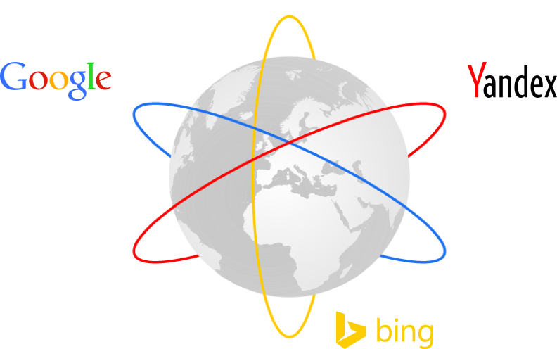
Global Search Engines

Slide 4
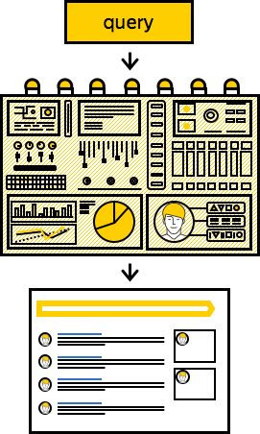
Machine Learning at Yandex
  Search Engine tasks:
    Processing of the entire web (~10¹⁰ pages, http://www.worldwidewebsize.com)
    Aggregation of users on behaviour analytics and
    micro-segmentation (~10⁸-10⁹)
    Personalized delivery of relevant URLs/Images/Ads with the highest click probability
  Internal Machine learning application examples:
    Navigation / maps
    Natural Language Translation
    Speech recognition/ synthesis
    Music streaming / recommendation
    Weather prediction (“nowcasting”)
    Ya.Taxi – demand prediction for specific space-time region, driving cars
    Self-driving car
    Voice Assistant “Alice”

Slide 5
Yandex School of Data Analysis
Established in 2007. Focuses the field of Statistics, Machine Intelligence and Deep Learning
Joint master’s program with leading Russian universities
2 years, 12+ courses (https://yandexdataschool.com/edu-process/program)
  Algorithms & Data Structures
  Programming Languages (C++ and Python)
  Machine Learning
  Big Data Storage & Processing
  Information Retrieval
  Deep Learning
  Reinforcement Learning
Admission:
  4000 applications per year
  250 are accepted per year
  ~600 graduated so far

Slide 6


Global Search Engines

Slide 7

HSE Faculty of Computer Science
  Established in March 2014,
  Active support from Yandex (more than 50 lecturers/seminarists are Yandex employee)
    Also cooperates with Kaspersky, WorldQuant, Huawei, …
  Goal: enter the world’s top 30 Computer Science faculties by 2020
    big data storing and processing,
    software development and system programming,
    machine learning
  370 students enter bachelor program per year
  ~100 graduate master’s program per year
  Member of LHCb collaboration since June 2018

Slide 8
International Partner Universities
  Humboldt-Universität zu Berlin
  Technische Universiteit Eindhoven
  Technische Universität Dresden
  Université Grenoble Alpes
  Université Blaise Pascal, Clermont Ferrand
  Radboud University, Nijmegen
  Aalto University, Helsinki
  Lappeenranta University of Technology

Slide 9
Laboratory of Methods for Big Data Analysis
  Group working on data analyses in Natural sciences
  4 physicists and 15 computer scientists
  Close partnership with Yandex School of Data Analysis
  Collaborates with LHCb, SHiP, OPERA, NEWS, CRAYFIS experiments
  Project examples:
    Storage/Speed optimization for triggers
    Particle Identification algorithms
    Ultra-High Energy Cosmic Ray Detection
    Fast MC Generation
  Open for internships!
https://cs.hse.ru/lambda

Slide 10




MLHEP - iterative training experiment
  2015 – Academic University, Saint Petersburg, Russia
  2016 – Lund University, Sweden
  2017 – Imperial College London, Reading, UK
  2018 – St Ann College, Oxford, UK

Slide 11
MLHEP 2019 timeline
Mon
Tue
Wed
Thu
Fri
Sat
Sun
Mon
Tue
Wed
Phase1-2
Phase3-4
Phase5-6

Slide 12

Sunday event
https://www.terascale.de/ml2019

Slide 13


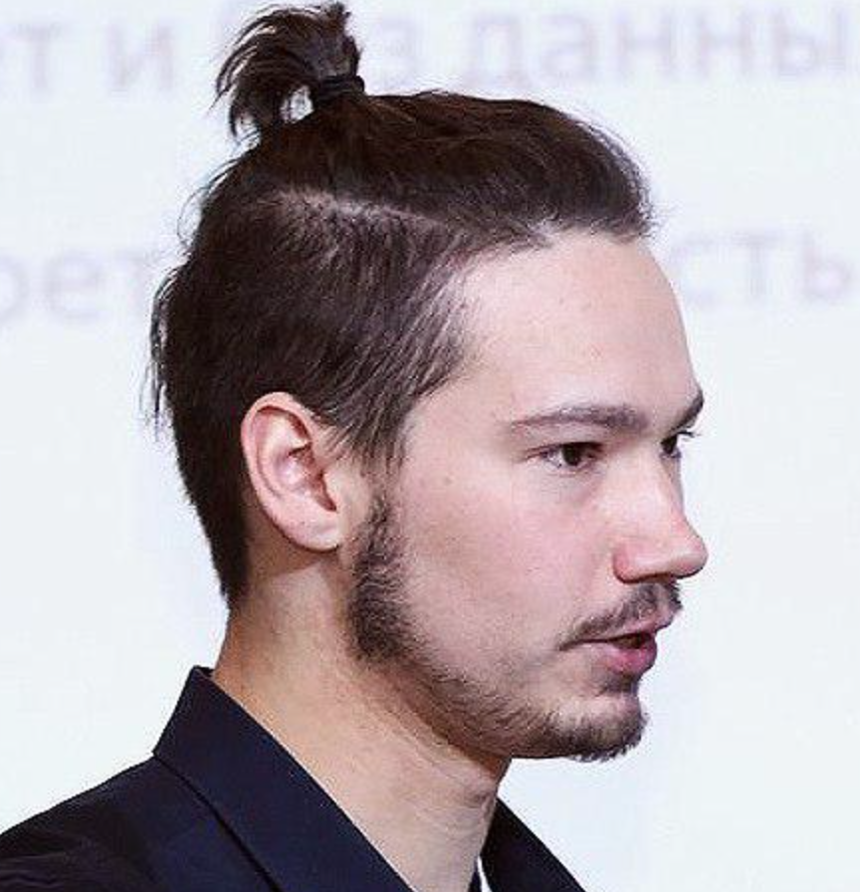
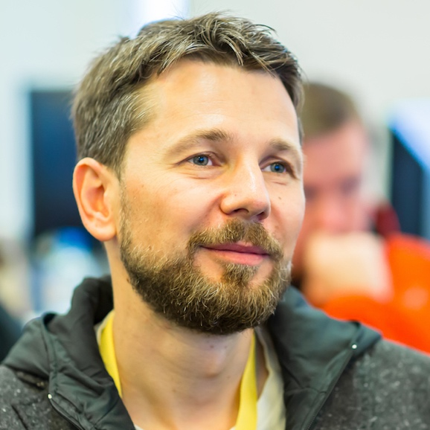
Want more? Ask us how
  Dr. Alexey Artemov, Skoltech, HSE
  Dr. Artem Maevsky, HSE
  Maxim Borisyak, YSDA
  Nikita Kazeev, YSDA, HSE
  Vladislav Belavin, HSE
  Mikhail Hushchyn, HSE, YSDA
  Dr. Andrey Ustyuzhanin, YSDA, HSE, ICL

Slide 14
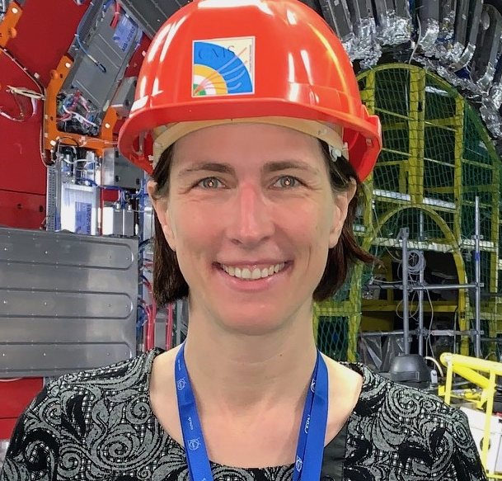
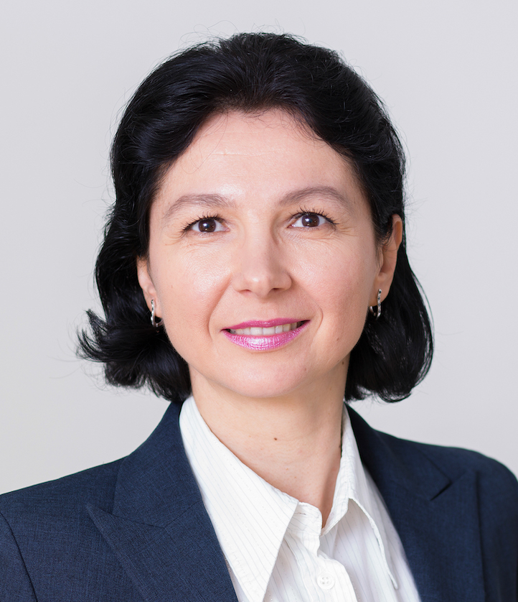
DESY Team
  Dr. Isabell Melzer-Pellmann
  Inna Henning

Slide 15
Important Items
  Repository with slides and notebooks:
    https://github.com/yandexdataschool/mlhep2019
  Distributed intelligence
    https://t.me/joinchat/DMMgwheJKrVrNJq6JcDsLA
  Social network tags
    #mlhep2019 , #mlhep
  Reception this evening!

Slide 16


Many thanks to our sponsors
https://amva4newphysics.wordpress.com
https://www.insights-itn.eu

