Slide 1
Job Monitoring at STAR
This presentation is the personal view of the author. It was not approved (yet) by STAR

Slide 2


STAR Collaboration: production since 1999
Man power - 53 institutions from 12 countries, with a total of 524 collaborators (http://www.star.bnl.gov/central/collaboration/ )
Data volume – Run 2010 – 1 Pb DAQ data / 6 months ( 2010 = 10 x 2009)
Storage – 2 HPSS equipped centers:
  BNL - https://web.racf.bnl.gov/Facility/GCEGangliaRHIC/
  PDSF- http://www.nersc.gov/nusers/resources/HPSS
Computer: 2 large farms:
  BNL/RACF -https://web.racf.bnl.gov/Facility/GCEGangliaRHIC/
  https://web.racf.bnl.gov/Facility/LFGangliaRHIC/
    CAS - CPUs ~ 3000/ 4 TB RAM/ 1 Pb disks
    CRS - CPU ~ 2000/4 TB RAM / 1 PB disks
  PDSF - http://www.nersc.gov/nusers/resources/PDSF
    CPU ~ 1000/ 2 TB RAM/ 0.4 Pb disks
Bunch of the regional small centers to serve their local researchers
“Cloud” computing.

Slide 3
The Types of the Software Jobs / Users
Calibration (STAR wide)
Simulation (STAR wide)
Reconstruction (STAR wide)
Analysis (PWG wide)
Interactive analysis (PWG)
Regression tests (aka nightly)
Custom reconstructions ( researchers and institutions )
Custom analysis (everybody can do that )

Slide 4
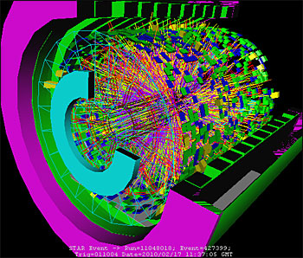


Data flow
RHIC/STAR
Jobs / Users are split by two major centers:
BNL/HPSS
BNL
PDSF/HPSS
PDSF
and dozen of the smaller ones:
. . .

Slide 5
(Decentralized )Monitoring
The monitoring of the users’ jobs is the job of the monitoring users
Historically all 8 types of users were to build their own monitoring systems if any.
That leaded to the waste of workforce due duplications.
Lesson: The ordinary user can not monitor his/her job alone , the framework support is needed.
The common main tools to facilitate the job monitoring were built over time (As the demand had being growing up):
STAR File Catalog (perl scripts)
SUMS “STAR Unified Job Submission Utility – http://www.star.bnl.gov/public/comp/Grid/scheduler - Java applications
UCM – C++ library to back C++/Fortran/Java applications
Web interface / Web service – to access the Accumulated information

Slide 6
STAR Monitoring Tools:
The tools provided by RACF/PDSF centers.
Set of submissions SHELL scripts “grep”ing the output logs of the jobs to populate the production data based (use “File Catalog”) – Production, regression nightly tests.
File Catalog + SUMS – submit the jobs to the nodes were the data files are local. That requires the data move monitoring rather the monitoring of the jobs.
UCM – real “job monitoring” (SBIR (DOE) funded project made by Tech-X and BNL. Tech-X contact and PI D.Alexander, BNL contact and PI J.Lauret).

Slide 7
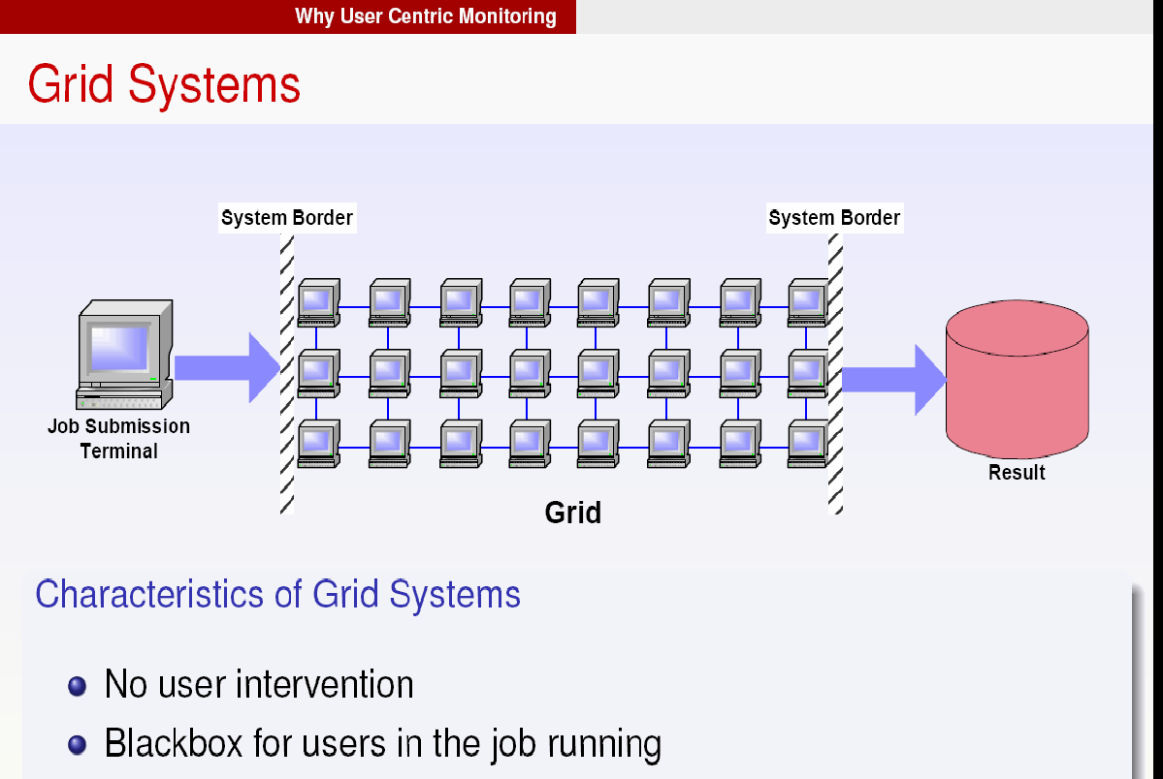
“Black” hole

Slide 8
STAR Users on 24/7 Job monitoring shift
Chronic lack of resource to process data encourages the users to watch the process to make sure the wise usage of the existing facilities. There is no need for 24/7 shifts.
STAR – the users watch his/her jobs voluntary and report any inconsistency immediately .
However, the ordinary user can not monitor his/her job alone , the framework support is needed.
Lesson: Users reports the “observations”. To find and fix the cause of the complain the time and forensic skill are needed or “dedicated monitoring tools and facility” to address and prevent the issues quickly

Slide 9
UCM - User-Centric Monitoring
User-Centric Monitoring concentrates on Job, Task & Application monitoring for a given user.
Includes “messages” from applications unlike many other systems.
Aggregates information for various parts of the workflow (job definition, submission, scheduling, application contexts)
TASKS
SCHEDULING
APPLICATION
Many jobs
Site Execution
Event messages

Slide 10
Design Requirements (aka “Constrains”)
The UCM infrastructure is built around of STAR MySQL server / Tomcat Web server and the abstract C++ interfaces.
Db design
Software design
No Monitoring Db problem should affect the job performance
No interruption of the job <–> Db communication problems should not affect the Db integrity. – The lost of messages is the anticipated cost of doing business.
No “UCM” evolving” should affect the users’ job flow (i.e. the “user” should not be asked to change his/her code because of any change of the monitoring facility
The layer should be useful for the end–user too. I.e. any portion of the user job (either the “Shell script” or “Fortran written simulation” should be able to emit the “monitoring” messages

Slide 11
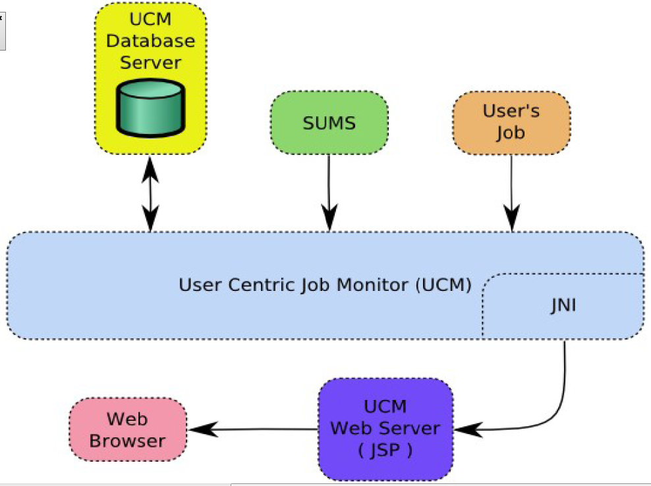
Solution:

Slide 12
Hierarchical Db Design
We ended up with the simple scalable Db design:
(STAR “task” == ATLAS “jobset” )
One may realize that the schema above is quite generic.
As soon as one introduces the special “system” tasks/jobs it becomes capable to cover the wide range of the “system” needs (like “harvesting” the statistic across jobs and tasks)
Tasks
Tasks
Jobs
Jobs_TaskID
Jobs_TaskID
Jobs_TaskID
. . .
messages
messagesTaskID
messagesTaskID
messagesTaskID

Slide 13
Db “Message” table
Timestamp
JobID (index from the JOB table)
Message type (enumerate)
Message key (arbitrary string)
Message value (arbitrary string)
Examples:
Key=“CPUTime” ->Value=“201.3” (secs)
Key =“RAM” -> Value=“234.5” (Mgb)
and
Key=“Average CPUTime” ->Value=“204” (secs)
Key =“Average RAM” -> Value=“240” (Mgb)
fits the schema too.

Slide 14
UCM – Software design
There are 3 clients:
STAR Offline applications
STAR Scheduler (aka SUMS)
STAR Tomcat Web server (fc3.star.bnl.gov)
All clients communicate the Db via the abstract interface and its implementations tailored to satisfy the concrete clients

Slide 15
C++ → Java / Python / Perl
TxEventLog.h
SWIG
TxEventLogFile
TxEventLog.java
TxEventLog.py
TxEventLogCollector
TxEventLogWeb
TxEventLog.pl
TxUCMCollector

Slide 16
Example: C++ vs. Java nterfaces
C++
Java
int main(int argc , char *argv[]){
TxEventLog &ucm =
*TxEventLogFactory::create(“ucm");
const char *username = "starreco";
ucm.setRequesterName(username);
StUcmTasks &tasks = *ucm.getTaskList(10);
Iterator task = tasks.taskIterator();
StRecord *r = 0;
if (task.hasNext()) {
r = task.next();
StUcmJobs &jobs = *ucm.getJobList(r,20);
Iterator job = jobs.jobIterator();
while (job.hasNext() ) {
r = job.next();
r->printHeader();
r->print();
StUcmEvents &events=
*ucm.getEventList(r,20);
Iterator event =
events.eventIterator();
while(event.hasNext() ){
r = event.next();
r->print();
}
}
. . .
class testUcm {
public static void main(String [] argv) {
TxEventLog ucm =
TxEventLogFactory.create("ucm");
String username = "starreco";
ucm.setRequesterName(username);
StUcmTasks tasks = ucm.getTaskList(10);
Iterator task = tasks.taskIterator();
StRecord r=null;
if (task.hasNext()) {
r = task.next();
StUcmJobs jobs = ucm.getJobList(r,20);
Iterator job = jobs.jobIterator();
while (job.hasNext() ) {
r = job.next();
r.printHeader();
r.print();
StUcmEvents events=
ucm.getEventList(r,20);
Iterator event =
events.eventIterator();
while(event.hasNext() ){
r = event.next();
r.print();
}
}
. . .

Slide 17
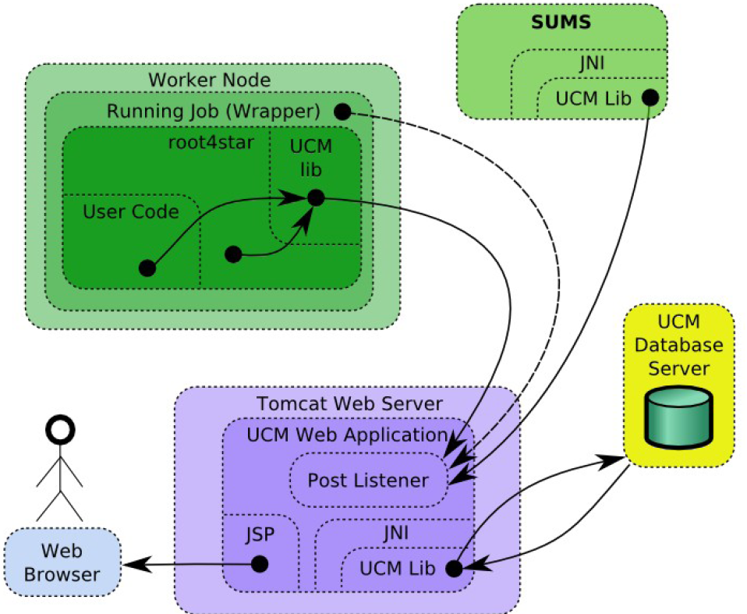
UCM UI via Web Frontend

Slide 18
UCM – scalable (?) solution
“Functional scalability”
  any new type of information can be added without breaking the developers’ legs.
  The real functionality is built with C++ code leveraging the C++ robustness, performance, code re-use. C++ is the only interface @ STAR that the end-user C++ applications can use. Therefor STAR had no other choice.
  Java/Python/Perl interfaces are built automatically leveraging the script languages flexibility and quick customization.
“Performance scalability”
  adding some extra information to the customer demand does not affect the other jobs / customers.
  All Db tables are relatively small hence the retrieving information for any particularly job ought to be fast. Easy to introduce the distributed “solution” - each job/message table for the concrete task can be allocated the separate Db / node / machine / location if needed.

Slide 19
Conclusion (aka “Lessons”;-)
The framework support is essential.
Stable simple abstract (C++) API helps significantly . It features no distraction for the “client code” and “freedom” for the developers to polish things and meet the new challenges.
Automatically conversion to the other languages interfaces helps to minimize the workforce to maintain the monitoring framework, reducing the costly future “surprises”.
“Real time” job monitoring is required.
Hierarchical Db table organization to provide the fast access.
Stable abstract Db schema for the low level layers to allow flexibility.
Standard Web server (TomCat) to satisfy the “future” requirements

Slide 20
Acknowledgement
Special thanks:
Jerome Lauret -- STAR Computing leader,
Lidia Didenko – STAR Production Manager

Slide 21

Questions ?

