Slide 1

TAG and iELSSI Progress
Elisabeth Vinek, CERN & University of Vienna
on behalf of the TAG developers group

Slide 2
TAG data management news
TAG TYPE | # events (M) | DB Storage (GB) | Avg. space/event (kB)
First Pass 2010 | 1155 | 3978 | 3.8(¹)
September Reprocessing | 557 | 940 | 1.6(²)
Monte Carlo 2009 | 865 | 2552 | 2.9(³)
(¹) Average for latest events (first pass is a mix of merged and unmerged TAG and TAG_COMM data)
(²) We are now applying vertical partitioning to reprocessed data.
  Details can be found here (ATLAS S&C Week July): http://indico.cern.ch/getFile.py/access?contribId=38&sessionId=16&resId=0&materialId=slides&confId=76895
(³) MC data is not compressed (>255 columns)

Slide 3
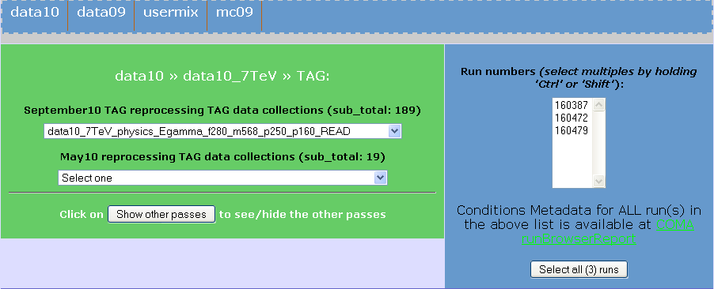
iELSSI news: hiding data distribution
TAG DB sites: CERN, DESY, PIC, BNL, TRIUMF
Previously, the user had to select a site
Now, this selection is done automatically, based on:
  data locality
  proximity to iELSSI browser

Slide 4
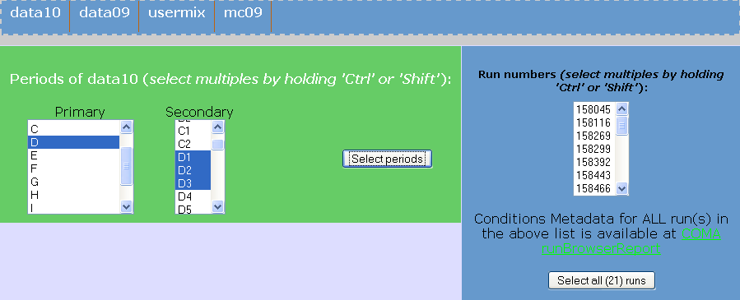
iELSSI news: period-based selection
TAG data selection based on periods and sub-periods
PERIOD -> RUN mapping in COMA tables
  based on information from Data Preparation

Slide 5
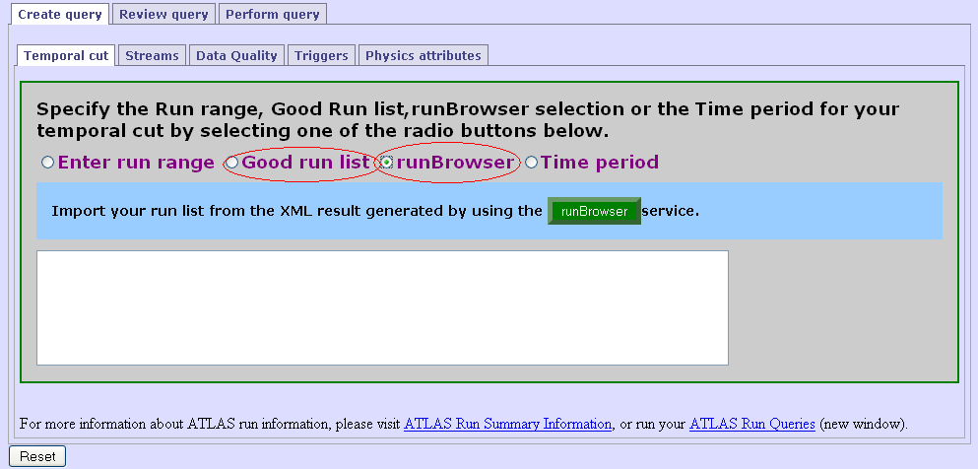
iELSSI news: RunBrowser Integration
For details on RunBrowser, see talk „Conditions Metadata and RunBrowser Update” by E. Gallas

Slide 6
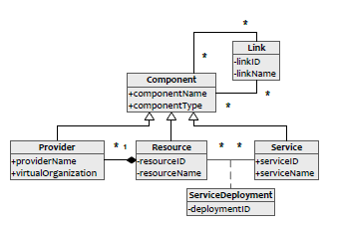
Architecture news: service catalog
Site-transparency as first step towards a distributed system – achieved with the „data catalog“.
Next steps: put service catalog into production catalog in order to:
  Make service distribution transparent
  Make the system more robust as regarding responding to outages
Need to catalog the TAG services in terms of:
  Functionality (service groups)
  Available resources (at sites)
  Compatibility
  Several non-functional attributes
Components of a distributed system:
  Sites
  Resources
  Services
  Deployments
  Links

Slide 7
Architecture news: service catalog (2)
Further service catalog use cases:
  Improve software management by:
    Defining dependencies between deployments/versions
    Keeping configuration parameters centrally
  Use the service catalog schema to log service activity:
    Gather statistics
    Analyze and use them to:
      Optimizing caching strategies
      Optimizing data and services distribution
      Ultimately, optimize request distribution

Slide 8
Conclusion
First step (data distribution transparency) completed and changes implemented on iELSSI.
Second step (services distribution transparency) currently in development, to make the TAG system:
  Modular
  Transparent
  easily configurable
Continuous effort to improve on covering the TAG use cases. Thanks to the modular architecture new use cases are easy to implement.
TAG database at RAL is ready and waiting for data.
Now waiting for December TAG reprocessing.

