Slide 1

Operation of a Cryogenic Current Comparator for continuous beam intensity measurements in the AD
Miguel Fernandes
Beam Instrumentation Group Seminar
30/11/2018
BI seminar

Slide 2
The Antiproton Decelerator (AD)

Slide 3
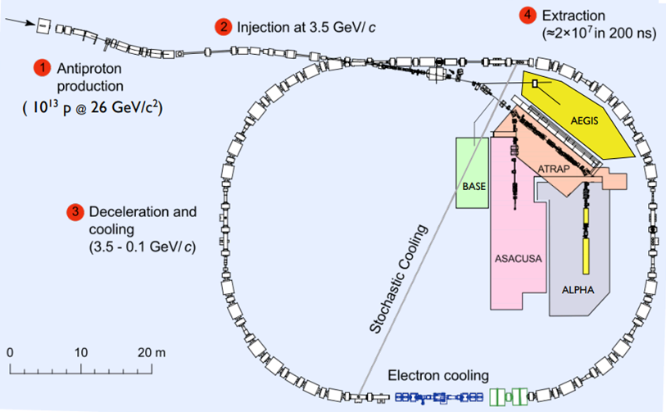
Antiproton Decelerator (AD)
C = 182.5 m

Slide 4
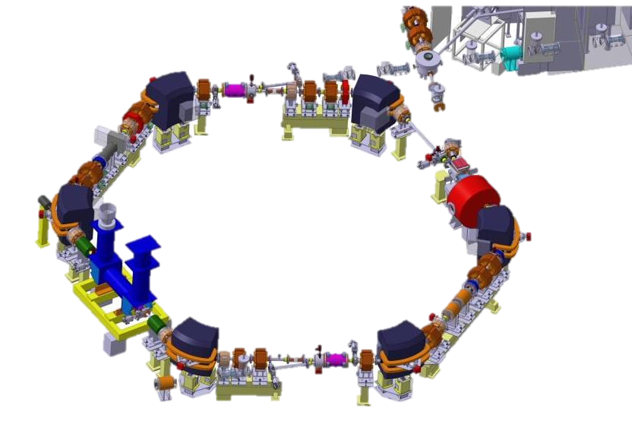
Antiproton Decelerator (AD)
ELENA
Reduce the energy of antiprotons coming from AD from 5.3 MeV to 100 keV
Should allow the experiments to trap
( ~ x 100) more antiprotons
ELENA
C = 30.4 m
C = 182.5 m

Slide 5
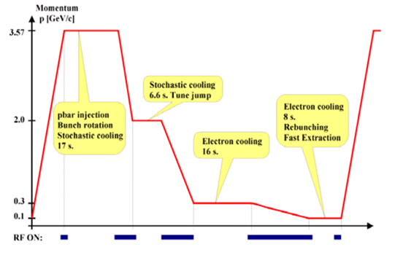
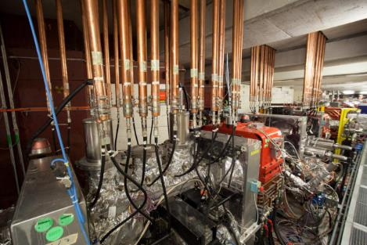
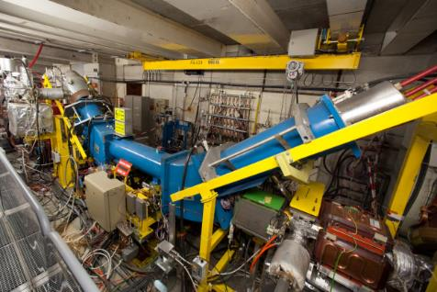
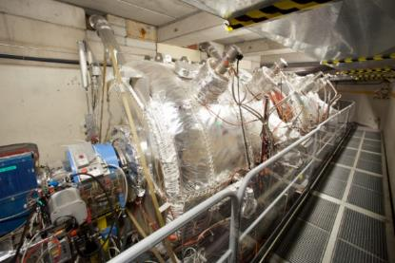
AD beam and cycle parameters
AD beam parameters
Beta | (0.97 - 0.11) c
Cycle | ~110 s
Frev | (1.59 - 0.17) MHz
N particles | (5 - 1) x 10⁷
Current | (12 - 0.1) μA

Slide 6
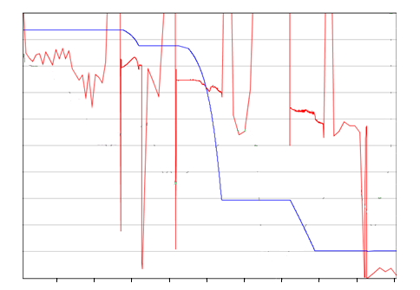
Beam intensity monitoring
  DCCT:
  Insufficient resolution: > 1µA
  Fast BCTs:
  Limited to bunched phases
  Schottky monitor:
1.0
4
0.8
3
0.6
N [x 10⁷ pbar]
β [c]
2
0.4
1
0.2
0
0.0
10
20
30
40
50
60
70
80
90
time [s]

Slide 7
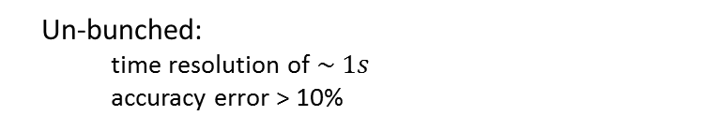
Beam intensity monitoring
Coasting beam plateaus
  DCCT:
  Insufficient resolution: > 1µA
  Fast BCTs:
  Limited to bunched phases
  Schottky monitor:
1.0
4
0.8
3
0.6
N [x 10⁷ pbar]
β [c]
  Un-bunched:
    time resolution of $\sim 1s$
    accuracy error > 10%
2
0.4
1
0.2
0
0.0
10
20
30
40
50
60
70
80
90
time [s]

Slide 8
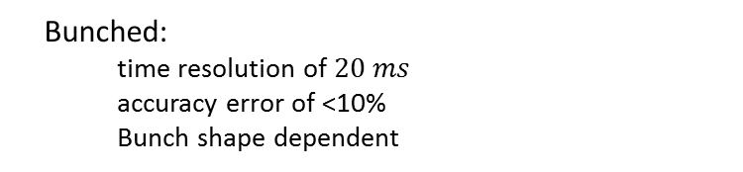
Beam intensity monitoring
  DCCT:
  Insufficient resolution: > 1µA
  Fast BCTs:
  Limited to bunched phases
  Schottky monitor:
Bunched beam ramps
1.0
4
0.8
3
0.6
N [x 10⁷ pbar]
β [c]
2
0.4
1
0.2
  Bunched:
    time resolution of $20 ms$
    accuracy error of <10%
    Bunch shape dependent
0
0.0
10
20
30
40
50
60
70
80
90
time [s]

Slide 9




Specifications for new monitor
Current/intensity measurement:
Measure beam: Bunched and debunched
Current resolution: < 10 nA
Intensity resolution: < 5 x 10⁵ charges
Bandwidth: DC - 1 kHz
Operations ready:
Integrated acquisition: FESA based
Automatic operation: synchronized with AD cycle
Requirements for the cryostat
“Zero-boil off” using a pulse tube cryocooler as He reliquefier unit
Stand-alone long term availability
Collaboration:

Slide 10
Overview of the CCC

Slide 11
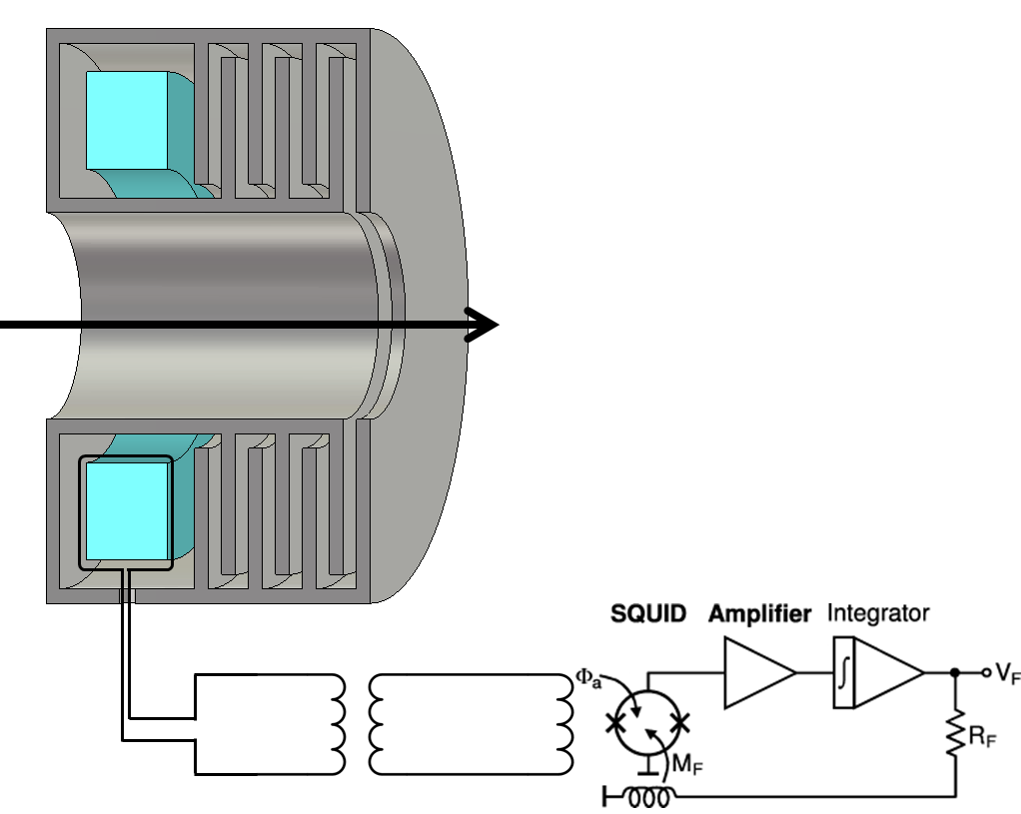
CCC functioning overview
Magnetic shield:
  Suppresses all field components except azimuthal beam component
Pickup coil:
  Soft ferromagnetic material with high-permeability concentrates flux
Flux transformer:
  Couples magnetic flux (down to DC) to SQUID
SQUID + Electronic readout:
  Superconducting QUantum Interference Devices
  Measures the magnetic field induced in the SQUID’s input coil
Superconducting
Room temperature

Slide 12
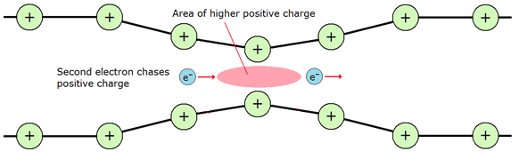
SQUID’s in a nutshell
Superconductors:
  Zero resistance to electrical currents
  Magnetic field expulsion from bulk material
  Conservation of magnetic flux in closed loops
Current carriers are bounded states of two electrons (Cooper pairs)
Copper pair
From: https://dc.edu.au/hsc-physics-ideas-to-implementation/

Slide 13
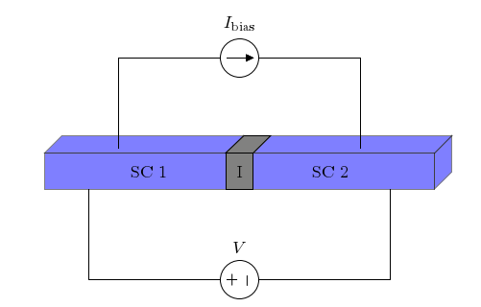
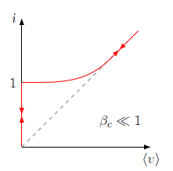
SQUID’s in a nutshell
Josephson junction:
  Mixed superconducting and resistive current flow
Tunneling of electron-pairs allows for a superconducitng current through a barrier
I_{c}
Tunneling of electrons resulting from pair break-up approximates an ohmic current **
*
* Only for certain parameters of Josephson junction. In general I-V curve is hysteretic.
** For small V

Slide 14
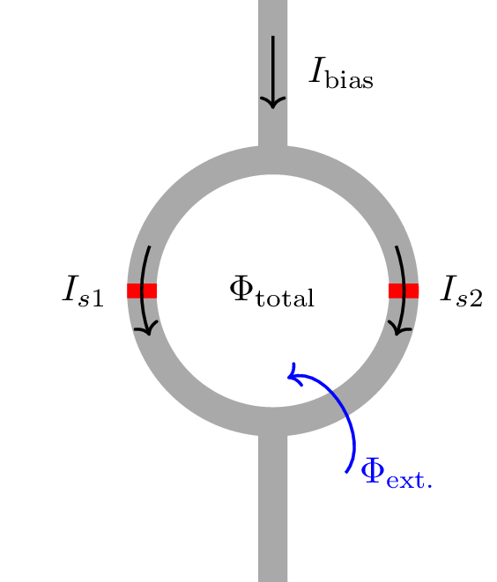
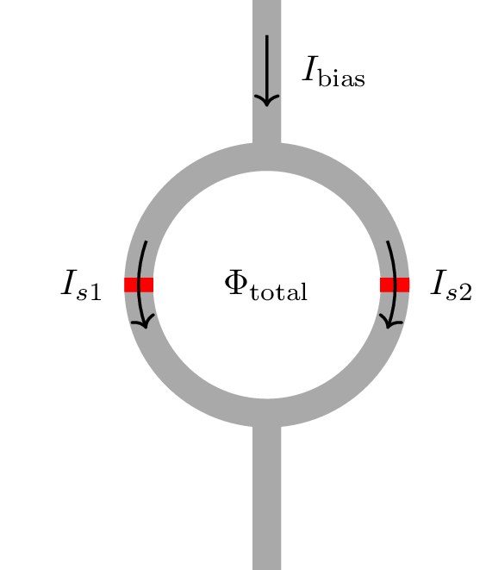
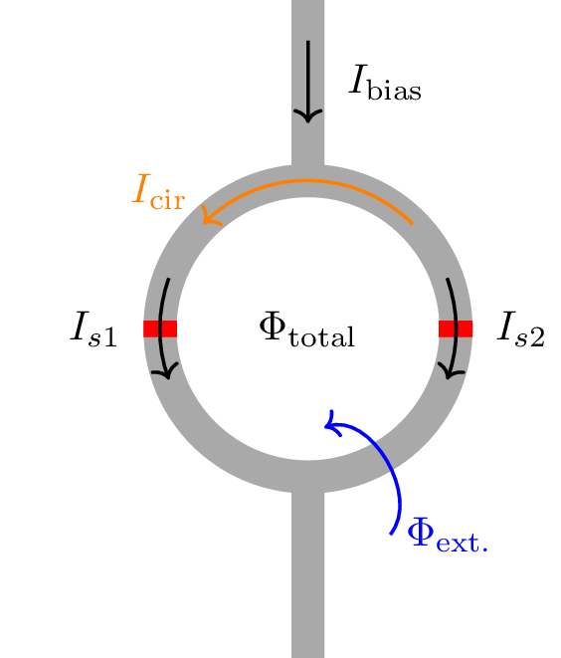
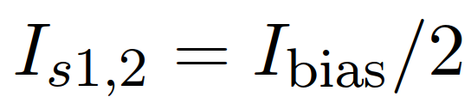
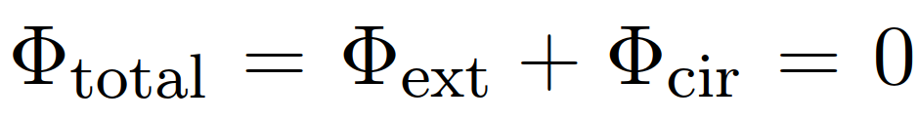


SQUID’s in a nutshell
  dc-SQUID
  Two Josephson junctions in parallel
No external flux applied:
Constant magnetic flux threading closed loops:
I_{bias}
2I_{c}
Applying external flux:

Slide 15
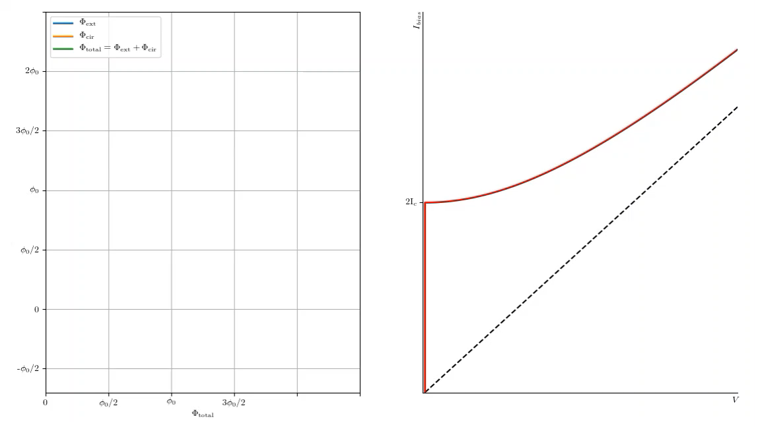
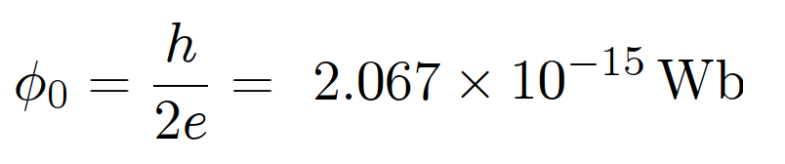

SQUID’s in a nutshell
for A=1mm²

Slide 16
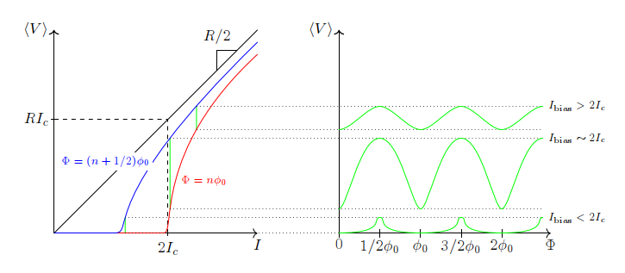

SQUID’s in a nutshell

Slide 17
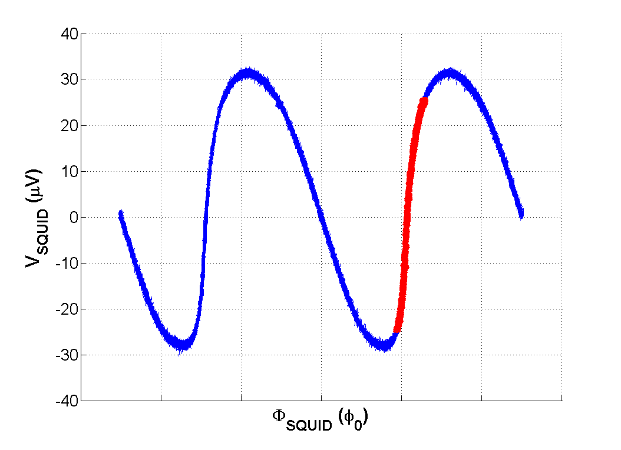
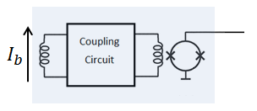



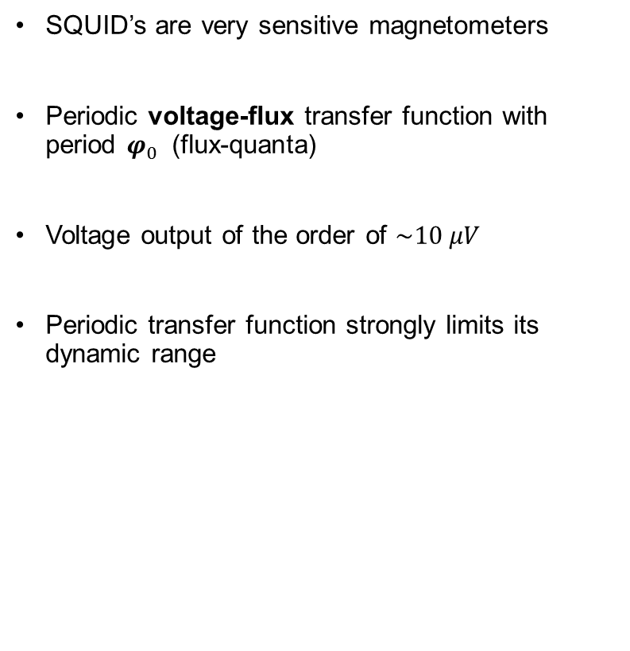
SQUID devices
$$φ_{0}$$
SQUID’s are very sensitive magnetometers
Periodic voltage-flux transfer function with period $φ_{0}$ (flux-quanta)
Voltage output of the order of $\sim 10 μV$
Periodic transfer function strongly limits its dynamic range
$$φ_{SQUID}$$
$$V_{SQUID}$$

Slide 18
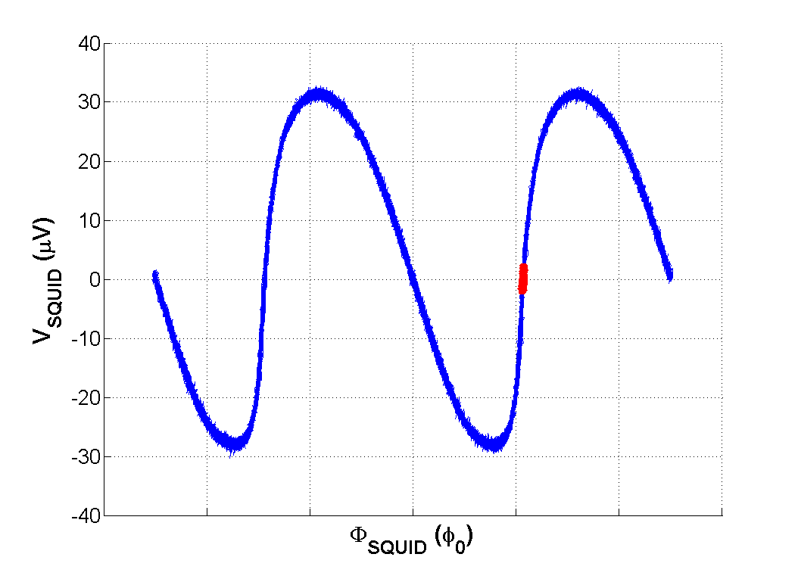
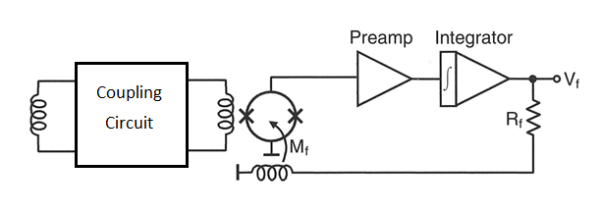


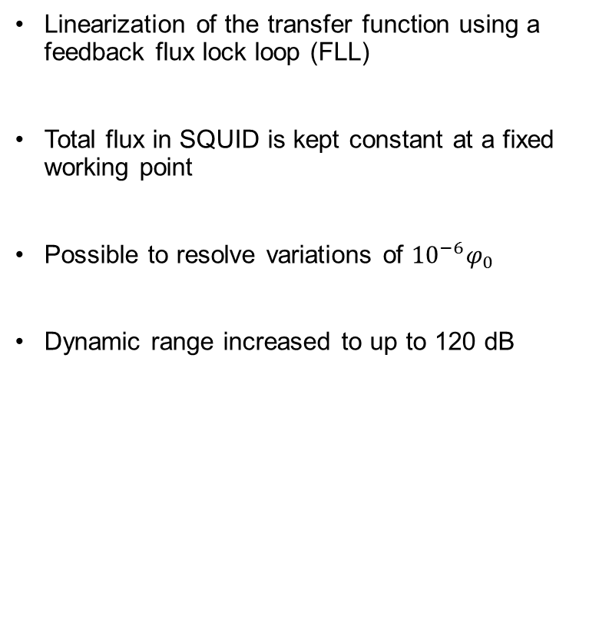


SQUID devices
Linearization of the transfer function using a feedback flux lock loop (FLL)
Total flux in SQUID is kept constant at a fixed working point
Possible to resolve variations of ${{10}^{−6}φ}_{0}$
Dynamic range increased to up to 120 dB
$$φ_{0}$$
Constant Working Point
$$V_{SQUID}$$
$$I_{b}$$
$$φ$$

Slide 19

SQUID devices
Flux jumps of working point may occur
If feedback loop is too slow to track input signal
If too much flux noise is coupled to the SQUID
Increasing FLL bandwidth makes it faster, but also adds more flux noise
Necessary to limit slew-rate of coupled signal to avoid flux-jumps
$$φ_{0}$$
$$V_{SQUID}$$
$$I_{b}$$
$$φ$$

Slide 20
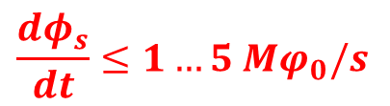
SQUID devices
Flux jumps of working point may occur
If feedback loop is too slow to track input signal
If too much flux noise is coupled to the SQUID
Increasing FLL bandwidth makes it faster, but also adds more flux noise
Necessary to limit slew-rate of coupled signal to avoid flux-jumps
$$φ_{0}$$
$$V_{SQUID}$$
    $$\frac{dφ_{s}}{dt}≤1…5 Mφ_{0}/s$$
$$I_{b}$$
$$φ$$

Slide 21
Adaptation of the CCC to the AD beam

Slide 22
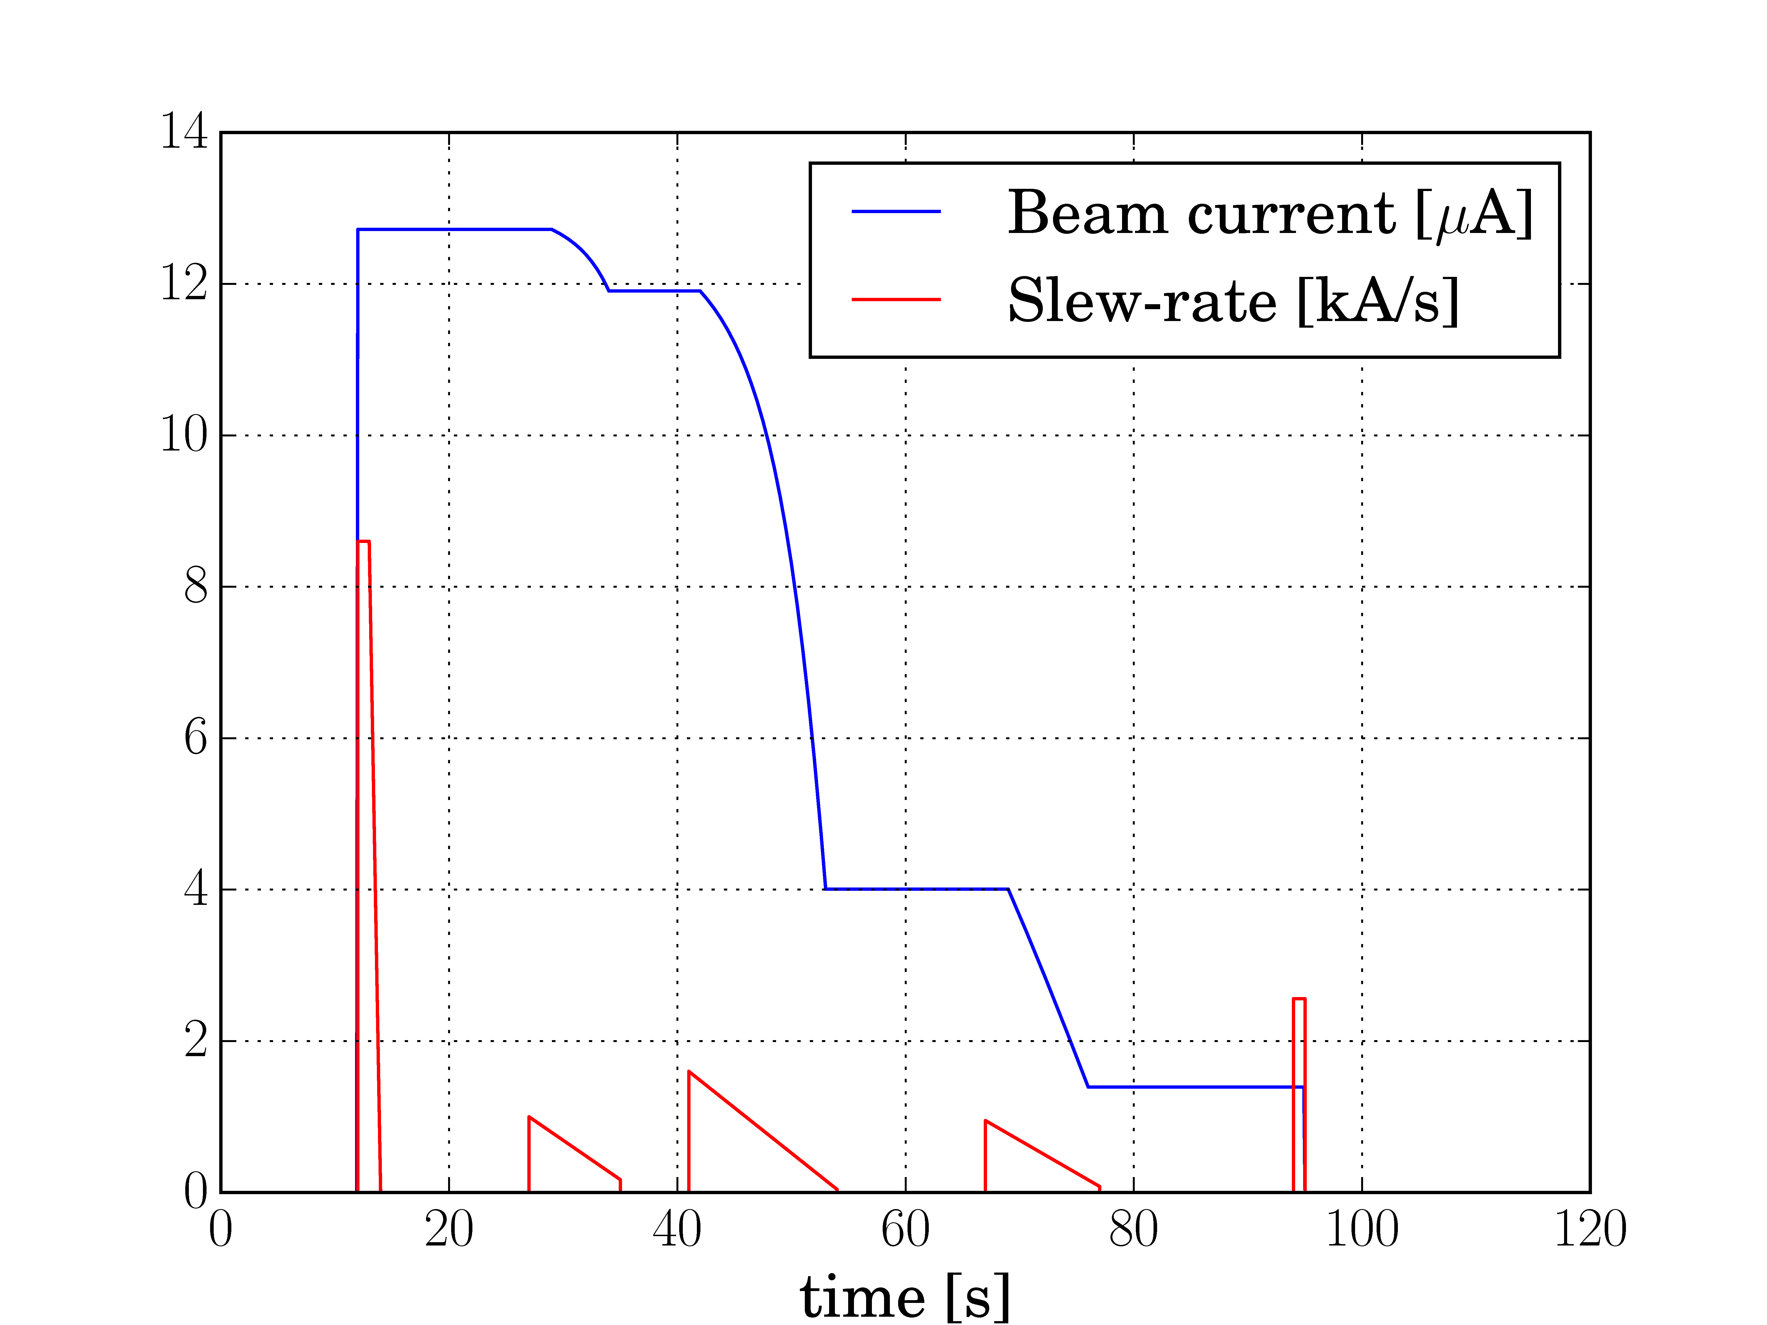
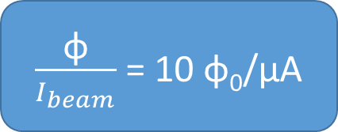
AD beam slew-rate
$\frac{\text{φ}}{I_{beam}}$ = 10 φ₀/μA
Flux slew-rate at SQUID
Filtering | Slew-rate
None | 86 Gφ₀/s
Core permeability | 1.2 Gφ₀/s

Slide 23
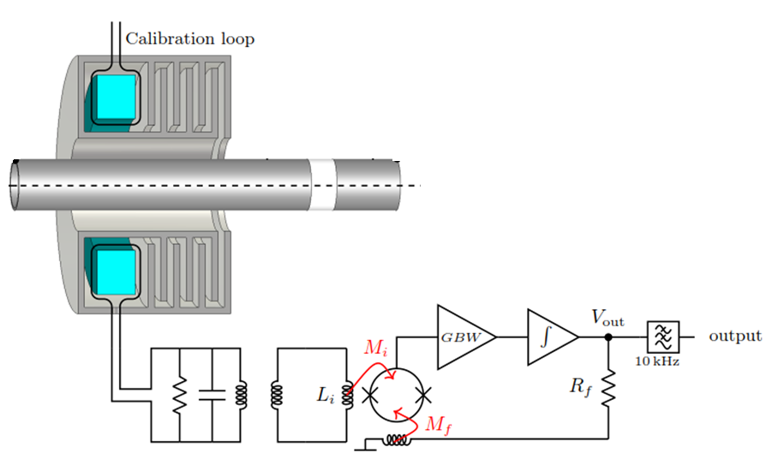
Filtering beam current signal
Low pass filtering to reduce signal slew-rate
Maximum possible bandwidth
SC

Slide 24
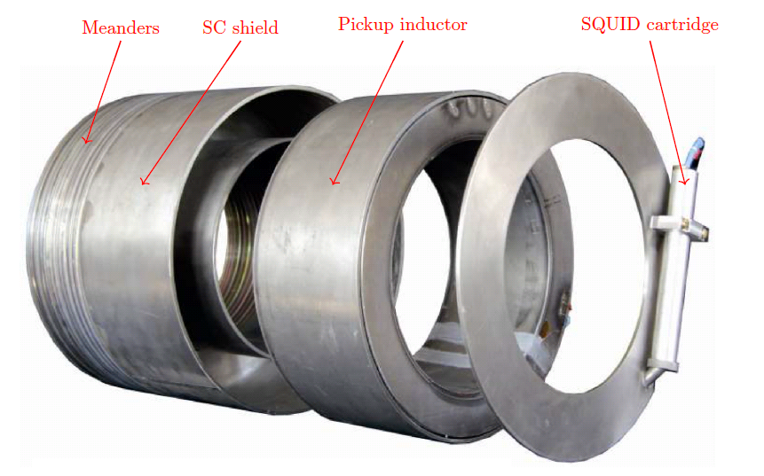
CCC components
Magnetic shield had previously been fabricated by GSI and Univesity Jena as prototype for FAIR

Slide 25
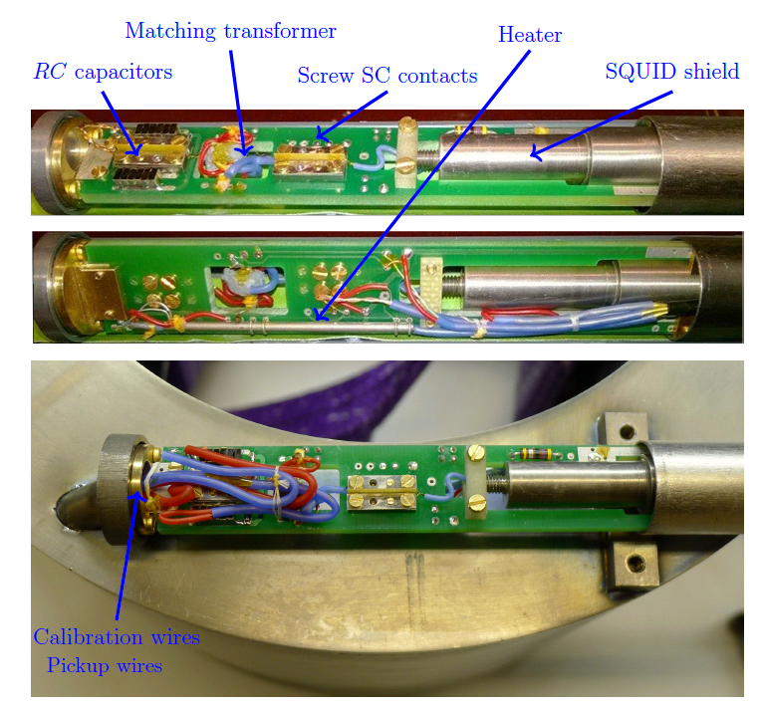
CCC components

Slide 26
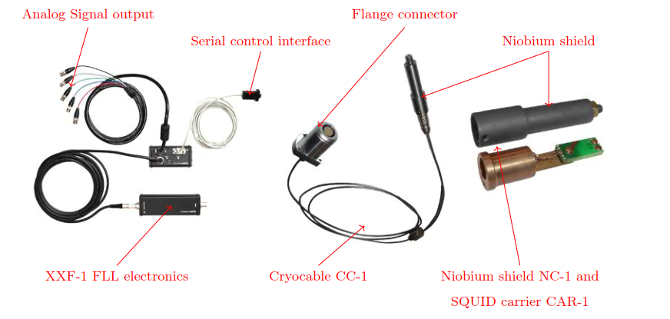
CCC components
Magnicon SQUID and FLL electronics system

Slide 27
Cryostat design

Slide 28
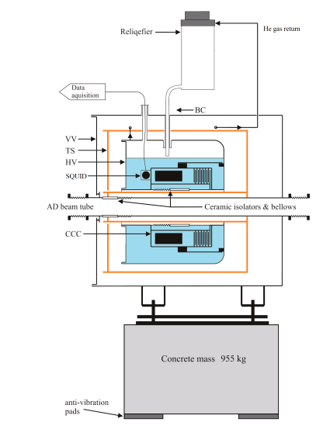
Cryostat design
VV: Vacuum Vessel
TS: Thermal Shield
HV: Helium Vessel
BC: Bayonet Connection
New custom cryostat was designed and fabricated to host CCC monitor
Insulating ceramic integrated to prevent mirror currents from shielding the beam signal
Low heat-load to allow stand-alone operation
Cooling power entirely provided by pulse-tube cryocooler
HV Support designed to mitigate vibration transmission

Slide 29
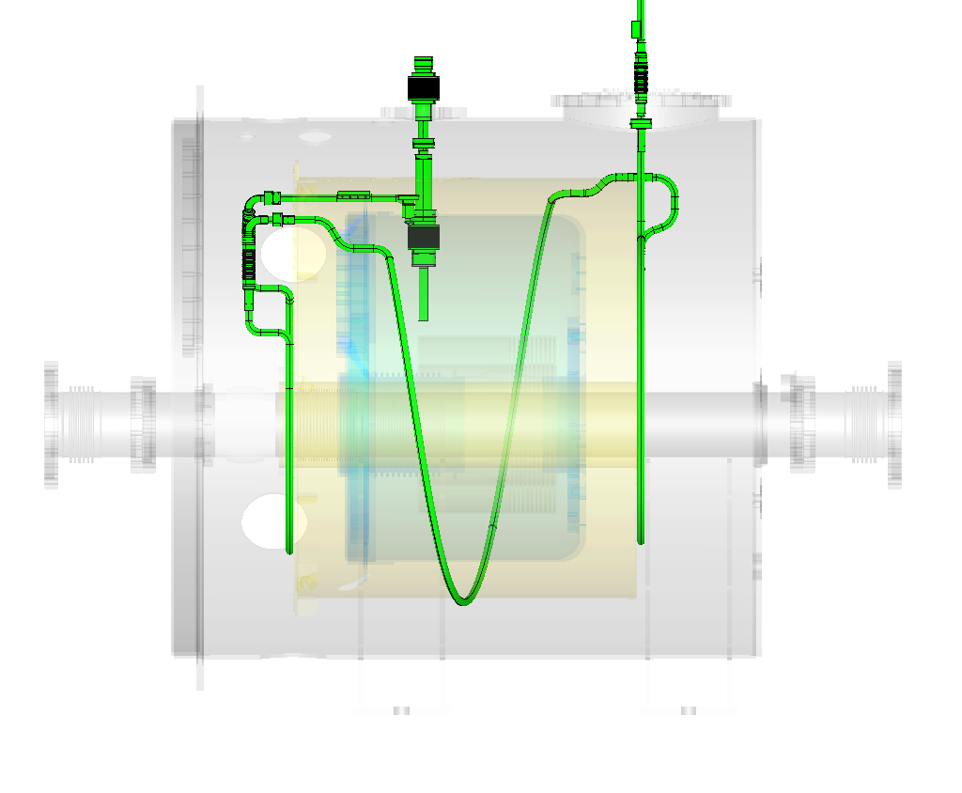
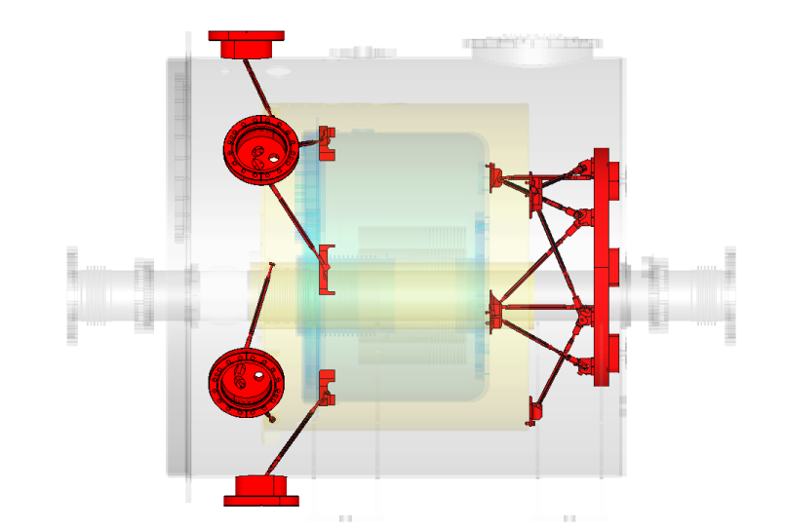
Cryostat design
LHe vessel support
Closed circuit cooling of termal shield

Slide 30
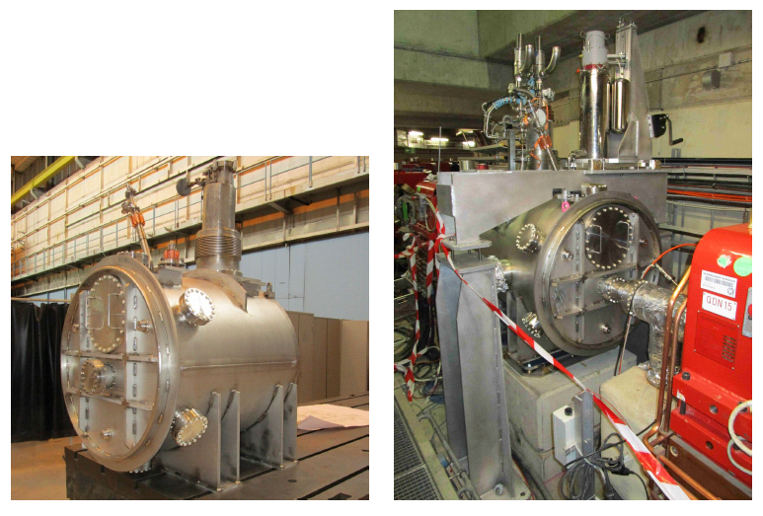
Cryostat installed in AD

Slide 31
CCC Acquisition and Control

Slide 32
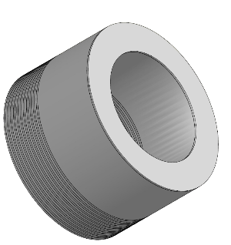



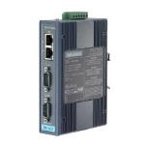
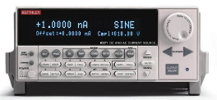
Acquisition and controls
FLL Electronics
Magnicon (20MHz)
Settings:
  R_{FLL} = 1 kOhm
  GBW = 1.04 GHz
Acquisition / Controls
VME architecture
FESA SW + Expert GUI
Signal acquisition at end of cycle and on-line
Control of multiple SQUID/FLL parameters
VME Crate
CPU L866
CTRV timing
VD80 ADC
  16 channels
  16 bit
  +/- 10V
  800kOhm
  Isolated diff. inputs
Ethernet
Triax
RS-232
Calibration loop
Low-pass
filter
Calibration Source
Advantech
Serial Server
NIM Crate
AD B-field cycle
Current/Nparticlenormalization

Slide 33
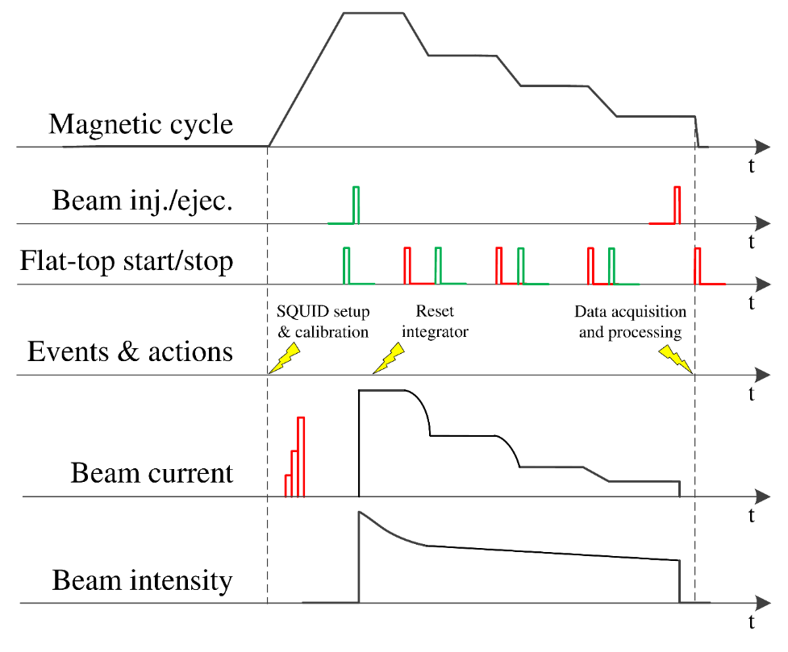
AD cycle synchronization

Slide 34
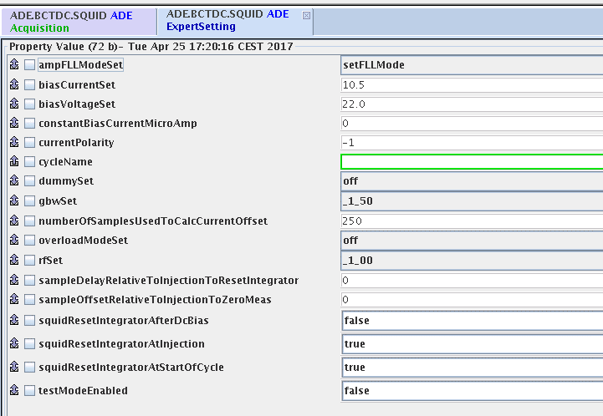
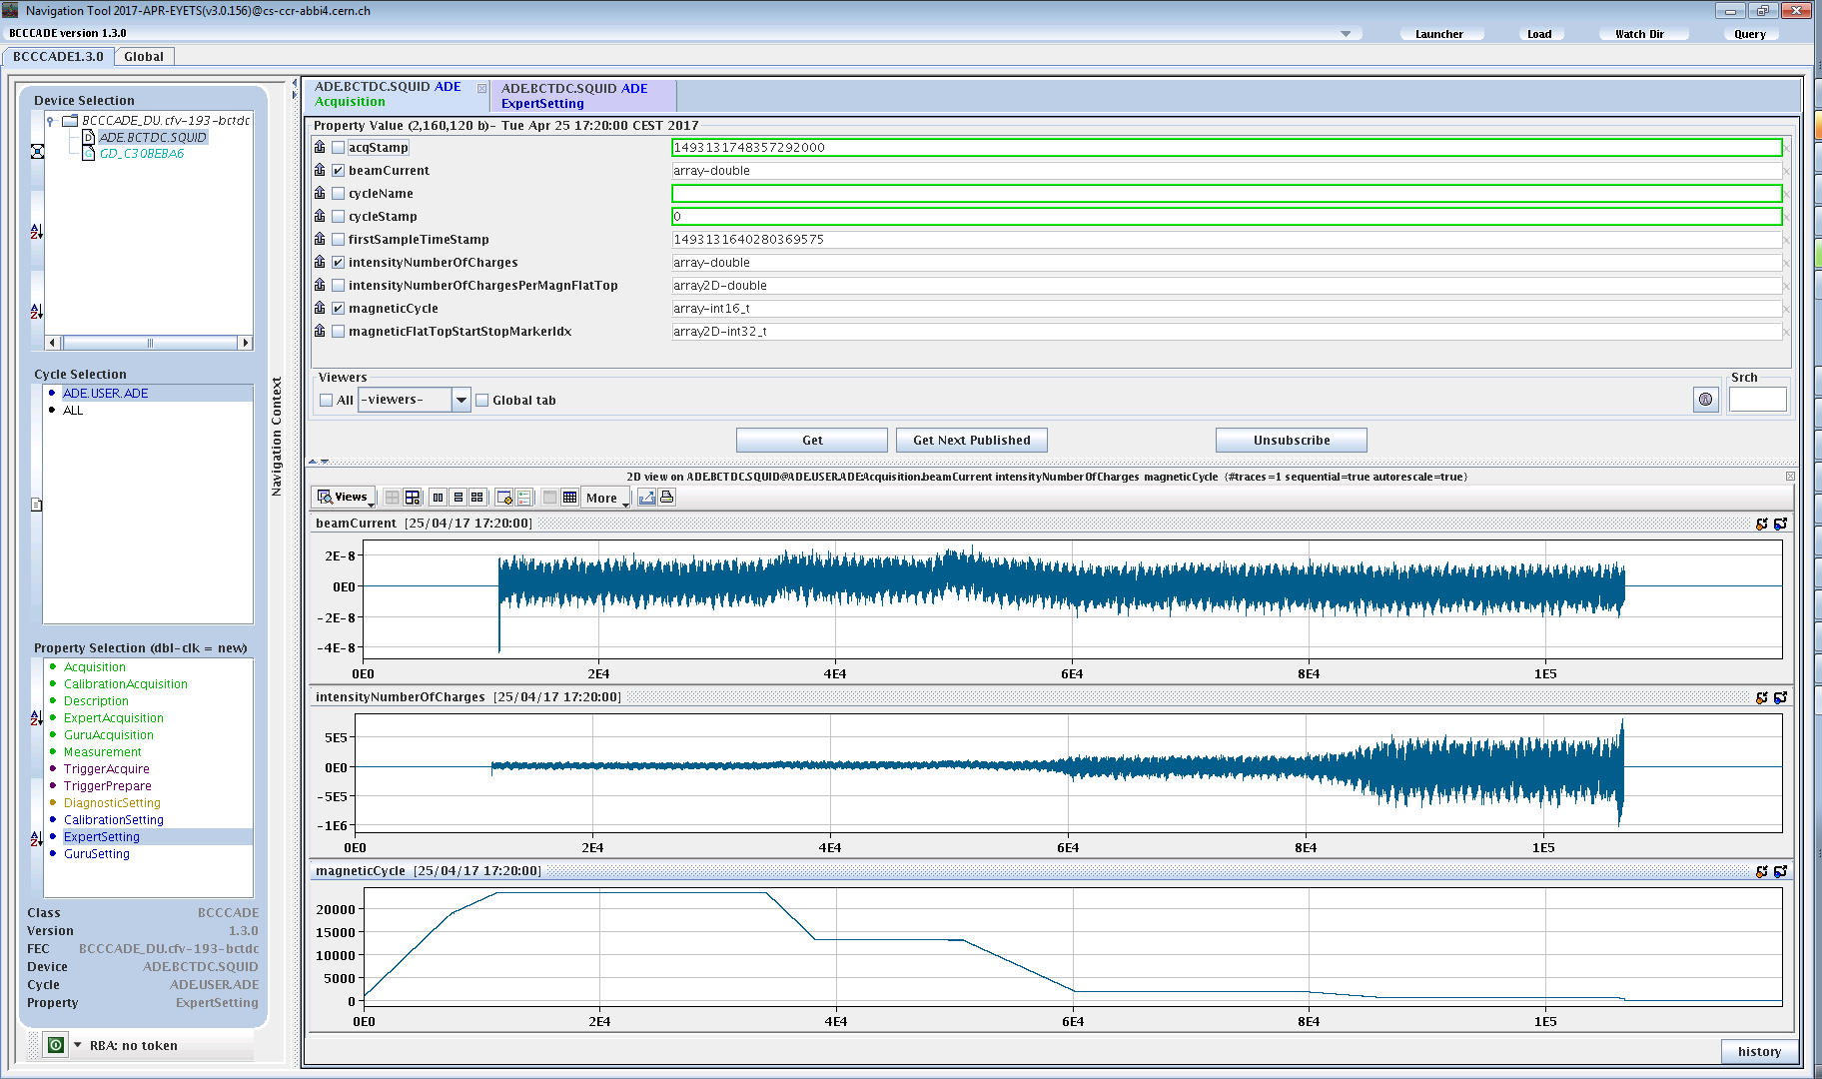
FESA Class
BEAM CURRENT [uA]
σ_{total} = 5.8 nA
NUMBER OF PARTICLES
AD MAGNETIC CYCKE

Slide 35
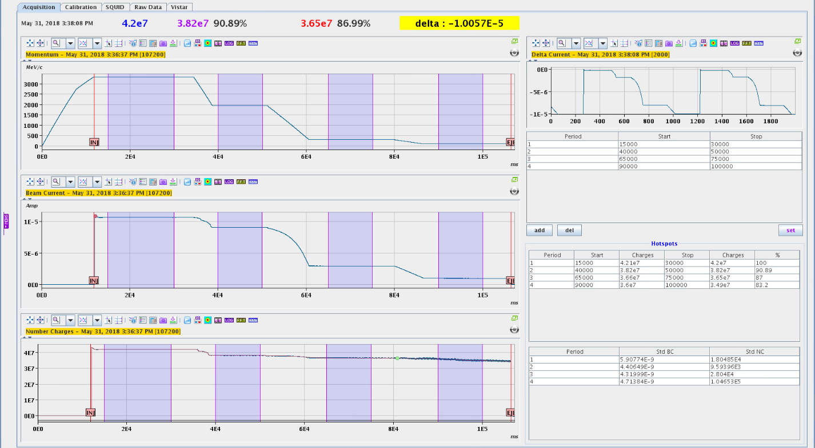
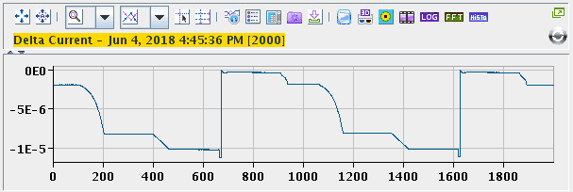
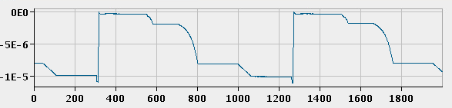
Expert GUI

Slide 36
Beam measurements and performance

Slide 37
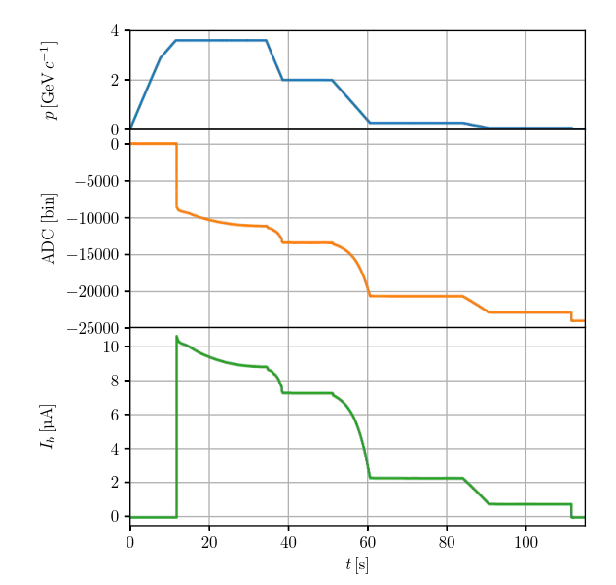
Beam current measurement
Flux jump at injection causes loss of baseline
SQUID/FLL stable throughout the rest of the cycle
Resolution within < 10 nA (with cryocooler and vacuum pumps running)
σ = 5.8 nA

Slide 38
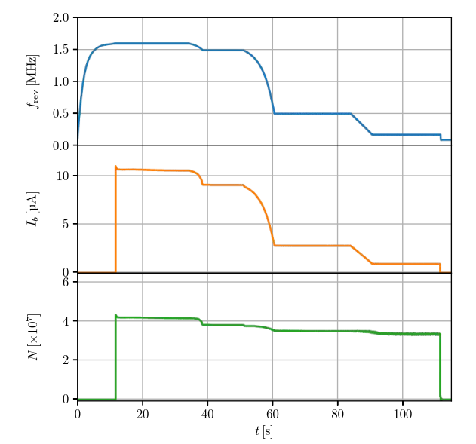

Beam intensity measurement
Baseline corrected at the end of the cycle
Beam intensity calculated by normalizing against f_{Rev}
Intensity resolutions at low-energy ~10⁵ charges
σ = 1.3x10⁵
σ = 1.2x10⁴

Slide 39
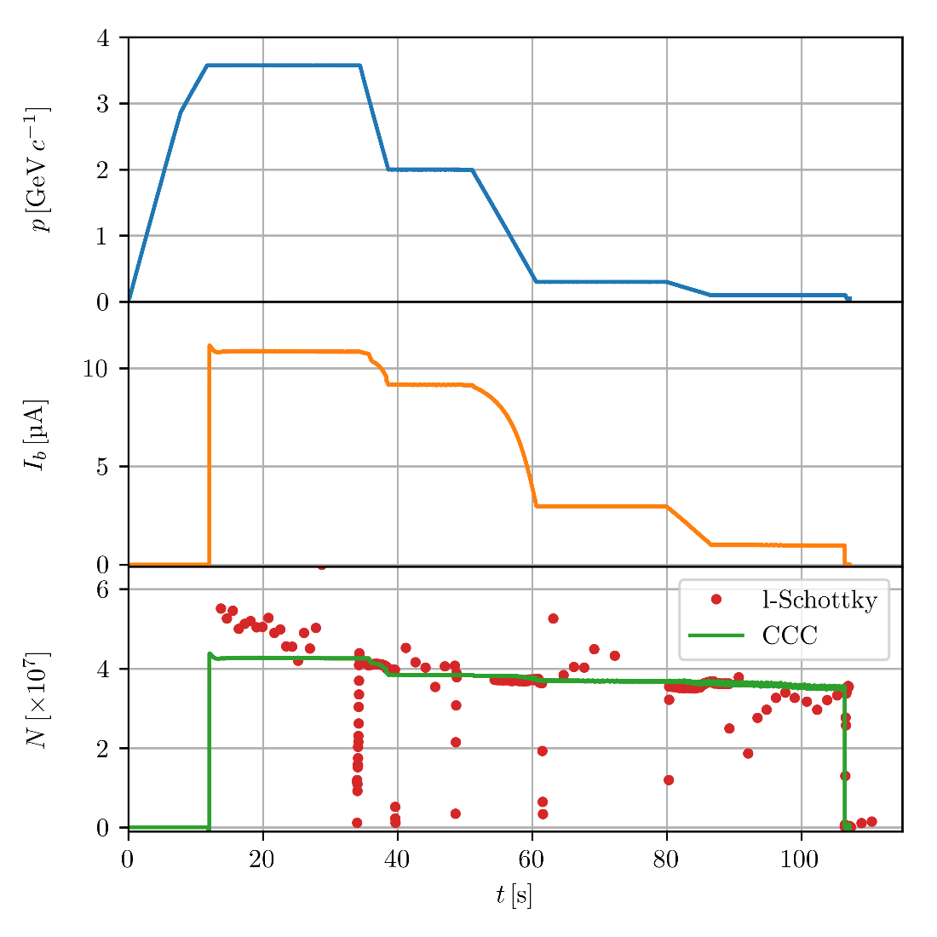
Comparison with Schottky monitor

Slide 40
Comparison with Schottky monitor

Slide 41

Comparison with Schottky monitor

Slide 42

B. Lefort
AD
Ref: https://indico.cern.ch/event/641870/contributions/2619208/

Slide 43

Performance analysis
Measurement resolution
Computed as the signal standard deviation in 1s interval
Analysis of ~25000 cycles
With cryostat insulation vacuum pumps on/off
Corresponds to resolution in terms of number of particles of:
  N = (1-3) x 10⁴ at injection energy
  N = (1-3) x 10⁵ at ejection energy
Current resolution

Slide 44


Performance analysis
Slower baseline drifts are dominant measurement error
These are mainly caused by helium gas pressure variations
Additionally perturbation induced by cycling the acccelerator
Baseline drift obtained from cycles with no injected beam
Baseline variation

Slide 45


Extra: Noise performance improvements
Perturbation from cryocooler
Perturbation from magnetic cycle
σ = 5.5 nA

Slide 46

Conclusions
Measurement noise performance under initial specification
Able to stably cope with AD bunched beams (except at injection)
Very good immunity to mechanical vibrations
Cryogenic system enables “long” term operations (~3/4 month)
Assessed long term stability over entire year run
Automatic system control with FESA class and expert GUI
On-going work
Investigate source of flux jump at injection
Improve availability of cryogenic system
Mitigate perturbations by controlling and stabilizing cryostat pressure
Proposal of a new CCC monitor for the ELENA

Slide 47





Acknowledgements
J. Tan, S. Pederson, D. Alves, E. Oponowicz, M. Ludwig, T. Koettig, A. Lees, A. Vacca, F. Carrasco,
J.P. Brachet, D. Lombard, G. Foffano, R. Speroni
T. Schwickert; T. Sieber; F. Kurian;
R. Geithner; R. Neubert , J. Golm
C. Welsch
Thank you for your attention!

Slide 48
Backup

Slide 49






Coupling circuit low-pass filter
Filtering | Slew-rate
Core permeability + RC-parallel | 0.97 Mφ₀/s
Additional flux noise at low freq:

Slide 50


Calibration vs. Temperature
0.3 (nA/φ₀) / K
Ib = 10uA
σ(Ib) < 10nA
δT < 300 mK

Slide 51

Flux jumps

Slide 52



Cryogenic availability
2016
Started actively pumping the insulation vacuum
Air contamination at end of year
2017
Power glitch stopped turbo pump that compromised vacum
Still possible to work with gas
~1 month unavailable
2018
New controls for vacuum pumps and vacuum valves
New remotely controlled gas flow-valve was installed
~2 month unavailable

Slide 53

Stabilize cryostat operation

Slide 54

Stabilize cryostat pressure

Slide 55


Immunity to mechanical vibrations
Main vibration modes as captured by SQUID:
  65 Hz
  115 Hz
  78 Hz
  5 Hz

