Slide 1
Exercises
Software security

Slide 2

Exercises
Small pieces of code in C, Java, shell, PHP, HTML/JS
Find security vulnerabilities
Exploit them
(as an external attacker, without changing the code)
Correct them
Any order – start with your programming language
HTML exercise is an extra challenge

Slide 3
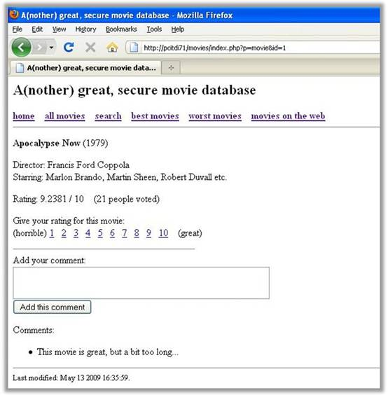
PHP

Slide 4
PHP
PHP exercise is a sample Web application
“Movie database”
play with it a bit, to see what it can do
6 sub-questions about different vulnerabilities
=> because Web applications are often vulnerable
even if you don’t know PHP, try it – it’s easy
(and you may need it one day)

Slide 5
Hints, solutions, answers
If you don’t know how to proceed, see the hint
If you are still stuck, see the solution
Start with the sample exercise to see how hints and solutions work
When providing answers:
  try different things
  call me if you are sure that you have a good answer, but docs don't accept it
After providing a correct answer => read the solution
  (you may still learn something interesting!)

Slide 6
Source code tools
... for C/C++, PHP, Java...
Try them!

Slide 7
The goal
Complete at least 3 exercises
  displaying hints and even solutions is OK
  the more exercises completed the better
Competition: which team solves most (all?) exercises?
  (without seeing solutions)
But the main goal is TO LEARN
BTW, don't try to hack machines of your colleagues

Slide 8
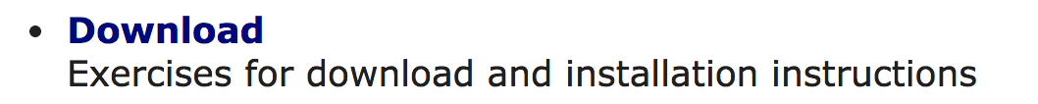
Go to https://cern.ch/csc-security
Log in with your csc_user account
Enter your table number + both names
Start the VM
Do one of the following (only one):
  ssh -p 27222 csc_user@localhost
  log in to the VM and open a terminal
Follow instructions from the “Download” section
Check if http://localhost:27280/movies works

