Slide 1


RI-Paths Workshop at CERN
https://cds.cern.ch/record/2319300
Johannes Gutleber
Accelerator and Technology Sector Directorate Office
CERN
Switzerland
November 13, 2018
https://cds.cern.ch/record/2319300

Slide 2
What is CERN?
International organization established by convention of
1 July 1953, in force in 1954 and revised in 1971
Full name: European Organization for Nuclear Research; acronym CERN referring to the body in charge of the drafting of the Convention: Conseil européen pour la Recherche nucléaire
First established in Switzerland (Headquarters Agreement in 1955) and then extended into France (Status Agreement in 1965, revised in 1972)
  Unique location of the physical assets in two states
  Develops own rules necessary for proper functioning in agreement with host states (safety, financial, procurement)
  Has its own social security system (health insurance + pension scheme)

Slide 3
Who is CERN?
Currently 22 Member States
Open to non-European states since 2010
  4 Associate Member States
  (India, Pakistan, Turkey, Ukraine)
  3 Associate Member States in pre-stage for full membership
  (Cyprus, Serbia, Slovenia)
  6 Observers to Council
  (Japan, Russia, USA, EU, JINR, UNESCO)

Slide 4
How does it Work?
CERN represents the co-operation of the member states
Its assets are owned and administered by the co-operative of the member states
Host states have a double role
  They co-own assets and contribute to implement its program
  CERN and the host states work together to ensure that the member states can achieve the mission within the host-states

Slide 5
Employed personnel
(ca. 2’400,
and 750 fellows)
Associated personnel (ca. 13’000)
scientists, engineers, project associates linked to a home institution and using CERN infrastructure for their experiments / assisting CERN in the construction of accelerators / detectors and carrying out its projects
Staff members
Fellows
International collaboration
(Users)
Exchange of scientists
(e.g. Scientific Associates, Guest Professors)
Training
(Apprentices, Students, Trainees)
Two categories of personnel

Slide 6
The Governance of CERN
Council
Supreme decision-making body
Decides on major aspects of CERN activities
Composed of Member States’ representatives
Headed by a president
Ursula Bassler
1 year, renewable 2x
Directorate
Director General appointed by the Council
Acting as a “Chief Executive Officer”
Mandated to manage CERN under the Council’s governance
Fabbiola Gianotti
5 years,
1.1.2016-31.12.2020

Slide 7
Organigram
COUNCIL
Scientific Policy Committee
Finance Committee
Audit
Committee
TREF
IT
TH
Research and Computing
EN
BE
TE
Accelerators and Technology
SMB
FAP
HR
Finance and Human Resources
Director-General
PFGB
International Relations
IPT
EP
External Auditors
Communication, Education, Outreach
Relations with States and IGOs
Supreme Decision-Making Authority
Management of the Organisation
Health Safety Environment
Legal Service
Internal Audit
Council Support
Council assisting bodies

Slide 8
What is a Research Infrastructure?
Definition from Council Regulation (EC) No 723/2009
of 25 June 2009 on the Community legal framework for a European Research Infrastructure Consortium (ERIC)
Facilities, resources and related services that are used by the scientific community to conduct top-level research in their respective fields and covers major scientific equipment or sets of instruments; knowledge-based resources such as collections, archives or structures for scientific information; enabling Information and Communications Technology-based infrastructures such as Grid, computing, software and communication, or any other entity of a unique nature essential to achieve excellence in research. Such infrastructures may be ‘single-sited’ or ‘distributed’ (an organised network of resources);
From the H2020 glossary: An Installation is a part of a research infrastructure that could be used independently from the rest. RIs are made up of one or more installations.

Slide 9
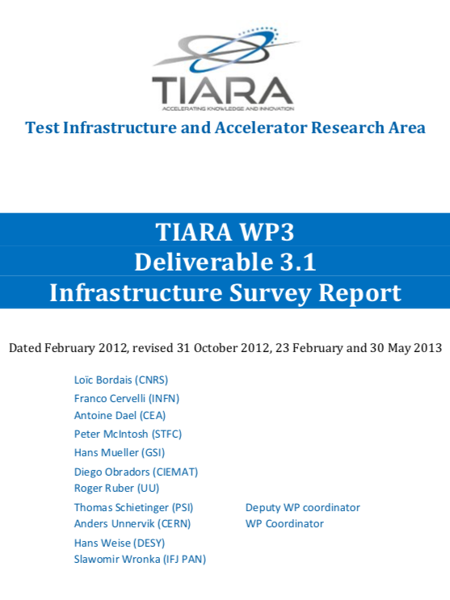
Examples for RI Installations
Programmes (examples)
  LHC/HL-LHC consisting of collider + fractional use of injectors + experiments + fractional use of computing infrastructures
  - Antimatter factory + fractional use of injectors + experiments + fractional use of computing infrastructures
Facilities (examples)
  Magnet testing facility
  Isotope production
  Co-development with NGOs, SMEs, students
Services (examples)
  World-wide computing grid
  Carrier-neutral Internet Exchange point
  Library services
  Data curation and long-term data preservation

Slide 10
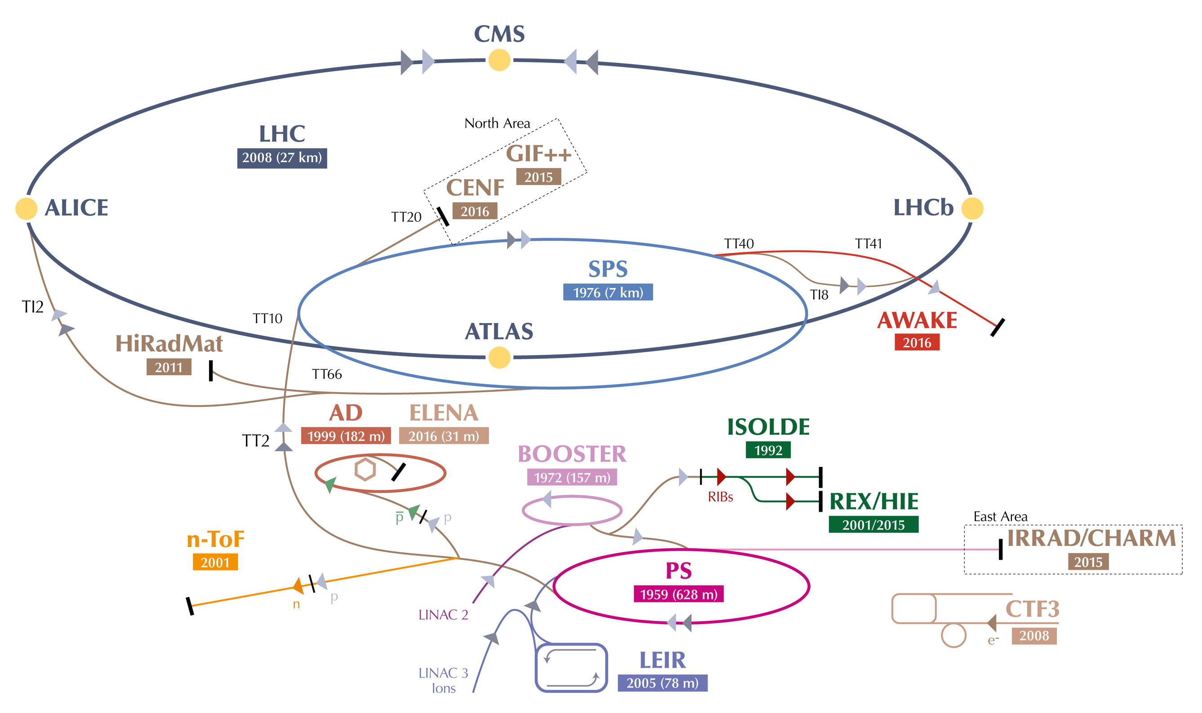
CERN – An “RI” with Many Installations
Large Hadron Collider: Highest energy hadron collider with experiments ATLAS, CMS, LHCb, ALICE, TOTEM, LHCf and MoEDAL
Fixed target experiments at beamlines: SPS, PS
Antimatter factory at AD, ELENA
Research facilities for new acceleration technologies: AWAKE, CLEAR

Slide 11
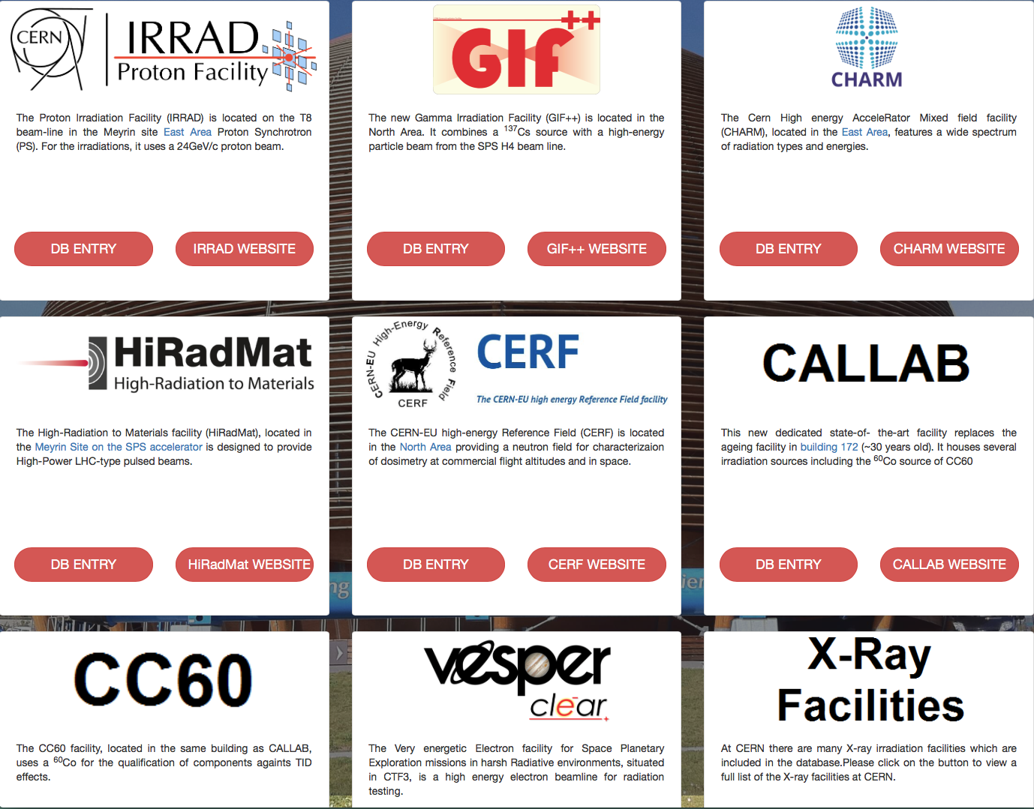
CERN Irradiation Facilities
http://irradiation-facilities.web.cern.ch

Slide 12
CERN Engineering Facilities
Large magnet and cryostat manufacturing faciliy
Magnetic measurement facility
Coating facilities
Cryogenic laboratory and tensile facility
Chemistry laboratory
Nano stabilisation and positioning infrastructure
Electrical standards laboratory
High-precision coordinate measuring (metrology)
Horizontal vacuum brazing facility
Large-scale heat reaction and treatment facility
High-voltage dielectric insulation laboratory
Vacuum material characterization laboratory
Laser resonance ionization spectroscopy laboratory
Polymer laboratory
Superconductor and cabling facility
Surface analysis and treatment laboratory
Radioactive waste treatment and management facility

Slide 13
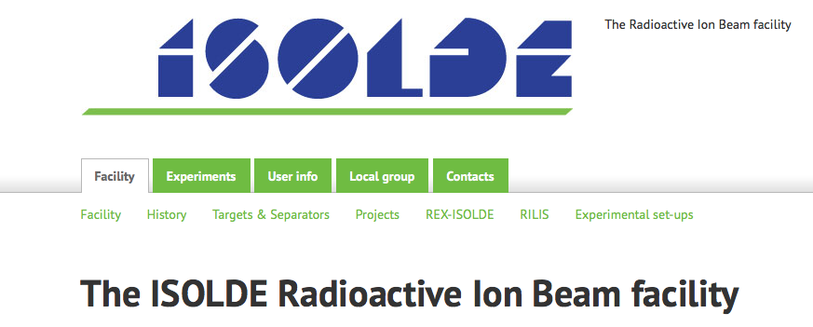


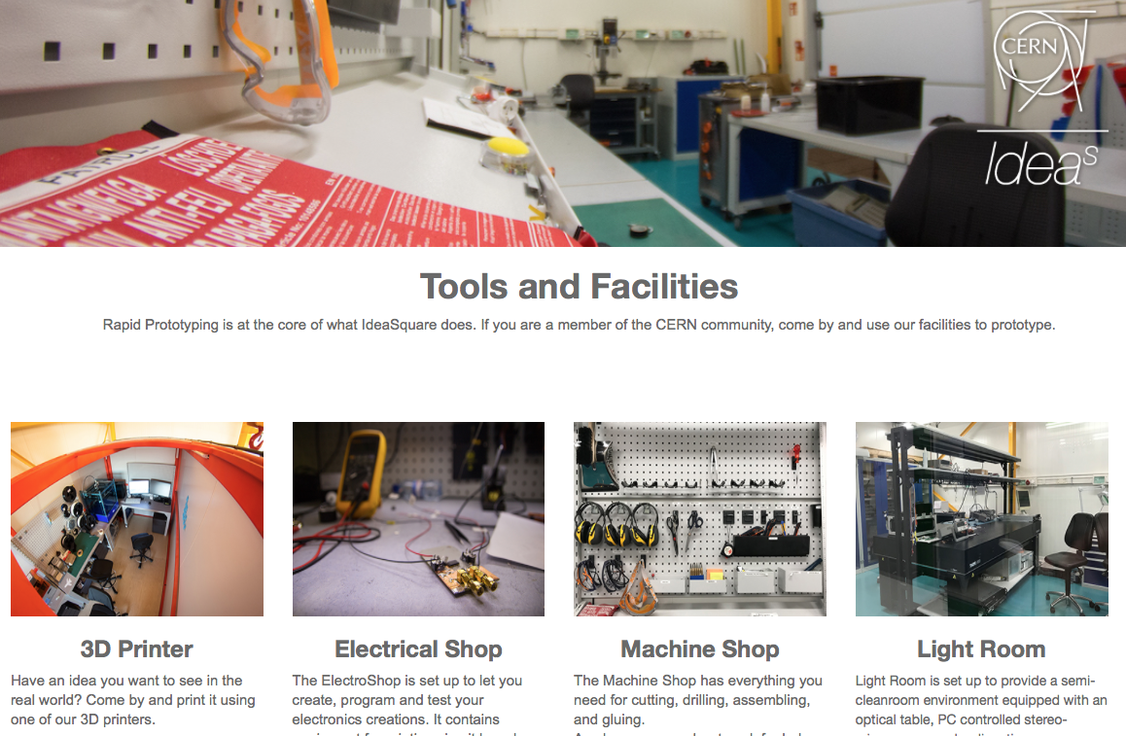
Examples for “special” facilities

Slide 14
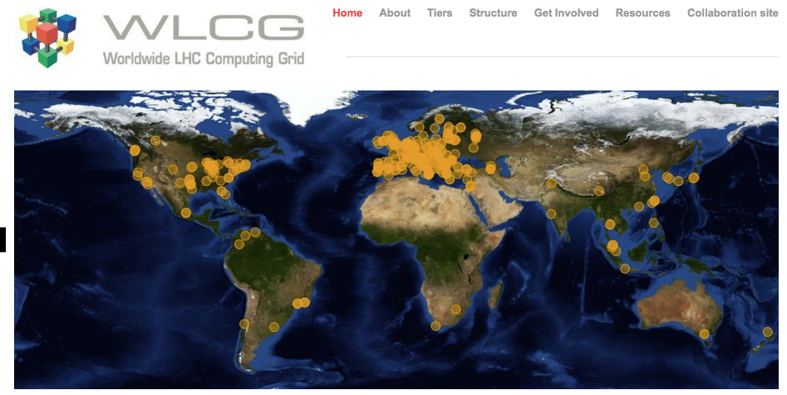
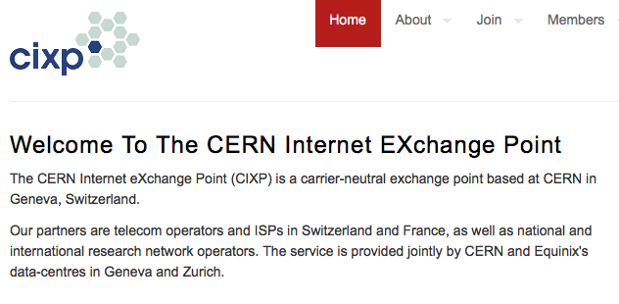
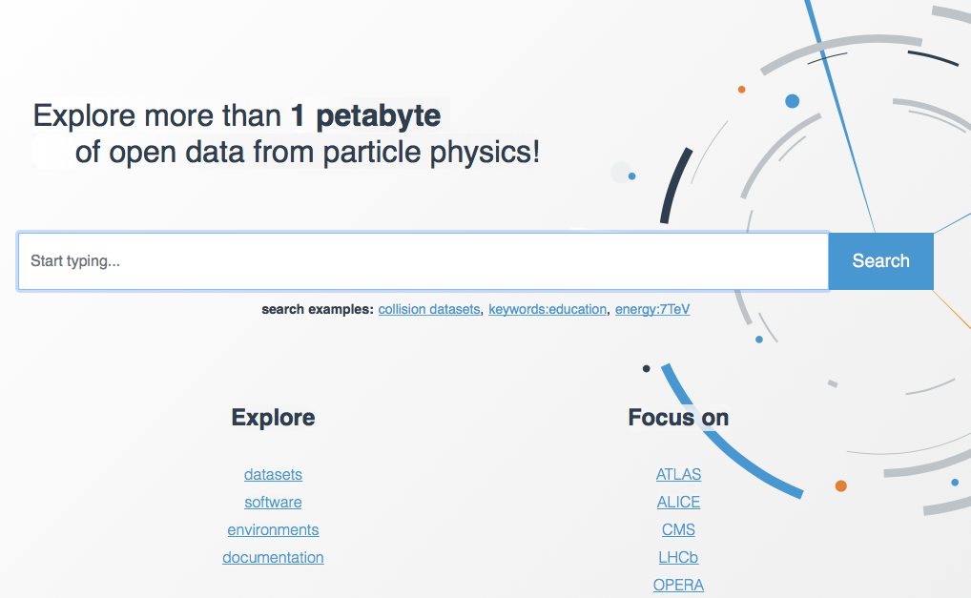

CERN Computing Facilities (Examples)

Slide 15
Questions from project

Slide 16
External Expectations on Impact Assessments
By whom (today) ?
  Host states (FR, CH) and some member states (Sweden, Czech republic)
What are they (today)?
  No formal requests so far for quantitative impact
  Mainly stistics that permits member states to quantify the the return of investment
      Number of students, post-docs, staff from the country per year at CERN
      Number of visitors including teachers and pupils/students
      Value of procurement actions with member state
      Number of patents filed, list of technologies developed
      Number of publications with authors of host state
How has it changed in recent years?
  Tomorrow: See next stide…

Slide 17

For a future infrastructure project…
Required by EC for obtaining EU structural, cohesion and ERDF funding
Asked by EIB to obtain loans
  «.. The economic decision-criterion is based on the incremental cost benefit/effectiveness of the project […] as represented by the incremental discounted-cost-per-benefit-point»

Slide 18
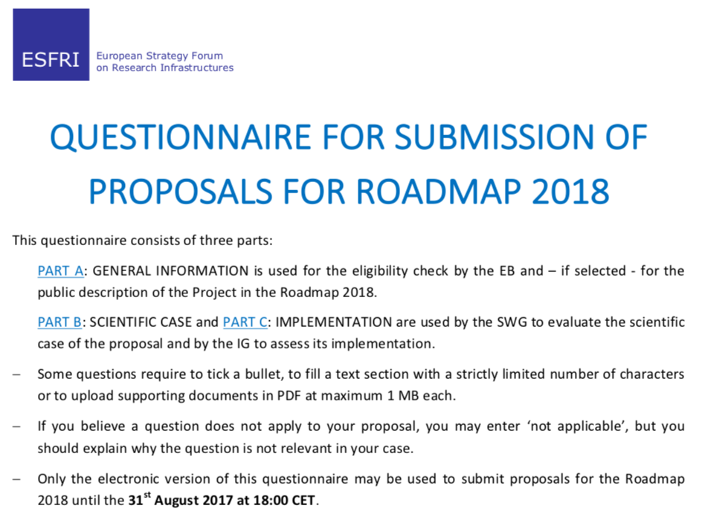
Why this Activity now?
Pre-condition to enter the
European Strategy for
Research Infrastructures
(ESFRI) roadmap since 2018
Section 7, paragraph 7.1: «7.6 Elaborate on the business case of your RI effectively linking the described scientific case, funding commitments, user strategy, access policy and Cost-Benefit Analysis (CBA) demonstrating the long term sustainability of the operations of your RI and explain whether and how this business case has already been reviewed».

Slide 19

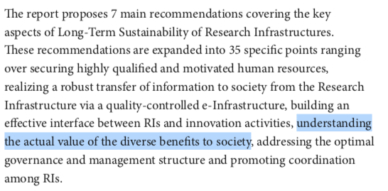

Why this Activity at CERN now?
Recommended for research
Infrastructures who receive
co-funding from the EC and
which are included in the
ESFRI roadmap already.
http://cds.cern.ch/record/2319300

Slide 20
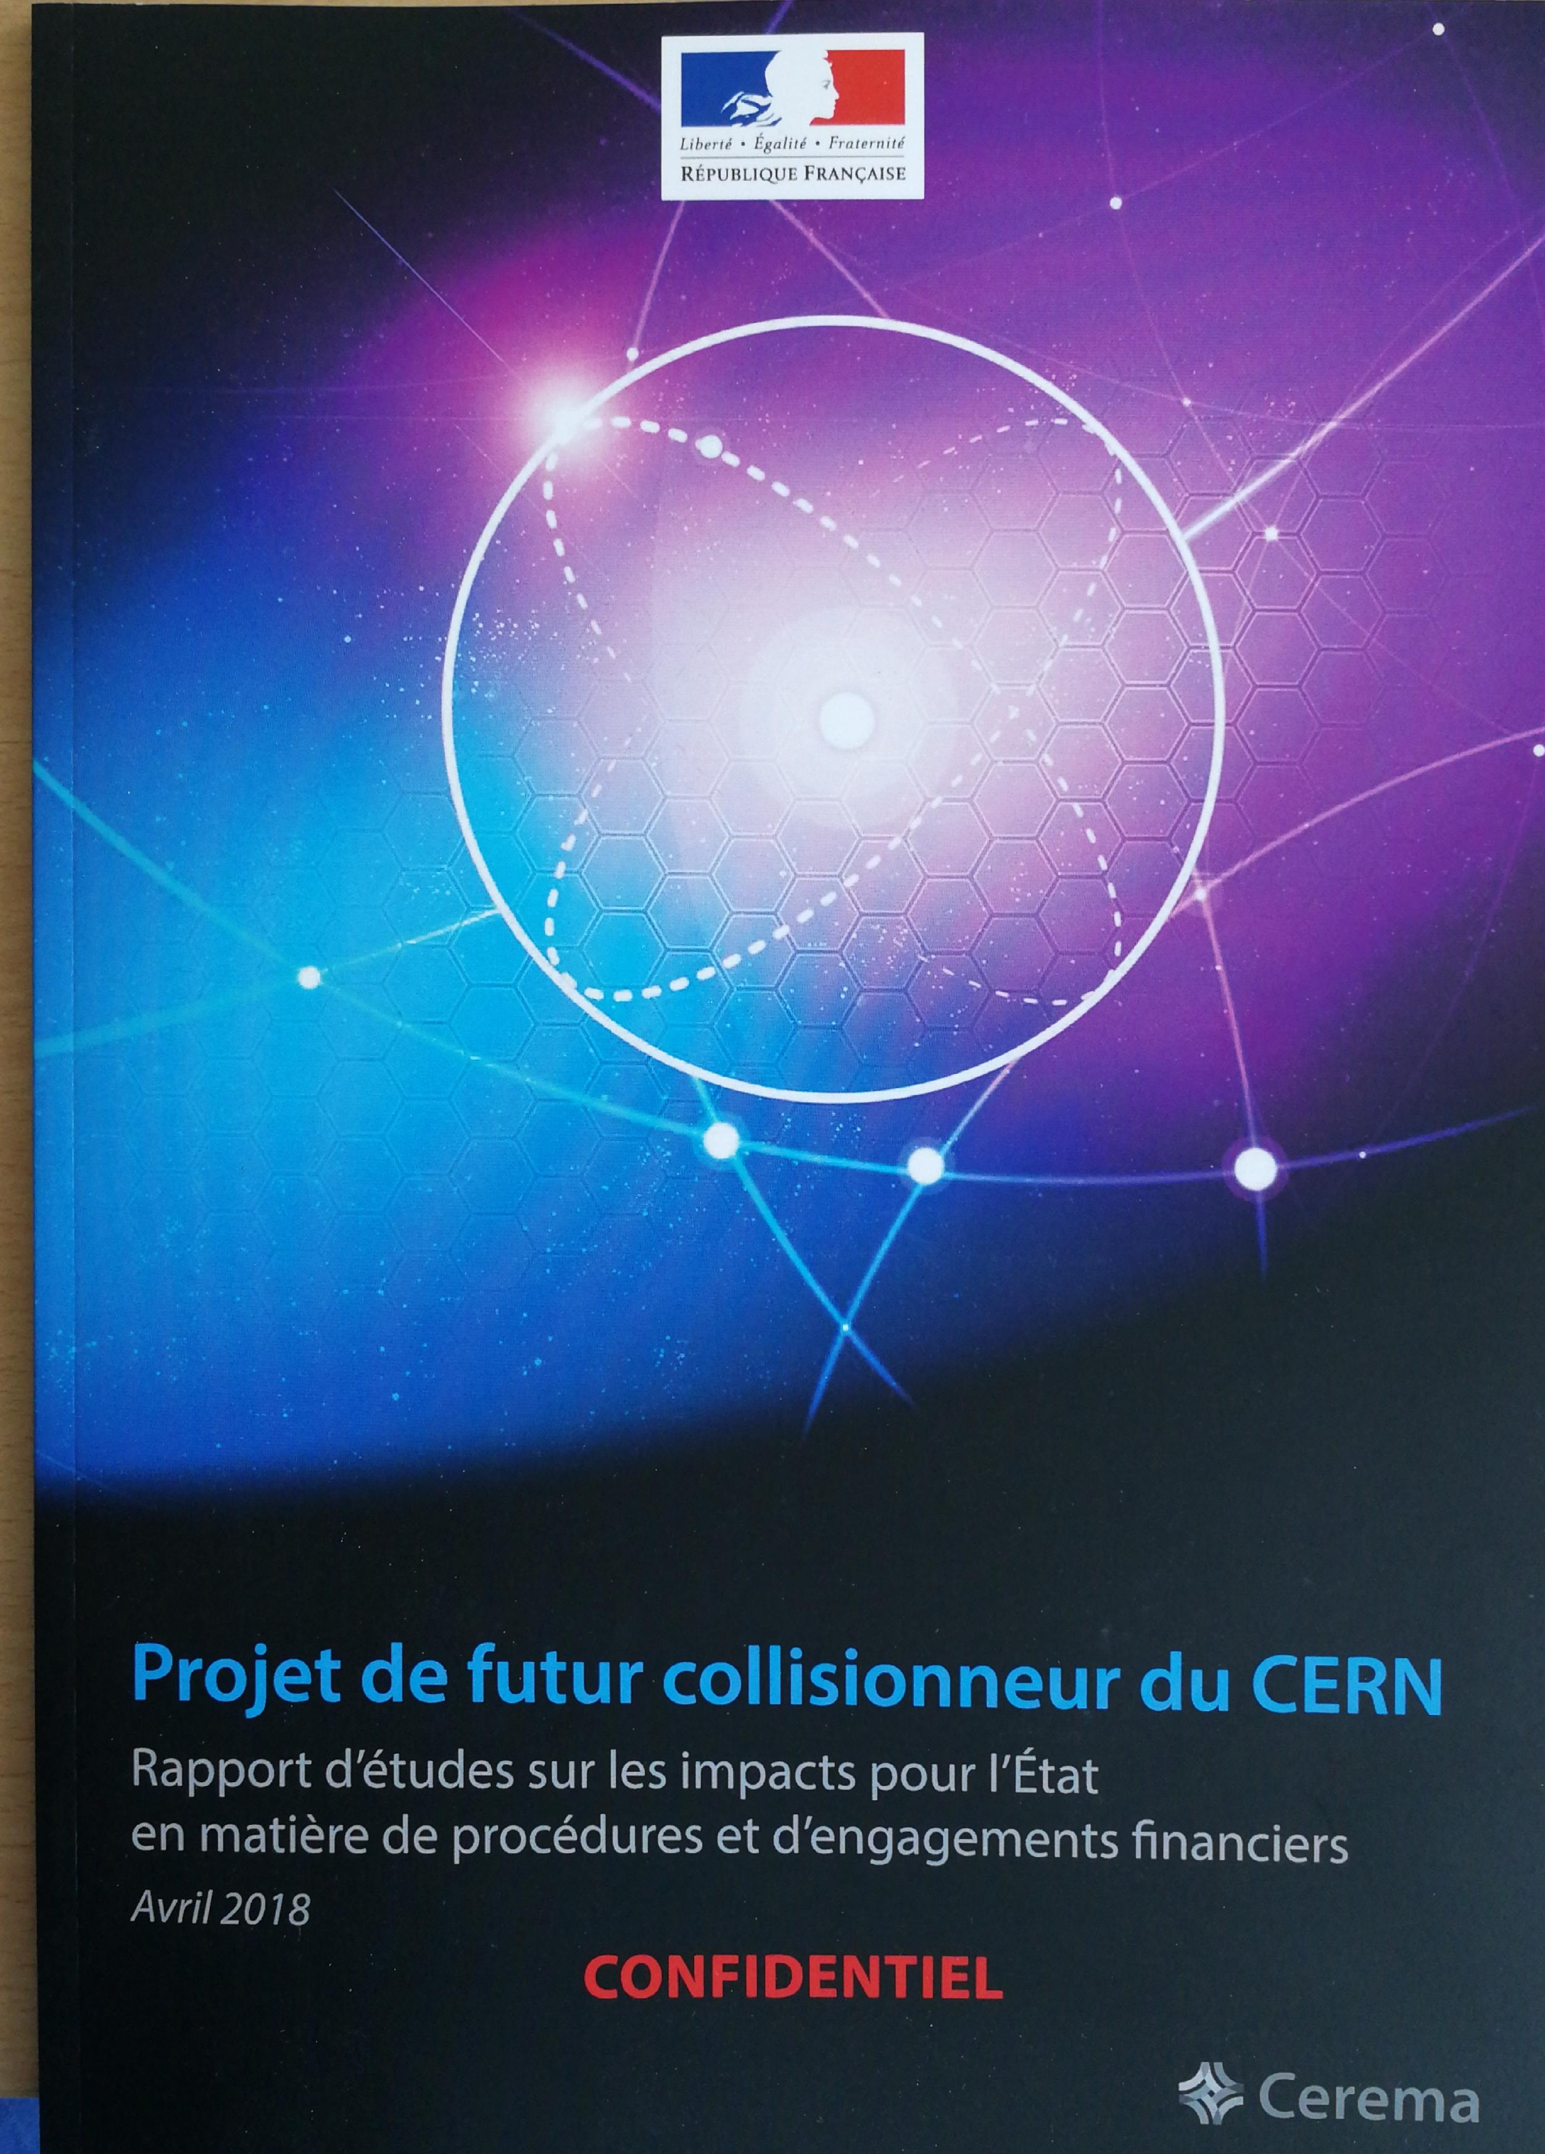
Requested by FR and CH
Requested by France and Switzerland as host states for the pre-validation of a scenario for a significant extension of CERN’s activities with host-state contributions.
Particularly asked by Switzerland to analyse the evolution of the impact of CERN without a new project after the end of the (HL-)LHC programme.

Slide 21
Rational To Undertake IA Exercises
Reactive or proactive?
  Reactive for member state requests
  Proactive for impact through procurement
  (see http://procurement.web.cern.ch)
  Proactive for developing an integrated framework for CBA
  for a future project via the LHC/HL-LHC case as a basis
In what areas do you seek to trace impact?
  See model next page
Do you differentiate between long-term effects of science and immediate ones?
  Scientific impact not assessed (cannot quantify or predict)
  Socio-economic impact from ”start of project” to “end of operation period” applying social discount rate

Slide 22

Impact Assessment Architecture
Capital Expenditures
Capital Expenditures
Operation Expenditures
Training
Spillover
(industry +
ICT)
Science
Products
Cultural
Effects
Public
Good Value

Slide 23
Where do we seek to trace?
Training
  Number and duration of apprentices, MSc./Phd students, post-docs/ESRs
  Salary and hiring location survey after leave
  Professional training impact (qualitative)
Spillover
  Utility/sales ratio (sales utility impact)
  Industrial sales impact cause-effect network (causality, impact factor in % of contract volume, technology level impact, market expansion factor)
  Tracking of software tools above a relevant impact threshold
  Use of software tools in outside CERN including user profile academia, research, industry, private
  Establishment of a value model for software
Scientific products
  Tracking of publication baskets and first and second level citations for a project
  Tracking of accessible data sets and usage count of data sets (difficult for non experiment data such as materials databases)
  Inclusion of topics in schools (e.g. Geneva International School) and academic curricula
Cultural effects
  Tracking of visitors at CERN and their spending (TCM), exhibitions, travelling exhibitions, events such as science fairs, TEDs, lectures, workshops engaging the public
  Tracking of videos, Web sites, social media, books, press cuttings
Public good value
  Surveys in member states via market-research companies

Slide 24
Challenges
Accountability
  CERN is a multi installation/facility RI. It is difficult to account the overall tracked impacts to individual installations
Causality
  It is difficult to decide on inclusion/exclusion of impact elements since the causality between the impact and the specific CERN installation/facility needs to be demonstrated (e.g. Angels & Daemons book and movie can or cannot be attributed to the LHC cultural goods?)
Resources
  Comprehensive, regular and credible impact assessment requires a quality managed process with an adequately staffed team and committed support from all departments and groups. Today, only support on a best-effort basis exists and no dedicated CBA team at CERN exists. For an FCC CBA study, a dedicated working group can be created with contracts in place, but only for a limited period of time and for a specific purpose (e.g. study of a future project).
Cost
  Comprehensive, regular and credible impact assessment requires substantial amounts of financial engagements. CBA for benefit if impact assessment?

Slide 25
What Would You Need for the Future?
Underexplored areas
  Value of training
      Long-lasting salary and job profile/hiring surveys are urgently needed, but are difficult to implement in-house due to data protection fears, limited resources and knowledge ”how to”.
  Value of professional training not explored
      No method known on how to measure the training effect of company employees coming to work at CERN in the frame of projects (see impact via procurement below)
Measured, but method not satisfactory
  Value of software products and services
      Approach to assume the “purchase value of a commercial software” for using an open source tool is not appropriate since a long term (different business models and Web-based services are used today)
  Financial impact of procurement regularly reviewed
      Utility/sales ratio of industrial procurement is only reviewed at rather long time scales. A more regular approach with more rigorous cause/effect matrix would be beneficial also for industry to know how to improve the industrial impacts of large-scale research infrastructure projects. This requires a substantial effort (thousands of companies need to be interviewed an causal networks need to be analysed)

Slide 26
Do Yourself or Outsource?
Inhouse
  Establish data gathering catalogue
    what, who, how, when
  Instrument tools (e.g. counters on Web sites, cookies, provide organization only tailor questionnaires developed by experienced professionals)
  Develop background materials for surveys
  Work with consultants to develop the process for data gathering commonly to ensure that appropriate data is collected effectively (had good experience already with external partners)
  Instruct departments and groups for
  Analyse and integrate the results to the overall impact report
Outsource
  Contract as much of the data gathering and analysis work to companies, cooperation partners, universities, consultants
  Use outside platforms for surveys as much as possible
      Compliant with data protection regulations, assure confidentiality and independence as well as compliance with ethics committee guidelines
  Training of in-house personnel about need and value of the activity (usually better perceived if it comes from an independent organization or trainer)

