Slide 1
Material procurement of seamless cavities and characterization of spun half-cells
Carolina Abajo
EN/MME
Manufacturing of Seamless cavities - CERN-LNL meeting 07·11·2018

Slide 2
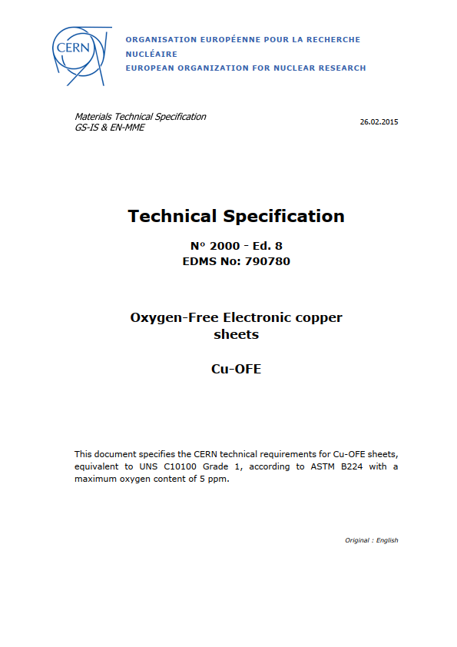
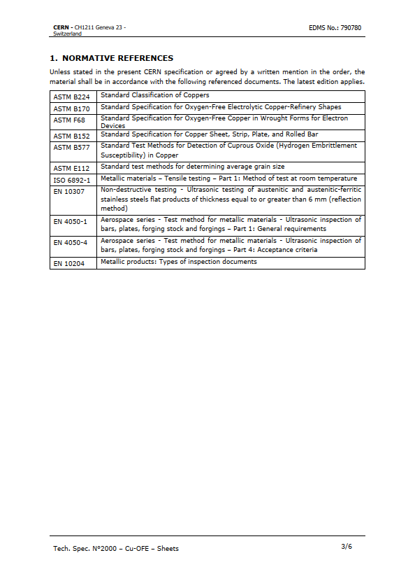
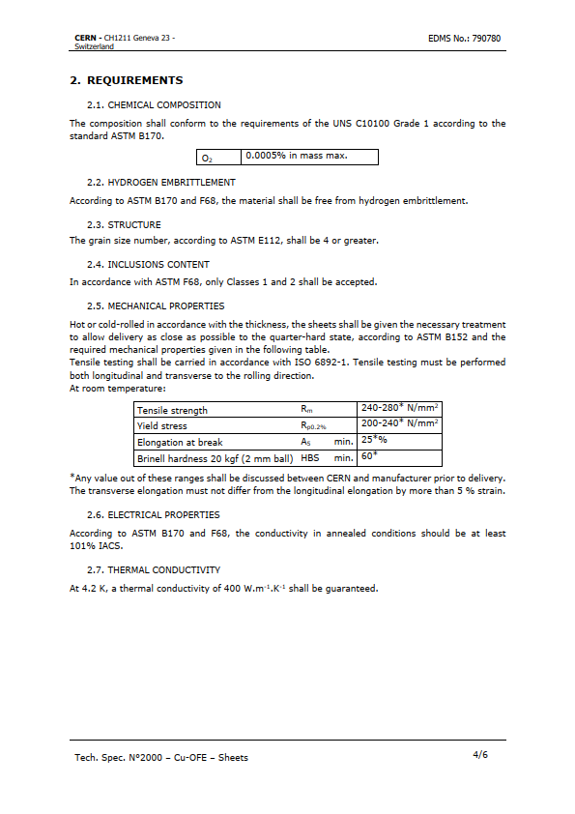
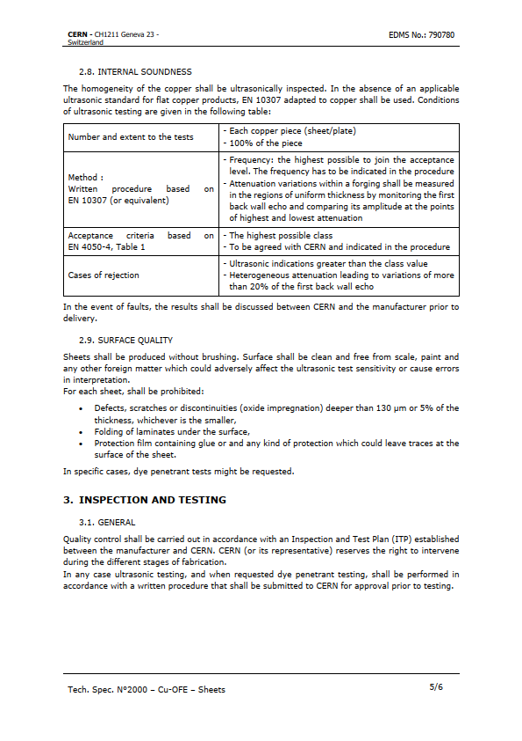
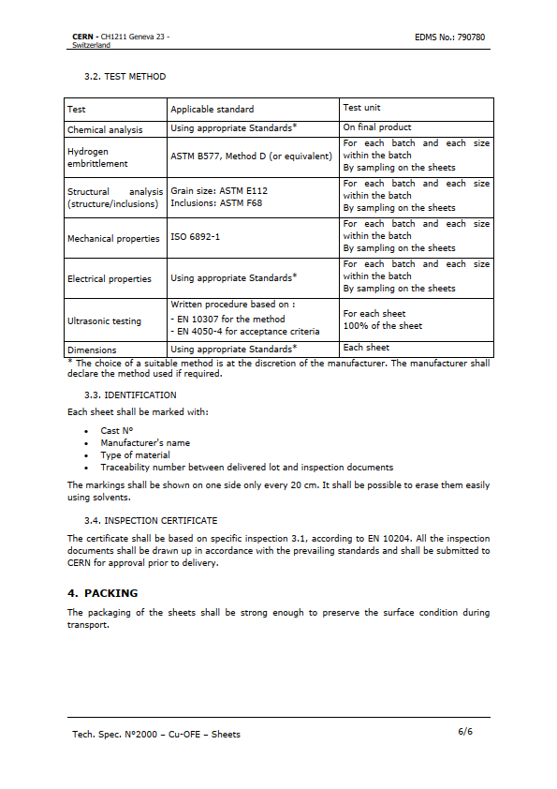
1. LNL – Material requirements
Manufacturing of 400 MHz seamless cavities
Large size copper discs
Φ1500mm
Manufacturing of Seamless cavities - CERN-LNL meeting
1

Slide 3
2. CERN strategy & suppliers
Firm | Cu OFE | Comments | Alternative
Schmelzmetall | No offer | No Dimensions | DECLINE
ILF products | No offer |  | DHP BSEN1652
Goodfellow | No offer |  | Cu 99,9% CW024 C106H H (DHP)
Prometall | No offer |  | CW0211A R240 Demi dur
SISO | No offer |  | Cu DHP demi dur R240
Tresoldi metalli | No offer |  | DECLINE
Hauselmann | No offer |  | Cu DHP R240 Demi dur
Luvata | No offer | max rolling width 1020mm | DECLINE
Aurubis | No offer | max rolling width 1100mm | DECLINE
Metal sheets | No offer | max thickness 3mm | DECLINE
Metelec | No offer | max thickness 3mm | DECLINE
Matthey | No offer |  | DECLINE
Wieland | No offer |  | DECLINE
Columbia metals | No offer |  | DECLINE
Aviva | No offer | (3x) 3060.7x1231.9x4.7mm | DECLINE
Eisenmetall | No offer | 1000x2000mm | DECLINE
Ametra metall | No offer |  | DECLINE
Amco metall | No offer |  | DECLINE
Swissmetal | No offer |  | DECLINE
KME | OFFER | 6000Kg min
MKM | OFFER | out of specs. surface
Bikkar | OFFER | unreacheable firm
Carl Shreiber | OFFER | closed
Cu OFE
CERN specs
Ø1500mm
Manufacturing of Seamless cavities - CERN-LNL meeting
2

Slide 4
2. CERN strategy & suppliers
Cu OFE
CERN specs
Ø1500mm
Cu OFE Alternatives
Ø1500 mm
Cu | Cu % | Other elements | Rp0.2 | Rm | Elongation min A ₅₀ |  | cold froming propierties
OFE | 99.99 |  | 220-260 | <140 | 33 | 40-65 | Excellent
OF | 99.95 | Pb 0.005 | 220-260 | <140 | 33 | 40-65 | Excellent
HCP | 99.95 | P(0.002-0.007)Pb0.005 | 220-260 | <140 | 33 | 40-65 | Excellent
DHP | 99.99 | P (0.015-0.04) | 220-260 | <140 | 33 | 40-65 | /
Manufacturing of Seamless cavities - CERN-LNL meeting
3

Slide 5
2. CERN strategy & suppliers
Firm | Cu OFE | Comments | Alternative
Schmelzmetall | No offer | No Dimensions | No offer
ILF products | No offer |  | DHP BSEN1652
Goodfellow | No offer |  | Cu 99,9% CW024 C106H H (DHP)
Prometall | No offer |  | CW0211A R240 Demi dur
SISO | No offer |  | Cu DHP demi dur R240
Tresoldi metalli | No offer |  | No offer
Hauselmann | No offer |  | Cu DHP R240 Demi dur
Luvata | No offer | max rolling width 1020mm | No offer
Aurubis | No offer | max rolling width 1100mm | No offer
Metal sheets | No offer | max thickness 3mm | No offer
Metelec | No offer | max thickness 3mm | No offer
Matthey | No offer |  | No offer
Wieland | No offer |  | No offer
Columbia metals | No offer |  | No offer
Aviva | No offer | (3x) 3060.7x1231.9x4.7mm | No offer
Eisenmetall | No offer | 1000x2000mm | No offer
Ametra metall | No offer |  | No offer
Amco metall | No offer |  | No offer
Swissmetal | No offer |  | No offer
KME | OFFER | 6000Kg min
MKM | OFFER | out of specs. surface
Bikkar | OFFER | unreacheable firm
Carl Shreiber | OFFER | closed
Cu OFE
CERN specs
Ø1500mm
Cu OFE Alternatives
Ø1500 mm
Manufacturing of Seamless cavities - CERN-LNL meeting
4

Slide 6
2. CERN strategy & suppliers
Firm | Cu OFE | Comments | Alternative
Schmelzmetall | No offer | No Dimensions | No offer
ILF products | No offer |  | DHP BSEN1652
Goodfellow | No offer |  | Cu 99,9% CW024 C106H H (DHP)
Prometall | No offer |  | CW0211A R240 Demi dur
SISO | No offer |  | Cu DHP demi dur R240
Tresoldi metalli | No offer |  | No offer
Hauselmann | No offer |  | Cu DHP R240 Demi dur
Luvata | No offer | max rolling width 1020mm | No offer
Aurubis | No offer | max rolling width 1100mm | No offer
Metal sheets | No offer | max thickness 3mm | No offer
Metelec | No offer | max thickness 3mm | No offer
Matthey | No offer |  | No offer
Wieland | No offer |  | No offer
Columbia metals | No offer |  | No offer
Aviva | No offer | (3x) 3060.7x1231.9x4.7mm | No offer
Eisenmetall | No offer | 1000x2000mm | No offer
Ametra metall | No offer |  | No offer
Amco metall | No offer |  | No offer
Swissmetal | No offer |  | No offer
KME | OFFER | 6000Kg min
MKM | OFFER | out of specs. surface
Bikkar | OFFER | unreacheable firm
Carl Shreiber | OFFER | closed
Cu OFE
CERN specs
Ø1500mm
Cu OFE Alternatives
Ø1500 mm
Cu OFE
CERN specs
Ø1200-1150mm
Manufacturing of Seamless cavities - CERN-LNL meeting
5

Slide 7
2. CERN strategy & suppliers
Firm | Cu OFE | Comments | Alternative
Schmelzmetall | No offer | No Dimensions | No offer
ILF products | No offer |  | DHP BSEN1652
Goodfellow | No offer |  | Cu 99,9% CW024 C106H H (DHP)
Prometall | No offer |  | CW0211A R240 Demi dur
SISO | No offer |  | Cu DHP demi dur R240
Tresoldi metalli | No offer |  | No offer
Hauselmann | No offer |  | Cu DHP R240 Demi dur
Luvata | No offer | max rolling width 1020mm | No offer
Aurubis | No offer | max rolling width 1100mm | No offer
Metal sheets | No offer | max thickness 3mm | No offer
Metelec | No offer | max thickness 3mm | No offer
Matthey | No offer |  | No offer
Wieland | No offer |  | No offer
Columbia metals | No offer |  | No offer
Aviva | No offer | (3x) 3060.7x1231.9x4.7mm | No offer
Eisenmetall | No offer | 1000x2000mm | No offer
Ametra metall | No offer |  | No offer
Amco metall | No offer |  | No offer
Swissmetal | No offer |  | No offer
KME | OFFER | 6000Kg min
MKM | OFFER | out of specs. surface
Bikkar | OFFER | unreacheable firm
Carl Shreiber | OFFER | closed
Cu OFE
CERN specs
Ø1500mm
Cu OFE Alternatives
Ø1500 mm
Cu OFE
CERN specs
Ø1200-1150mm
Cu OFE
CERN specs
Ø1200-1150mm
Manufacturing of Seamless cavities - CERN-LNL meeting
6

Slide 8
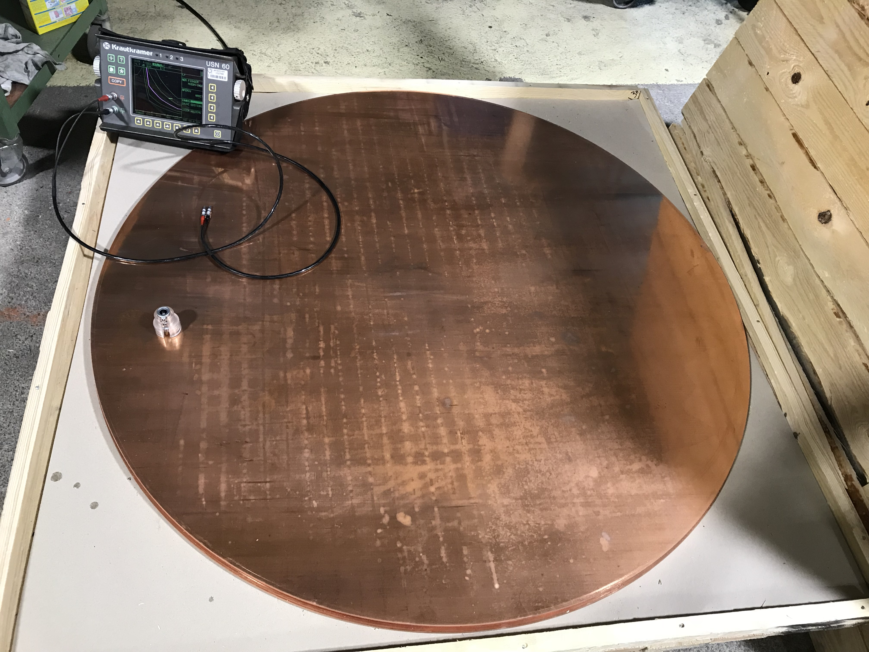
2. CERN strategy & suppliers
Inspection certificate 3.1, EN 10204
Ultrasonic testing
No possibility to characterise the material
Before forming
After forming
Material characterisation in terms of composition and surface state after Electropolishing
Manufacturing of Seamless cavities - CERN-LNL meeting
7

Slide 9

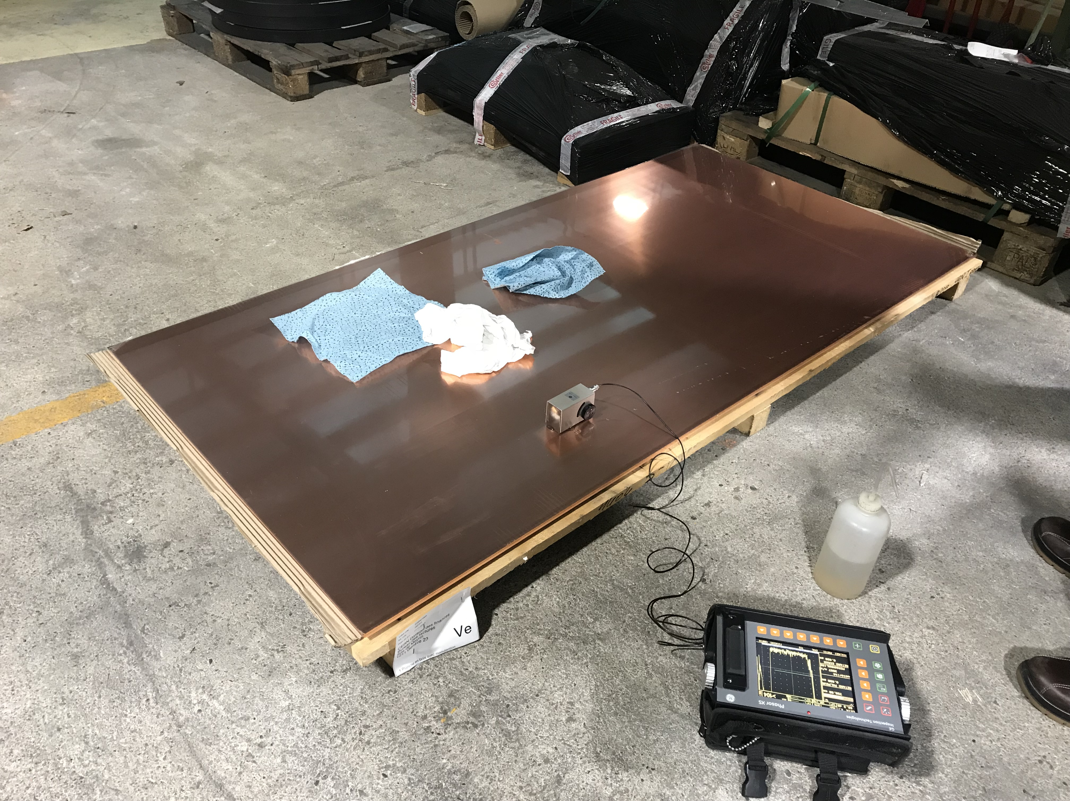
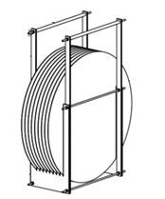
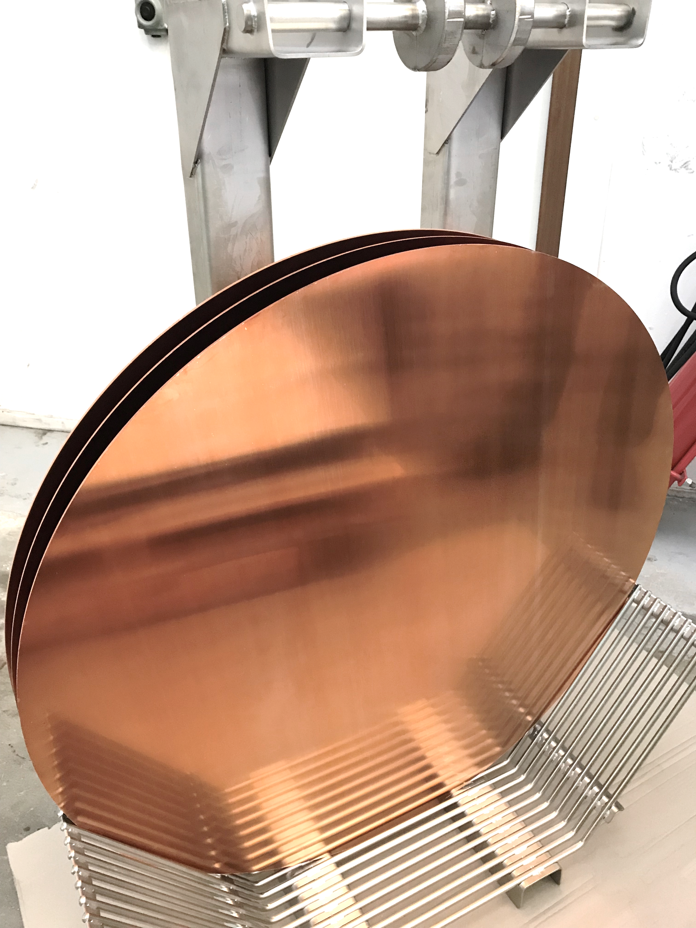
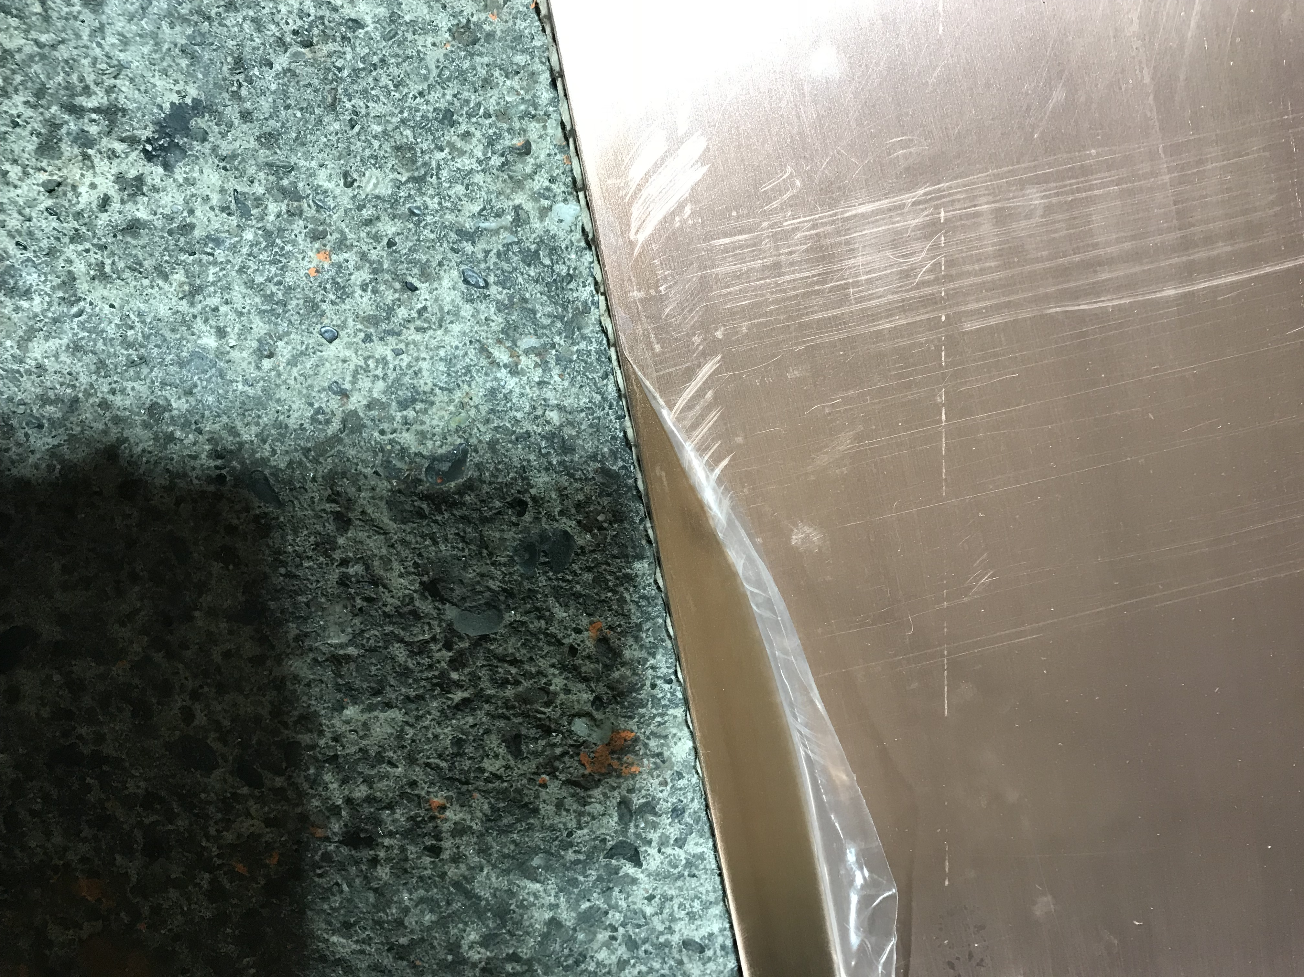
2. CERN strategy & suppliers
New dimensions → new supplier?
Aurubis: maximum width is 1100 mm and MOQ is 2000 kg.
Material preparation procedure at CERN
Supply chain- stores
NDT
Water jet cutting
US inspections
Cleaning
Annealing
Reception
Material certificate
Protection layer (Pavatex)
Between the sheet and the equipment
Teflon holder
SS holder
3.1 EN 10204
Film
Manufacturing of Seamless cavities - CERN-LNL meeting
8

Slide 10
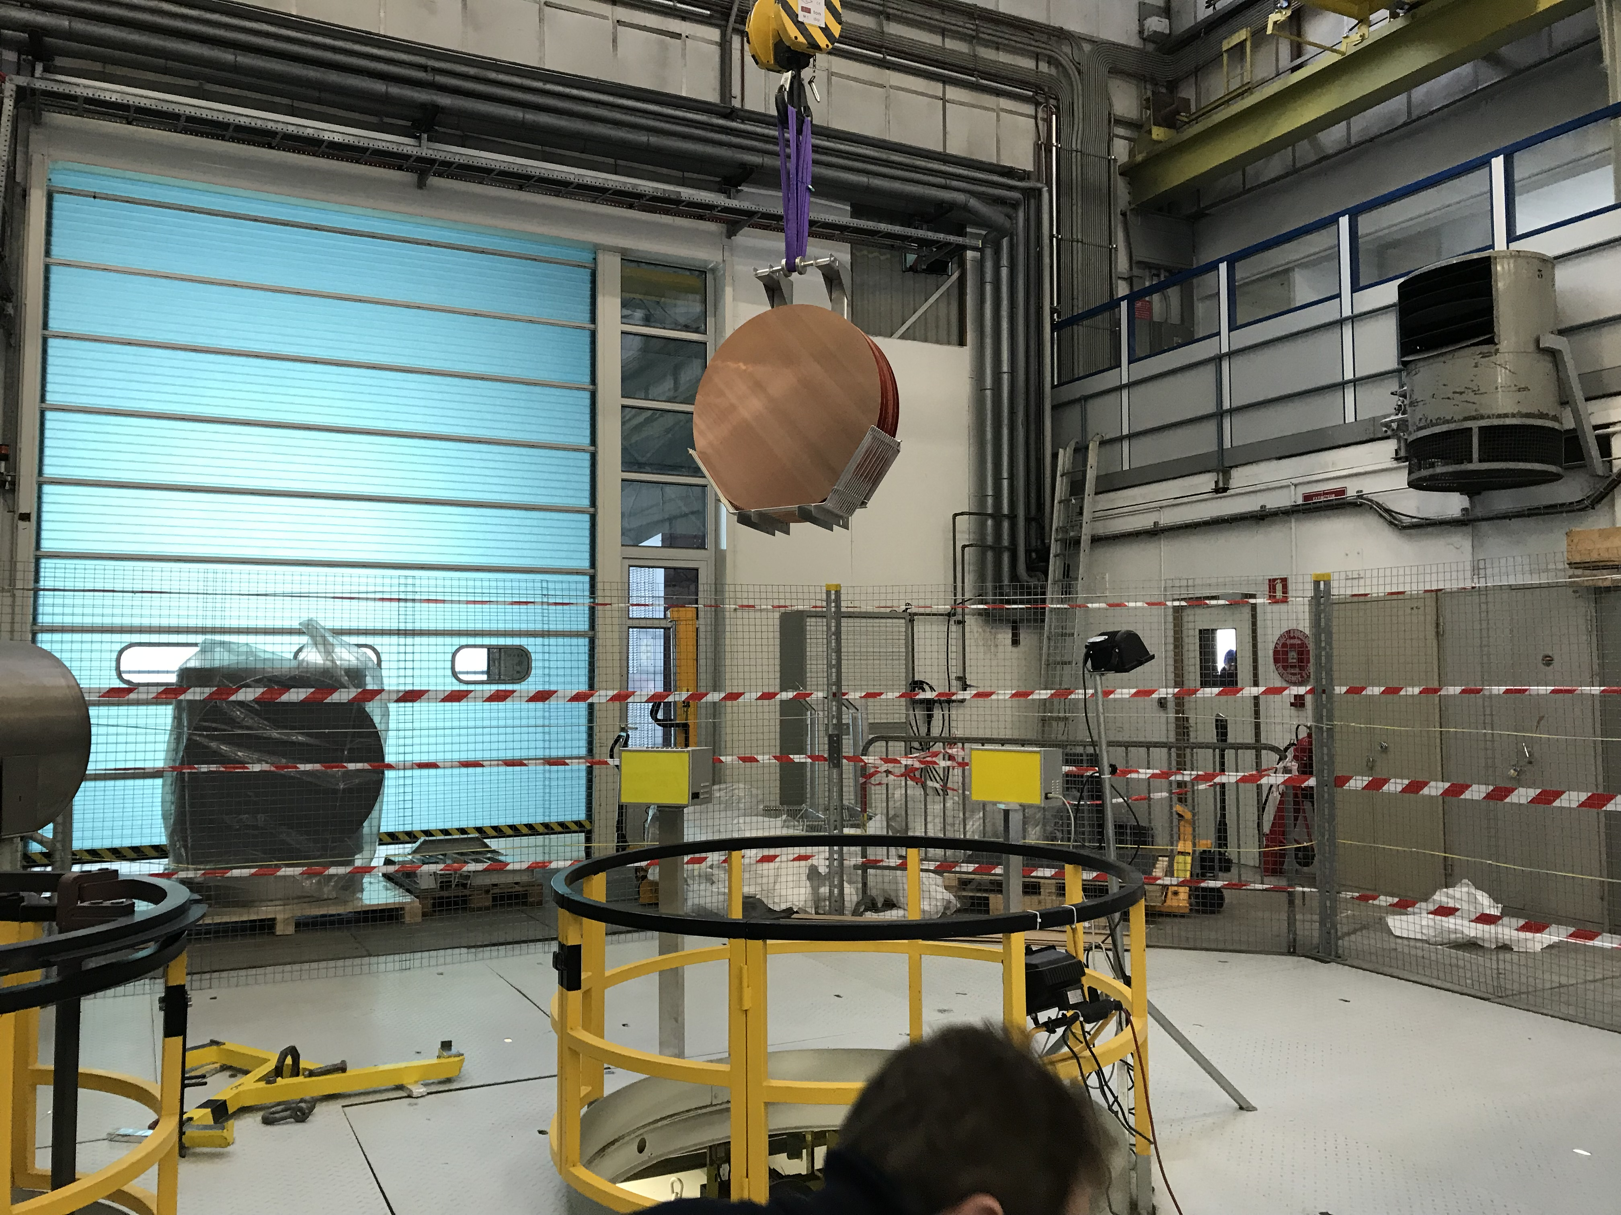
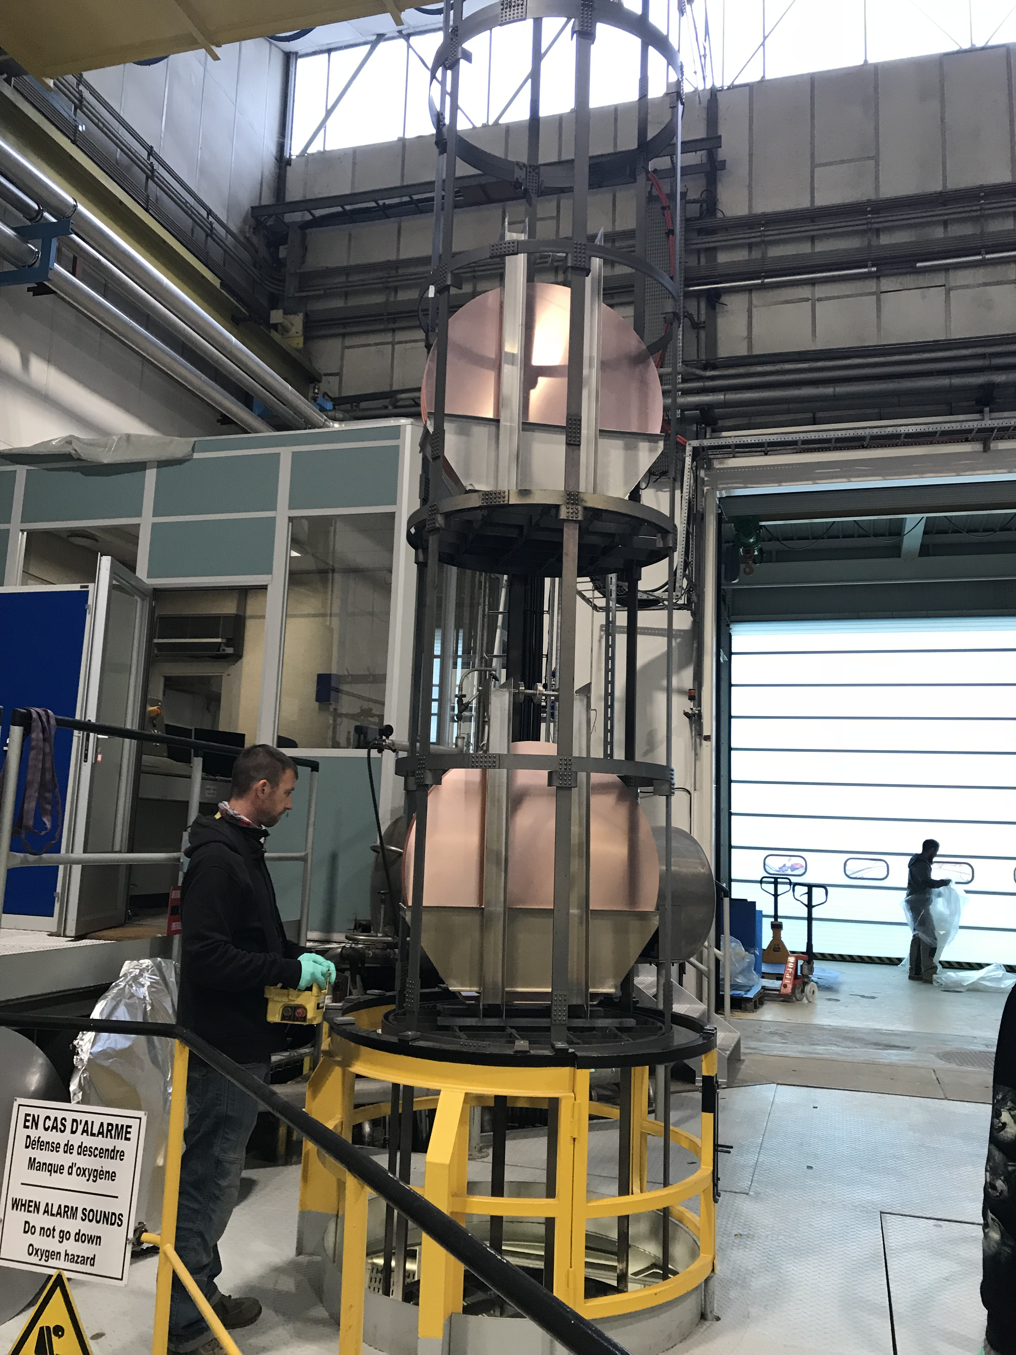
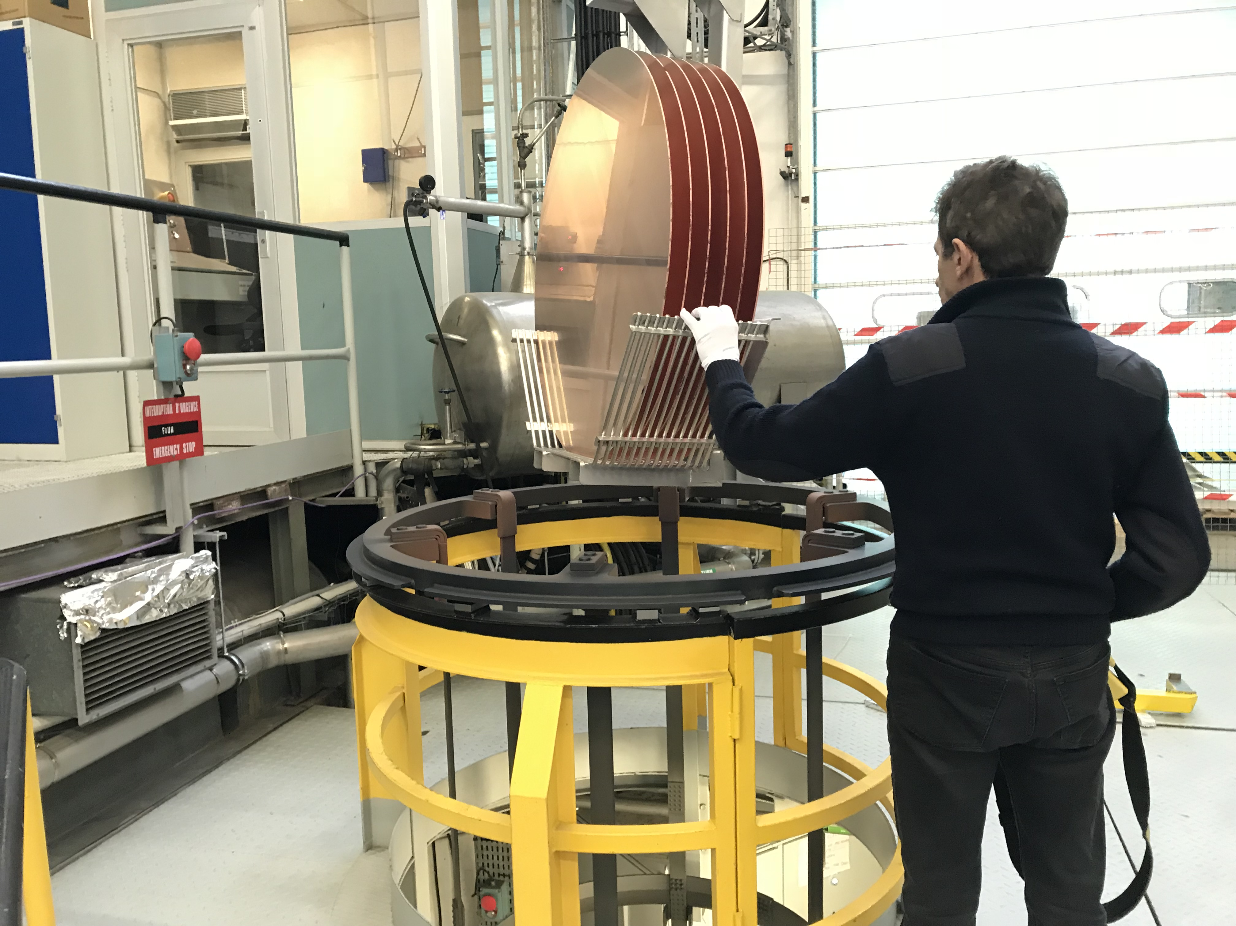
2. CERN strategy & suppliers
Up to 20 discs in one cycle
Ø940mm
Manufacturing of Seamless cavities - CERN-LNL meeting
9

Slide 11
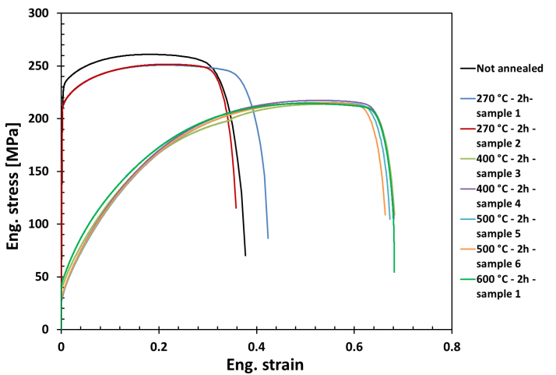
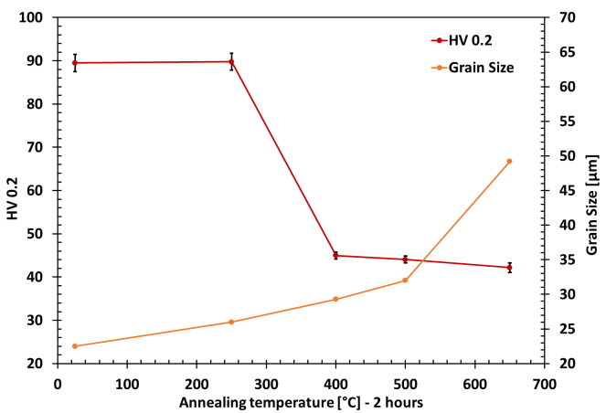
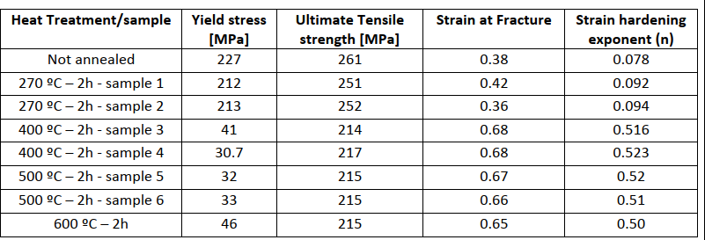
3. Annealing of Cu OFE in CERN
Base material OFE Cu th.3mm
E. Cantergiani EDMS 1711461
600°C – 2h in vacuum 10⁻⁶-10⁻⁷mbar
Manufacturing of Seamless cavities - CERN-LNL meeting
10

Slide 12
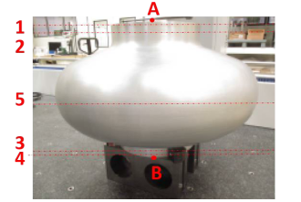

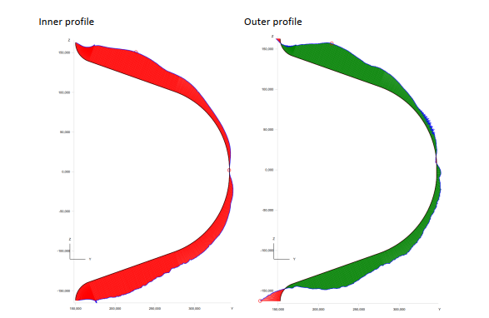
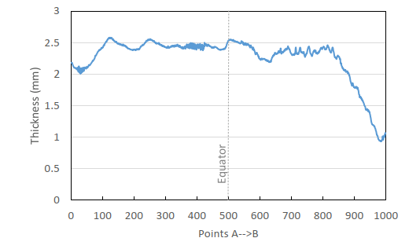
4. Control of cavities at CERN
Metrology
Diameter and circularity
Shape profile
Thickness profile
Manufacturing of Seamless cavities - CERN-LNL meeting
11

Slide 13
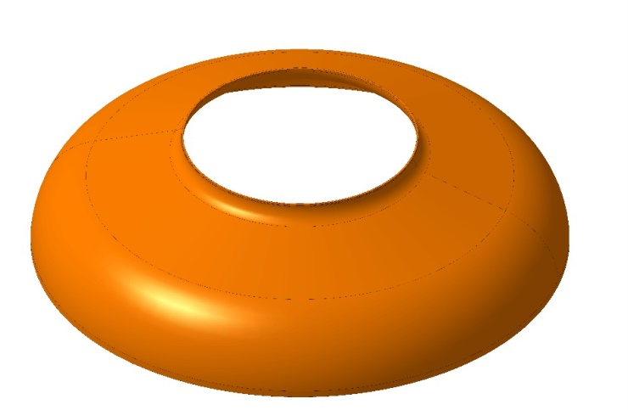
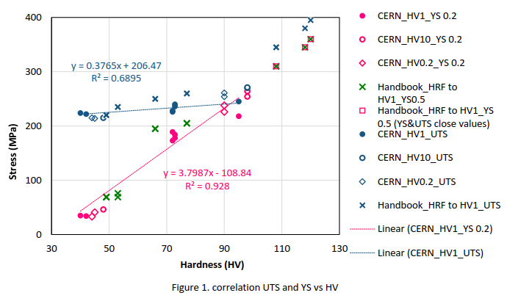
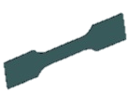
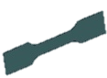
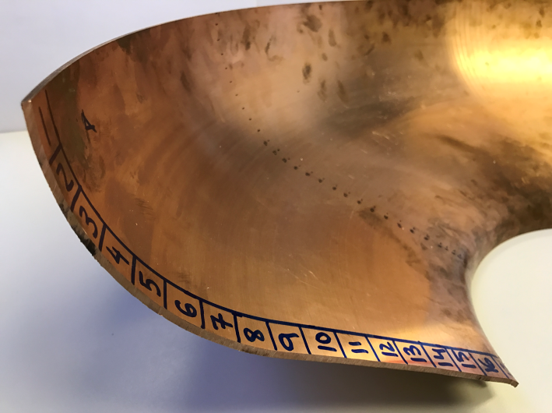
Half cells characterisation
4. Control of cavities at CERN
Mechanical properties
Stress and hardness relation
UTS
Transverse
Longitudinal
Hardness Profile
YS
Equator
Iris
Manufacturing of Seamless cavities - CERN-LNL meeting
12

Slide 14
5. Manufacturing procedure of half cells
Hardness Profile
No annealing
20 years ago
Equator
Iris
200°C
290°C
Manufacturing of Seamless cavities - CERN-LNL meeting
13

Slide 15
5. Manufacturing procedure of half cells
Hardness Profile
No annealing
20 years ago
Equator
%Cold Work
Intermediate annealing
Recrystallization temperature
Iris
Fully annealed iris
Base material
Equator
Iris
200°C
290°C
Manufacturing of Seamless cavities - CERN-LNL meeting
14

Slide 16
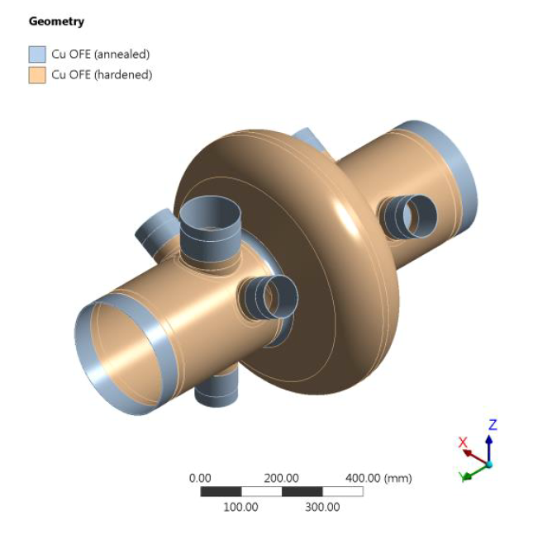
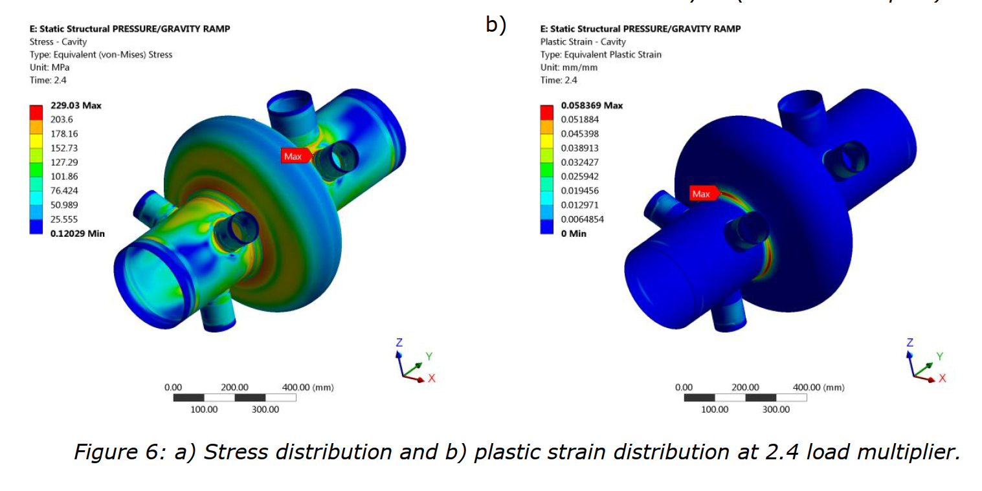
5. Manufacturing procedure of half cells
Intermediate annealing during spinning of half-cells
EDMS 1986651 P.Pastuszak
“The cavity succeeds on all criteria established in this report (Global failure 1, Local failure, Non-linear buckling), which are in accordance with ASME code. The cavity is judged safe by authors and suitable for use in the LHC RF cryomodule.”
Manufacturing of Seamless cavities - CERN-LNL meeting
15

Slide 17
5. Manufacturing procedure of half cells
Hardness Profile
No annealing
20 years ago
Equator
%Cold Work
Intermediate annealing
Recrystallization temperature
Iris
Fully annealed iris
Influence of annealing temperature
290°C
Base material
Equator
Iris
290°C
Manufacturing of Seamless cavities - CERN-LNL meeting
16

Slide 18
5. Manufacturing procedure of half cells
Hardness Profile
No annealing
20 years ago
Equator
%Cold Work
Intermediate annealing
Recrystallization temperature
Iris
Fully annealed iris
Influence of annealing temperature
200°C
250°C
290°C
Base material
Equator
Iris
290°C
Manufacturing of Seamless cavities - CERN-LNL meeting
17

Slide 19
5. Manufacturing procedure of half cells
Hardness Profile
No annealing
20 years ago
Equator
%Cold Work
Intermediate annealing
Recrystallization temperature
Iris
Fully annealed iris
Influence of annealing temperature
200°C
250°C
290°C
Base material
Equator
Iris
290°C
Manufacturing of Seamless cavities - CERN-LNL meeting
18

Slide 20
5. Manufacturing procedure of half cells
Hardness Profile
No annealing
20 years ago
Equator
%Cold Work
Intermediate annealing
Recrystallization temperature
Iris
Fully annealed iris
Influence of annealing temperature
200°C
250°C
290°C
Base material
Equator
Iris
200°C
290°C
Manufacturing of Seamless cavities - CERN-LNL meeting
19

Slide 21
5. Manufacturing procedure of half cells
Hardness Profile
No annealing
20 years ago
Equator
Intermediate annealing
Iris
Fully annealed iris
Influence of annealing temperature
200°C
250°C
290°C
Base material
Equator
Iris
New forming procedure
200°C
290°C
Manufacturing of Seamless cavities - CERN-LNL meeting
20

Slide 22
6. Final remarks
To take into account…
New suppliers/new dimensions
In order to fulfill the technical specifications of CERN
Final required mechanical properties
In case of intermediate annealing during forming is needed
Manufacturing of Seamless cavities - CERN-LNL meeting
21

