Slide 1
U.S. plan development for the SFGD Electronics
Christopher Mauger, Vittorio Paolone, Martin Tzanov

Slide 2
U.S. Institutions
LSU, Pittsburgh, Pennsylvania
Extensive experience in electronics development
Penn: several full-time scientist/engineers who develop analog and digital electronics from ASIC design to board design, firmware, DAQ – essentially end-to-end. Recent projects include the ATLAS TRT, DUNE-related efforts, SNO electronics

Slide 3
Scope for U.S. on SFGD Electronics
Presentation next week to DOE for initial discussions to define the scope
CITIROC proprietary
On FEB, is it reasonable to consider any of te following?
  ADC
  FPGA/firmware development
  HV distribution?
  timing synchronization?
Ancillary boards/systems
  HV/signal fanout boards/connections to MPPCs
  Master Clock Board
Other activities
  development and testing of FEBs

Slide 4
Neutron beam test

Slide 5
Neutrons and neutrino energy reconstruction
Neutrons often part of the hadronic system emerging from the nucleus in intermediate-energy neutrino interactions
Typical kinetic energies - hundreds of MeV, so should account for them when reconstructing neutrino energies
Important to do this with 3DST for DUNE and Super-FGT for T2K
In the case of DUNE, the 3DST will measure neutrons escaping from the gas argon TPC

Slide 6
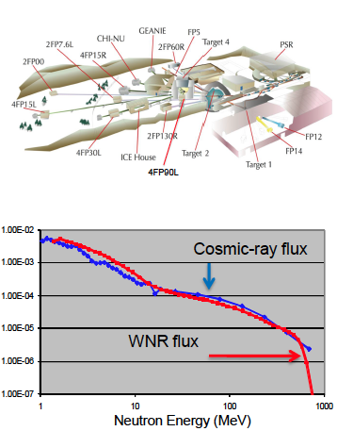
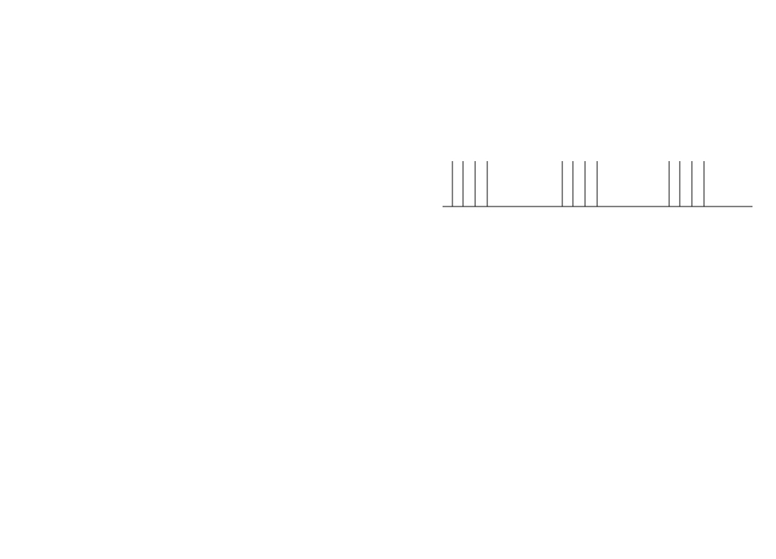
Neutron Beam at LANL
High flux neutron beam, broad energy
spectrum similar to high altitude
cosmic-ray spectrum
Neutrons up to energy of 800 MeV produced by protons impinging on a bare (un-moderated) tungsten target
Time structure of the beam
  sub-nanosecond micro pulses 1.8 microseconds apart within a 625 μs long macro pulse
  Repetition rate: 100 Hz
10 ms
625 μs
1.8 μs

Slide 7
Neutron Beam at LANL
Typical user wants high neutron flux
Mini-CAPTAIN run with very low flux (<1 neutron per macropulse)
Constrain shutter to achieve low flux
Use time-of-flight to independently determine the neutron kinetic energy
Upstream flux detectors independently determine neutron flux and cross-section

Slide 8
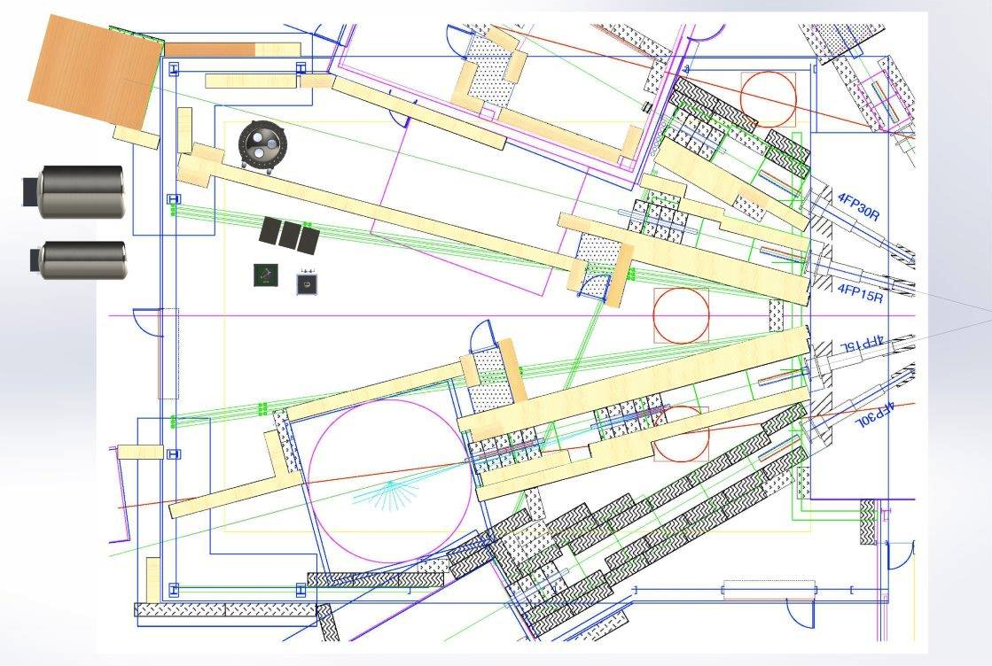
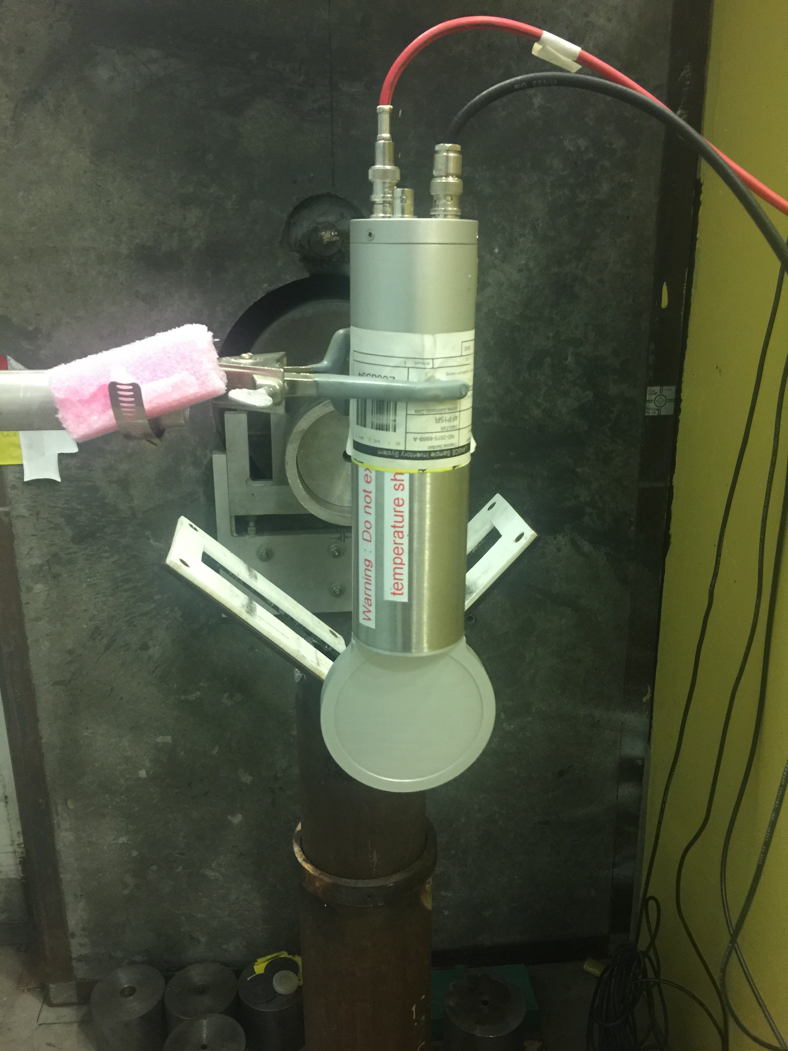
Detector shown
displaced from the
beamline – it was
in the beam during
running
Fission chamber
and scintillator
Shutters upstream

Slide 9
SuperFGD Prototype Neutron Beam Test
Absolute flux and neutron spectrum can be independently determined
Neutron kinetic energies up to 800 MeV
Neutron energy in the detector independently determined by time of flight
LANSCE is very supportive of its users – exceptional scientific environment
Some 3DST members already have experience at this facility and in this beamline

Slide 10
Process at LANL
LANSCE is a user facility with a yearly beam schedule – begins in late spring or summer
Proposals due a few months before first beam – this year, 2 March
Oral presentation (can be remote) to the LANSCE PAC soon after – this year, week of 19 March
Typical run time: one to few weeks
Typical set-up time: one or two days
  staging is possible

Slide 11
Neutron Beam Test
Employ prototype detector that already exists
Important to understand assembly/commissioning process at LANL (generally want to avoid long set up time, though there is a small staging area)
What if any technical development we must do between now and a beam test
  DAQ OK as is?
  team timing signal? any electronics modules needed?
Logistical issues
  availability of the prototype (what are other prototype plans)
  owner permission

