Slide 1







Kinematics of electron beam cooling and performance optimization
Bianca Veglia
AVA Topical Workshop
GSI, February 6th 2019

Slide 2
Contents
Introduction
Electron Cooling and Cooling force
Challenges
Simulations
Data
Outlook

Slide 3
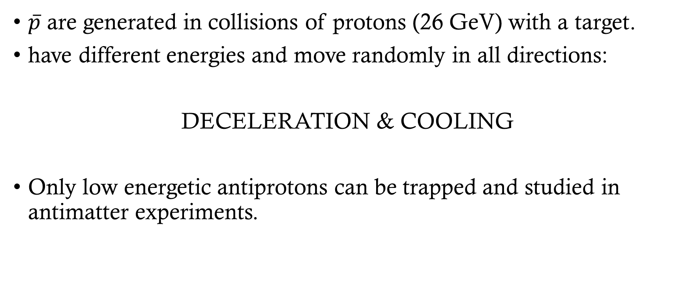
Antimatter
$\overline{p}$ are generated in collisions of protons (26 GeV) with a target.
have different energies and move randomly in all directions:
DECELERATION & COOLING
Only low energetic antiprotons can be trapped and studied in antimatter experiments.

Slide 4
What is electron cooling?
A fast process to reduce phase space volume, emittance and momentum spread of a circulating charged particle beam.
Loss free compression of ion beams:
  Improve beam quality.
  Compensation of heating effects.

Slide 5

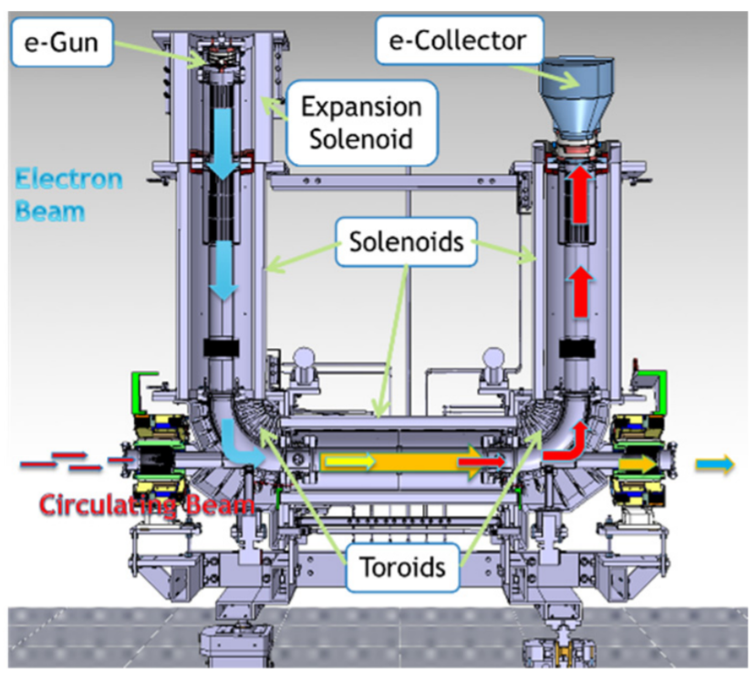
Electron Cooler
e-Gun
e-Collector
Expansion solenoid
In the beam frame:
hot ions interacting with
cold electrons
Electron beam
Solenoids
The ions transfer their energy to the electrons through Coulomb scattering.
Electrons are continuously renewed.
Circulating beam
Toroids

Slide 6
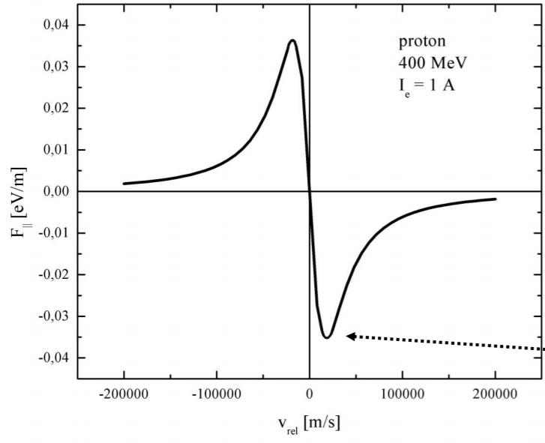
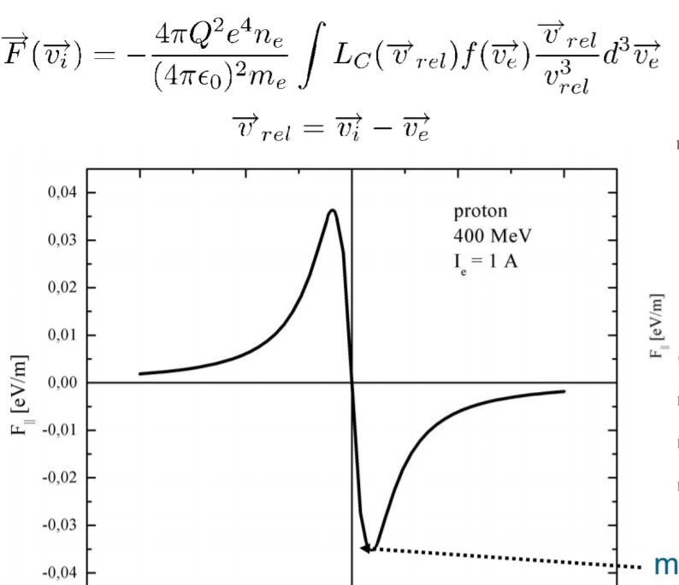
Cooling force
• binary collision model:
description of the cooling process by successive collisions of two particles and integration over all interactions

Slide 7
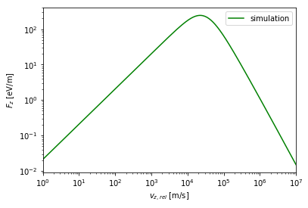
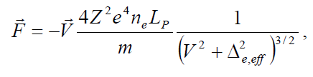
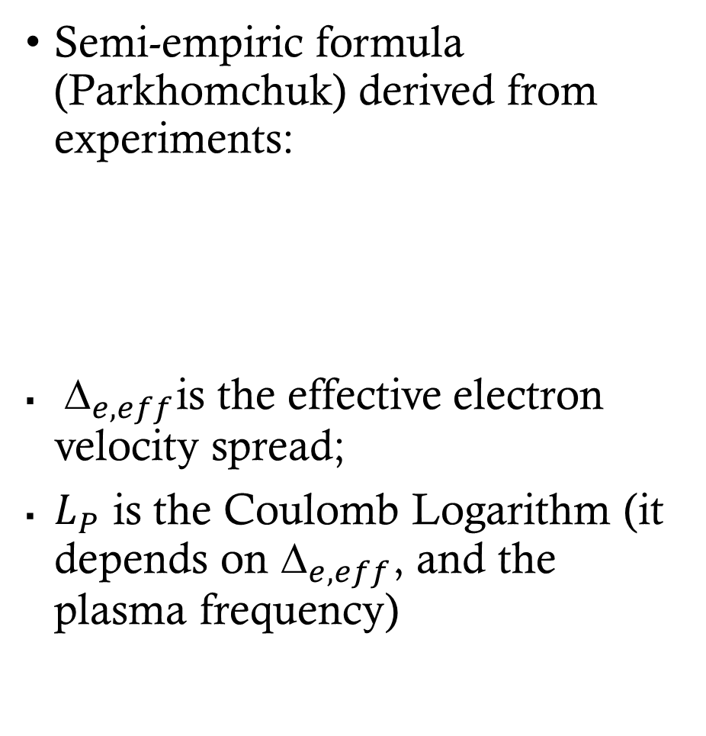
Semi-empiric formula (Parkhomchuk) derived from experiments:
${\text{∆}}_{e, eff}$is the effective electron velocity spread;
$L_{P}$ is the Coulomb Logarithm (it depends on ${\text{∆}}_{e, eff}$, and the plasma frequency)

Slide 8
Difficulties and challenges
Closed evaluations of the general expressions for the cooling force are only possible for limiting cases.
The semi-empirical formula (Parkhomchuck) may not suit all the energy ranges. The electron beam transport systems can be very different.
It is necessary to understand what needs to be taken into account for different machine parameters.

Slide 9
Simulations
Betacool
The BETACOOL program is a kit of algorithms to simulate long term processes leading to a variation of the ion distribution function in six dimensional phase space.
RF-Track:
RF-Track is a general-purpose tracking code that excels for its flexibility, accuracy, and simulation capabilities. It can track particles of arbitrary mass and charge, even in mixed-species beams.

Slide 10
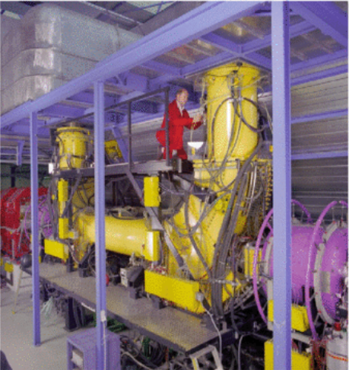
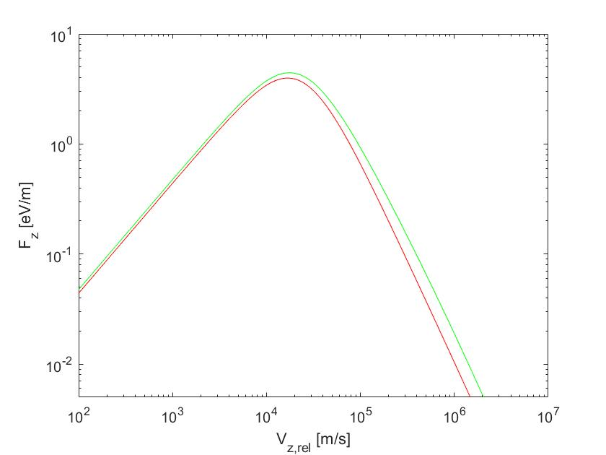
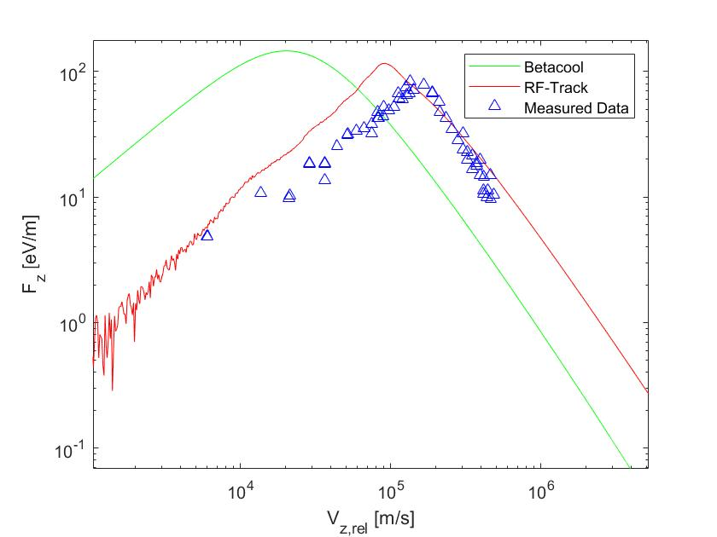
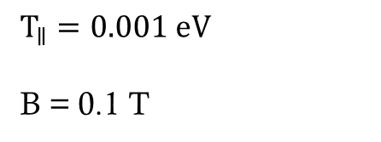
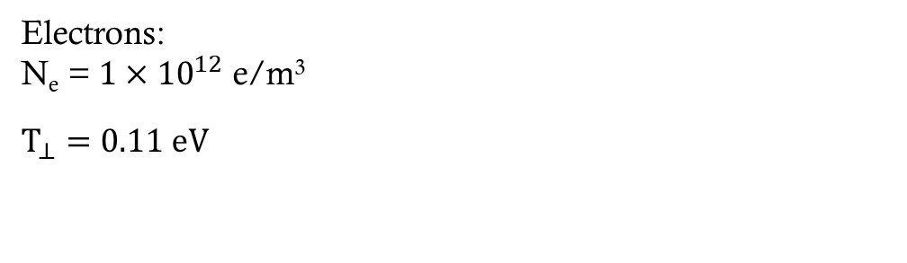
Cooling force at ESR
Ions:
A = 131.2 proton mass (Xenon)
Q = 54⁺
Electrons:
N_{e} = $1×{10}^{12}$ e/m³
$$T_{⊥}=0.11 eV$$
$$T_{∥}=0.001 eV$$
B = 0.1 T

Slide 11
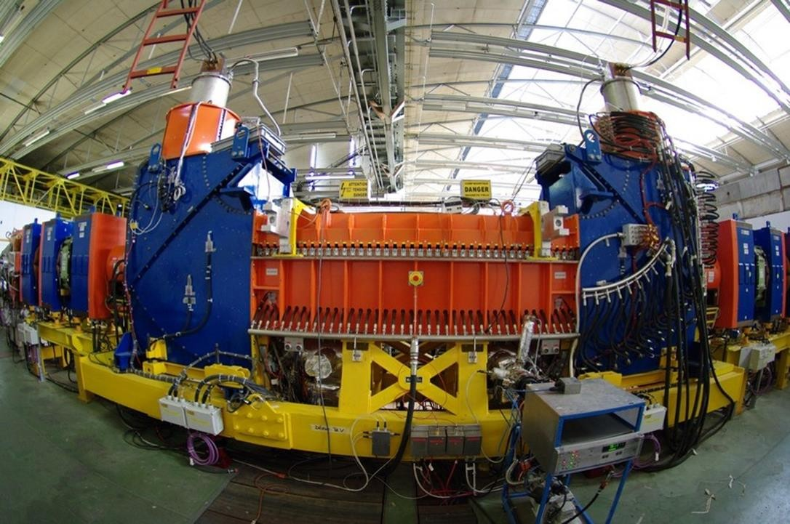
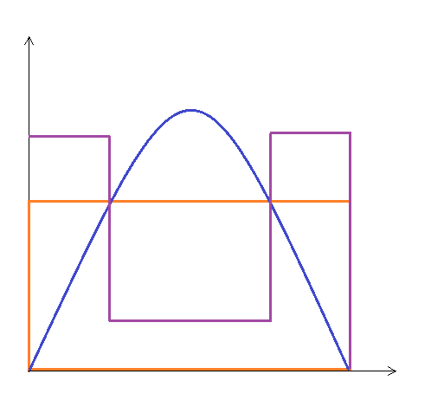
LEIR Measurements
Different electron distributions
N_{e}
Lead ions
Lots of available data
Experimental flexibility
r

Slide 12
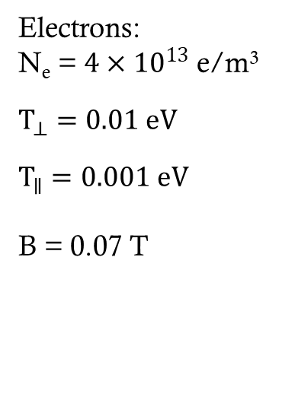
Cooling Force at LEIR
Ions:
A = 207.2 proton mass
(Lead)
Q = 54⁺
Electrons:
N_{e} = $4×{10}^{13}$ e/m³
$$T_{⊥}=0.01 eV$$
$$T_{∥}=0.001 eV$$
B = 0.07 T

Slide 13
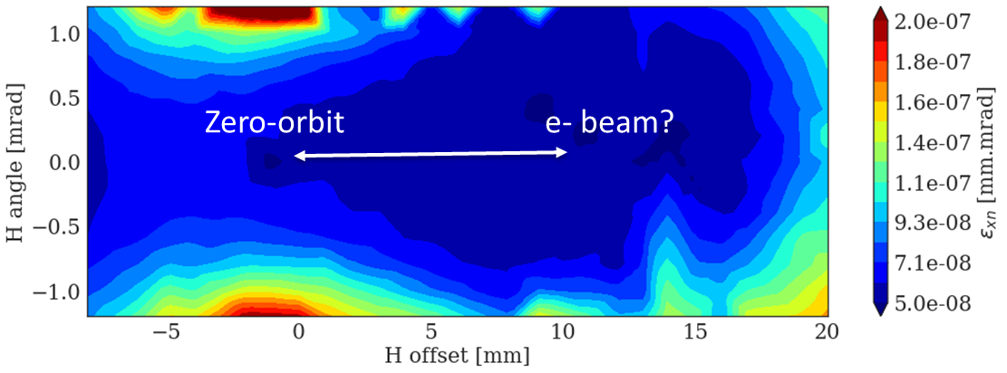
Cooling Maps at LEIR
Measurements performed with the help of A. Saa Hernandez, D. Gamba,N. Biancacci

Slide 14
Ongoing and future work
Data analysis (LEIR and ELENA)
IBS in RF-Track
Imperfections study

Slide 15

Thank you for your attention!
Any questions?

Slide 16
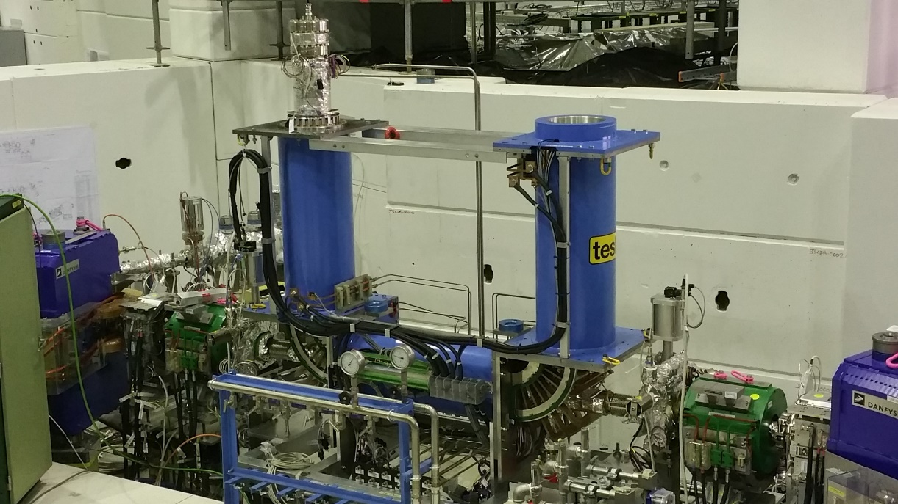
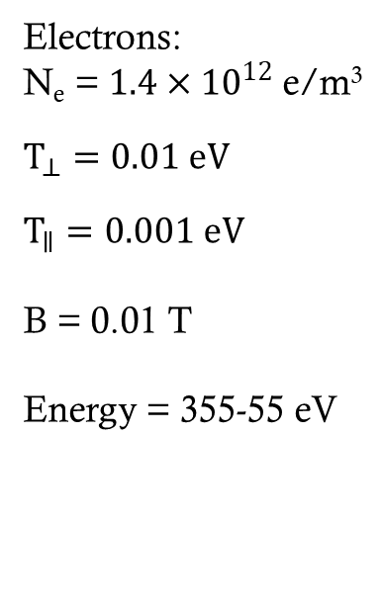
ELENA
Electrons:
N_{e} = $1.4×{10}^{12}$ e/m³
$$T_{⊥}=0.01 eV$$
$$T_{∥}=0.001 eV$$
B = 0.01 T
Energy = 355-55 eV

