Slide 1









Embedding instrument read-out in online accelerator simulations
Volodymyr Rodin
Notes:
Hello everyone, my talk is last but not least one. I will tell you about embedding of instrumental read-out in online accelerator simulations. This topic isn’t my subject of major interest. But I still have some ideas and experience related to it.

Slide 2

Outline
Problem
An example
Optimization VS Simulation
Interface
Conclusion
Notes:
A very short structure of my presentation. First of all I will show that such problem exist, give some practical example from my project. Then how this issue can be solved with two similar approaches but different cost, one slide about interfaces that are required for such operation. And brief conclusion

Slide 3

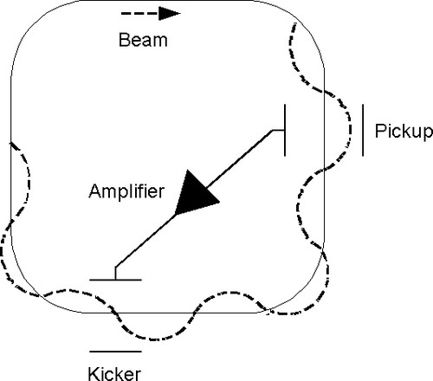

Problem
Intrinsic machine instabilities: Non-ideal elements, time dependences, beam repetition
Commonly used solutions: Pickup technique, optimization algorithms and manual operation
Disadvantages: minimal beam intensity, beam time and man-hours
Notes:
So for next 12 minutes my main problem is beam instabilities in circular or linear machines caused by non-ideal elements, time dependences in their work or repetition of the beam. Fine, we already have a number of solution that are used to get rid of these things, like pickup. Direct machine optimization and manual operation. As well mentioned methods have their own pros and cons.

Slide 4
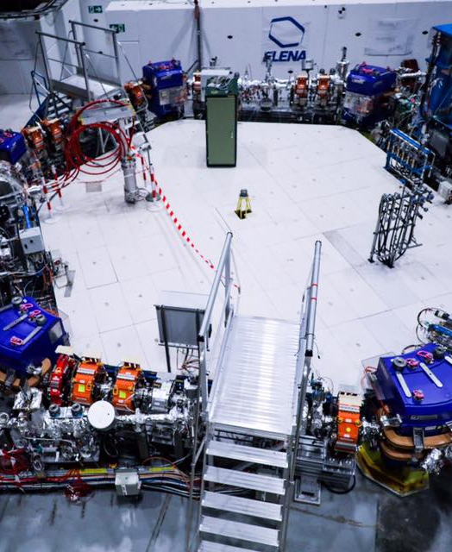
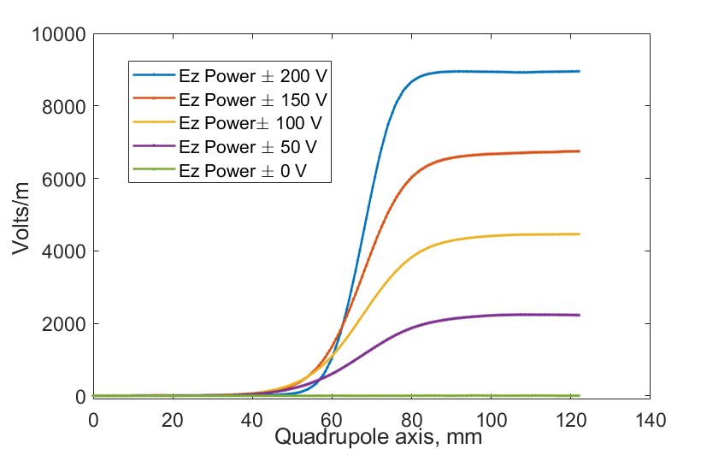
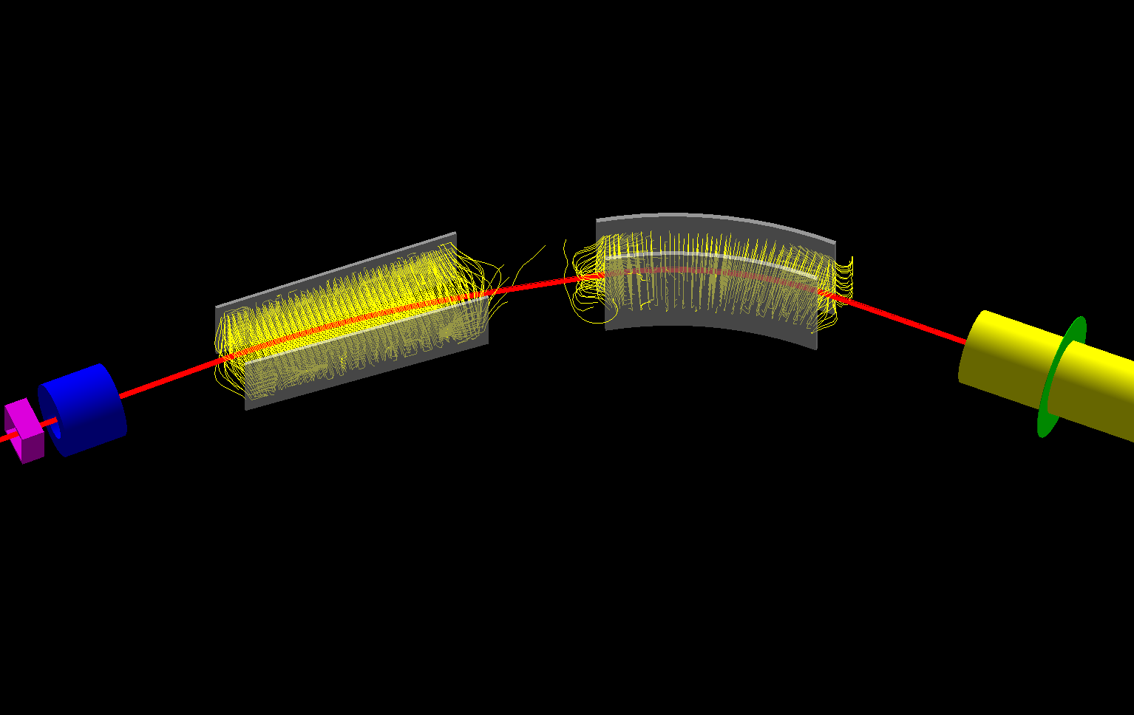

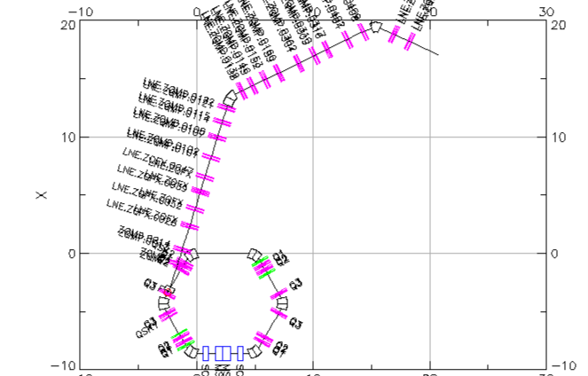
An example
Tricky elements and unusual effects…
Notes:
My example of machine with such problems is ELENA with it’s transfer lines that contains list of smart but tricky decisions related to facility operation. At the right side only some of them. First of all fringe fields and their dependence from power supplying. Than combination of two different bending element, so operator must decide which one is more important to steer beam correctly. And bottom image just show ring and the longest transfer line just give a feeling how many variables are there.

Slide 5
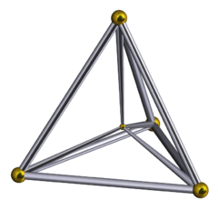

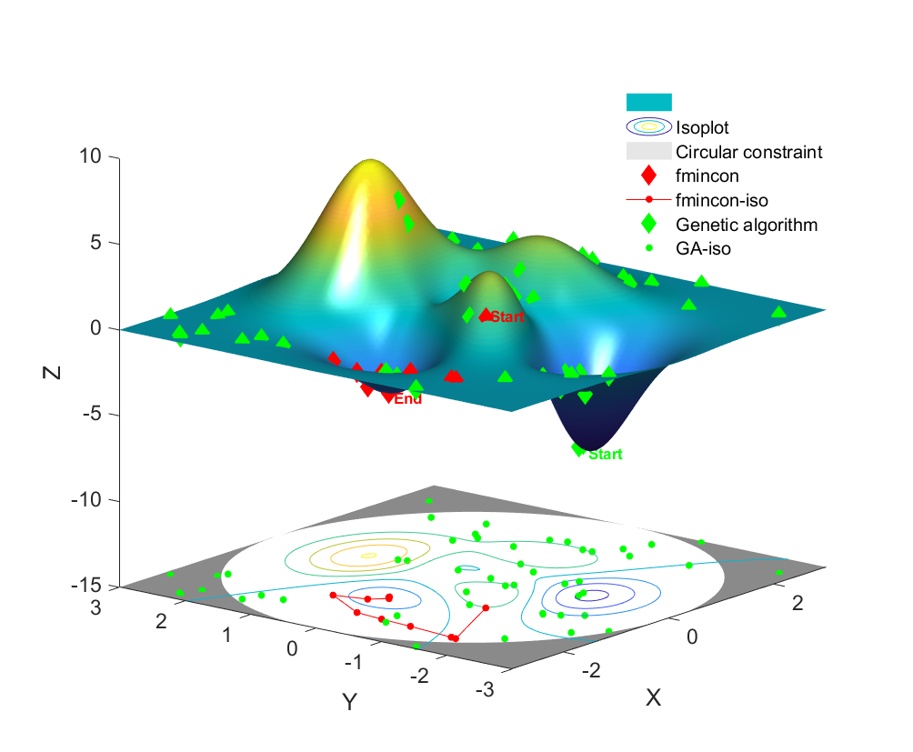
Optimization VS Simulation
An iterative parametrization
Nelder–Mead method – simplex based algorithm
Genetic algorithms - many function evaluations to work
Optimization

Slide 6
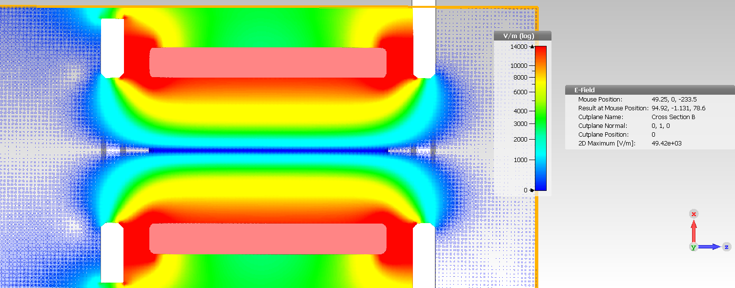
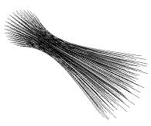

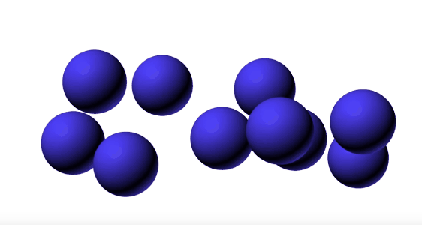
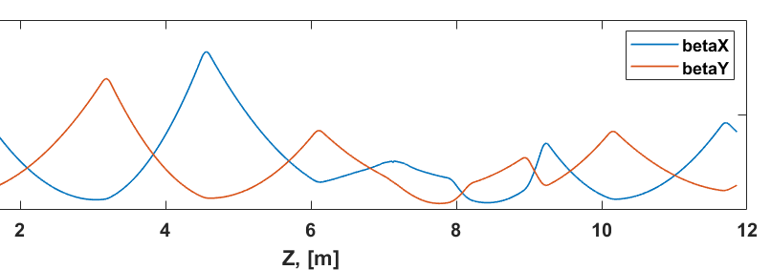
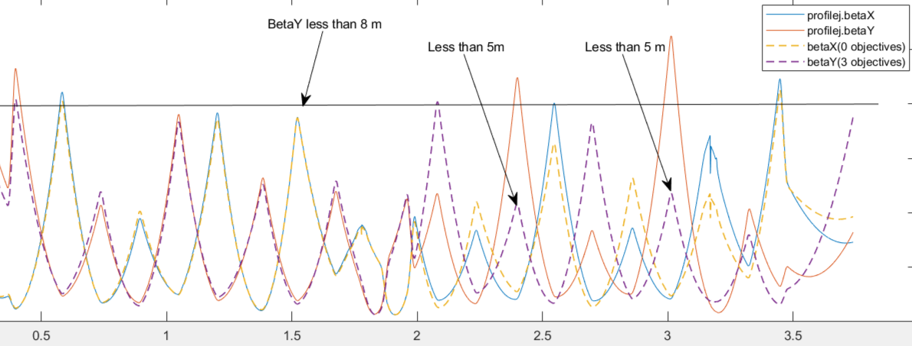
Optimization VS Simulation
Simulation
(post-construction stage)
A comprehensive method that includes all relevant effects
Measurements and machine settings based input.
Prediction and matching with data.
Multi-objective optimization

Slide 7
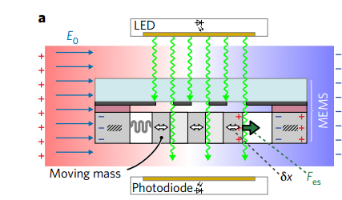
Beam
Machine settings
Simulation
Feedback system
diagnostics
and optimization
Optimization VS Simulation:
transfer line, e+ production target

Slide 8
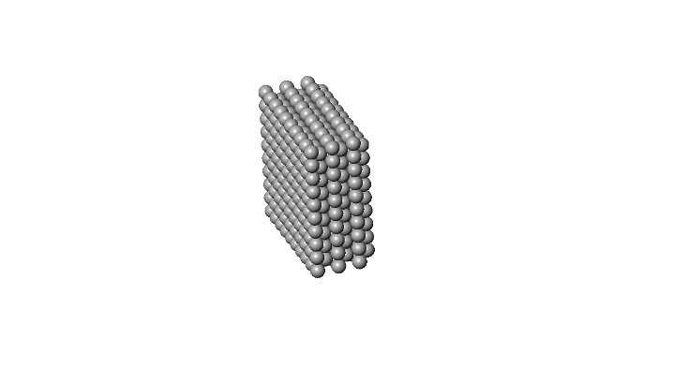

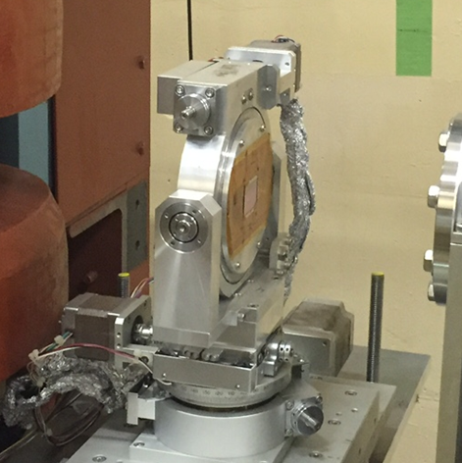
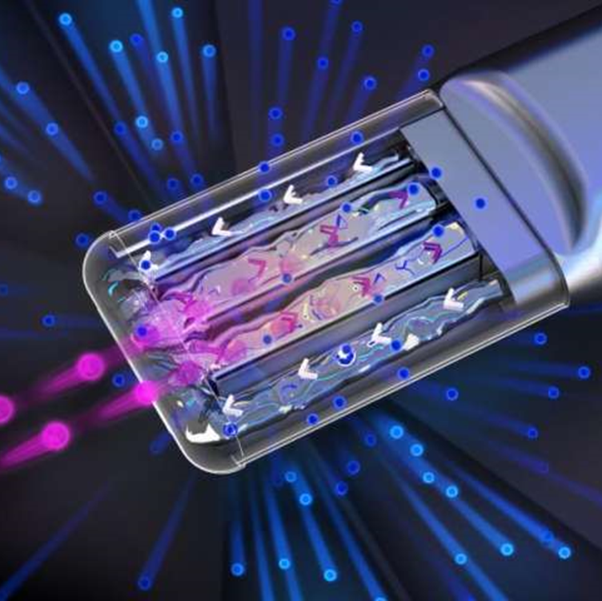
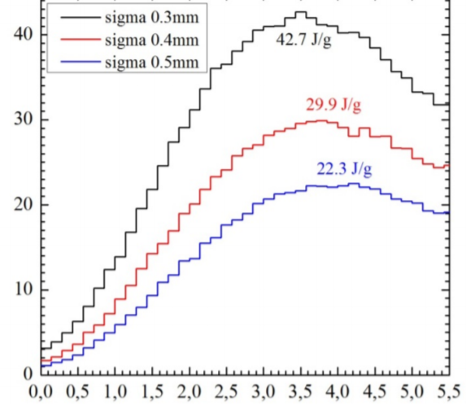
Optimization VS Simulation:
transfer line, e+ production target

Slide 9

Interface
Matlab: Instrument Control
LabVIEW
“Master” and “Slave”
control
Embedded system boards

Slide 10

Conclusion
Problem of optimization and solving of beam instabilities inherited for the most of accelerator machines
Straightforward or simulation optimization can be applied for mitigation of perturbations
Choose of technique depends on complexity of the problem and number of objectives
Wide range of application for different facilities
A number of interfaces is already present for implementation of online control

