Slide 1

Diamond membrane detectors
GSI, 7.2.2019
Miha Červ, CIVIDEC Instrumentation

Slide 2
CVD diamonds
CVD = Chemical Vapor Deposition
Little impurities
High temperature, low pressure
Ionized hydrogen, methane gas
0.1 μm to 10 μm per hour

Slide 3
Why diamond detectors
Radiation resistant
Low noise
Low leakage current
No cooling required
Fast response – sub nanosecond

Slide 4
Applications for diamond detectors
Beam instrumentation and spectroscopy
Neutron spectroscopy and flux monitoring
X-ray and gamma beam position and beam intensity monitoring

Slide 5
pCVD and sCVD
Polycrystalline (pCVD)
  Cheaper per area
  Can be up to 75 cm²
Single crystal (sCVD)
  Smaller sizes – up to 8mm * 8mm
  For spectroscopy, particle recognition

Slide 6
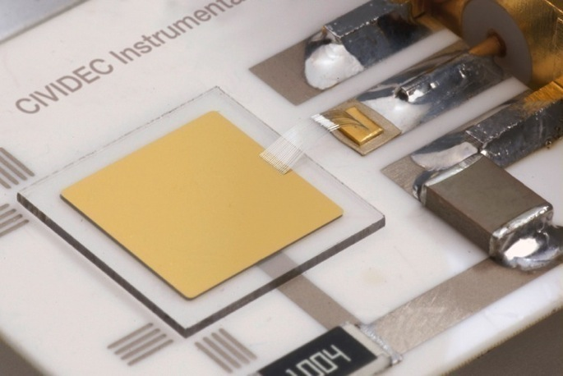
pCVD diamond detector

Slide 7
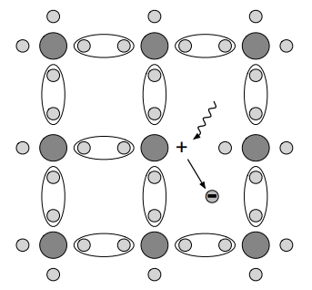
Ionization

Slide 8
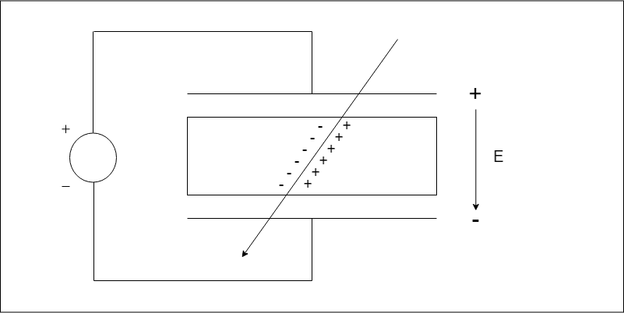

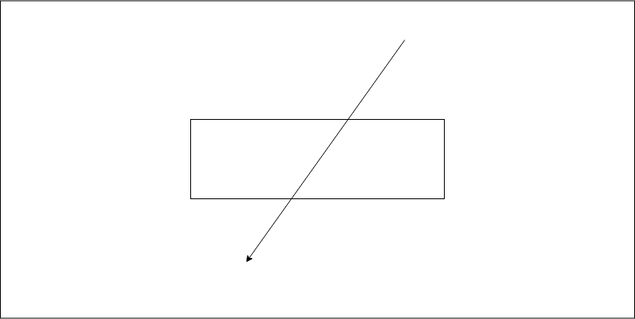
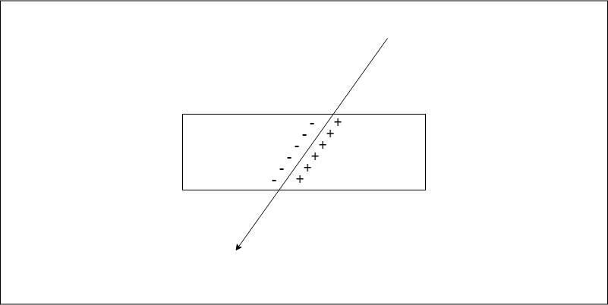
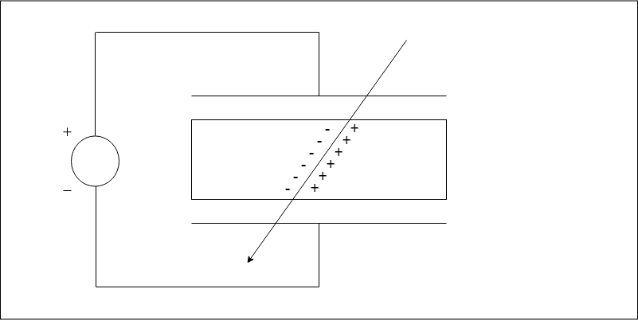
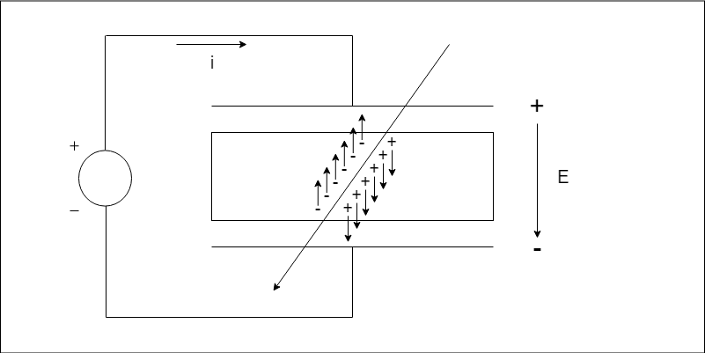
Particle detection

Slide 9




Drift velocity
Electrons and holes have different mobilities
Holes have higher mobility
Shockley-Ramo theorem :
$$I=\frac{q∗v}{d}$$
$$q$$
$$v$$
-
-
-
-
-
$$d$$

Slide 10
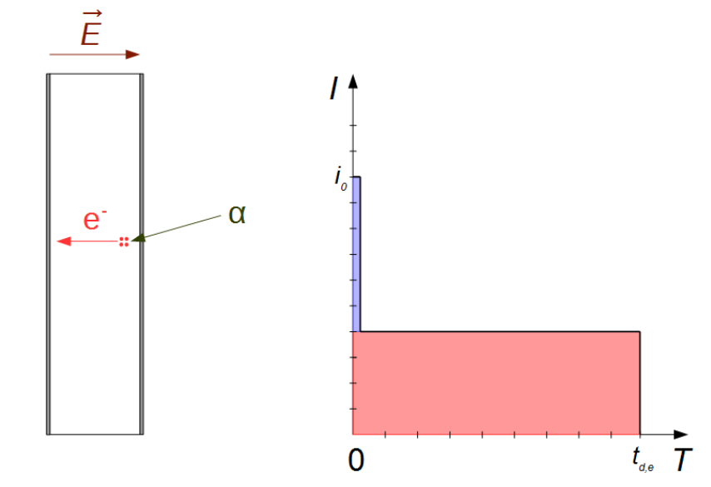
Electron drift

Slide 11
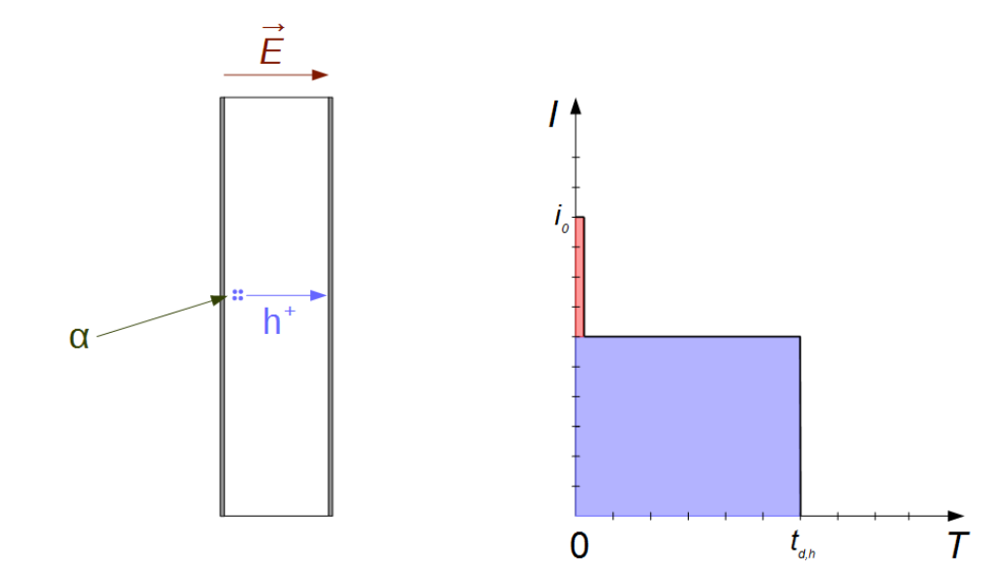
Hole drift

Slide 12
Amplifiers
Current amplifiers
  Counting
  Pulse shape analysis
Charge amplifiers
  Spectroscopy

Slide 13
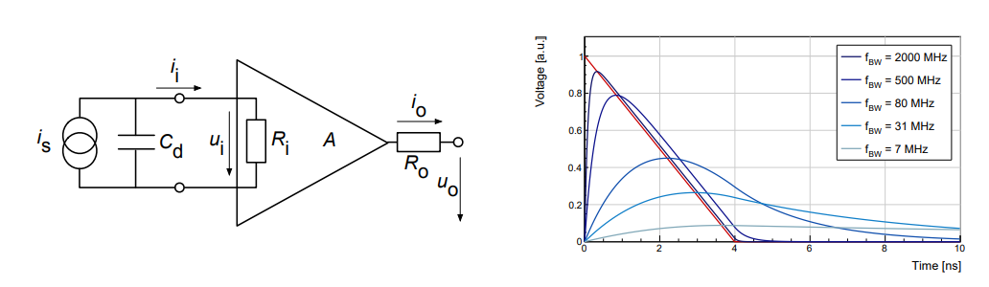
Current amplifier

Slide 14
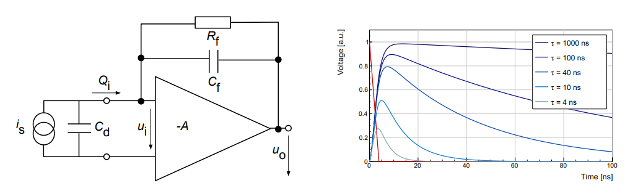
Charge amplifier

Slide 15
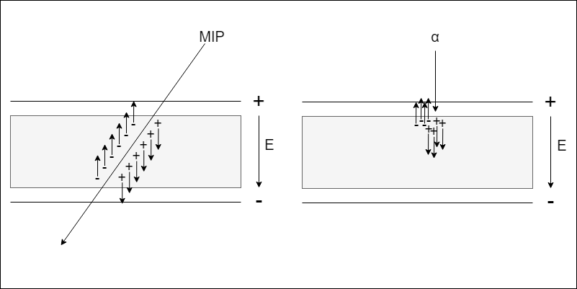
Particle Identification

Slide 16
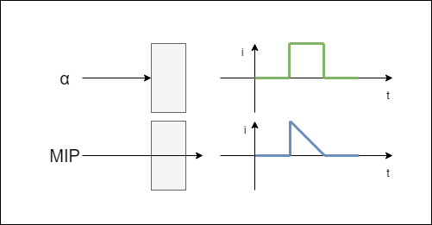
Particle Identification

Slide 17
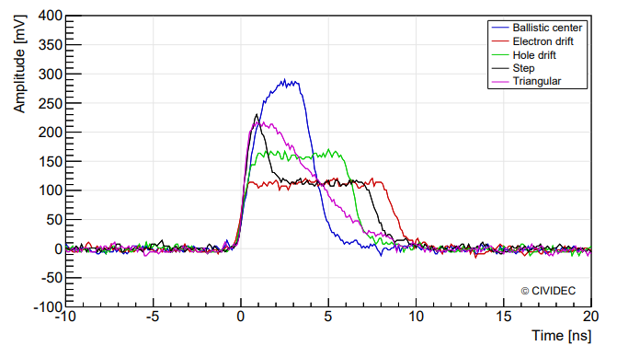
Particle identification

Slide 18
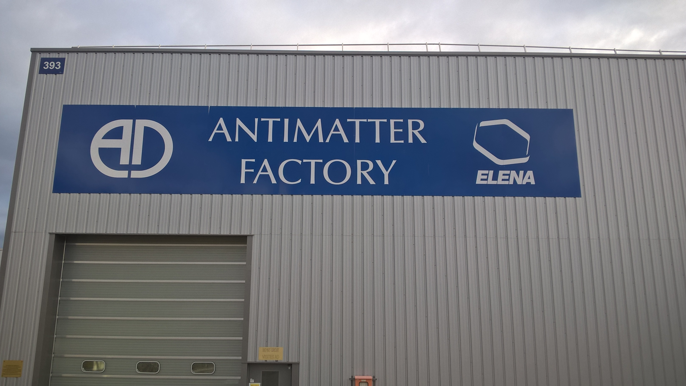
My measurements
Grace beam line at AEgIS at CERN
Low energy antiprotons

Slide 19
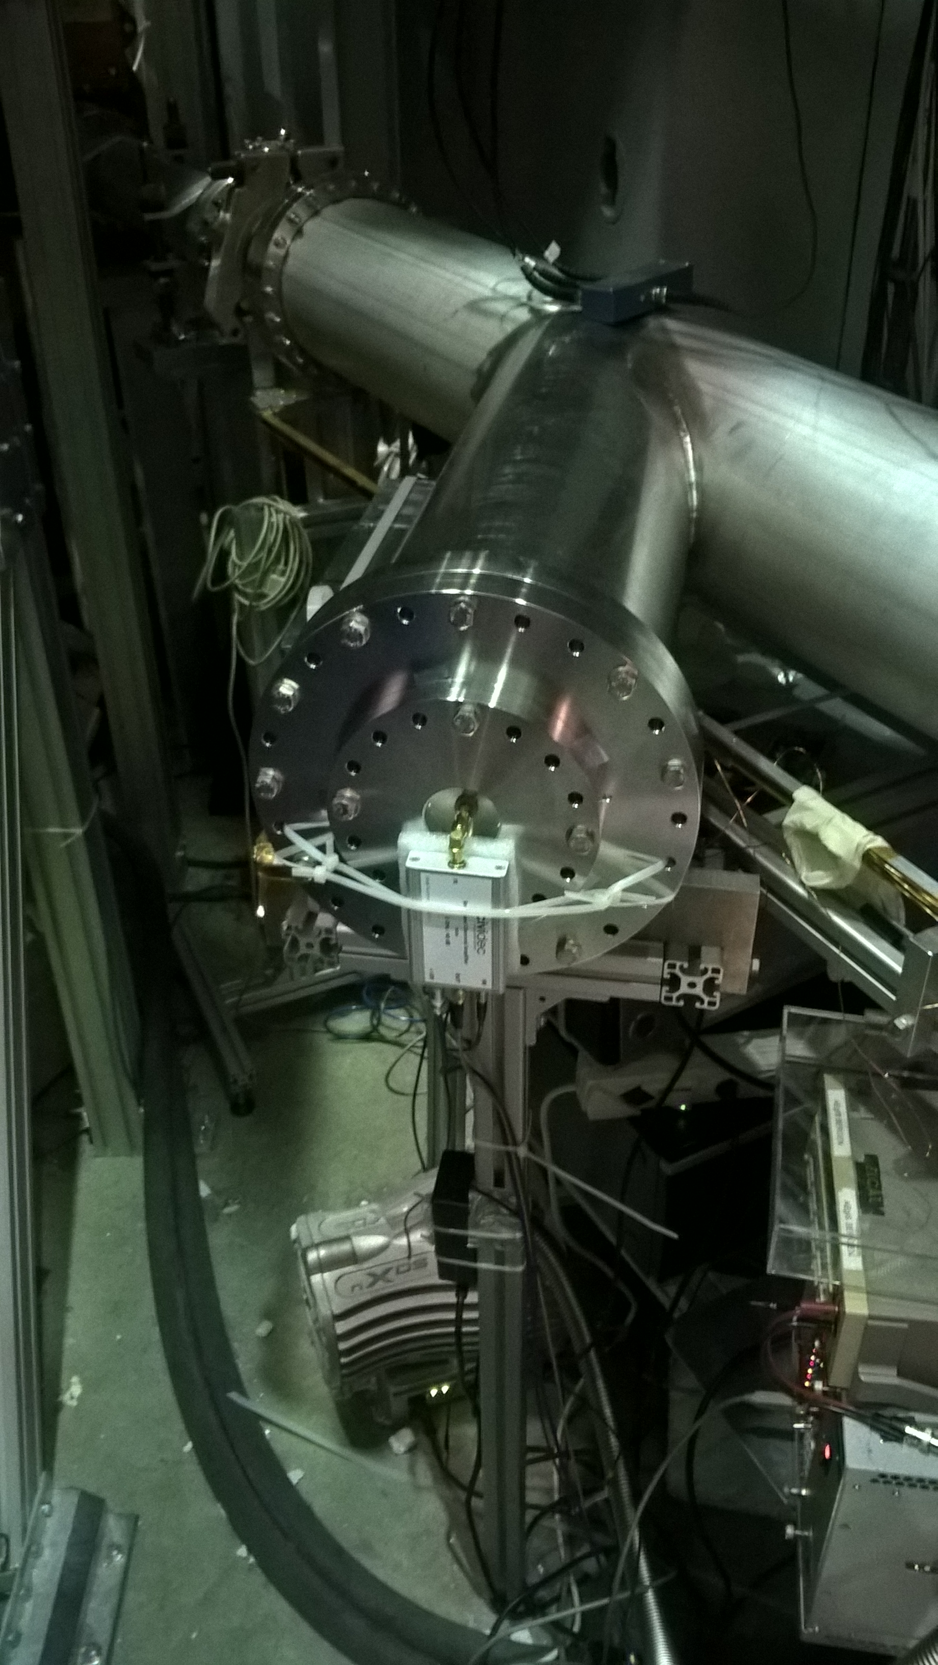
Measurement setup
Knopf detector
C2 current amplifier
ROSY readout system

Slide 20
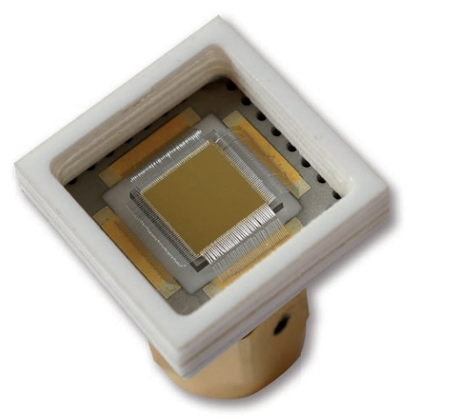
Knopf detector
sCVD diamond
500 μm thickness
4mm * 4mm sensor area
Fits directly onto the SMA connector

Slide 21
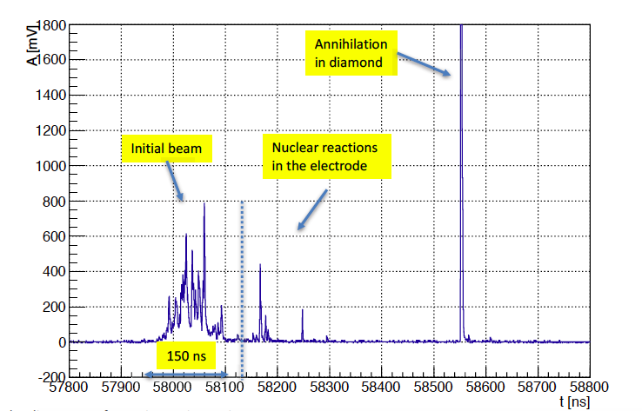
Measured waveforms

Slide 22
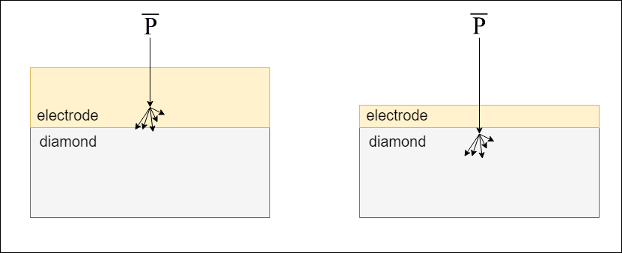
Annihilation

Slide 23
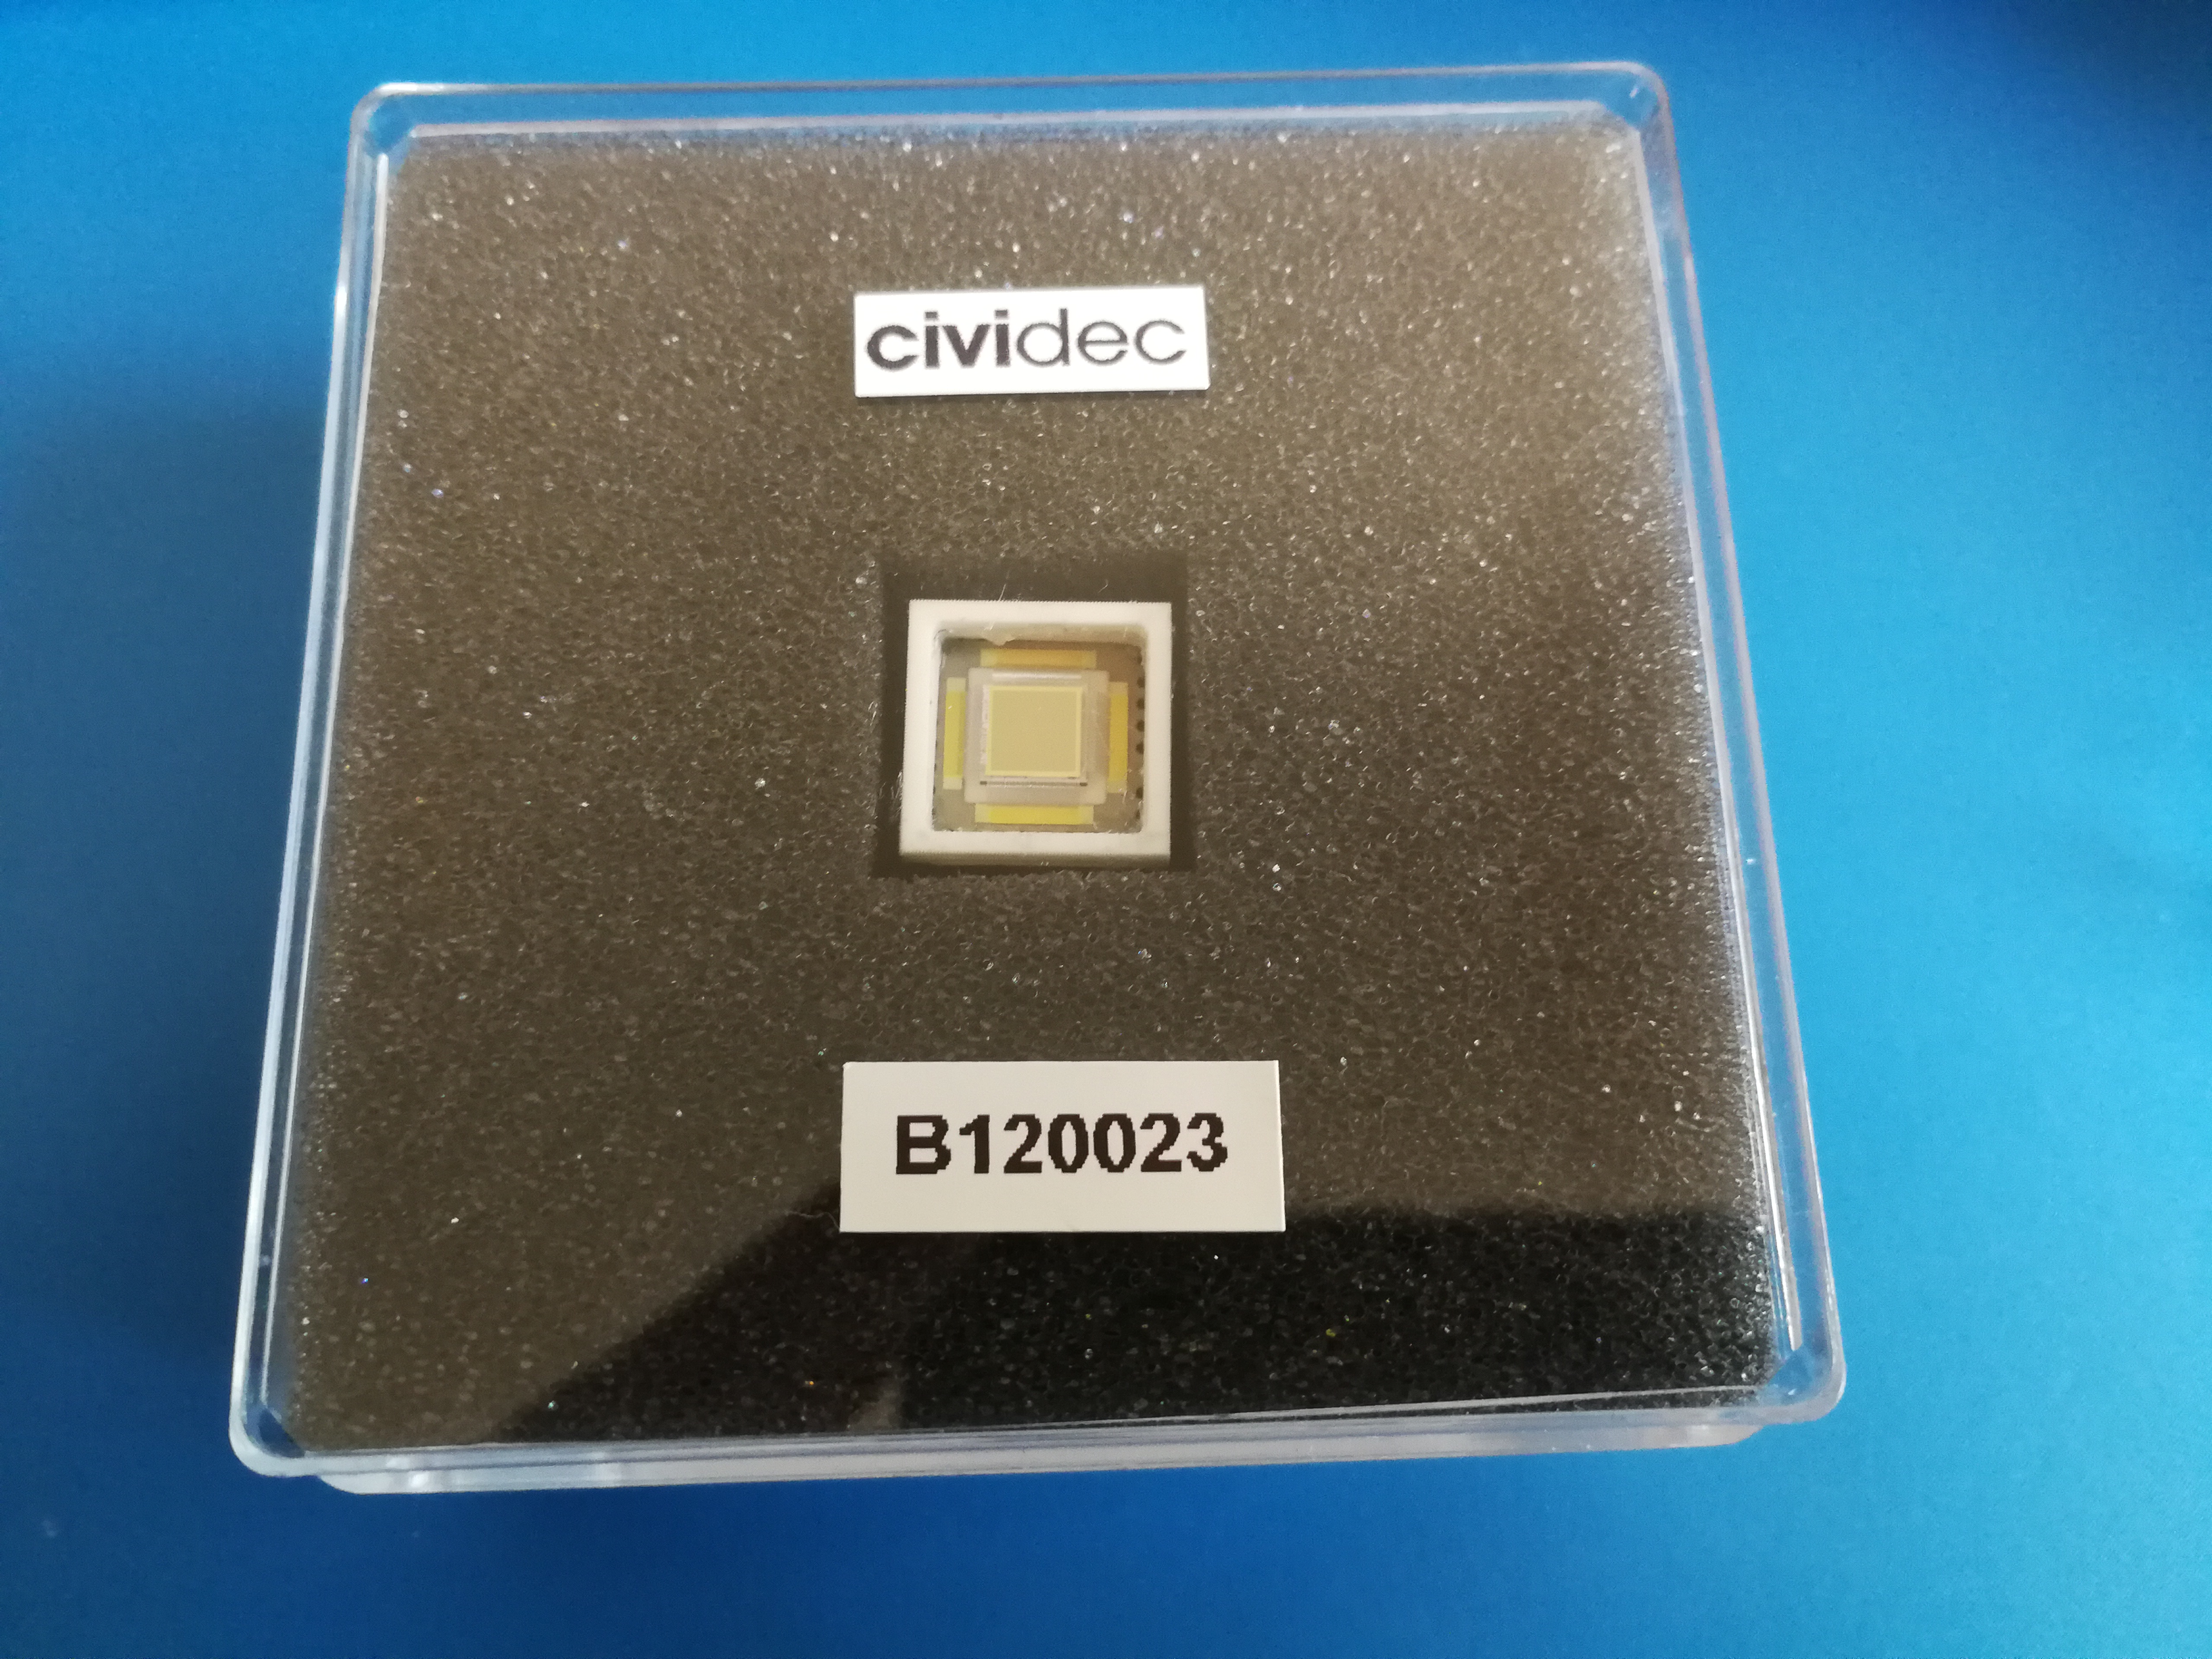
Second measurement
Repeat measurements with thinner electrode
Expected more annihilation in the sensor
Thin electrode Knopf detector

Slide 24
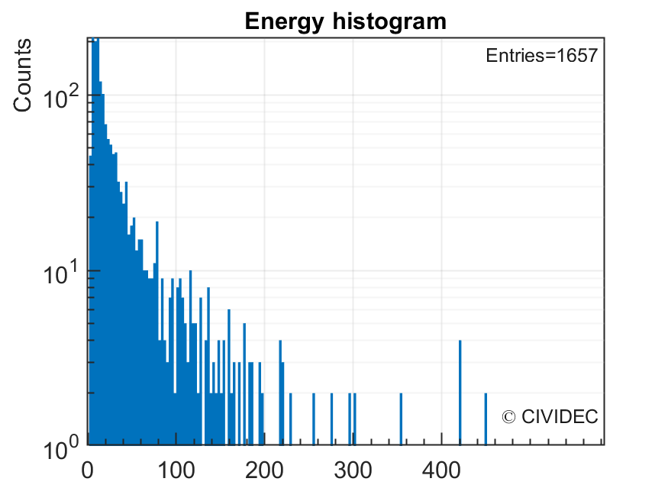
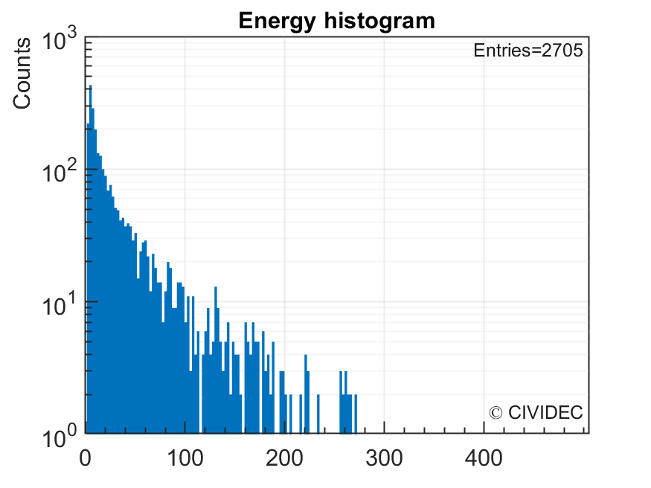
Energy histogram
Energy [MeV]
Energy [MeV]
Measurements from 2017
Measurements from 2018

Slide 25
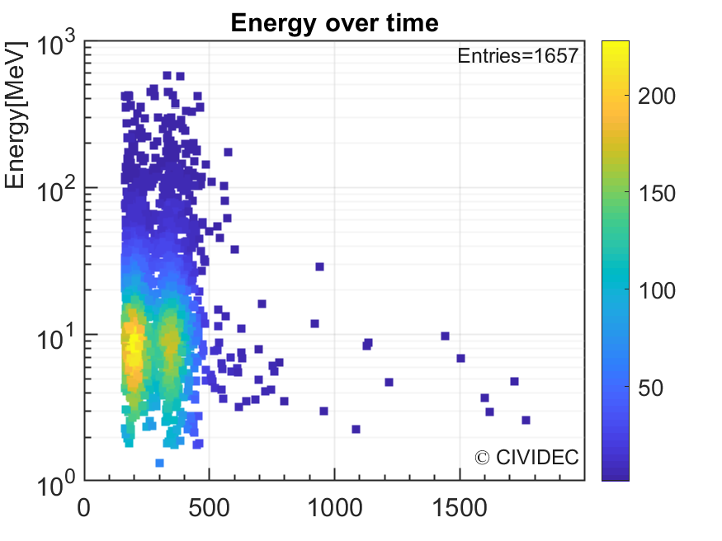
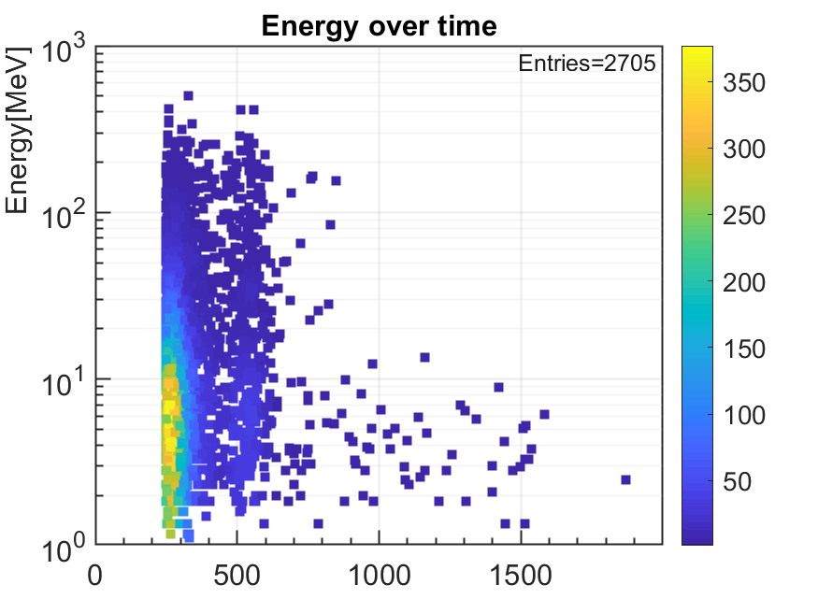
Energy over time plots
Delay [ns]
Delay [ns]
Measurements from 2017
Measurements from 2018

Slide 26
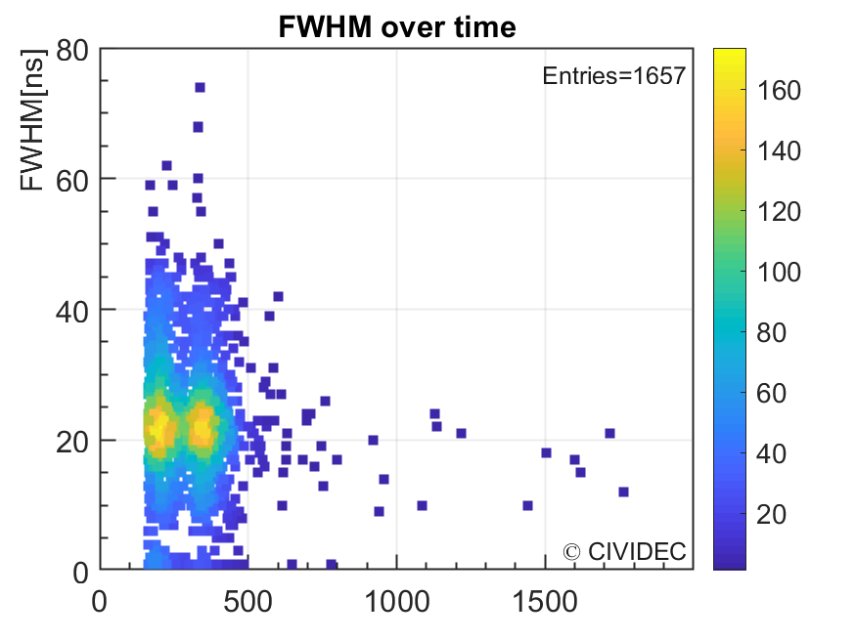
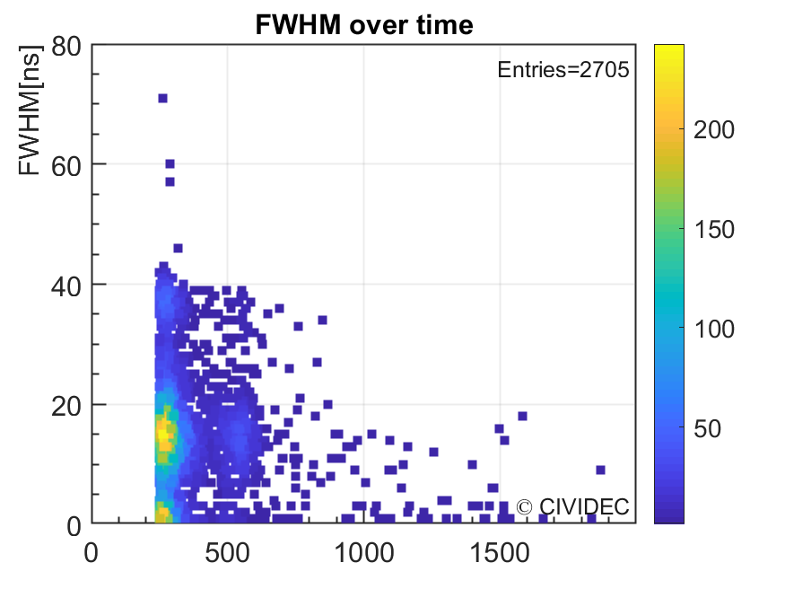
FWHM over time plots
Delay [ns]
Delay [ns]
Measurements from 2017
Measurements from 2018

Slide 27
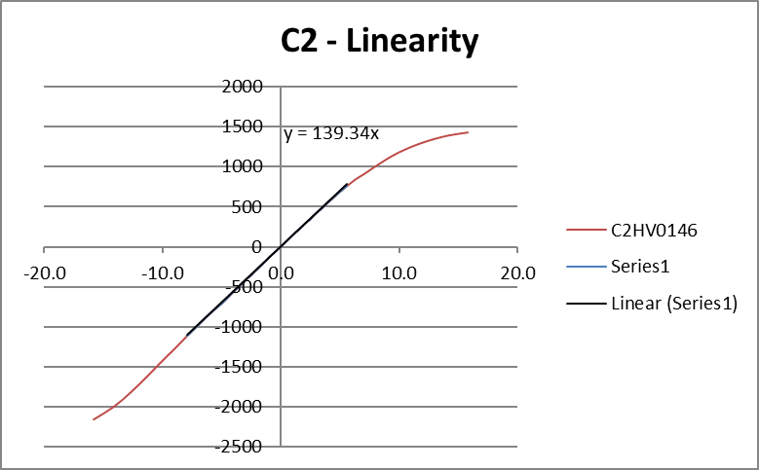
Nonlinearities
Amplifier nonlinearity
Pulse height defect
Pulse height defect (PHD)
Measured energy deposition
Deposited energy
C2 amplifier nonlinearity
Pulse height defect

Slide 28
Thin diamond detectors
Maximum thickness 500 um
Standard sizes 140 um and 50 um
Experiments with 20 um diamonds
  Limit for producibility
  Extremely fragile

Slide 29


Effects of thinning detectors
Higher output signal
Higher capacitance
$$I=\frac{q∗v}{d}$$
$$C=ε_{r}ε_{0}∗\frac{A}{d}$$

Slide 30
Crystal bending
sCVD
glue
PCB

Slide 31
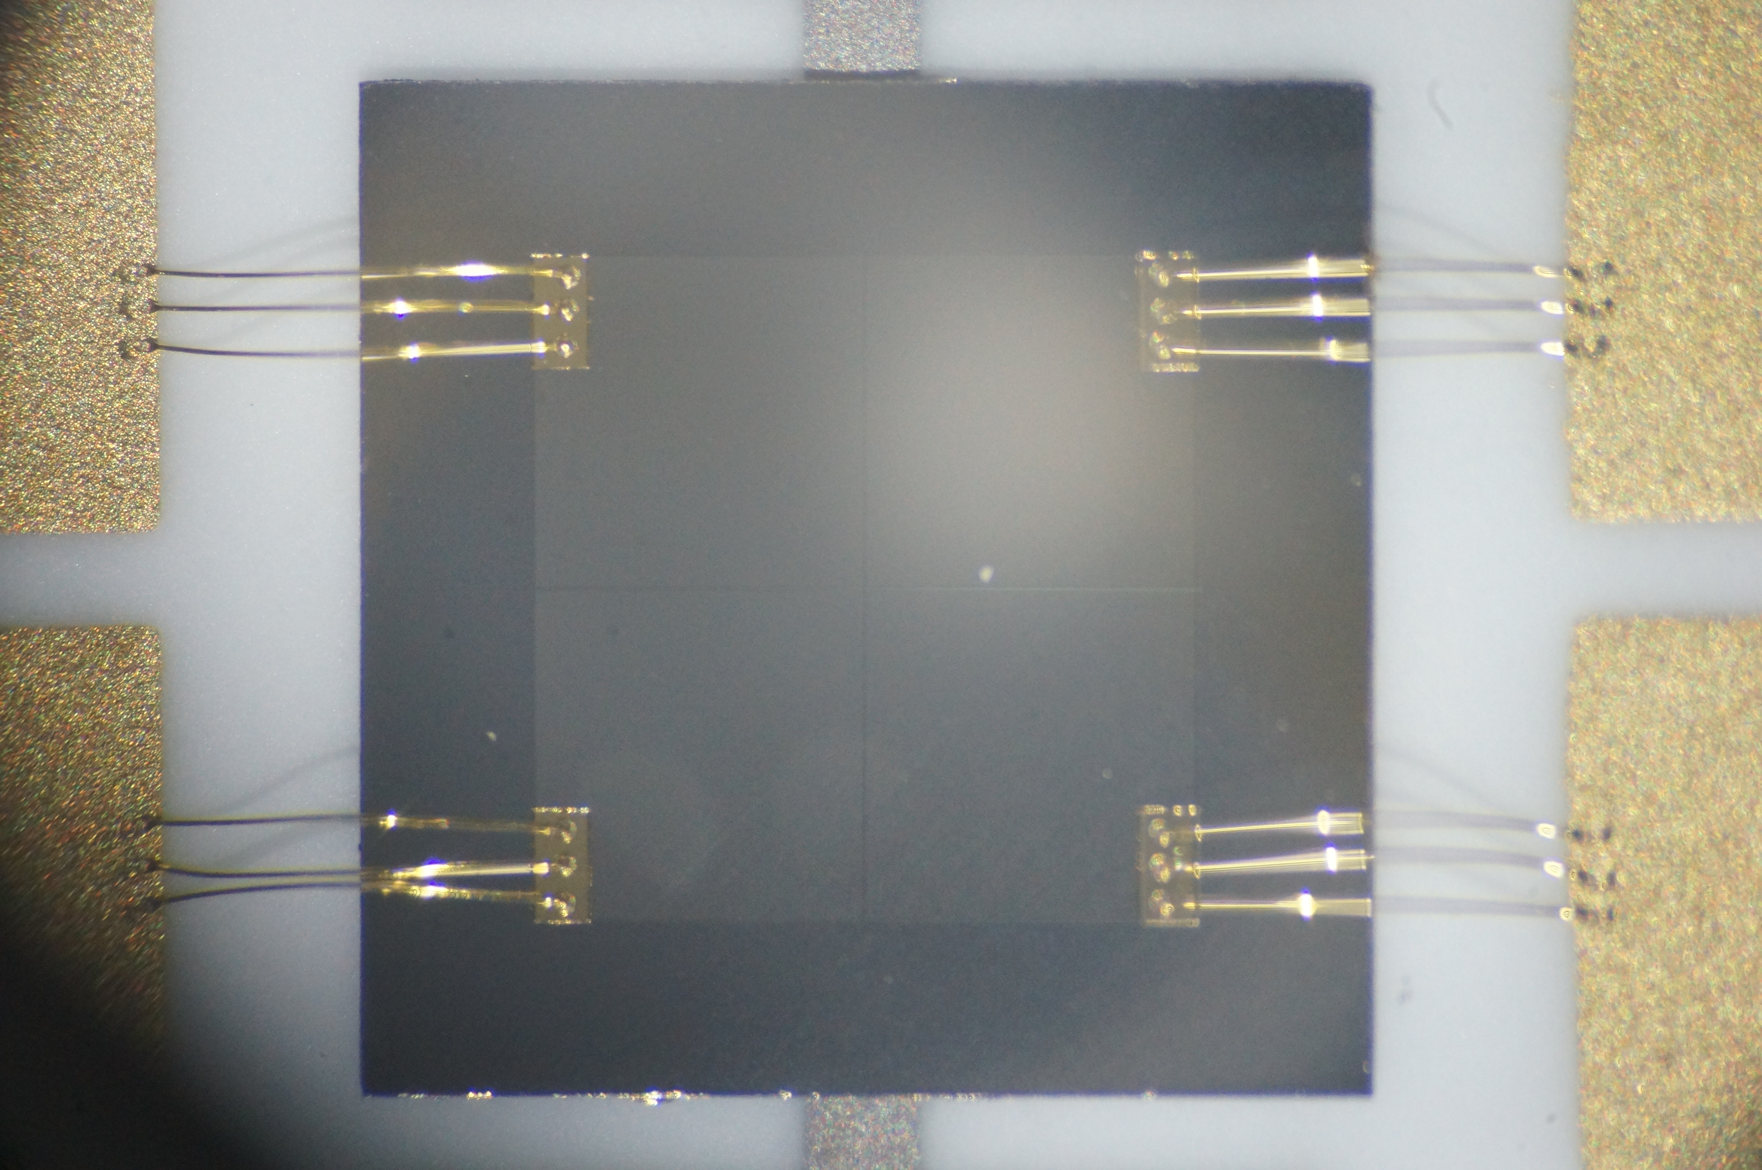
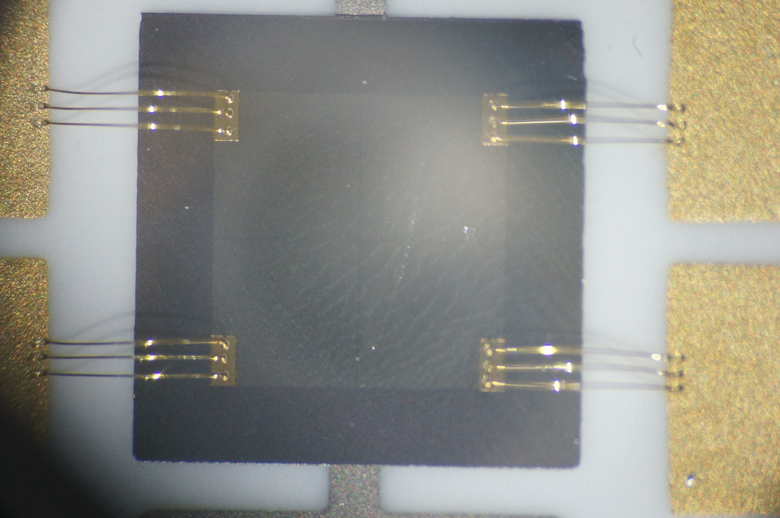
50 µm and 20 µm crystal comparison
50 µm crystal
20 µm crystal

Slide 32
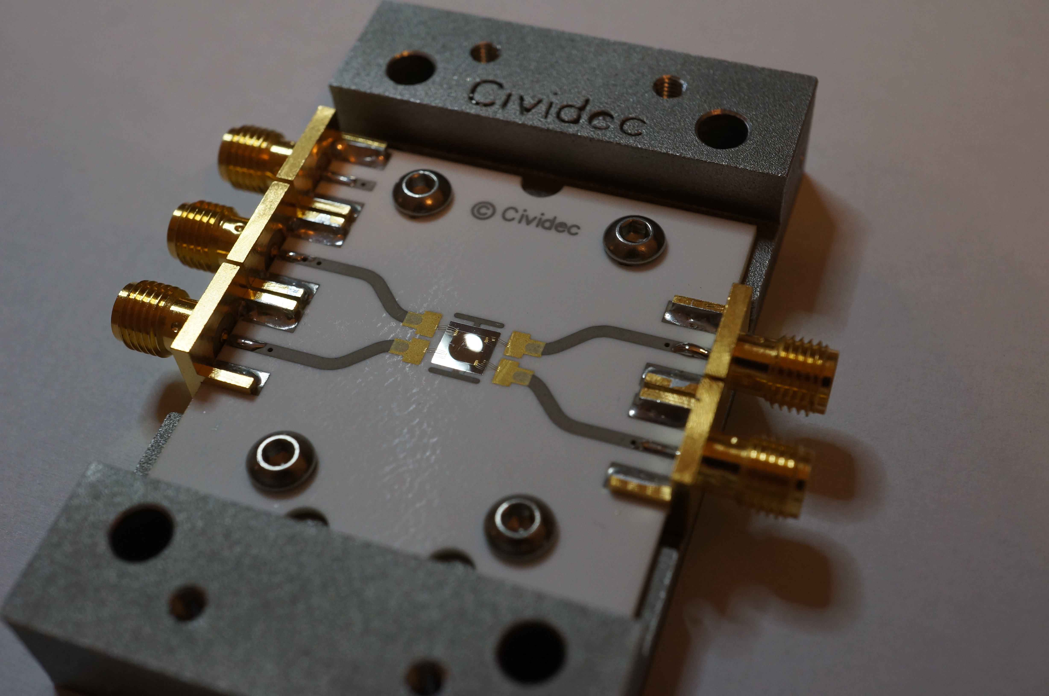
Bent crystal

Slide 33
www.cividec.at

