Slide 1
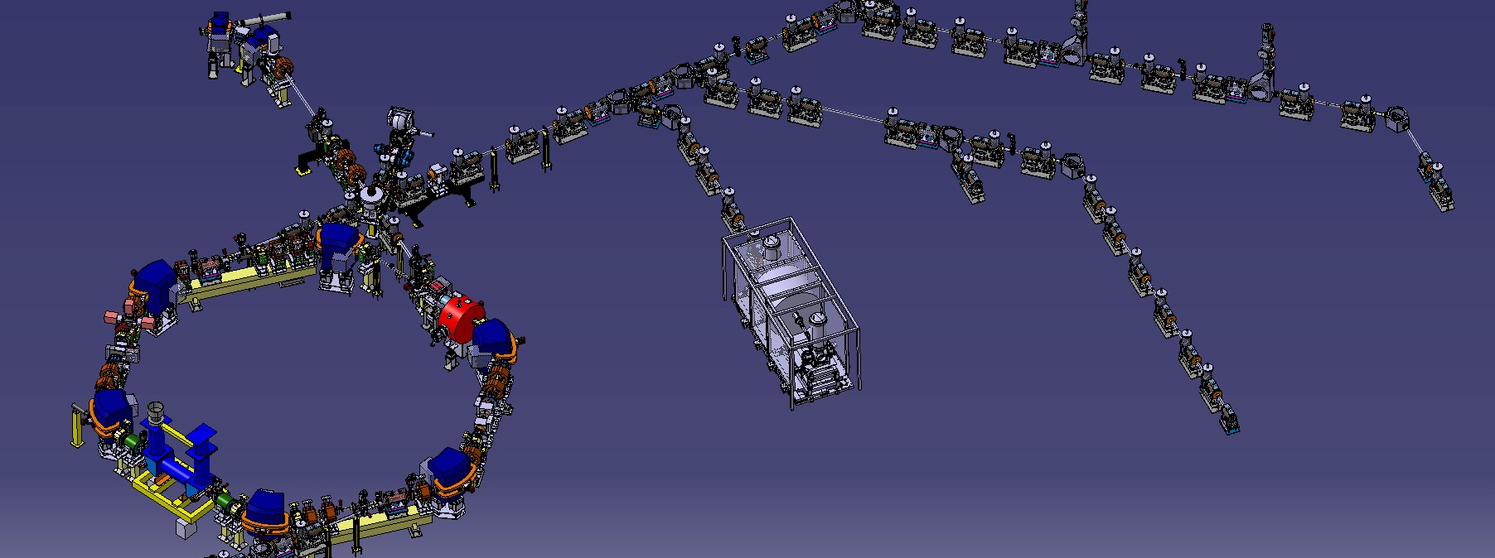
Progress with Pbars and H- beams
D. Gamba, on behalf of AD/ELENA team ELENA Commissioning Meeting 1th Nov2018
GBAR transfer line
ELENA Commissioning Meeting, 1st Nov 2018

Slide 2
Present Optics

Slide 3
First Monitor – first measurement

Slide 4
Acting on defl. And ELENA orbit

Slide 5
Warning

Slide 6
Second monitor

Slide 7
Second monitor

Slide 8
Something strange…

