Slide 1
Evolution of Scientific Computing in the next decade: HEP and beyond
Simone Campana - CERN

Slide 2
Introduction
Those ideas were presented and refined in several stages
  The 1st scientific computing forum: https://indico.cern.ch/event/581096/
  The November 2010 WLCG Overview Board: https://indico.cern.ch/event/734889/
The outcome was submitted as whitepaper to the European Strategy for Particle Physics Open Symposium, on behalf of the WLCG OB
  http://wlcg-docs.web.cern.ch/wlcg-docs/technical_documents/HEP-Computing-Evolution.pdf
The proposal has been informally discussed with HEP projects other than LHC (read DUNE)

Slide 3
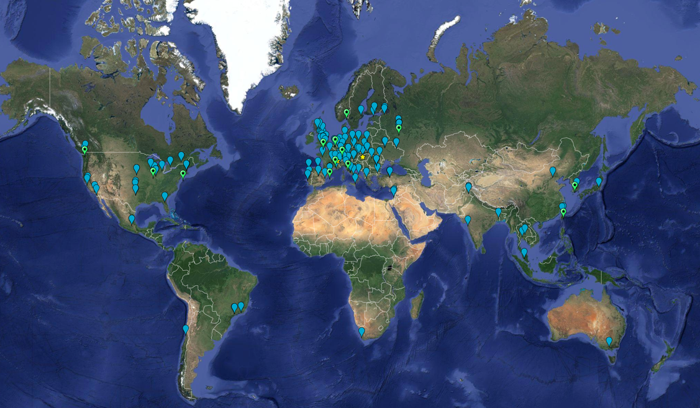
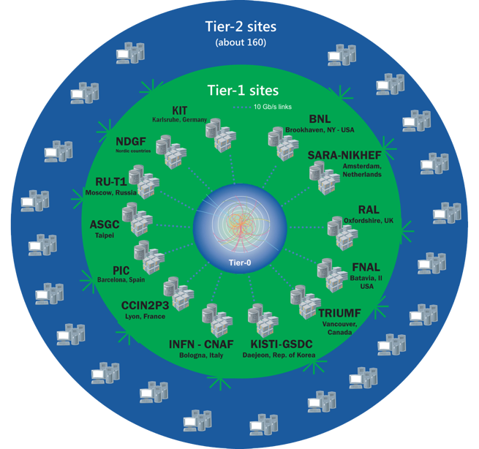
The Worldwide LHC Computing Grid
Tier-0
(CERN and Hungary):
data recording, reconstruction and distribution
~170 sites,
42 countries
~1M CPU cores
Tier-1: permanent storage, re-processing,
analysis
~1 EB of storage
> 2 million jobs/day
Tier-2: Simulation,
end-user analysis
10-100 Gb links
WLCG: an International collaboration to distribute and analyse LHC data
Integrates computer centres worldwide that provide computing and storage resource into a single infrastructure accessible by all LHC physicists

Slide 4
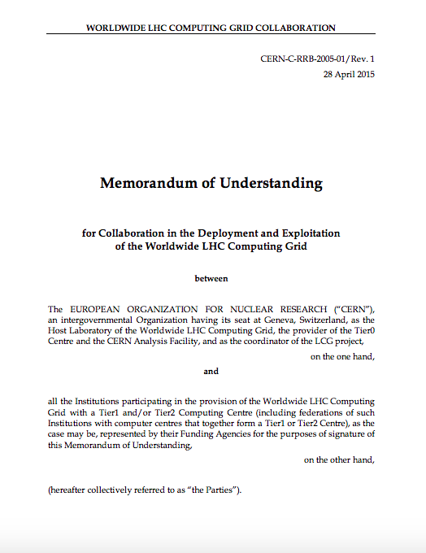


Slide 5
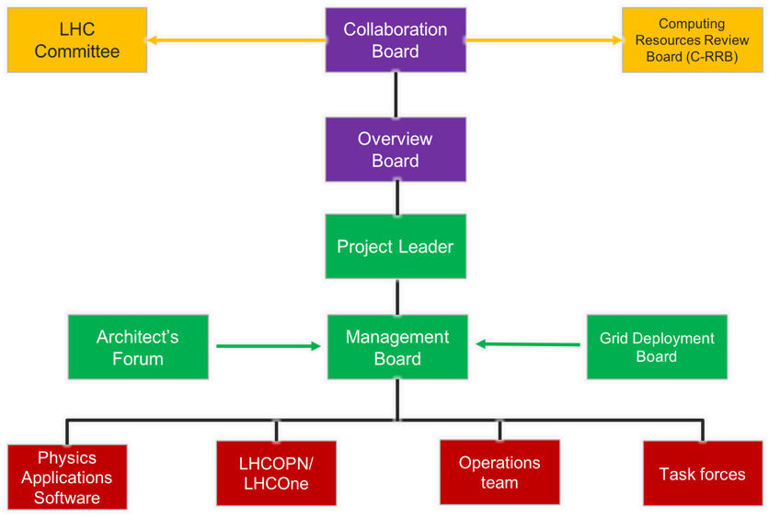
Governance of the WLCG collaboration
(as in Annex 5 of the MoU)
Collaboration Board: general assembly of WLCG members
Overview Board: standing body of the CB. Strategic directions.
Project Leader: executive director
Management Board: organizes the program of work, ensure the execution of the CB/OB directions
Grid Deployment Board: infrastructure planning and deployment
Architects Forum: software planning and evolution

Slide 6
10 Billion of these

Slide 7
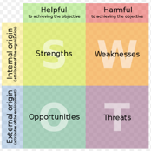




S.W.O.T analysis
  WLCG established, trust network among stakeholders. Reputation of a success story.
  Lightweight decision making processes
  Consolidated infrastructure – common building blocks, policies, federation, resource sharing, etc.
  Lack of investment in software for the future; initial investment in WLCG applications has levelled off; future need more weight on software
  WLCG does not have development effort – reliance on external providers – some developments and efforts were of marginal use
  Flat funding but expectation of more and more computing and data
  Other sciences now compete with WLCG for resources at similar scales; WLCG may lose influence
  Need to use facilities not particularly suited to our problems – HPC
  No financial support for software nor career recognition
  Leverage experience and be central to evolution of scientific computing and become the reference, for the benefit other sciences, resource providers, funding agencies
  Leverage extra resources (HPCs) by investing in software and building relationships
  Retain significant leadership role in setting direction

Slide 8
Scientific Computing Evolution: the strategy
1) Leverage the existing HEP computing infrastructure and evolve it to serve as a common computing system for HEP and beyond HEP
2) Evolve the facilities and services to build a HEP Data Cloud
3) Invest in common software and software techniques including training, dissemination and recognition
For this to happen, the current governance of the WLCG organization should be changed to factor out the infrastructure related aspects

Slide 9
Leverage the existing HEP computing infrastructure and evolve it to serve as a common computing system for HEP and beyond HEP
Expose the well established WLCG services to other HEP and non HEP sciences into a marketplace. Different projects will flexibly adopt different service sets
Complement such marketplace with services developed and supported by non WLCG sciences, for the benefit of all
Consolidate the infrastructure around the current core services at WLCG facilities. Strongly encourage commonality across sciences.
  Authentication, Authorization and Identity management. Security
  Networks, Storage and Data Management
  Operations
Favor, without imposing, sharing of infrastructure,
tools, service and support as far as possible.

Slide 10
Evolve the facilities and services to build a HEP Data Cloud
Storage Orchestration Services
Storage
Asynchronous
Data Transfer
Services
Storage
Data (Lake)
Infrastructure
Distributed Storage
Storage
Storage
Volatile
Storage
Storage
Content Delivering and Caching Services
Data Center
Data Center
Grid Compute
Grid Compute
Cloud Compute
HPC
Compute
@HOME
Grid Compute
Compute
Infrastructure
Compute Provisioning

Slide 11
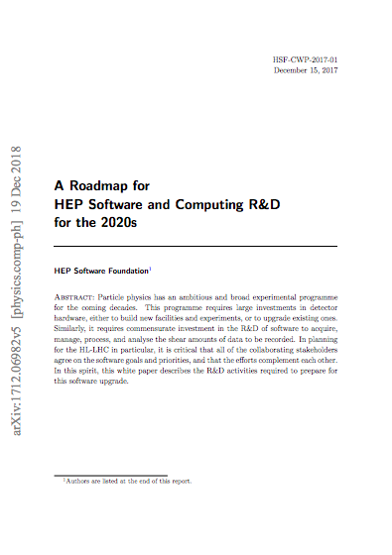


Invest in common software and software techniques including training, dissemination and recognition
Complement the project specific effort with common effort: tools and procedures, training, actual libraries
The HSF: a bottom up approach collecting a set of tools contributed, developed, maintained and evolved by the community.
Develop the state-of-the-art software cyberinfrastructure required for the challenges of data intensive scientific research at the HL-LHC and other planned HEP experiments of the 2020’s.
25M USD
e.g.

Slide 12
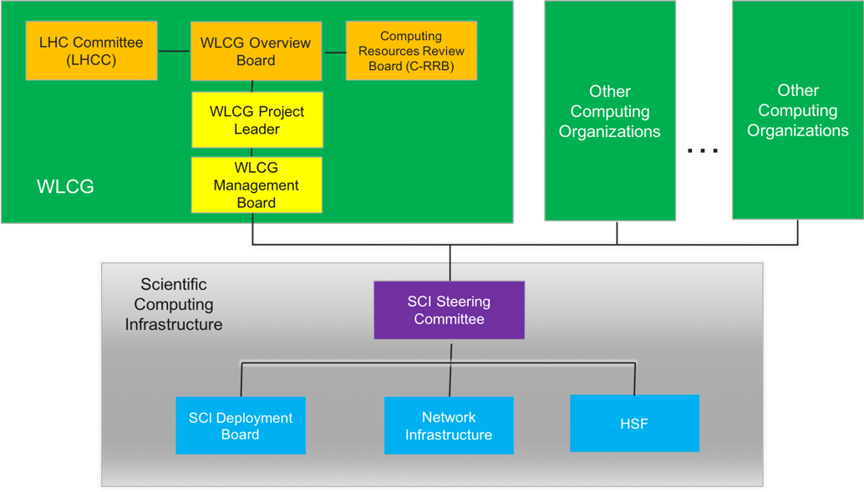
Governance, Organization and Steering
Governance must remain science-led and lightweight
The Scientific Computing Infrastructure gets established, factoring out the aspects common to all organizations, as infrastructure and software
WLCG collaboration retains the LHC specific aspects
Other organizations implement their own equivalent

Slide 13
The Scientific Computing Infrastructure
Driven by the sciences with a stake on the common infrastructure,
as part of the Scientific Collaboration Steering Committee
The steering committee defines/steers direction, encourages funding, brokers needs on licensing, policies, joint procurements
Members of the committee:
  The heads of Information and Communication Technology of the major HEP laboratories being part of the Infrastructure
  The computing project leaders from the major projects and experiments
The committee reaches decisions by consensus, while a voting procedure would formally exist. It reports to the involved sciences through their representatives

Slide 14
The Scientific Computing Infrastructure
The Scientific Steering Committee overseas the activities of and provide recommendations to different bodies:
The SCI deployment board, replacing the WLCG Grid deployment board
  Broadened to all parties of the SCI
  Covering all integration and deployment aspect of services
  Evolving in a more forward looking body in terms of computing technologies
The HSF would be the vehicle by which common software tools, libraries and techniques is fostered across the SCI community

Slide 15
Risks and Mitigation
Two main risks were identified in the proposed model and possible mitigations were considered
1) Risk of loss of control
  Today, the tight coupling of the WLCG organization with the infrastructure ensures control
  In the new model the infrastructure and WLCG are loosely coupled and more projects compete with WLCG
  Minimized building up the SCI steering committee on the backbone of the current WLCG OB, bringing on board the new key stakeholders (sciences)
2) Risk of dominant role
  Other organizations than WLCG would refuse a model imposed upon them
  Minimized by presenting the SCI as a marketplace of tools/services rather than a top-down monolithic system

Slide 16
Conclusions
We intend to have the next round of discussion at the HOW meeting in JLAB
  https://indico.cern.ch/event/759388/
  Open discussion on Monday’s plenary
  Closed discussion at the WLCG Collaboration Board on Wednesday
  To facilitate the discussion we opened a google document. Please contribute.
  https://docs.google.com/document/d/1ePXsKa8mtFk1-ow6rVOQ30bAoguu7yg_pgDHBqdqC4g/edit

