Slide 1


ELENA Project
TRANFER LINES SEM’s schedule

Slide 2
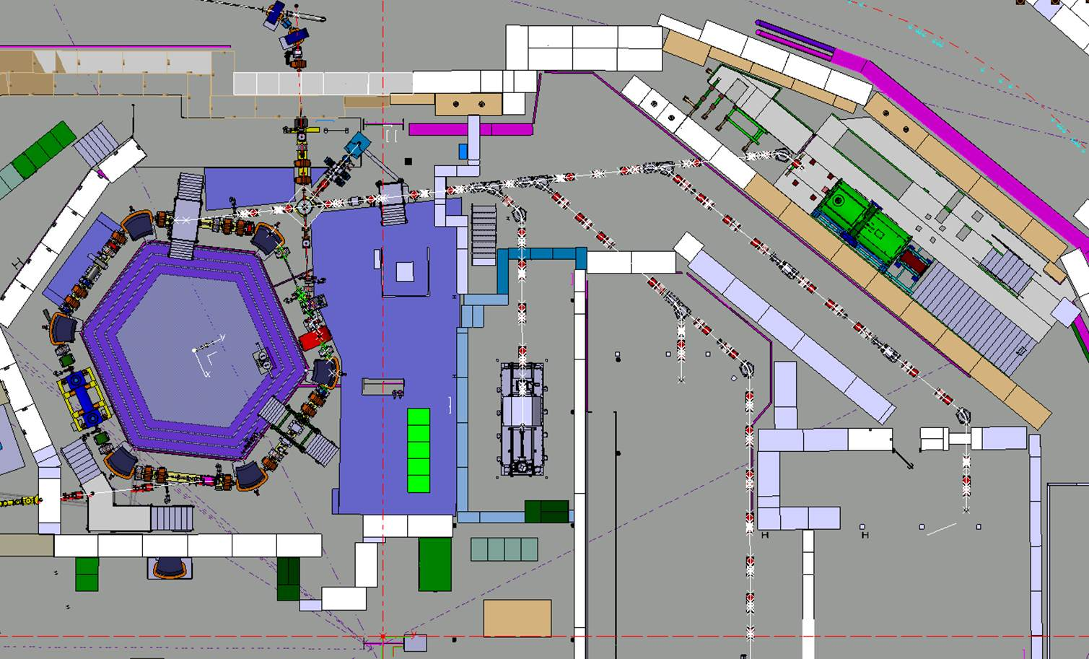
Electrostatic lines to be installed
LNE02
LNE00
LNE01
LNE03
LNE07
LNE06
LNE04
LNE50
LNE05
LNE51

Slide 3
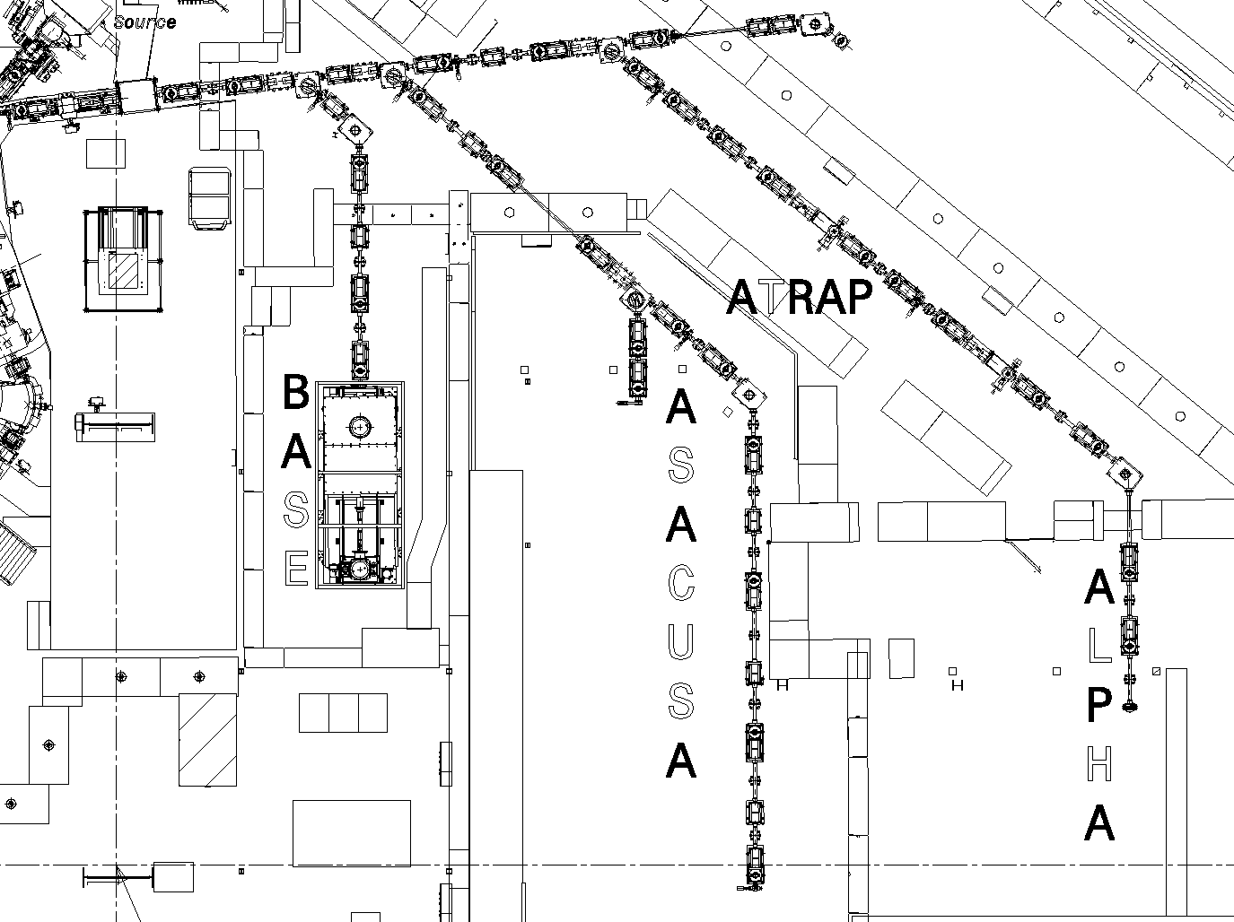
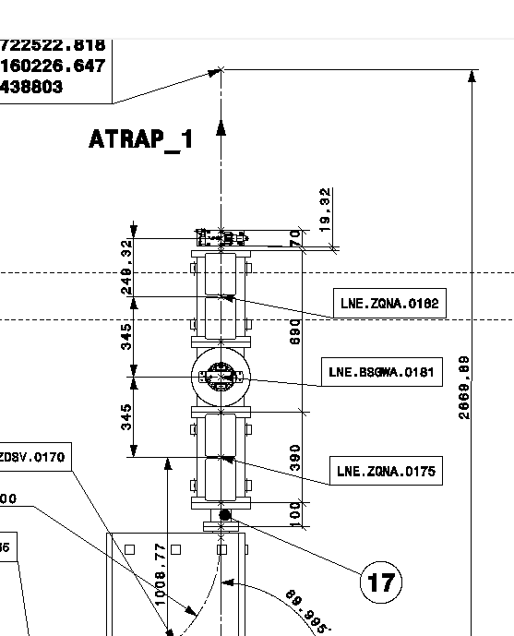
Vacuum sectors
Sector 1-2
Sector 0-1
Sector 2
ATRAP 1
Sector 6-5
Sector 1-3
Sector 7
ATRAP 2
Sect valve
SEM
Sector 3-4
Sector 5

Slide 4
Assumptions for delivery
9 complete systems delivered by M. Hori for end Nov 2018 (including coated rods), then 3 new units every 6 weeks delivered at CERN
BE-BI takes 1 week to fully assemble and test 1 setup: Continuous dedication of BE-BI for SEM’s assembly from Nov 2018 till end 2019
3 weeks for vacuum acceptance test + transport + installation of 3 complete setups: part dedication of TE-VSC for tests !

Slide 5
SEM HW delivery vs installation
14/10/2019
09/12/2019
20/01/2020
Pump down – Bake-out
Cabling by EN-EL
Elelctrostatic elements installation
Cables connections
Survey - alignement
Commissioning start

Slide 6
Number of SEM per vac sector
Sector 3-4: 6 SEM (6/24) Leak check: 05/09/2019
ATRAP 2: 1 SEM (7/24) Leak check: 05/09/2019
Sector 1-3: 6 SEM (13/27) Leak check: 17/09/2019
ATRAP 1: 1 SEM (14/27) Leak check: 17/09/2019
Sector 1-2: 3 SEM (17/27) Leak check: 23/09/2019
Sector 2: 1 SEM (18/27) Leak check: 27/09/2019
Sector 0-1: 4 SEM (22/27) Leak check: 07/10/2019
Sector 7: 3 SEM (25/27) Leak check: 11/10/2019
Sector 6-5: 6 SEM (31/27) Leak check: 21/10/2019
Sector 5: 5 SEM (36/30) Leak check: 29/10/2019

Slide 7
Conclusions
Last moment for SEM’s installation is vacuum check of concerned sector
Bake-out operations 05/09/2019 – 21/12/2019 (after that: cables installation till April 2020)
According to planned delivery schedule, 9 missing SEM’s won’t be available by end 2019
Impacted lines: LNE05-06 (ASACUSA): install 4 blank flanges on vac sector 6-5 to bake-out sector 0-1
Missing SEM’s installed when available, but bake-out possible only after cable pulling: impact on start of commissioning of LNE05-06 only.
All efforts should be done to speed –up delivery

