Slide 1






Modelling Studies (Benchmarking) Bianca Veglia
bianca.veglia@liverpool.ac.uk

Slide 2

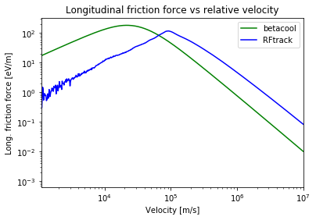



Friction force computed as one passage through the electron cooler
Uniform distribution of electrons
RF-Simplified version
Cooling meeting

Slide 3
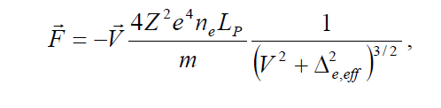
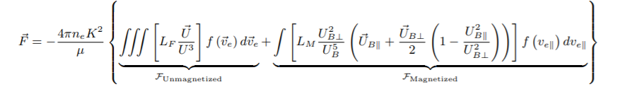
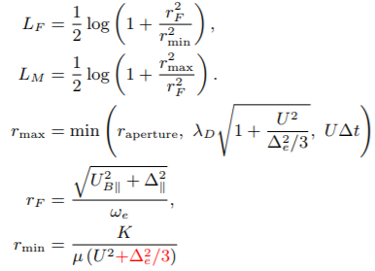
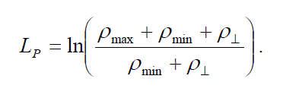
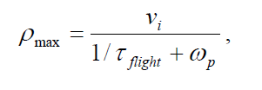
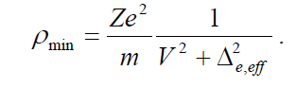



BETACOOL → Parkhomchuk semi-empirical formula
RF-TRACK → Binary Collisions approach
Different impact parameters!
Is assumed that
(fitting parameter)
Cooling meeting

Slide 4
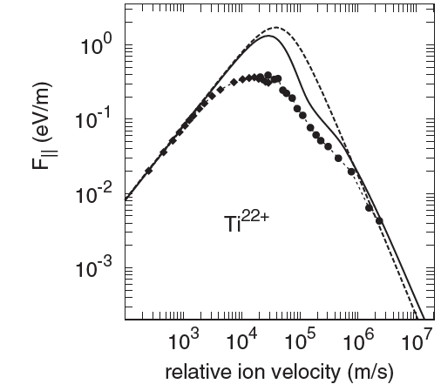
Why then this??
H. Nersisyan et al. , Interactions Between Charged Particles in a Magnetic Field (2007)
Cooling meeting

Slide 5
Get an analytical description of how considering negative ions change the general expression of the force
Emittance evolution comparisons (?)
Is the effect of ions on e⁻ negligible or not?
IBS
Cooling meeting

