Slide 1

RADWG Meeting November 2018
Salvatore Danzeca EN/SMM/RME on behalf of the RADWG

Slide 2
AGENDA
Activities Overview by Salvatore Danzeca
QPS developments status and CHARM test results by Jens Steckert and Surbhi Mundra
BE/CO : CHARM Radiation test results of the Cu-Cu repeater by Julien Palluel
CHARM tests on the pressure sensors by Beatrice Mandelli

Slide 3

RADWG Mandate
It provides support to the accelerator sector equipment groups for the assessment of radiation tolerance of electronic equipment to be installed in radiation exposed areas.
It is as a forum for electronic engineers to discuss
  design practices
  radiation tests
  radiation induced failures in the accelerators.
It coordinates radiation test campaigns inside and outside CERN
The RADWG assists the R2E Project leader for the evaluation of the technical aspects of the proposed mitigation actions with the representatives of the equipment groups

Slide 4
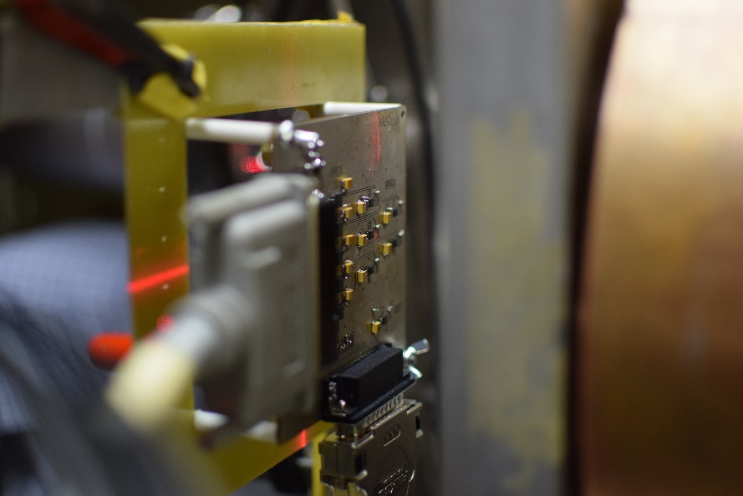
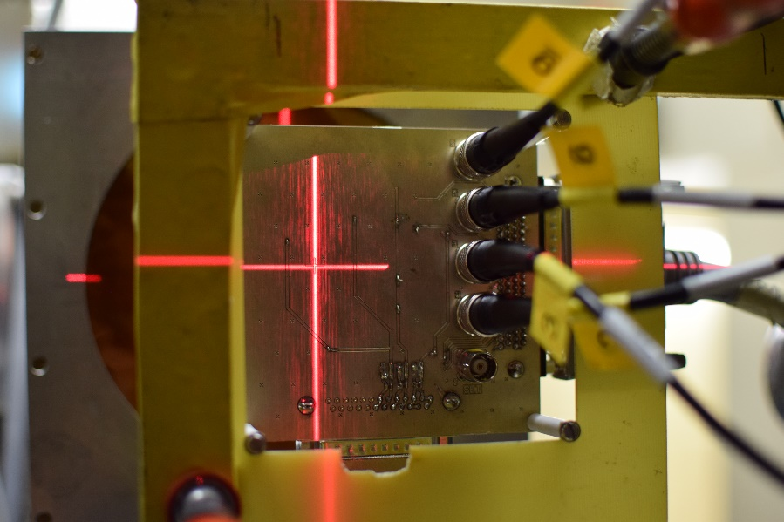
Radiation Tests
71 components tested under irradiation in the 2018 requested by TE/VSC, TE/EPC, BE/BI, TE/MPE
8 PSI-PIF proton test campaigns
5 years collaboration with PSI to ensure continuity of the radiation tests also during the LS2
Radiation test database available online: https://radwg-table.web.cern.ch/public/

Slide 5
Radiation test campaigns
PSI Facility Updates
  2019 Requests open
Test date | Components | Test group | Equipment owner
January | Sensor calibration, Vacuum components, DCDC Converter from Atlas | EN/SMM | TE/VSC – EN/SMM
April | Voltage regulators, transistors, misc | EN/SMM | TE/VSC , TE/MPE
May | Timer, Logic | EN/SMM | BE/BI – TE/VSC – TE/MPE – BE/CO
June | Zener Diodes, DAC, FLASH, misc | EN/SMM | BE/BI – TE/VSC – TE/MPE – BE/CO
July | Logic, Diodes, I2C buffer from Atlas | EN/SMM | BE/BI – TE/VSC – TE/MPE – BE/CO
August | Voltage regulators, RFMos, OpAmp | EN/SMM | BE/BI – TE/VSC – TE/MPE – BE/CO
October | Sensor calibration, Diodes, FPGA misc, | EN/SMM | BE/BI – TE/VSC – TE/MPE – BE/CO
November | Lot qualification, ADC, Vreg , MCU | EN/SMM | BE/BI – TE/VSC –

Slide 6
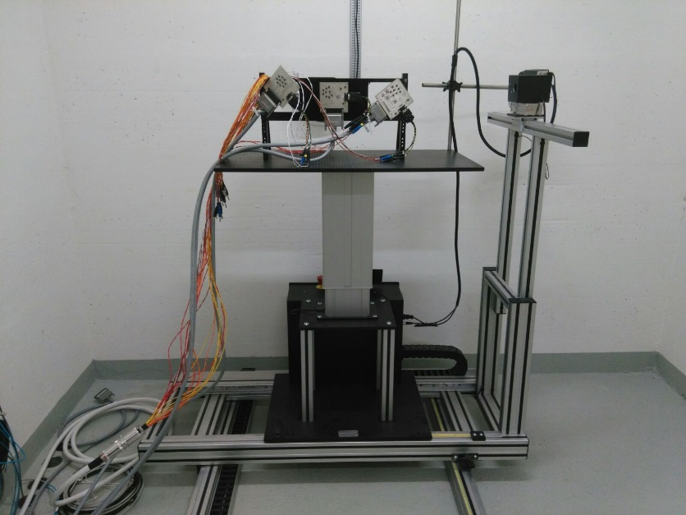
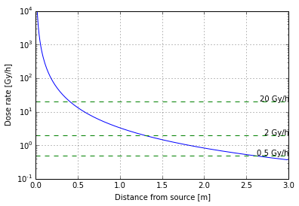
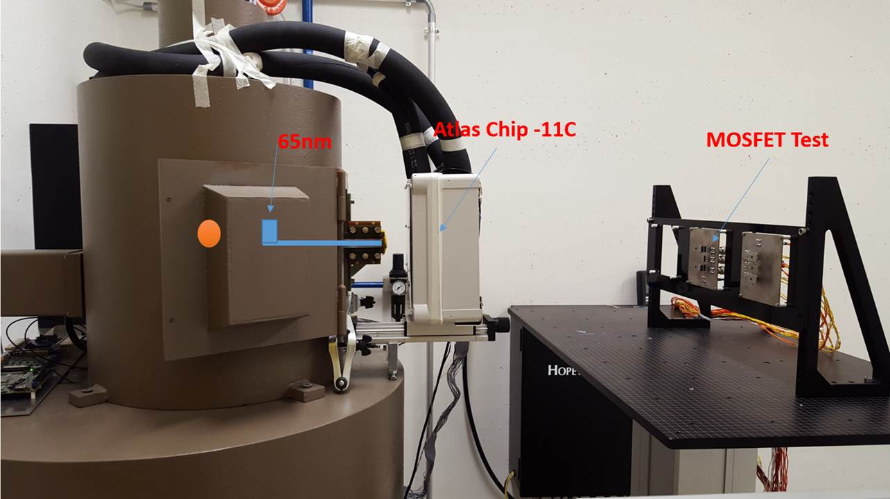
⁶⁰Co facility @ CERN
Reminder: dose rates from 20Gy/h up to 0.36Gy/h
Inside the irradiator setup: 300Gy/h to 100Gy/h on a small surface
Past Users:
  Kurtis Johnson (31 May to 16 Aug)
  Rudy Ferraro (16 Aug to 10 Sept)
  Joan Cesari (multiple tests)
  Matteo Brucoli (15 June to 22 June)
  Atlas FPGA TID testing
  Dosimeter characterization
Planned tests: DC/DC converter
Call for tender for the new source of 100TBq completed.
Installation next year
  Modification of the irradiator might be necessary
The new source can allow us to reach 1MGy in 20 days on 4x4 cm. Larger sample size will require more time.

Slide 7

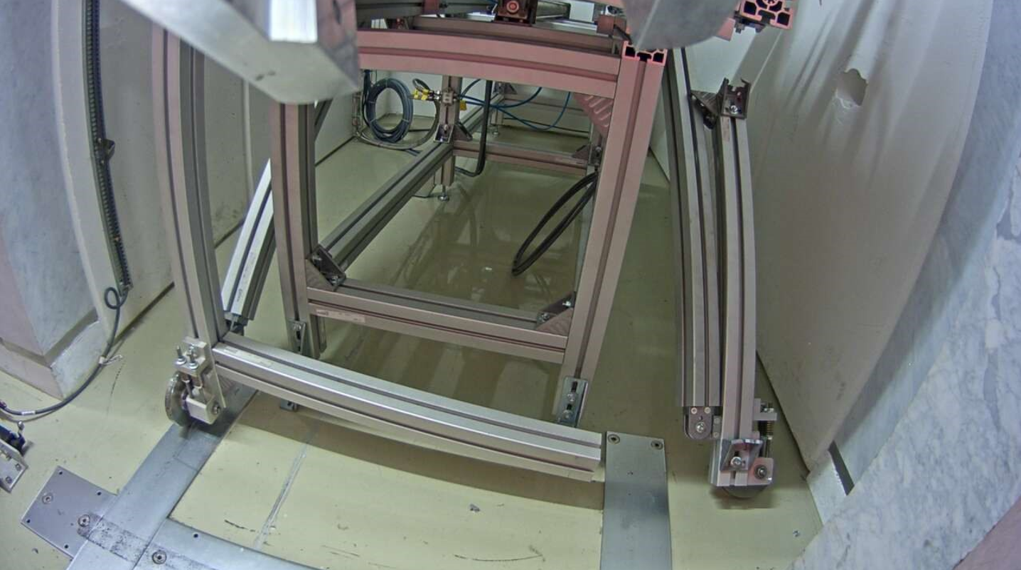
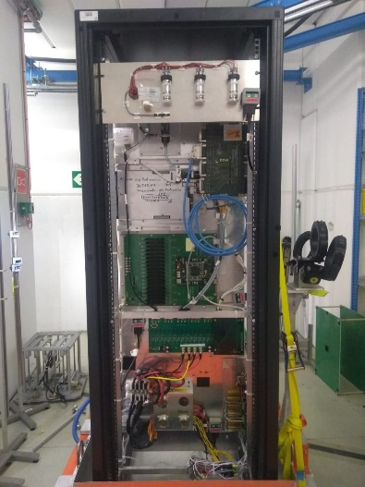
CHARM Facility
Fully booked for the 2018
Last day with protons 11/11/2018
More than 50 users (2x 2017) from CERN and external institutes
  Reports available online : http://charm.web.cern.ch/content/radiation-test-report
Problem on the target solved in two weeks with the help of the EN-STI and Robotics intervention
  All the users have been re-scheduled and no beam lost
Up to 8 users running in parallel in different positions (last year was 6)
Online dosimetry using the RadMon system
Second ion beam (Lead) in CHARM during the 2018 started on the 12/11/2018 will end on the 3rd of December

Slide 8
R2E RHA documents
RHAPS: Process Structure → Pure RHA guideline which gives information about the process and guides the user through the design and qualification methodology
RHAPV: Project Validation (new project) → report of the project information, radiation environment, radiation tests [linked to Engineering Change Request]
RHACD: Check document (existing equipment) → report the cards changed and if they are conform with the RHAPS
New Developments
Have to follow a radiation assurance procedure RHA
The criticality needs to be assessed
The system has to be tested in a representative radiation environment
System already installed
Their fault rate should be assessed
The relocation should be notified
The integration document will have a field pointing at the RHA document
Any system change should be notified

Slide 9
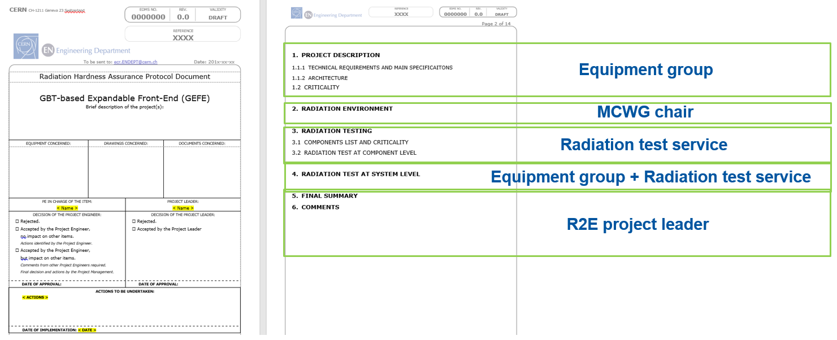
RHAPV – Project Validation
Example: GEFE BPM FE system
Document template available on EDMS (2028777)

