Slide 2
Radiation testing of Quench Protection Systems
Surbhi Mundra (TE-MPE-EP)
Supervisor: Jens Steckert

Slide 3
Contents
QPSs
CHARM Irraditation campaigns
DQLPUBv2
  About, test setup, results, summary of performance
uQDS
  About, test setup, results, summary of performance
Notes:
To describe the presentation topic, first I will be explaining what is CHARM and what is DQLPUB.
Then, I will be discussing the test methodology, the kind of setup we used, the stimulus and references and how the data is recorded.
Next I will be discussing the results
In the results, first I will be showing the timelines displaying various events observed over the duration of test, a couple of slides showing events in a day.
I will also show the variation of signals with radiation.
Next I will discuss the performance of the system under radiation.
Lastly, I will present my conclusions

Slide 4
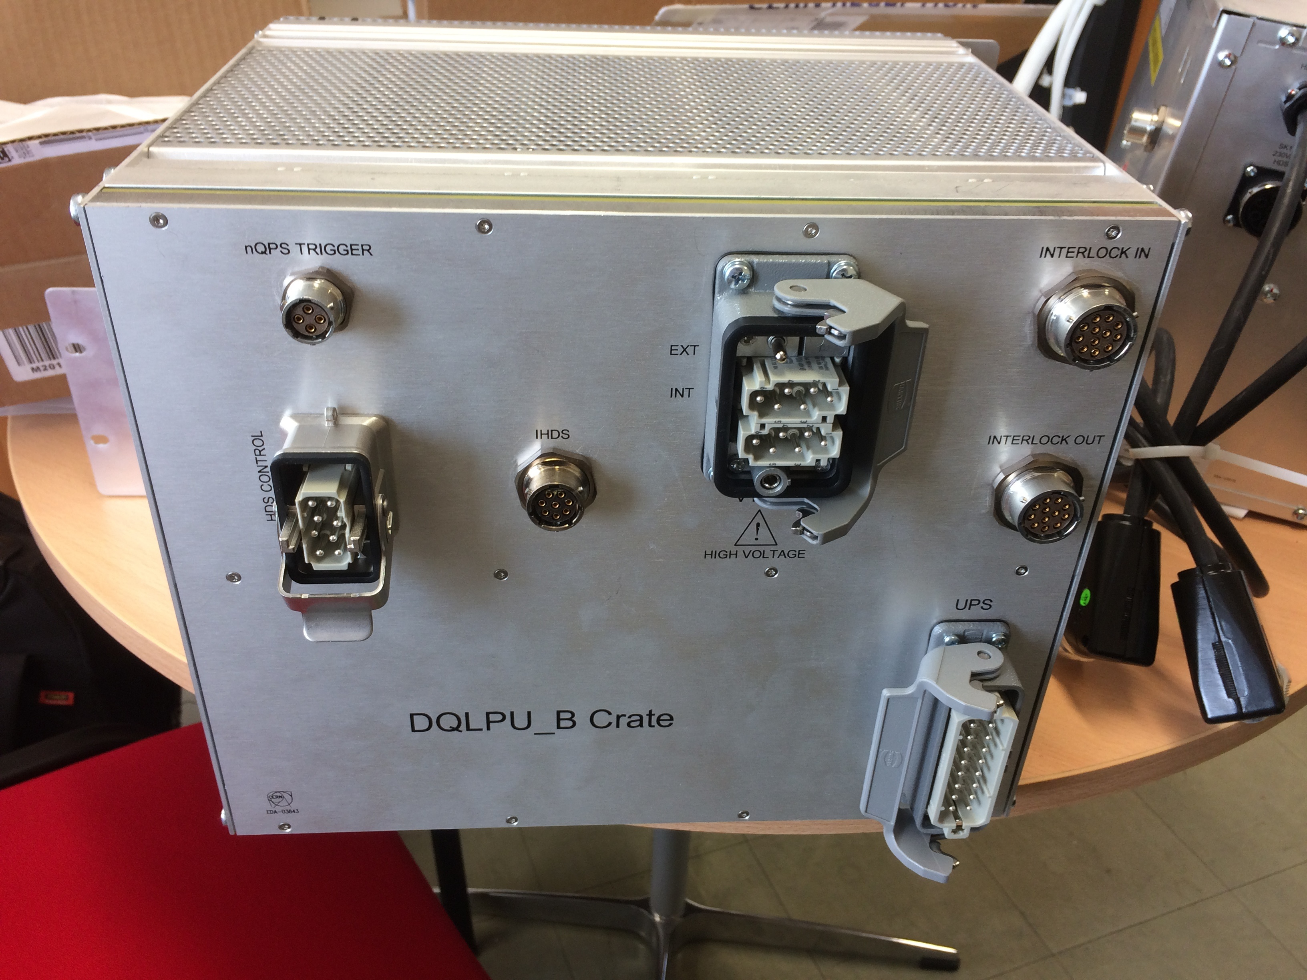
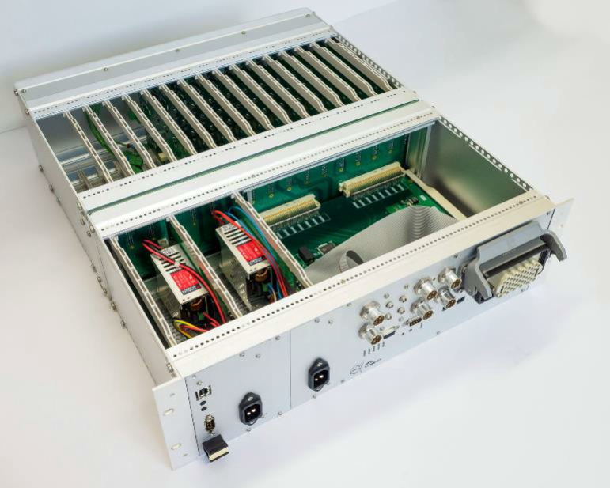
Quench Protection Systems
DQLPUBv2
Replacing 392 DQLPUBv1
Enhanced diagnostics and maintainability
Components radiation tested in PSI
Universal QDS (uQDS)
Modular, versatile and universal quench detection system
Uses tested commercial out of the shelf (COTS) components
Notes:
The MPE-EP group has been working on 2 quench protection systems, DQLPUBv2 and uQDS.
DQLPUBv2 is a development over DQLPUBv1 and 392 of this units will be installed in the yellow rack below the dipoles. It is equipped with enhance diagnostics and maintainability. The components used are either same as used already or have been tested for radiation tolerance at PSI.
Other is uQDS, this modular, versatile system can be universally used to protect against quench in different kind of magnets and systems. It finds its first use in High Lumi Project and further projects like FAIRE. It is new of its kind and has been made out of tested or COTS components.

Slide 5
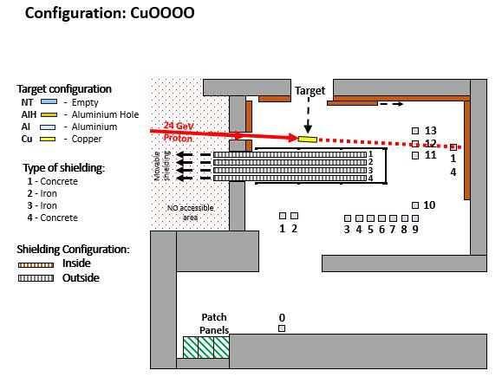
CHARM Irradiation campaigns
 | Configuration | Position | Target Inside | Target Outside | Dose [Gy] | Total POT
DQLPUBv2(1) | “CuOOOO” | 10 | 2018-06-13 | 2018-06-18 | 218.69 | 1.27E+16 | Run 1
DQLPUBv2(2) | “CuOOOO” | 10 | 2018-06-20 | 2018-06-25 | 229.25 | 1.64E+16 | Run 2
DQLPUBv2(1) | “CuOOOO” | 10 | 2018-09-05 | 2018-09-10 | 156.5 | 1.78E+16 | Run 3
DQLPUBv2(2) | “CuOOOO” | 10 | 2018-09-12 | 2018-09-17 | 197.22 | 1.47E+16 | Run 4
uQDS | “CuOOOO” | 10 | 2018-09-26 | 2018-10-01 | 247.7 | 1.98E+16 | Run 1
Notes:
In this year we had practically 3 irradiation campaigns in CHARM, 2 spanning 2 weeks each for DQLPUv2 and 1 week for uQDS. In all the cases the configuration was CuOOOO and the DUT was placed at position 10. At this position the dose rate is roughly 1.5Gy/hr hence TID of 200-250 Gy in 1 week.

Slide 6
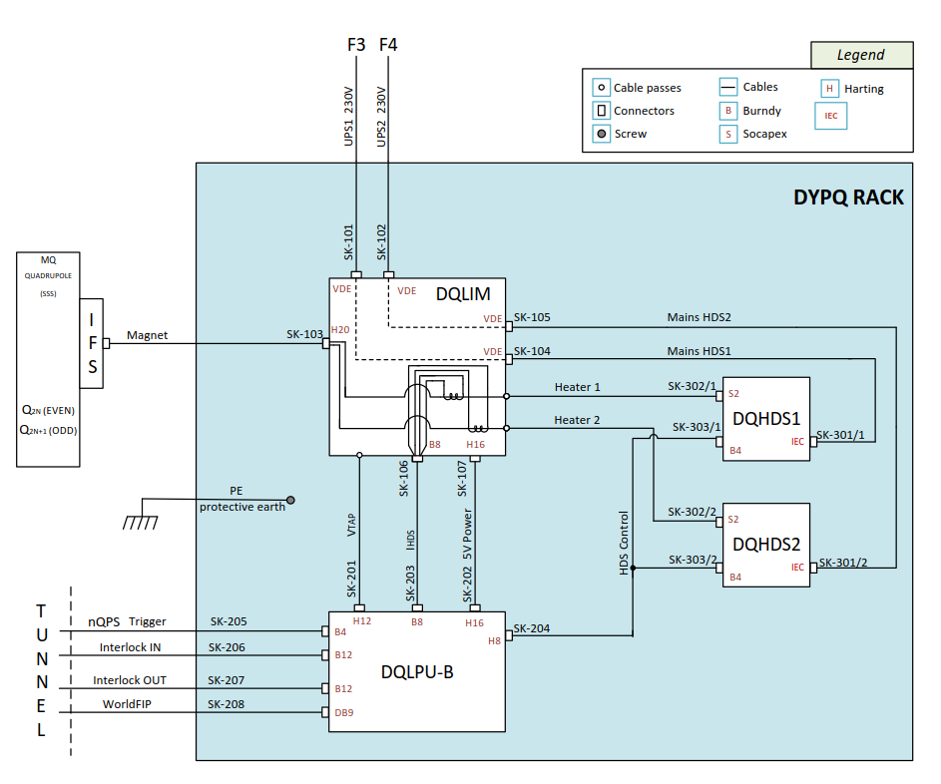
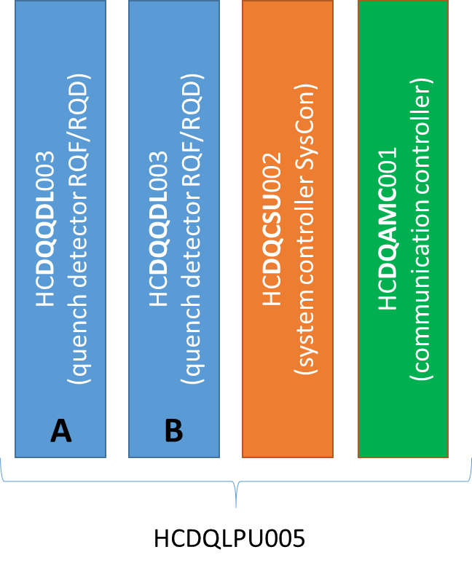
About DQLPUBv2
DQLPU Type B
DYPQ Rack
Notes:
The DYPQ rack consists of DQLIM (Local Interface Protection Module), DQLPUB and 2 DQHDS (heater discharge supplies). In the event of a magnet quenching, DQLPU unit detects the quench, opens the interlock loops, and triggers the heater firing. It protects one quadruple magnet assembly and is located under the dipole magnets. At this position, it is expected to receive a dose at rate of 10Gy/year. Expecting a life cycle of 10 years, the unit should work at least till 100Gy.
The DQLPU unit consists of 2 redundant quench detection units (DQQDL), 1 crate supervision unit (DQCSU) and acquisition and monitoring controller (DQAMC). It also provides the interface to communicate with unit through WorldFIP.

Slide 7
Radiation test campaigns: DQLPUBv2
Tested in PSI
Tested in CHARM
Notes:
Here is a graph showing the radiation tolerance of components used in DQLPUBv2, many of these have been tested at PSI, thanks to the RadWG. One has been passively tested in CHARM while performing the full system test. Details of the full system test are shown in next few slides.

Slide 8
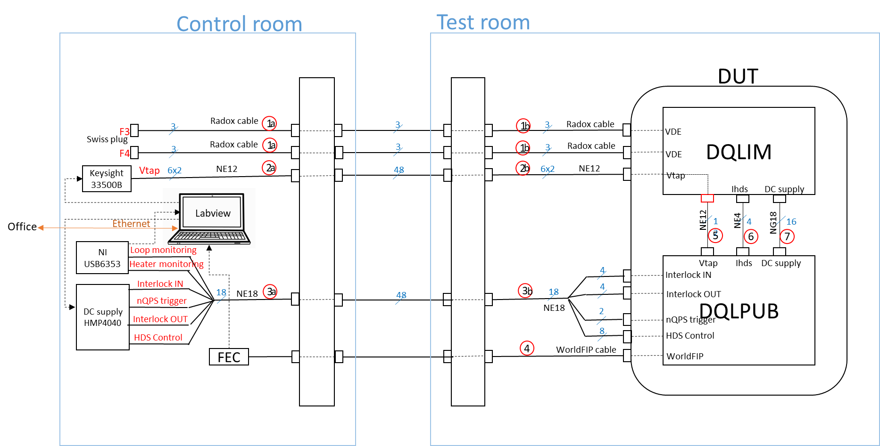
Test setup: Signals and supplies
Differential sinusoidal signals with amplitude 18Vpp and frequency 10mHz were used as Vtaps
A fix voltage of 4.265V was used as Heater discharge supply voltage
Interlock loop was provided with 60mA current using 12V, 200Ω
1kΩ resistors were used as loads to mimic DQHDS relay loads
Notes:
- The charm facility utilizes a control room and test room. Control room is used to connect the signal generators, recorders and units we don’t want to irradiate. The test room contains the unit we want to irradiate.
In this test we connected DQLPUB and DQLIM and places them under radiation.
Differential sinusoidal signal with … was used as magnet voltage to check for full range of input. Slow because magnet signals are normally DC, sine to see variation of Vtaps.
A fix voltage of 4.265V was used as Heater discharge supply voltage. It is equivalent to fully charged capacitor bank inside HDS.
Interlock loop was provided with 60mA current using 12V, 200Ω
to mimic DQHDS relay loads, we used 1kohm resistors

Slide 9
Test setup: Data recording
National Instrument I/O box: to monitor Interlock loop and heater firing
WorldFIP: to record analog voltages, status registers and configuration parameters and save the data on NAS server
Labview: to control the NI box, signal generator and DC supplies remotely
Notes:
HDS control signals and interlock loop status were monitored to observe quench detection
Data was also recorded using WorldFIP and was saved on NAS server for further analysis.
The signal generator and DC supplies could be varied with a labview program remotely operable from lab.

Slide 10
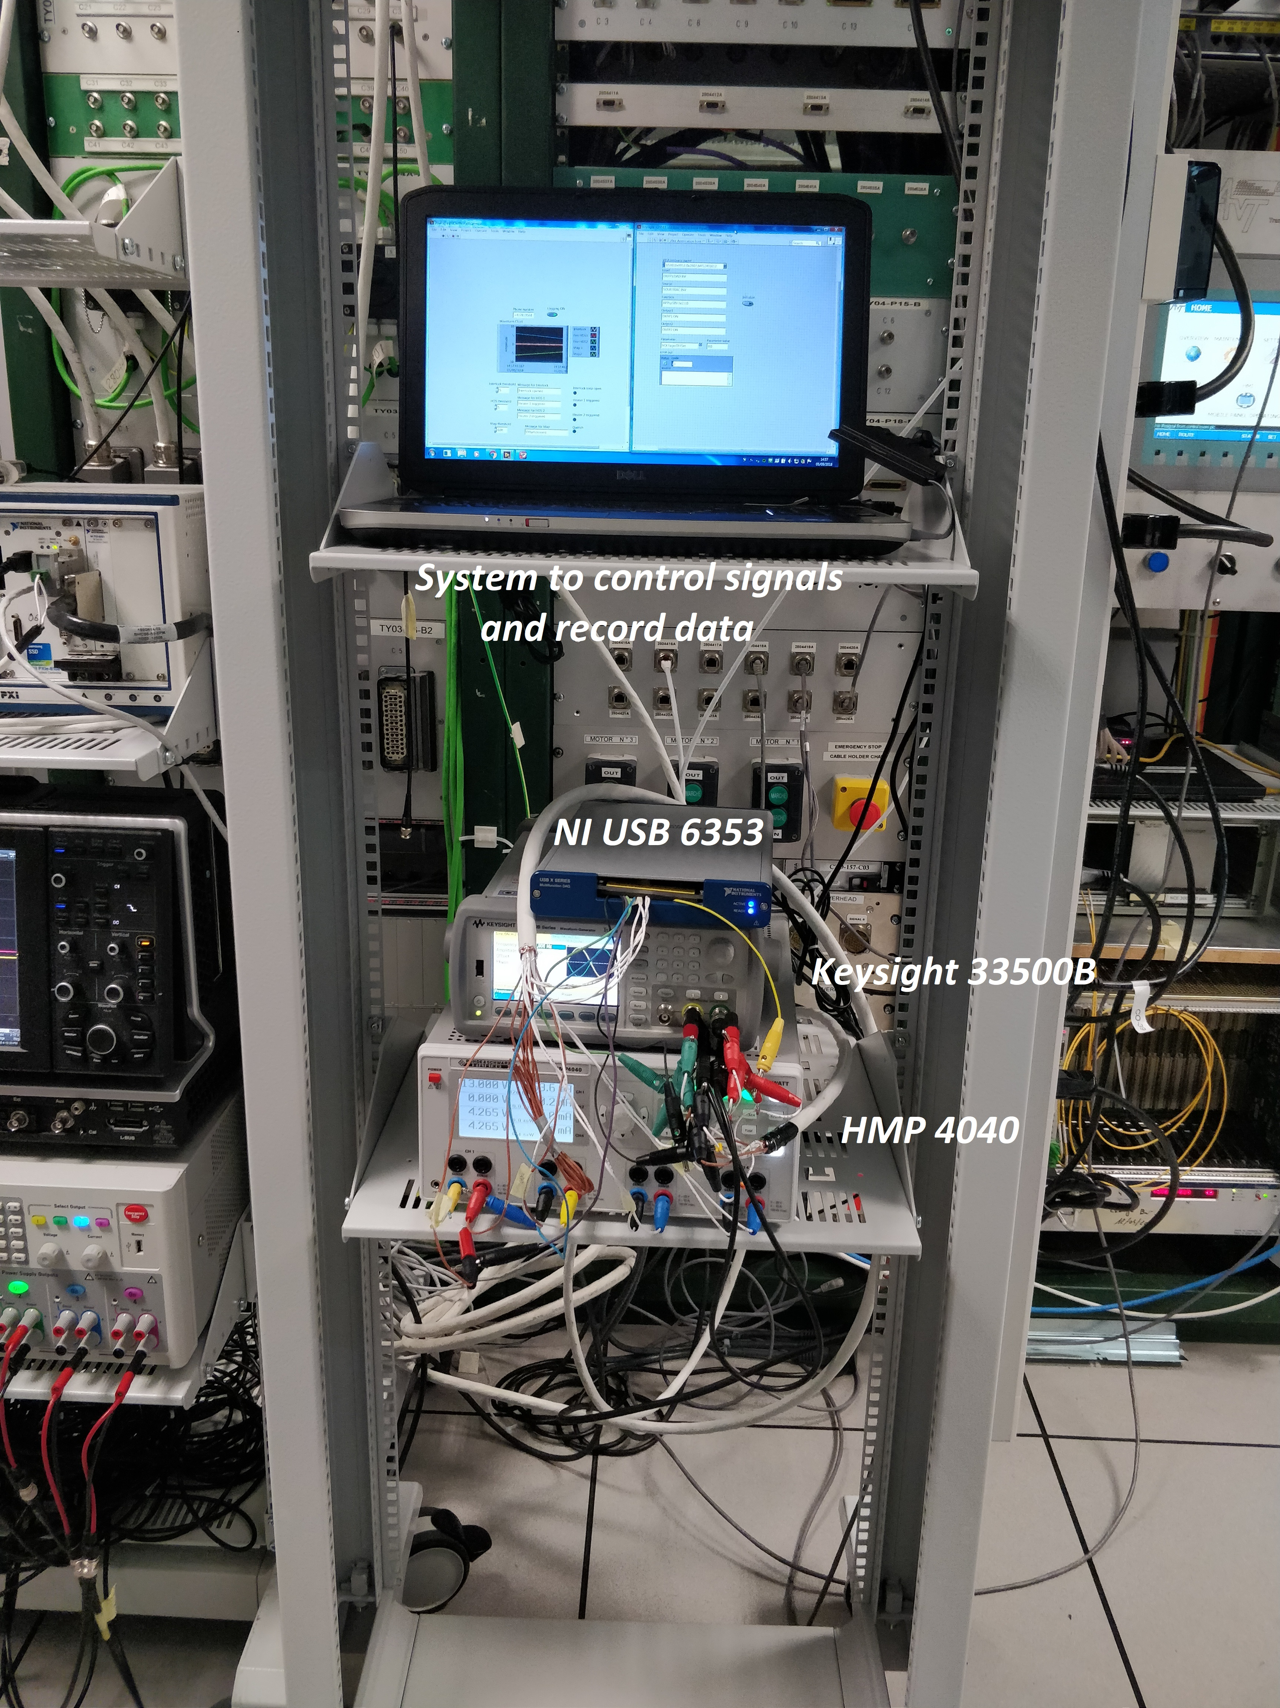
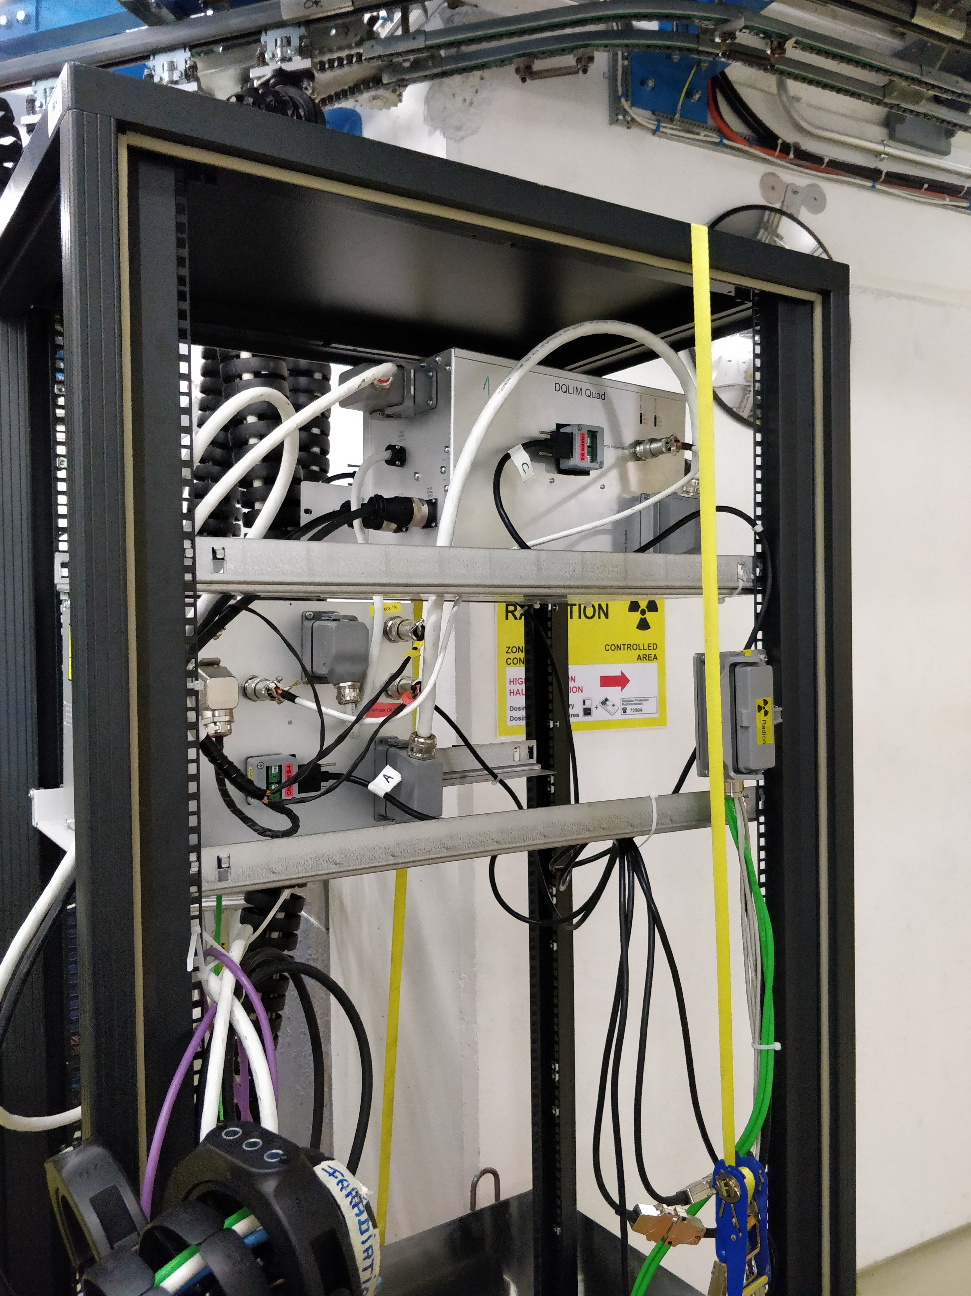
Test setup: DQLPUBv2
Control Room
DUT in facility

Slide 11
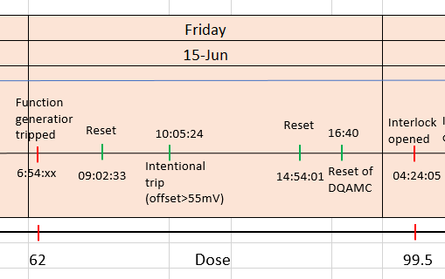
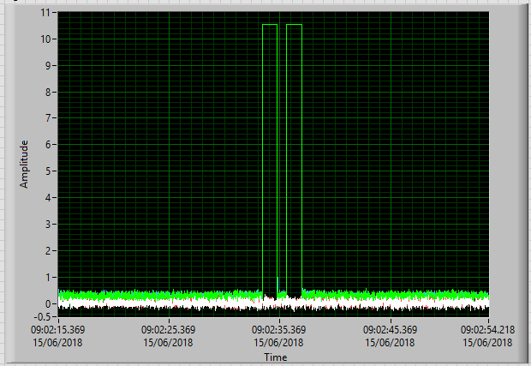
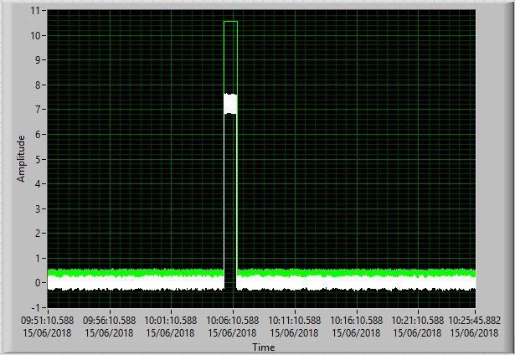
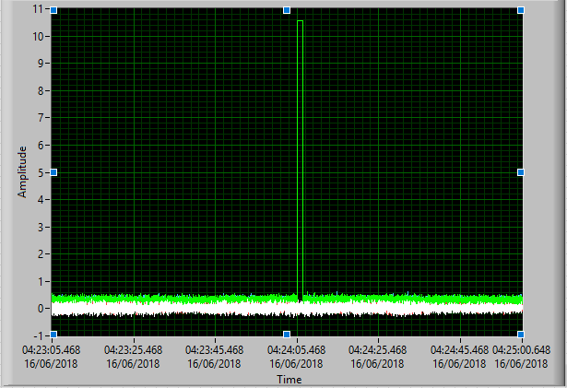

Events observed
Notes:
This figure is from run1
We observe a interlock loop opening 2 times, lets call it double pulse. We see interlock loop opening one times, lets call it single pulse. We see events where we change the input signals to cause a trigger.
Double pulse happens when we do a reset and single pulse happens when CSU sees a loss of communication with WorldFIP. This is a bug in firmware and will be resolved.

Slide 12
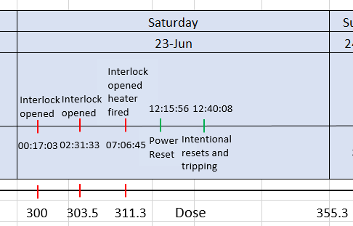
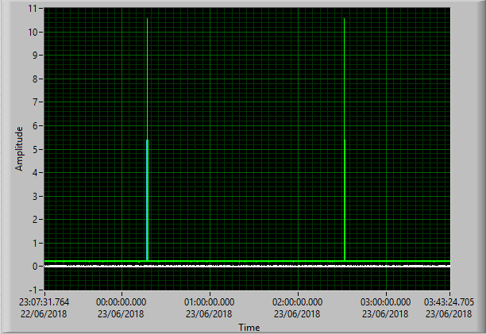
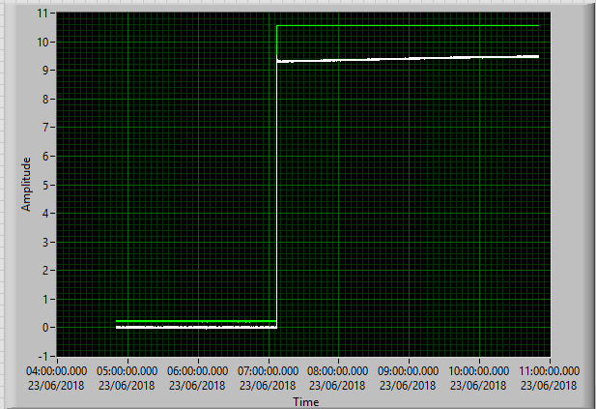
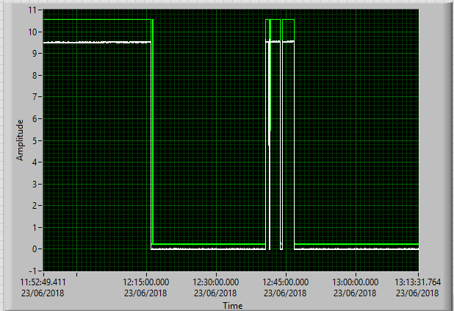
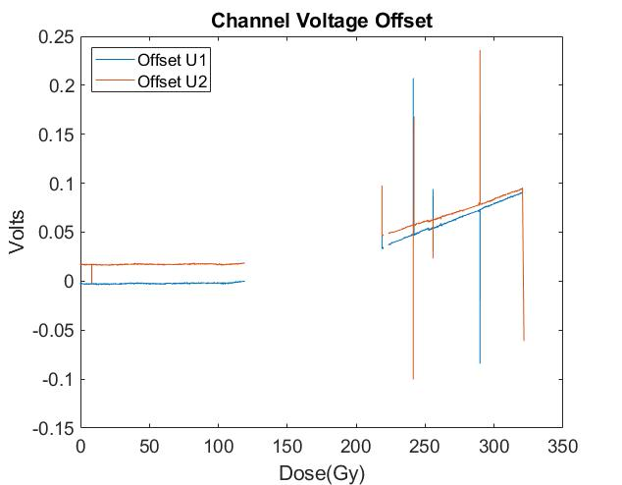
Events observed
Notes:
This figure is from run2
We observe single pulses, automatic firing of heaters and opening of interlocks at a dose of 310Gy and further manual operations.
After a firmware update, AMC will not open loop anymore when there is no communication with WorldFIP. This functionality was tested in second set of tests.
Before I present the data I would like to point out that AMC becomes unoperational at around 110Gy so we have only limited data for both runs.

Slide 13
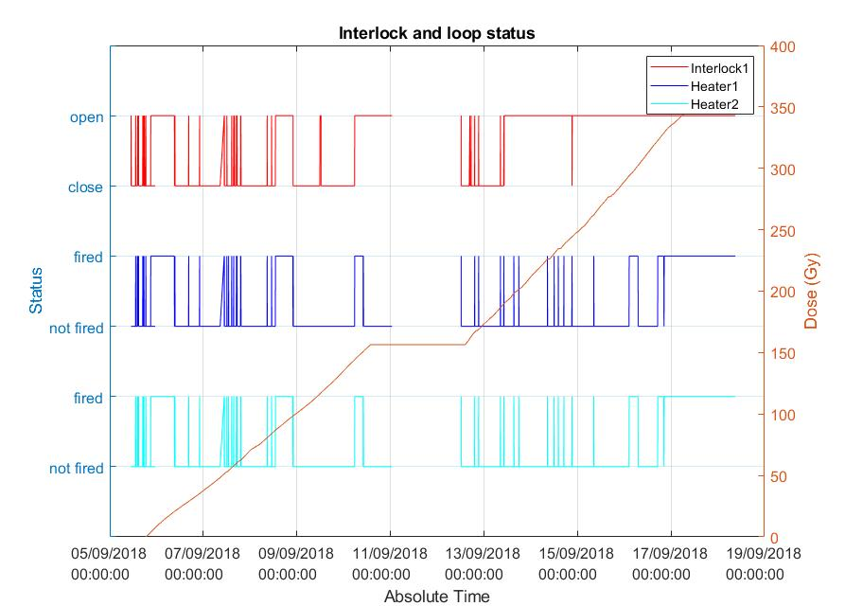
Run 3 & 4
Feedback from the review community and team members
To test updated hardware and firmware
To improve test statistics and diagnosis
Notes:
Since there were concerns about single pulses and CSU results, the DQLPUB review committee suggested to repeat the experiment.
In the updated unit, the firmware was updated to remove single pulse events and the mezannin boards of DQCSU were inbuilt.
In the second round of tests, more diagnosis data was available and functionality was tested more frequently.

Slide 14
Summary of performance of DQLPUBv2
Run 1
Run 2
Run 1 & Run 2
Run 3
Run 4
Run 3 & Run 4
DQAMC survives for 100 Gy on average, then it fails due to the microFIP IC
DQCSU works atleast upto 240 Gy
DQQDL performs well upto 330Gy
For Run 3 and Run 4, failure of DQQDLB was attributed to failure of one digital isolator and one opamp respectively.
Individual tests of isolator and opamp show good performance upto 500 Gy.

Slide 15
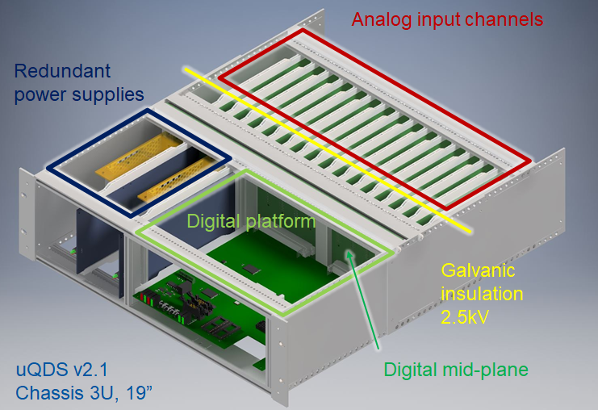
About uQDS
Notes:
The uQDS or universal Quench Detection System is a modular, versatile quench detection system developed to protect the superconducting elements. the unit is powered with redundant 5 V DC supplies generated by AC-DC converter boards. It consists of 16 galvanically insulated analog input channels and high speed, high resolution electronics to process these signals. It has an FPGA based board which can be custom programmed based on the protection requirements.
Due to the presence of radiation in some of the dedicated installation areas, the system is designed to be radiation tolerant up to about 1 Gy/a. In this test the unit was exposed to a mixed field of radiation with dose rate 1.5 Gy/h.

Slide 16
Radiation test campaigns: uQDS
Tested in PSI
Tested in CHARM
Notes:
Similar to DQLPU, we have a graph showing the radiation tolerance of components used in uQDS, again many of these have been tested at PSI. Others were passively tested in CHARM while performing the full system test. One interesting component was traco AC-DC power converter which provided a stable 5V supply to the unit throughout the test.
Details of the full system test are shown in next few slides.

Slide 17
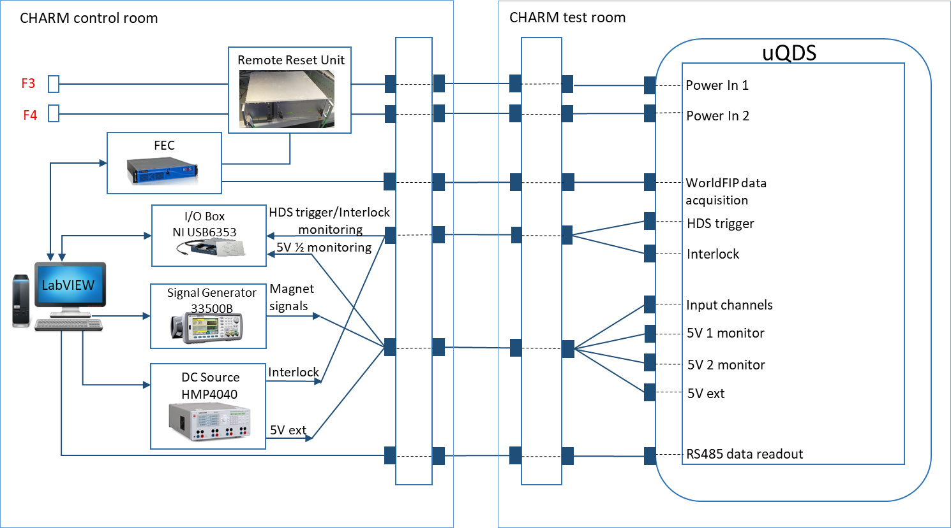
Test setup: uQDS
2 channels were equipped with lead voltage signals and other 2 with magnet voltage signals all supplied through signal generators
  sinusoidal signal with 100 mHz frequency and 20 mV amplitude as lead voltage
  sinusoidal signal with 100 mHz frequency and 18 V amplitude as magnet voltage
Interlock loop was provided with 60mA current using 12V, 200Ω
2kΩ resistors were used loads to mimic DQHDS relay loads
Notes:
In this test we connected uQDS to patch panel and places it under radiation at position 10.
To test its functionality, 2 channels were equipped with lead voltage signals and other 2 with magnet voltage signals. The remaining 12 channels were replicated using firmware. For leads, a small sinusoidal signal with 100 mHz frequency and 20 mV amplitude was applied at Channel 1 and Channel 2. For magnet voltages, differential sinusoidal signals with amplitude 18Vpp and frequency 10 mHz were used. To execute a quench, one can increase the voltage of lead voltages (Uleads) or difference of magnet voltage (U1 and U2) beyond 100 mV. An artificial quench using these schemes was performed from time to time and system was tested for appropriate response.
Interlock loop was provided with 60mA current using 12V, 200Ω
to mimic DQHDS relay loads, we used 2kohm resistors

Slide 18
Test setup: uQDS
National instrument box: to monitor interlock loop and heater trigger status. It also kept track of 5V supplies coming form AC-DC converters.
WorldFIP: to record analog voltages, status registers and configuration parameters and save the data on NAS server
RS485: to log data from FPGA using SPI communication
Labview: to control the NI box, signal generator and DC supplies remotely
Remote reset unit: to power cycle the unit using WorldFIP
Notes:
- A National instruments I/O box was used to monitor interlock signals and heater trigger signals.
Data was also recorded using WorldFIP and was saved on NAS server for further analysis.
RS485 was connected to the unit and data from FPGA was extracted and saved on the server.
The signal generator and DC supplies could be controlled with a labview program accessible remotely
A notification system was kept in place to get instant notification of system failure.
A remote reset unit, operable using WorldFIP was used to remote power cycle the unit.

Slide 19
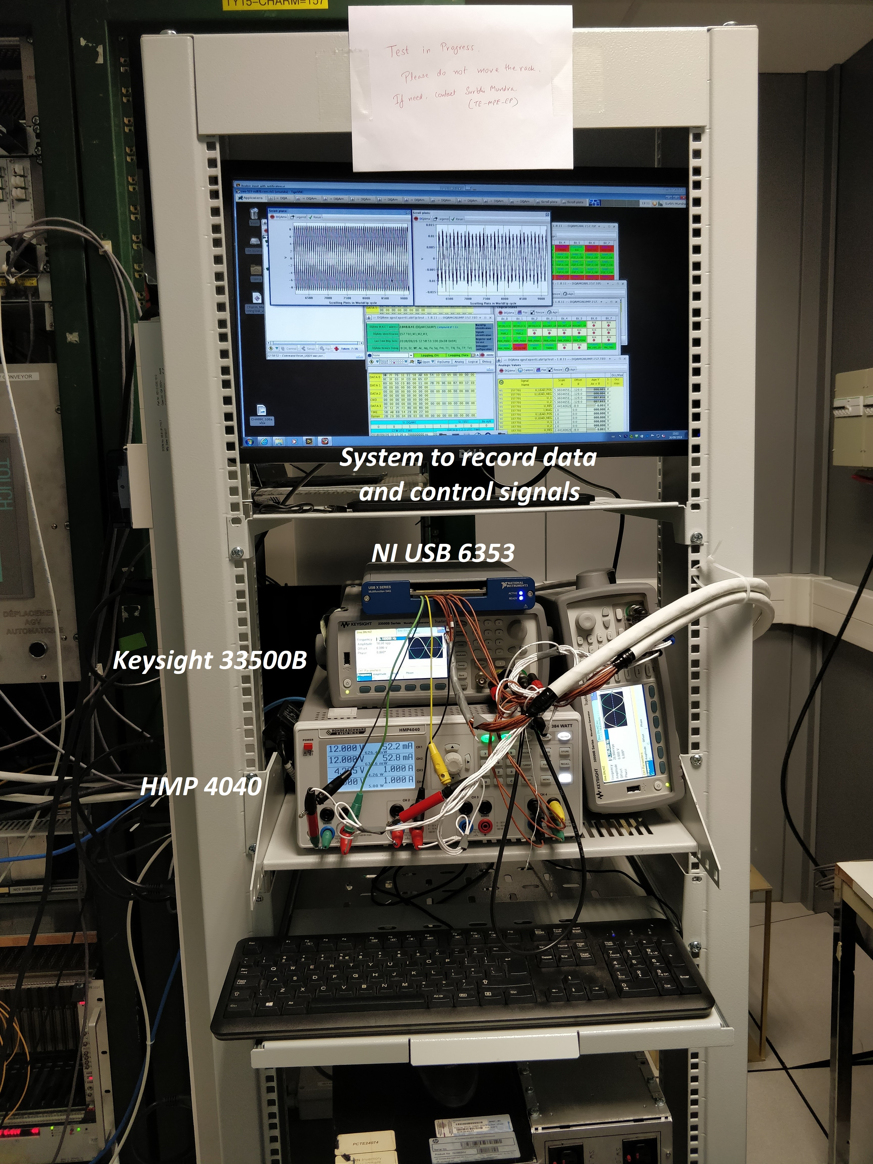
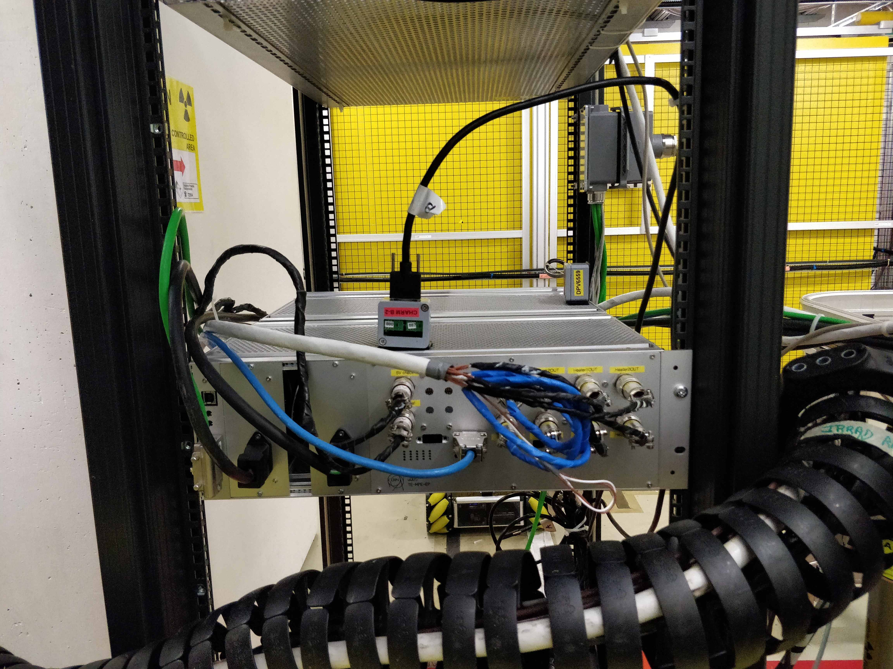
Test setup: uQDS
Control Room
DUT in facility

Slide 20
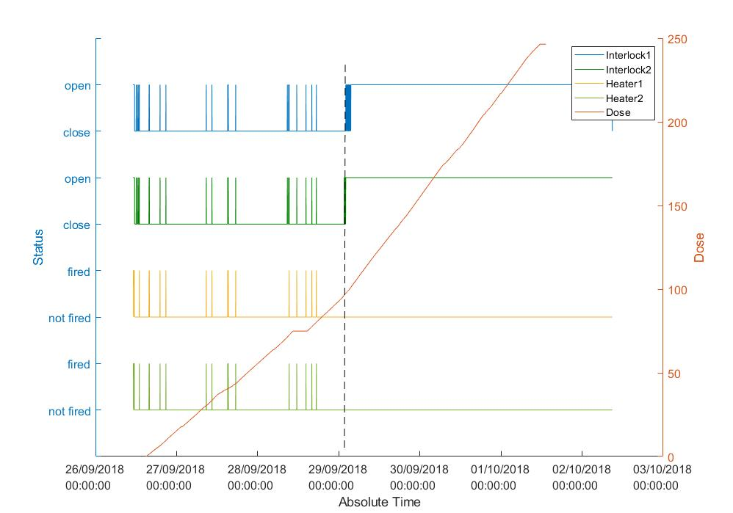
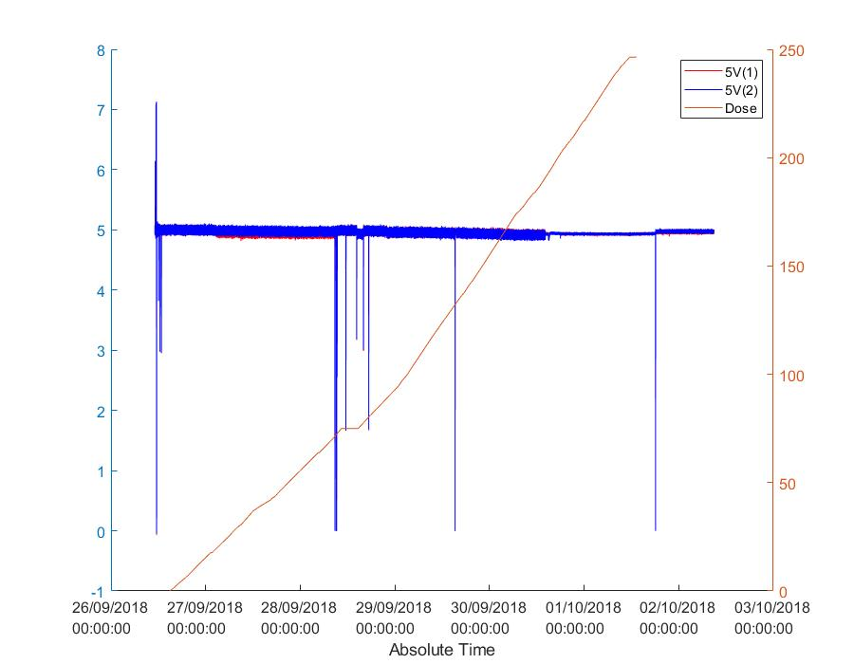
Summary of performance of uQDS
Power cycle
WorldFIP interface card stopped working at 60 Gy
At ~100 Gy Interlock loop opened and could not be closed
Analog channels worked well (at least) up to 130 Gy (RS485 reading was stopped at 130Gy, unable to resume at 250 Gy)
Power supply survived 250 Gy!
More detailed analysis of the irradiated unit pending|

Slide 21
Questions?

Slide 22
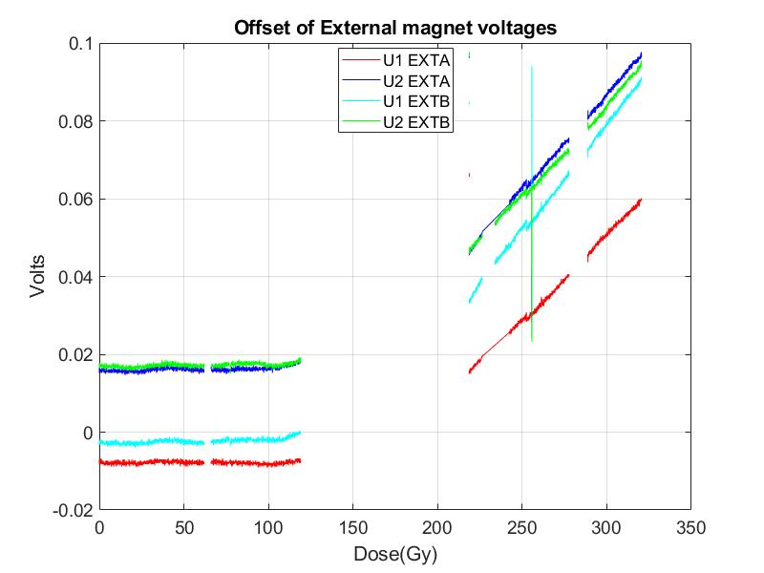
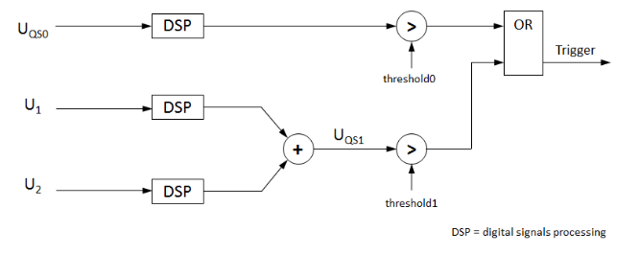
Results: Trigger voltage of External magnets
Offset voltage increases rapidly for higher dose
This variation is due to the variation of reference voltage known to show variation with dose
The same variation in observed in UQS0 → Trigger
Notes:
It was observed that the system self triggers at around 310Gy because of offset in EXTB. To find into the cause of such behavior, we plotted the change of gain and offset. A variation of less than 0.3% was observed in channel gain which was same for EXTA, INTA and INTB.
The offset was more or less constant with lower dose but was observed to be changing quite drastically with higher dose. And a combination of varying channel gains and offset lead to the self triggering of the system.

Slide 23
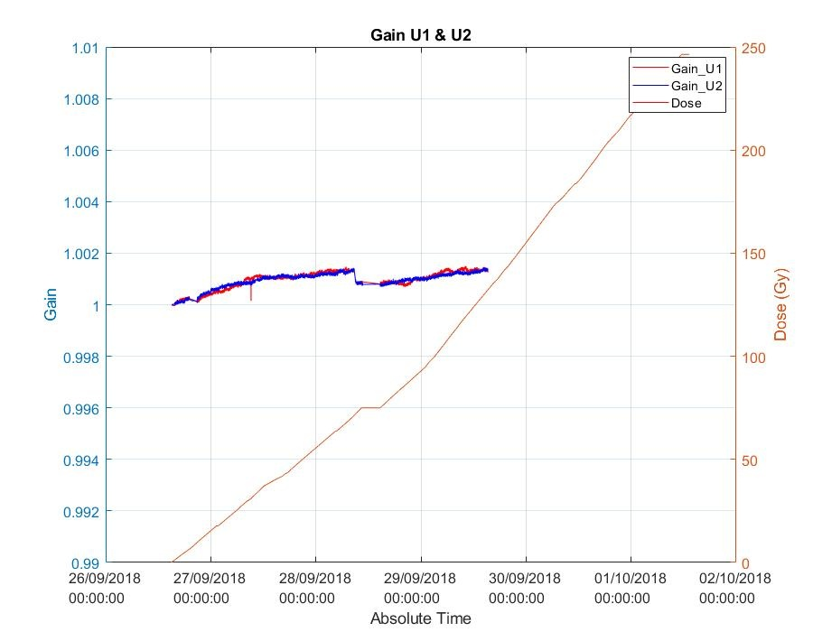
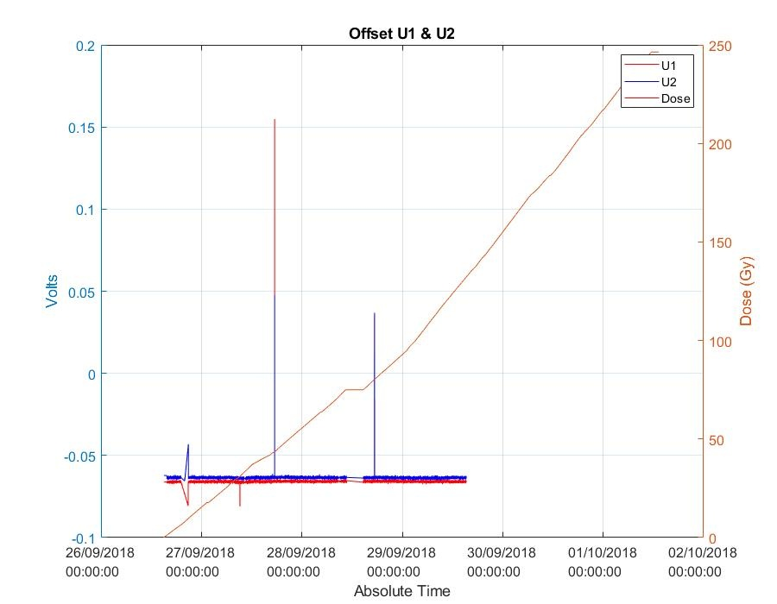
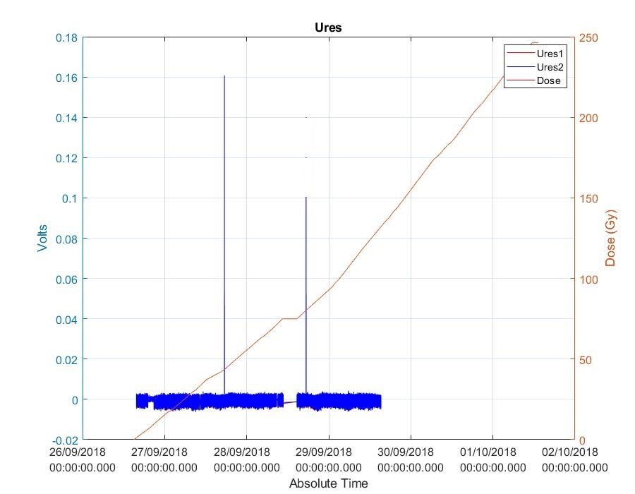
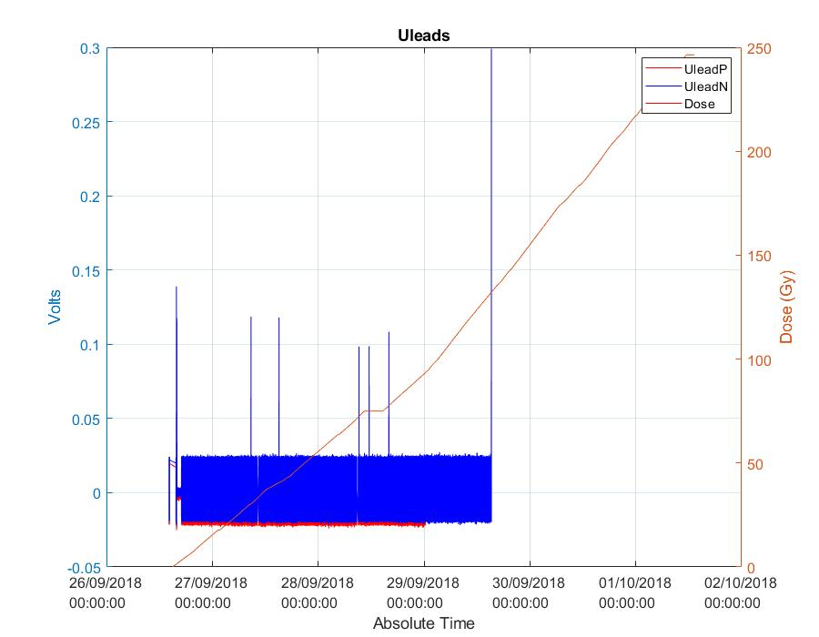
Results: Trigger voltage variation (uQDS)
Intentional functional tests
Intentional functional tests

