Slide 1

BE-CO Generic Infrastructure
Distributed I/O Tier and Fieldbus project
GREG DANILUK | EVA GOUSIOU
RADWG | 29 NOV 2018

Slide 2
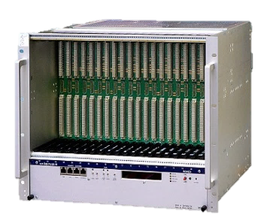
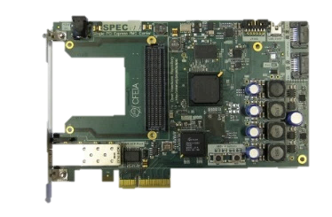
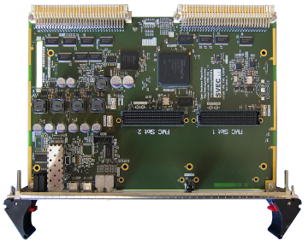

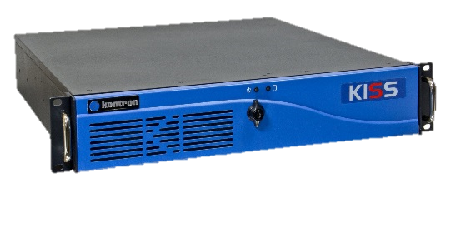

Custom Electronics Architecture
Front-End Tier
Front-End Computer
(VME/PICMG/PLC)
master
Fieldbus (WorldFIP/PROFINET/etc)
Fieldbus Tier
DIO1
DIO2
DIO3
DIOn
slave
slave
slave
slave
Distributed I/O Tier
actuator
actuator
sensor
sensor

Slide 3
Custom electronics architecture
Front-End Tier
Front-End Computer
(VME/PICMG/PLC)
master
Fieldbus (WorldFIP/PROFINET/etc)
Fieldbus Tier
DIO1
DIO2
DIO3
DIOn
slave
slave
slave
slave
Distributed I/O Tier
actuator
actuator
sensor
sensor

Slide 4



Rad-tol Communication Technologies
GBTx/LpGBTx
performance
500 Gy

Slide 5
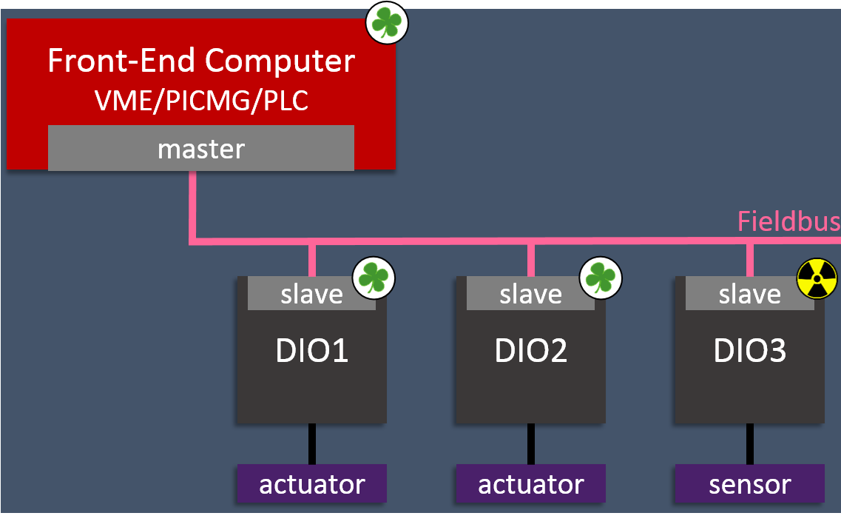
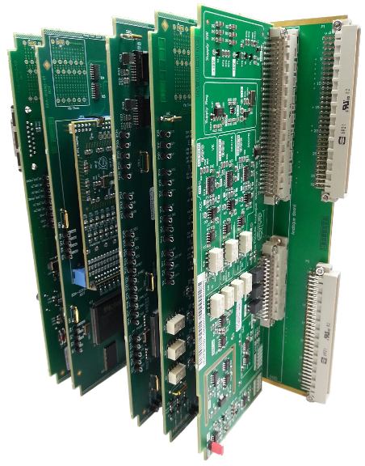
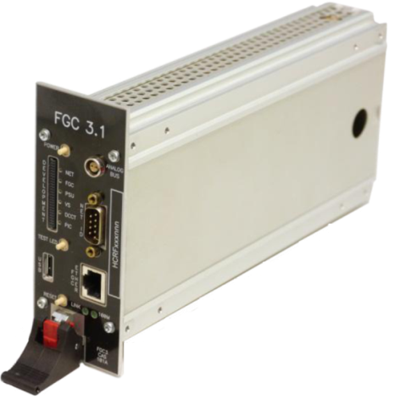
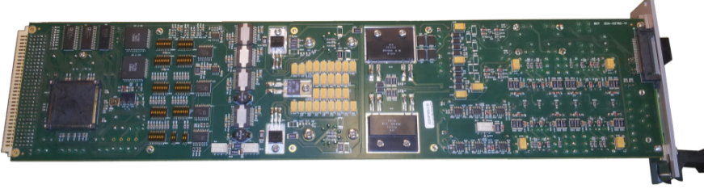
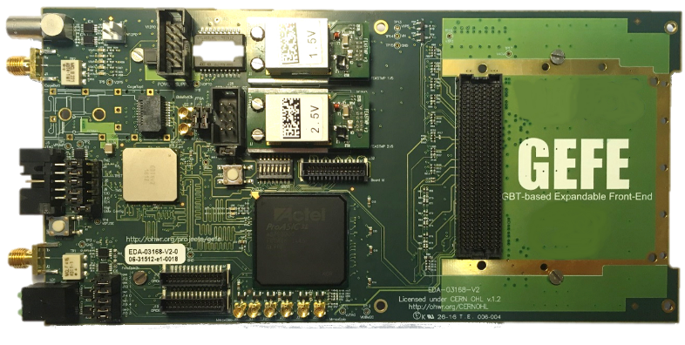
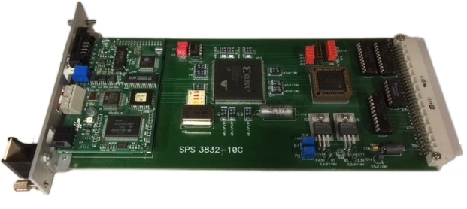
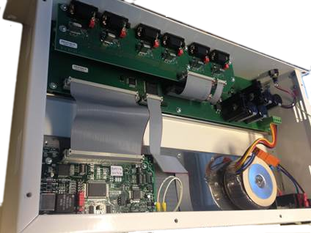
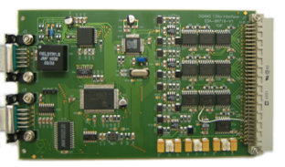
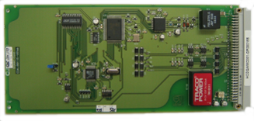
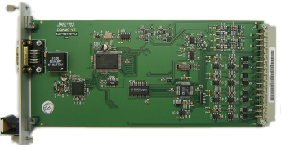
DIOT today
Power Converters
Beam Instrumentation
Cryogenics
Machine Protection
Beam Transfer
Magnets Positioning

Slide 6


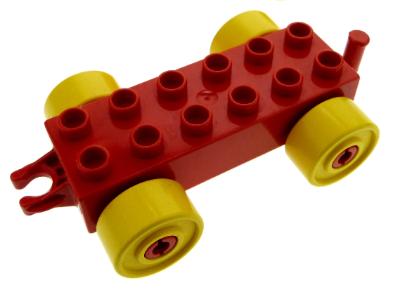




Future DIOT Recipe
Magnets Positioning
Power Converters
+
=
Beam Transfer
Modular hw kit
Designed in collab
Maintained by BE-CO
App-specific parts
Designed by eq. groups
Beam Instrumentation
Machine Protection
More robust designs
Benefit from existing developments
Re-use between equipment groups
Notes:
Modular hw kit designed by CO in collab with eq. groups
Mainenance by CO

Slide 7

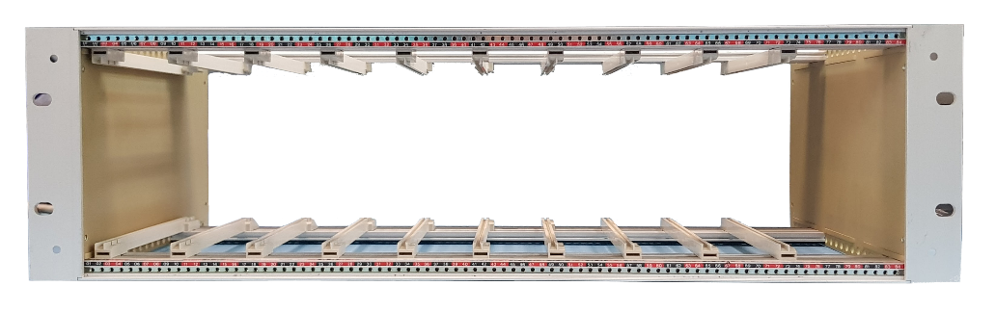
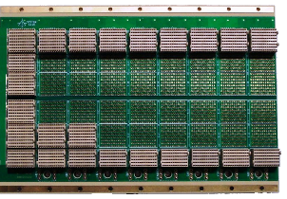

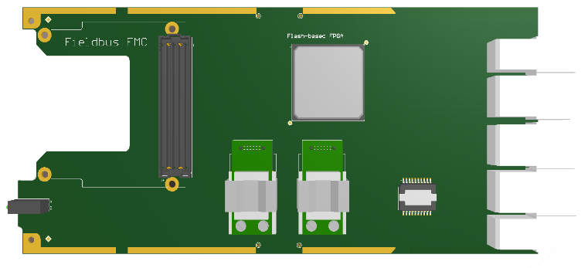
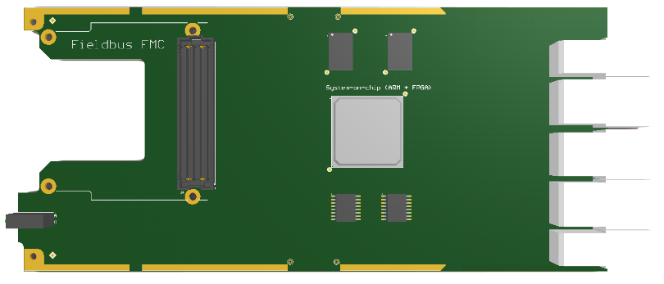
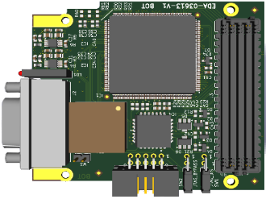
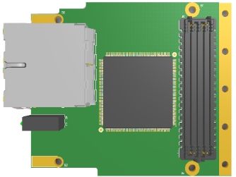
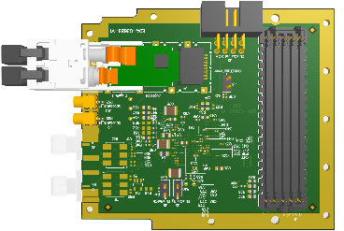
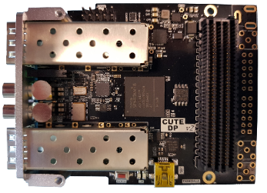
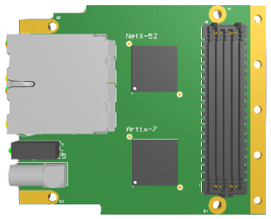
Common hardware kit for DIOT
Power
supply
Radiation-tolerant System Board
System Board
WorldFIP FMC
POWERLINK FMC
LpGBTx FMC
White Rabbit FMC
Industrial Ethernet FMC
Notes:
Here is the kit.
A 3U crate with passive backplane and rad-tol power supplies

Slide 8
3U Chassis & Backplane
Power
supply
Hosts Power Board, System Board & App-specific peripheral Boards
Low cost crate
9-slots backplane with RTM space
Off-the-shelf CompactPCI-Serial backplane
  Fully passive
  Star-topology differential lanes from System to Peripheral
Robust AirMax connector
  Used in transportation applications
  18 and 26 diff pair variants
Notes:
No PCIe in radiation
Robust connector used in transportation

Slide 9
Rad-tol Power Supply
Lalit (FELL) dedicated to this task (BE-CO, R2E, TE-EPC colab)
Gathering requirements and drafting specs
  +12V, +5V, 100W
  Redundancy
  PMBus monitoring interface
  Standard PSU connector FCI 51939-667
First lab prototype using FEAST chips as controller of switched supply

Slide 10
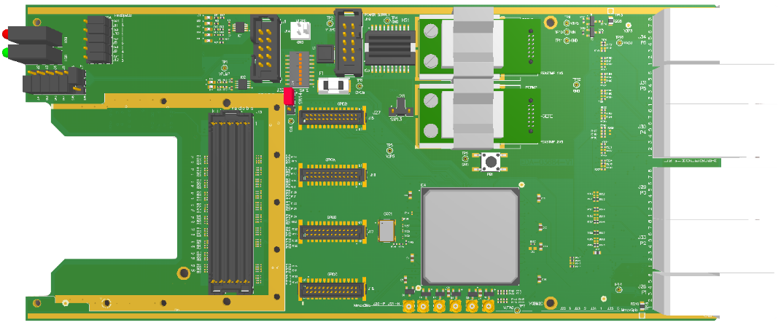
Rad-tol System Board
Backplane connector:
communication with
peripheral boards
FMC for fieldbus
FPGA for
  application-specific logic
  crate monitoring and diagnostics

Slide 11
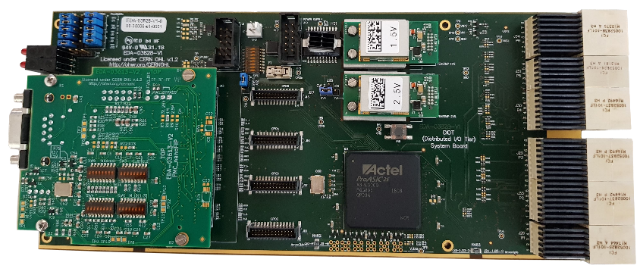
Rad-tol System Board
v1.0: modified C-GEFE with nanoFIP FMC

Slide 12
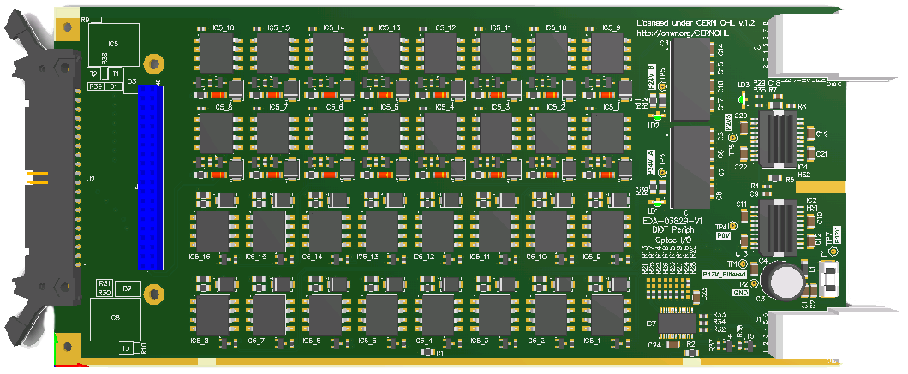
Template Peripheral Board
EDA-0829
I/O board based on WIC requirements
  24V generation (TRACO)
  16 opto-coupled current loop inputs (HCNR200)
  16 opto-coupled relay driving outputs (HCNR200)

Slide 13
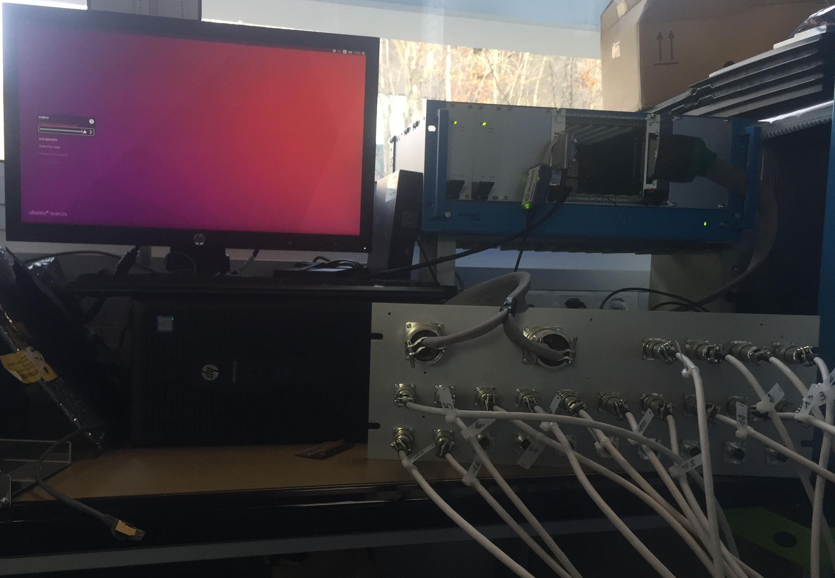
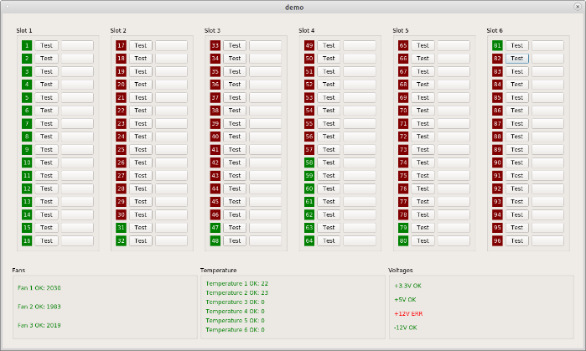
Proof of Concept
DIOT crate
Sys Board
Perip Board
WorlldFIP master
WIC sensors/actuators
Notes:
Off-the shelf non-rad-tol supplies in the demo crate

Slide 14
Resources & Collabs
HL-LHC WP 18
  Rad-tol power supply design
  Crate diagnostics
  Rad-tol System board
  Reliability Studies
R2E task force
  POWERLINK implementation
EN-SMM, TE-MPE, BE-BI

Slide 15
Timeline
2016
Iterative process with eq. groups to define modular hw kit
Proof of concept
Sep 2018
First POWERLINK tests in CHARM
2019-2020
Building blocks available for eq. groups
LS3
Deployments in eq. groups

