Slide 1
CI updates

Slide 2
Experimental objectives before our Collaboration meeting in December
1. Evaluate the density of the gas jet, both for the neon and nitrogen
2. Evaluate the cross section of the gas jet density in 2 dimensions
3. Evaluate the ratio of fluorescence between Neon and Nitrogen and compare to literature
4. Add an orifice to simulate a Turbo Pump DN63 on the interaction chamber. Assuming a pumping speed of 80 l/s, the orifice should be 27 mm, to be checked.
5. Add a back-stream blocker, basically an orifice with a hole of some 20mm in the interaction chamber towards the dump chamber
6. Optimise the blackening and add filters for the precise Neon line
7. Remove 3rd skimmer and make a skimmer as Marton proposed, only by making a cutout in an copper disk used a gasket. (Not discussed, but long proposed)

Slide 3
Task 1: gas jet density
Finish the gauge scan for Nitrogen.
For horizontal or vertical 3rd skimmer, wait for next chamber opening today or tomorrow depends on the new bandpass filter results.

Slide 4
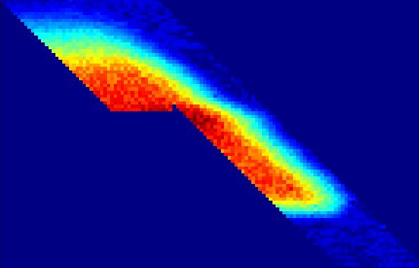
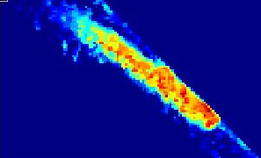
Moving gauge scan
Y axis
X axis
Gas jet size after the interaction chamber
Gas jet length = 8.6mm
Gas jet Width = 1.06mm
Assuming linear expansion
Gas jet length at the interaction point = 7.24mm
Gas jet width at the interaction point = 0.86mm

Slide 5
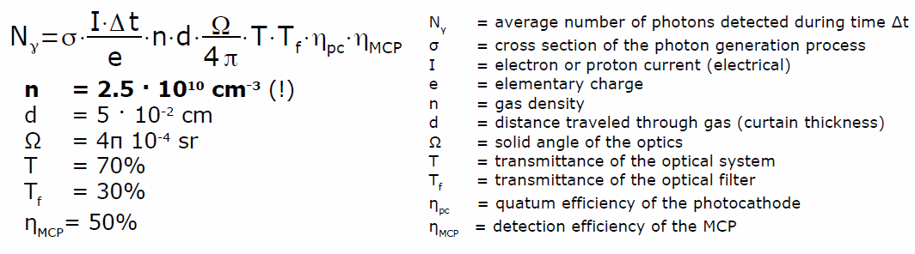
Task 2: cross section
Known from gas jet image
Will get from the density measurement
From Gauge scan
Check these numbers!!!
When using gasjet image, Need to consider the geometry issue
Could be done using residual gas as well.

Slide 6
Task3: Ratio of fluorescence
Gas jet condition: inlet 5 bar
Photon number per second
  Nitrogen: 5.63
  Neon: 0.77
Ratio of Nitrogen/Neon: 7.32
Prediction: ~250???
Possible reason:

Slide 7
Task 4&5: Vacuum test with reduced pumping speed and back flow blocker.
There is some changes during this week.
We have a agreement in this week for what to do.
The special gasket and back flow blocker will arrive tomorrow.
Elbow or not?

Slide 8
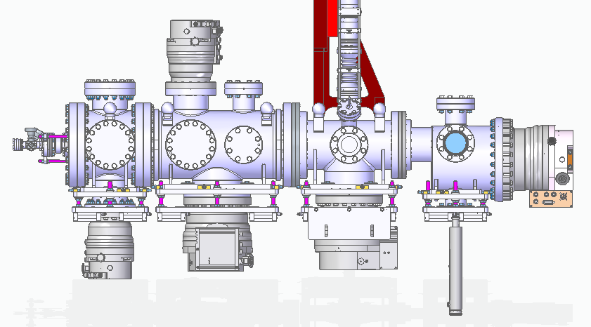
I don’t think DN160 gasket with 63 mm hole needed since there is 3 skimmer upstream
DN100 gasket with 63 hole
DN160 gasket with 32 mm hole
HiPACE700 here with standard gasket before CERN Elbow arrived
HiPACE700 with 63 mm hole gasket here before CERN Primary pump arrived
DN160 to DN100 adaptor + DN100 gasket with 63 hole + Hipace300
DN160 to DN100 adaptor + DN100 gasket with 63 hole + Hipace300

Slide 9
Task 6: Optimise the blackening and add filters for neon
Amir did the experiments with new filter (585 nm CWL)
Current test not showing Neon gas jet.
We are currently working on what happened.

Slide 10
Task 7: 3rd skimmer
Local workshop later replied they cannot do it.
Find a laser machining company to do the job, but their laser can only do 100-200 um thickness stainless steel.
Will not finish before the collaboration meeting.
  4*0.4
  4*0.1
  8*0.4
  8*0.1
  20*0.4?
  Other sizes?
  They have a minimum charge of £200. adding more skimmer will not increase much of the cost.

