Slide 1
LHC integration update
2018-11-15
Marton Ady

Slide 2
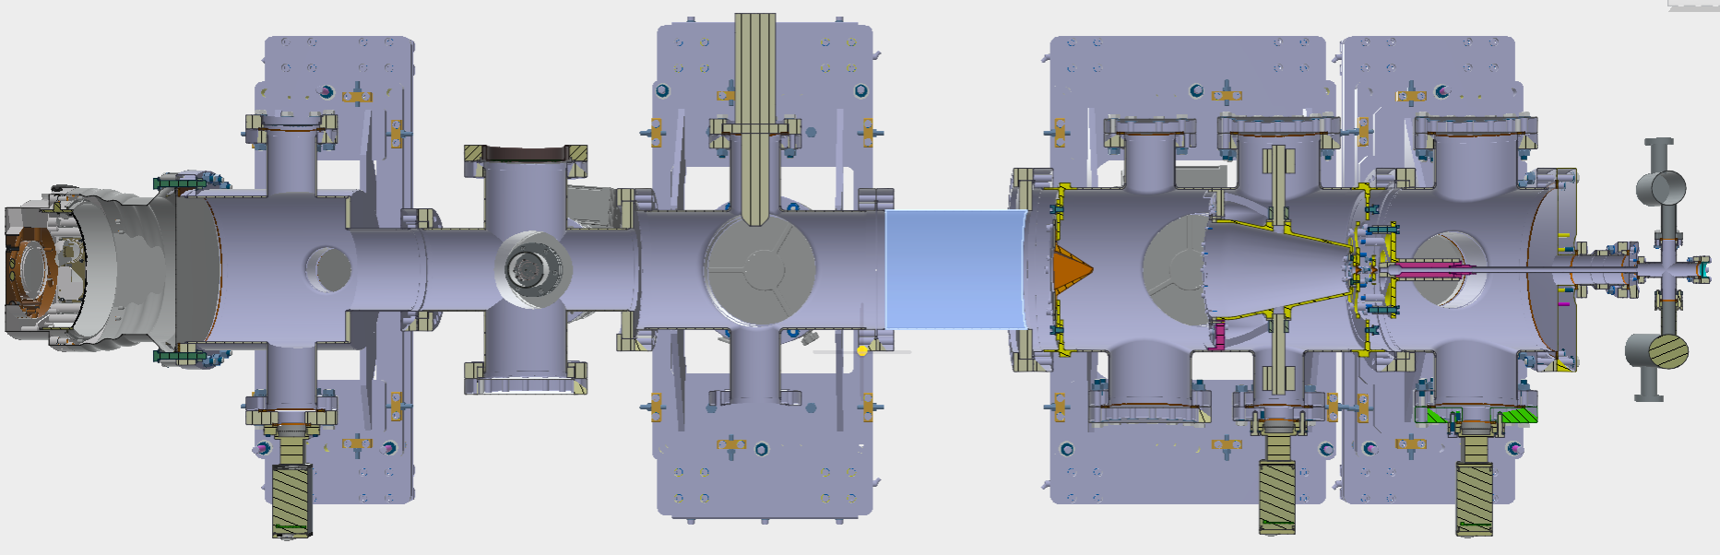
Current setup at Cockroft (“version 2”)
3D model: Tom Dodington

Slide 3
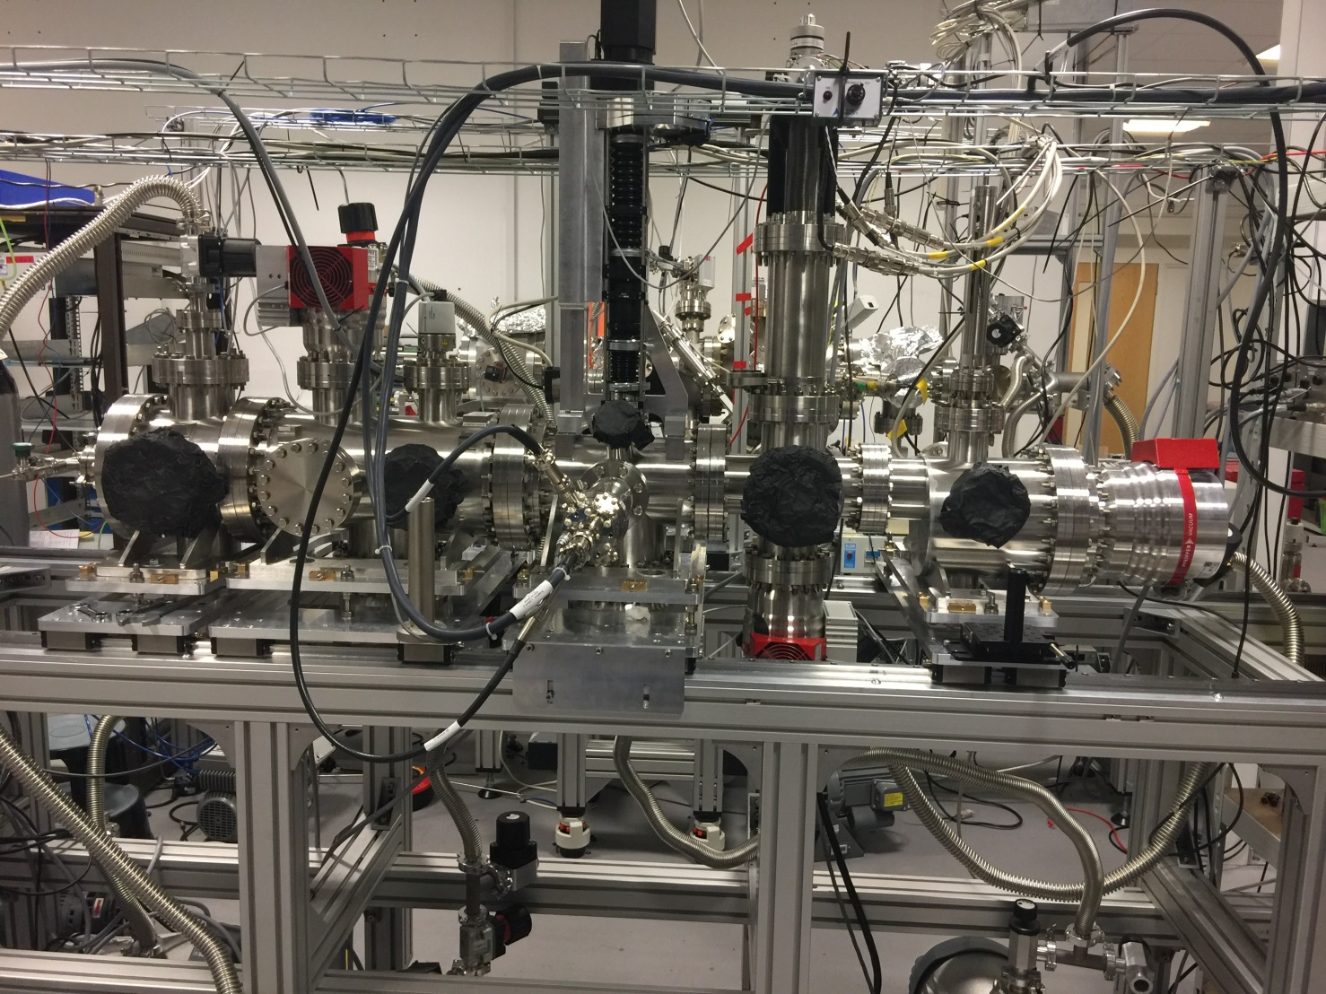
Slide: Hao Zhang
nXDS10i scroll pump from Edwards
HIPACE 300
300L/s
SP25K Speedivalve
2 m 25KF hose
DN 16 ISO-KF to DN25 KF adaptor
This Channel is used for initial pumping, will be turned of when Turbo turns on.
DN100 – DN40 CF adaptor and DN40 CF to KF25 adpator
SP25K Speedivalve
HIPACE 300
700L/s
HIPACE 300
300L/s
HIPACE 300
300L/s
HIPACE 700
700L/s
SP25K Speedivalve
1 m 25KF hose
DN 16 ISO-KF to DN25 KF adaptor
HIPACE 700
700L/s
DN 16 ISO-KF to DN25 KF adaptor
SP25K Speedivalve
SP25K Speedivalve
SP25K Speedivalve
KF25 Tee
SP25K Speedivalve
2 m 25KF hose
1 m 25KF hose
0.75 m 25KF hose
0.5 m 25KF hose
2* KF25 Tee
nXDS15i scroll pump from Edwards
nXDS15i scroll pump from Edwards
nXDS15i scroll pump from Edwards
1 m 25KF hose

Slide 4
V3 goal: most probably primary only
Hao: experimental primary from CERN
V3 goal: use flat skimmer instead of pyramid-shape
V3 goal: use DN63 valve
V3 goal: DN63 valve with ~25mm backscattering reducer
The 90-deg turn can be replaced by tilted turbo,
to be finalized
1
Hi-pressure nozzle
2
Between skimmers 1-2
Gauge: Penning
Ne
3
Between skimmers 2-3
Gauge: Piezoelectric (?)
Gauge: 2xPenning + Pirani
Gauge: 2xPenning + Pirani
Gauge: 2xPenning + Pirani
4
Interaction chamber
5
Dump area
max. 1E-3 mbar
~1E-5 mbar
~1E-7 mbar
~1E-9 mbar
nozzle
skim1
skim2
skim3
blackened tube
32mm
10 bar injection
Backscattering reducer
1
2
3
DN63
DN63
5
separator cone
min. spacing
200mm
4
DN63
DN63
DN63
DN63
CF/KF adpt.
63/100 adpt.
63/100 adpt.
63/100 adpt.
TMP
300l/s
TMP
300l/s
DN63
TMP
300l/s
63/100 adpt.
TMP
300l/s
Gauge: Penning + Pirani
Primary
Primary
Primary
Primary
Primary
Leak det. valve
2 venting valves
Leak det. valve
2 venting valves
Leak det. valve
2 venting valves
Leak det. valve
2 venting valves
Leak det. valve
2 venting valves
V3 goal: DN63 opening, DN63->100 adaptor and 300l/s pumps

Slide 5
Goal:
Imitate version 3 schematics with experimental setup
Get “matrix of pressures” at every step
  Change 1 parameter at a time
  Pressures as a function of injection pressure (0-10bar)
  Each data point with e-gun off/on

Slide 6
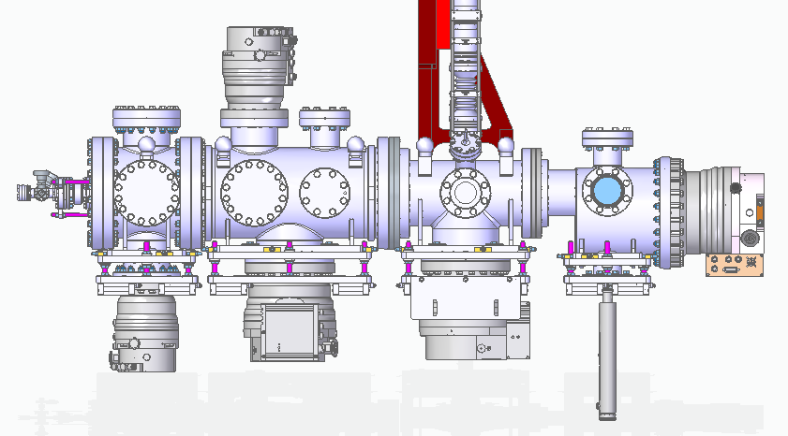
I don’t think DN160 gasket with 63 mm hole needed since there is 3 skimmer upstream
DN100 gasket with 63 hole
DN160 gasket with 32 mm hole
HiPACE700 here with standard gasket before CERN Elbow arrived
HiPACE700 with 63 mm hole gasket here before CERN Primary pump arrived
DN160 to DN100 adaptor + DN100 gasket with 63 hole + Hipace300
DN160 to DN100 adaptor + DN100 gasket with 63 hole + Hipace300
Slide: Hao Zhang

Slide 7
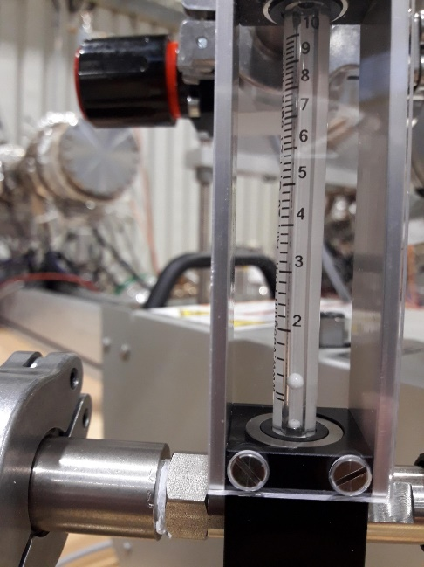
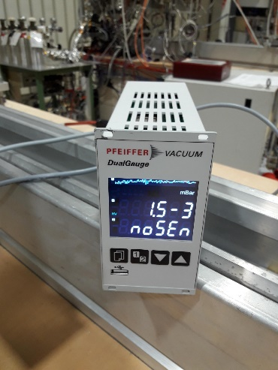
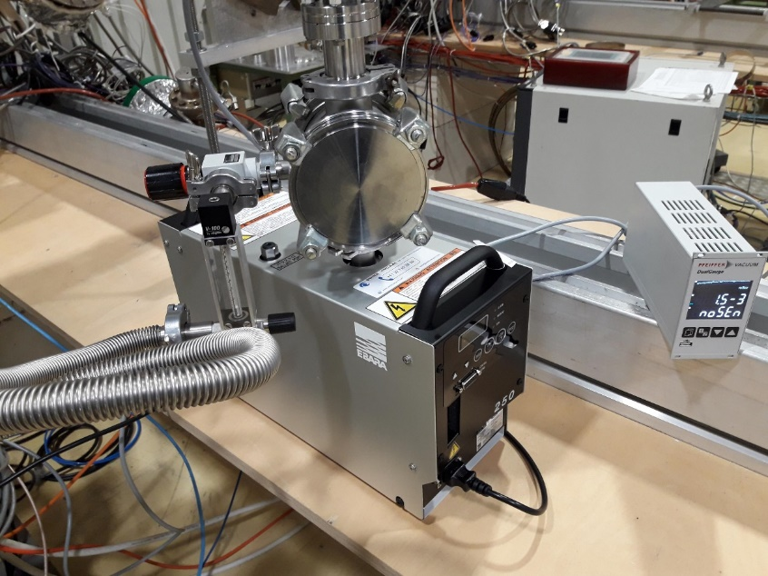
TE-VSC: Testing dry pump
Images: Eric Page

