Slide 2
LHC BIF test setup - update
S. Mazzoni, 15/11/2018

Slide 3
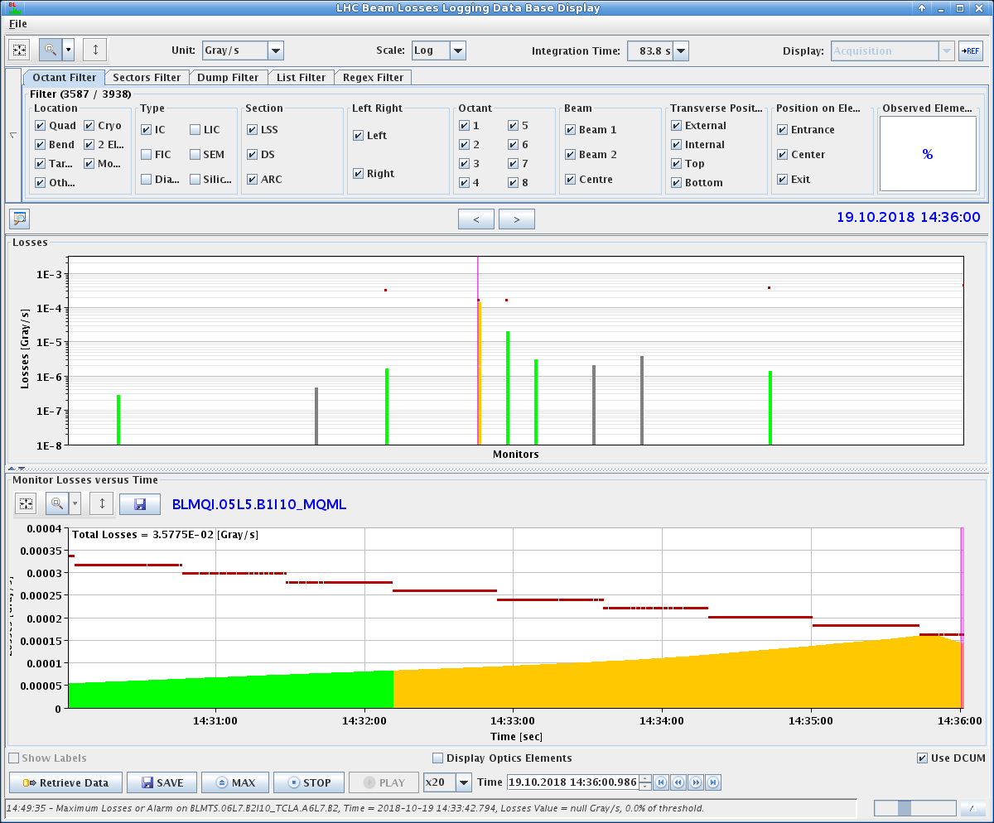
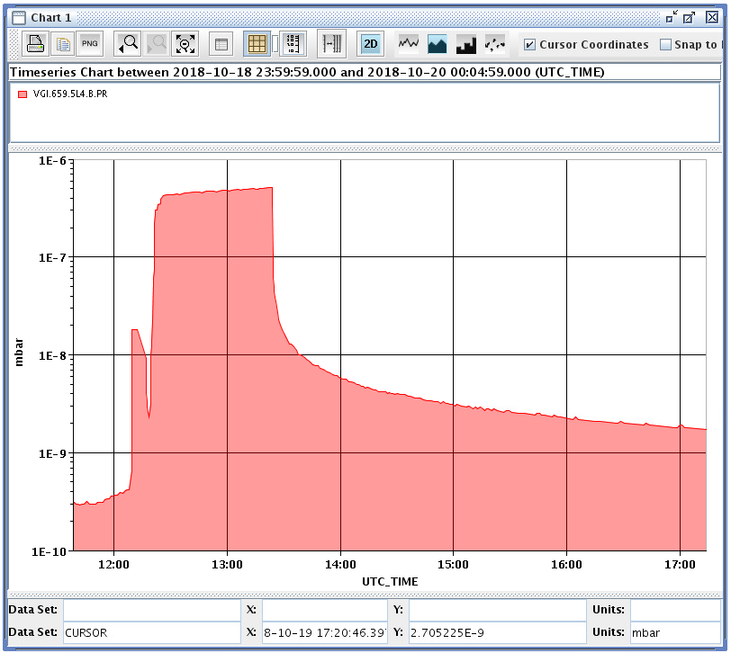
Status
On 19/10/2018, ‘manual’ injection of Ne at 4x10⁻⁷ mbar caused the LHC beam to dump due to losses on tertiary collimators of point 5 (20 s integration time).
No significant losses on primary collimator (point 7)

Slide 4
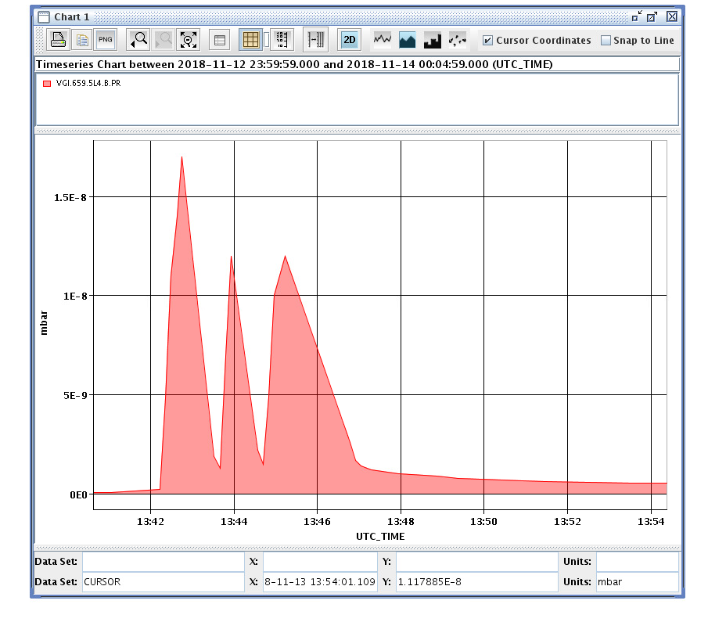
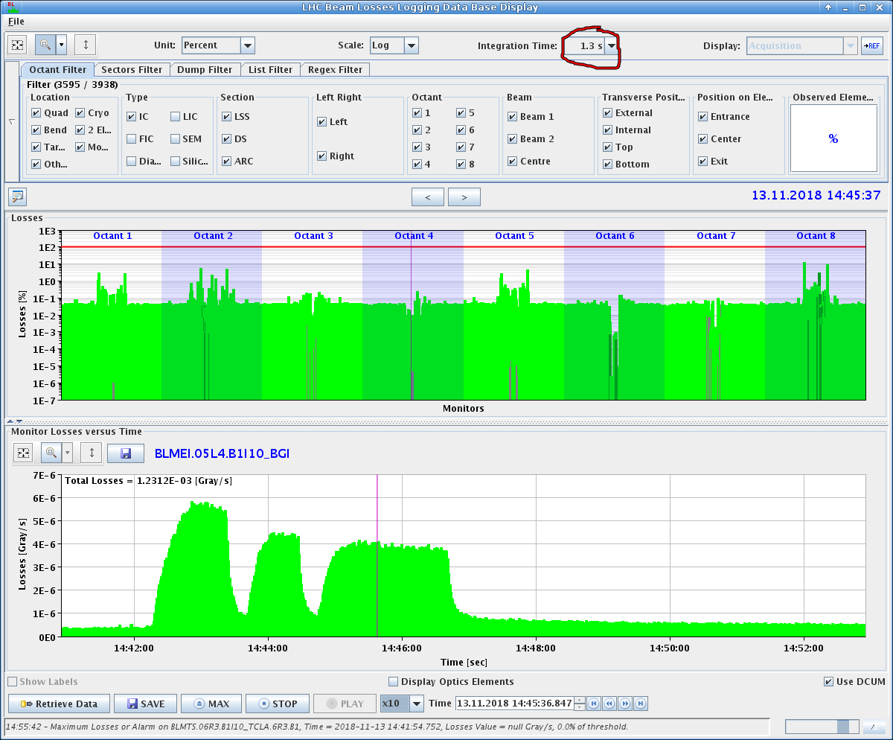
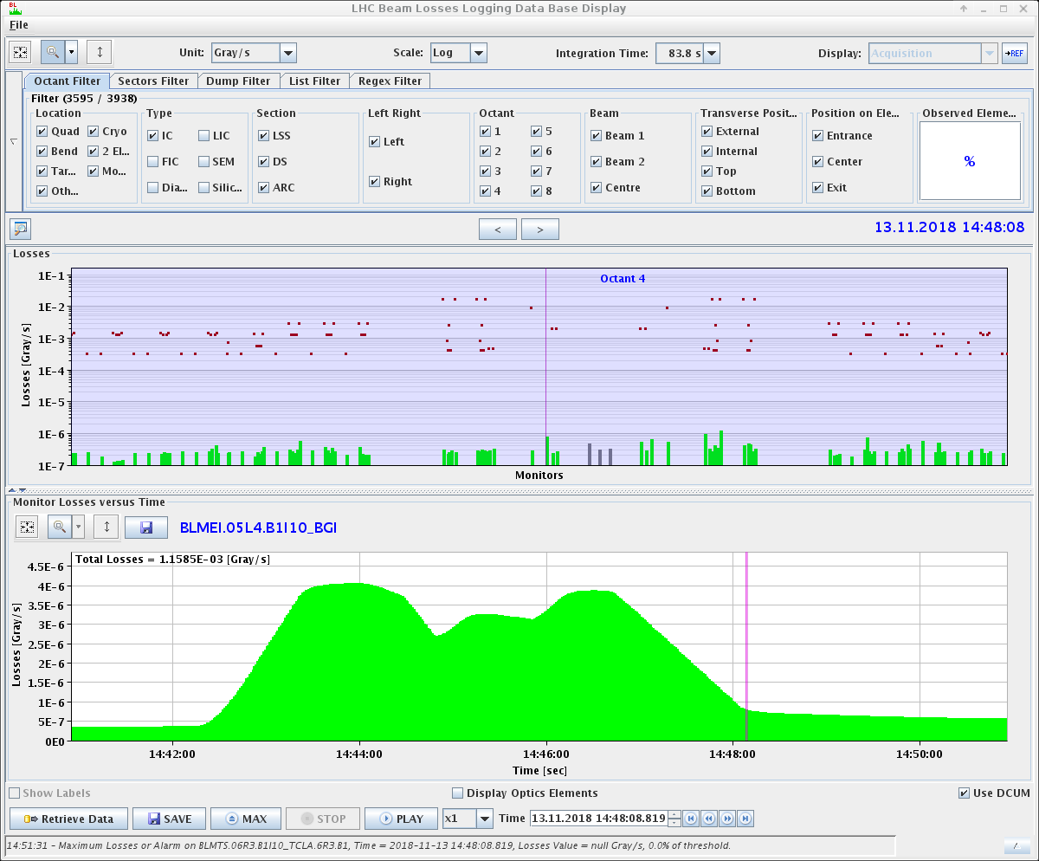
Status
Test injection with Pb ions performed on Tue 13/11. Nominal injection around 10⁻⁸ mbar.
Low (<1%) losses in Pt. 4, almost not distinguishable losses in pt. 5.
OK to continue injection during Pb run.

Slide 5
Status
Data acquisition during Pb ion run:
  Z² = 82² = 6724 light yield Pb⁺ vs p⁺
  p⁺ intensity: 1E11 x 2556b = 2.5e14 p+ per fill
  Pb⁺ intensity: 1.2E8 x 600b = 7.2E10 Pb+ per fill
Got inelastic scattering data form BGV team. Comparison between noise level in present configuration vs gas jet (collab meeting?)
Beam dynamics simulations needed for evaluating effect of gas curtain on LHC beam
x2 light yield

