Slide 1
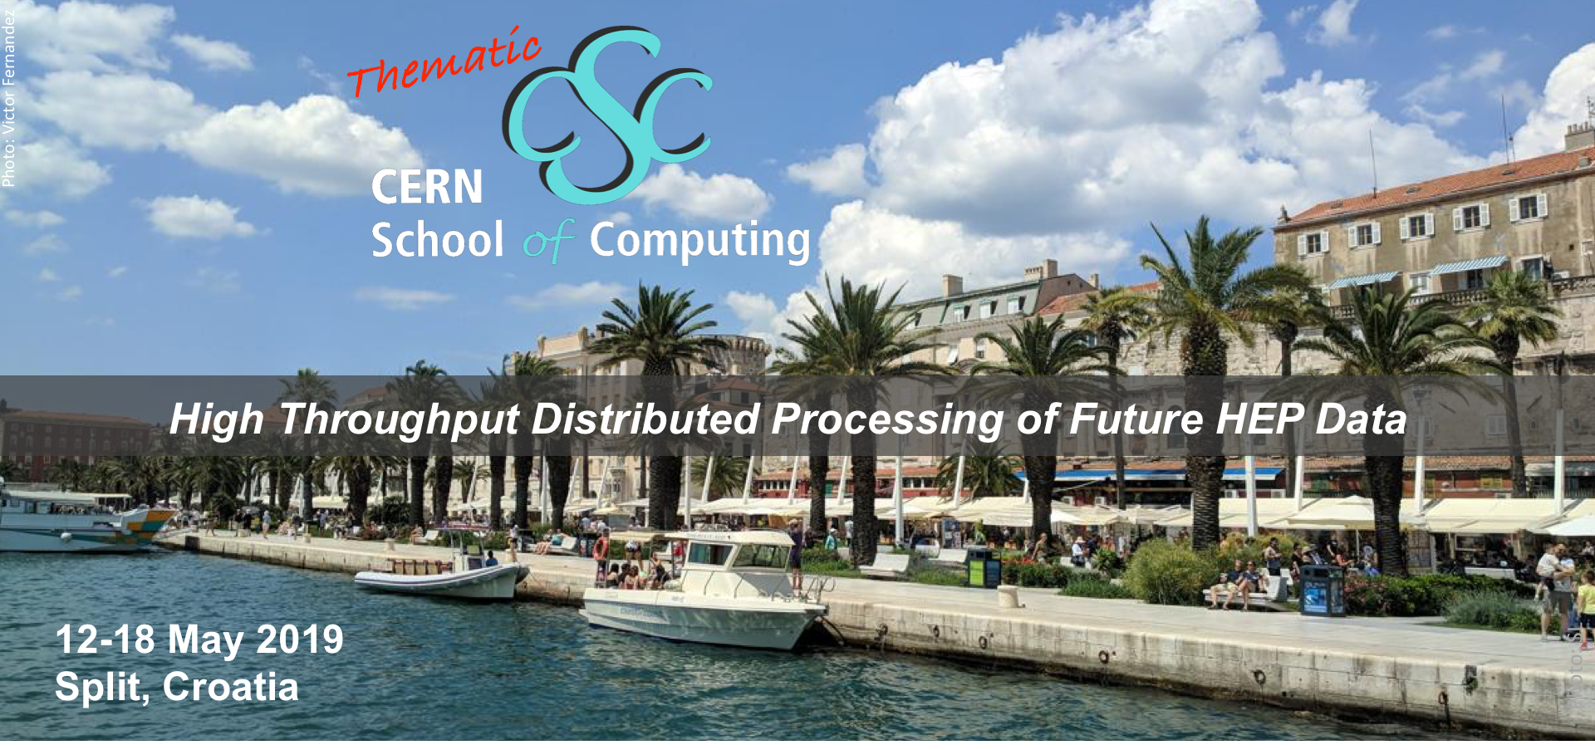




Welcome to tCSC 2019

Slide 2
tCSC 2019 Opening Ceremony
Sunday May 12, 15:30
“Welcome to University of Split and FESB”
by prof. Dragan Ljutic, rector University of Split by prof. Sven Gotovac, dean of FESB
“Welcome to Croatia, Dalmatia and Split”
by prof. Ivica Puljak, University of Split
(and chair of CSC Advisory Committee)
“Computing challenges for LHC”
by Frédéric Hemmer, CERN IT department head
“Introduction to CERN School of Computing”
by Sebastian Łopieński, CERN, CSC director

Slide 3
Introduction to the School
Sebastian Łopieński, CSC director

Slide 4



CERN’s mission
Innovation
Education
CERN
uniting people
We are here
Research
?
Discovery
Accelerating beams
(accelerators)
Detecting particles
(experiments)
Large-scale computing (analysis)

Slide 5
CERN’s three main schools
CERN Accelerator School (CAS)
CERN School of Physics
CERN School of Computing (CSC)
We are here

Slide 6
A school with a long history
The school was created in 1970
  42nd edition in 2019
2800 students of ~80 different nationalities
have followed the school
  usually 50-80 per year
  alumni web site: http://cern.ch/CSC/alumni
The school has visited 22 countries
  http://cern.ch/CSC/past-schools
  recent: Israel, Spain, Belgium, Greece, Portugal, Cyprus

Slide 7
Mandate and mission
Create a common culture in scientific computing
among young scientists and engineers involved
in particle physics or other sciences,
as a strategic direction to promote mobility
and to facilitate the development of
large computing-oriented transnational projects.

Slide 8
Bridging science and computing
Technological evolution in computing empowers science
  especially in data-intensive domains such as High Energy Physics
  computing is the main strategy for many scientific fields
  to do research efficiently on a large scale
It is nowadays essential that:
  scientists master computing technologies
  as a main tool for their research
  computer engineers understand the scientific needs
  in order to deliver computing services to research projects

Slide 9
CSC participants
Come from CERN (~50%) and elsewhere:
  from other laboratories and universities, worldwide
Postgraduate scientists and engineers
involved in particle physics or other sciences, e.g.:
  a Ph.D. student in particle physics,
  involved with an experiment
  a computer engineer with M.Sc. degree (or completing it),
  working in a physics laboratory or institute
More applicants than places => a selection process
Notes:
We usually have 50-80 students. They are postgraduate scientists and engineers involved in particle physics or other sciences. They come from CERN and other scientific labs, from Europe but also from other continents. Not everyone who applies for the School is accepted - there is a competitive selection process in place to ensure high quality and motivation of School participants. Local students (from the hosting country / university) are of course very welcome; for various reasons, they are usually not numerous (less than 10%).

Slide 10
Academic dimension
CERN School of Computing…
is not a conference
  lecturers do not present
  their work or promote their projects
is not a training session
  not a replication of training courses
  commonly available at home institutes
  focus on persistent knowledge,
  less on know-how
Training
Programme
C++
Java
Python

Slide 11
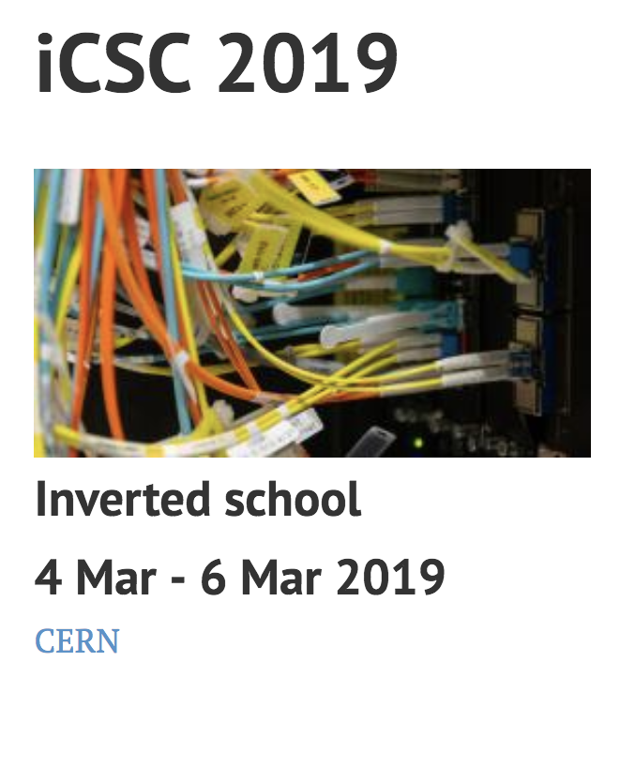
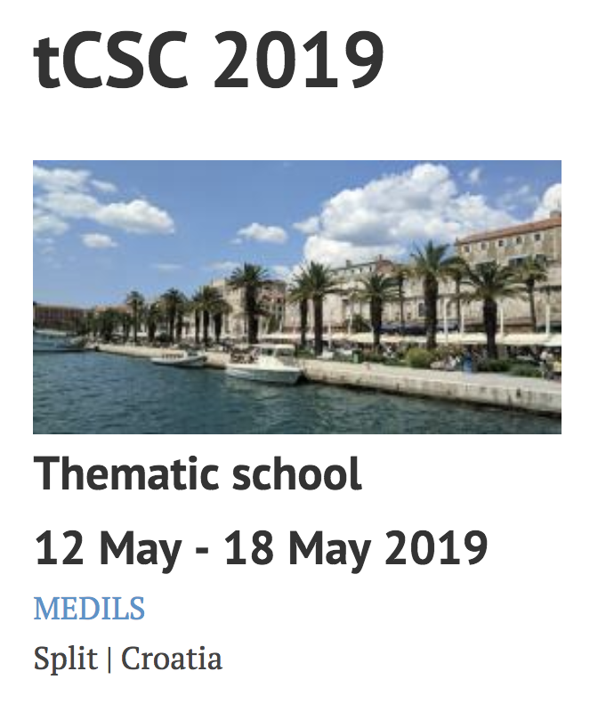
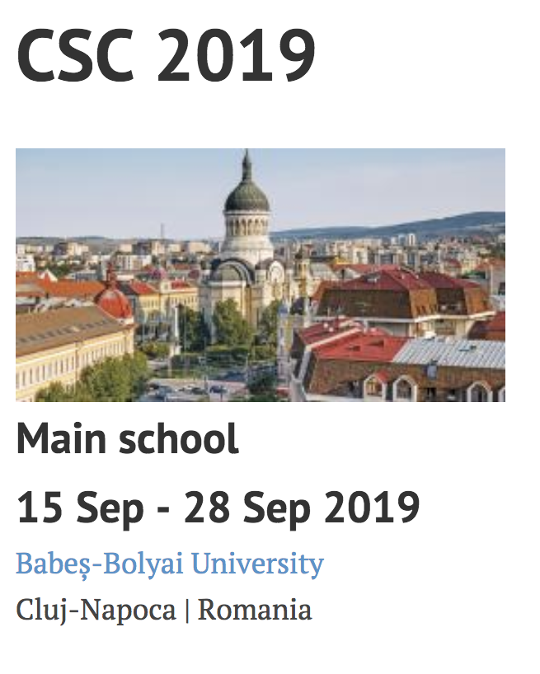
Three CERN Schools of Computing
We are here

Slide 12
7th Thematic CSC
In a partnership with University of Split, FESB (Faculty of Electrical Engineering, Mechanical Engineering and Naval Architecture)
1 week (5.5 days of tuition)
  12 hours of lectures
  12 hours of exercises
  1 guest lecture, 1 special evening talk
  a session of student presentations
Clear goals:
  Academic dimension
  Theory and practice
  Networking and socialising

Slide 13
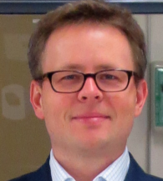
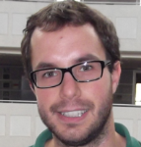
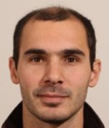
7th Thematic CSC – programme https://indico.cern.ch/event/771113/page/15251-academic-programme
“High Throughput Distributed Processing of Future HEP Data”
3 tracks:
  Technologies and Platforms
  by Andrzej Nowak, TIK Services, Switzerland
  Parallel, Optimised Software Development
  by Danilo Piparo, CERN
  and Sebastien Ponce, CERN
  Effective I/O for Scientific Applications
  by Sebastien Ponce, CERN

Slide 14
But what gives the most value to the School?

Slide 15
21 participants https://indico.cern.ch/event/771113/page/15257-participants
12 different nationalities
16 different institutes from 9 countries
4 BSc, 3 MSc students, 2 MSc, 8 PhD students, 4 PhD
50%-50% computer science vs. physics
2 students from previous main CSC students (2013, 2000)
1 local students from FESB, University of Split
Diverse, talented, passionate for science and technology

Slide 16








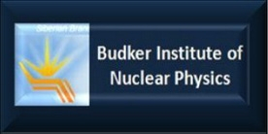












Slide 17











Slide 18
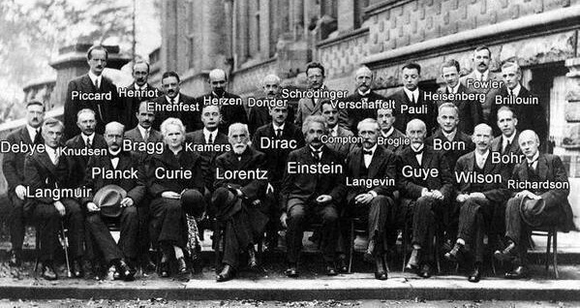
It’s a small world
All top scientists knows each other very well

Slide 19
One of the previous tCSC

Slide 20
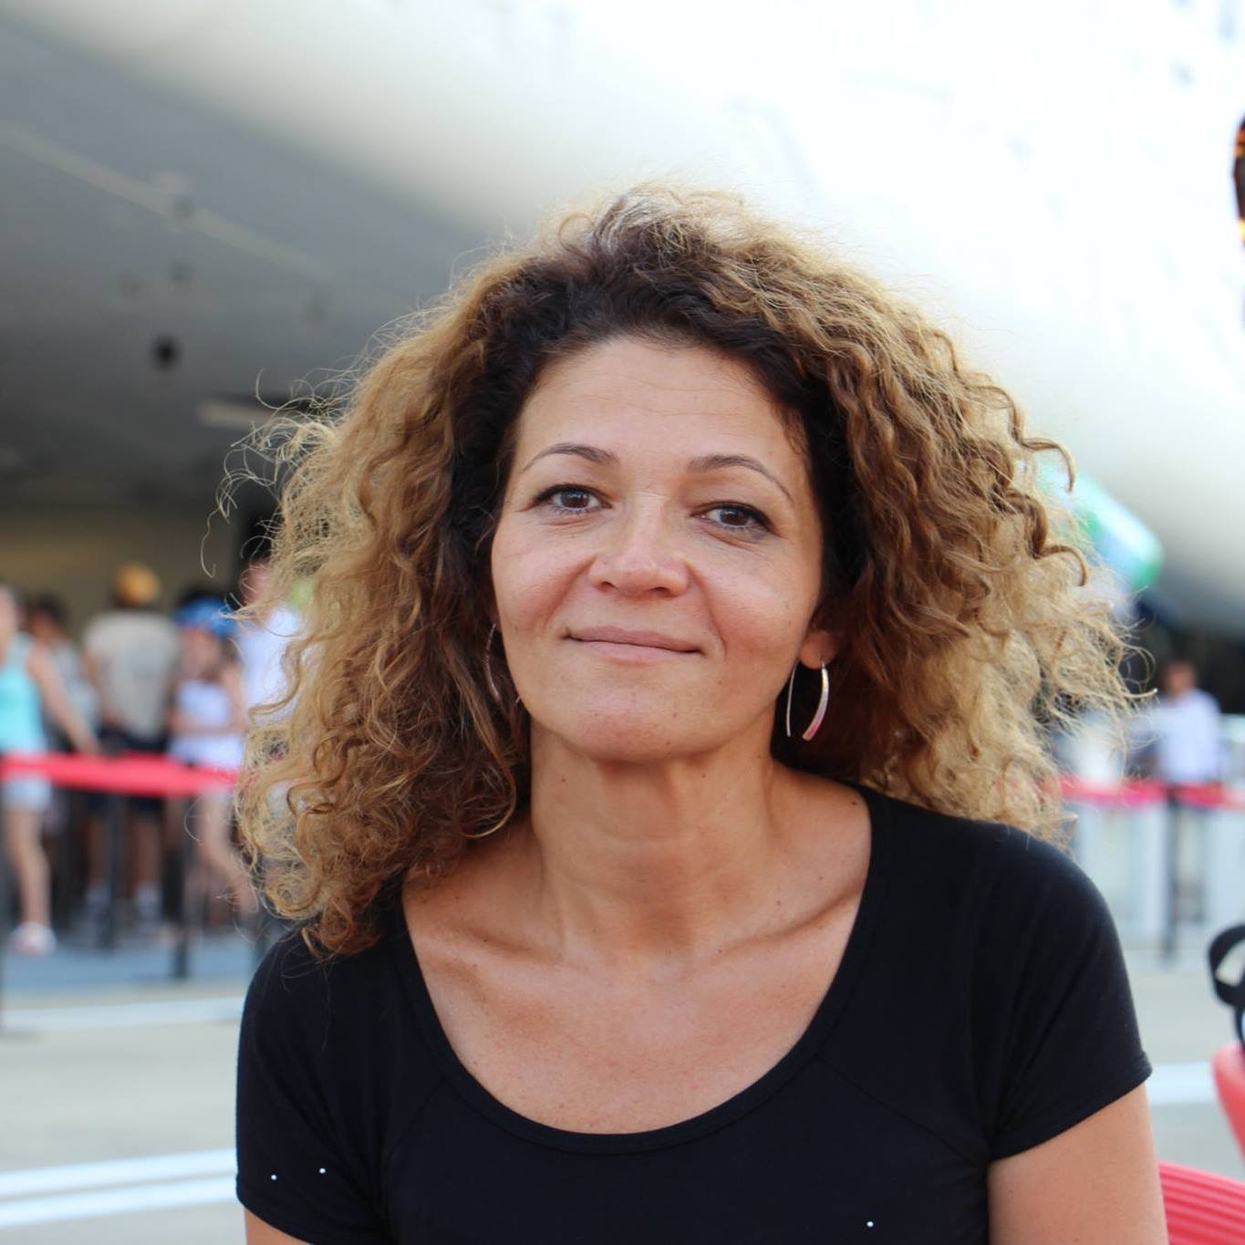
Introducing the CSC organisers
Joelma Tolomeo
  CSC administrative manager (+41 75 411 40 86)

Slide 21
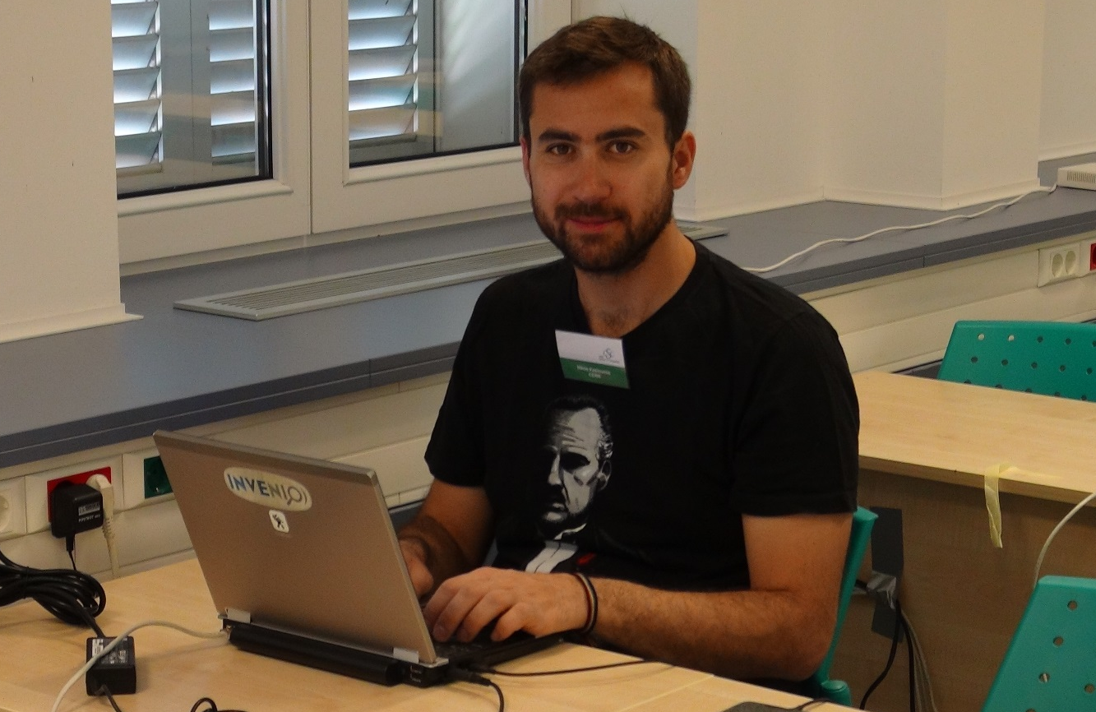
Introducing the CSC organisers
Joelma Tolomeo
  CSC administrative manager (+41 75 411 40 86)
Nikos Kasioumis
  CSC technical manager (+41 75 411 81 70)

Slide 22
Introducing the CSC organisers
Joelma Tolomeo
  CSC administrative manager (+41 75 411 40 86)
Nikos Kasioumis
  CSC technical manager (+41 75 411 81 70)
Ivica Puljak
  Chair of the CSC Advisory Committee (+385 91 5389 040)

Slide 23
Introducing the CSC organisers
Joelma Tolomeo
  CSC administrative manager (+41 75 411 40 86)
Nikos Kasioumis
  CSC technical manager (+41 75 411 81 70)
Ivica Puljak
  Chair of the CSC Advisory Committee (+385 91 5389 040)
Sebastian Lopienski
  CSC director (+41 75 411 20 03)

Slide 24
Local tCSC organizing committee
FESB, University of Split
Ivica Puljak - chairperson
Nikola Godinović
Damir Lelas
Toni Šćulac

Slide 25
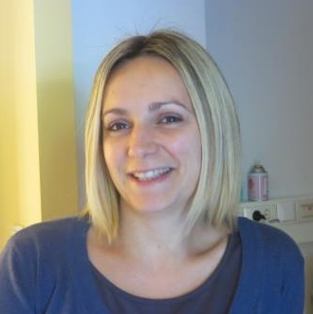
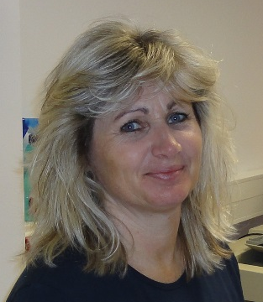
Local tCSC organizing committee
MEDILS (Mediterranean Institute for Life Sciences)
Irena Lilina

Slide 26
School rules

Slide 27
School rule #1
Participate
Attendance at all lectures and exercises is mandatory
You should attend all meals and coffee breaks
Taking part in social and sports events is optional
  You must let us know whether you participate or not

Slide 28
School rule #2
Be on time
Check what the schedule says:
  “Lecture starts at 9:00” => You must be in the room before 9:00
    Sign the presence sheet beforehand – it will be removed at 9:00
  “The bus leaves at 18:00” => It will leave at 18:00
If you’re late, we won’t wait

Slide 29
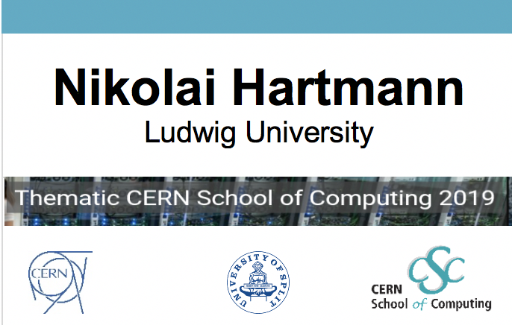
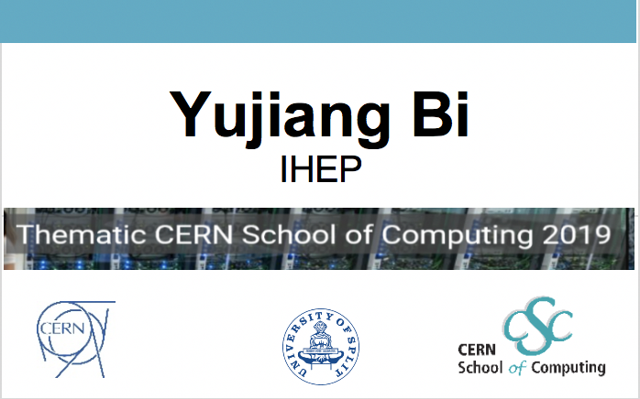
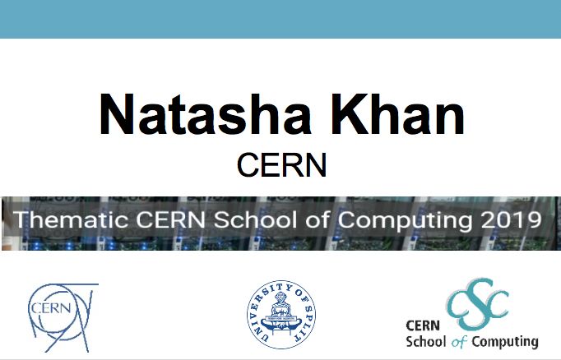
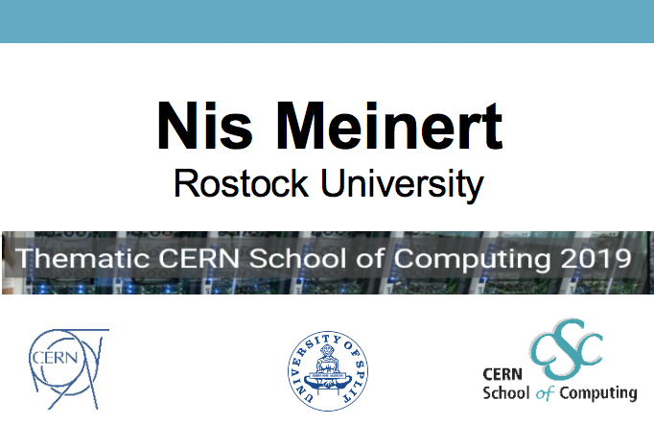
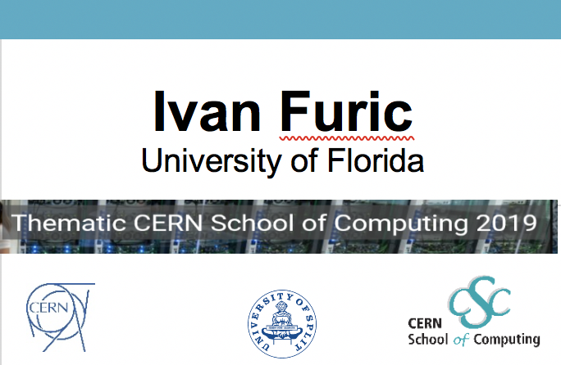
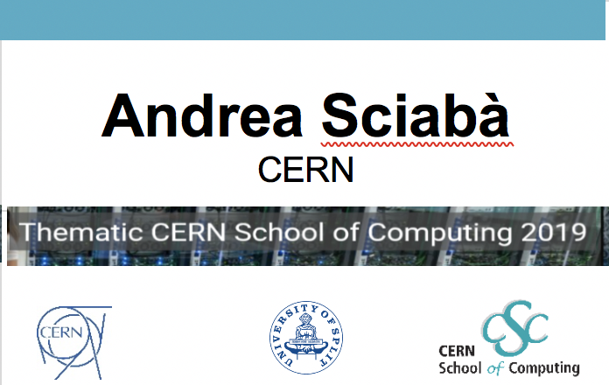
School rule #3
Wear your badge

Slide 30
School rule #4
ENJOY AND PROTIF
FROM THE SCHOOL!

Slide 31
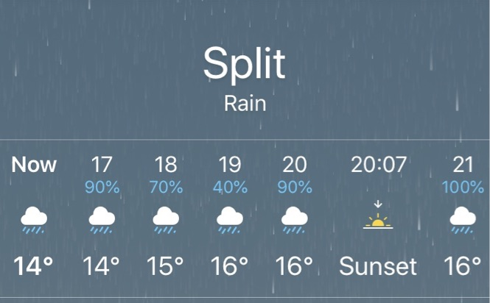
Tonight

Slide 32
Tonight
Walking tour of Split city – CANCELLED
  We will try to have it later during the week (Friday?)
18:00 lecture by Sebastien Ponce
  but tomorrow we start at 10:00 instead of 9:00 !
19:45 buses from MEDILS to Split
20:00 dinner in restaurant Konoba Fetivi
  meat and fish
22:00 buses back to MEDILS
More details on CSC Live

Slide 34
Welcome to…
Andreas Alexopoulos, U.Thessaly, Greece
Fabrizio Alfonsi, U.Bologna, Italy
Luca Ambroz, University of Oxford, UK
Francesco Antoniazzi, INFN CNAF, Italy
Tom Byrne, STFC, UK
Julio Calvo Pinto, CERN
Diego Davila Foyo, CERN
Victor Jose Garcia Fernandez, CERN
Jochen Gemmler, KIT, Germany
Jan-Paul Hucka, T.U. Darmstadt, Germany
Jan Kapała, AGH, Poland
Stanko Kruzic, FESB U. Split, Croatia
Dominik Kulikowski, CERN
Alexander Melzer, U. Bonn, Germany
Andrea Merli, UNIMIA and INFN, Italy
Felix Metzner, KIT, Germany
Simone Mosciatti, CERN
Konstantin Pugachev, Budker Inst., Russia
Alexander Ruede, ErnstAbbeHS, Germany
Nicolas Scharmberg, U.Manchester, UK
Marcel Andre Schneider, CERN
Toni Sculac, FESB U.Split, Croatia
Antoni Shtipliyski, I.C.London, UK
Ralf Von Cube, RWTH Aachen, Germany
Vadim Wagner, T.U. Darmstadt, Germany
Zehua Xu, Tsinghua University, China
Darko Zarić, FESB U.Split, Croatia
Miha Zgubic, University of Oxford, UK

