Slide 1
Overview of LEIR operation during the LHC-Ion run
N.Biancacci for the LEIR/Linac3 team
LIU Beam Performance meeting
13-12-2018

Slide 2
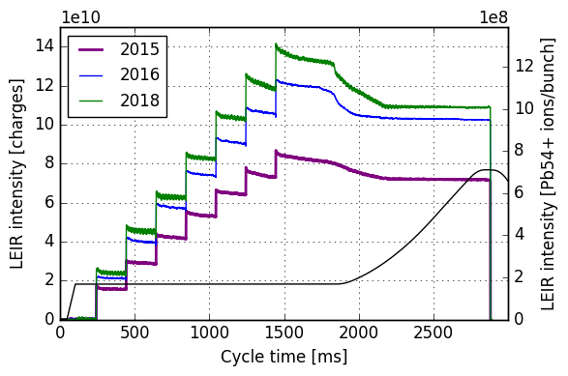
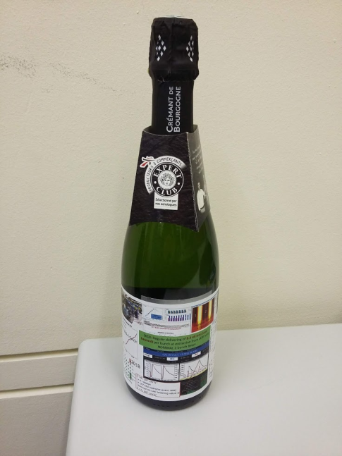
A new record year!
H.Bartosik
LEIR/Linac3 end of ion run celebration!

Slide 3
LEIR performance overview
Details on data analysis :
LHC Ion run for LEIR started on 4/11/2018 and ended on 3/12/2018.
~93 LHC fills (7401 to 7493) analyzed.
100ns (NOMINAL h2+4) and 75ns (NOMINAL h3+6) bunch spacing delivered when requested.
NOMINAL h3+6 requested from fill 7459 onwards.
First order statistics analysis performed on the delivered intensity during LHC filling time: timespan from fill start to beginning of ramp / end of fill (if not ramped).

Slide 4
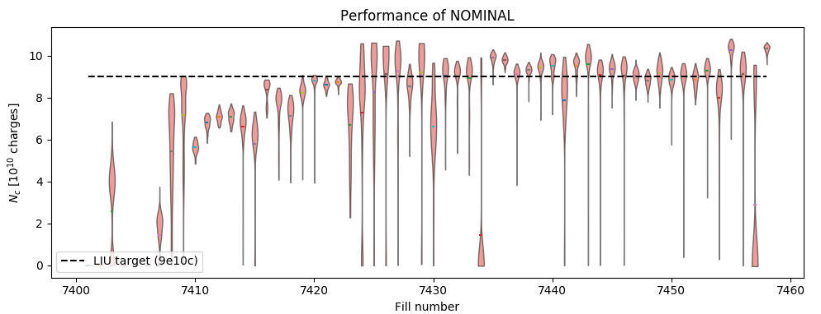
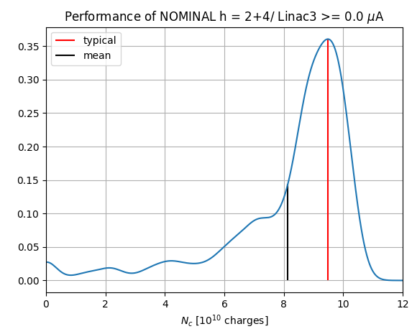
NOMINAL h = 2+4
Statistical analysis on extracted intensity: all fill data considered, no filters on Linac3 current or machine occasional issues (Btrain, instabilities, etc.)
Mean: 8.14
Typical: 9.49 (machine in optimal state)

Slide 5
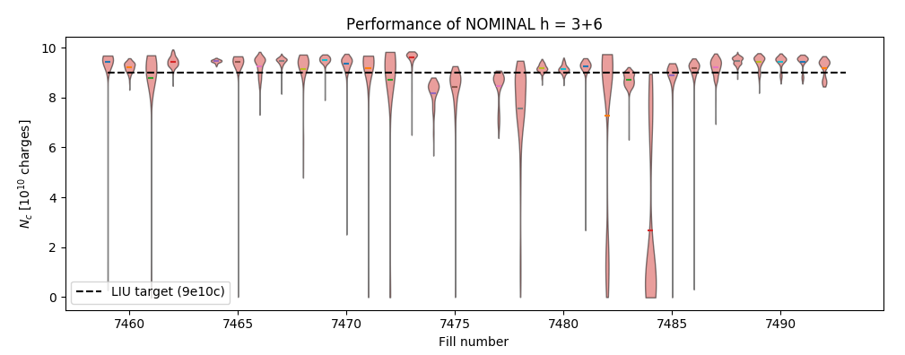
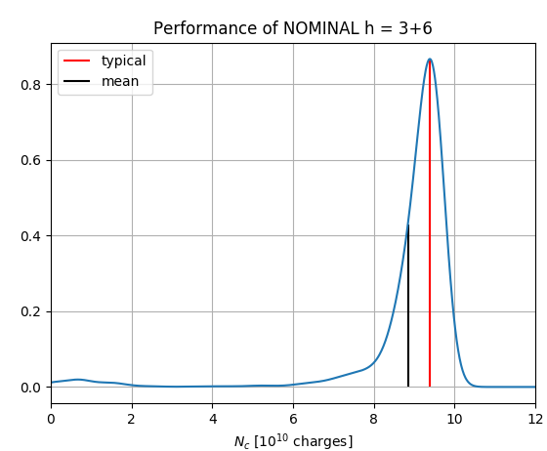
NOMINAL h = 3+6
Statistical analysis on extracted intensity: all fill data considered, no filters on Linac3 current or machine occasional issues (Btrain, instabilities, etc.)
Mean: 8.84
Typical: 9.39 (machine in optimal state)
Profited from the performance established during the
first part of Ion run.

Slide 6
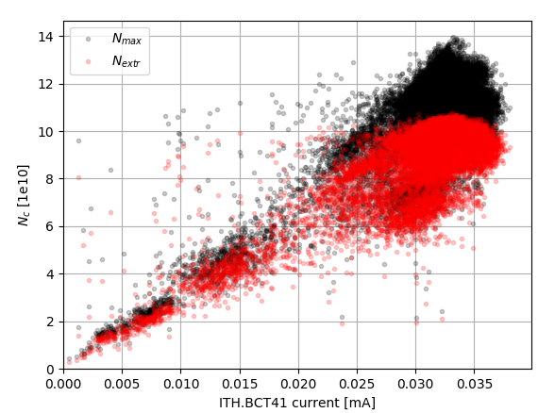
Lessons learnt and perspectives
Extracted intensity dependent on Linac3 current and machine injection efficiency.
Most of LHC run at 30 uA $→$ LEIR “comfortably” at LIU performance.

Slide 7
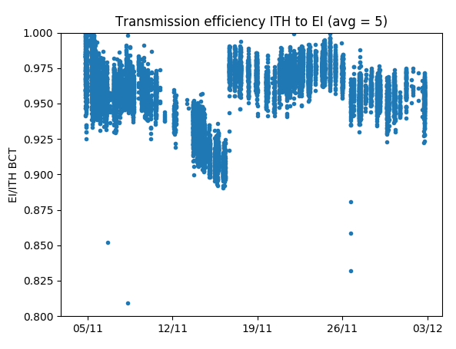
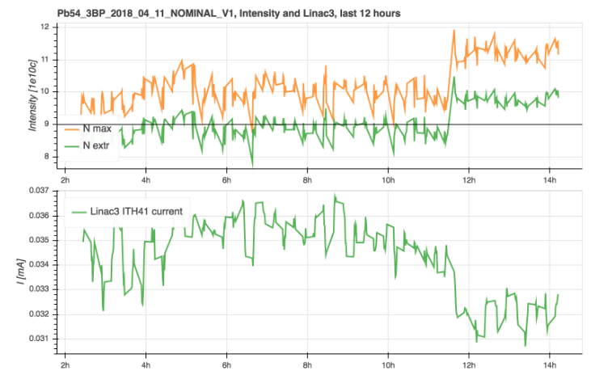
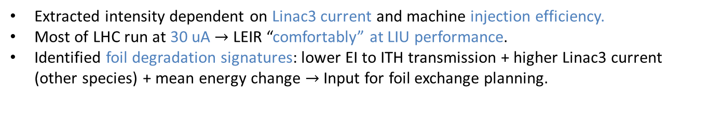

Lessons learnt and perspectives
Extracted intensity dependent on Linac3 current and machine injection efficiency.
Most of LHC run at 30 uA $→$ LEIR “comfortably” at LIU performance.
Identified foil degradation signatures: lower EI to ITH transmission + higher Linac3 current (other species) + mean energy change $→$Input for foil exchange planning.
Drop in ITH$→$EI transmission efficiency
Foil exchange

Slide 8
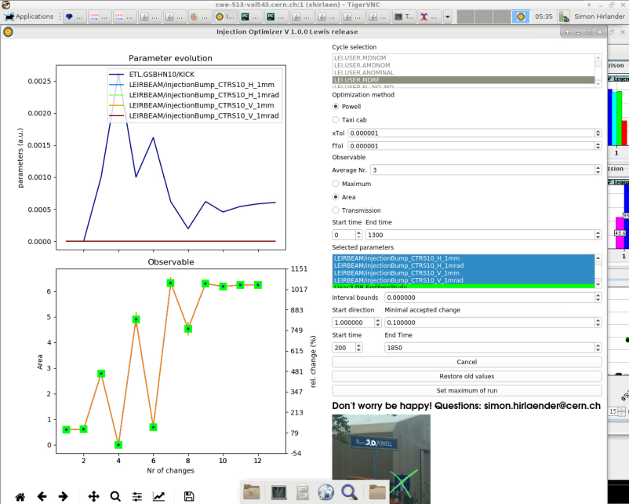
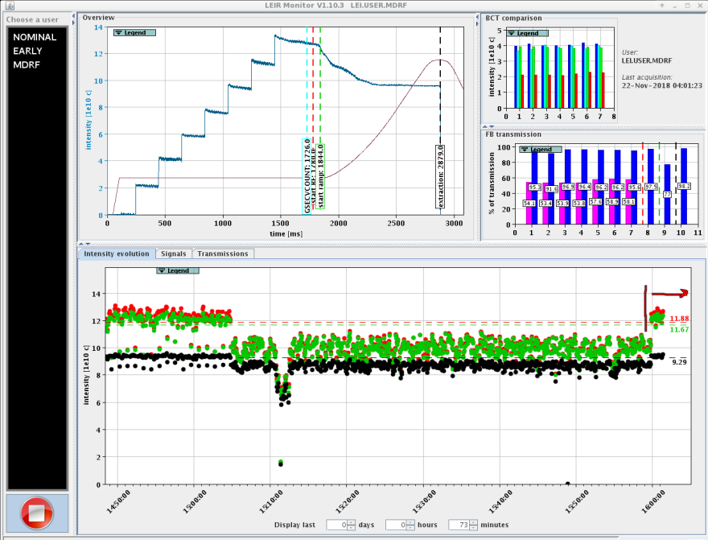
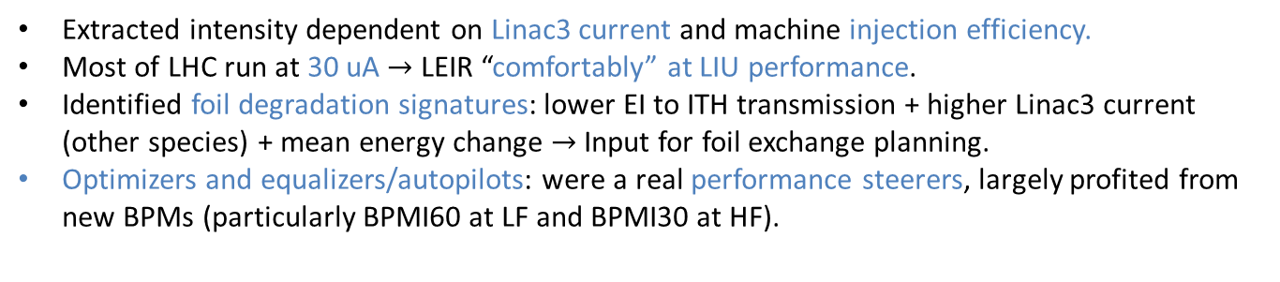
Lessons learnt and perspectives
Extracted intensity dependent on Linac3 current and machine injection efficiency.
Most of LHC run at 30 uA $→$ LEIR “comfortably” at LIU performance.
Identified foil degradation signatures: lower EI to ITH transmission + higher Linac3 current (other species) + mean energy change $→$Input for foil exchange planning.
Optimizers and equalizers/autopilots: were a real performance steerers, largely profited from new BPMs (particularly BPMI60 at LF and BPMI30 at HF).
A case of immediate performance recover with optimizer
Injections equalized

Slide 9
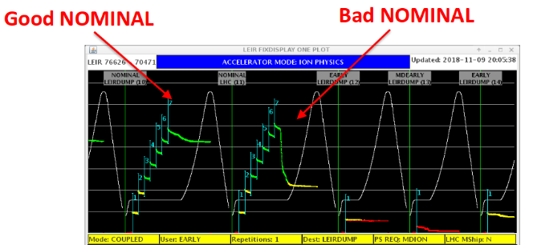
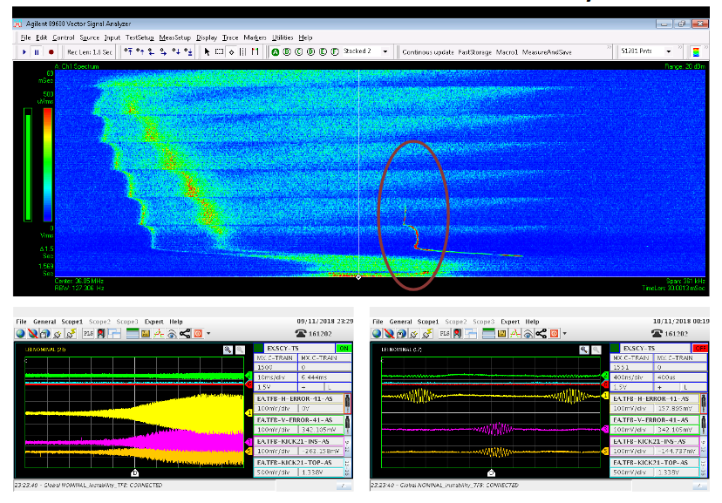
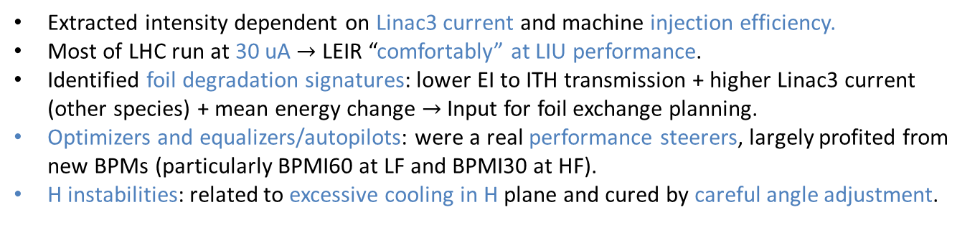
Lessons learnt and perspectives
Extracted intensity dependent on Linac3 current and machine injection efficiency.
Most of LHC run at 30 uA $→$ LEIR “comfortably” at LIU performance.
Identified foil degradation signatures: lower EI to ITH transmission + higher Linac3 current (other species) + mean energy change $→$Input for foil exchange planning.
Optimizers and equalizers/autopilots: were a real performance steerers, largely profited from new BPMs (particularly BPMI60 at LF and BPMI30 at HF).
H instabilities: related to excessive cooling in H plane and cured by careful angle adjustment.

Slide 10
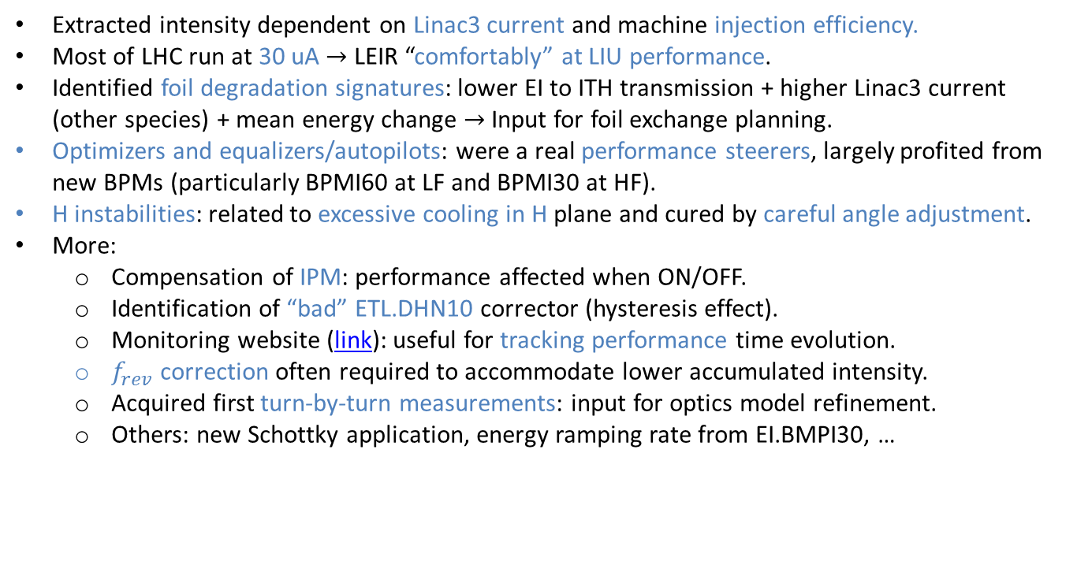
Lessons learnt and perspectives
Extracted intensity dependent on Linac3 current and machine injection efficiency.
Most of LHC run at 30 uA $→$ LEIR “comfortably” at LIU performance.
Identified foil degradation signatures: lower EI to ITH transmission + higher Linac3 current (other species) + mean energy change $→$Input for foil exchange planning.
Optimizers and equalizers/autopilots: were a real performance steerers, largely profited from new BPMs (particularly BPMI60 at LF and BPMI30 at HF).
H instabilities: related to excessive cooling in H plane and cured by careful angle adjustment.
More:
  Compensation of IPM: performance affected when ON/OFF.
  Identification of “bad” ETL.DHN10 corrector (hysteresis effect).
  Monitoring website (link): useful for tracking performance time evolution.
  $f_{rev}$ correction often required to accommodate lower accumulated intensity.
  Acquired first turn-by-turn measurements: input for optics model refinement.
  Others: new Schottky application, energy ramping rate from EI.BMPI30, …

Slide 11
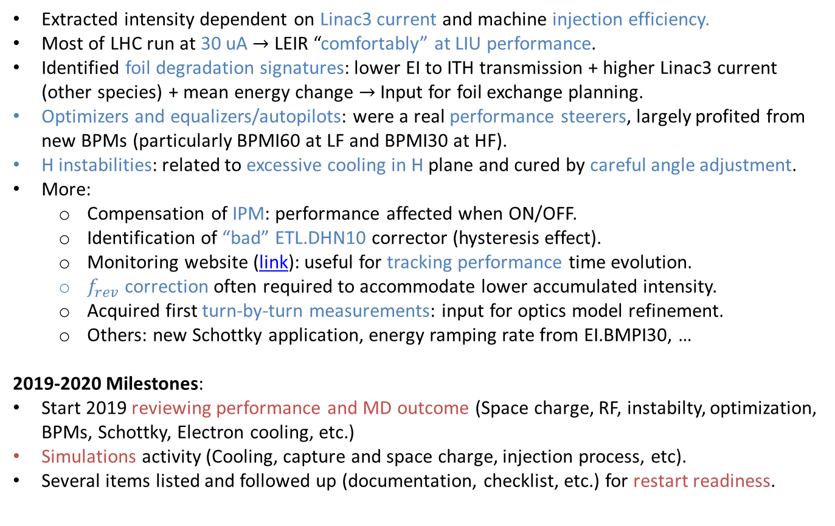
Lessons learnt and perspectives
Extracted intensity dependent on Linac3 current and machine injection efficiency.
Most of LHC run at 30 uA $→$ LEIR “comfortably” at LIU performance.
Identified foil degradation signatures: lower EI to ITH transmission + higher Linac3 current (other species) + mean energy change $→$Input for foil exchange planning.
Optimizers and equalizers/autopilots: were a real performance steerers, largely profited from new BPMs (particularly BPMI60 at LF and BPMI30 at HF).
H instabilities: related to excessive cooling in H plane and cured by careful angle adjustment.
More:
  Compensation of IPM: performance affected when ON/OFF.
  Identification of “bad” ETL.DHN10 corrector (hysteresis effect).
  Monitoring website (link): useful for tracking performance time evolution.
  $f_{rev}$ correction often required to accommodate lower accumulated intensity.
  Acquired first turn-by-turn measurements: input for optics model refinement.
  Others: new Schottky application, energy ramping rate from EI.BMPI30, …
2019-2020 Milestones:
Start 2019 reviewing performance and MD outcome (Space charge, RF, instabilty, optimization, BPMs, Schottky, Electron cooling, etc.)
Simulations activity (Cooling, capture and space charge, injection process, etc).
Several items listed and followed up (documentation, checklist, etc.) for restart readiness.

Slide 12
BACKUP

Slide 13
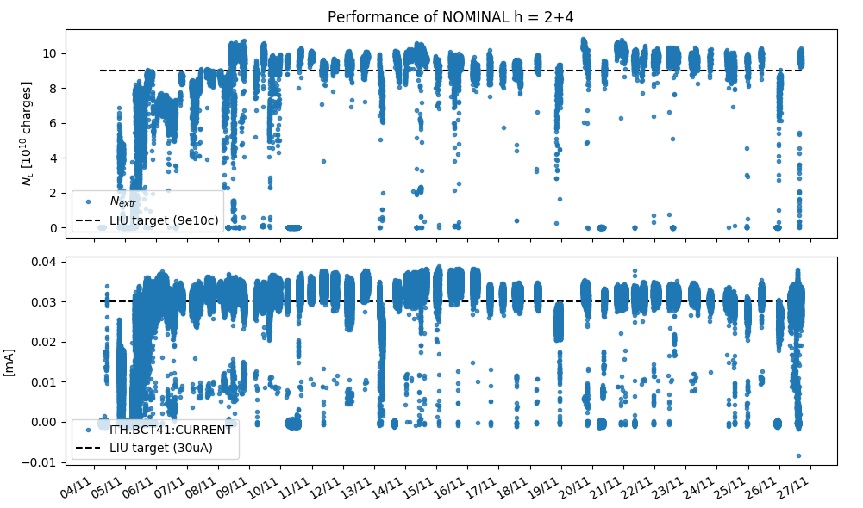
Performance overview: NOMINAL h = 2+4

Slide 14
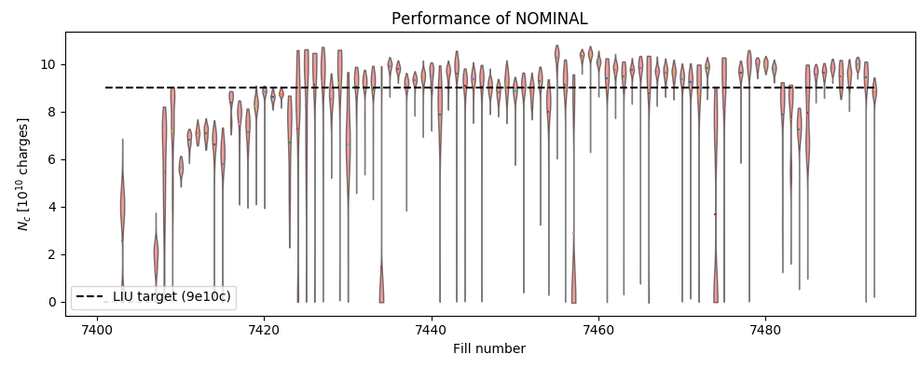
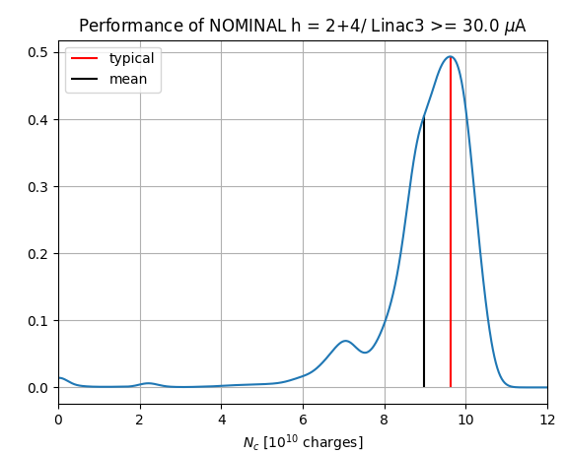
NOMINAL with Linac3 >= 30uA
Statistical analysis on extracted intensity: all fill data considered, filters on Linac3 current, not on machine occasional issues (Btrain, instabilities, etc.)
Mean: 9.1
Typical: 9.76 (machine in optimal state)

Slide 15
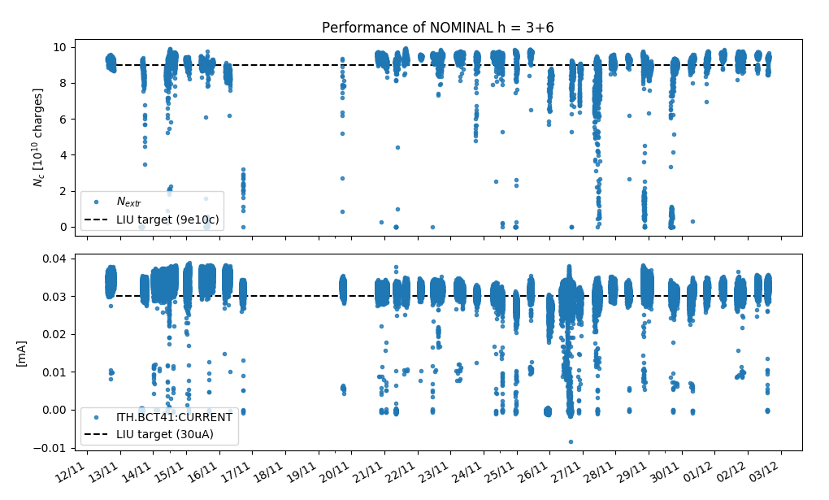
Performance overview: NOMINAL h = 3+6

Slide 16
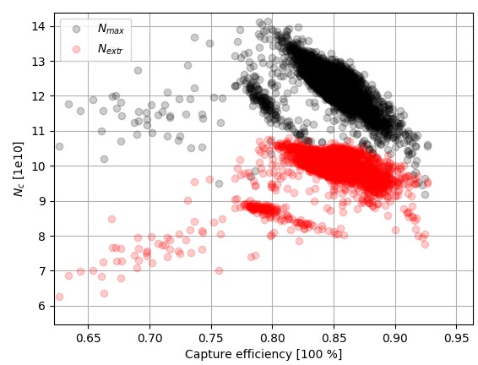
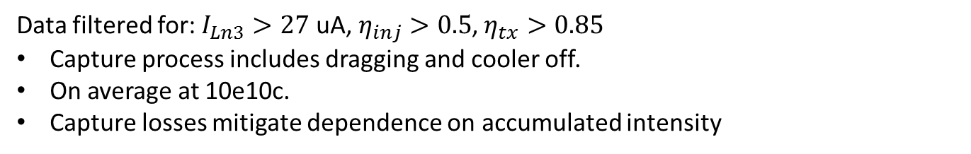
Dependence on capture process
Data filtered for: $I_{Ln3}>27$ uA,$η_{inj}>0.5$, $η_{tx}>0.85$
Capture process includes dragging and cooler off.
On average at 10e10c.
Capture losses mitigate dependence on accumulated intensity

Slide 17
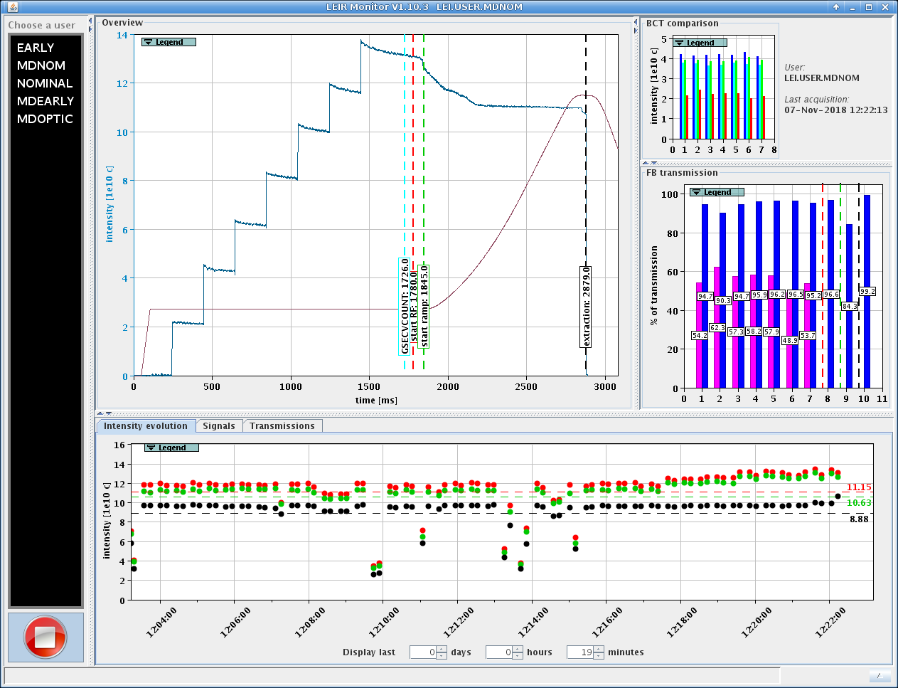
Record
10.63

