Slide 2
PS experience for LHC ion run
LIU Beam Performance meeting
13 December 2018
H. Damerau, A. Lasheen
Many thanks to the LEIR Team, S. Albright,
H. Bartosik, S. Energico, A. Huschauer

Slide 3
Introduction
Standard operational beams
Re-established without issues in the PS
  Single-bunch beam now also accelerated to the flat-top at h = 21
Scaling 2017 experience from Xe beam to Pb
  https://indico.cern.ch/event/710562/contributions/2918961/attachments/1613638/2564171/75nsXeIons.pdf
Initial longitudinal setting-up of 75 ns bunch-spacing in May
3 bunches only, but ideally 33% higher intensity per bunch
Cycle | # | Spacing | Comment
EARLY Pb⁵⁴⁺ | 1 | n.a. | Accelerated on h = 16 and 21 in 2018
ILHC100#4b | 4 | 100 ns | No change with respect to previous years
ILHC100#2b | 2 | 100 ns | Not set-up in 2018
ILHC200#2b | 2 | 200 ns | Partially stripped ion tests, no change with respect to previous years

Slide 4
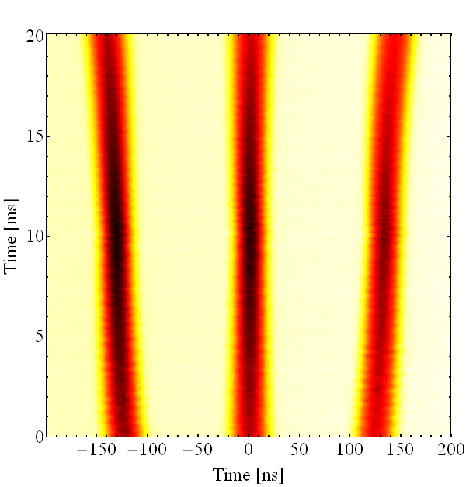
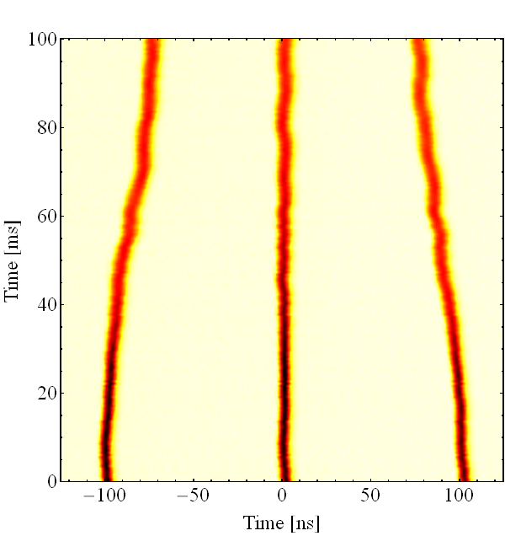
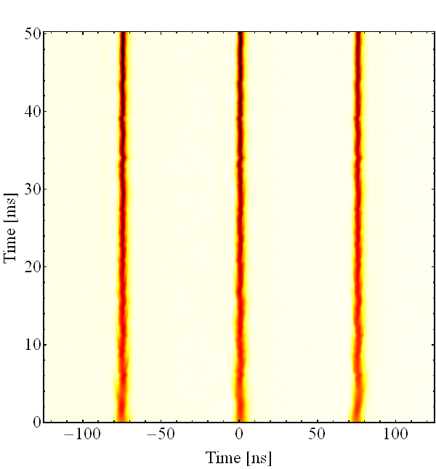
75 ns bunch spacing
Simple RF manipulation scheme in PS:
  Inject 3 bunches: h_{LEIR} = 3 corresponds to h_{PS} = 24
  Accelerate to intermediate flat-top on h = 24
  Expand spacing: h = 24 → 21 (due to frequency range of cavities)
  Compress spacing: h = 21 → 28 (80 kV at 10 MHz, 20 kV at 13.2 MHz)
    Added beam phase loop at h = 28, sequence h_{PL} = 24 → 21 → 28 → 169
  Handover from h = 28 to 169 (80 MHz for bunch shortening)
h = 24 → 21 (3.)
h = 21 → 28 (4.)
h = 28 → 169 (5.)

Slide 5
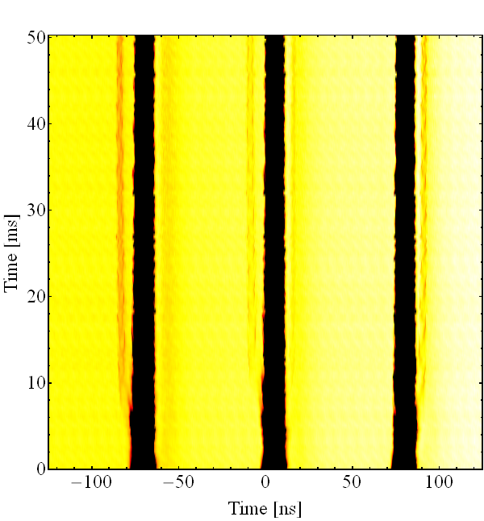
75 ns bunch spacing – satellite bunches
Re-bucketing of operational beams directly from 10 to 80 MHz
  200 kV total voltage from main acceleration system, 120 kV used for handover
Rebucketing of 75 ns beam from 13.2 MHz to 80 MHz
  Only ~20 kV available from single cavity operated at its low frequency end
Zoom on h = 28 → 169
  Pre- and post-satellite bunches during handover from 20 MHz to 80 MHz
  at ±12.5 ns
  Between buckets in SPS
  Issue for LHC?

Slide 6
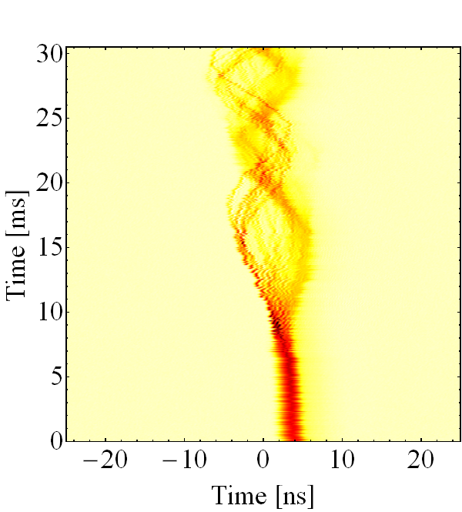
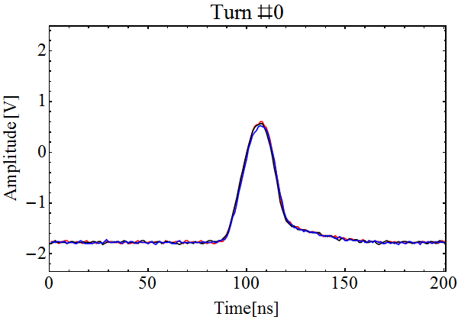
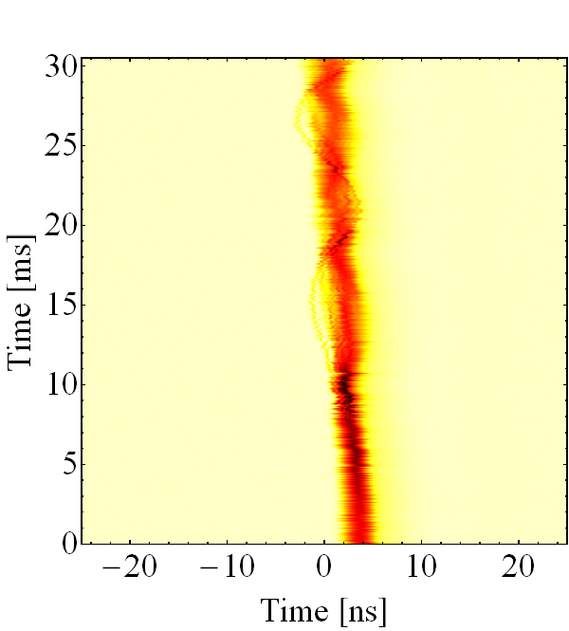
75 ns bunch spacing – transition
Fast beam break-up after transition crossing
  Signature of microwave instability (at ~2 GHz), most likely longitudinal
  Controlled longitudinal blow-up with 200 MHz cavities before transition (at intermediate flat-top), but at stability limit with N_{b} = 2.8 ∙ 10¹⁰ charges/p
Overall experience in PS from 2018 run with 3-bunches, 75 ns
  Moderate effort to operationally maintain sufficient beam quality
Zoom on bunch #2
Overlay of all 3 bunches

Slide 7
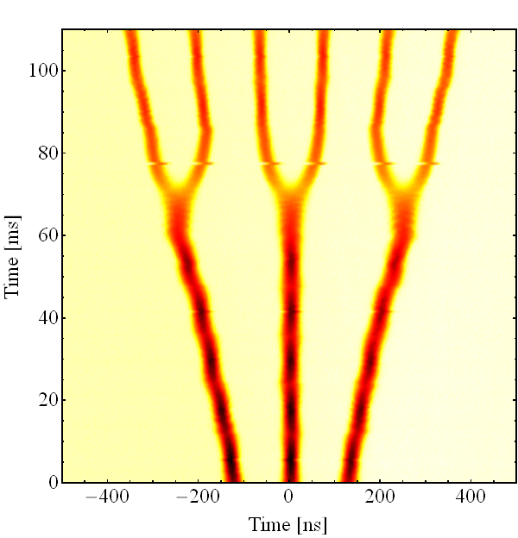
Alternative bunch patterns from PS
6 bunches with 100 ns spacing → Test beam for SPS
  Split 3-bunches from LEIR and adjust batch length
  Suggested by H. Bartosik in 2016, first beam test during 2018 ion run
More than 3 bunches with bunch spacing of 75 ns?
  Initial ideas to operate Finemet cavity with pulsed RF for batch compression
  RF manipulation fits in standard duration of intermediate flat-top:
  h = 24→21→18→16→14→12→24→22→21
  Moderate beam intensity after splitting
  No issues at transition crossing or beyond
  Can be made available again after LS2

Slide 8
Conclusions and outlook
Standard beams set-up as in previous runs
  Single bunch (EARLY), 4 bunches spaced by 100 ns
New 3-bunch beam with 75 ns spacing
  Early setting-up in May paid off to implement changes to beam control
  Main issues: satellites and transition crossing instability
  Luminosity production in LHC during 2nd half of ion run (~2.8 ∙ 10¹⁰ charges/p)
New test beam after LS2: 6 bunches with 100 ns spacing
Transition crossing instability
  Complete analysis of MD data, longitudinal and transverse
  Tracking simulations to identify driving impedance of microwave instability
Alternative schemes
  More than 3 bunches spaced by 75 ns (or less)?

Slide 9

THANK YOU FOR YOUR ATTENTION!

