Slide 1
Linac3 experience for LHC ion runs
G Bellodi for the Linac3 team
Keywords:
      beam performance
      reliability
      set up time
      results of MDs
      remaining unknowns

Slide 2
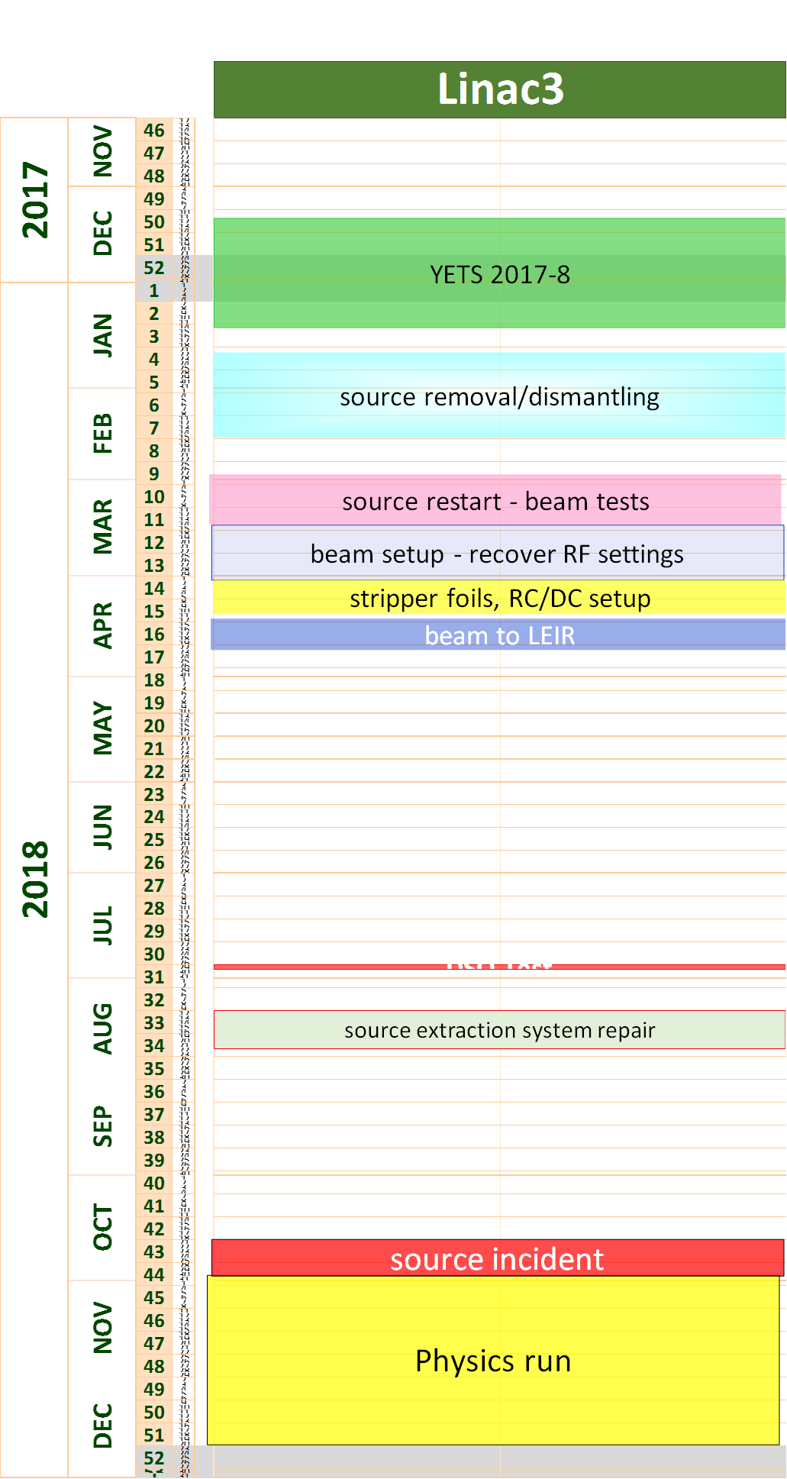
A year in perspective
Source removed: change of main insulators, fix non-conformity issues – good exercise in retrospective!
<2 months to restart
RF reference settings moved with insertion of new couplers
Beam to LEIR
Source extraction system repair to cure high voltage breakdowns
Source incident: LHC ion run program slightly re-organized as mitigation measure

Slide 3
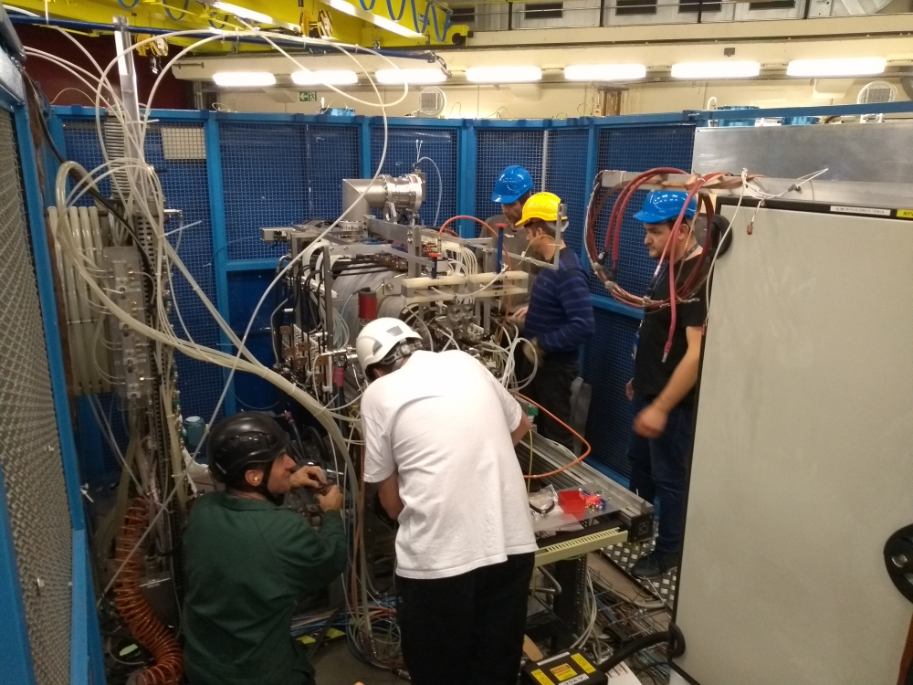
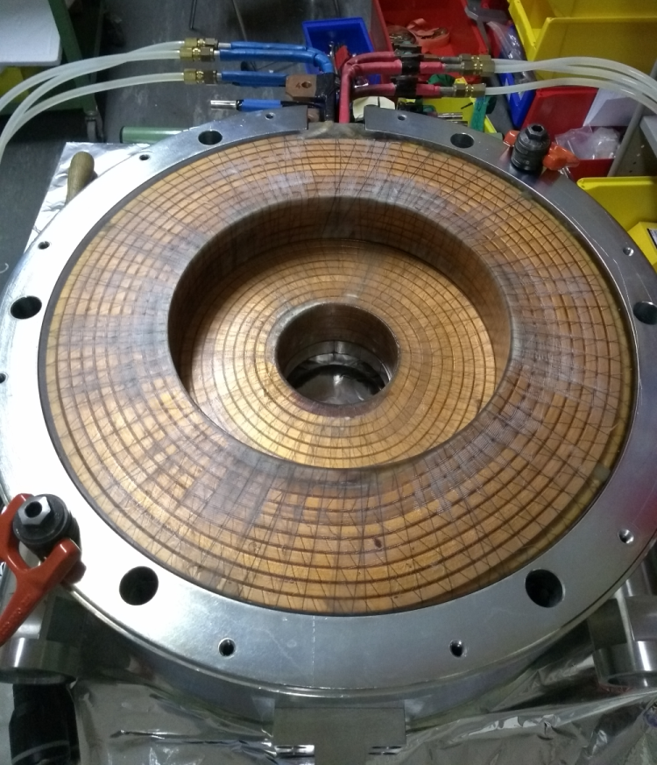
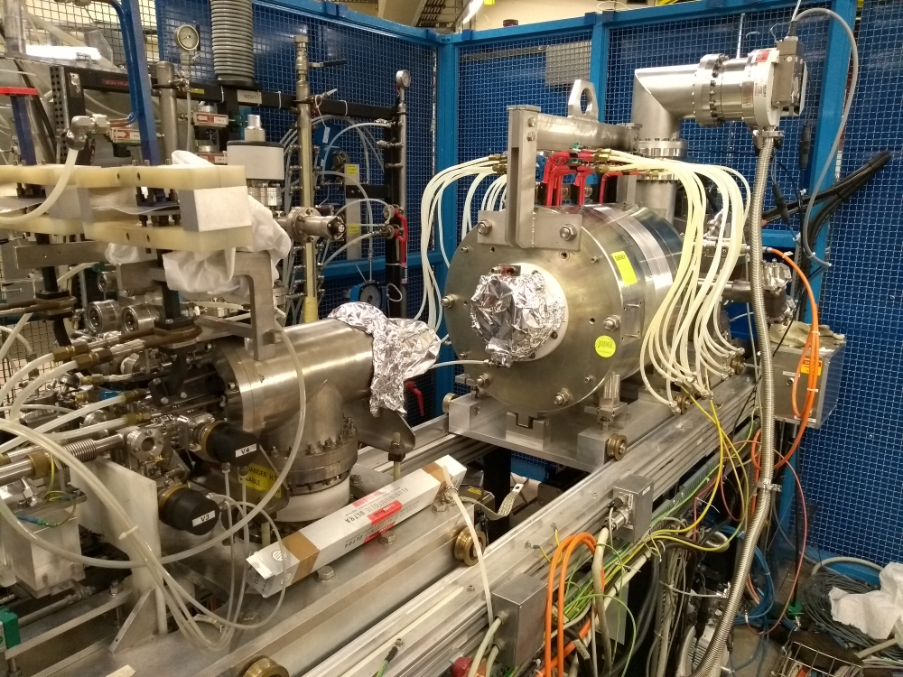
October 29th source repair in detail
Monday late evening: one of the 1200 A solenoid coils in the source went into open circuit.
Tuesday 30/10 : decision of full dismantling to install the spare coil. By the end of the day, the source was open on the support in the tunnel. TE-MSC made a rapid certification of the spare (which was untested for 10 years).
Wednesday 31/10 : the (800 kg) magnetic circuit could be dismounted, rotated and opened. By the end of the afternoon TE-MSC could return the spare, and it was squeezed into the yoke.
Thursday 01/11 : the magnetic circuit was remounted and connected to the cooling and power supplies. A fast measurement of the internal field was made and seen to be as expected. By the end of the day the source was pumping.
Friday 02/11 morning : the vacuum was good enough, and the final reconnection and remounting of the shielding was made. In the afternoon, the source could be restarted for conditioning.
Extremely efficient restart thanks to fast prioritization, good coordination and prior dismantling experience!

Slide 4
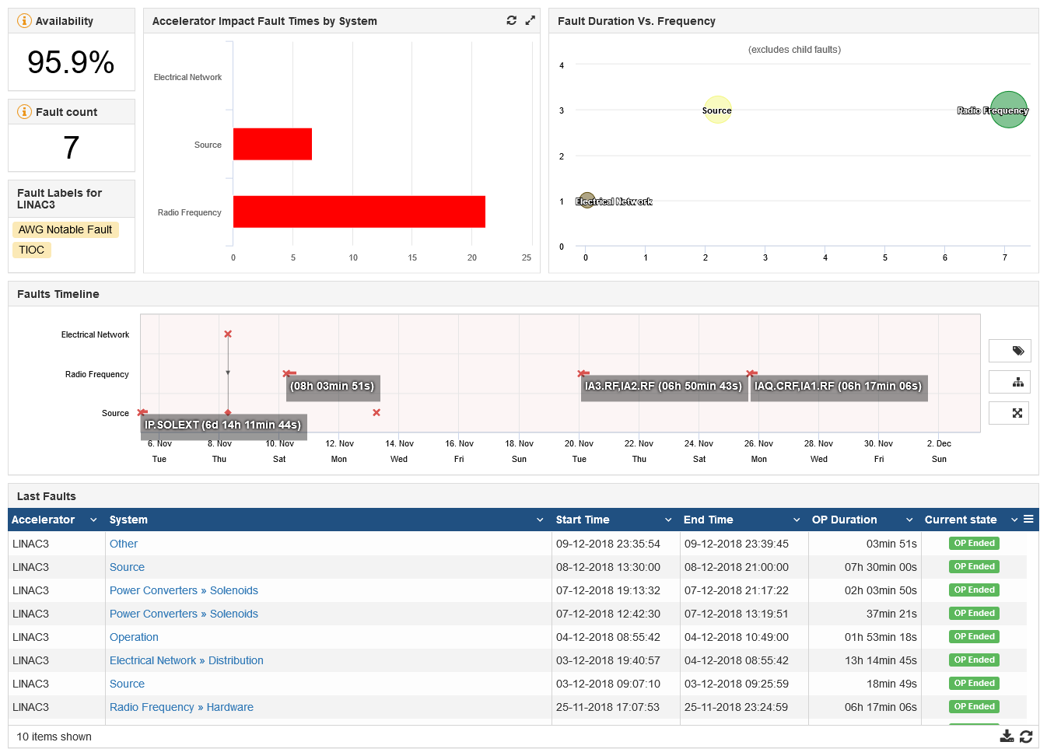
AFT statistics from start of the LHC ion run (05/11 to 03/12)
27.8h total downtime
Injectors’ downtime impact on LHC
LINAC3~13h (2% downtime)

Slide 5
Linac3 Power Amplifier Failures:
10 Nov: IGBT & trigger unit of Tank3 failed: 8 hrs downtime – probably damaged IGBT of Tk2 and led to
20 Nov: IGBT & trigger unit of Tk2 & Tk3 failed: 7 hrs downtime – failure of Tk2 caused failure of Tk3 system
  Consolidation of the common power supply with two new individual systems will prevent interaction
25 Nov: 100 MHz RFQ system ignitron unit failed - first failure to our knowledge
At start-up of Tank1 amplifiers: contact issues – both failures likely due to aging but latter difficult to manage
  Replacement of RFQ amplifier launched BUT missing financing for Tank1 amplifier
Financing of full consolidation should be made a priority!
HLRF Consolidation
Replacement of small 2.5 kW amplifiers for buncher, debuncher and ramping cavities (in sync with LLRF cons.)
Replacement of 350 kW Bertronix amplifiers for RFQ and IH-DTL Tank1
After initial market survey results, only 1 replacement 350 kW amplifier can be financed with the funding agreed
Maintenance of Linac1 RF amplifiers foreseen for IH-DTL Tank2 & Tank3 – 1955 technology!
TE-EPC replacement of PC (Tank2 and Tank3) planned for after LS2

Slide 6
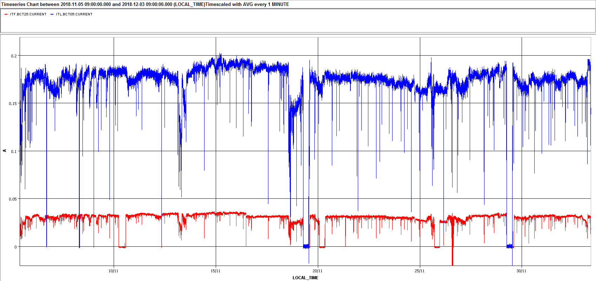
Beam current performance extraction from 05/11 to 03/12/2018
<BCT05>~175 uA
<BCT25>~30.6 uA
source
LEIR injection
RF faults
MD
30uA
Oven refills

Slide 7
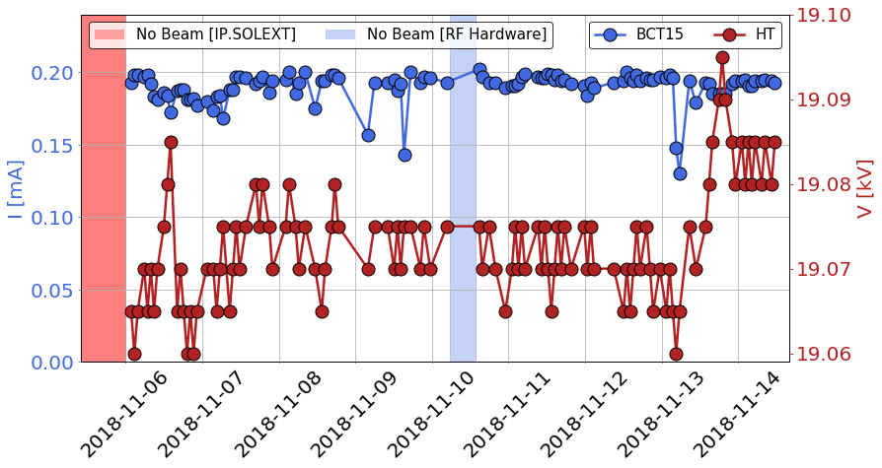
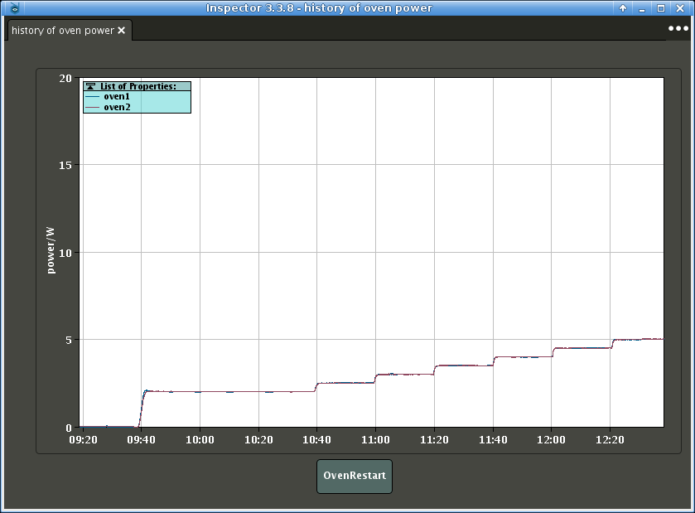
Source stability
Choices leading to more reliable 2018 operation:
  old Thomson RF generator replaced with Sairem before start of operation
  only fresh Pb was used (→ turnaround time after oven refill reduced to 8-9 hours)
P Zisopoulos
GHOST modules: two scripts produced and tested so far (P Zisopoulos)
Source HT extraction voltage optimization (scan in ±5V steps and maximize the beam current in BCT15 )
Automatic ramping of the oven power at source restart after an oven refill
P Zisopoulos

Slide 8
Foils
After recurrent issues with ACF foils, new GSI-produced stripping foils of different thicknesses were procured and installed
Confirmed better quality and performance of GSI-produced foils (in terms of reproducibility from foil to foil, and results better matching expectations).
Possible hints of shorter lifetime. If confirmed, would need to schedule more frequent exchanges (every 2 weeks, alternating with oven refills?) Stock of 16 foils installed on 4 arms, a single arm exchange can be carried out in the shadow of an oven refill.)
Foil history

Slide 9
Foils characterization
Mean energy and energy spread measurements in ITFS spectro line : clear correlation b/w beam energy and foil thickness
CSD scans: Pb54+ production higher for thicker foils?

Slide 10
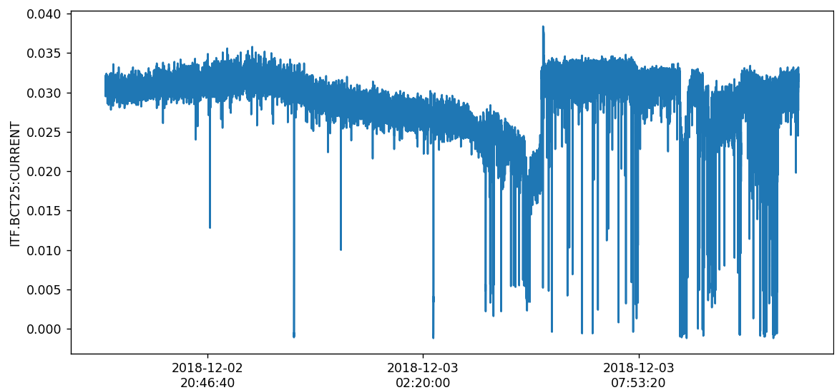
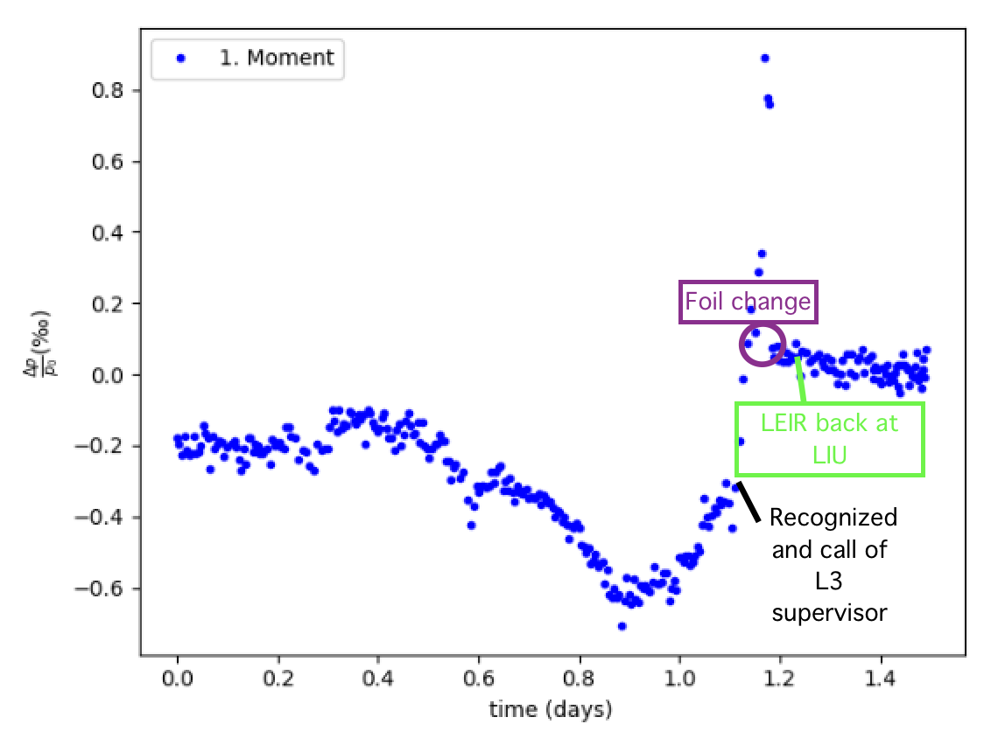
Foil degradation and energy drift
Seen from Linac3
Foil degradation marked by increase in energy spread of the beam and shift towards lower beam average energies (“foil thickening effect”??)
03/12 Foil failure
S Hirlander
Seen by LEIR
Monitoring by:
- weekly measurements in Linac3 ITFS spectro line (dedicated and destructive)
- running Schottky measurement of the injected beam energy in LEIR (transparent to operation, very powerful tool!)
Seen by LEIR

Slide 11
Conclusions and lessons learnt
After a 2017 beam availability near 99%, 2018 made for some rolling up of sleeves...
Progress made towards better beam stability/performance:
- replacement of source RF generator → better reliability
- oven refills with fresh Lead → better stability, shorter recovery time
- progress in the automatisation of source adjustments
- installation of better performing GSI foils → better stability
- progress in understanding beam performance through systematic monitoring
(e.g. foils degradation)
RF remains a weak point:
- HLRF consolidation during and after LS2 is critical & full funding for amplifier replacement should be made available
- LLRF upgrade will bring more operational flexibility.
Source incident → availability of spares is critical as is expertise in dismantling/re-installing.
A hot spare source (parallel Linac3 source stand?) is for the nice-to-nave list, but missing ABP manpower to work on it (…double wish for Father Xmas?)

Slide 12
Milestones 2019-2020
Wrap-up of MD data and documentation of Panos’s GHOST scripts
Preparation of ion source tests in 2020
Set milestones dates (end of March?) for :
- final LLRF upgrade specifications
- detailed planning of HW commissioning and beam startup in 2020
- GHOST release on a stable platform

Slide 13
Spare slides

Slide 14
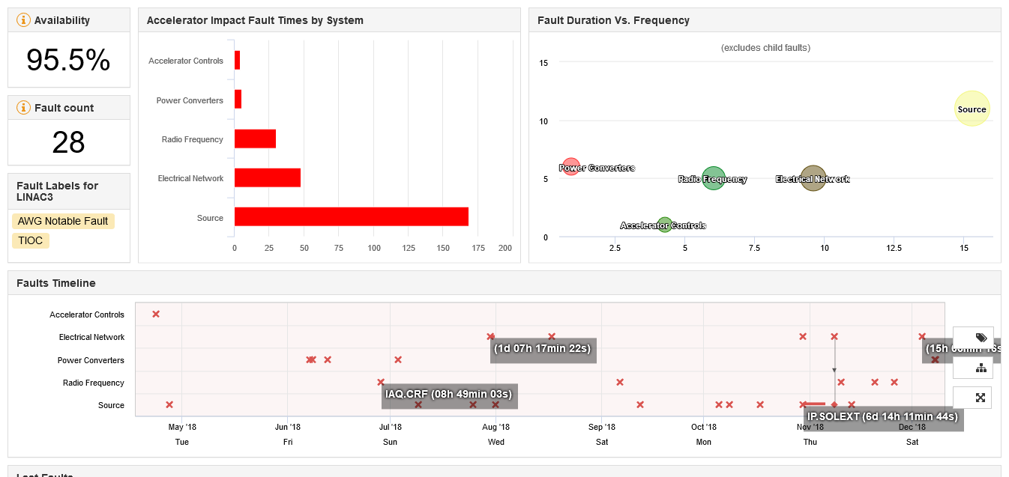
AFT statistics from 17/04 (beam to LEIR)

Slide 15
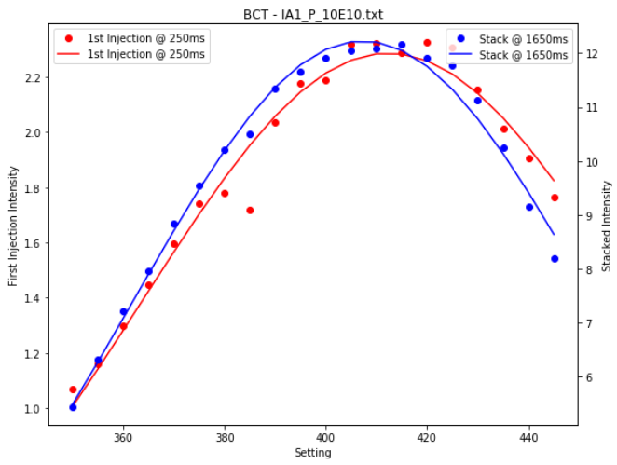
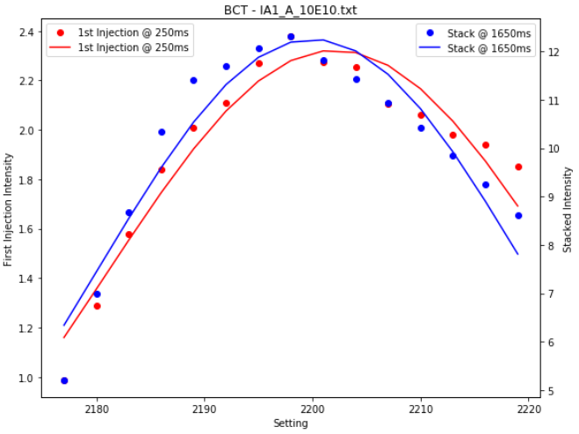
LEIR injected intensity vs RF parameters
Sensitivity studies were carried out to determine the stability margins required for the LLRF upgrade at Linac3, measuring variations in the beam intensity injected into LEIR as function of the individual RF cavities phase and amplitude settings.
Sensitivity of LEIR to Tank1 settings
R Scrivens EDMS 2038110
phase
amplitude
In order to control the most sensitive equipment, the amplitude should be reproducible to 0.1%, and the phase to 0.5 degrees

Slide 16
Foils characterization
Mean energy and energy spread measurements in ITFS spectro line
CSD scans

