Slide 1




Welcome to CBI A³

Slide 2
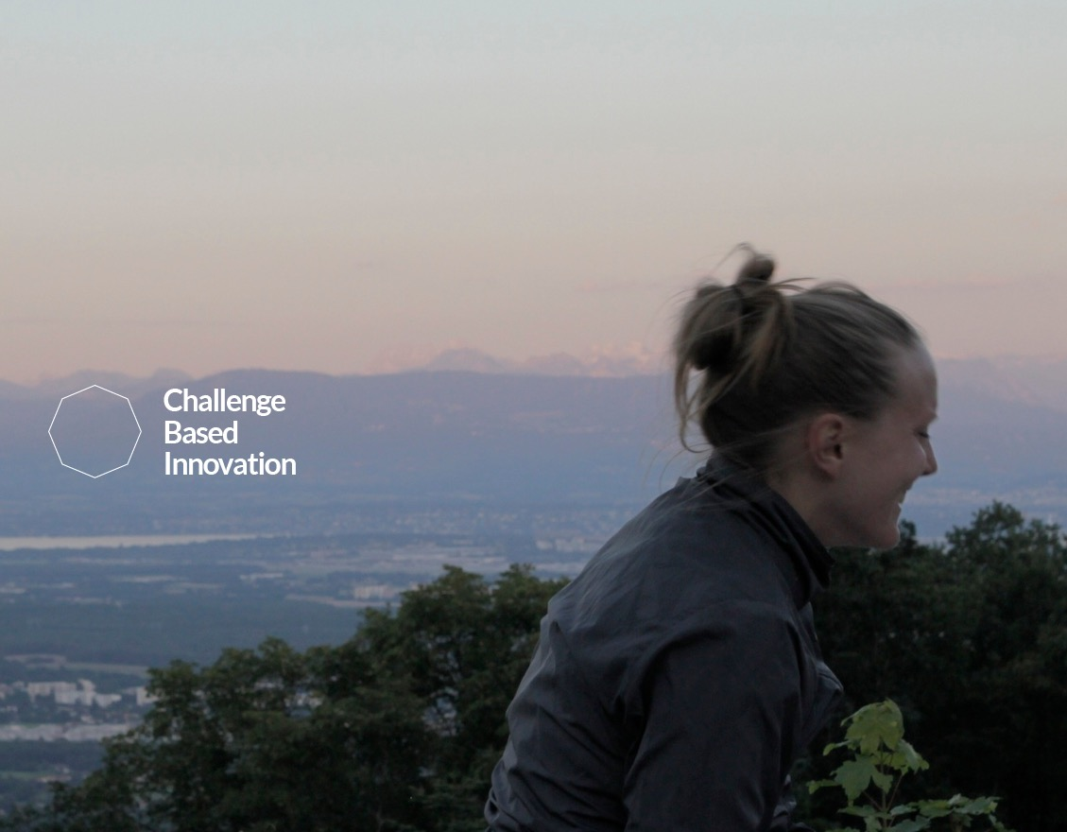
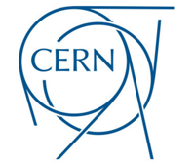

Challenge Based Innovation
The first CBI experiment in 2013/14
connecting students to CERN researchers
Notes:
Challenge Based Innovation (CBI) is a project course, where multidisciplinary student teams and their instructors collaborate with researchers at CERN to discover novel solutions for the future of humankind. The projects are an elaborate mixture, where the technologies derived from research at CERN meet societal, human-driven needs.
Our students come from a mix of disciplines. We believe that the wildest combinations will produce the most delightful outcomes. So far we’ve worked with students from industrial design, electrical and mechanical engineering, a variety of economists and business students, architecture and robotics.

Slide 3

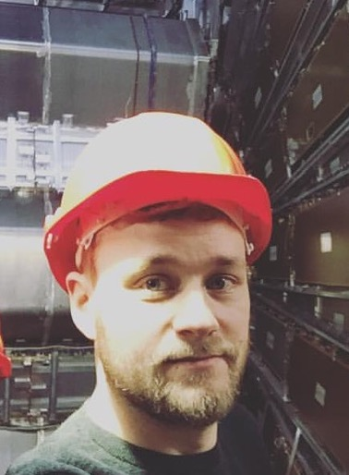
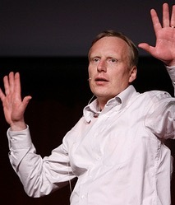

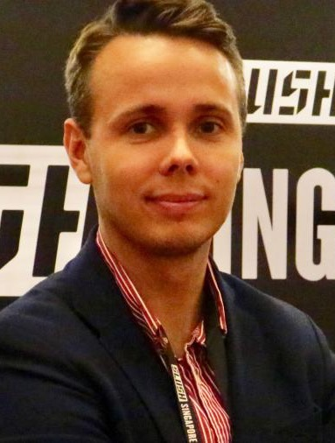
Idea^{s} people
Jani Kalasniemi
Markus Nordberg
Harri Toivonen*
Santeri Palomaki*
Tuuli Utriainen
** Harri & Santeri are our main CBI³ contacts
Notes:
Markus - mastermind
Harri - magician
Tuuli - Imagineer
Jani - Technovator
IdeaSquare is an experiment itself, and it explores new ways to demonstrate the value of basic research. It aims at delivering innovation to society at a marginal cost
It brings together CERN personnel, visiting students, and external project collaborators from the domains of research, technology development and education. The purpose of IdeaSquare is to bring together people to generate new ideas and work on conceptual prototypes in an open environment, and contribute to KT Group activities by providing new socially and globally relevant product ideas and innovation, which the KT Group could contribute disseminating further.

Slide 4




A³ CBI
2018 partners

Slide 5

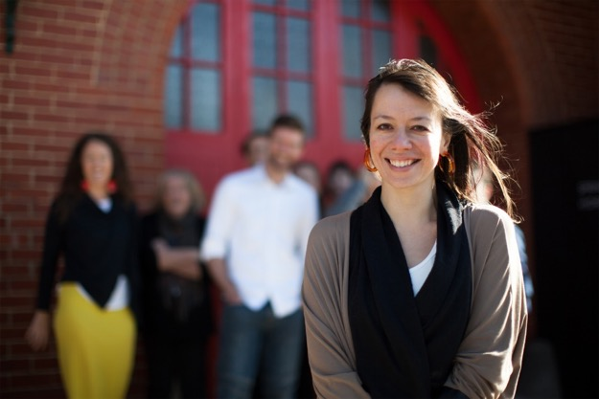

Christine Thong
Aaron Down

Slide 6

José Reis

Slide 7

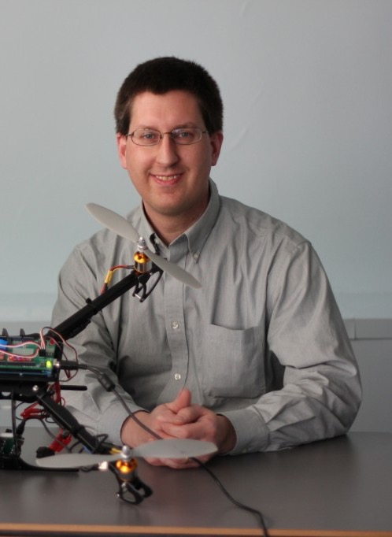
Andreea Cotoranu
Rick Kline

Slide 8

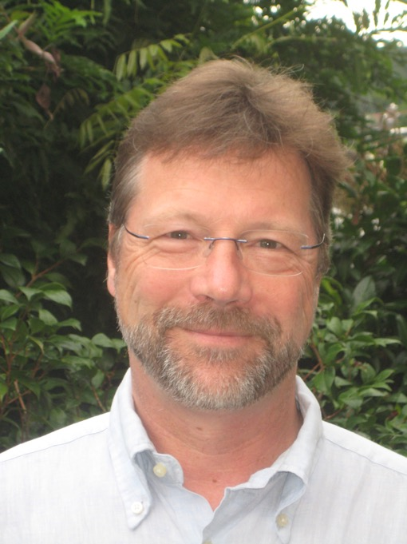
Catarina Batista
Peter Kaiser

Slide 9
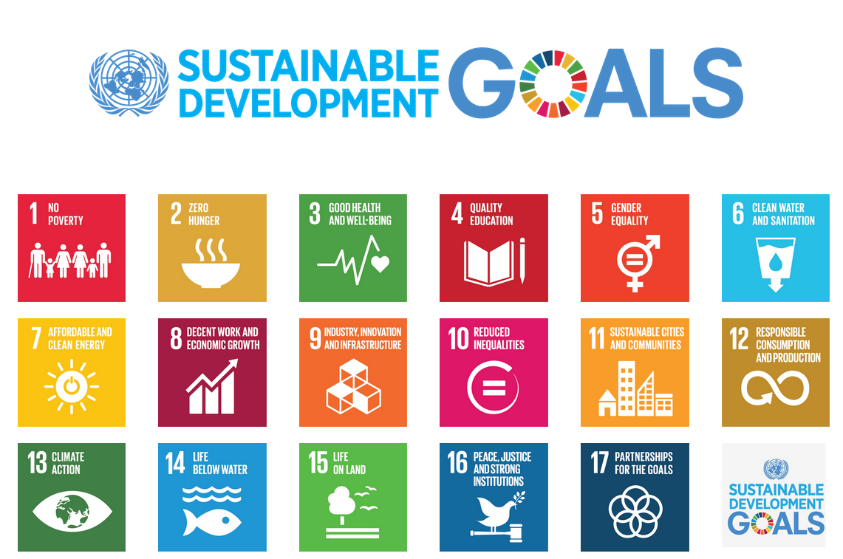
Notes:
On 1 January 2016, the 17 Sustainable Development Goals (SDGs) of the 2030 Agenda for Sustainable Development — adopted by world leaders in September 2015 at an historic UN Summit — officially came into force. Over the next fifteen years, with these new Goals that universally apply to all, countries will mobilize efforts to end all forms of poverty, fight inequalities and tackle climate change, while ensuring that no one is left behind.
The SDGs, also known as Global Goals, build on the success of the Millennium Development Goals (MDGs) and aim to go further to end all forms of poverty. The new Goals are unique in that they call for action by all countries, poor, rich and middle-income to promote prosperity while protecting the planet. They recognize that ending poverty must go hand-in-hand with strategies that build economic growth and addresses a range of social needs including education, health, social protection, and job opportunities, while tackling climate change and environmental protection.
While the SDGs are not legally binding, governments are expected to take ownership and establish national frameworks for the achievement of the 17 Goals. Countries have the primary responsibility for follow-up and review of the progress made in implementing the Goals, which will require quality, accessible and timely data collection. Regional follow-up and review will be based on national-level analyses and contribute to follow-up and review at the global level.

Slide 10
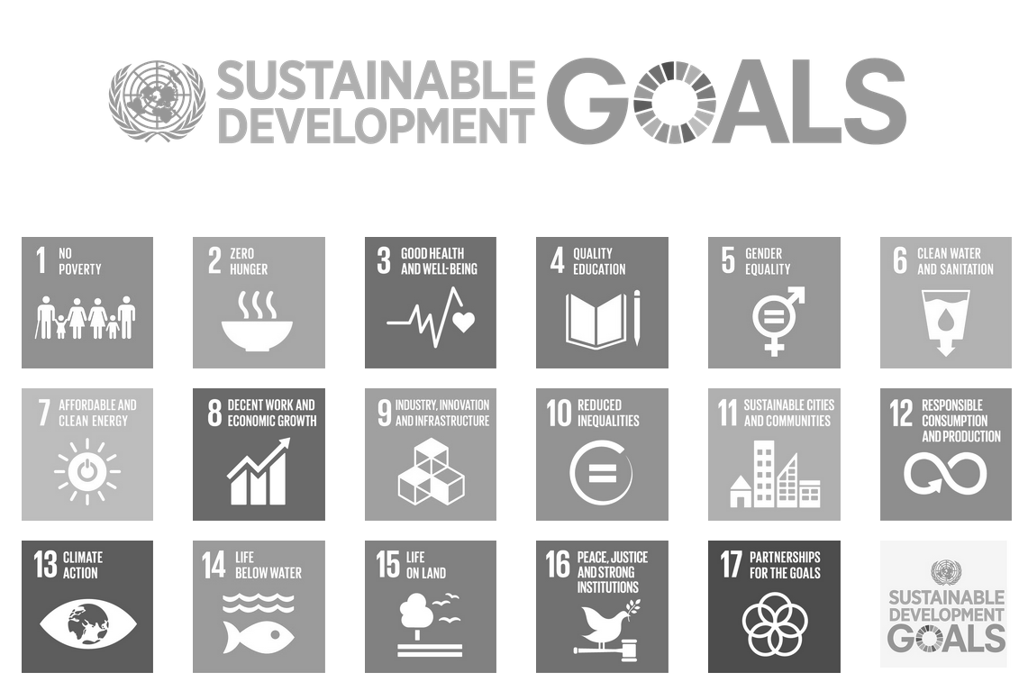
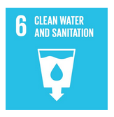
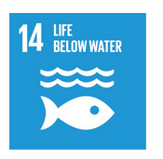
Notes:
On 1 January 2016, the 17 Sustainable Development Goals (SDGs) of the 2030 Agenda for Sustainable Development — adopted by world leaders in September 2015 at an historic UN Summit — officially came into force. Over the next fifteen years, with these new Goals that universally apply to all, countries will mobilize efforts to end all forms of poverty, fight inequalities and tackle climate change, while ensuring that no one is left behind.
The SDGs, also known as Global Goals, build on the success of the Millennium Development Goals (MDGs) and aim to go further to end all forms of poverty. The new Goals are unique in that they call for action by all countries, poor, rich and middle-income to promote prosperity while protecting the planet. They recognize that ending poverty must go hand-in-hand with strategies that build economic growth and addresses a range of social needs including education, health, social protection, and job opportunities, while tackling climate change and environmental protection.
While the SDGs are not legally binding, governments are expected to take ownership and establish national frameworks for the achievement of the 17 Goals. Countries have the primary responsibility for follow-up and review of the progress made in implementing the Goals, which will require quality, accessible and timely data collection. Regional follow-up and review will be based on national-level analyses and contribute to follow-up and review at the global level.

Slide 11

CBI A³
Builds on previous CBI experiments
Linking CERN technology to social needs by focusing on UN SDG (2030)
Developing conceptual design solutions for the future
Using Design Innovation Methods

Slide 12
CBI A³ program overview
Notes:
More info on the 2 week intensive coming soon

Slide 13
1. Connections:
Identified
problems
CERN
technology
Outcome:
define project direction – local challenge related to a water SDG with scope for CERN tech in the solution
Notes:
Lots of ideas and familiarity with multiple CERN techs gives best chance to find a meaningful connection. Not just applying technology for the sake of it.

Slide 14
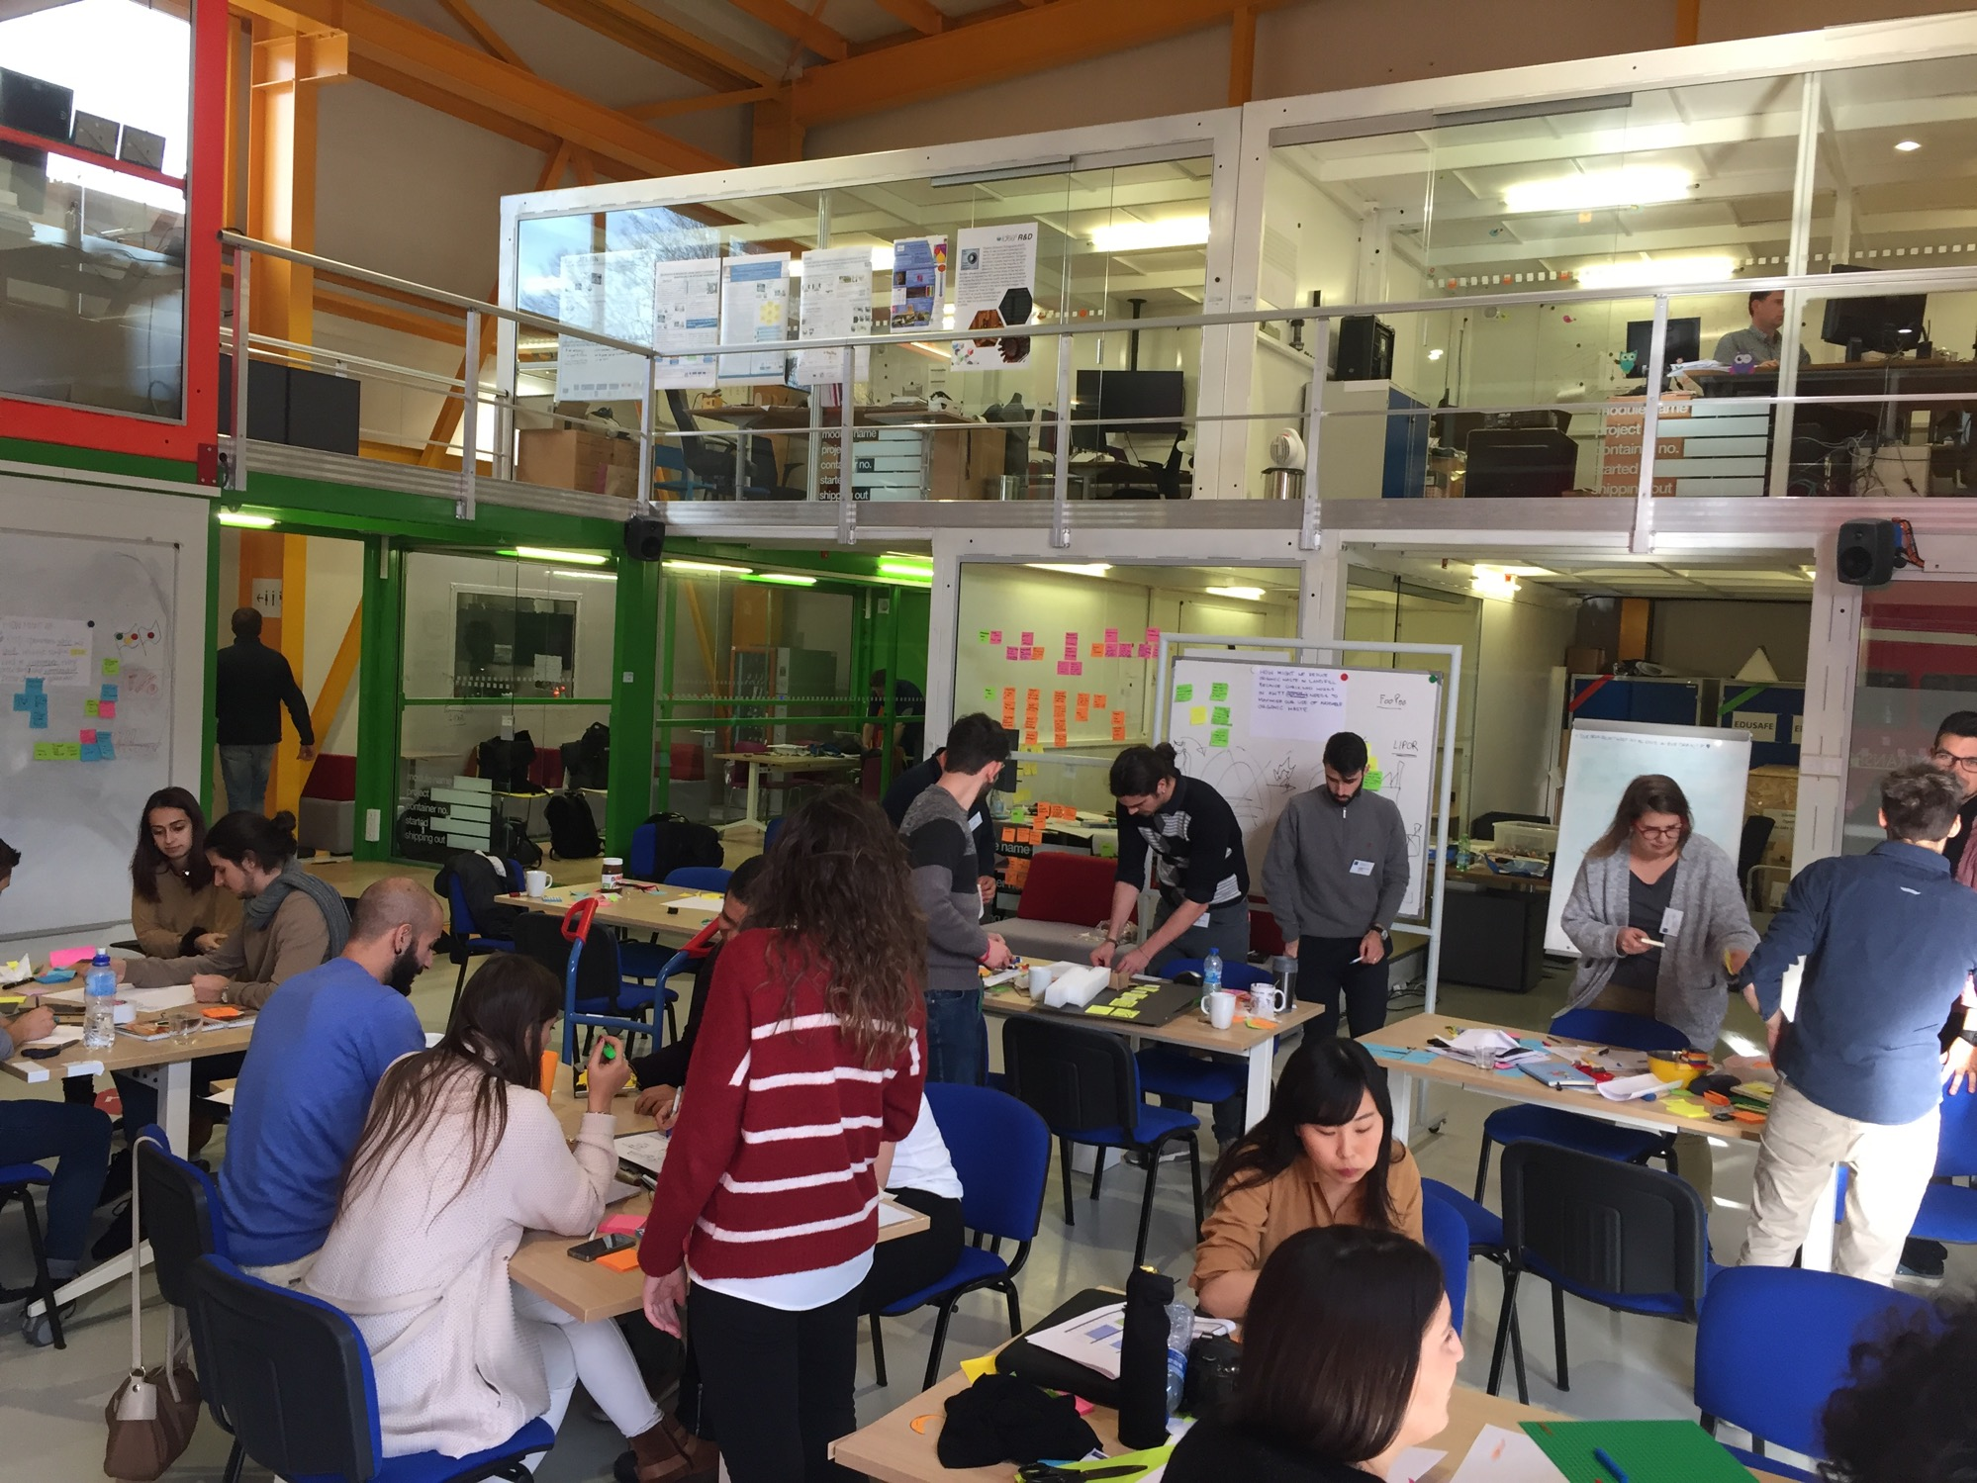
explore project ideas
CBI A³ jam is about…
immerse in CERN context
embrace innovation culture
have fun, experiment & learn
share global perspectives
Notes:
More info on the 2 week intensive coming soon

Slide 15
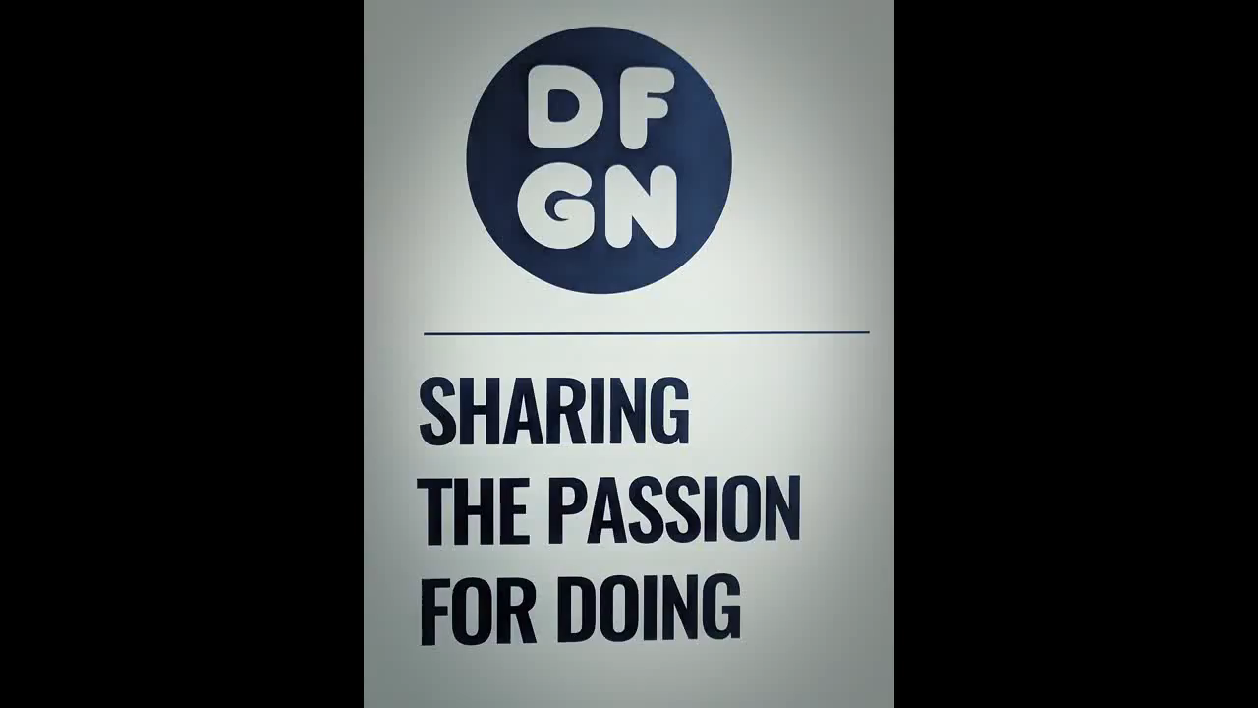
Movie

Slide 16
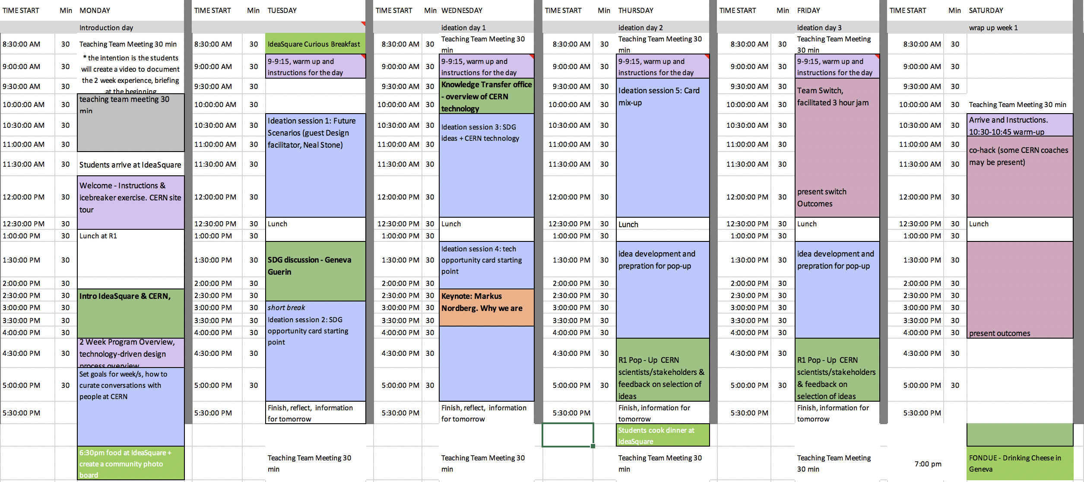
CBI A3 Jam - Week 1
* Schedule is dynamic & subject to ongoing tweaks & updates

Slide 17
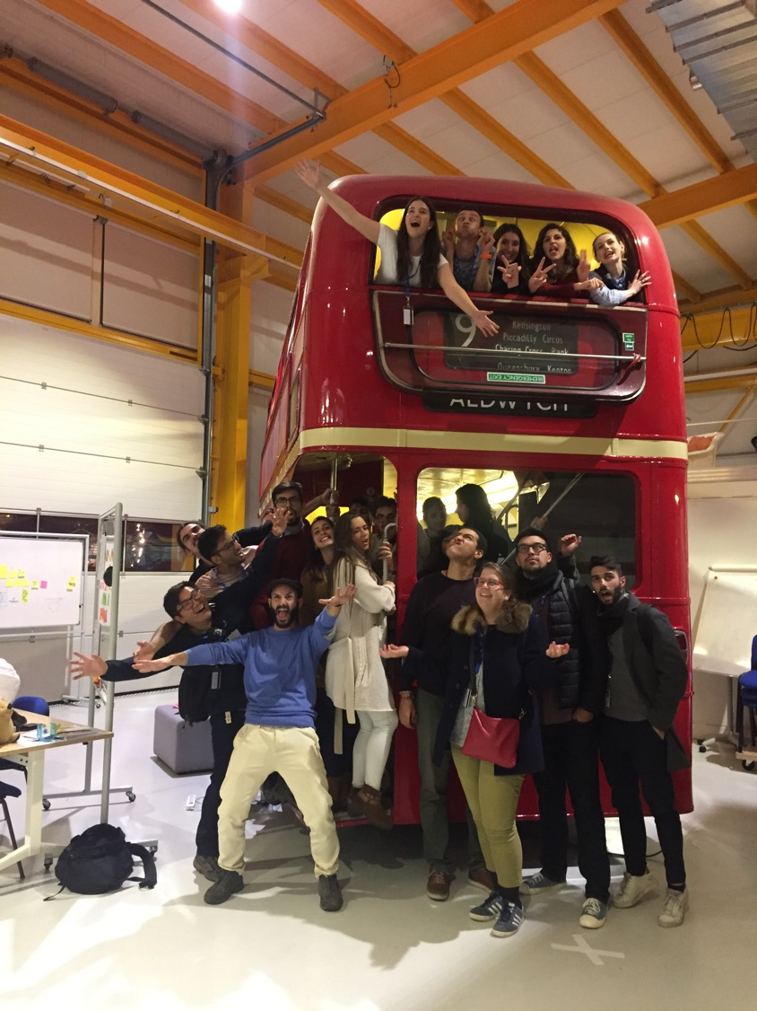
End of day reflections
CBI jam 2018
Daily warm-ups!
1 hour lunch break
Mixture of presentations & team time (structured & freestyle)

Slide 18
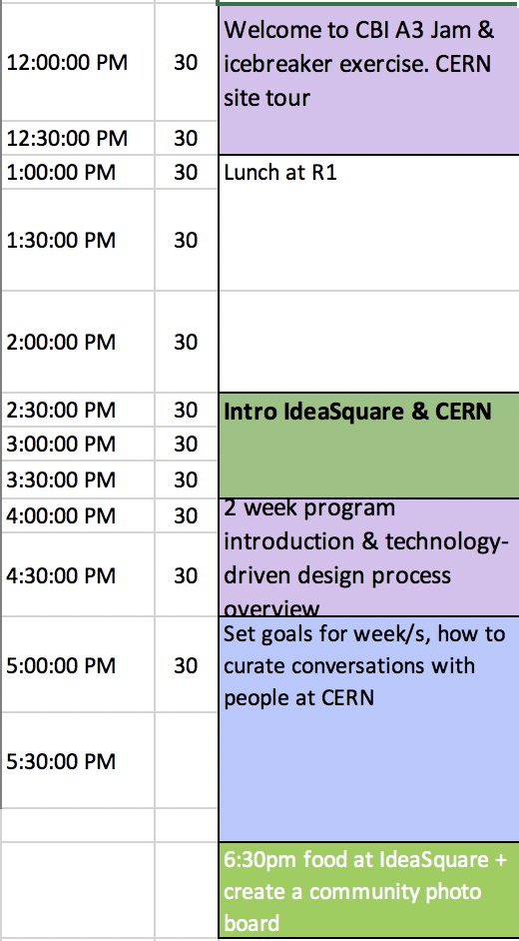
Todays schedule:

Slide 19

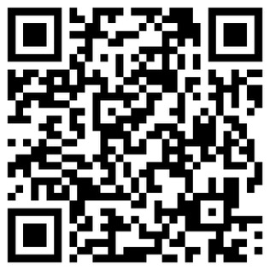
Communication:
WhatsApp group
https://chat.whatsapp.com/IbDzkoJExq2DK5Cby6fRu2

