Slide 1
CSC Track Finder upgrade
Focusing on algorithm logic now
  Design
  Performance evaluation
Hardware details will come later

Slide 2
CSC Track Finder upgrade
Current design is totally adequate for LHC luminosity
  2 LCTs (di-muon signal) + 1 (background) = 3 LCTs per Port Card per BX
With luminosity upgrade, we expect ~7 LCTs per Port Card per BX.
  Preliminary simulated data, no measurements so far
  Reality could be worse
Port Card becomes a bottleneck
Solution:
  Keep 2 Trigger Primitives per chamber
  Bring all LCTs to SP (18 per Port Card per BX), no filtering
    May keep the filtering option in Port Cards, in case it’s needed
See this talk by Darin Acosta for explanation of above numbers
  Based on simulations performed by A. Safonov and V. Khotilovich (TAMU)
Notes:
Explanation of Port Card as choking point for upgraded luminosity, proposed solution

Slide 3
SP upgrade
Current SP logic structure
Conversion of trigger primitives to
coordinates
BX adjustment to 2nd trig. primitive
Pt, φ, η calculation
Multiple Bunch Crossing Analysis
Extrapolation units
Track assembly
Sorting, ghost cancellation

Slide 4
Trig. Primitives → Coordinates
Wiregroup pattern
φ
Strip pattern
LUT
η
Chamber ID
Currently performed in large 2-stage LUTs
Unacceptable for upgrade – too much memory
  4MB per trig. primitive
  6 times more trig. primitives in upgraded design
  Need ~400 MB per SP

Slide 5
Trig. Primitives → Coordinates
For upgrade:
  Make conversion inside FPGA
  Combine LUTs and logic to reduce memory size
  We receive Trig. Primitives from all chambers
    no need to analyze Chamber ID
    saves precious LUT input bits
  Use different angular coordinates – φ with half-strip resolution and θ
    Why θ ?
      Allows for uniform angular extrapolation windows, no need to adjust them depending on θ
    Why φ with half-strip resolution?
      Makes conversion easier, for 80-strip 10° chambers (ME1/2, ME2/2, ME3/2, ME4/2) as easy as one addition with fixed value.
      Easier to handle in FPGA

Slide 6

Wiregroup → θ
θ₁
8-bit
Wiregroup
5 to 7-bit
θ
8-bit
Wiregroup
6-bit
+
LUT
32 to 128 cells
LUT
θ₂
8-bit
+
Strip₁
6-bit
θ conversion
all chambers except ME1/1
θ corrections
4-bit
LUT
WG MSB
2-bit
Strip₂
6-bit
WG₁ θ₁
WG₁ θ₂
LUT
WG MSB
2-bit
WG₂ θ₁
WG₂ θ₂
ME1/1 θ conversion
θ corrected and duplicated ☹ because of wire tilt (if chamber has 2 trig. primitives)

Slide 7
Strip → φ
Half-Strip
7 or 8-bit
φ in sector
10-bit
×F
+
Initial φ
10-bit (fixed)
corrected
φ in sector
12-bit
CLCT pattern 4-bit
φ correction
2-bit
LUT
Chamber | Strip angle | F
ME1/2, ME2/2, ME3/2, ME4/2 | 0.1333° | 1 (no multiplication)
ME2/1, ME3/1, ME4/1 | 0.2666° | 2 (shift)
ME1/1a | 0.2222° | 1.667
ME1/1b | 0.1695° | 1.272
ME1/3 | 0.1233° | 0.925
Use built-in multiplier or LUT. “F” factor depends on chamber type

Slide 8
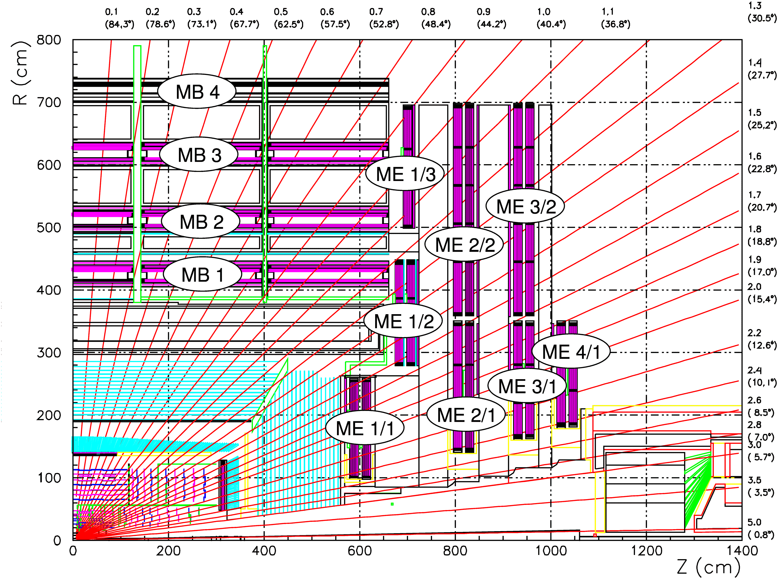
Geometry constraints for track building
Consider only physically allowed chamber combinations from one disk to the next in track extrapolations and in track assembly to reduce logic resources
Not all combinations need testing due to
  Limited bending in magnetic field (<10°) in φ
  Chamber coverage structure in θ view
η(θ)

Slide 9
Geometry constraints for track building
ME1→ME2
Total: 52 paths
ME1→ME3
Total: 58 paths
- means path to chamber directly behind

Slide 10
Geometry constraints for track building
ME1→ME4
Total: 42 paths
ME2→ME3, ME2→ME4, ME3→ME4
Total: 33 paths
- means path to chamber directly behind

Slide 11
Extrapolation units
What does extrapolation unit do?
  Compares trigger primitives from 2 stations (chamber layers)
  Checks that they are within certain “window” relative to each other
    |φ_{A} – φ_{B}| < max Δφ
    |θ_{A} – θ_{B}| < max Δθ
Window
Trig. primitive from
Station A
Trig. primitive from
Station B

Slide 12
Number of extrapolations
more θ EUs because of ME1/1 θ duplication
Try all wire-strip combinations for each CSC, to account for “ghosts”
  Currently done only for station 1
Extrapolation | φ EU | θ EU
ME1→ME2 | 208 | 248
ME1→ME3 | 232 | 336
ME1→ME4 | 168 | 272
ME2→ME3 | 132 | 132
ME2→ME4 | 132 | 132
ME3→ME4 | 132 | 132
ME1→MB1 | 32 ? | 0
ME2→MB1 | 32 ? | 0
Total | 1068 | 1252

Slide 13
Track Assembly Units
What does Track Assembly Unit do?
  Analyzes extrapolation results
  Attempts to build the best track from available trigger primitives

Slide 14
Track Assembly Units
Implementation:
  Find best extrapolations
    minimum φ difference between primitives
    valid θ extrapolations
  Make track out of corresponding segments
  Need to do that for each trig. primitive in key stations
Number of trigger primitives received from key stations
Key station | Current design | Upgraded design
ME2 | 3 | 18
ME3 | 3 | 18
ME4 | 3 | 18
ME2 in DT overlap | 3 | 12
Total | 12 | 66

Slide 15
Sorting and Ghost Cancellation
Purpose:
  Select 3 best tracks out of all track candidates
  Remove “ghosts” – multiple track candidates created by the same physical track
Implementation:
  Compare each candidate with all others
Problem:
  Sorting and Ghost Cancellation is already the largest part of SP design
  Logic size grows as square of the number of track candidates
  May not be able to afford this even with FPGAs available at the time of upgrade!

Slide 16
Track reconstruction logic:
Expanding Current design
Module | % in current design | increase factor | % upgraded
Multiple Bunch Crossing Analysis (BXA) | 8 % | 36 | 282 %
Extrapolation units (EU) | 23 % | 11 | 262 %
Track assembly (TAU) | 1 % | 4.5 | 4 %
Track parameters assignment (PAU) | 13 % | 4.5 | 57 %
Sorting, ghost cancellation (FSU) | 51 % | 20 | 1012 %
Output Multiplexor (MUX) | 2 % | 4.5 | 9 %
BX adjustment to 2nd trig. primitive (BXCORR) | 2 % | 1 | 2 %
Total | 100 % |  | 1628%
Total upgraded design size relative to current: about 16 times bigger
Main contributors: FSU, BXA, EU
That’s too big, may not find suitable FPGA for reasonable cost.

Slide 17
Pattern-based detection
Investigating another approach:
  Pattern-based detection
  Separately in φ and θ
  Once the patterns are detected, merge them into complete 3-D tracks
Benefits:
  Logic size reduction
  Size does not explode if 3 track segments per chamber are needed
  Certain processing steps become “natural”, logic for them is greatly simplified or removed
    Multiple Bunch Crossing Analysis
    Ghost Cancellation
    Assigning timing on second track segment

Slide 18
Pattern-based detection
Target: importing all available trig. primitives from all CSCs
Status: this section complete (initial attempt)
Starting integration and tests with CMSSW very soon
Trig. primitives to θ and φ conversion
Raw hit construction
Raw hit persistence (time extension)
φ and θ pattern detectors
best pattern selectors (3 in each zone,
total 12 best φ and 18 best θ patterns)
φ and θ pattern merging into 12 track candidates
selection of best three tracks,
precise φ, η, Pt assignment

Slide 19
Raw hit reconstruction: layers and zones
4 layers of chambers make up detector layers
Split the sector into zones according to phi and theta coverage
theta
phi

Slide 20
Zone boundaries
Phi
9 bit
Theta
7 bit

Slide 21
Raw hit construction
Based on simple decoders
Phi and theta coordinates converted to positional codes (hits)
Put into zones according to chamber that they came from

Slide 22
Raw hit persistence
Each raw hit is time-extended to 4 BX
The hits overlap in time, so delayed track segments can be taken into account by pattern detectors
This used to be BXA functionality

Slide 23
Pattern detectors
Phi pattern detection is in double strips, to save logic
  Detection precision seems to be sufficient
  Full 12-bit phi will be assigned to the best tracks
Phi patterns are constructed so that:
  They accommodate max 10 degree bending (ME1-ME2)
  High-PT (straightest) tracks are detected most precisely
  As bending increases, the precision becomes worse
  Minimum two layers must be hit
Quality code:
  The more layers – the better
  Patterns with ME1 hit have priority
Theta patterns are similar but simpler
  No bending in theta direction
ME
1234
Station
16
8
4
2
1
1
1
2
4
8
16
Number of di-Strips ORed
One of the patterns
Possible φ pattern envelope structure

Slide 24
Remaining steps
Best pattern selection in each zone
Merging phi and theta patterns into 12 track candidates
Three best tracks selection
Precise parameter assignment

Slide 25
Performance evaluation
Just starting to work on this
Great help from Bobby Scurlock with CMSSW
Approximate sequence:
  Raw primitives conversion into phi and theta (done)
  Straight tracks, “scan” the entire sector
  Multiple tracks, pileups, background
  Bent tracks, analyze ghosting
  Delayed segments, multiple BX processing
  General efficiency plots

