Slide 1
V6 Vertical insert upgrade
A. Macpherson, T. Mikkola, F. Peauger, P. Schneider
06/11/18

Slide 2
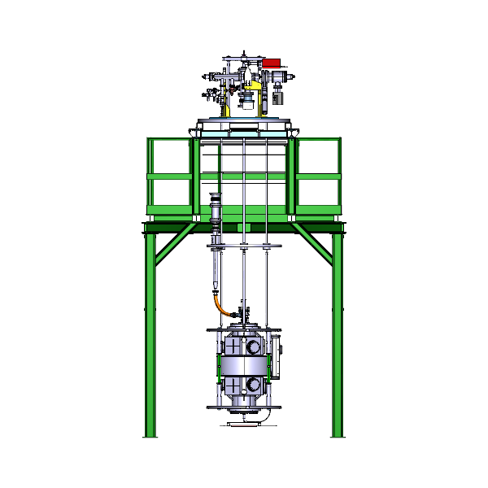
V6 Insert upgrade: Overview
Goal: standardise assembly & testing of SRF cavities in vertical cryostats
Objectives
  Preserve clean environment inside the cavity
  Minimise mechanical risks during insert assembly
    Avoid the 90 deg. rotation
  Permit improved RF testing
    Implement mobile coupler
  Develop standardise assembly infrastructure
  Accommodate both LHC and WOW cavities

Slide 3
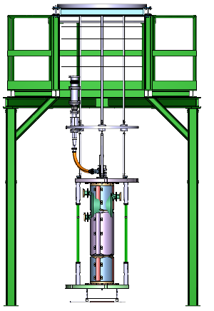
Insert Overview
Insert foreseen for 2 cavity types
  WOW & LHC

Slide 4
Various weights
LHC:
  Cavity : 150 kg
  Cavity + tank: 210 kg
  Cavity + tank + transport frame: 372 kg
  Cavity + tank + transport frame + insert infrastructure insert : 508 kg
WOW:
  Cavity: 287 kg
  Cavity + transport frame: 576 kg
  Cavity + frame + insert infrastructure: 660 kg
V6 top plate:
  No detailed model, but similar to V3 top plate =>weight ~ 968 kg.
Total maximum loads
  Cavity Unit
      LHC => 372 kg <=> fine for current installation sequence
      WOW => 576 kg <=> too heavy for current installation sequence
  V6 Insert (LHC cavity +tank): 1476 kg
  V6 Insert with WOW cavity: 1628 kg

Slide 5
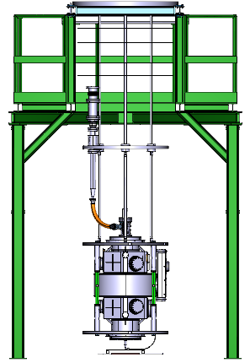
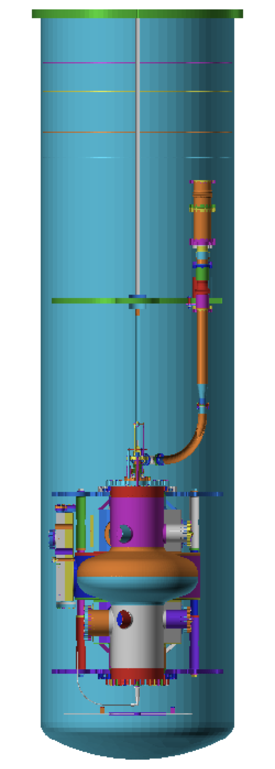
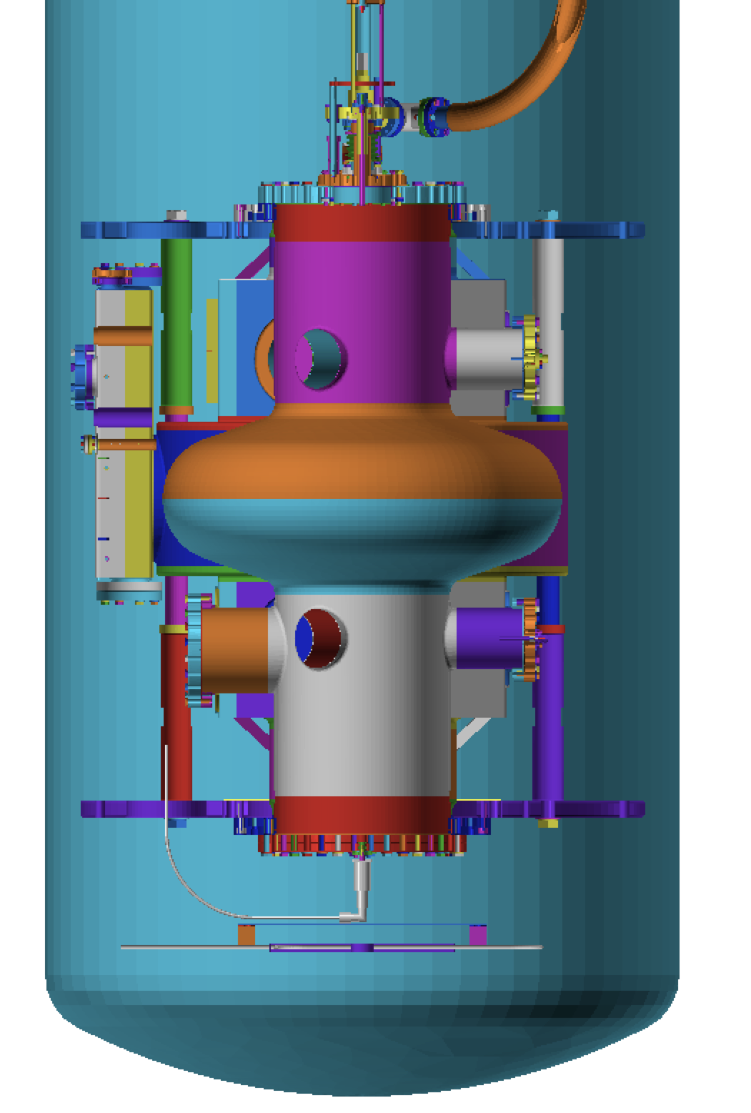
Insert Length
Defined so no risk of mechanical interference
Evaporator can circulate
cold gas without
cavity being in liquid
50 mm margin from floor
with existing green structure
100 mm margin from
end of cryostat cylinder

Slide 6
LHC vs WOW
To switch from LHC to WOW
  WOW must define its own transport frame
  Change the length of vacuum line connection
  Change length of rods that fix frame to insert
Shortened
Pumping
Line
Shortened
Supporting
Rods
WOW
Transport
Frame

Slide 7
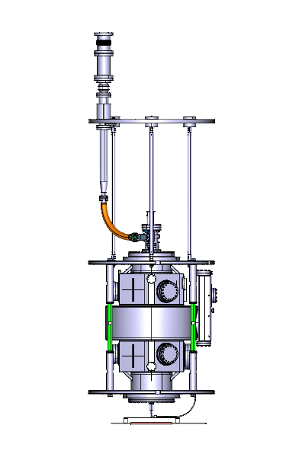
V6 insert modifications
Existing bellow
Pumping tube
Insulator
New bellow
Fixed Point
Pumping line
Flexible Line
Double Valve
assembly
50 mm margin from the floor with existing green structure

Slide 8
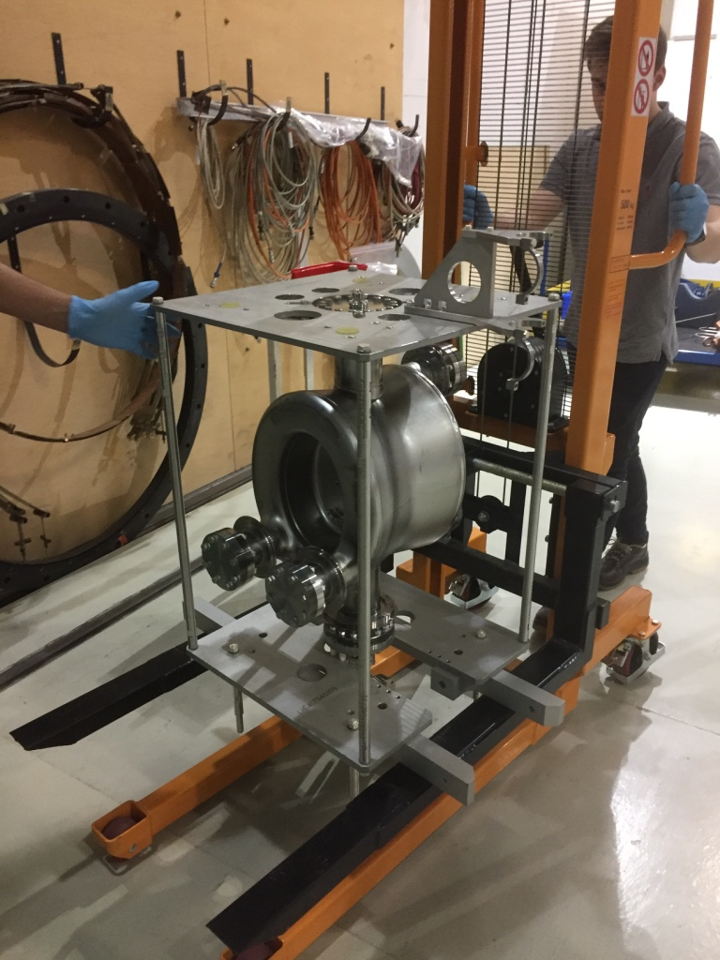
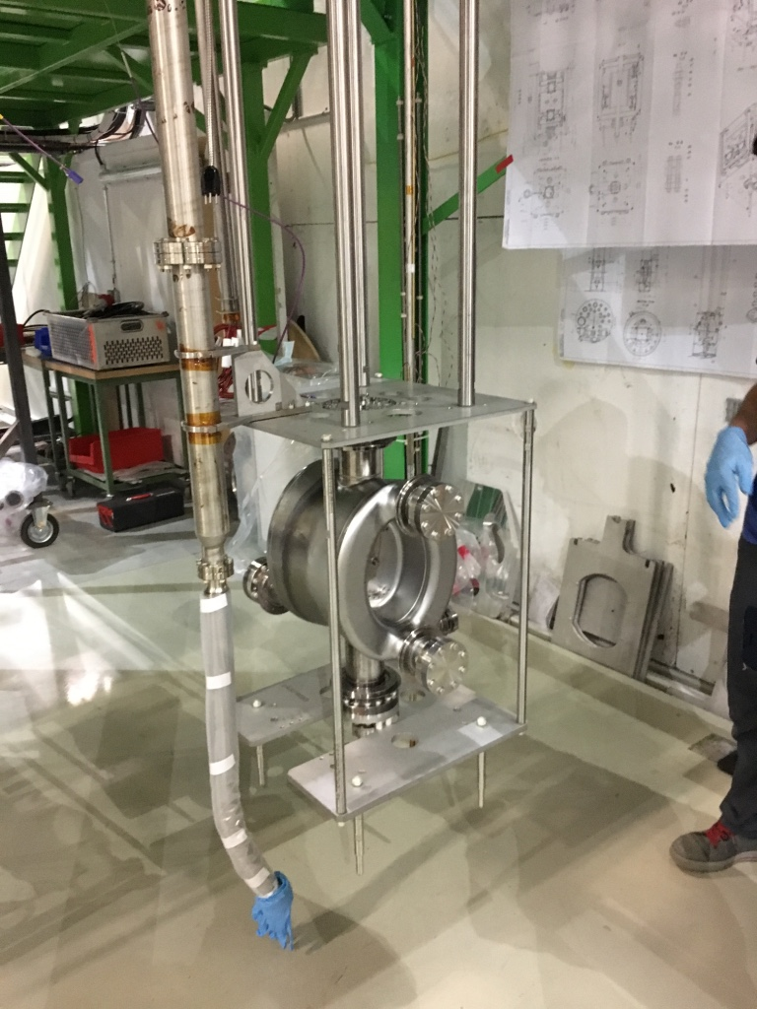
Installing Cavity on insert
Cavity + transport frame raised vertically
  Use Gerber to raise the cavity unit:
    Existing Gerber: Max load = 500kg
  Fix transport frame to supporting rods

Slide 9
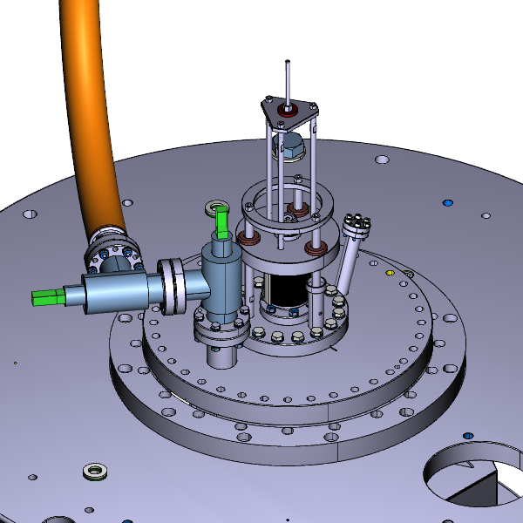
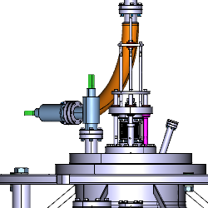
Top beam port connections
RF power: Via mobile coupler interface
Pumping line: Via DN40 flange on 2 angle valves
Optional: antenna port:
  not ideal as next to RF power antenna
Mobile coupler
Angle valve 1 to keep clean environnement inside the cavity
Angle valve 2 to keep the pumping line clean when disconnected
RF port

Slide 10
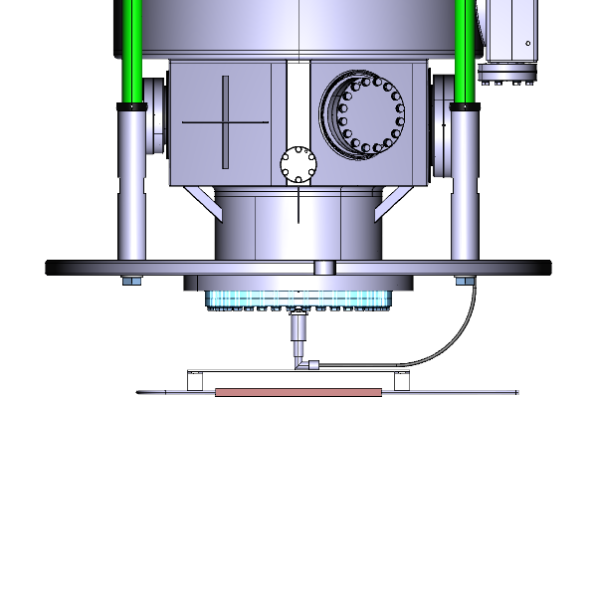
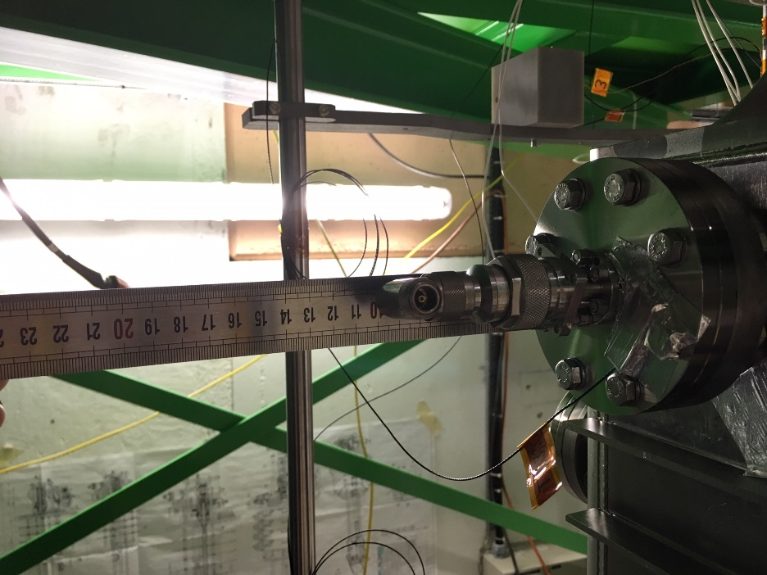
Bottom beam port
RF Pickup antenna
  Line requires elbow connection
Evaporator mounted below
Evaporator
RF connector and cable

Slide 11
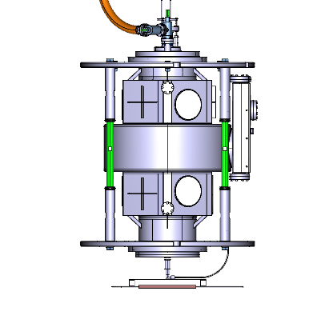
Warmup System
Heating system remains unchanged
Level gauge mounting remains unchanged
1kW Ceramic
heating straps
1kW Ceramic
heating straps
400W Evaporator

Slide 12
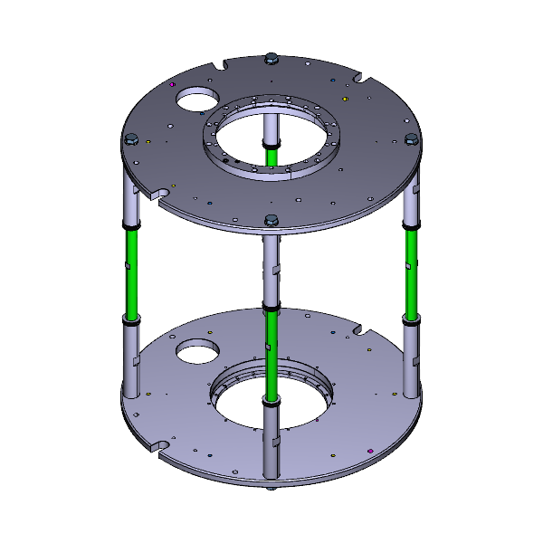
Transport Frame
Remains unchanged:
  Thermal contraction compensated via brass rods
    Cavity rigidly fixed top and bottom.
  Slots needed for cryo instrumentation
Brass rods
Instrumentation
slot

Slide 13
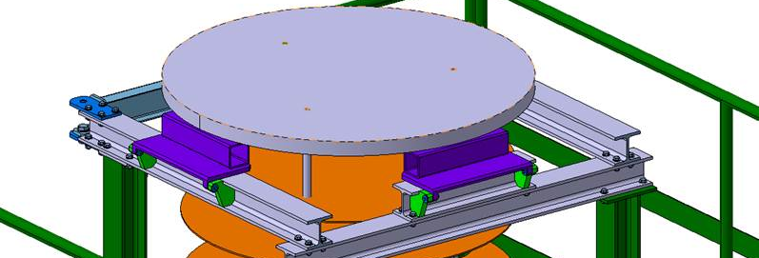
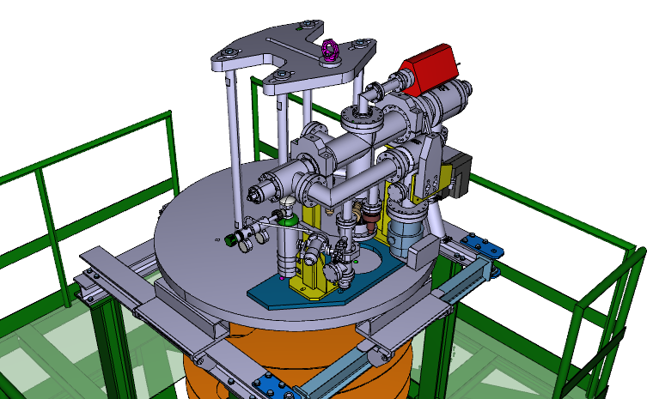
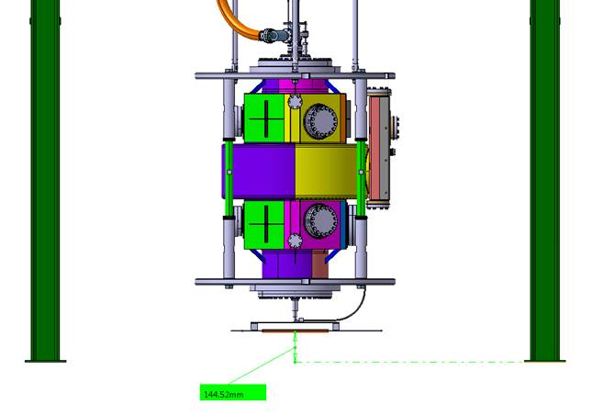
Installation on Green structure
V6 top plate smaller than V3/V4 top plate
  => need to adapt top of green assembly structure
    => add spacers dedicated to V6 insert
        => Gives additional space at floor
V6 Insert
structure spacer
144.5 mm

Slide 14
Summary
Insert re-design
  Allows for vertical assembly of insert
  Cavity stays clean/sealed through mount process
  Cavity transport Frame is un-modified
  Cavity top beam port flange needs to be changed
  Pumping line remains connected to top beam port
  Supports use of mobile coupler
  Pickup is well away from power coupler
  Heating system & cryogenic instrumentation unchanged
Note
  Design permits full electrical insulation of LHC frame
    implies minor modification of top plate of cavity transport frame (3x dia18.1 holes -> 3x M24 threads)

Slide 15
Significant improvements of V6 insert are feasible
  Minor changes to existing top plate => reduced costs:
  3D layout nearly finished, detailed drawings to be done
List of investments:
  1 beam port flange with 2 or 3 ports
  Two angle valves (all metals)
  1 flexible hose
  2 pumping lines with DN40 reduction (1 for LHC, 1 for WOW)
  1 pumping tube
  1 ceramic pumping line transition ( as per V3) for electrical isolation
  1 bellow + mechanical fixtures
Modifications
  Re-machining of 3 supprt rods for LHC, and 3 news rods for WOW
  Insert intermediate plate: Simple re-machining
  Green Assembly Structure: Needs spacers for smaller top plate

Slide 16
Spare slides

Slide 17
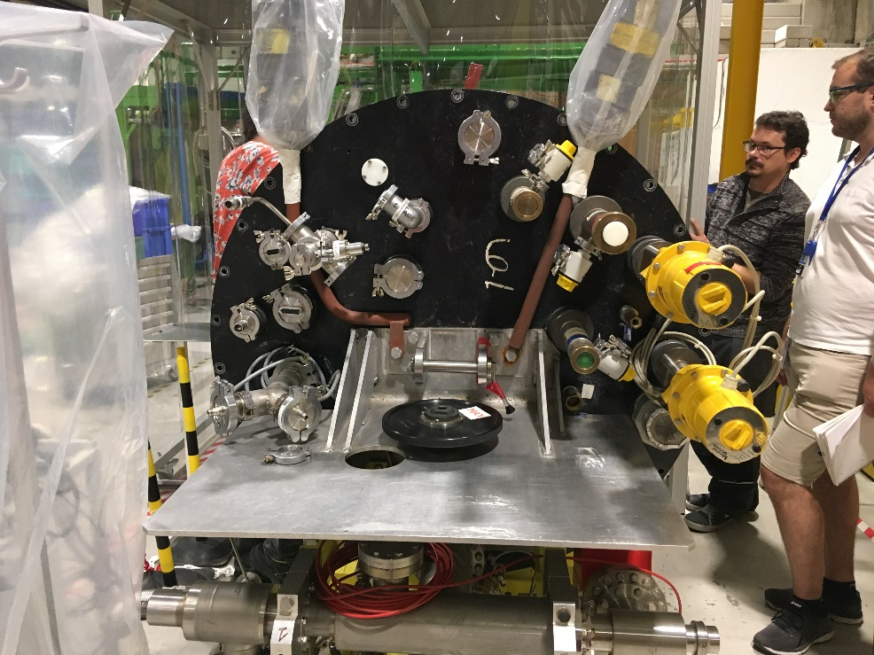
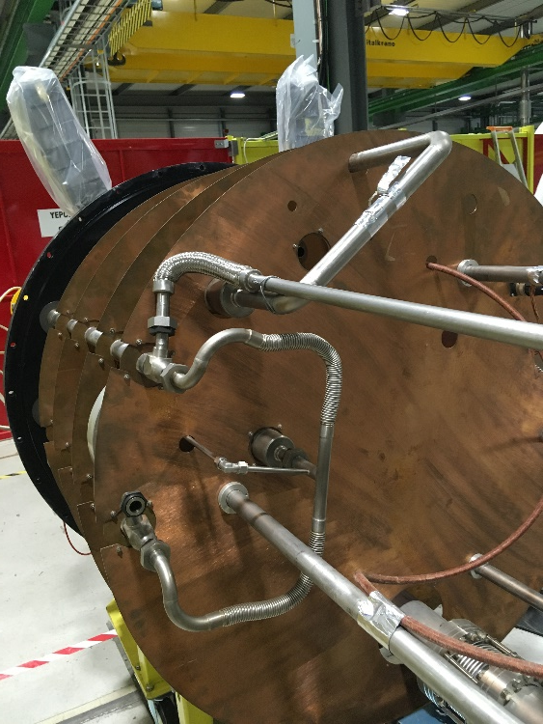
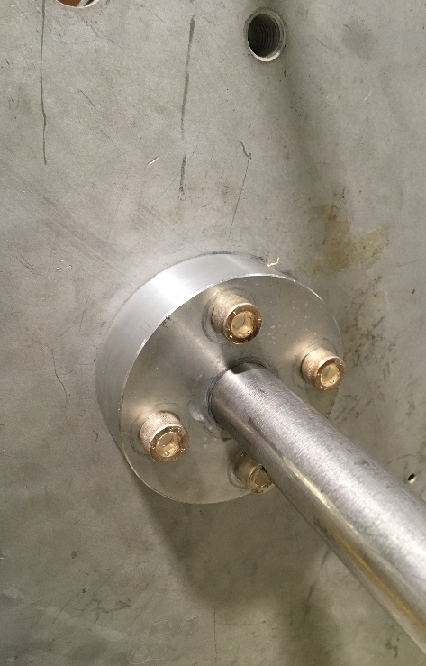
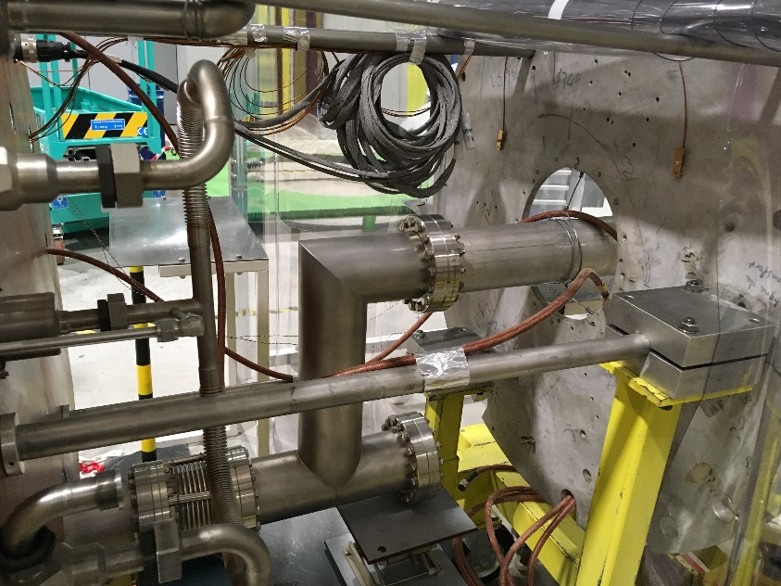
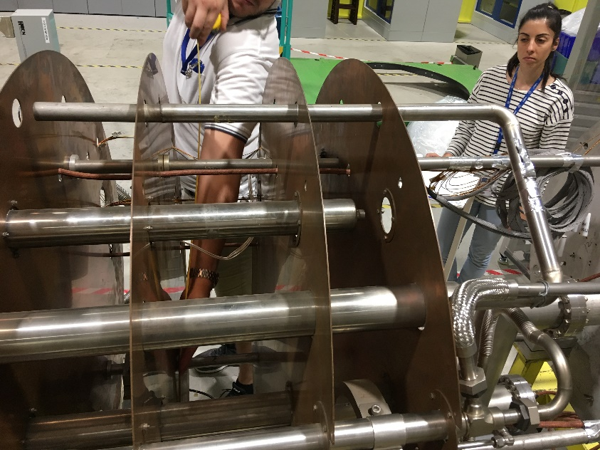
Pictures of the present V6 insert

Slide 18
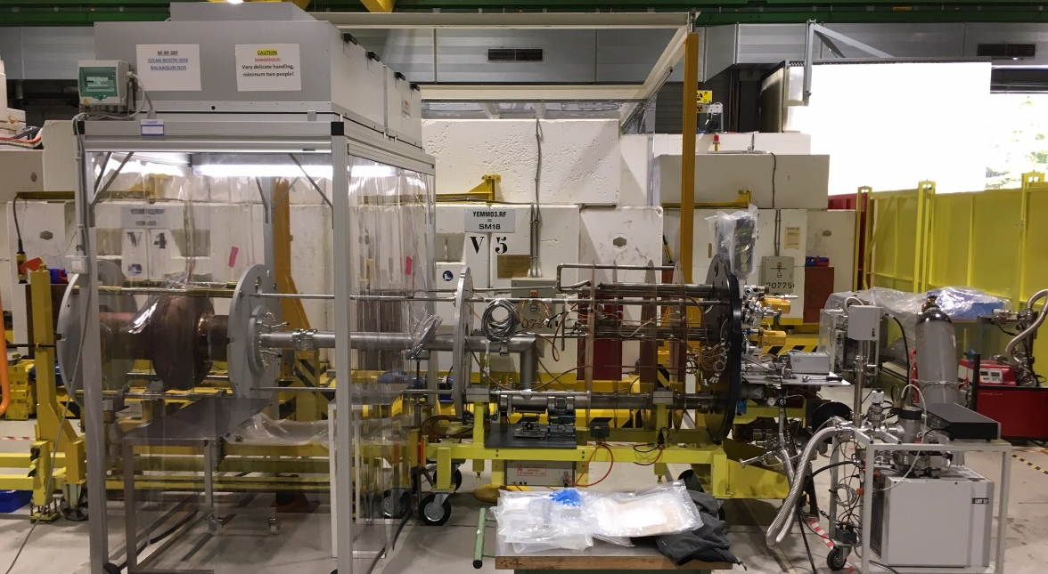
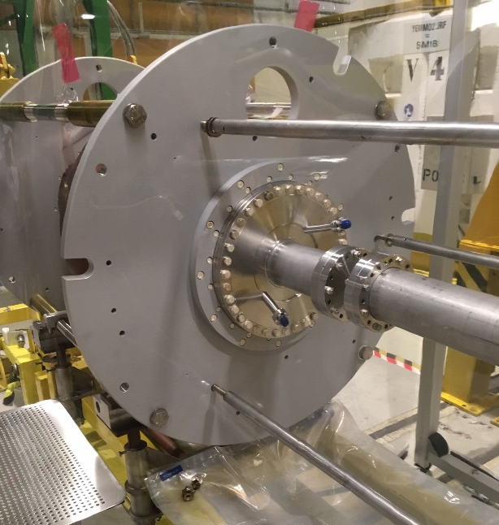
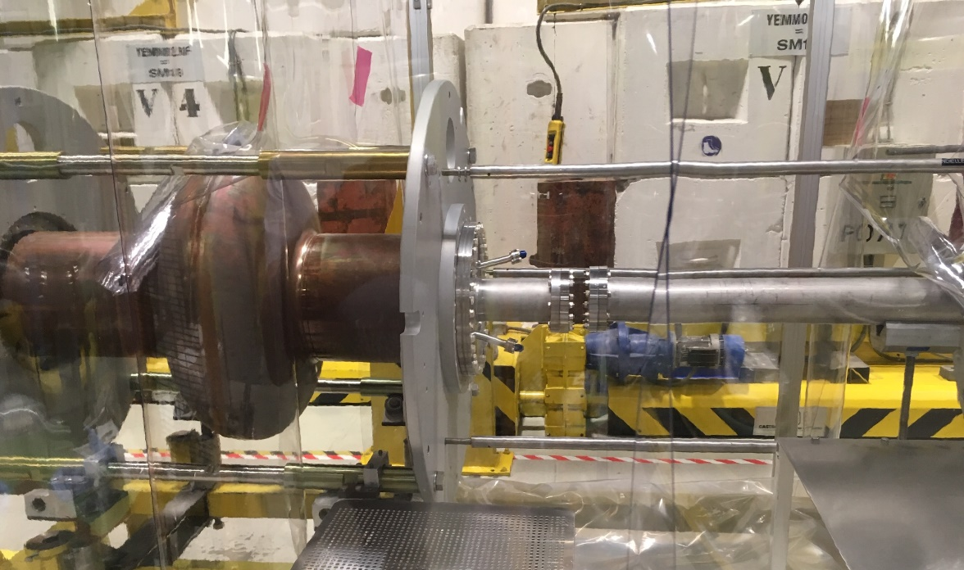
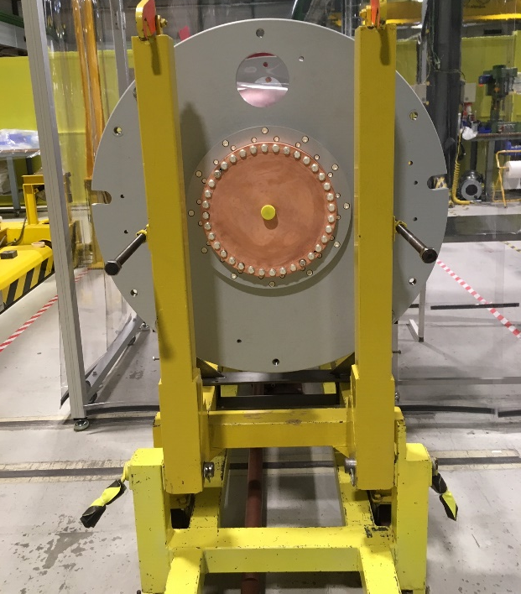
Pictures of the present V6 insert

