Slide 1
Firewall controversy and
Euclidean path integral approach
Dong-han Yeom
염동한
Asia Pacific Center for Theoretical Physics
아시아태평양이론물리센터

Slide 2
Firewall controversy and
Euclidean path integral approach
Dong-han Yeom
염동한
Asia Pacific Center for Theoretical Physics
아시아태평양이론물리센터

Slide 3
How can we define information of a black hole?
Preliminaries

Slide 4
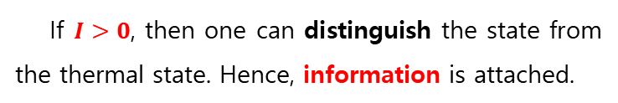

Preliminaries (Page, 1993)
states
B
A
states
states
$$I=S\left(B\right)−S(B|A)$$
If $I>0$, then one can distinguish the state from the thermal state. Hence, information is attached.

Slide 5
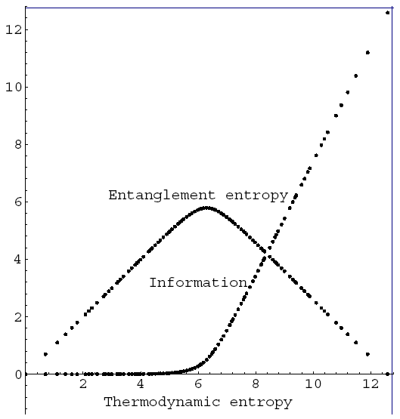

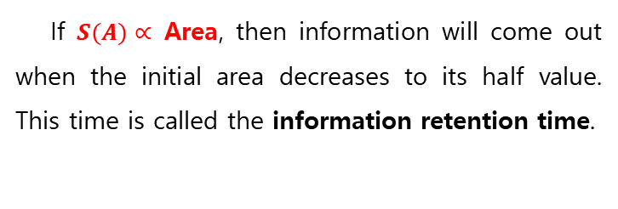

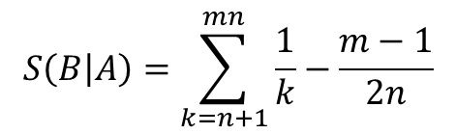



Page’s argument (Page, 1993)
$S\left(A∪B\right)=\log{N}$ = constant
$S(A)$ = black hole entropy
$$S(B)$$
$$I=S\left(B\right)−S(B|A)$$
$$S\left(B\right)=\log{m}$$
$$S\left(B | A\right)=\sum_{k=n+1}^{mn}{\frac{1}{k}−\frac{m−1}{2n}}$$
(For a pure and random system,
conjectured by Page, 1993; proven by Sen, 1996.)
If $S(A)∝$ Area, then information will come out when the initial area decreases to its half value. This time is called the information retention time.

Slide 6
(Reformulated) information loss problem (Hawking, 1976)
Let us assume that general relativity and quantum mechanics are all true. Also, we assume that the black hole area is proportional to the Boltzmann entropy.
According to the Page argument, after the information retention time, information should come out. Around the information retention time, the black hole is still large enough. Hence, Hawking radiation should carry information.
However, according to Hawking’s calculation, the radiation from the black hole is totally thermal.
How can we reconcile this tension?

Slide 7
Speculations toward black hole complementarity
Let’s believe that everybody was right.

Slide 8
Black hole complementarity (‘t Hooft, Susskind, …)
The principle of black hole complementarity says that no observer sees violation of natural laws.
For in-falling observer, general relativity is a good description.
For asymptotic observer, unitary semi-classical (local) quantum field theory is a good description.
Both observers are complementary: for any observer, unitarity of quantum mechanics and its consequences (e.g., no-cloning theorem) should be satisfied.

Slide 9
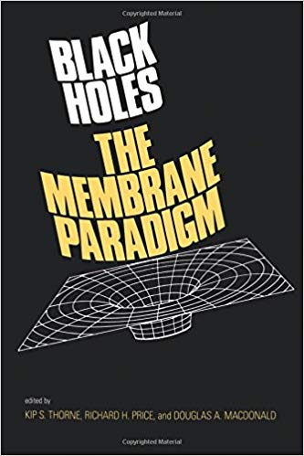
Membrane paradigm/D-brane picture (Thorne, Callan, Maldacena, …)
One strong motivation of black hole complementarity was the membrane paradigm.
Since it takes the infinite coordinate time to cross the event horizon, one may interpret that the outside observer never sees that the infalling matter crosses the horizon.
The infalling matter are attached by the stretched horizon outside the event horizon. This picture is consistent with the D-brane picture, where the interior of the black hole is identified to the D-branes which wrap the horizon.

Slide 10
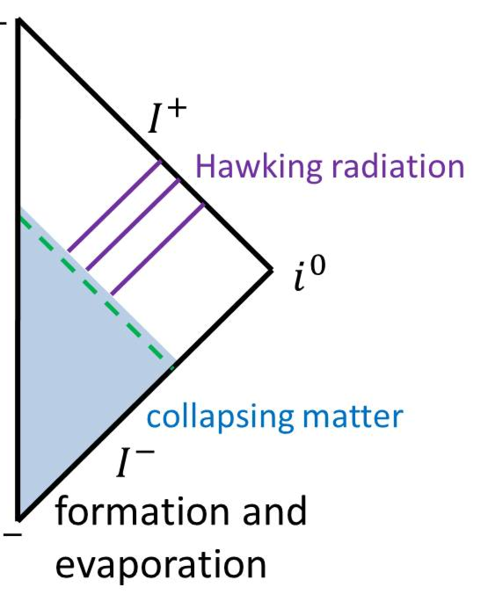
Membrane paradigm/D-brane picture (Thorne, Callan, Maldacena, …)
Then can there be a black hole formation?
There have been some suggestions that there is no formation of a true apparent horizon nor a singularity, e.g., Kawai-Matsuo-Yokokura model or Baccetti-Mann-Terno model.
However, after the detailed calculations, one can show that an apparent horizon as well as a singularity do form (Chen, Unruh, Wu and DY, 2018).
So, from the beginning, the physical ground of black hole complementarity was too poor.

Slide 11
Black hole complementarity (‘t Hooft, Susskind, …)
The principle of black hole complementarity says that no observer sees violation of natural laws.
For in-falling observer, general relativity is a good description.
For asymptotic observer, unitary semi-classical (local) quantum field theory is a good description.
Both observers are complementary: for any observer, unitarity of quantum mechanics and its consequences (e.g., no-cloning theorem) should be satisfied.
Are they consistent?

Slide 12

Duplication experiment (Susskind and Thorlacius, 1994)

Slide 13
Duplication experiment (Susskind and Thorlacius, 1994)
Information duplication?

Slide 14



Duplication experiment (Susskind and Thorlacius, 1994)
Is a duplication experiment possible?
information retention time
$$\sim τ \sim M^{3}$$
$$∆t \sim e^{− \frac{τ}{r_{0}}}\sim e^{−M^{2}}$$
$$∆E \sim { e}^{M^{2}}>M$$
Safety condition of duplication

Slide 15
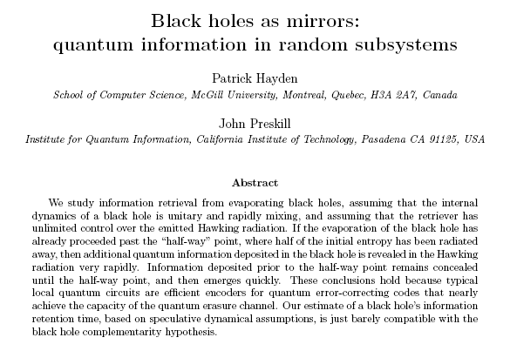
Scrambling time

Slide 16



Duplication experiment
scrambling time
$$\sim τ \sim M\log{M}$$
$$∆t \sim e^{− \frac{τ}{r_{0}}}\sim 1/M$$
$$∆E \sim M≥M$$
Marginally safe
No observer can see the duplication of information. Therefore, two observers are complementary. (Susskind, Thorlacius and Uglum, 1993; Susskind and Thorlacius, 1994)

Slide 17
Two arguments against black hole complementarity
Large N rescaling and AMPS arguments

Slide 18
Large N rescaling (DY and Zoe, 2011)
singularity
event horizon
apparent horizon

Slide 19
Large N rescaling (DY and Zoe, 2011)

Slide 20
Large N rescaling (DY and Zoe, 2011)

Slide 21


Large N rescaling (DY and Zoe, 2011)

Slide 22






Application to black hole complementarity
For the information retention time
➔
For the scrambling time
➔

Slide 23
So what?
Duplication of information is observable, if there are many scalar fields within the semi-classical limit.
Regarding the information retention time, the required scalar field is exponentially large. However, regarding the scrambling time, the required scalar field can be sufficiently reduced.
Hence, black hole complementarity can be violated by duplication experiments.

Slide 24
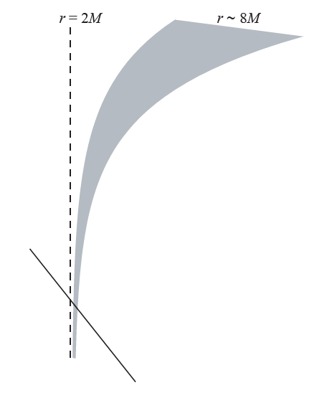




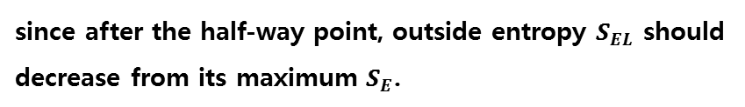

AMPS arguments (Almheiri, Marolf, Polchinski and Sully, 2012)
$$S_{EL}+S_{LF}≥S_{L}+S_{ELF}$$
strong subadditivity
$$\left|S_{E}−S_{LF}\right|≤S_{ELF}≤S_{E}+S_{LF}$$
subadditivity
First,
$$S_{EL}<S_{E}$$
since after the half-way point, outside entropy $S_{EL}$ should
decrease from its maximum $S_{E}$.
infalling part F
later part L
Second,
since nothing happens for free-falls.
$$S_{LF}=0$$
In the end, $S_{L}<0$?
information retention time
earlier part E

Slide 25
Firewall controversy
Which natural law should we throw out?
General relativity
Quantum mechanics
Bekenstein-Hawking formula

Slide 26
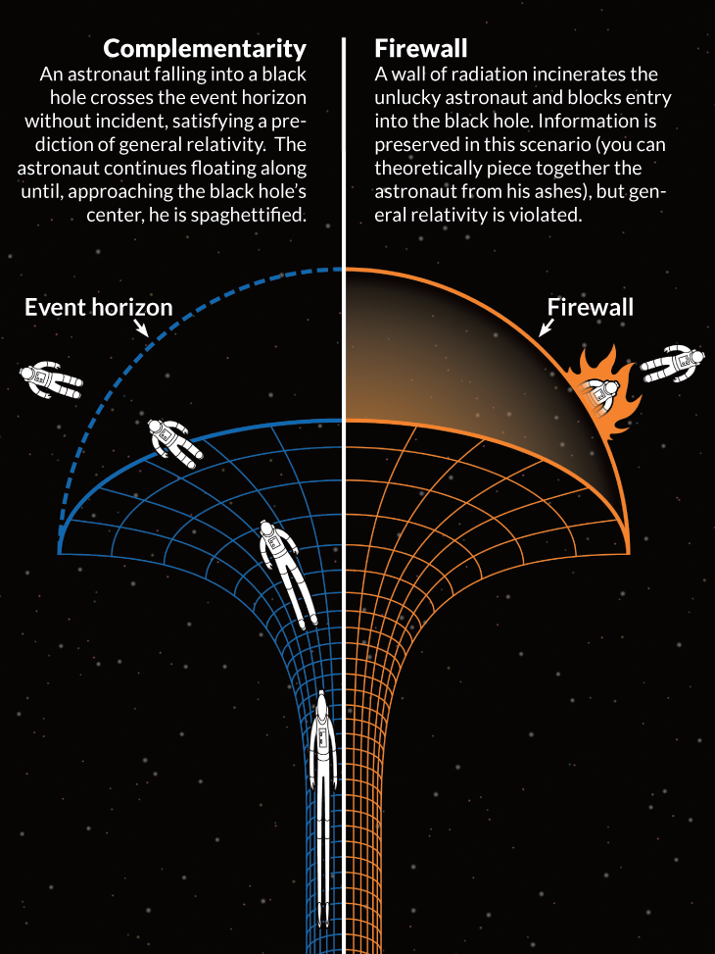
AMPS gave up GR: firewall

Slide 27
If there is a firewall, it can be naked!
Hwang, Lee and DY, 2013; Kim, Lee and DY, 2013
Chen, Ong, Page, Sasaki and DY, 2016

Slide 28
Can we construct a firewall?
Embed to string-inspired model?
Kang and DY, 2019 (appear tomorrow)

Slide 29
Can we construct a firewall?
Embed to string-inspired model?
Kang and DY, 2019 (appear tomorrow)

Slide 30
More on naked firewall
Weak-coupling limit:
Manifestly, there is no interior.

Slide 31
More on naked firewall
Strong-coupling limit:
Eventually, it rapidly disappears.
Junction equation for star-like interior
Condition for w = -1
stable region exists

Slide 32
A bird’s-eye view for candidate resolutions

Slide 33
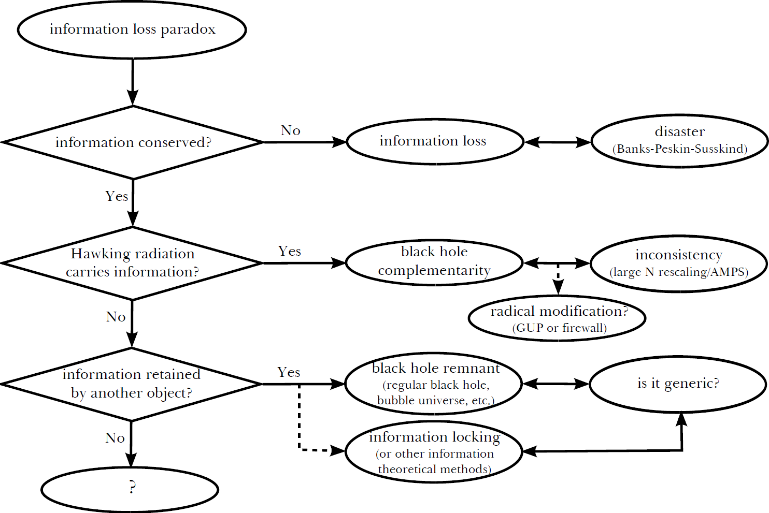
A bird’s-eye view (from Chen, Ong and DY, 2014)

Slide 34
A bird’s-eye view: Information loss vs. unitarity
Hawking, 1976
Banks, Peskin and Susskind, 1984
Wald and Unruh, 1995
Maldacena, 1997; Witten, 1998

Slide 35
A bird’s-eye view: Black hole complementarity controversy
Thorne (Membrane paradigm), 1986
‘t Hooft, 1990
Strominger and Vafa, 1995
Callan and Maldacena, 1996
Polchinski, Preskill, etc.
DY and Zoe, 2008; 2011
Almheiri, Marolf, Polchinski and Sully, 2012
Susskind, Thorlacius and Uglum, 1993
Page, 1993
Almheiri, Marolf, Polchinski and Sully, 2012
Hwang, Lee and DY, 2013
Kim, Lee and DY, 2013
Chen, Ong, Page, Sasaki and DY, 2015

Slide 36
A bird’s-eye view: Remnant picture
Adler, Chen and Santiago, 2001
Bardeen, 1968
Ashtekar and Bojowald, 2005
Farhi, Guth and Guven, 1989
Review: Chen, Ong and DY, 2014
Horowitz and Maldacena, 2003
Smolin and Oppenheim, 2006

Slide 37
A bird’s-eye view
Maldacena, 2001; Hawking, 2005
Sasaki and DY, 2014

Slide 38
Euclidean path integral approach and the resolution of the information loss problem
Maldacena, 2001; Hawking, 2005
Sasaki and DY, 2014
Lee, Lee and DY, 2015
Chen, Domenech, Sasaki and DY, 2015; 2017
Chen, Hu and DY, 2015

Slide 39
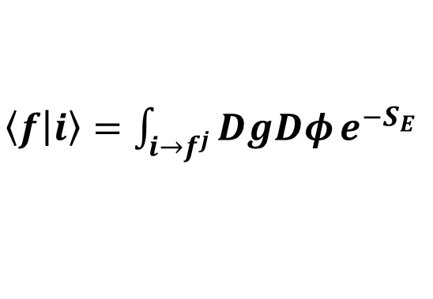

Understanding information loss problem
$\left\langle f | i\right\rangle =\int_{i→f^{j}}^{ }{DgDφ}e^{−S_{E}}$
$$|i⟩$$

Slide 40


Understanding information loss problem
$\left\langle f | i\right\rangle =\int_{i→f^{j}}^{ }{DgDφ}e^{−S_{E}}$
$$|f^{1}⟩$$
$$|i⟩$$

Slide 41



Understanding information loss problem
$\left\langle f | i\right\rangle =\int_{i→f^{j}}^{ }{DgDφ}e^{−S_{E}}$
…
$$|f^{1}⟩$$
$$|f^{j}⟩$$
$$|f⟩=\sum_{j}{a_{j}|f^{j}⟩}$$
$$|i⟩$$
Hartle and Hertog, 2015

Slide 42
Understanding information loss problem
$\left\langle f | i\right\rangle =\int_{i→f^{j}}^{ }{DgDφ}e^{−S_{E}}$
…
$$|f^{1}⟩$$
$$|f^{j}⟩$$
$$|f⟩=\sum_{j}{a_{j}|f^{j}⟩}$$
$$|i⟩$$

Slide 43
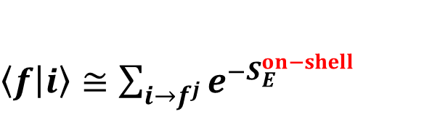
Understanding information loss problem
$\left\langle f | i\right\rangle ≅\sum_{i→f^{j}}^{ }{e^{−S_{E}^{on−shell}}}$
…
$$|f^{1}⟩$$
$$|f^{j}⟩$$
$$|f⟩=\sum_{j}{a_{j}|f^{j}⟩}$$
Lorentzian
Euclidean
Lorentzian
$$|i⟩$$

Slide 44


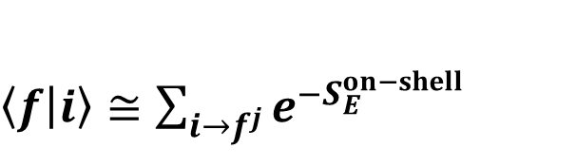
Understanding information loss problem
$\left\langle f | i\right\rangle ≅\sum_{i→f^{j}}^{ }{e^{−S_{E}^{on−shell}}}$
…
$$|f^{1}⟩$$
$$|f^{j}⟩$$
$$|f⟩=\sum_{j}{a_{j}|f^{j}⟩}$$
If there is a trivial geometry,
then every correlations will be recovered by
the geometry.
Information exists in the wave function.
Lorentzian
Euclidean
Lorentzian
$$|i⟩$$

Slide 45
Understanding information loss problem
$\left\langle f | i\right\rangle ≅\sum_{i→f^{j}}^{ }{e^{−S_{E}^{on−shell}}}$
…
$$|f^{1}⟩$$
$$|f^{j}⟩$$
$$|f⟩=\sum_{j}{a_{j}|f^{j}⟩}$$
If there is a trivial geometry,
then every correlations will be recovered by
the geometry.
Information exists in the wave function.
The asymptotic observer should superpose
geometries: GR may not be satisfied.
Lorentzian
Euclidean
Lorentzian
$$|i⟩$$

Slide 46

Understanding information loss problem
$\left\langle f | i\right\rangle ≅\sum_{i→f^{j}}^{ }{e^{−S_{E}^{on−shell}}}$
$$|f^{1}⟩$$
If one follows only one dominant history,
then information cannot be recovered,
though GR and local QFT can be satisfied.
“Effective loss of information”
$$|i⟩$$

Slide 47


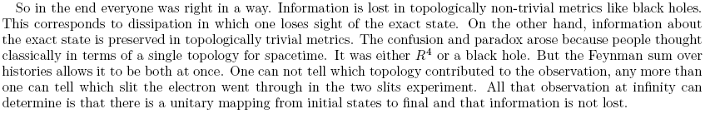
Maldacena argument, revisited (Maldacena, 2001)
black hole
AdS (in-state)
AdS (out-state)
trivial
Hawking, 2005

Slide 48
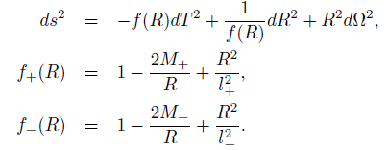

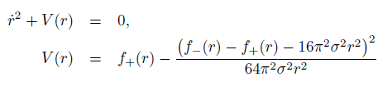
Example: True vacuum bubble in AdS
Let us consider the true vacuum bubble in AdS.
outside:
inside:
junction equation:
effective potential:

Slide 49

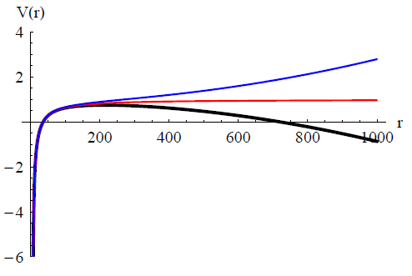
Example: True vacuum bubble in AdS
For given , , and ,
there exists such that allows a bouncing solution,
even for a large (hence, eternal) black hole in AdS.

Slide 50
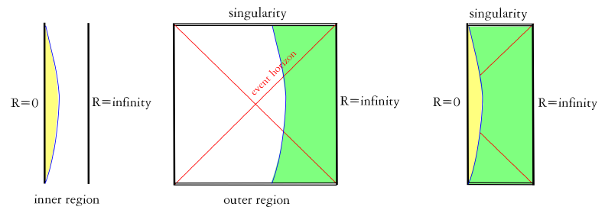
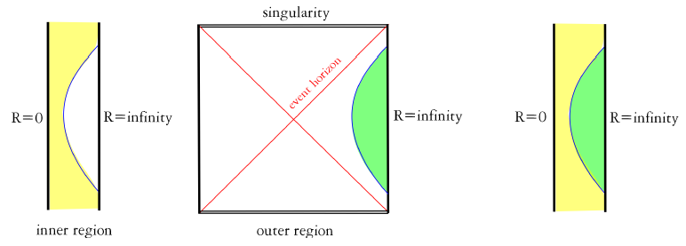
Classical trajectories

Slide 51
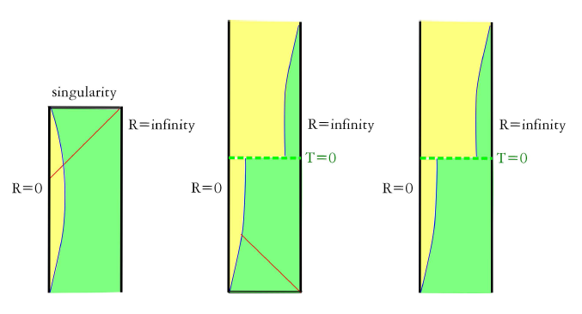
Power of non-perturbative effects
Semi-classical geometry
Fischler-Morgan-Polchinski tunneling
(non-perturbative process)
toward trivial topology

Slide 52
Power of non-perturbative effects
Semi-classical observer (non-unitary)
GR and QFT hold, the most probable history

Slide 53
Power of non-perturbative effects
Unitary observer
Doesn’t have to satisfy GR: firewall phenomena

Slide 54
Comments and future aspects
One can show that very generically there exists an instanton toward the trivial geometry (Chen, Sasaki and DY, 2018).
One needs to check whether this is enough to explain the information loss problem or not.
The nature of dynamical spherical symmetric instantons needs to be investigated further.

