Slide 1
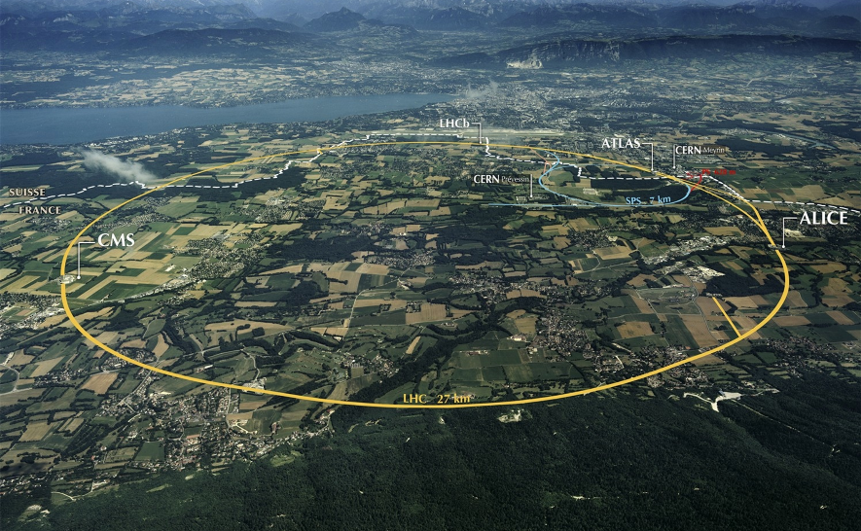
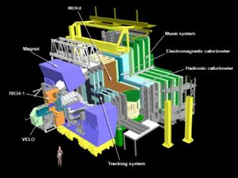
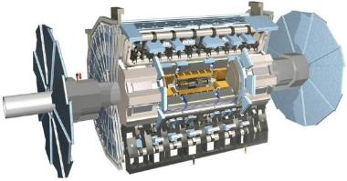
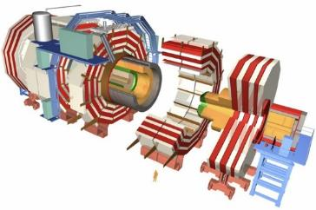
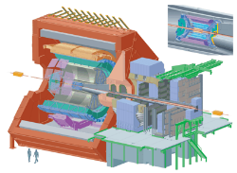
IHEP with HSF
>1 GB/s
~700 MB/s
~10 GB/s
Xiaomei Zhang
Institute of High Energy Physics
November 8, 2018

Slide 2





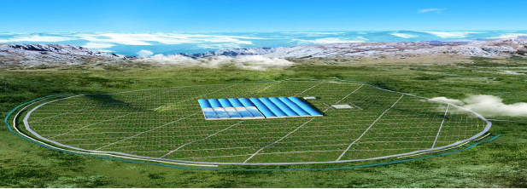
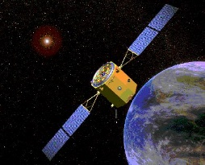


IHEP Experiments (Reminder)
Collider :
  BESIII – Study physics on tau-charm energy region
  CEPC – Precision measurement of the Higgs/Z boson
Neutrino :
    DayaBay – measurement of the missing angle
    JUNO -- determine neutrino mass hierarchy and precisely measure oscillation parameters
Astrophysics:
    LHAASO -- detector array for high energy gamma ray and cosmic ray detection （after YBJ)
    Ali -- Observation of Gravitational Waves
    HXMT/eXTP -- X-ray astronomy satellite for high energy astrophysical space observations
LHAASO
HXMT

Slide 3
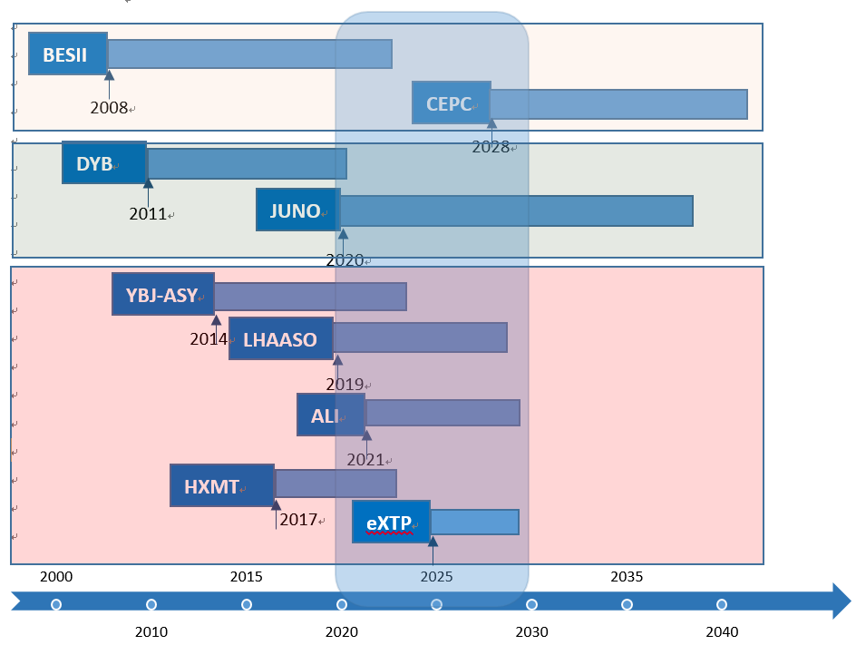
Time line （Reminder）

Slide 4
IHEP software and computing team
IHEP software team (mainly from experiments, also from computing center)
  BESIII
  JUNO
  CEPC
IHEP computing team (from IHEP computing center)
  HTCondor Cluster
  Storage ( Lustre, EOS, Castor)
  Network
  Database and Web services
  Distributed computing
~20 staffs for software, ~37 staffs for computing

Slide 5
BESIII software (1)
  BESIII is in its 10th year and software is mostly stable
    Use Gaudi as the underlying software framework from the beginning
  With large aggregated data, analysis will become a significant part of BESIII data processing
  I/O is bottleneck for physics analysis
  Some studies on speeding up analysis already started a few years ago
    Partial Waves Analysis with GPU
      Got experience, but only used by small groups due to complexity
      Would like to extend it to the whole group in an easy way
    High performance analysis clusters based on Hadoop
      BESIII Physical Analysis on Hadoop Platform (CHEP2103)

Slide 6
BESIII software (2)
  Data analysis would be their interested points
  In the following 2 years, inner chamber of MDC is planned to be upgraded with CGEM, development of corresponding software is one of main task.
    The research of application of machine learning in PID or tracking is ongoing
    They are also interested in ML for recontruction
  Also interested in Gaudi new features on Accelerator and Multi-threading

Slide 7
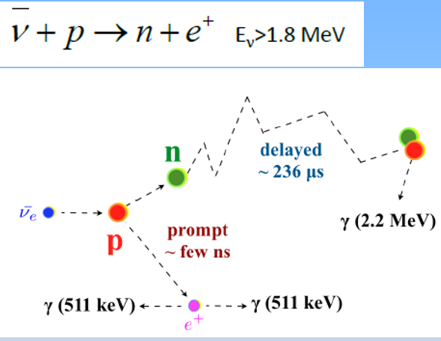
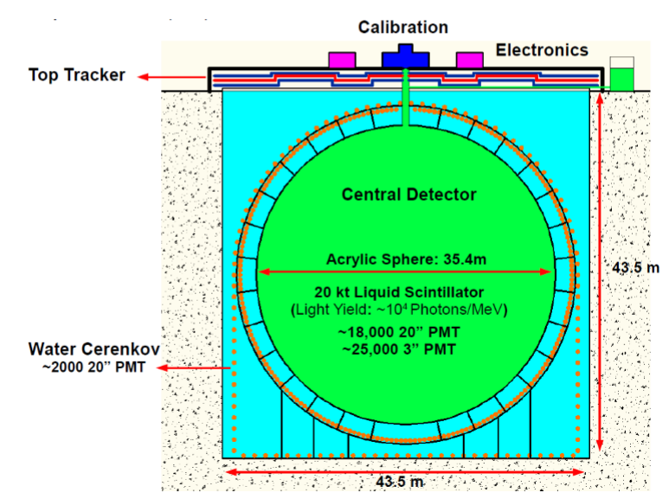
JUNO software (1)
  JUNO takes data in 2021, the largest software group in IHEP
    Work on framework, simulation, reconstruction
  The central detector is made of liquid scintillator (LS) and ~18,000 PMTs
    For such a large LS detector, the rate of cosmic muons reaching the inner detector is about 3 Hz
  Crucial part or special requirement of the experiment
    Understanding muon induced background, one 100Gev comic Muon create several millions of optical photons
    Event correlation, analysis has to cover more than one event in one loop

Slide 8
JUNO software (2)
  SNiPER framework was developed to meet special requirements of Neutrino program
    Multi I/O stream, Event correlation and Hits mixing
    Light-weighted and simple, becoming a common framework for IHEP medium and small experiments
  Simulation of massive optical photons produced by Muon push us to consider efforts on parallelism
    Multi-threading with Geant4.10.x, future with GeantV
    Full simulation using massive parallelism with GPU
    Fast simulation with Machine Learning
  In Reconstruction, precisely rejecting muon induced background is the hard part due to complexity of effects of optical photons in LS
    Start to try CNN for Muon Reconstruction

Slide 9
Cooperation interests in JUNO
  In software framework, from framework level
    Support multi-thread, multi-process, ML, GPU and other heterogeneous infrastructures
  In simulation, reconstruction and analysis
    Parallelism and ML to speed up
  Also need common Condition Database Infrastructure
    Discuss with crest, cms condb, frontier on the HSF condition data solution as JUNO condb infrastructure

Slide 10
CEPC software
  CEPC software is still in its early stage
  Would like to benefit efforts from HL_LHC
    Common infrastructure and tools
  Currently interested in
    Future software framework, Gaudi?
    Geometry description, DD4HEP?
    Packaging tool

Slide 11
Summary for software
  Generally speaking, Framework, Data Analysis, Reconstruction, Simulation, packaging tools are all what we are interested in
  But different experiments have different focuses because of man power
  Ways of joining from IHEP side
    Closely combined with what experiments need
      Eg. Parallelism to solve Muon problem
    Closely combined with the funding supported
      Eg. NFS and CAS supports HPC, ML applications in HEP
  Software group in IHEP are keen to join, but need time to eventually fit in the working mode
    Can start from one or two points, eg. CEPC work on DD4HEP
  Workshop and tutorial in IHEP or China can be a good way to deepen the cooperation

Slide 12
IHEP Distributed Computing (1)
IHEP distributed computing is built in 2014 for BESIII, then JUNO and CEPC
  Integrate resources from collaborations and commercial resources
With very limited manpower (1~3 people), make things as easy as possible
  Adopt DIRAC as WMS, simple and flexible
  Simple computing model, allow sites to join just as clusters, one big data center……
  Anyway, just “easy” grid
Good cooperation with DIRAC community
  Join DIRAC consortium in 2016
  Benefit a lot from DIRAC
  Join the efforts on common need

Slide 13
IHEP Distributed Computing (2)
Recent efforts and cooperation with DIRAC
  Become a common infrastructure for multi-experiments
    Work have been done on WMS and file catalog
    Need more efforts on condition database, bookkeeping, monitoring, data transfer, production system……
  Integrate more available resources
    Done with Cloud, Cluster……
    and also consider HPC
  Multi-core supports for parallelized experiment software
    Efficiency need to be further study with real use cases

Slide 14
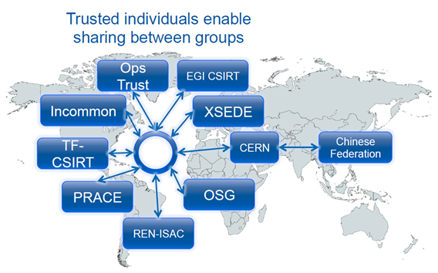
Network and Cyber Security
Cooperation on network and cyber security
  Join LHCONE in 2018
  IHEP established the Chinese cyber security federation in June 2016
  Held the workshop on Cyber Security for HEP since 2017, sharing the workflow, experiences and knowledge on WLCG security
  Foreseeable further collaboration
  Establish more comprehensive and practical solution in cyber security
  Research on the new network technologies

Slide 15
Summary for Distributed Computing
Future experiment CEPC plans to use distributed computing as main way to organize resources
It is important for us to follow WLCG working group on evolution of Scientific Computing Infrastructure for HEP, AAI, security, data management, etc.
With limited power, could start as one of test points for WLCG new solutions in Asia
  Could have more contributions and involve in developments if group and funding grew
Currently pay attention to the DOMA and AAI working group
  Common data federation, data transfer, data management solutions
  Interested in joining AAI federation
  Meeting mostly in US and Europe time zone, not easy to join, one difficult part

Slide 16
Summary
IHEP software and computing group are interested in joining HSF working groups
  Our experiments share common concerns as LHC
Already have some involvements, but not so much
  Have people join HSF workshop, but few
Need time and ways to get more involved
  Familiar with working mode of the working group
  Get more involved the activities of working group
  Small group of workshop and tutorials in China would be helpful
Would be more focus on fields what our funding supports and our experiments currently need

