Slide 2
Trident Automated system tool for collecting and analyzing hardware performance counters
Servesh Muralidharan & David Smith
IT-DI-WLCG, UP Team
CERN
Mar 2019

Slide 3
Introduction
Existing tools
Execution and profiling are separate steps
Focus more on HPC Applications
Fine grained analysis
Architecture specific optimizations
Typical HEP Applications (As it is today!!!)
A cluster of several hundred algorithms
Complex framework interconnecting these algorithms
Linear instruction spread (no hotspots)
Non existence of classical numerical loops
Average runtime of several hours
Proposed Solution: Trident
Continuous performance analysis
System perspective
Node level measurements
Non-virtualized environment
Low overhead and lightweight
Utilizes hardware counters to measure Core, Memory and IO metrics
Presents it in a HEP-human readable form

Slide 4
Trident Architecture
Hardware Detection
Events
Detects the events supported by the node
Extensible event files for future architectures
Configures metrics based on these events
These metrics are sampled at preconfigured rate
Stored temporarily in local disk
Plugins perform transformations to the data
Simple low overhead online analysis
Data exported to centralized storage for offline analysis
Configurator
Collector
Storage
Plugin
Plugin
Plugin

Slide 5
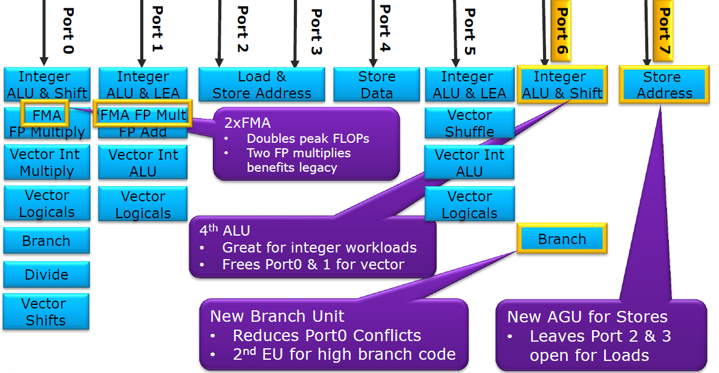
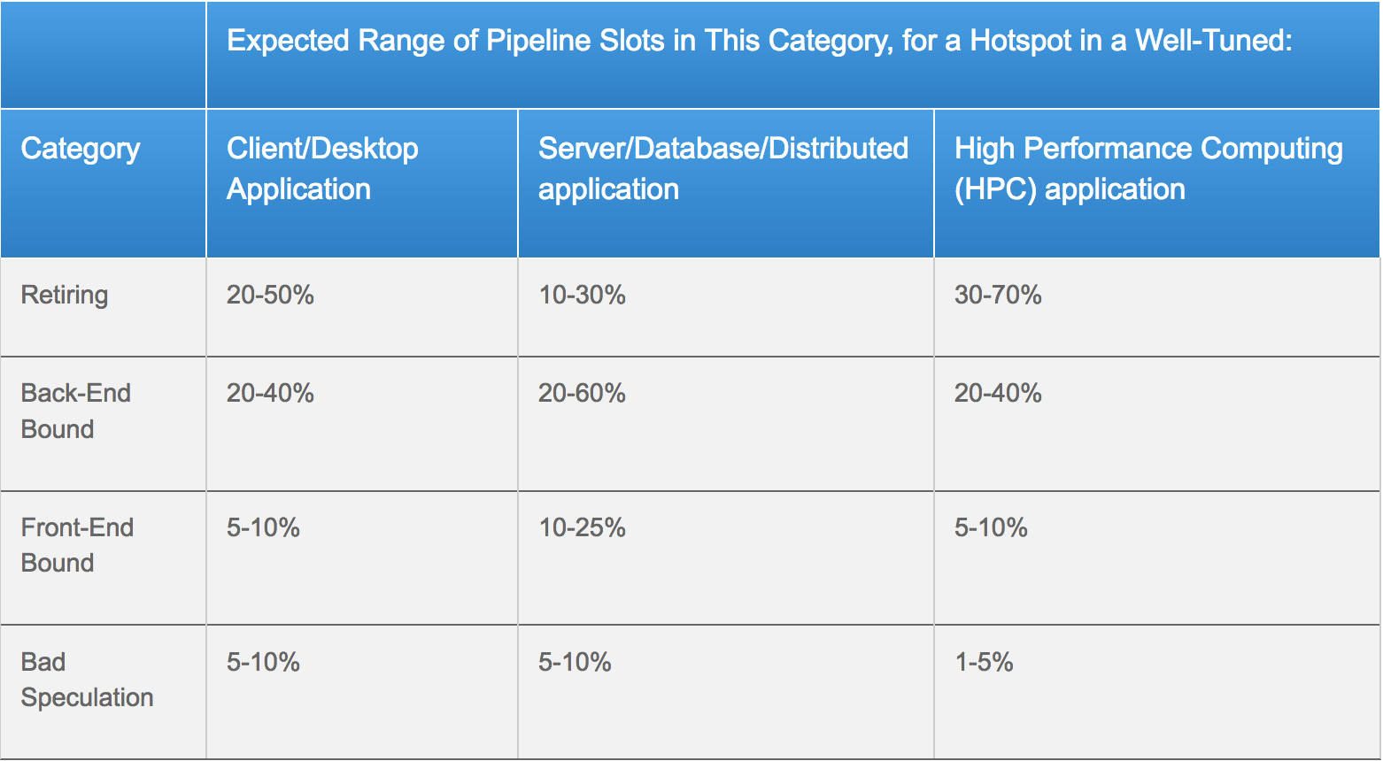
Trident - Core Performance Analysis
Intel Haswell EP
Instruction Per Cycle (IPC)
Denotes ratio of parallel instructions executed
Modern processors like Intel Haswell EP can do 4 IPC
Top down characterization
Identifies the resources dominated by workload
Front-End – fetch and decode program code
Back-End – monitor and execution of uOP once the dependent data operands availability
Retiring – Completion of the uOP
Bad speculation – uOPs that are cancelled before retirement due to branch misprediction
Execution Unit Port Utilization
Determines how many cycles the port was busy
Identifies broadly the pressure from different types of uOPs
INT & FP operations, address calculation, etc.,
Source: https://arstechnica.com/gadgets/2013/05/a-look-at-haswell/2/
Source: https://software.intel.com/en-us/vtune-amplifier-help-tuning-applications-using-a-top-down-microarchitecture-analysis-method

Slide 6
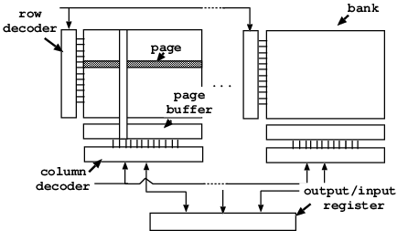
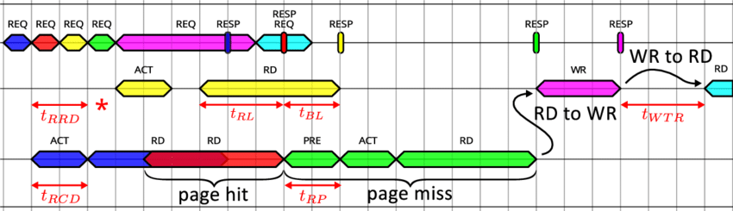
Trident - Memory Performance Analysis
Memory bandwidth usage
Amount of data read and written to main memory
Memory transaction classification
Memory transaction occurs through pages from memory bank
Page-Hit
Memory bank in open state
Lowest access latency (Open)
Sequential memory access usually have high page hits
Page-Empty
Memory bank is idle and needs to be activated
Moderate access latency (Usually 2x of page hit)
Random memory access usually have high page empty counts
Page-Miss
Memory to be accessed requires closing of a page in the same bank
Worst access latency (Usually 3x of page hit)
Source: https://www.researchgate.net/figure/Multi-banked-SDRAM-architecture_fig1_221341164
Source: https://www.researchgate.net/figure/Example-of-a-typical-TLM-trace-with-DRAM-related-phases_fig4_282806593
Further info: https://www.anandtech.com/show/3851/everything-you-always-wanted-to-know-about-sdram-memory-but-were-afraid-to-ask/5

Slide 7
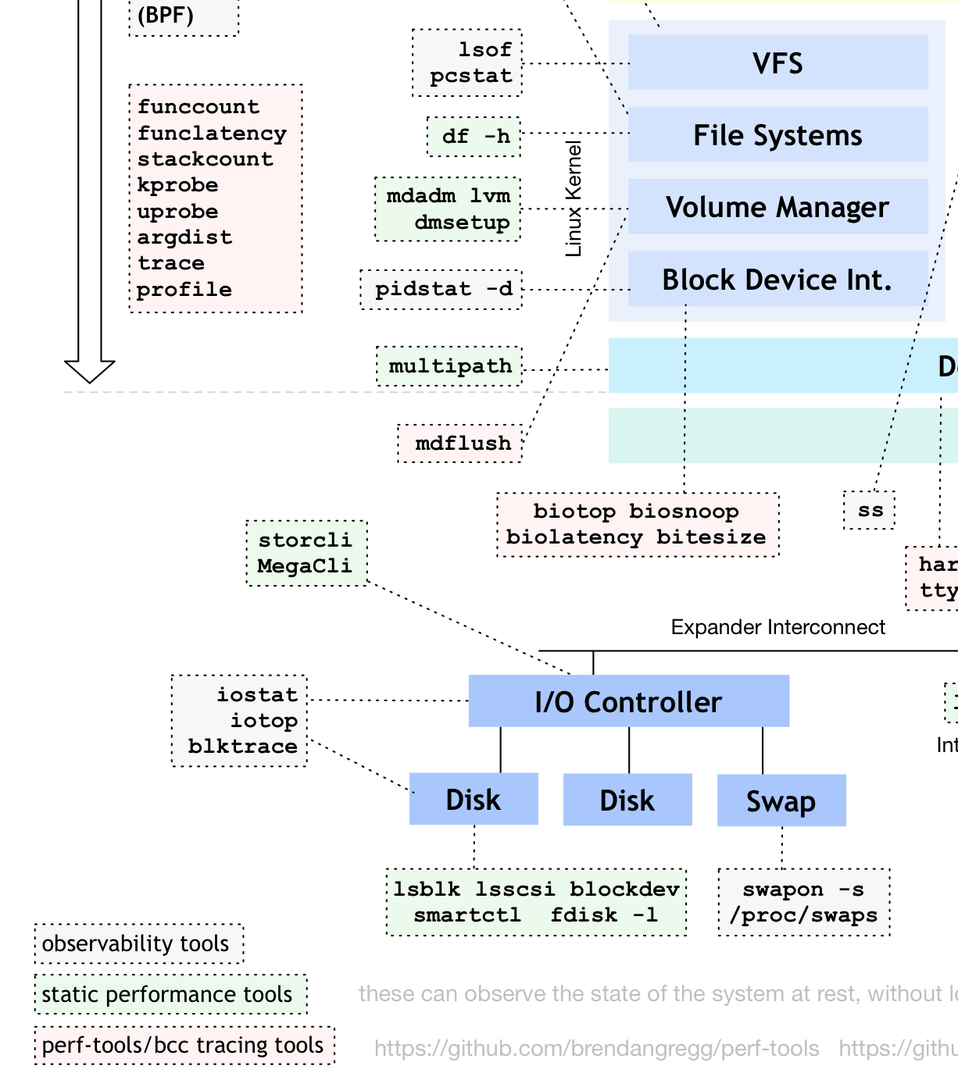
Trident - IO Performance Analysis
Data recorded form ProcFS
Transfer Rate Analysis
Amount of data read and written to storage
Limited by interface and type of memory
Sustained Vs Bursts
Operation Rate Analysis
Amount of operations performed
Limited by controller for fast memory
Limited by disk head for HDDs
Random Vs Sequential accesses

Slide 8
Experiment setup
Test System
2x Intel(R) Xeon(R) E5-2630 v3@2.40GHz /
64GB DDR4-2133 RAM
Centos 7 (3.10.0-957.5.1.el7.x86_64)
Non-HT, 8 physical cores per socket
Workloads
Standard Benchmarks – Repeated five times
Extracted from Domenico Giordano’s Cloud Benchmark Suite
HEPSPEC06 Benchmark Suite
450.soplex,471.omnetpp,447.dealII,473.astar,444.namd,453.povray,483.xalancbmk
SPEC17 Benchmark Suite
508.namd_r,510.parset_r,511.povray_r,520.omnetpp_r,523.xalancbmk_r,526.blender_r,531.deepsjeng_r,541.leela_r
HEP Workload Based Benchmarks - Pre & Post wait time of 60 seconds
ATLAS – MC Simulation, MC Digitization & Reco, Derivation production
CMS – Gen+Sim, Digi+Trigger+PileupSimualtion, Reco+Analysis data creation – Streaming Inputs
LHCb – Generation + Simulation (DG Cloud Benchmark Suite)
ALICE – Generation + Simulation (DG Cloud Benchmark Suite)

Slide 9
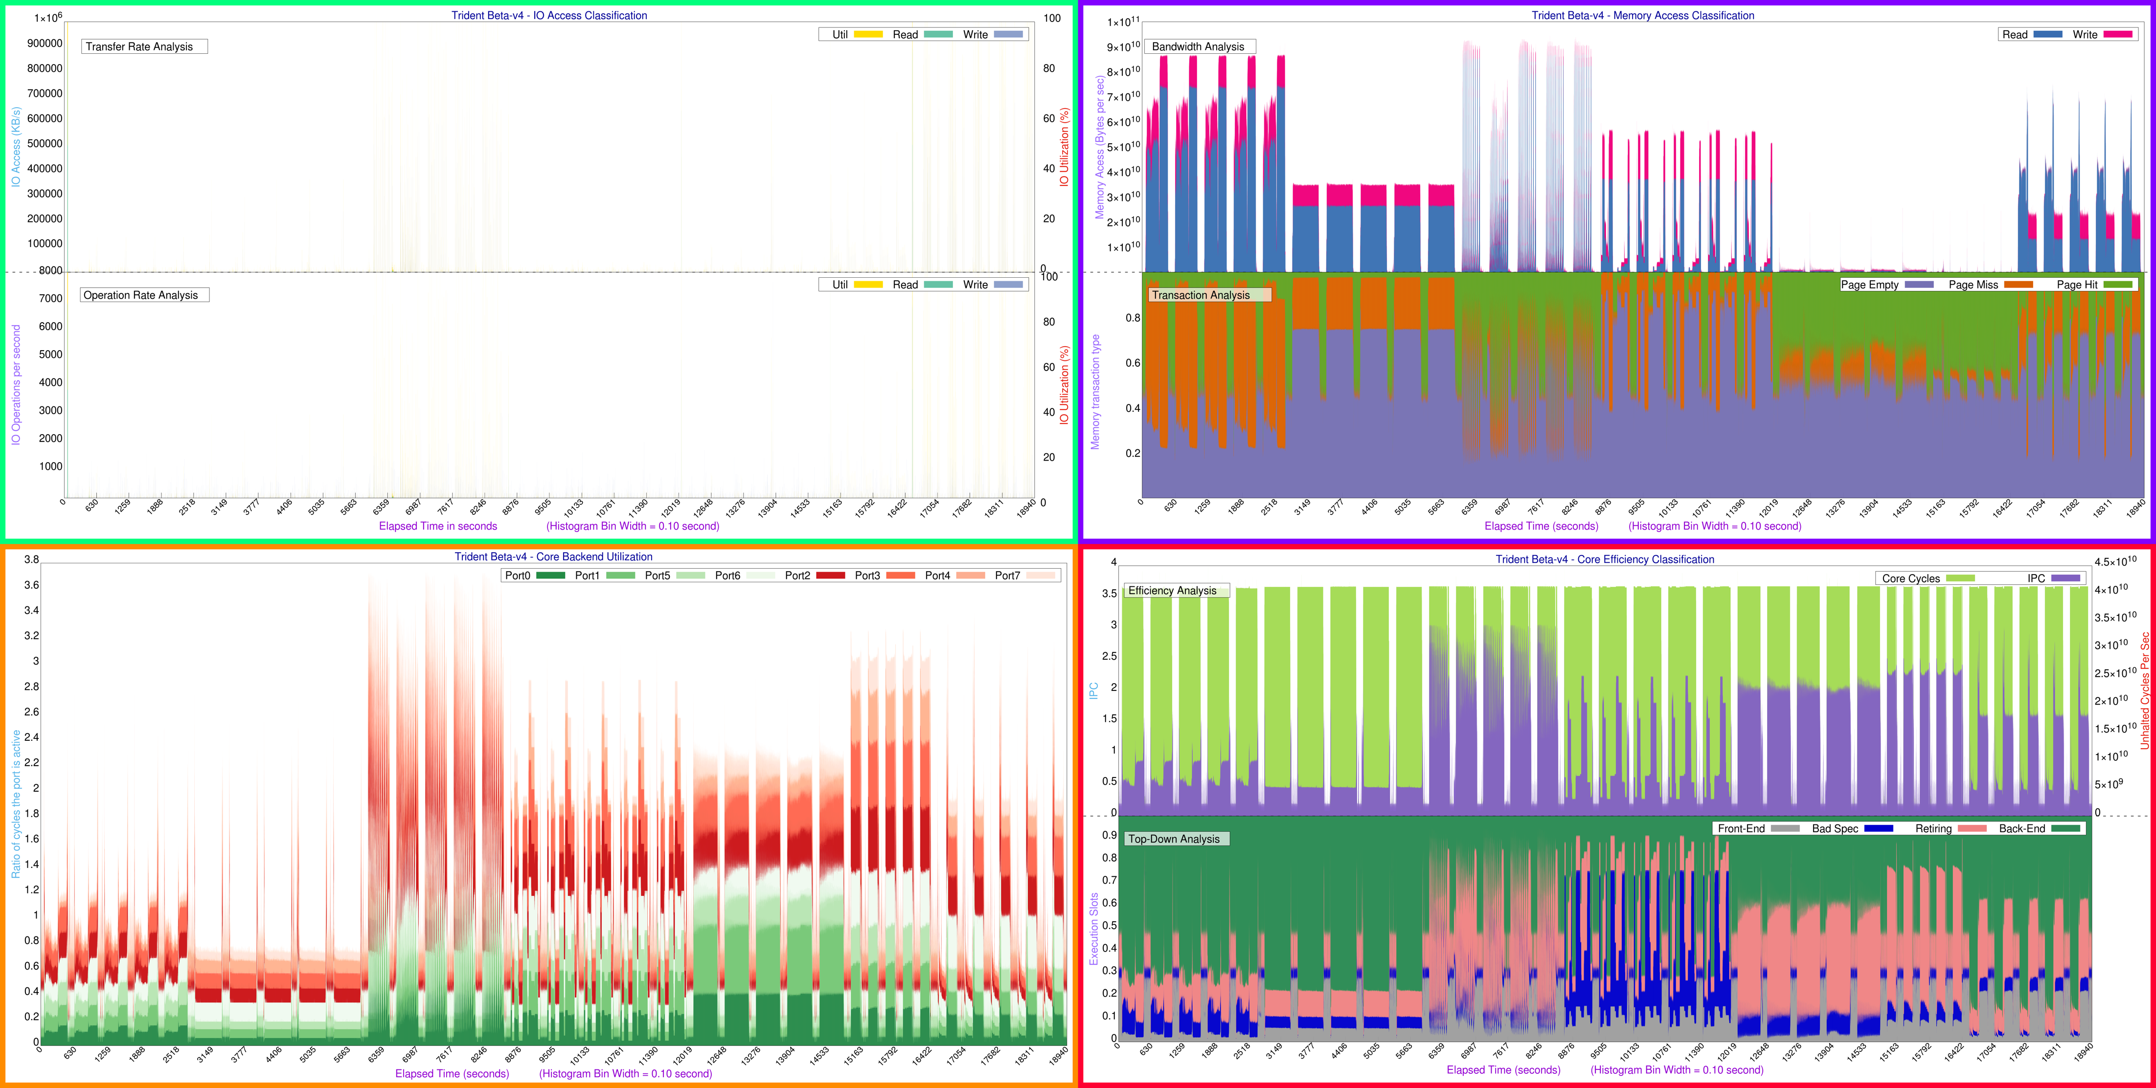
HS06

Slide 10
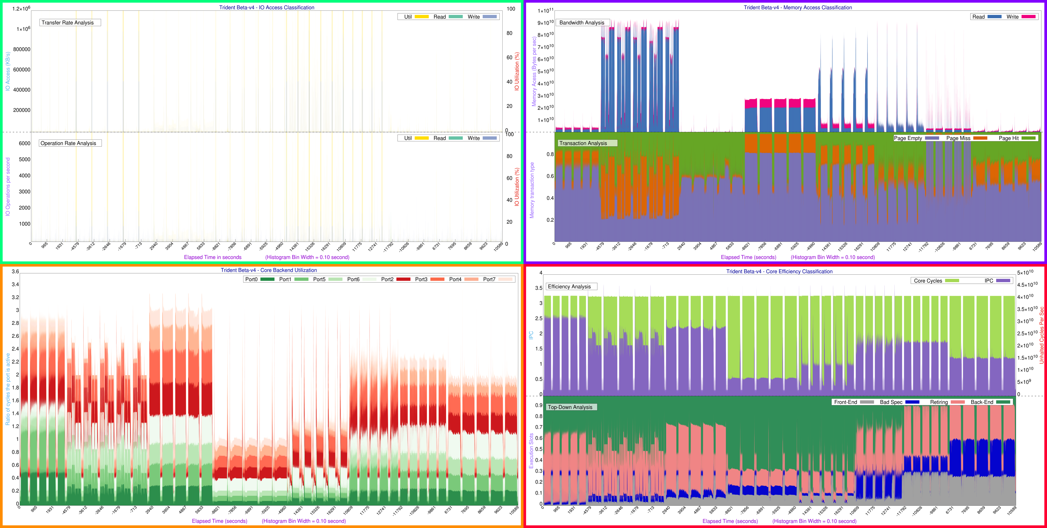
SPEC2017

Slide 11
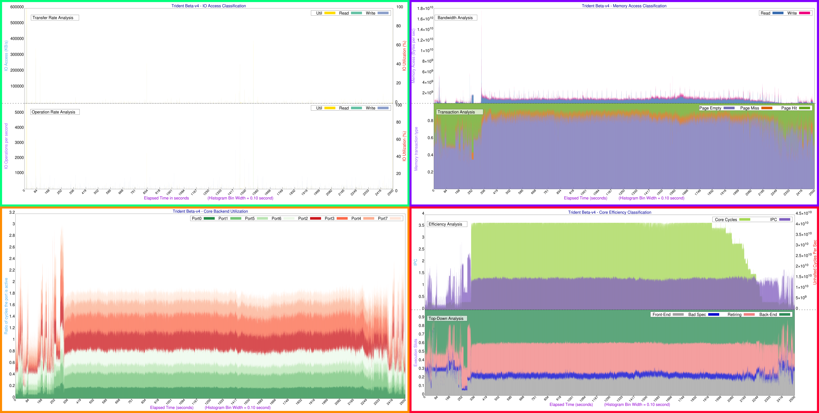
ATLAS – MC Simulation

Slide 12
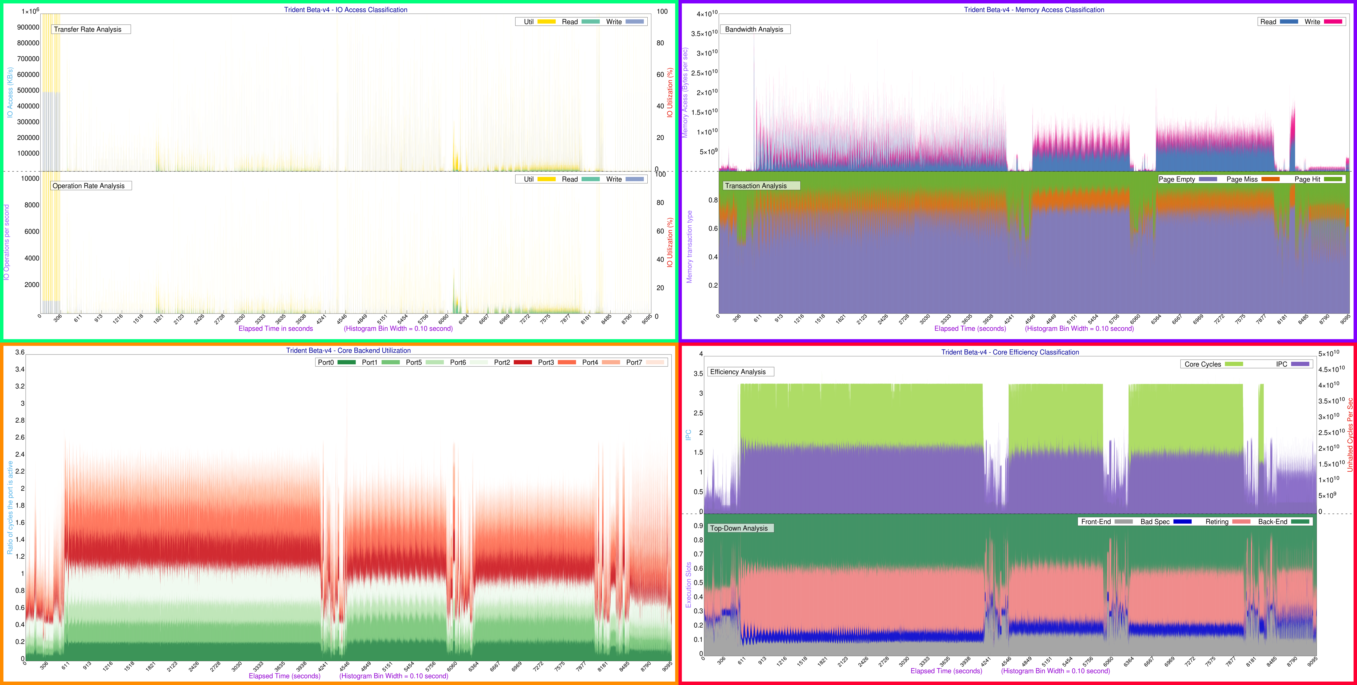
ATLAS – MC Digi + Reco

Slide 13
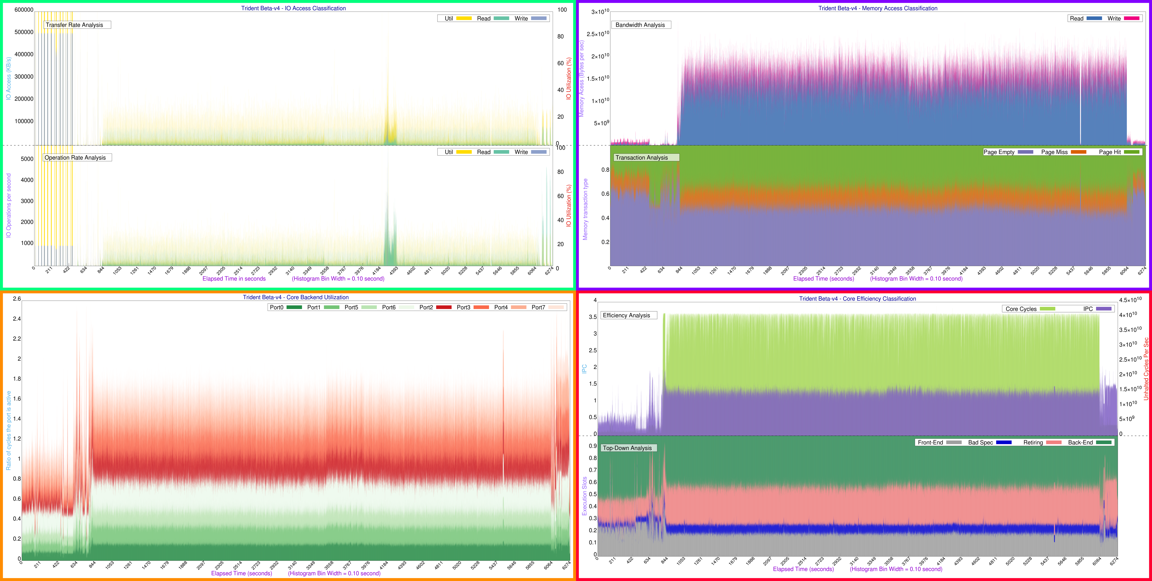
ATLAS – Derivation Production

Slide 14
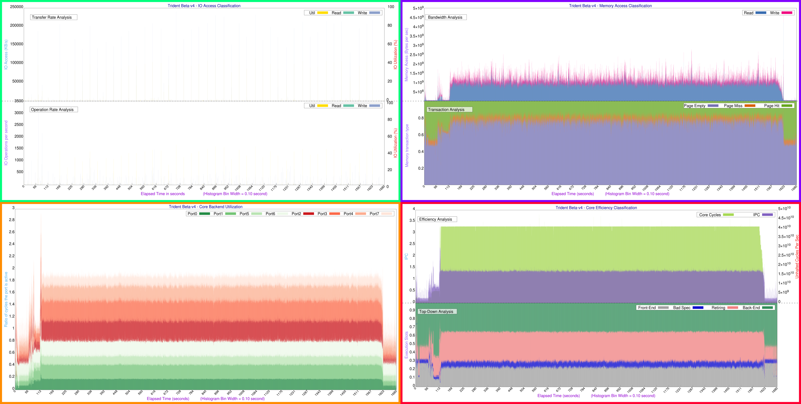
CMS – Generation + Simulation

Slide 15
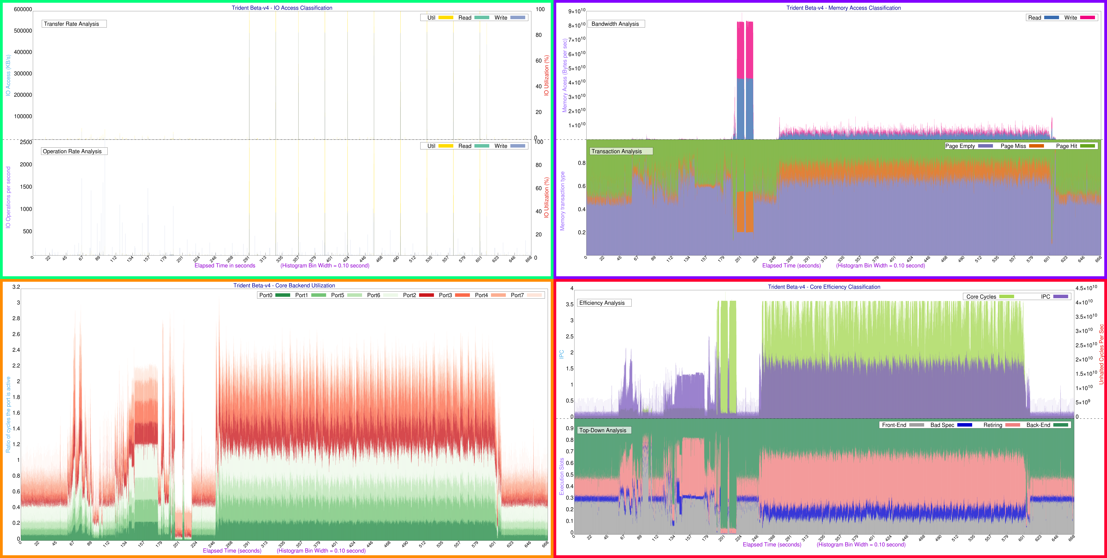
CMS – Digitization + Trigger + Pileup Simulation

Slide 16
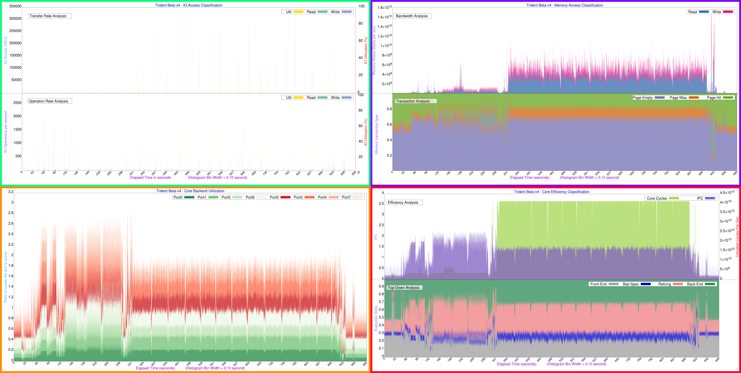
CMS – Reconstruction + Analysis Data Creation

Slide 17
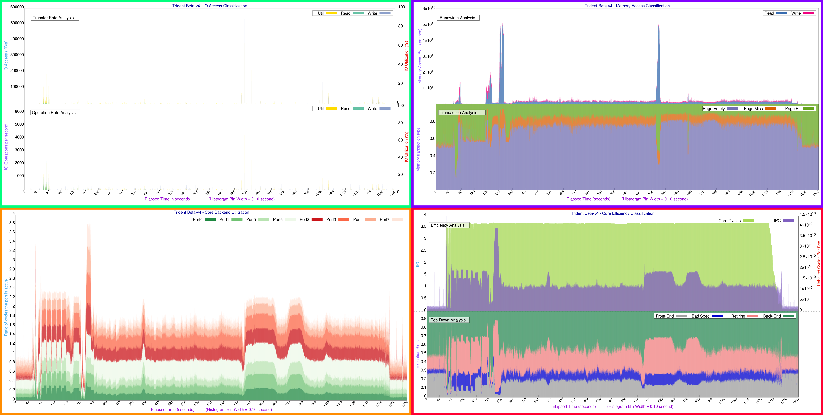
LHCb – Gen+Sim

Slide 18
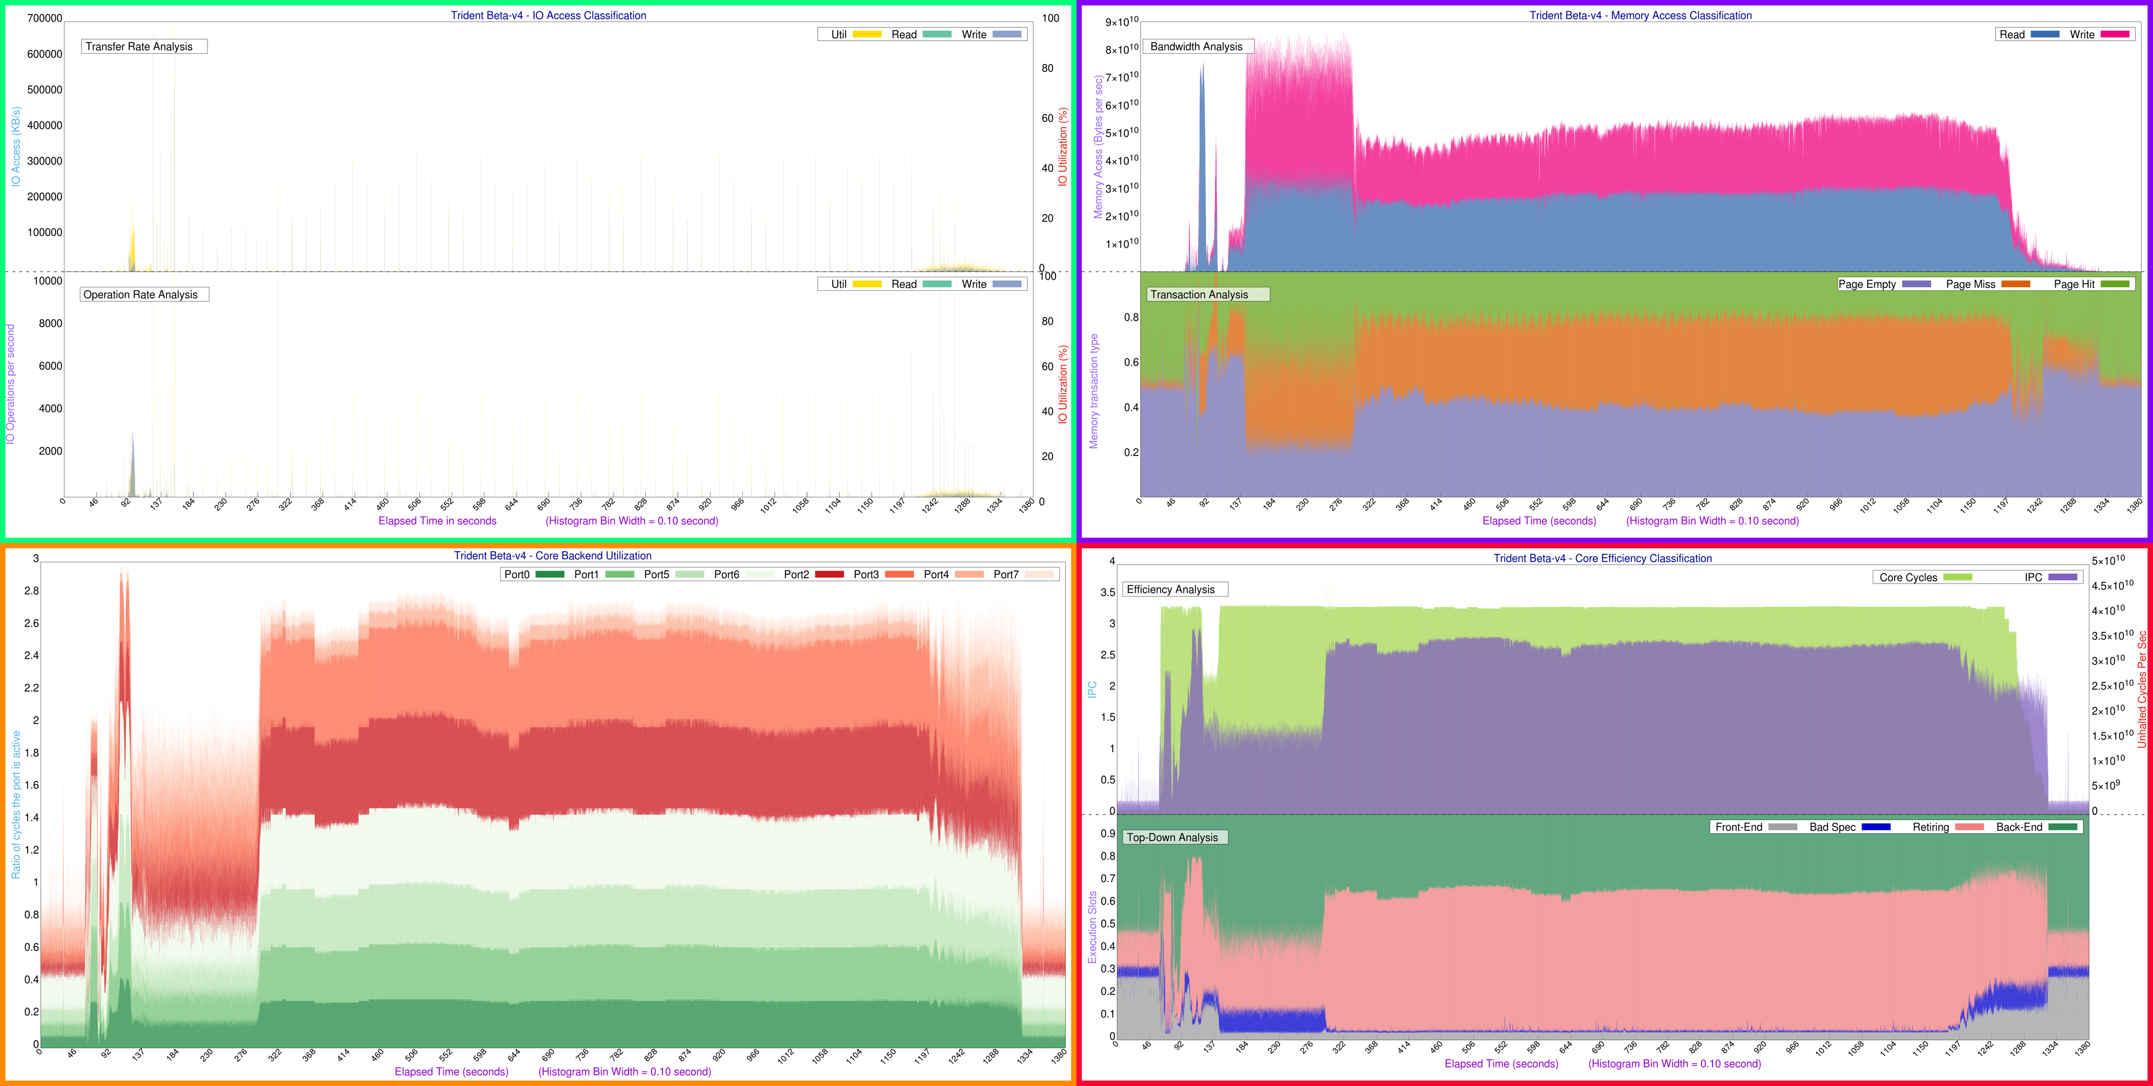
ALICE – Gen+Sim

Slide 19
Domenico.G & Eva.S - Further Analysis

