Slide 1

WP5 Undulators Cost Matrix
Thomas Schmidt :: Paul Scherrer Institut
^{7th} WP5 meeting November, 8 2018

Slide 2
Undulators Cost Matrix
Undulator costs
is much more than the price for hardware
Undulator costs cover
Design costs
manpower (magnet design, engineering, controls) (full costs)
software (i.e. COMSOL, ANSYS, ...)
Hardware procurement
magnets, (sc-)coils, construction (tolerances!), drive systems, vacuum, cryo
Optimization
know-how, measurement benches, ...
Commissioning
Operation
running costs (electricity, cooling, ...), maintenance
End of life

Slide 3
Undulators Cost Matrix
Technologies
Permananent Magnets
out of vacuum (ppm, hybrid, SmCo, NdFeB, ...)
in-vacu
CPMU (LN2, cryo cooler, ...)
Electromagnets
room temperature (few very long period undulators)
sc
NbTi, Nb₃Sn, HTS
adapted measurement facilities
granite benches (costly, inflexible, ...)
SAFALI like systems (closed loop replaces stiff mechanics)
Pulsed Wire (cheap, limits?)

Slide 4
Undulators Cost Matrix
Installation
control system
Motion control systems with building blocks
highly specialized ones only when its really needed, not because its standard in our facility
lean cabling
controls in tunnel (power and ethernet only, wireless, ...)
Standardization
we do similar or even identical things on x ways (and all leads to Rome!)
common toolkit will help us and related industry
Industry (partnership)
what can we buy
technology transfer

Slide 5
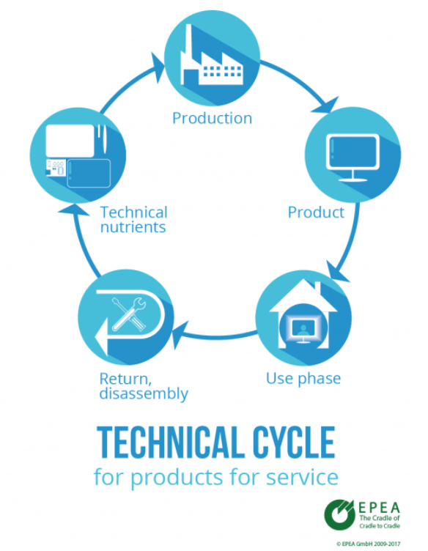
Undulators Cost Matrix
Compact light source
„lets leave a small footprint“
refurbish undulators
i.e. in-vac -> CPMU for DLSR
keeping force balanc:
higher fields but smaller pole tips
energy consumption in
design (XLS!)
fabrication
running
receycling
Environmental aspects:
cradle to cradle principle

Slide 6
Undulators Cost Matrix
planar: hard x-ray
 |  | out of vac | in-vac | CPMU | SC NbTi | SC Nb₃Sn | HTS
Performance: K (λ/gap) | 15 / 4 mm
 | 10 / 3 mm
Design
Fabrication by Lab
Magnetarray
Support
Drive System / Controls
Vacuum System
Optimization
Fabrication by Company
Installation / Infrastructure
Commisssioning
Operation / Maintenance | 10 years
price / m [€]
total price [€] / saturation length [m]

Slide 7
Undulators Cost Matrix
EPU: soft x-ray
 |  | APPLE II | DELTA | APPLE III | in vac | CPMU | SCAPE
Performance: K (λ/gap) | 40 / 7 mm
 | 20 / 5 mm
Design
Fabrication by Lab
Magnetarray
Support
Drive System / Controls
Vacuum System
Optimization
Fabrication by Company
Installation / Infrastructure
Commisssioning
Operation / Maintenance | 10 years
price / m [€]
total price [€]/ saturation length [m]

