Slide 1



Microwave Undulator
Liang Zhang^{1,2}, Jim Clarke^{2,3}, David Zhu⁴ and Adrian W. Cross^{1,2}
¹Department of Physics, SUPA, University of Strathclyde, Glasgow, G4 0NG, UK
²The Cockcroft Institute, Daresbury Laboratory, Warrington. WA4 4AD, UK
³Science and Technology Facilities Council, Daresbury Laboratory, Warrington, WA4 4AD, U.K.
⁴ANSTO Melbourne, 800 Blackburn Road, Clayton, VIC 3168, Australia
ABP

Slide 2
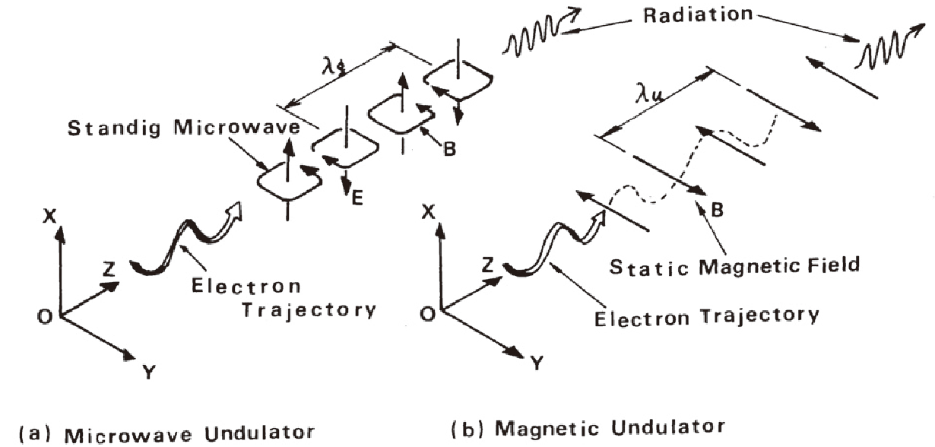

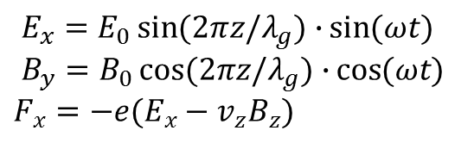
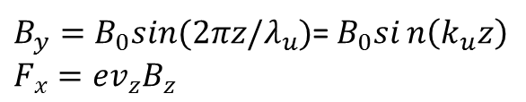
Microwave undulator
$E_{x}=E_{0}\sin{(2πz/λ_{g})∙}\sin{(ωt)}$
$B_{y}=B_{0}\cos{(2πz/λ_{g})∙}\cos{(ωt)}$
$F_{x}=−e(E_{x}−v_{z}B_{z})$
$B_{y}=B_{0}sin⁡(2πz/λ_{u})$=$B_{0}sin\left(k_{u}z\right)$
$F_{x}=ev_{z}B_{z}$
In microwave undulator, the electron bunch sees both the electric field and magnetic field.
Figure source: T. Shintake, Development of Microwave Undulator, 1983

Slide 3

What we propose?
Possible improvements:
Evaluate the possibility to operate at Ka-band, to achieve short wavelength operation
Use a corrugated waveguide & further reduce the field at the wall (HE Hybrid mode)
 | State-of-the-art undulator | Record breaking undulator | Dream Undulator
Period (mm) | 13.9 | 13.9 | 4.4
Beam Aperture (mm) | 5.0 | 5.0 | 5.0
Peak B Field (T) | 0.92 | 1.62 | 2.0
K Parameter | 1.2 | 2.1 | 0.82
Length (m) | 4.0 | 1.0 - 4.0 | 1.0 – 4.0
Operating frequency (GHz) | 11.424 | 11.424 | 36
Required microwave power (MW) | 152 | 185 - 464 | 108 - 272
Required pulse length (us) | 5.8 | 1.4 - 5.7 | 0.8 - 3.2
$P∝L^{2/3}$ $T∝L$

Slide 4
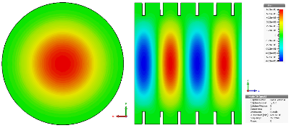
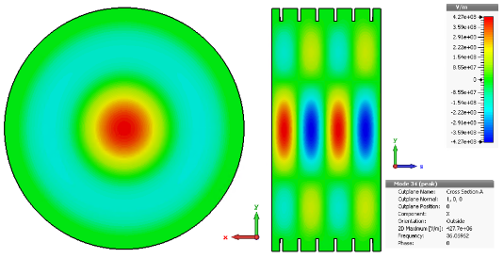
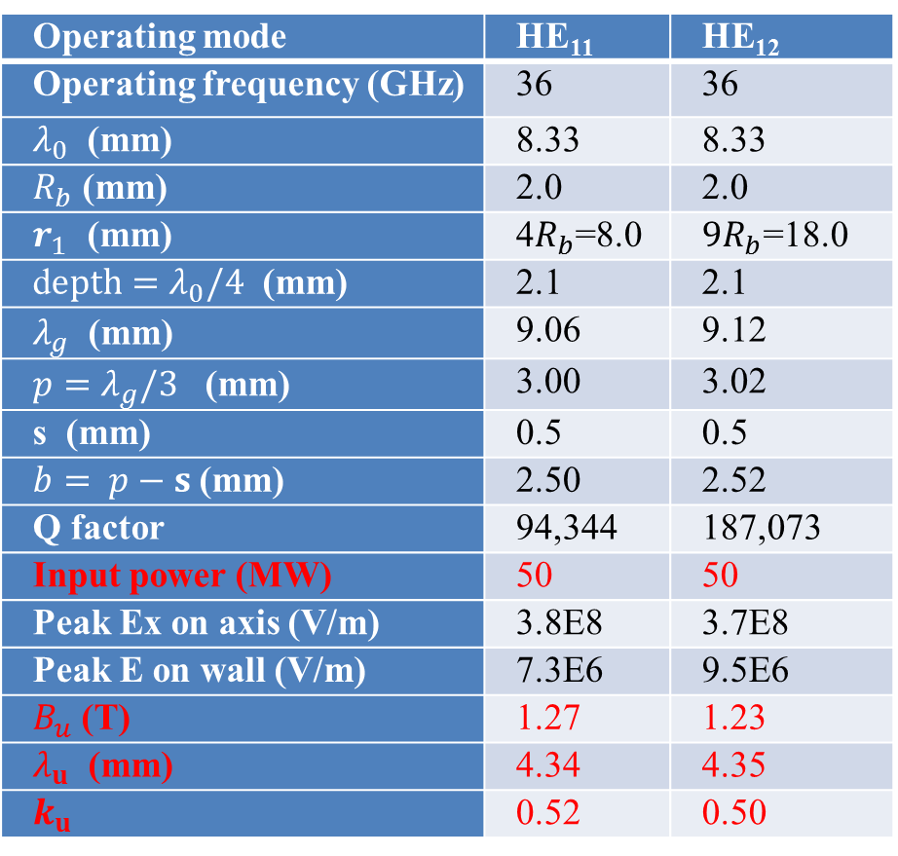
Corrugated waveguide design
Operating mode | HE₁₁ | HE₁₂
Operating frequency (GHz) | 36 | 36
$λ_{0}$ (mm) | 8.33 | 8.33
$R_{b}$ (mm) | 2.0 | 2.0
$r_{1}$ (mm) | 4$R_{b}$=8.0 | $9R_{b}$=18.0
d$epth=λ_{0}/4$ (mm) | 2.1 | 2.1
$λ_{g}$ (mm) | 9.06 | 9.12
${p=λ}_{g}/3$ (mm) | 3.00 | 3.02
s (mm) | 0.5 | 0.5
$b= p−s$ (mm) | 2.50 | 2.52
Q factor | 94,344 | 187,073
Input power (MW) | 50 | 50
Peak Ex on axis (V/m) | 3.8E8 | 3.7E8
Peak E on wall (V/m) | 7.3E6 | 9.5E6
$B_{u}$ (T) | 1.27 | 1.23
$λ_{u}$ (mm) | 4.34 | 4.35
$k_{u}$ | 0.52 | 0.50
HE11 mode
HE12 mode
Dimensions calculated
using theoretical equations
L. Zhang, W. He, J. Clarke, K. Ronald, A.D.R. Phelps and A.W. Cross, “Systematic study of the corrugated waveguide as a microwave undulator”, Journal of Synchrotron Radiation, accepted 2018

Slide 5
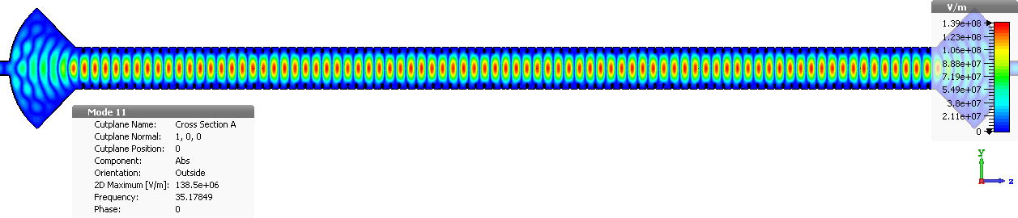
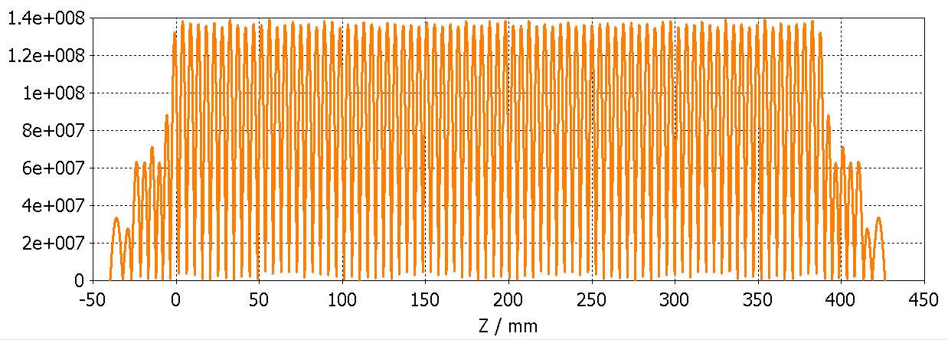
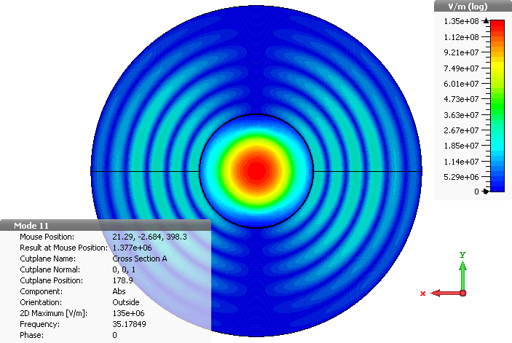
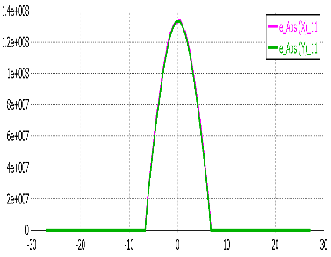
36 GHz corrugated cavity
100 period
Initial geometry parameters:
Radius of the waveguide: 9.13 mm Period of the corrugation: 3.83 mm
Corrugation depth: 2.37 mm Corrugation slot: 0.56 mm
Coupler radius: 35.55 mm

Slide 6
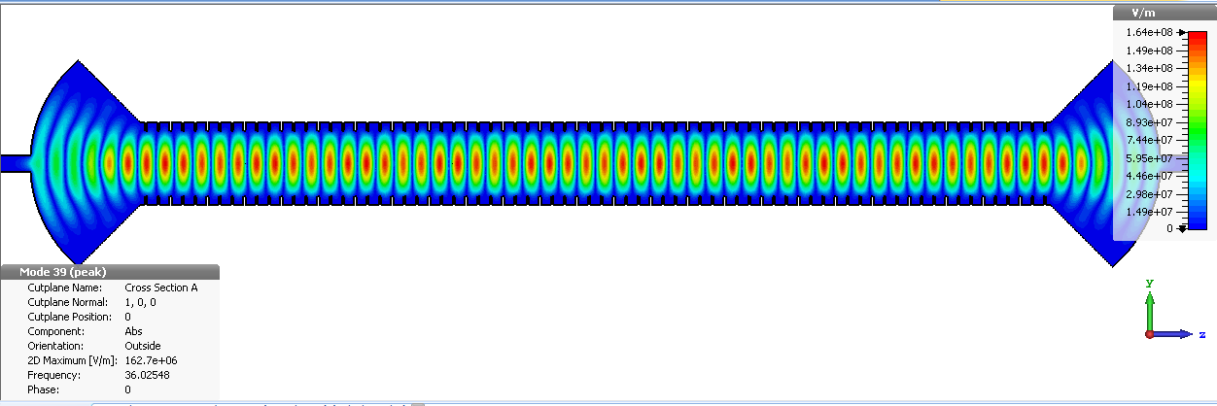
36 GHz corrugated cavity
The Q factor was improved from 64,400 to 89,650.
Nearly 40% improvement.
Normally we run simulated at smaller period numbers to save the simulation time and required memory, however it was found that the Q factors and eigenfrequencies changes with the period number (cavity length).
A set of Empirical formula has been derived and under testing for future design.
Driver: University of Strathclyde HPM source produced 65MW of power at 36GHz (I.V. Konoplev, A.W. Cross, P. MacInnes, W. He et al, Appl. Phys. Letts., 92, 211501, 2008)

Slide 7
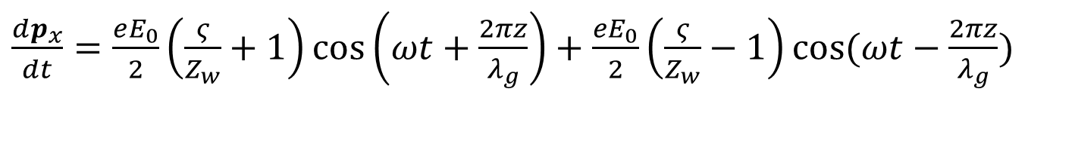
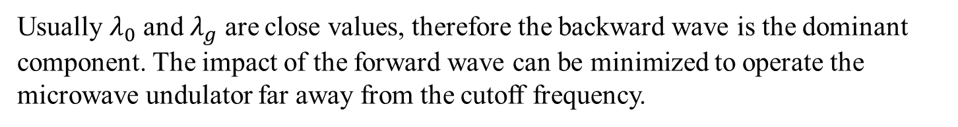
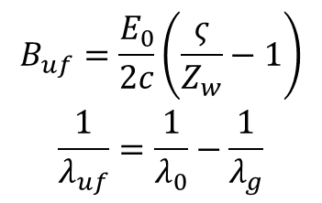
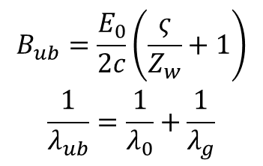
Principle of“Flying”undulator
Rewrite the motion of the electrons in a cavity-type microwave undulator as
$\frac{dp_{x}}{dt}=\frac{eE_{0}}{2}\left(\frac{ς}{Z_{w}}+1\right)\cos\left(ωt+\frac{2πz}{λ_{g}}\right)+\frac{eE_{0}}{2}\left(\frac{ς}{Z_{w}}−1\right)\cos{(ωt−\frac{2πz}{λ_{g}}})$
Backward wave
Forward wave
$$\begin{matrix}B_{ub}=\frac{E_{0}}{2c}\left(\frac{ς}{Z_{w}}+1\right) \\ \frac{1}{λ_{ub}}=\frac{1}{λ_{0}}+\frac{1}{λ_{g}}\end{matrix}$$
$$\begin{matrix}B_{uf}=\frac{E_{0}}{2c}\left(\frac{ς}{Z_{w}}−1\right) \\ \frac{1}{λ_{uf}}=\frac{1}{λ_{0}}−\frac{1}{λ_{g}}\end{matrix}$$
short wavelength.
long wavelength.
Usually $λ_{0}$ and $λ_{g}$ are close values, therefore the backward wave is the dominant component. The impact of the forward wave can be minimized to operate the microwave undulator far away from the cutoff frequency.

Slide 8
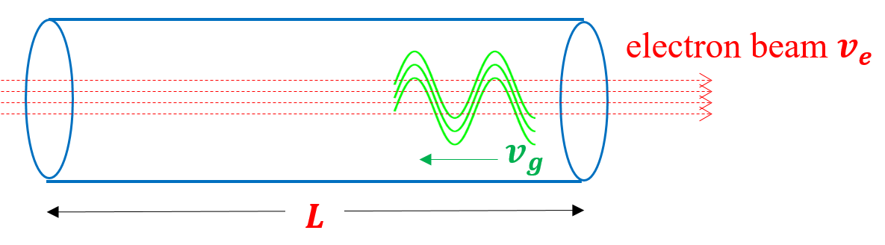
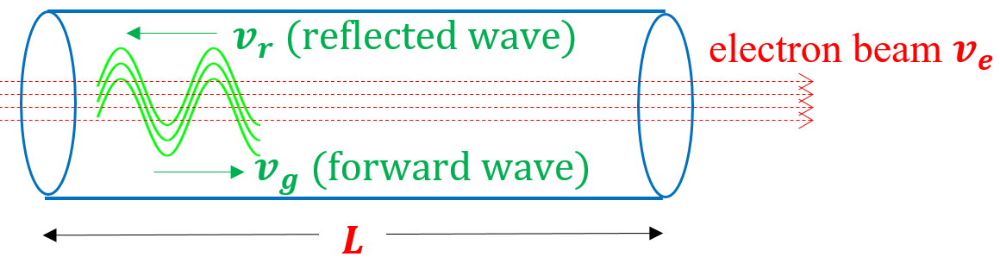
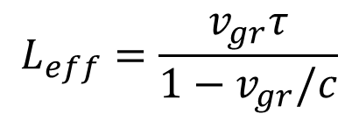
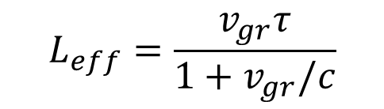
“Flying”undulator
A waveguide can be used as a undulator instead of a cavity structure. The wave can co-propagate or counter-propagate with the electron beam.
$$L_{eff}=\frac{v_{gr}τ}{1+v_{gr}/c}$$
$$L_{eff}=\frac{v_{gr}τ}{1−v_{gr}/c}$$
A co-propagating wave with backward group velocity has longer effective interaction length.
[1] S. V. Kuzikov, et al., "Flying radio frequency undulator," Appl. Phys. Lett., vol. 105, no. 3, p. 033504, 2014.
[2] S. V. Kuzikov, et al., "Configurations for short period rf undulators," Phys. Rev. S.T., vol. 16, no. 7, p. 070701, 2013.

Slide 9
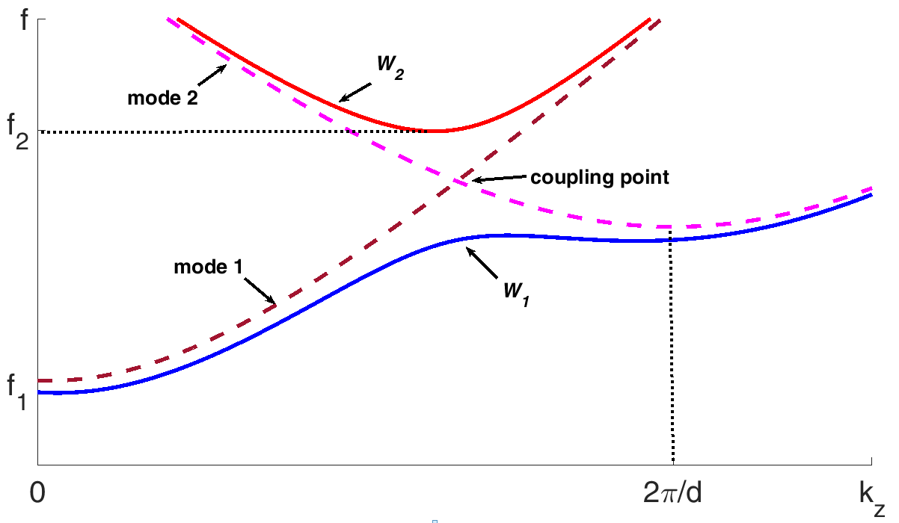
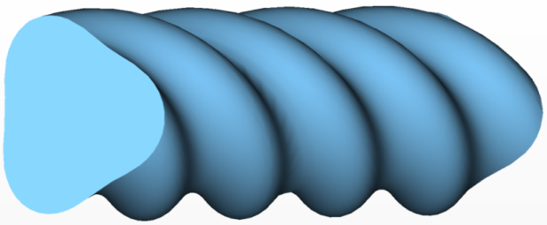

“Flying”undulator
“flying” undulator
Helically corrugated waveguide is able to couple two modes with opposite group velocity directions.
${r\left(θ,z\right)=R}_{0}+R_{1}cos(m_{B}θ+2πz/d)$
Circular polarization
The coupling modes 1 and 2 have opposite directions of group velocities.
[1] S. V. Kuzikov, et al., "Flying radio frequency undulator," Appl. Phys. Lett., vol. 105, no. 3, p. 033504, 2014.
[2] S. V. Kuzikov, et al., "Configurations for short period rf undulators," Phys. Rev. S.T., vol. 16, no. 7, p. 070701, 2013.

Slide 10
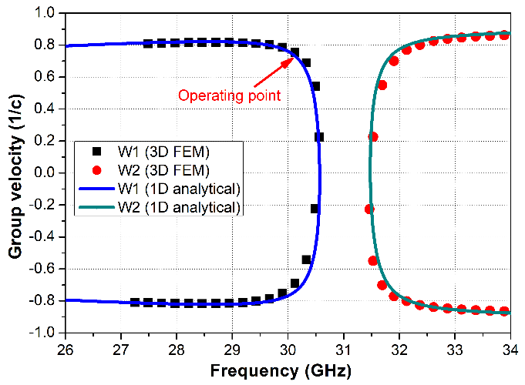
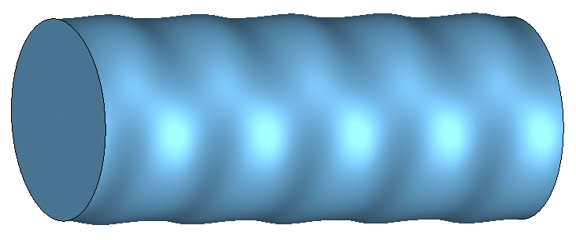


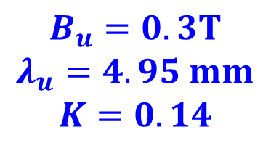
Design of“Flying”undulator
Linear polarization
Similar design to the circular polarization version
$r\left(θ,z\right)=R_{0}+R_{2}cos\left(m_{B}θ\right)cos\left(\frac{2πz}{d}\right)$
Operating mode: TE11 coupled with TE11 mode. Operating frequency: 30.3 GHz
The dimensions are chosen from the dispersion relation of the operating mode.
$$v_{g}≈0.6c$$
1 GW input power:
$$B_{u}=0.3T$$
$$λ_{u}=4.95 mm$$
$$K=0.14$$
$$R_{0}=5.8 mm,R_{2}=0.3 mm,d=5.6 mm$$
L. Zhang, W. He, J. Clarke, K. Ronald, A. D. R. Phelps, and A. W. Cross, “Microwave undulator using a helically corrugated waveguide” IEEE Trans. Electron Device, 2018.

Slide 11
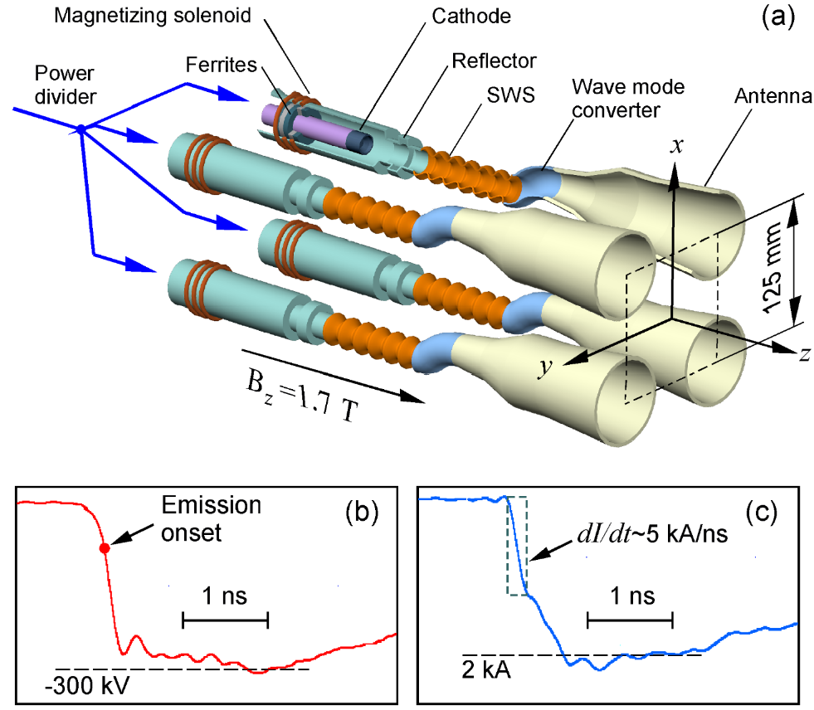

Principal scheme of four-channel Ka-band SR backward wave oscillator. (b) Accelerating voltage pulse applied to each cathode in the experiment. (c) Electron beam current recorded at the entrance of interaction space, corresponding to the cross-section z=3.5 cm
(a) Layout of the four-channel Ka-band generator;
(b) accelerating voltage pulse applied to each cathode;
(c) e-beam current recorded at the entrance of SWS.
Multi-sections driven by multiple SR sources!

Slide 12
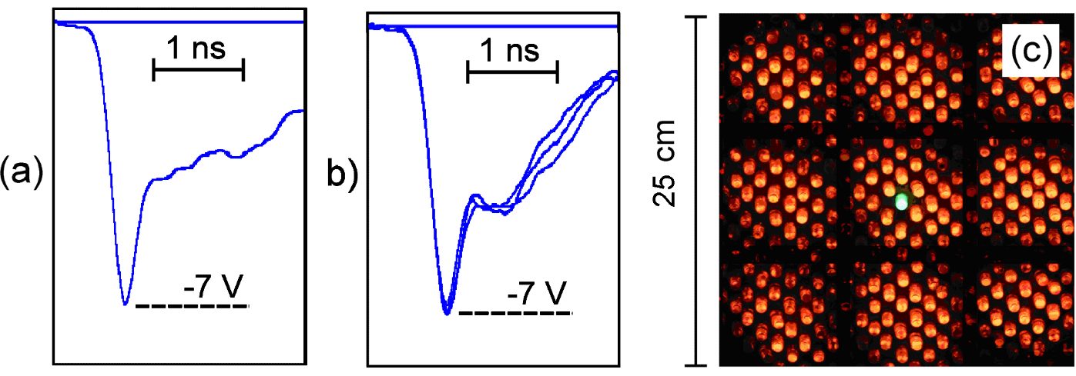
microwave detector signal with single generator;
three stored detector records (attenuated by power 16 times) of the sum of in-phase pulses from four generator;
interference pattern of the radiation recorded by a gas-discharge matrix panel at a distance of 1.5 m from an array.
Peak power in each channel 0.6 GW
N. S. Ginzburg, A. W. Cross, A. A. Golovanov , G. A. Mesyats, M. S. Pedos, A. D. R. Phelps, I. V. Romanchenko, V. V. Rostov, S. N. Rukin, K. A. Sharypov, V. G. Shpak, S. A. Shunailov, M. R. Ulmaskulov, M. I. Yalandin, I. V. Zotova, “Generation of electromagnetic fields of extremely high intensity by coherent summation of Cherenkov superradiance pulses”, Phys. Rev. Lett., Phys. Rev. Lett. 115, 11, 12 p., 114802 (2015).

Slide 13
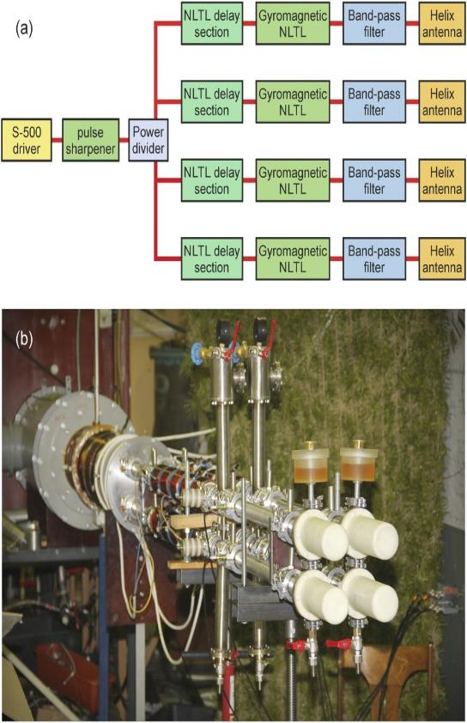
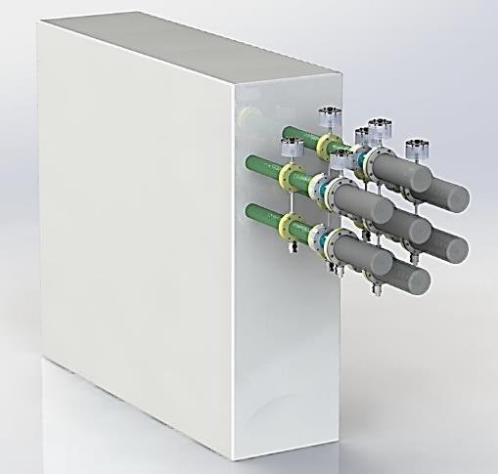
4-channel gyromagnetic source with beam steering
The general schematic;
The overall view of the four-channel NLTL RF source
Pulse repetition frequency 1kHz
≈ 4 m
I. V. Romanchenko, et al “Four channel high power rf source with beam steering” Rev. Sci. Instrum., 2017.

Slide 14
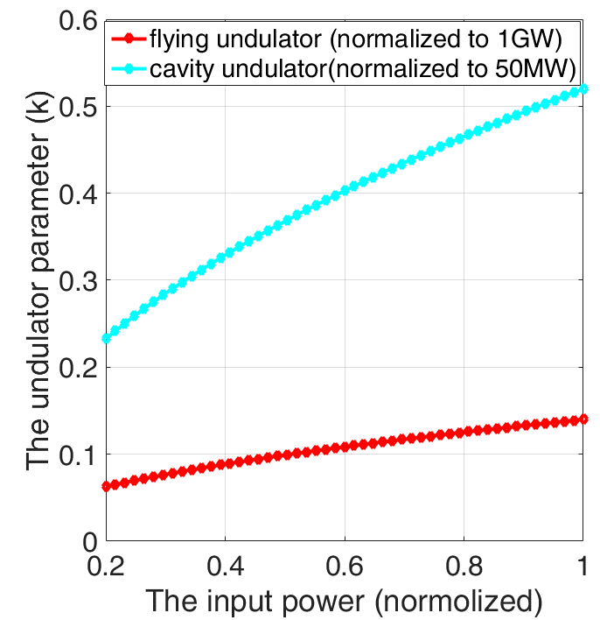
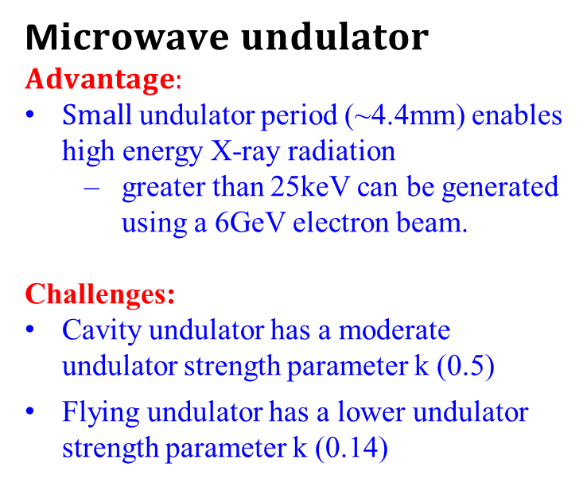
Conclusion
M$icrowave undulator$
$$Advantage:$$
$Small$undulator period (~4.4mm) enables high energy X-ray radiation
  greater than 25keV can be generated using a 6GeV electron beam.
Challenges:
Cavity undulator has a moderate undulator strength parameter k (0.5)
Flying undulator has a lower undulator strength parameter k (0.14)
The input power (normalized)
 | Cavity-type undulator | Flying-type undulator
Power supply | High energy per pulse (~200J) | Low energy per pulse (~1J)
Microwave source | High power, long pulse microwave source Co-axial Gyro-klystron (50 MW, 2 us), PRF (~50Hz) | Ultra high power Short pulse microwave source (1 GW, 1 ns), high PRF 1kHz

Slide 15

Acknowledgements
  The STFC UK is gratefully acknowledged for supporting this work.
  The University of Strathclyde is grateful to the Cockcroft Institute for supporting Dr. Liang Zhang.
  The European Commission Horizon 2020 Project “CompactLight” (777431-XLS) is gratefully acknowledged for supporting this work.
Thank you for your attention!
I’d be happy to answer any questions

