Slide 1
Executive summary from STRING review
Laurent Tavian, ATS-DO
On behalf of the Review Panel
15 November 2018

Slide 2
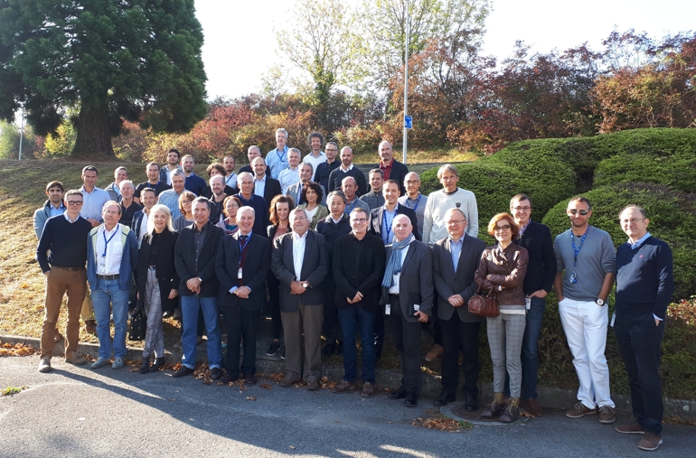
Content
Introduction: Scope, Review Panel Member and Review agenda
Executive summary (10 recommendations)

Slide 3
Introduction
Scope of the review:
  The main objective is to review the baseline configuration and the motivation of the associated test program foreseen during the installation and operation of the HL-LHC IT-STRING. The evaluation of the advantage and/or the disadvantage of moving, if possible, measurements and tests to another configuration (for example in single magnet test, or reduced IT-string configurations, etc.) will also be part of the review. This assessment will also consider material and personnel resources.
  (Internal) Review Panel Members:
    O. Bruning
    J-M. Jimenez
    Ph. Lebrun (European Scientific Institute),
    L. Rossi
    L. Tavian (Chair)
    A. Yamamoto
    S. Yammine (Scientific secretary)

Slide 4
Introduction (Cont’d)
Review agenda: (See https://indico.cern.ch/event/741801/ )
Time | Subject | Speaker
8:30 - 8:40 | Scope of the HL-LHC IT STRING Day | L. Rossi
8:40 - 9:00 | HL-LHC IT STRING baseline configuration | M. Bajko
9:05 - 09:30 | LHC STRINGs experience | F. Rodriguez-Mateos
9:30 - 9:50 | Lessons learned from LHC, challenges for HL-LHC | A. Verweij
10:15 - 10:40 | HL-LHC IT Magnets for STRING | E. Todesco
10:40 - 11:05 | Cold powering system in the HL-LHC IT STRING | A. Ballarino
11:05 - 11:25 | Warm powering system | S. Yammine
11:25 - 11:50 | Protection | R. Denz
11:50 - 12:10 | 3D Integration, installation and interconnections | D. Duarte Ramos
12:10 - 12:30 | Alignment | H. Mainaud-Durand
13:30 - 13:50 | Cryogenics and installations for the HL IT STRING | A. Perin
13:50 - 14:15 | Vacuum systems for the HL-LHC IT STRING | P. Cruikshank
14:15 - 14:30 | BPM test program - string test and alternatives | M. Krupa
14:30 - 14:50 | Data analysis tools : configuration and advantages of early test | M. Zerlauth
14:50 - 15:15 | HL-LHC IT commissioning and operation | M. Pojer
15:15 - 15:30 | Impact of faults/limitations on the performance of the HL-LHC | A. Apollonio
16:05 - 16:35 | Operation, Budget and Resources for the HL-LHC IT String | M. Bajko
16:35 - 17:05 | General discussions (open session)
17:05 - 18:15 | Closed Session of the Panel
Break
Break
Break

Slide 5
Executive summary: Motivations
The review panel has been convinced that the tests performed on the IT-string will be too late to provide feedback on the series production of the main equipment. However, the review panel stresses the importance of the IT-string test as an intermediate milestone for the HL-LHC project. This test should be focussed to validate the collective behaviour of the new technologies developed for the HL-LHC project. Moreover, the IT-string will be the only place where all magnets will be tested together, including the magnets tested by the HL-LHC collaborations, and together with their complex new powering system. In particular, the collective behaviour of Nb₃Sn cryo-magnet string coupled with an MgB₂
sc-link should be investigated with emphasis on:
  the possible cross-talk and coupling effect of different circuits,
  the understanding of the flux-jumps and their impacts on the strategy for the machine protection system and for the power-converter controls,
  the effectiveness of the synchronization between the quench protection system of various magnets and of the sc-link,
  the collective impact of the CLIQ system,
  the fully remote alignment system,
  the thermo-mechanical validation of the system,
  the identification of possible unknown-unknowns.
Recommendation 1: Focus the test on the IT-string to validate the collective behaviour of the new technologies developed for the HL-LHC and study/propose mitigation measures, if any.

Slide 6
Executive summary: Configuration
The review panel supports to keep the full magnet-circuit configuration as the baseline configuration, which includes the Q1, Q2A, Q2B and Q3 low-beta quadrupoles, a corrector package, a D1 beam-recombination dipole and the cold powering equipped with the final machine protection, warm powering, data analysis and controls systems. If prototypes are used, a study should be conducted to prove that they would have the same behaviour than series components and that they would not be identified as the main cause of a non-conforming test.
The review panel has not identified a strong added value to test the beam-screens and BPMs in the IT-string. Concerning the beam-screens, the thermal aspect is already covered by a long-term effort at the Cryolab and the impact on the magnetic field and on the CLIQ system could be assessed by a test with a single magnet. The integration of the beam-screen circuit and BPM in the magnet interconnect could be validated in dedicated representative mock-ups which are already foreseen to validate the corresponding interconnection procedure.
Recommendation 2: Confirm that the prototypes used in the IT-string are relevant for the test.
Recommendation 3: Simplify the IT-string configuration by removing equipment, which have known collective behaviour or which can be validated separately. Identify the corresponding cost saving (if any).

Slide 7
Executive summary: Resources and budget
According to the HL-LHC Budget Officer, a total cost saving of 1 MCHF should be needed to respect the total allocated budget at completion of the WP16. The review panel was not able to assess if a reduced magnet configuration will be sufficient to validate the collective behaviour of the new technologies. In addition, the full exploitation of the IT-string should reduce the commissioning time and consequently the resources required during the LS3 by the other Workpackages (e.g. WP3, WP6A, WP6B, WP7…).
The resources for the academic support to the IT-string tests are included and identified in the WP16; however, the resources required for the operation of the IT-string are outside the WP16, supplied by the Departments and not specifically identified.
Recommendation 4: Prepare a cost – benefit matrix for various IT-string configuration options.
Recommendation 5: Analyse possible cost reduction on other Workpackages due to the full exploitation of the IT-string.
Recommendation 6: Identify the resources required for the IT-string operation and maintenance (helium, spares, supervision, industrial support…) and ensure that they are included in the Department MPP.

Slide 8
Executive summary: Schedule
The master schedule of the IT-string presented to the review panel shows 10 months of installation starting September 2020, followed by 17 months of hardware commissioning and studies ending by end 2022. One year of operation has also been foreseen in 2023 as a margin for additional tests. The review panel stresses the need for disentangling operation and experimental programme and to contain the experimental programme to a bare minimum. The test programme shows as well a large number of resistive transitions provoked at high current.
Recommendation 7: Limit the IT-string test duration to end 2022 and concentrate the 2023-year resources on the LS3 preparation.
Recommendation 8: Confirm that the magnet design is compatible with the proposed quench programme.
Recommendation 9: Create an IT-string programme steering committee with the mandate to prioritize, filter and validate the requests, to guarantee that the IT-string will remain a safe tool, and to prioritize the requests within the allocated test period and budget. This committee should report to the HL-LHC TCC.

Slide 9
Executive summary: Project organization
(Maybe outside the review mandate ?)
The IT-string will be an opportunity to put people together and to define interfaces at an earlier stage. Consequently, the WP16 requires a large transversality with the HL-LHC project workpackages and with the support Groups. WP16 should be empowered by the management and the WP leadership should have a strong connection with the Project Office and with the Department Heads concerned. It is also important that the IT-string timeline is respected and that all technical and planning issues regarding the IT string should be solved in the TCC first. Some review-panel members advised to give a stronger mandate to the WP16.
Recommendation 10: The HL-LHC Project Leader and the concerned Department Heads should carefully follow the readiness of the WP16 with the help of the Technical Coordination Committee and the Project Steering Meeting. Review the situation in 6-12 months for possible actions.

Slide 10
Executive summary: Other considerations
(Definitely outside the review mandate !)
Even if not formally included in the review mandate, the panel members agreed that an important milestone in 2022-23 is necessary in front of decisions to be made in 2024 about long term European strategy at high level.

Slide 11
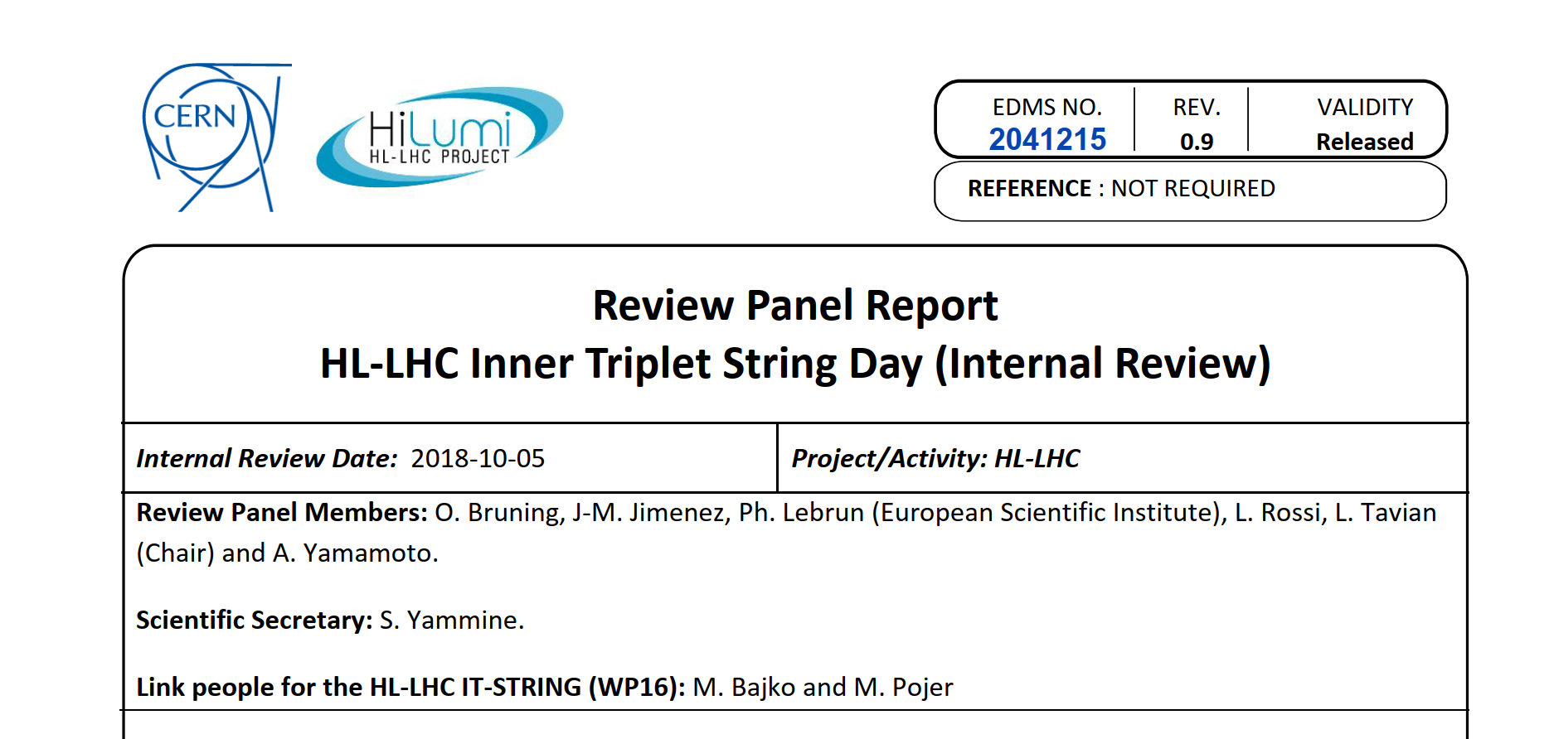
Executive summary: Report

Slide 12

Executive summary: Acknowledgements
The panel wishes to thank:
  M. Bajko and M. Pojer for the big efforts in the preparation,
  All the speakers for their availability, clear inputs and contributions,
  S. Yammine for the report writing,
  E. Kurzen and C. Noels for the review organization.
Photographer

Slide 13
Thank you !

